Slide 1

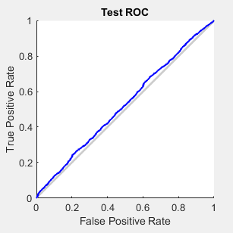
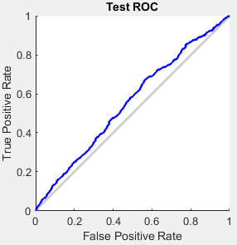
MATH 4432 Statistical Machine Learning Final Project: Football (Soccer) Betting Asian Handicap Prediction /w Neural Network
Introduction:
In previous projects, we used supervised learning methods to predict the Football Betting Asian Handicap results. However, the effectiveness of prediction is low – the percentage of correct predictions is just close to merely guessing.
We suspect that there are some predictors missing that resulted in the low correctness of predictions. With the topic of unsupervised learning and deep learning introduced, we are interested to the performance of prediction correctness of new methods.
Data Exploration
In this project, we used MATLABTM Neural Network Toolbox (NNT) to do the machine learning. We first used five original predictors – average and highest odds for home and away teams, and handicap size.
Table 1: Initial Predictors & Meaning
Methodology
NNT provides four NN tools: Input-output and curve fitting (nftool), Pattern recognition and classification (nprtool), Clustering (nctool) and Dynamic Time Series (ntstool).
Our problem is to classify the correct option of Asian-handicap betting that yields profit. Thus, the nprtool will be useful for our analysis.
A total of 11045 observations were involved in NN training, of which 85% of them are training data, 5% for validation and 10% for testing.
Results: Initial Predictors
Figure 1 shows the ROC Curve. Error rate hovers around 45% to 52%.
Figure 1: Test ROC Curve (Initial vs SPI-added)
Added Predictor: Soccer Power Index (SPI)
When human make decisions of placing bets, the odds is not the sole factor of consideration. The reputation and strength of teams are also important.
We added two columns, SPI-H and SPI-A (home & away SPI) to indicate the strength of each team. We hope the added columns helps NN to increase the prediction power.
SPI is drawn from FiveThirtyEight.
Results: With SPI Added
Figure 2 shows the ROC Curve when SPIs are added. Error rate hovers around 42 to 47%: Significant improvement observed.
Conclusion:
With neural network, we may try to add more predictors in the future, such that the machine can just make betting decisions like how human does. However, the major advantage of machine learning, if successful, is not necessarily intellectual. The fact that the machine is not an emotional species ensures that it will not feel nervous or hesitating when making betting decisions. Under high prediction accuracy, trained NN for football betting can make rational decisions, and bring significant profit when Cinderellas happen. It is just like AlphaGo – some steps it picks has very deep thinking, that the benefits pop up after many steps.
Predictor | Meaning
BbAHh | Handicap Size, multiples of 0.25.
BbMxAHH | Maximum Home Handicap Odds.
BbAvAHH | Average Home Handicap Odds.
BbMxAHA | Maximum Away Handicap Odds.
BbAvAHA | Average Away Handicap Odds.
By WU, Sen (20271863), Dept. Mechanical and Aerospace Engineering

