Slide 1









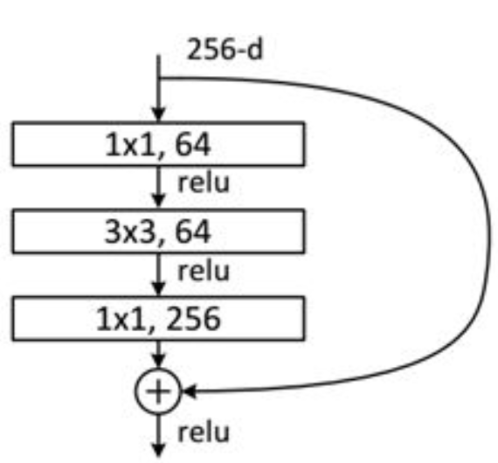
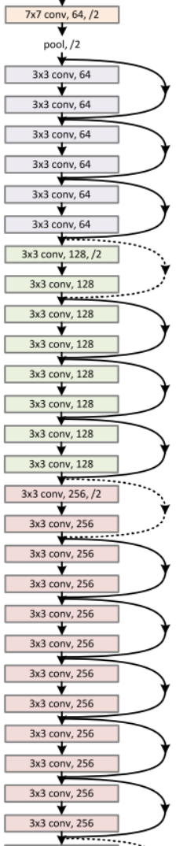

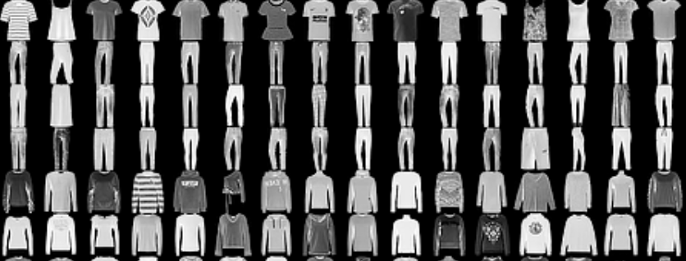


Transfer learning on MNIST&Fasion-MNIST
Yang Yifeng¹, Deng Yibo¹ and Li Mingxuan² {yyangbf, ydengat, mlibw}@ust.hk
¹: Department of Mathematics, HKUST ²: Department of Computer Science and Engineering, HKUST
Poster: Deng Yibo Yang Yifeng
Implemention & Theory: Li Mingxuan
MATH4432 Final Project
Introduction
Automated classification of items and numbers have always been an important topic in machine learning. Numerous methods have been invented to solve this problem.
In this report, we used pre-trained model to extract useful features from the dataset first. Then, various techniques were employed on these extracted features to classify items.
Procedure
Results
We obtained 80.72% test accuracy on Fashion-MNIST. Similarly, the accuracy on MNIST dataset is also around 80%. Indeed, this is not a satisfactory result, compared to others’ results online. It is common to see other people’s fined-tuned neural network achieve accuracy higher than 90% on Fashion-MNIST. The best model nowadays can even achieve accuracy higher than 99% on MNIST easily.
ResNet has won many championship on various computer vision competition. It should have performed well in our study. However, this is expected for the following reasons.
We use ResNet-50 to extract useful features. It is first proposed by He Kaiming. We apply it by freezing its convolutional layers and blocks for feature extraction. Extracted features are used as inputs for fully connected layers to perform classification.
Since MNIST and Fashion-MNIST have identical format, we performed the same procedure on both.
Figure3. Shortcut connection
Data
Two different datasets are used in this study.
MNIST dataset. It contains more than 60,000 training and 10,000 test 28*28 images of numbers.
Fashion-MNIST dataset. It contains more than 60,000 training and 10,000 test 28*28 images of fashion apparel. (Figure 1)
Feature Extraction(ResNet-50)
ResNet-50 means Wide Residual Network with 4 bottleneck blocks(Figure 2). One of the most important advantages of ResNet-50 is that it mitigates the issue of vanishing gradient. The invention of shortcut connection(Figure 3) between layers makes loss function become smooth, which facilitates the process of optimization. Moreover, over-parameterization will not cause overfitting.
Since ResNet-50 requires image input, i.e. (224,224,3), we cannot directly use Fashion-MNIST dataset, whose input is greyscale (28,28,1). We choose to use zero-padding to convert the input size to (224,224). Then we set all RGB channels to the same grey scale graph. In such way, we obtained our (224,224,3) dataset.
Analysis
We add too much noise into our data during preprocessing. For example, we used zero-padding to force the size of input to be (224,224), which brings too much useless information to our data. Since most part of the input is 0 due to zero-padding, the real informative part becomes very small. Here we do a simple calculation, the original information only accounts for 28*28/(224*224) of total input. In addition, we also notice that even in the original picture, the blank(black) area is also huge. ResNet was originally invented to classify Imagenet, whose dimension, training samples, number of classes are much more than MNISTs. Therefore, using ResNet directly may not be appropriate for MNIST. A suggestion is that we can train a shallow network whose first layer has the same number of output channels as the input of first block of ResNet. Then we substitute the first conv layer of ResNet with the first layer of our shallow network. ( Recall that in pytorch, network input shape is (batch size, channels, length, width) )
In comparison, we also used another shallow network on MNIST. (see attached code) It is a convolutional autoencoder , which consists of 3 encoding layers and 3 decoding layers. We obtained 99.6% test accuracy on MNIST.
In conclusion, the size of the network should be consistent of the data. A large network may not be ideal without effective data preprocessing or informative inputs .
Classification Method II: Neural Network (NN) After performing average pooling before the last fc layer of ResNet-50, the output feature takes format of (2048,1,1). We add 3 fully connected layers to construct a simple classifier. The input and output dimension of each layer are (512*4,1000),(1000,200),(200,10),respectively. ReLU is used as the activation function in hidden layers. Soft-max function is used as the final output.
Figure1. Fashion-MNIST
Figure2. ResNet-50
Methodology
Failure
Introduction to transfer learning
It is a common technique in machine learning that focuses on storing knowledge gained while solving one problem and applying it to a different but related problem. It is based on the assumption that one network is able to extract informative features from different datasets.
We also attempted to use WRN-50-2 to perform feature extraction.
On average, one epoch takes 13s/batch*600/batch-count-per-epoch (batch size 100). Therefore, it is expected that 100 epoch will cost more than 200 hours. Unfortunately, without the aid of more GPU, we are not able to make use of this network.
The reason why one epoch takes such long time is its wide layers. In addition, the author of the original model implement uses LUA, whose performance is not satisfactory. Our team is not able to convert it to perform CUDA acceleration in a short time. Therefore, we gave up WRN-50-2.
Reference
[1] He K, Zhang X, Ren S, et al. Deep Residual Learning for Image Recognition[J]. 2015:770-778.
[2] Xiao H, Rasul K, Vollgraf R. Fashion-MNIST: a Novel Image Dataset for Benchmarking Machine Learning Algorithms[J]. 2017.
[3] Lecun Y, Cortes C. The mnist database of handwritten digits[J]. 2010

