Slide 1
An explainable AI for poker bidding
Ye Yuan
Abschlussvortrag zur Bachelorarbeit
Aufgabensteller: Prof. Dr. François Bry
Betreuer: Felix Weitkämper
Datum des Vortrags: 15.07.2021

Slide 2
Outline
Motivation
Structure
Implementation
Conclusion
Future work

Slide 3
Properties of Poker
Motivation
Imperfect Information (Players‘ cards are hidden)
Uncertainty about future events
Deceptive strategies needed as a good player
Explore the bidding strategy of the top poker players.
Chose DeepStack AI as research target
Focus on the first round of Pre-Flop phase
Use Rule-based algorithm to explore the factors that influence the player decisions

Slide 4
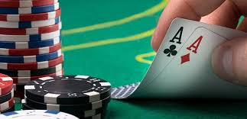
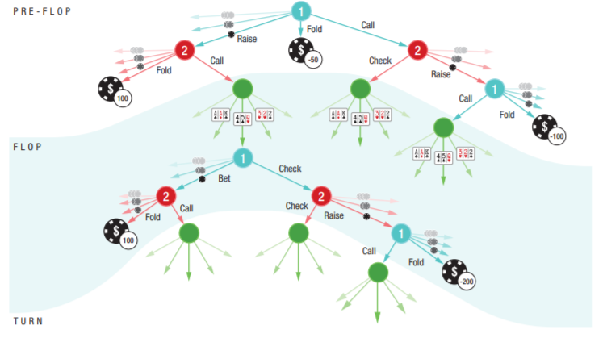
Motivation
Poker(Texas Hold’em)
2-10 players (here focus on 2 players)
4 Phases
2 hand cards and 5 community cards
The best five card poker hand formed from the hand cards and community cards wins
Pre-flop phase:
Two random handcards for each player at first. Players bet.
Flop phase
Three community cards are dealt face up. Players bet
Turn
Another community card is dealt face up. Players bet
River
The last community card is dealt face up. Players bet and show down
Bet
raise
call
fold

Slide 5
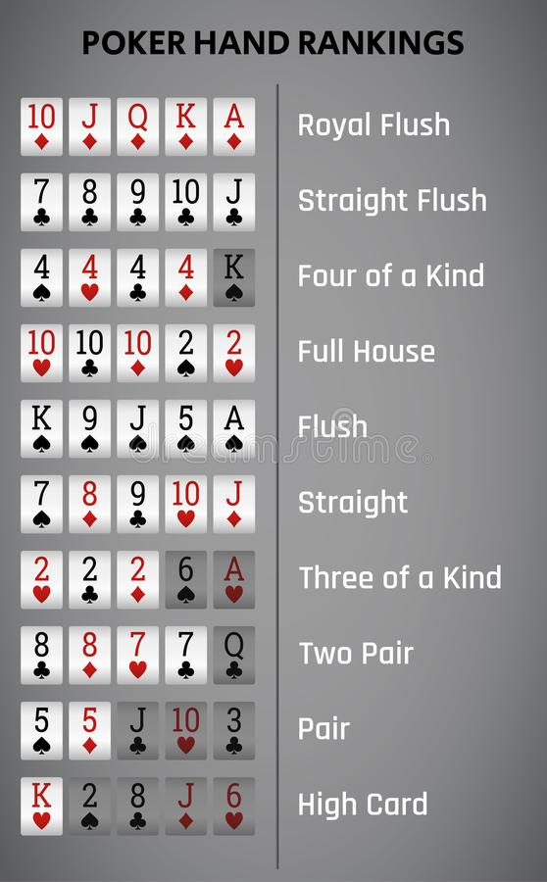
Motivation
Strength of the poker hand
In pre-flop phase:
Hand cards are the only information!
The rank of the hand card
If the hand cards are in the same suit

Slide 6
Structure
Using Rule-based algorithm to explore the bidding strategy
Data Source
1. CN2 Rule Induction (Propositional)
2. Slipcover(Probabilistic Inductive Logic Programming)
Analyzing the statistical data to make players’ moves explainable

Slide 7

Data Source
Hand information of DeepStack AI vs Professional players
Best Poker AI currently
Convenient to get the hand information
Has been playing with different professionals

Slide 8
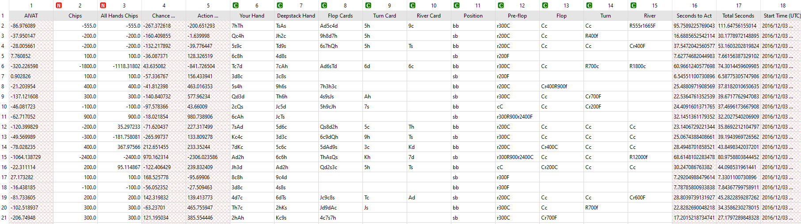
Data Source
Deepstack Hand
handcard1
handcard2
samesuit
Back

Slide 9

CN2 Algorithm
Learns propositional rule (If Conditions THEN C)
A searching algorithm using beam search
A control algorithm to implement the search repeatedly.
Implemented on Orange

Slide 10
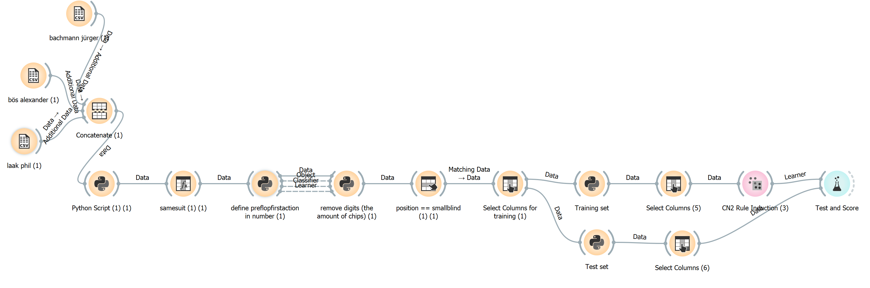
Implementation of the CN2 algorithm
50% for training, 50% for testing

Slide 11
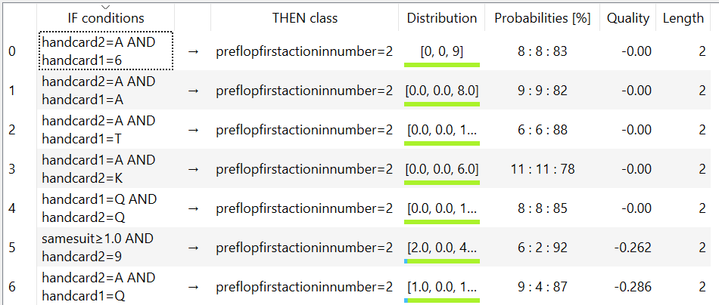
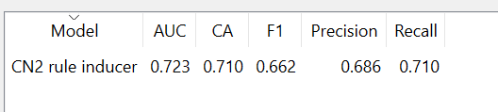
Result
CN2 Rule Induction
back

Slide 12
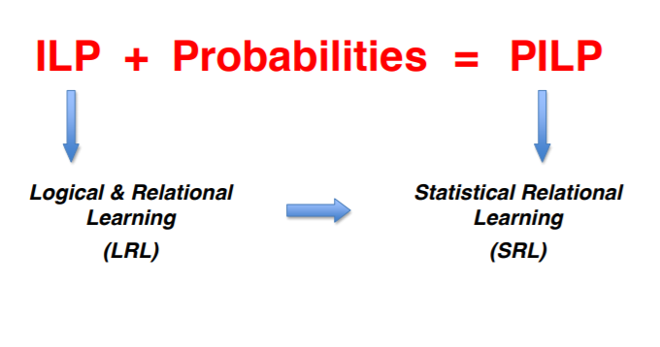

Slipcover
Probabilistic Inductive Logic Programming
The clauses and learned rules are annotated with probabilistic values
Structure Learning of Probabilistic logic programs by searching Over the clause space
Log likelihood as searching heuristic
Implemented on Swi-Prolog

Slide 13
Slipcover
Attribute Representation: samesuit(id), rank1(id, rank)...
Mode declaration: modeb(*, rank1(+id, -rank)). modeb(*, rank1(+id, -#rank)).
Negative Examples: bid(id, raise), neg(bid(id, fold)), neg(bid(id, call)).
Training Set: Same as CN2(50% for training, 50% for testing).

Slide 14
Result
AUC Value: 0.785
Some learned Rules:
bid(A,c) :0.065 :-rank1(A,j), smaller2T(A)
bid(A,r) :0.0522 :-rank1(A, B), samesuit(A),rank2(A,C).
bid(A,f) :0.012 :-smaller2T(A).
Final decision has been made by performing inference

Slide 15
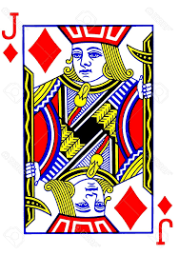
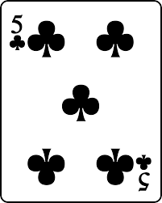
Result
52% chance to raise
36% chance to call
13% chance to fold

Slide 16
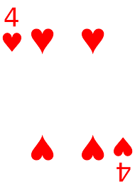
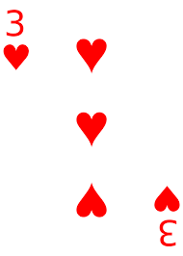
Result
61% chance to raise
28% chance to call
13% chance to fold

Slide 17
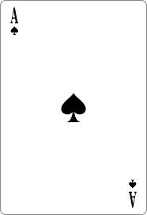
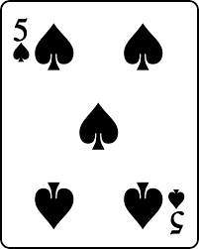
Result
66% chance to raise
22% chance to call
11% chance to fold

Slide 18
Implementation of the Slipcover algorithm
AUC Value of Slipcover: 0.785
AUC Value of CN2 Rule Induction: 0.723
An improvement of 9%!

Slide 19
Conclusion
Both algorithms have achieved good result:
PILP performs better than propositional rule learning:
Players tend to raise when:
Rules with probabilities are more persuasive
Tend to make moves with uncertainty(bluffing)
PILP more suitable when dealing with Poker
Rank of the hand cards are high
Same suit
Same rank(Pair)

Slide 20
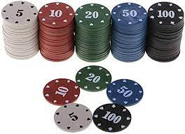
Future Work
Chips information can be added
To explore the other phases of poker using PILP
Apply rule-based learning to other game with imperfect information

Slide 21
Thank you for your attention!

