Slide 1


VIOLIN and VO (Vaccine Ontology)
Yongqun “Oliver” He Unit for Laboratory Animal Medicine Department of Microbiology and Immunology Center for Computational Medicine and Bioinformatics
University of Michigan Medical School Ann Arbor, MI 48109

Slide 2
Outline
VIOLIN: a web-based vaccine research database and analysis system
Vaccine Ontology (VO) development
VO applications

Slide 3
VIOLIN: Vaccine Investigation and Online Information Network
Summary: A vaccine research database and vaccine data analysis system
Aims:
Curate data from publications: licensed vaccines, vaccines in clinical trials, and vaccines in research
Vaccine data mining and comparison
Vaccine design
Study vaccine-induced immune networks
Build community-based vaccine information network
Publically available: http://www.violinet.org/

Slide 4
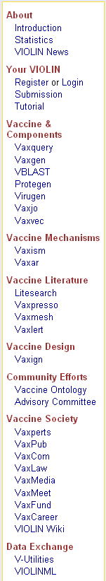
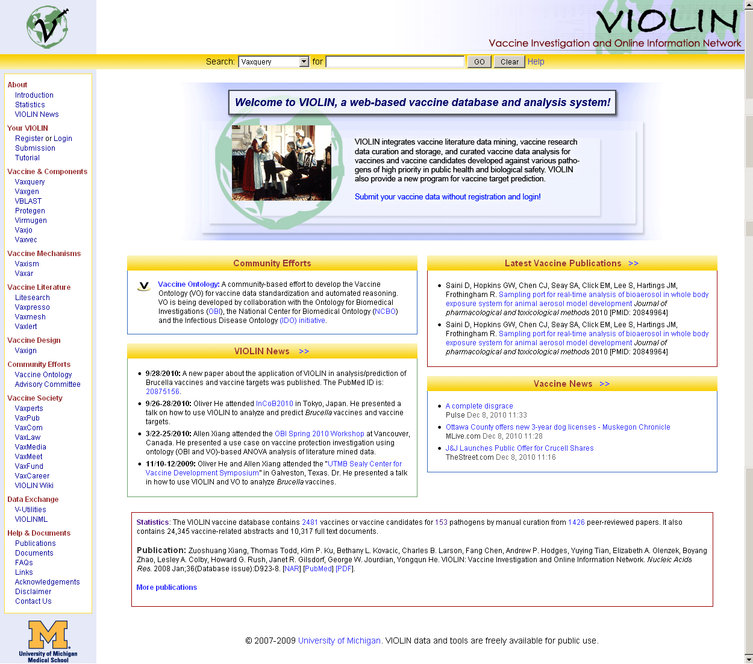
VIOLIN Programs

Slide 5
VIOLIN Database Contents
Host
Host
Response
Host Gene
Response
induce
protect
cause
disease
Gene/ Protein
Vaccine
against
made by
Gene
Engineer
Pathogen
Focuses: molecular engineering & mechanisms

Slide 6
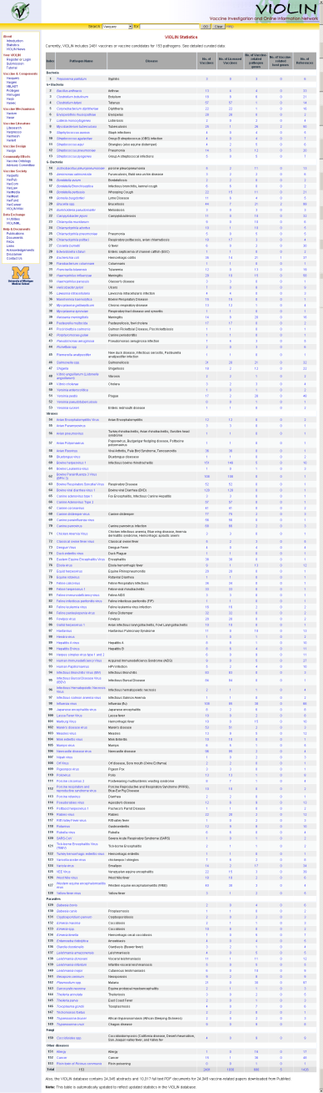
VIOLIN Statistics
2481 vaccines
1930 licensed vaccines
153 pathogens / diseases
~ 600 protective antigens
1426 references
> 24,000 abstracts/full text
Aim: Include all licensed vaccines worldwide and selected vaccines in clinical trials and research
http://www.violinet.org/stat.php

Slide 7
Selected VIOLIN Publications
Original Publication: Xiang Z, Todd T, Ku KP, Kovacic BL, Larson CB, Chen F, Hodges AP, Tian Y, Olenzek EA, Zhao B, Colby LA, Rush HG, Gilsdorf JR, Jourdian GW, He Y. VIOLIN: Vaccine Investigation and Online Information Network. Nucleic Acids Res. 2008 Jan;36:D923-8.
Demo using Brucella: He Y, Xiang Z. Bioinformatics analysis of Brucella vaccines and vaccine targets using VIOLIN. Immunome Res. 2010 Sep 27;6 Suppl 1:S5.
VIOLIN Vaxign (Vaccine Design) Program: He Y, Xiang Z, Mobley HLT. Vaxign: the first web-based vaccine design program for reverse vaccinology and an application for vaccine development.J Biomed Biotechnol. 2010;2010:297505.
VIOLIN Protegen (Protective Antigen) program: Yang B, Sayers S, Xiang Z, He Y. Protegen: a web-based protective antigen database and analysis system. Nucleic Acids Research. 2010. 2010 Oct 19.
Five papers using VO
No formal VO paper yet, still work on it.

Slide 8
VO: Vaccine Ontology
VO: a biomedical ontology in the vaccine domain.
Aims: vaccine data representation and automated reasoning
Utilize the Basic Formal Ontology (BFO) as the top-level ontology
Follow OBO Foundry principles, e.g.,
Developed in a collaborative effort
Use common relations that are unambiguously defined
Provide procedures for user feedback
Reference: Smith B, Ashburner M, Rosse C, Bard J, Bug W, Ceusters W, Goldberg LJ, Eilbeck K, Ireland A, Mungall CJ; OBI Consortium, Leontis N, Rocca-Serra P, Ruttenberg A, Sansone SA, Scheuermann RH, Shah N, Whetzel PL, Lewis S. (2007). The OBO Foundry: coordinated evolution of ontologies to support biomedical data integration. Nat Biotechnol 25 (11): 1251-5.

Slide 9

Collaborative VO Development
VO is developed as a collaborative effort:
VIOLIN and Vaccine Researchers at U of Michigan (UM)
Yongqun “Oliver” He (Interest: Bioinformatics & Brucella vaccine R&D)
Harry Mobley (Interest: E. coli vaccine R&D)
UM vaccine informatics and resource advisory committee
NCIBI: National Center for Integrative Biomedical Informatics
Infectious Disease Ontology (IDO, http://www.infectiousdiseaseontology.org/ )
Lindsay Cowell (Duke)
Barry Smith (Buffalo)
National Center for Biomedical Ontology
(NCBO, http://bioontology.org/ )
Barry Smith (Buffalo)
Trish Whetzel / Mark Musen (Stanford)
Ontology for Biomedical Investigations (OBI)
Bjoern Peters (La Jolla)
Richard H. Scheuermann (Texas)
Alan Ruttenberg (Science Commons)
Ryan Brinkman / Melanie Courtot (BC, Canada – PCIRN)
Gene Ontology
Alexander Diehl (MGI, Jackson Laboratory)
Chris Mungall
http://www.violinet.org/vaccineontology

Slide 10
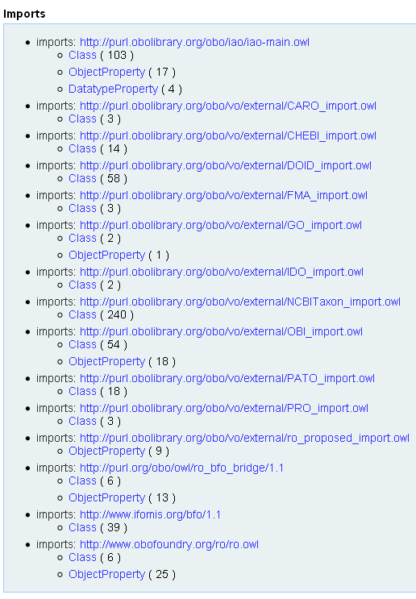
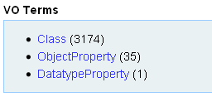
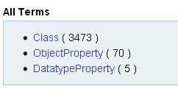
VO Statistics
Import other ontology terms using OntoFox: http://ontofox.hegroup.org/

Slide 11

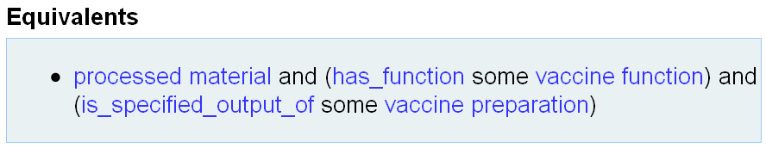
Vaccine Definition
Definition : A vaccine is a processed material with the function that when administered, it prevents or ameliorates a disorder in a target organism by inducing or modifying adaptive immune responses specific to the antigens in the vaccine.

Slide 12
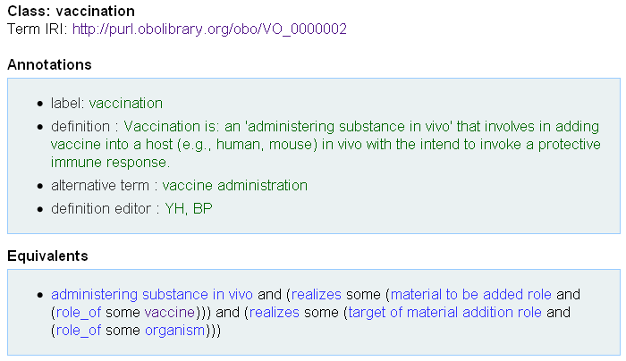
Vaccination Definition

Slide 13
Vaccine Immunization (or: artificial active immunization)
Difference between vaccination and ‘vaccine immunization’:
Vaccination does not consider the outcome
Immunization consider the outcome
Superclasses:
has_specified_input_of some vaccine
realizes some (‘host role’ and inheres_in some organism)
realizes some (‘immunization target role’ and inheres_in some disorder)

Slide 14
Example: Afluria Influenza Vaccine

Slide 15
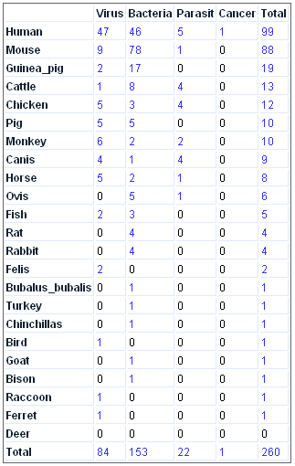
Vaccines in VO
Other vaccines: 508
Total: 768
>1000 vaccines to be added to VO soon, including licensed animal vaccines and curated vaccines in VIOLIN.
Vaccines by host & diseases

Slide 16
Protection assay with Brucella vaccine RB51 using VO and OBI
Reference: He Y, Xiang Z, Todd T, Courtot M, Brinkman R, Zheng J, Stoeckert CJ, Malone J, Rocca-Serra P, Sansone S, Fostel J, Soldatova LN, Peters B, Rutternberg A. Ontology representation and ANOVA analysis of vaccine protection investigation. Proceeding of Bio-Ontologies 2010: Semantic Applications in Life Sciences, ISMB, July 9-10, 2010. Boston, MA, USA. Full length paper.

Slide 17
VO Applications
Integrate VIOLIN vaccine data
Help VIOLIN relational database design
Generate vaccine instance data for data exchange purpose
Enhance vaccine literature mining power
Indexing of PubMed vaccine papers
Vaccine induced network

Slide 18
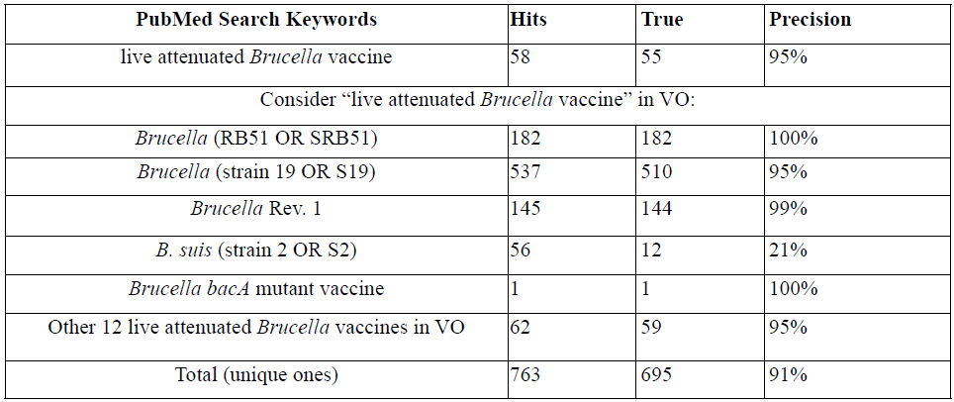
VO Improve Vaccine Literature Mining
→ With VO knowledge, the PubMed search results are significantly improved

Slide 19
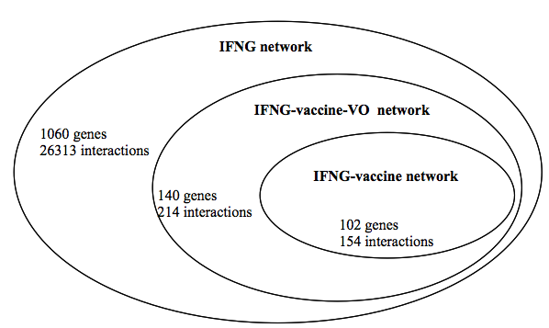
VO-based Literature Mining of IFNG Network
References:
Ozgur A, Xiang Z, Radev D, He Y. Mining of vaccine-associated IFN-γ gene interaction networks using the Vaccine Ontology. Proceeding of Bio-Ontologies 2010: Semantic Applications in Life Sciences, ISMB, July 9-10, 2010. Boston, MA, USA. Full length paper.
Ozgur A, Xiang Z, Radev D, He Y. Literature-based discovery of IFN-γ and vaccine-mediated gene interaction networks. Journal of Biomedicine and Biotechnology. Volume 2010 (2010), Article ID 426479, 13 pages. [PMID: 20625487]

Slide 20
Acknowledgements
Oliver He Lab at UM:
Zuoshuang Xiang
Thom Todd
Fang Chen
Andrew Hodges
G. Bill Jourdian
Charlie Larson
Kimberly Ku
Bethany Kovacic
Elizabeth Olenzek
Boyang Zhao
Samantha Sayers
Kanika Kochhal
University of Michigan (UM):
NCIBI:
Brian Athey
Gil Omenn
Harry Mobley
Howard Rush
Lesley Colby
Janet Gilsdorf
BFO
IDO
OBI
GO
NCBO
OBO Foundry
Funding:
NIH-NIAID R01AI081062
University of Michigan

