Slide 1




SMAUG: Sparse Masked Autoencoder for Efficient Video-Language Pre-training
Yuanze Lin¹, Chen Wei², Huiyu Wang², Alan Yuille², Cihang Xie³
¹University of Washington, ²Johns Hopkins University , ³UC Santa Cruz

Slide 2
Motivation
Previous video-language pre-training approaches:
(1) Require heavy computation for pre-training.
(2) Usually perform masked modeling only for textual modality.
The proposed SMAUG:
(1) Explore how to efficiently introduce MAE for pre-training, which can
perform masked visual modeling and reduce computation costs.
(2) Introduce space-time token sparsification modules for further reducing
spatial and temporal redundancies among videos.

Slide 3
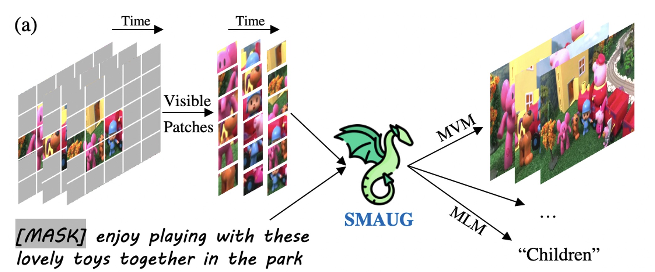
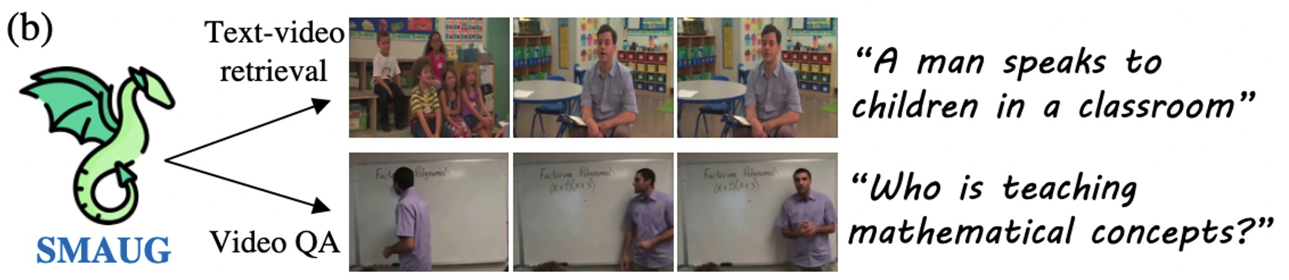
Overview
Figure 1. The overview of SMAUG.

Slide 4
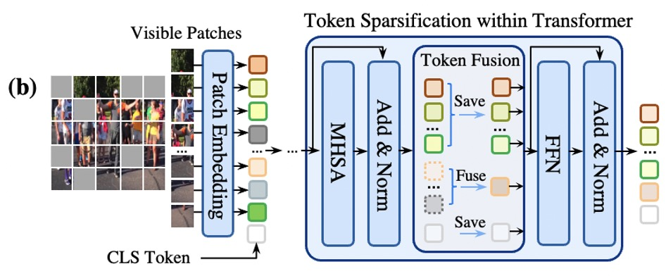
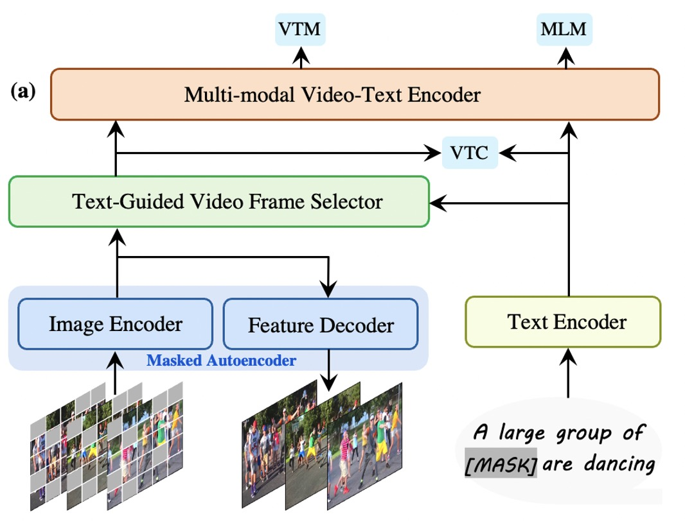
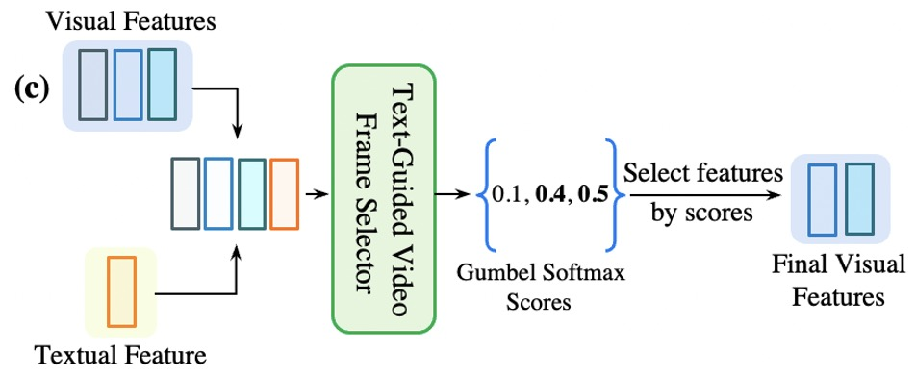
Method
Figure 2. The illustration of SMAUG architecture.

Slide 5
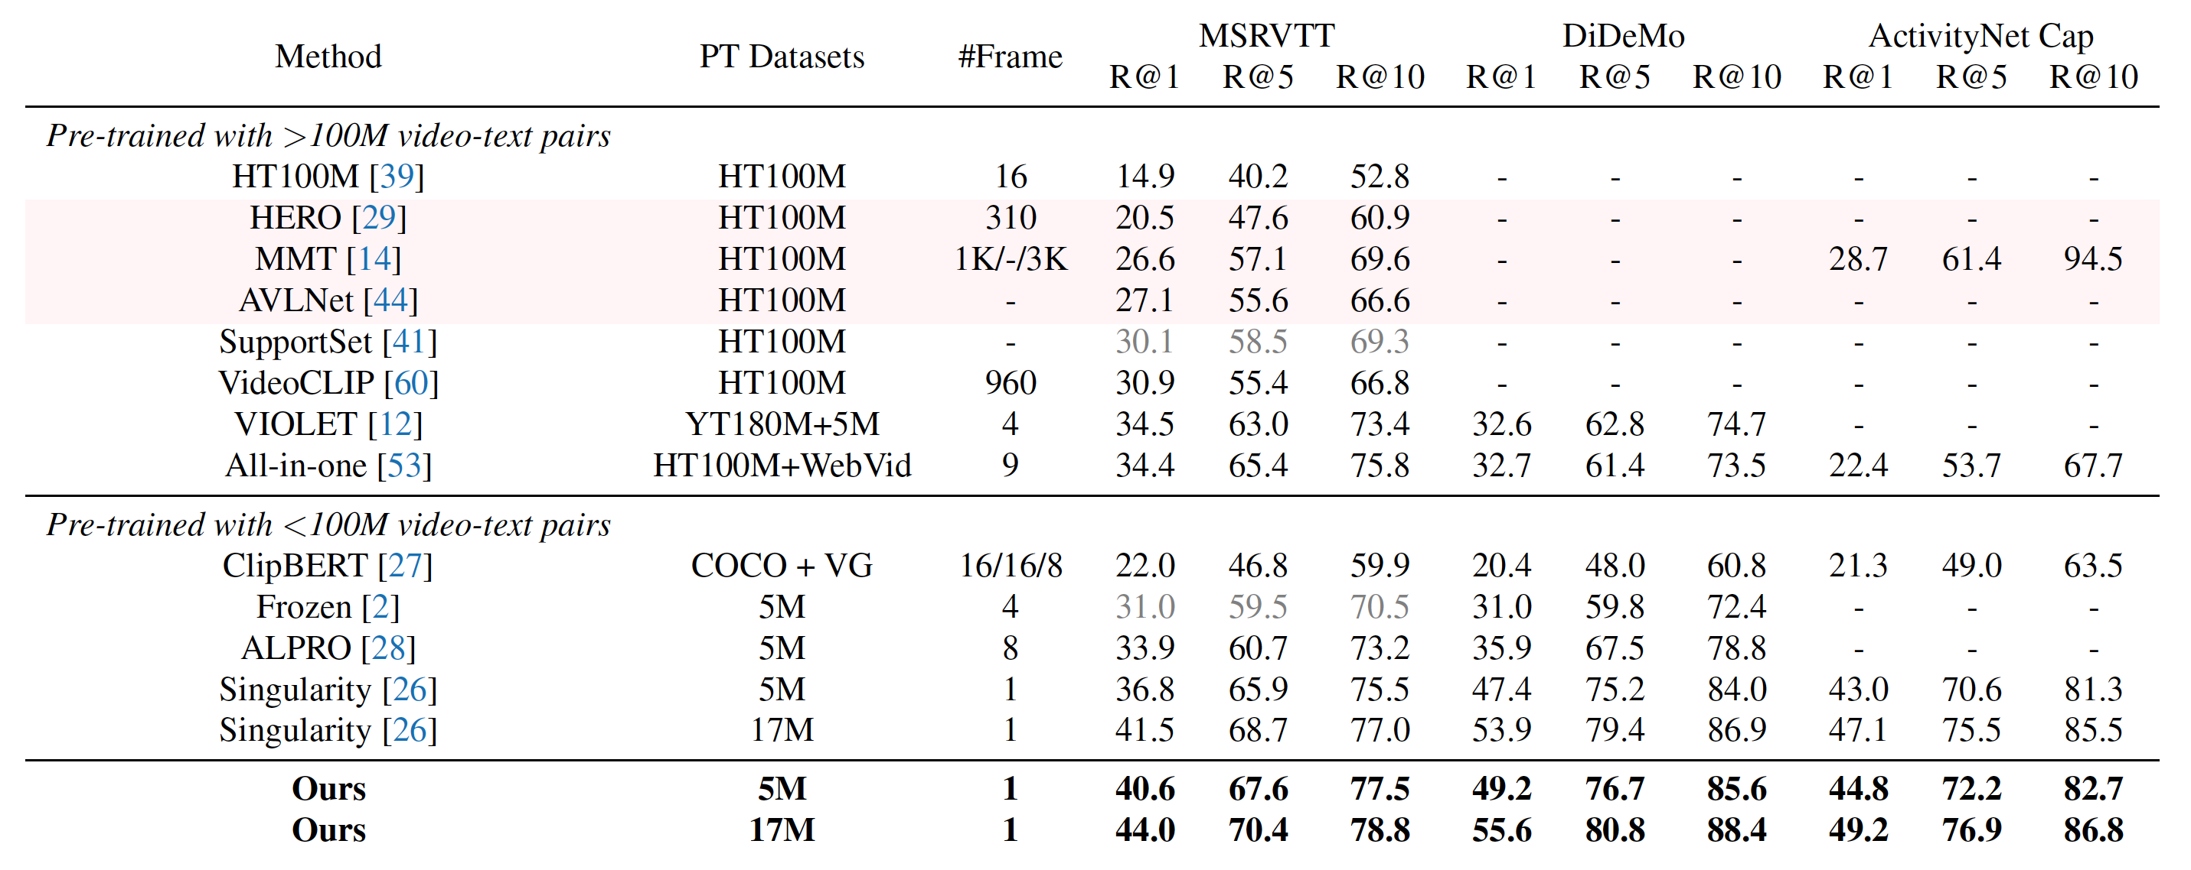
Experiment
Table 1. Results compared with existing video-language pre-training methods on text-to-video retrieval.

Slide 6
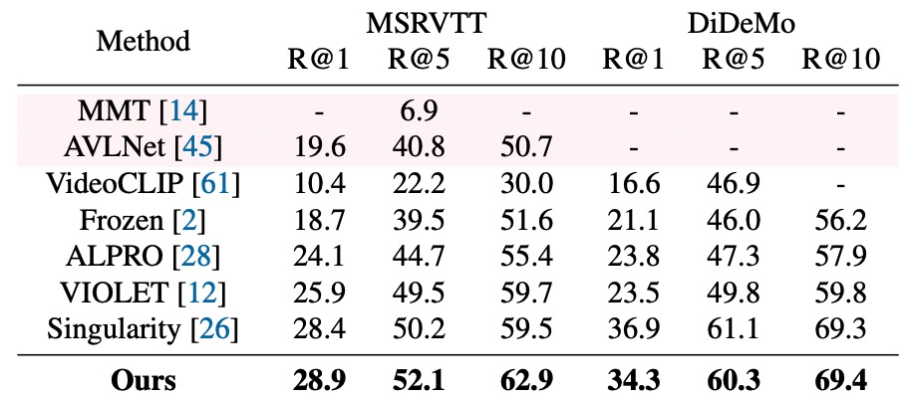
Experiment
Table 2. Zero-shot results compared with existing video-language
pre-training methods on text-to-retrieval tasks.

Slide 7
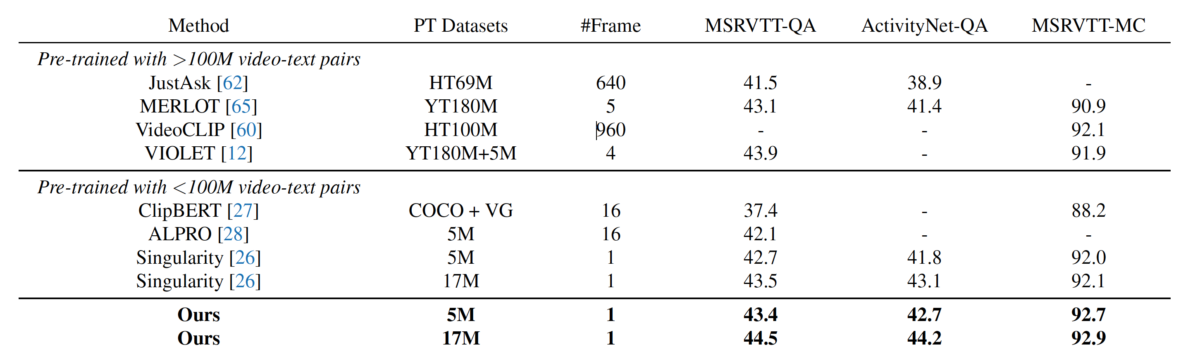
Experiment
Table 3. Results compared with existing video-language pre-training methods on video question answering.

Slide 8
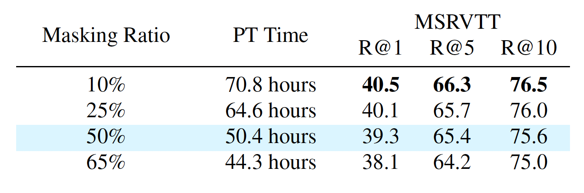
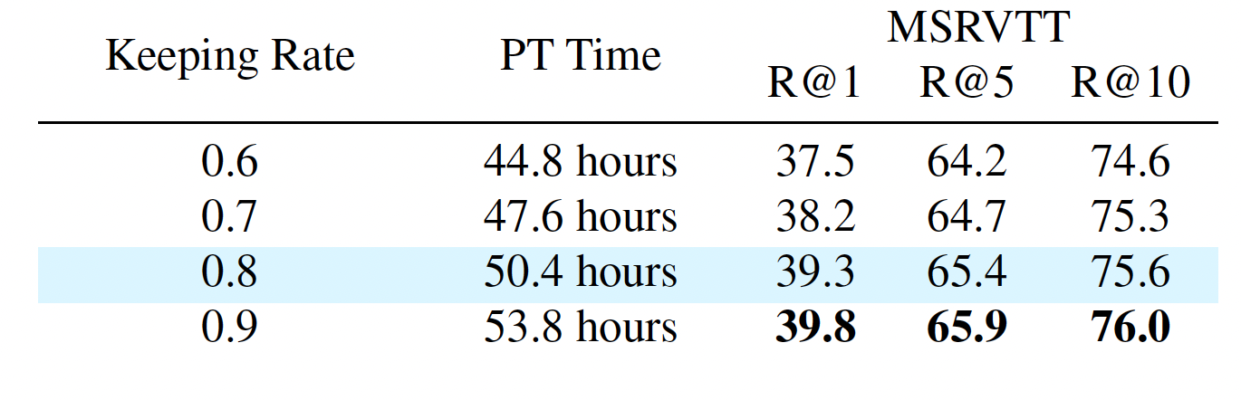
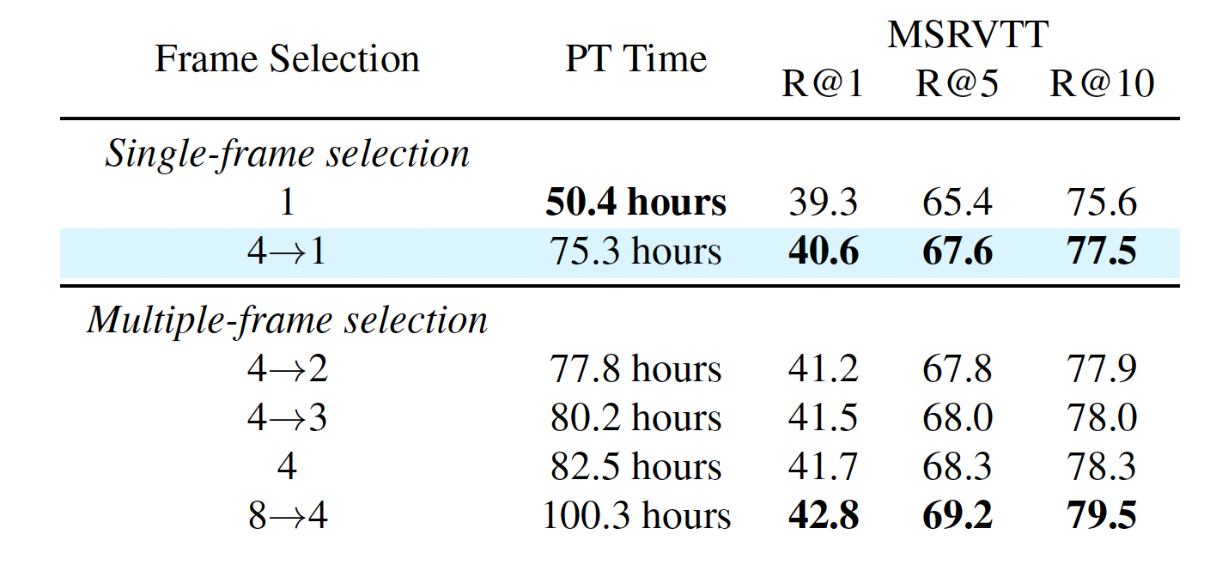
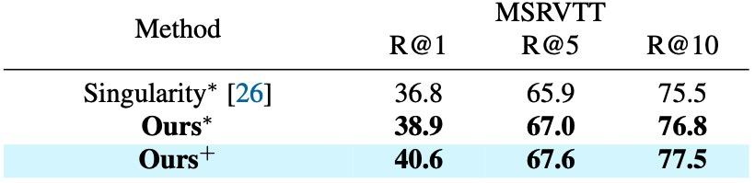
Experiment
Blue color highlights the default setting. PT Time: Pre-training time of using only one A6000 GPU.
Table 4. Different masking ratios.
Table 5. Different keeping rates.
Table 7. Using different visual encoders. * and +
mean BEiT-Base and CLIP-B/16 respectively.
Table 6. Selecting different frames. “4$→$1”
means selecting 1 frame among 4 input frames.

Slide 9
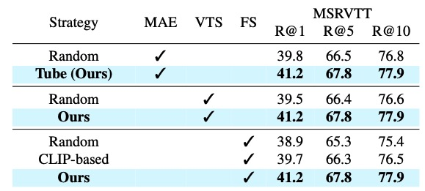
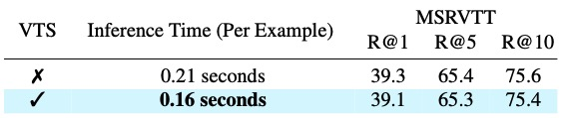
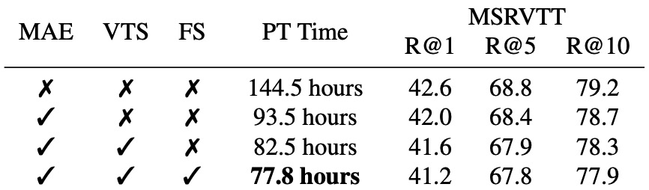
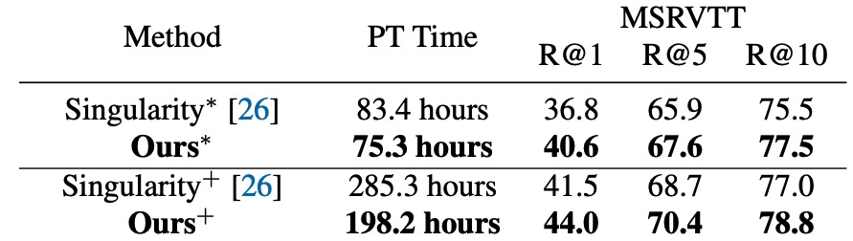
Experiment & Analysis
MAE: Masked Autoencoder VTS: Visual token sparsification FS: Frame selection
Table 9. Adopting VTS for inference.
Table 8. Adopting different strategies for MAE,
VTS and FS.
“*” and “+” mean the pre-trained models with 5M and 17M corpus.
Table 11. Pre-training with different scales of
the video-text corpus using sing-frame input.
Table 10. Influences of different proposed components.

Slide 10
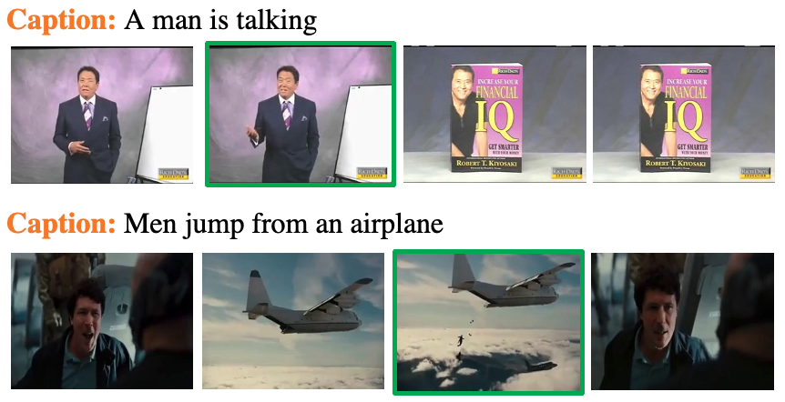
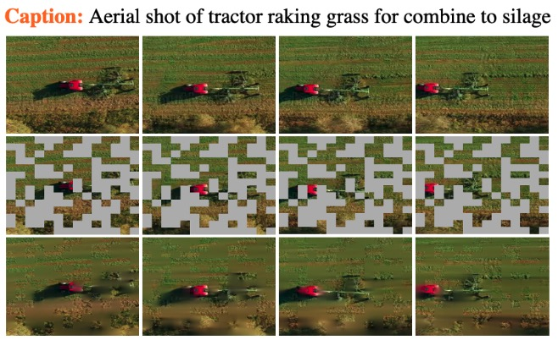
Visualization
Figure 3. Two examples of frame selection. Green box means
selecting the most important frame among each clip.
Figure 4. An example of prediction for masked patches.

Slide 11


