Slide 1
GUI for Mail-merge using Erlang and Erlguten
Yuan Zhiqian
2011-05-18

Slide 2
Thesis Background
Klarna AB wants an improved system for generating their transaction documents.
The current method they are using to generate documents is to manually write erlang codes to specify the documents' layout as well as generate them, which is inconvenient and inefficient.

Slide 3
Thesis Background(cont.)
They want the document generation to be automated and be able to processed in batches.

Slide 4
The goals
Achieve the automation in commercial document generating process.
Make it possible to generate large amount of documents in batches.
Provide a GUI prototype if possible, so as to facilitate the document template maintenance by marketing and product departments.

Slide 5
Solution
Use template and mail-merge
Implement a web-based system, the back end of which process the batches(mail-merging and document generating) automatically. And provide a GUI to let the users design templates and send document generation command.
The GUI prototype is made as a web app.

Slide 6
Issues to solve
Correctly manage the typesettings of texts, images, tables and lists.
Chose the proper template.
Correctly calculate the page amount.
Path problems. Different component has different environment.

Slide 7
System structure

Slide 8
Implementation(server side)

Slide 9
Implementation(server side cont.)
Preprocess:
  Template chosen: don't need to actually calculate total amount of pages needed.
  Page amount calculation: affected by template chosen.

Slide 10
Implementation(server side)
Template Chosen
  Template type:
    3
      Template_3 is chosen
    2
      Overthreshold2
        Yes: Template_3 is chosen
        No: Template_2 is chosen
    1
      Overthreshold1 etc ...

Slide 11
Implementation(server side)
Page amount calculation:
only needed when template_3 is chosen
Calculate the “middle pages” amount.
Iterate every time the page amount is updated – because the top space and bottom space should be calculated as well.

Slide 12
Implementation(server side)
Mail-merge: substitute dynamic texts with actual value found in user data file
Attach table data to table's format information in the template

Slide 13
Implementation(server side)
PDF generation
  Start pdf generation from the front page
  Table may occupy multiple pages, add new pages when it reaches the bottom limit.
  Print other frames in middle pages.
  Print frames in the end page.
  Return to front page to print out other frames.

Slide 14
GUI
Implemented using Cappuccino framework.
Web app.
A brief introduction to the infrastructure of GUI design in Cappuccino.

Slide 15
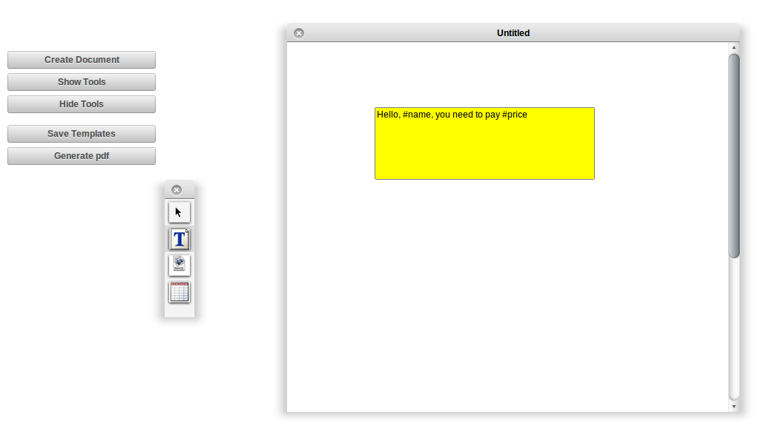
GUI

Slide 16
The integration of system
The system is web-based.
Template generation is done by using DOMs.
Templates are sent back to the server
from GUI.
Web service is written in RubyOnRails
Batch(mail-merge and pdf generation) is done by executing the script.

Slide 17
The integration of system(cont.)
Necessary configuration. e.g. coordinating the path environment among components etc.

Slide 18
Thank you

