Slide 1
标题：NoSQL-理论篇
讲师：萝卜兄
版权所有浪曦网 www.langsin.com

Slide 2
NoSQL-理论
数据模型
NOSQL分类
分布式模型
CAP+BASE原理
选型和使用场景

Slide 3
数据模型

Slide 4
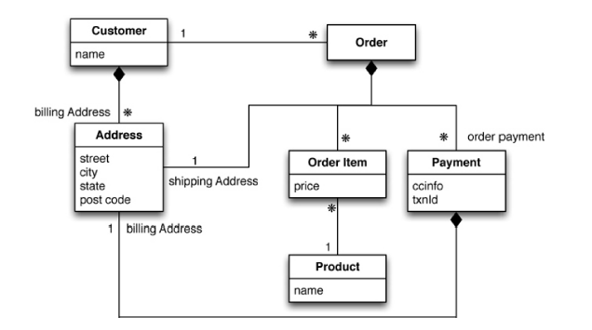
聚合模型
Notes:
//int customers
{
"id":1,
"name":"Martin",
"billingAddress":[{"city":"Chicago"}]
}
//int orders
{
"id":99,
"customerId":1
"orderItems":[
{
"productId":27,
"price":32.45
"productName":"NoSQL Distilled"
}
],
"shippingAddress":[{"city":"chicago"}]
"orderPayment":[
{
"ccinfo":"1000-1000-1000-1000",
"txnId":"abelif879rft",
"billingAddress":{"city":"Chicago"}
}
],
}
========================================================================
{
"customer":{
"id":1,
"name":"Martin",
"billingAddress":[{"city":"Chicago"}],
"orders":[
{
"id":99,
"customerId":1,
"orderItems":[
{
"productId":27,
"price":32.45,
"productName":"NOSQL"
}
],
"shippingAddress":[{"city":"chicago"}]
"orderPayment":[
{
"ccinfo":"1000-1000-1000-1000",
"txnid":"abelif879rft",
"billingAddress":{"city":"Chicago"}
}
],
}
]
}
}

Slide 5
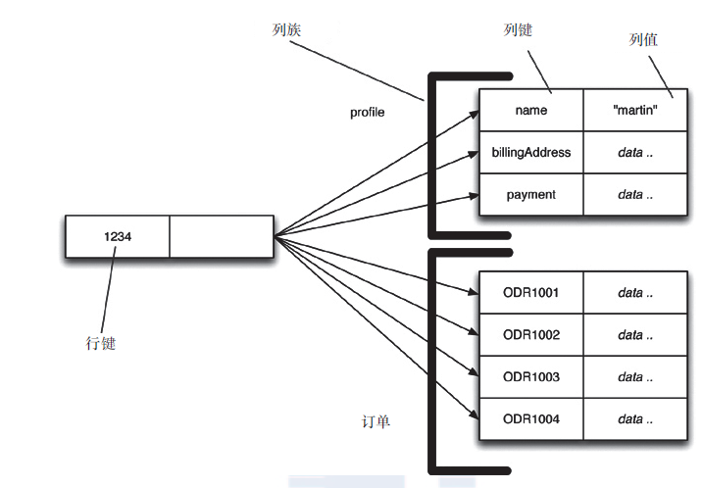
列数据模型

Slide 6
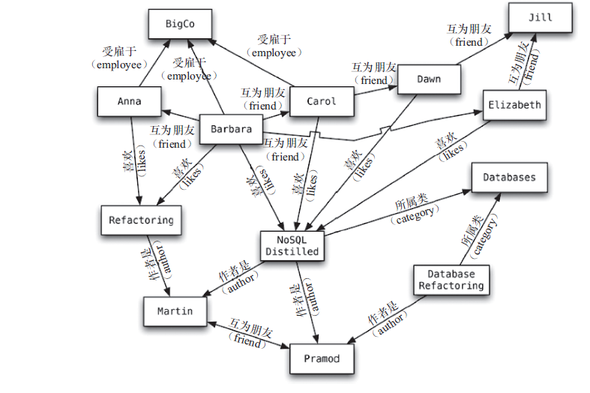
图数据模型

Slide 7
NoSQL分类

Slide 8
CAP+BASE

Slide 9
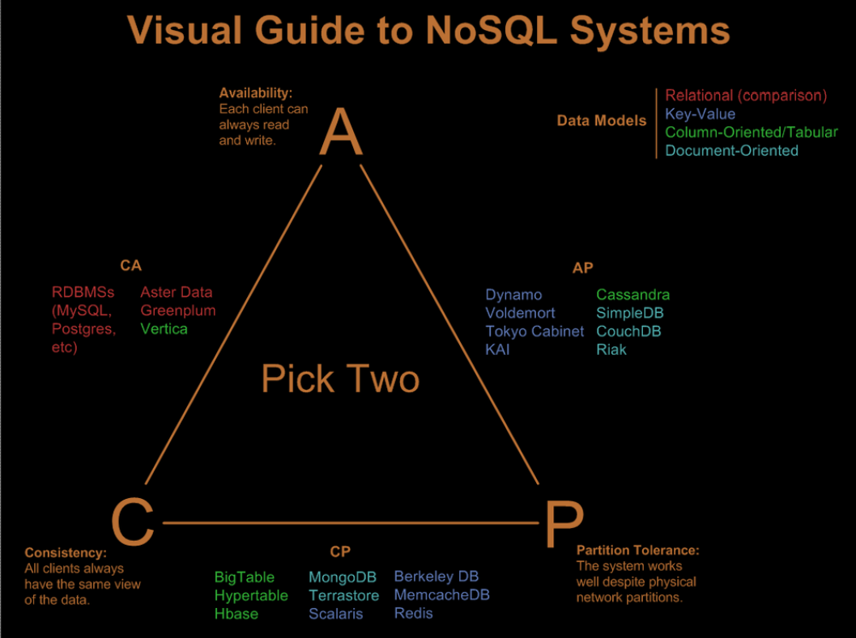

Slide 10
选型和使用场景

Slide 11
感谢您对浪曦网的大力支持！
版权所有浪曦网 www.langsin.com

