Slide 1
Self introduction
Zhang wei
A girl from china

Slide 2

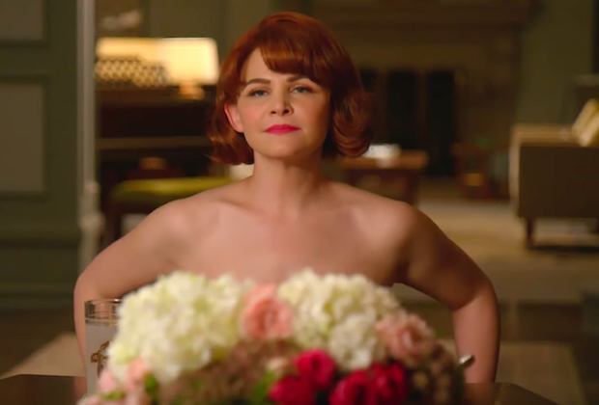
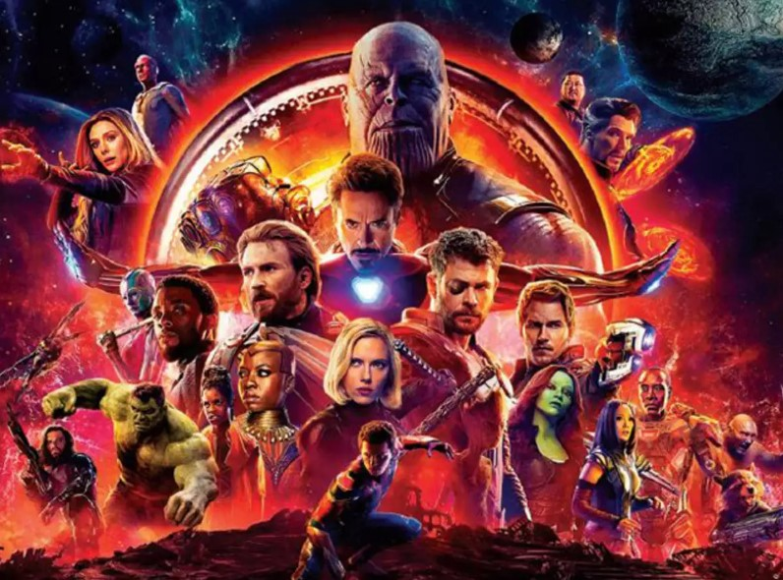
My hobby
Binge-watching
For instance
Why wumen kill
Shrelock
Marvel
And so on

Slide 3



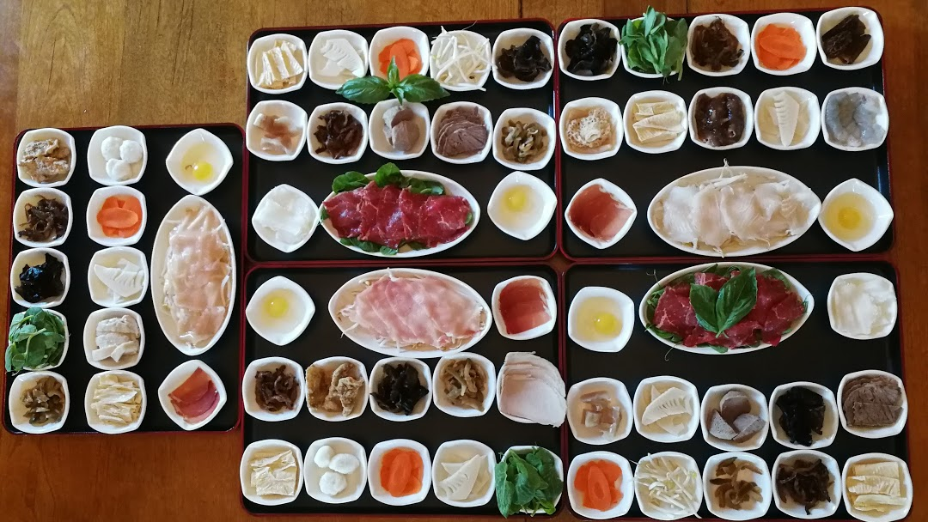
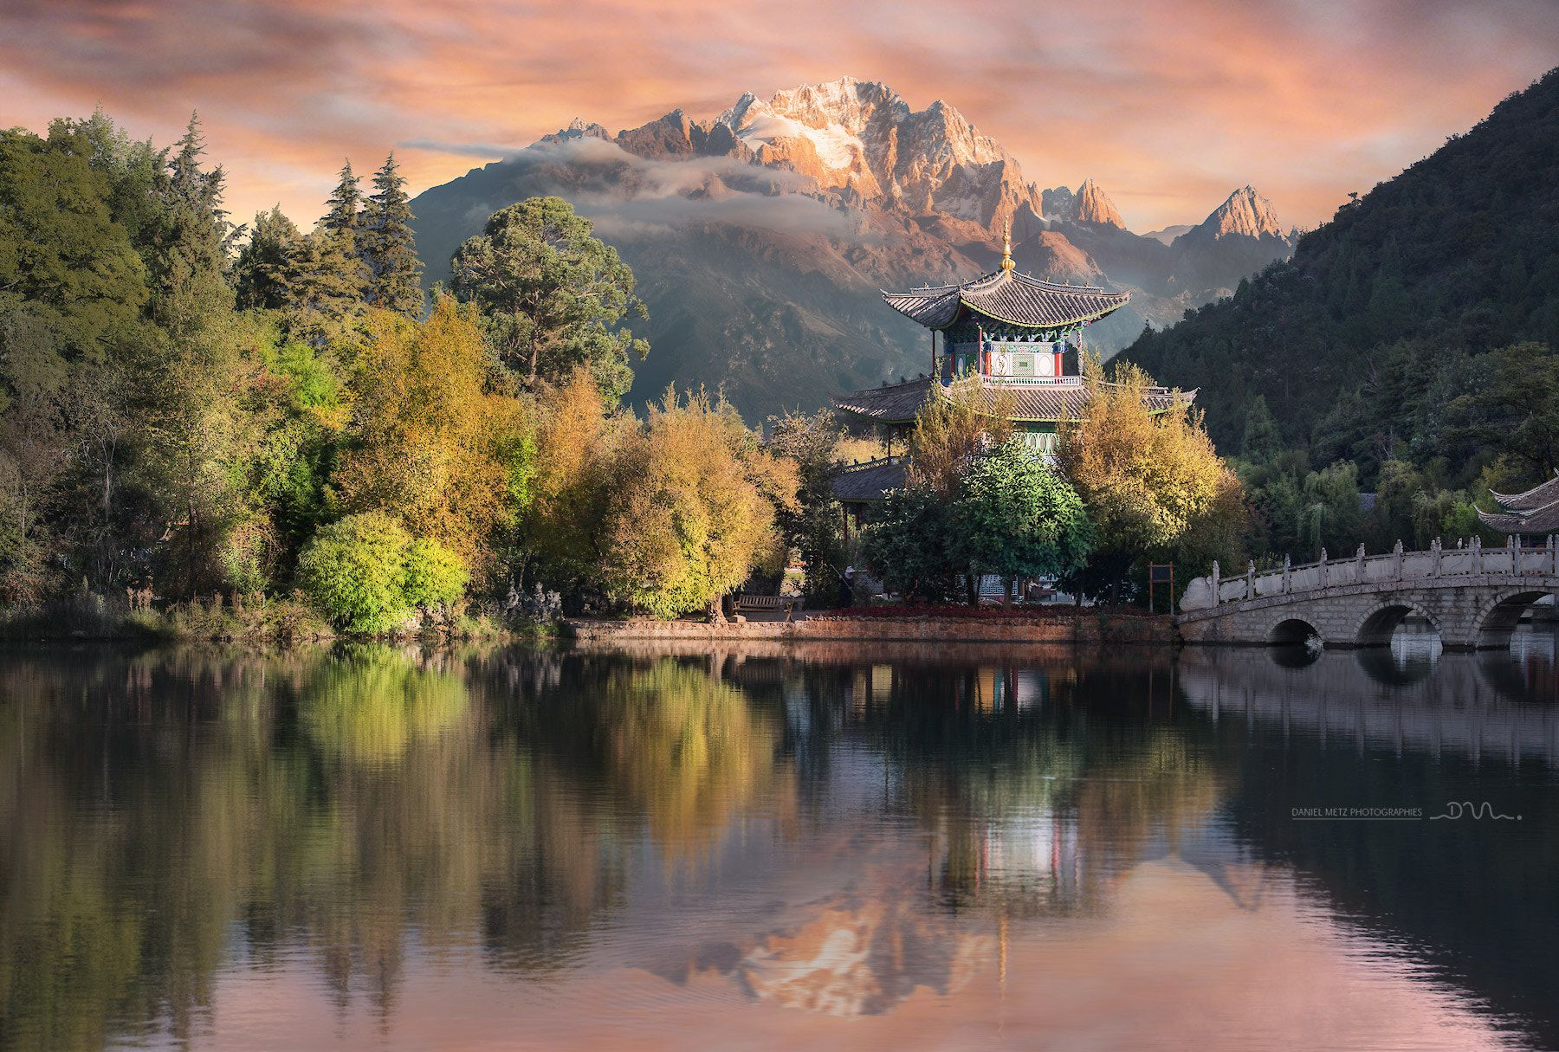
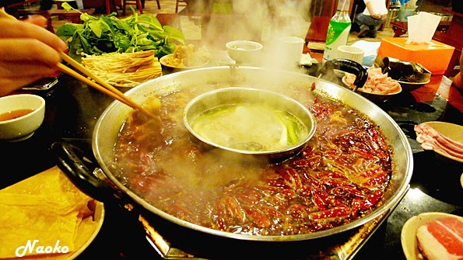
hometown
Yunnan province
Sichuan province and chongqin
Both of them has wonderful landscape
BOTH of them has delicious food

Slide 4
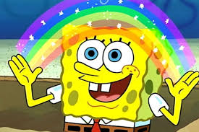
that’s all.
So glad to meet you guys!!!
WELcome to my hometown and follow me to enjoy the local cuisine.

