Slide 1
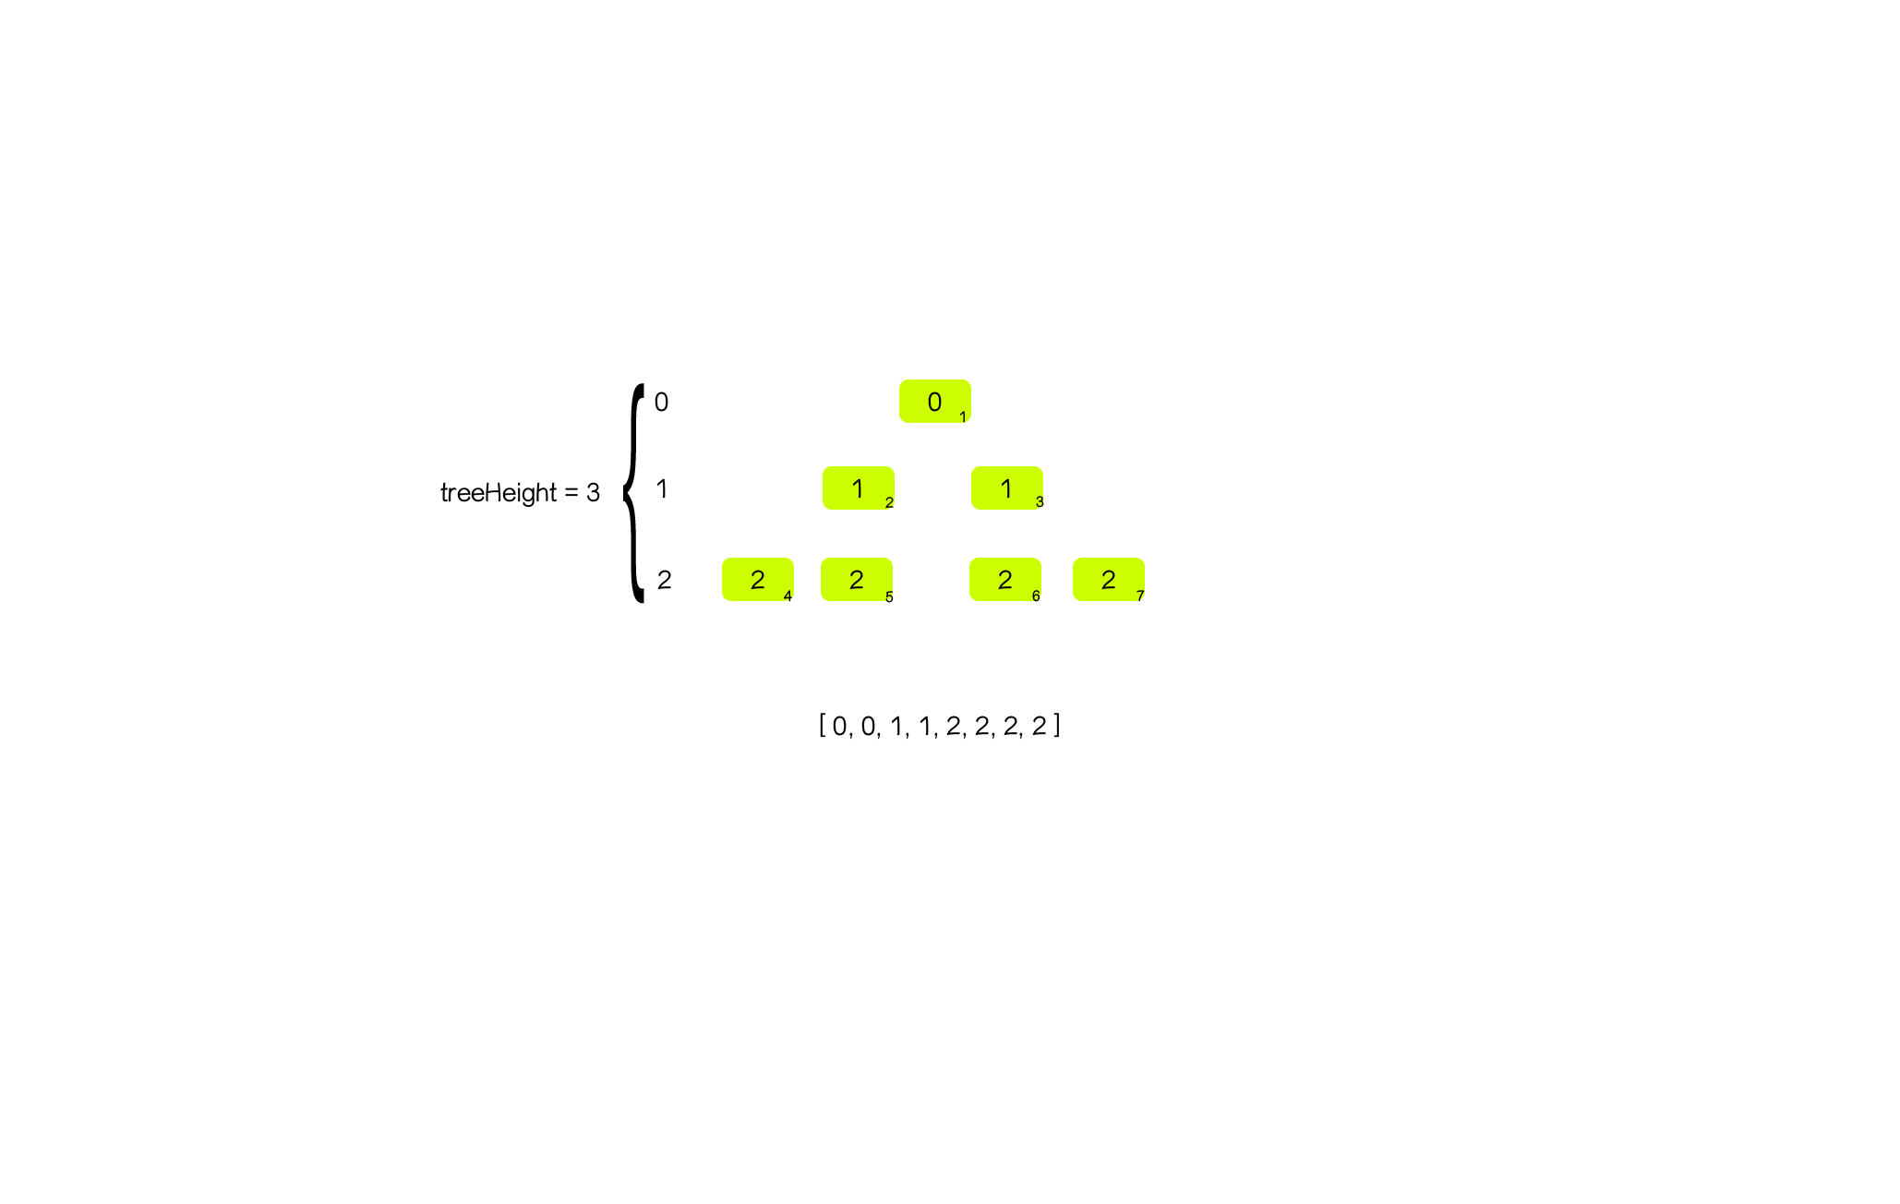

Slide 2
0
0
1
treeHeight = 3
1
1
1
2
3
2
2
2
2
2
4
5
6
7
[ 0, 1, 1, 2, 2, 2, 2 ]

