Slide 1









Group No.5
YAY
Basic idea:
i) basis
ii)Hamiltonian
iii)Diagonalization

Slide 2

YAY
Different strategy:
Y
AY
3
6
7
2
4
5
1
2
3
0
0
1
C++ vs Python
Windows vs Linux vs MacOs

Slide 3


YAY
Configuration & Hamiltonian:
step 1:
2p2h
0 h : (0, 1) p : (4, 5)
1 h : (0, 1) p : (6, 7)
2 h : (2, 3) p : (4, 5)
3 h : (2, 3) p : (6, 7)
4p4h
0 h : (0, 1, 2, 3) p : (4, 5, 6, 7)
6
7
4
5
2
3
0
1
step 2:
0p0h:11110000
2p2h: 00111100, 00110011…
4p4h: 00001111
step 3:

Slide 4
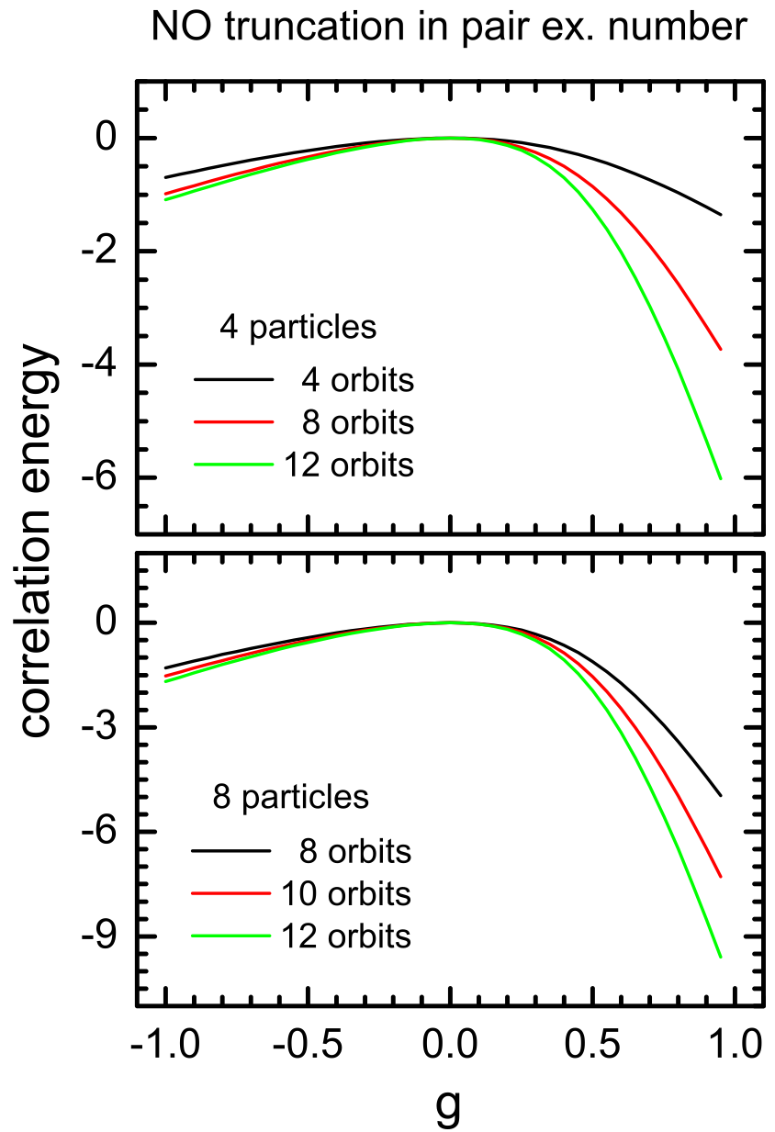

YAY
Configuration & Hamiltonian:

Slide 5
Thank you!
Group No.5
Yiyuan Chen
Adam Vernon
Yuanzhuo Ma
YAY

Slide 6
Group No.5
YAY
Y
YA

Slide 7
YAY
YAY
YAY
YAY
YAY
YAY

Slide 8
YAY
YAY
YAY

