Slide 1
Neutron matter

Slide 2
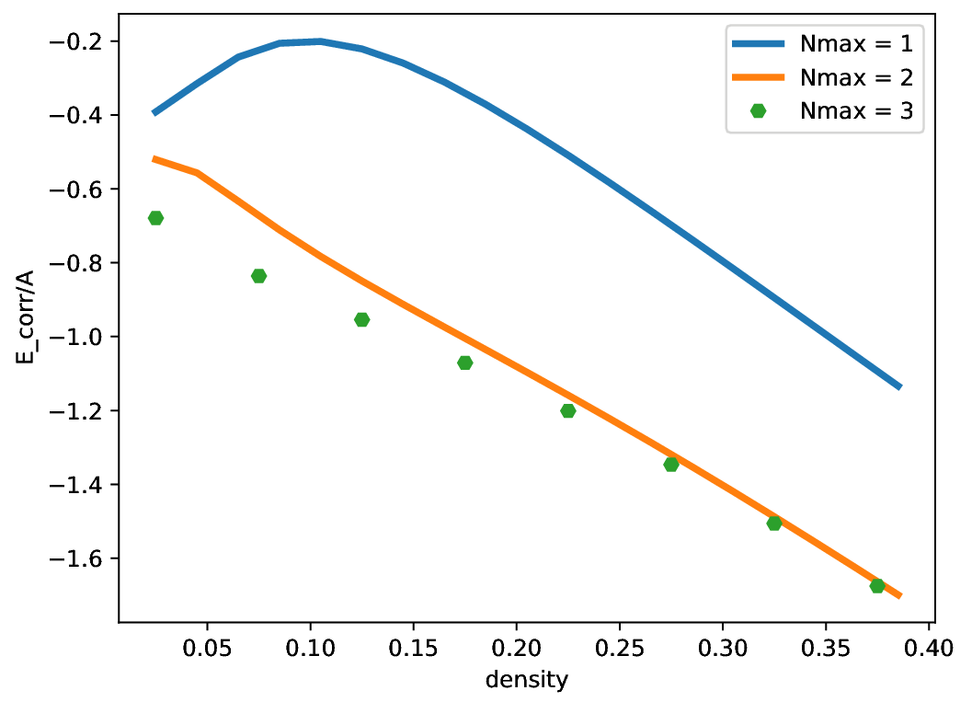
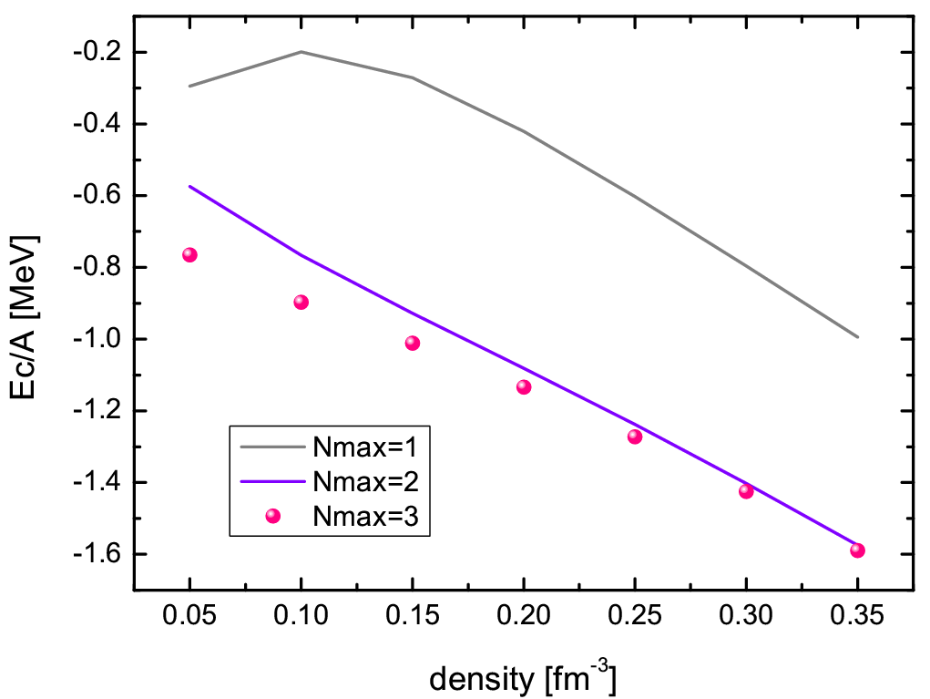
Neutron matter

Slide 3

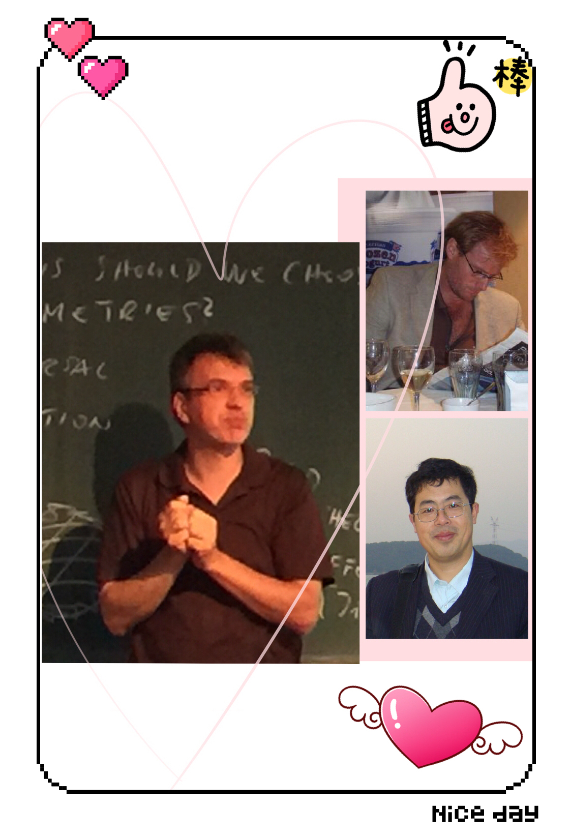

Many
Many
Many
Many
Thanks

