Slide 1


YAY
Neutron matter:
Group No.5
1) Momentum space basis
e.g. N_{max} = 1
n_{x}² , n_{y}² ,n_{z}² <= N²_{max}
[-0.5, +0.5]
N_{fermi} = 14
N_{particles} = 40
[-1,0,+1], [-1, 0, +1], [-1, 0, +1]
[-1,0,+1], [-1, 0, +1], [-1, 0, +1]
N_{fermi}=ρL³
2) Two particle states and grouping into Pij channels
P_{ij}
P’_{ij}
Less efficient
[k_{x}, k_{y}, k_{z}]
[n_{x}, n_{y}, n_{z}] 2π/L
P’’_{ij}

Slide 2

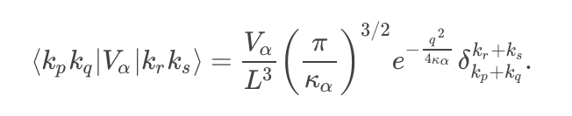
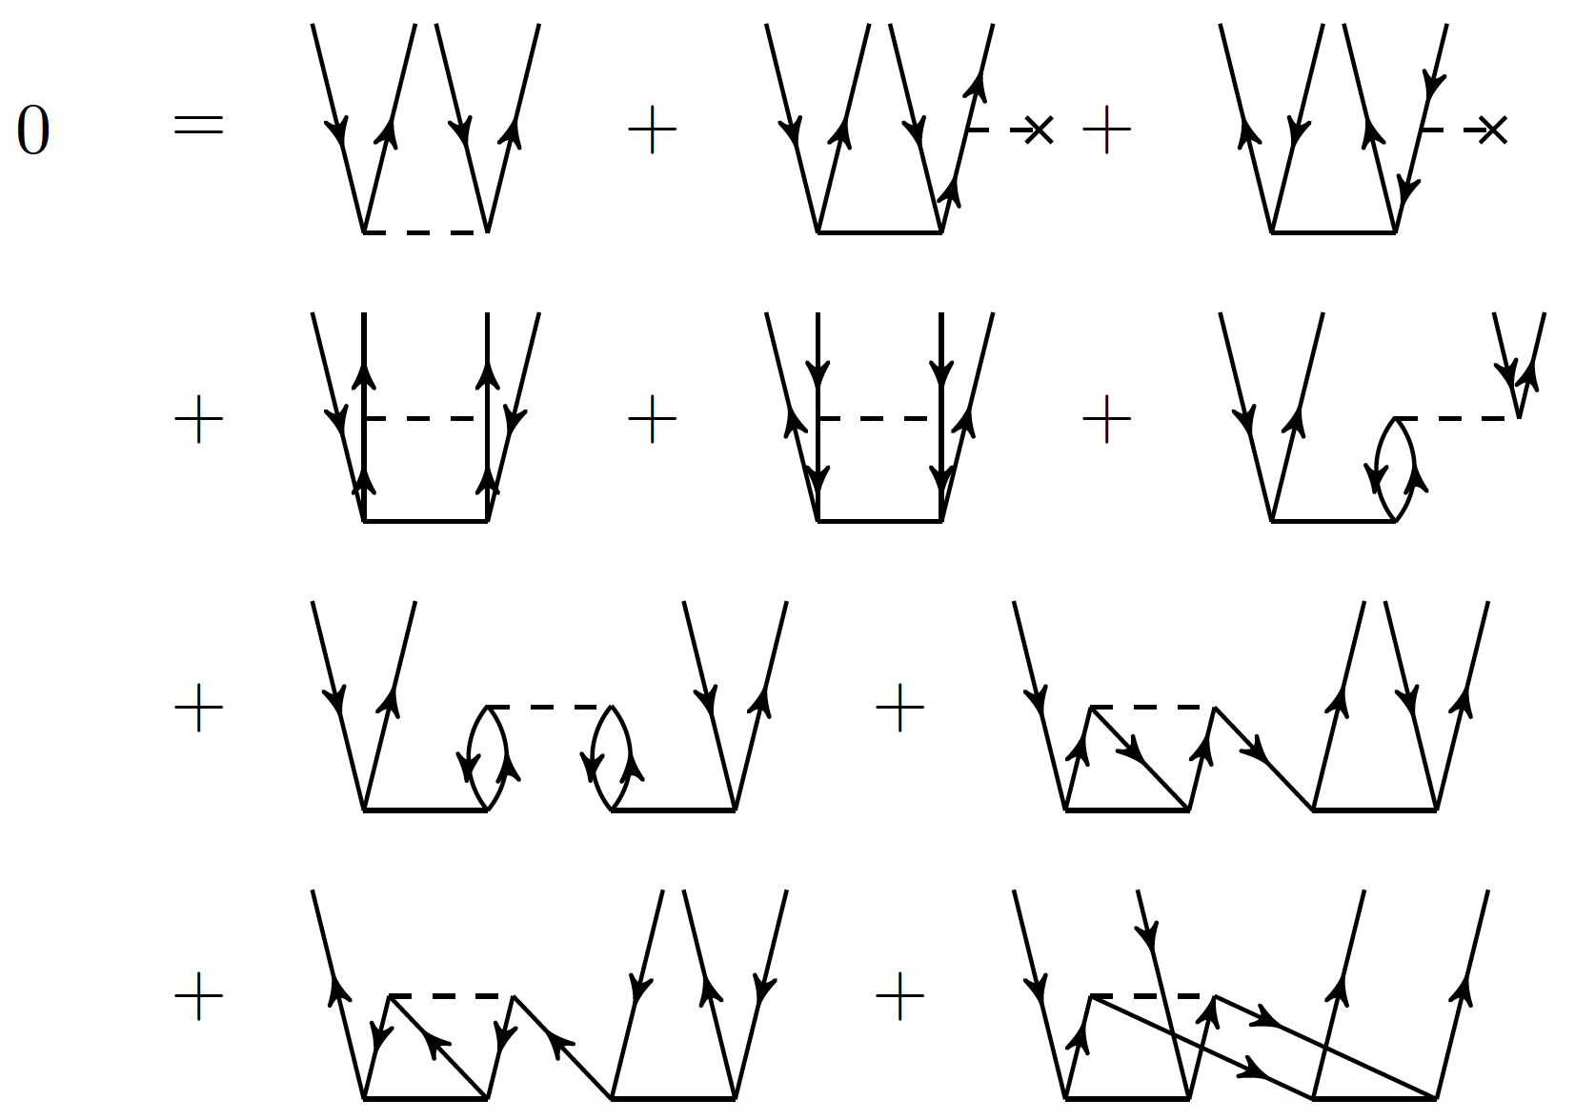

YAY
Neutron matter:
Group No.5
3) Matrix element calculation using Minnesota potential
P_{ij}
T =
P’_{ij}
P’’_{ij}
4) CCD using channel matrix multiplication iteration

Slide 3
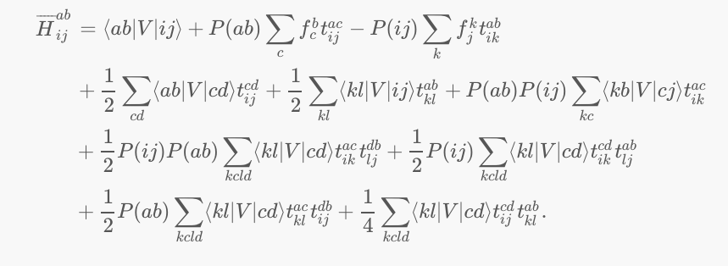

YAY
Neutron matter:
Group No.5
=>

