Slide 1



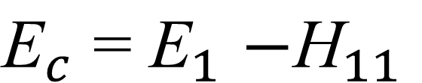
Group No.5
YAY
cc
Configuration Interaction Theory
H₁₁
H₁₂
H₁₃
E₁
H₂₁
H₂₂
H₂₃
E₂
H₃₁
H₃₂
H₃₃
E₃
If basis-1 is reference state,

Slide 2







Group No.5
YAY
cc
Coupled Cluster Theory

Slide 3
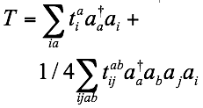
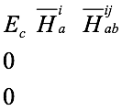
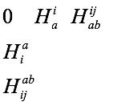


Group No.5
YAY
cc
Coupled Cluster Theory

Slide 4
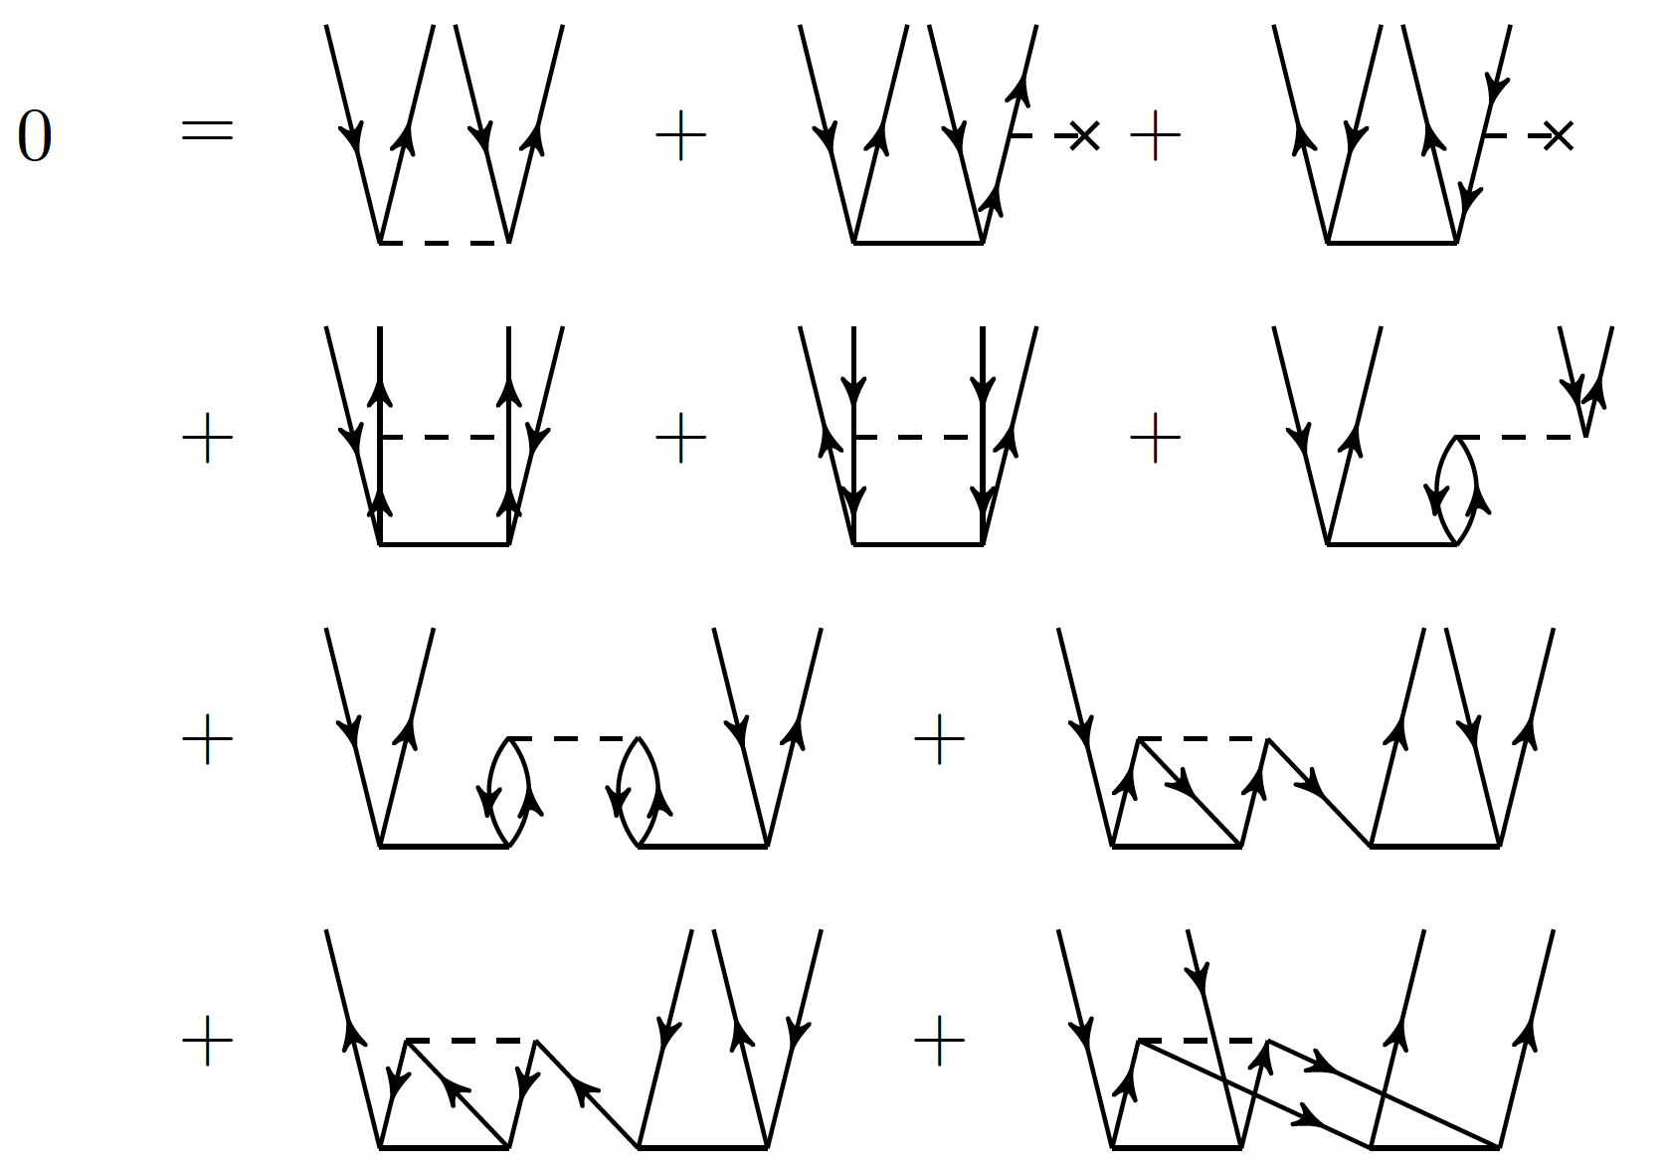
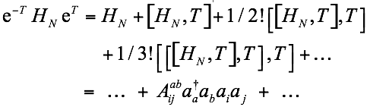

Group No.5
YAY
cc
Coupled Cluster Theory

Slide 5



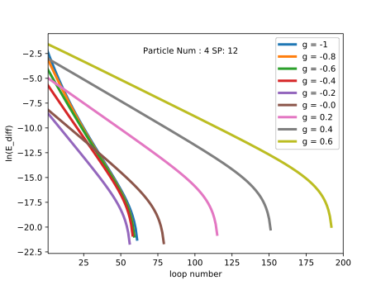


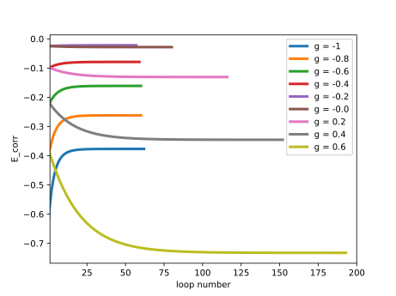



YAY
cc
Iteration & Convergence:
Condition:
Follows:
Limitation for convergence:
Particle number | SP number | g_min | g_max
4 | 4*2 | -1 | 8
4 | 8*2 | -1 | 36

Slide 6
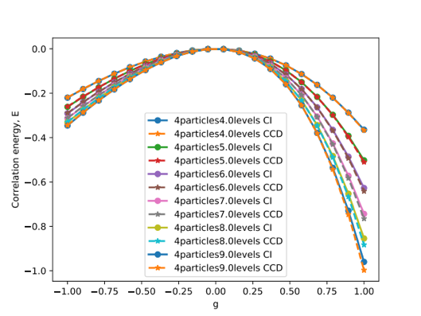
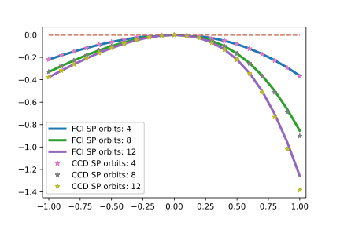
YAY
cc
Configuration & Hamiltonian:

Slide 7

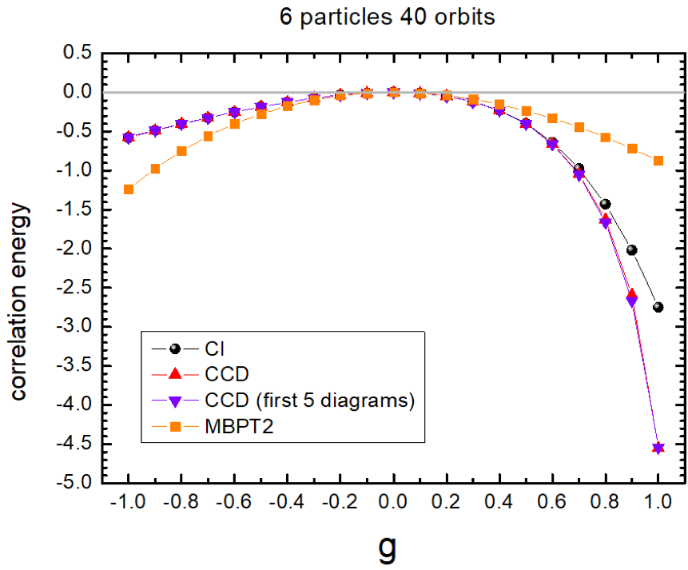

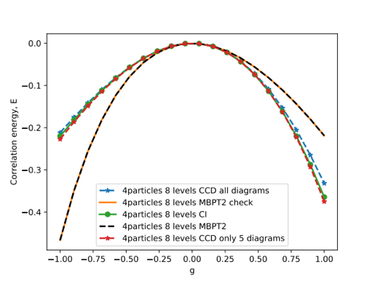
YAY
cc

Slide 8
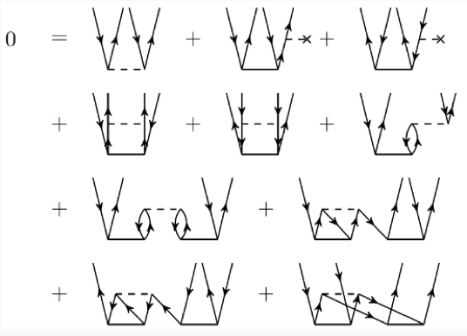
YAY
cc

Slide 9
YAY
cc

Slide 10
Thank you!
Group No.5
Yiyuan Cheng
Adam Vernon
Yuanzhuo Ma
YAY
cc

