Slide 1

YAY
Different strategy:
Y
AY
3
6
7
2
4
5
1
2
3
0
0
1
C++ vs Python
Windows vs Linux vs MacOs

Slide 2
Thank you!
Group No.5
Yiyuan Chen
Adam Vernon
Yuanzhuo Ma
YAY

Slide 3
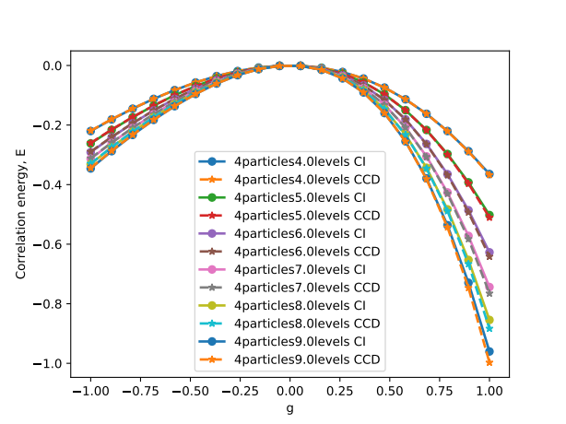
YAY
More orbits:
Group No.5

Slide 4
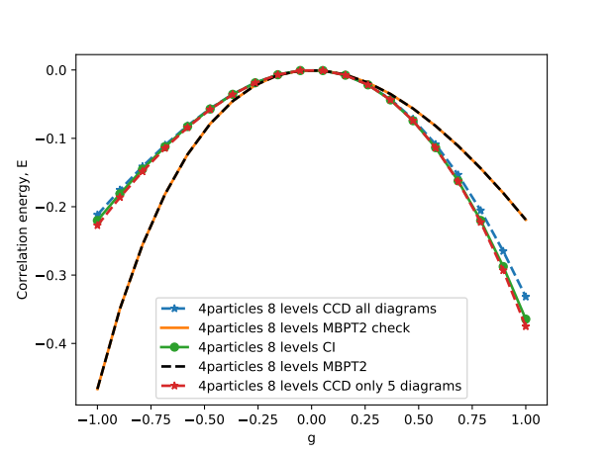
YAY
CCD:
Group No.5

Slide 5


YAY
CCD:
Group No.5

Slide 6
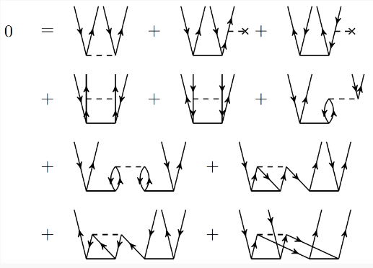
YAY
CCD:
Group No.5

Slide 7
YAY
CCD:
Group No.5

Slide 8
2 approaches, cpp and python, 3 checks
Similarity transformed Hamiltonian and cluster operator
CCD approximation- valid for pairing model or neutron matter
Intermediate diagrams
Correlation energy..
Perturbation result as starting point and iterate for convergence (starting point is MBPT2- valid for small g..)
mixing

