Slide 1

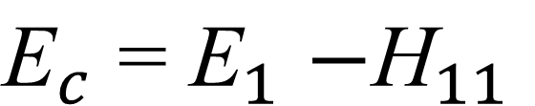
Group No.5
YAY
Configuration Interaction Theory
H₁₁
H₁₂
H₁₃
E₁
H₂₁
H₂₂
H₂₃
E₂
H₃₁
H₃₂
H₃₃
E₃
If basis-1 is reference state,
$${\text{E}}_{c}{\text{=} \text{E}}_{1}−{\text{H}}_{11}$$

Slide 2
Group No.5
YAY
Coupled Cluster Theory

Slide 3
Group No.5
YAY
Coupled Cluster Theory

Slide 4
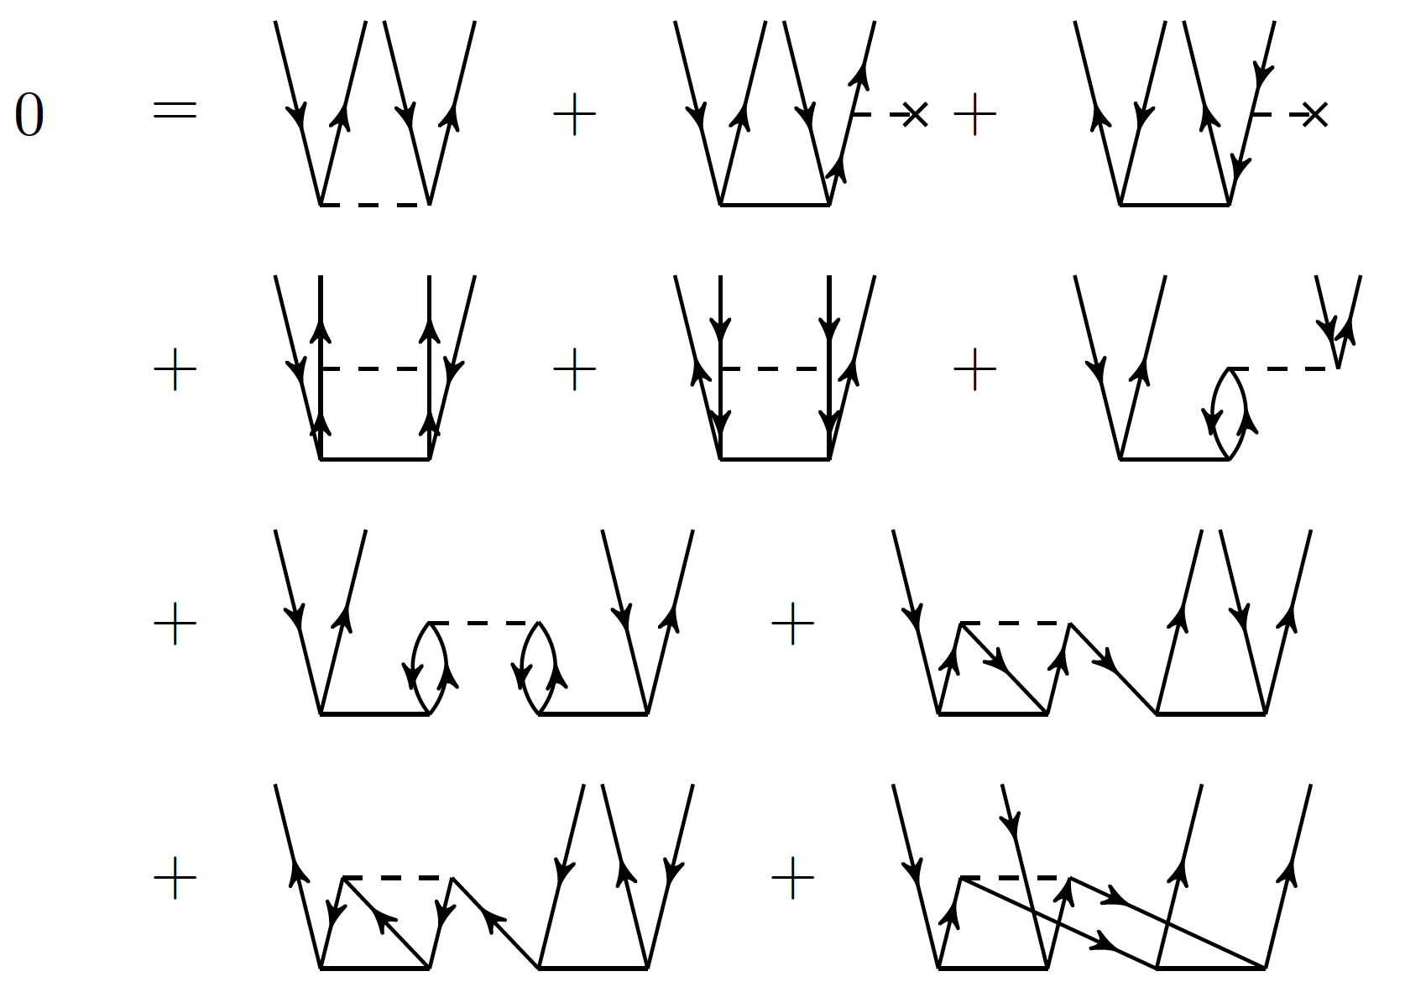
Group No.5
YAY
Coupled Cluster Theory

