Slide 1
Winning Space Race with Data Science
Yuan Zhou
03/08/2024

Slide 2
Outline
Executive Summary
Introduction
Methodology
Results
Conclusion

Slide 3
Executive Summary
Summary of methodologies
Data Collection through API
Data Collection with Web Scraping
Data Wrangling - Exploratory Data Analysis with SQL
Exploratory Data Analysis with Data Visualization
Interactive Visual Analytics with Folium
Machine Learning Prediction
Summary of all results
Exploratory Data Analysis result
Interactive analytics in screenshots
Predictive Analytics result from Machine Learning Lab

Slide 4
Introduction
SpaceX is a revolutionary company who has disrupt the space industry by offering a rocket launches specifically Falcon 9 as low as 62 million dollars; while other providers cost upward of 165 million dollar each. Most of this saving thanks to SpaceX astounding idea to reuse the first stage of the launch by re-land the rocket to be used on the next mission. Repeating this process will make the price down even further. As a data scientist of a startup rivaling SpaceX, the goal of this project is to create the machine learning pipeline to predict the landing outcome of the first stage in the future. This project is crucial in identifying the right price to bid against SpaceX for a rocket launch.
The problems included:
Identifying all factors that influence the landing outcome
The relationship between each variables and how it is affecting the outcome
The best condition needed to increase the probability of successful landing

Slide 5
Methodology
Executive Summary
Data collection methodology:
Perform data wrangling
Perform exploratory data analysis (EDA) using visualization and SQL
Perform interactive visual analytics using Folium and Plotly Dash
Perform predictive analysis using classification models

Slide 6
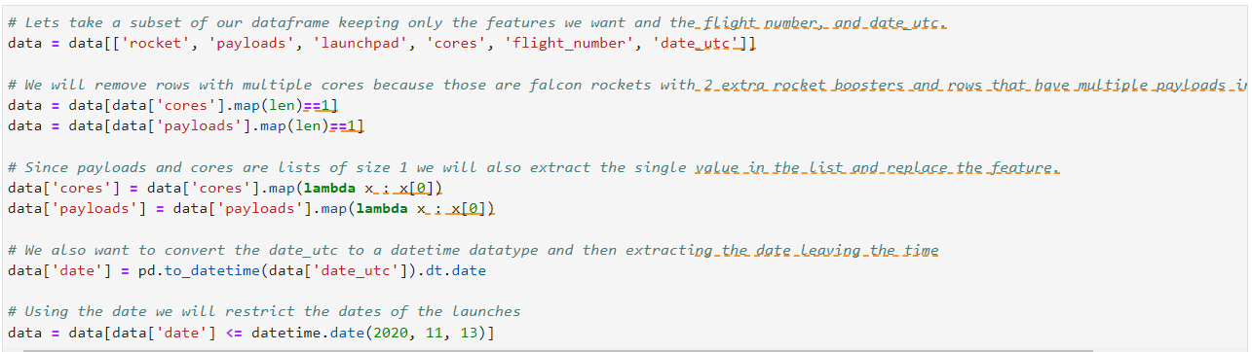
Data collection – SpaceX API

Slide 7
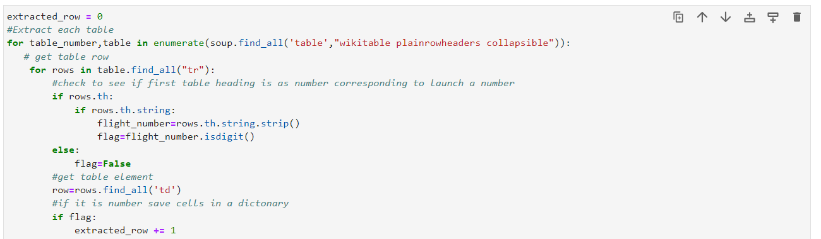
Data Collection - Scraping

Slide 8
Data Wrangling
Data Wrangling is the process of cleaning and unifying messy and complex data sets for easy access and Exploratory Data Analysis (EDA).
We will first calculate the number of launches on each site, then calculate the number and occurrence of mission outcome per orbit type.
We then create a landing outcome label from the outcome column. This will make it easier for further analysis, visualization, and ML. Lastly, we will export the result to a CSV

Slide 9
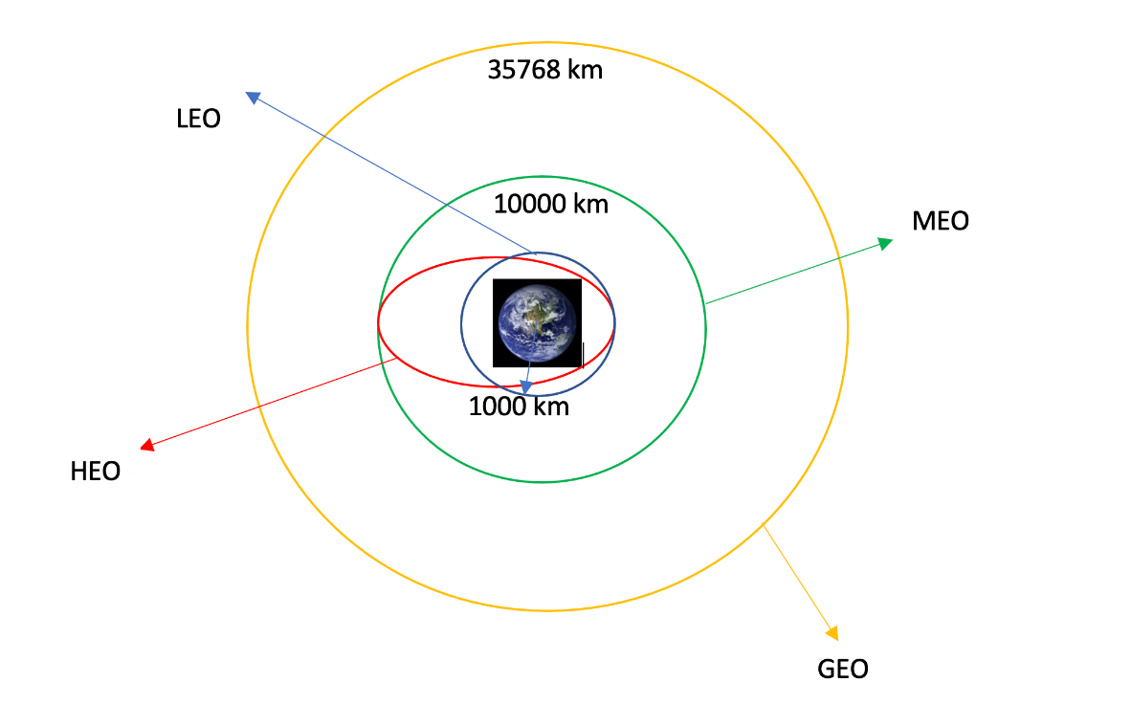
Data Wrangling

Slide 10
EDA with Data Visualization
We first started by using scatter graph to find the relationship between the attributes such as between:
Payload and Flight Number.
Flight Number and Launch Site.
Payload and Launch Site.
Flight Number and Orbit Type.
Payload and Orbit Type.
Scatter plots show dependency of attributes on each other. Once a pattern is determined from the graphs. It’s very easy to see which factors affecting the most to the success of the landing outcomes.

Slide 11
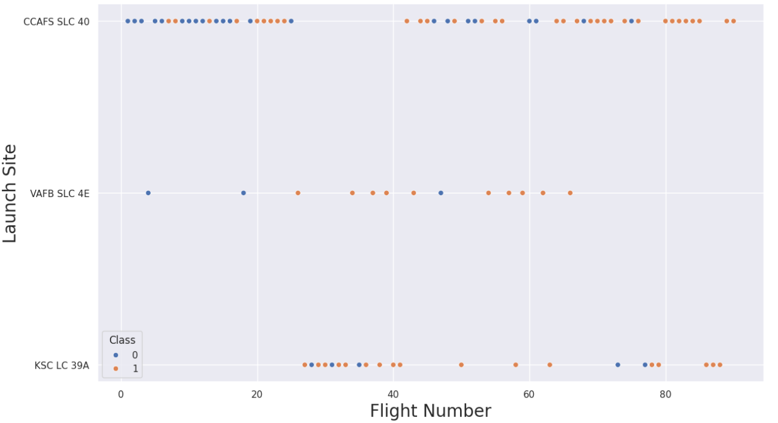
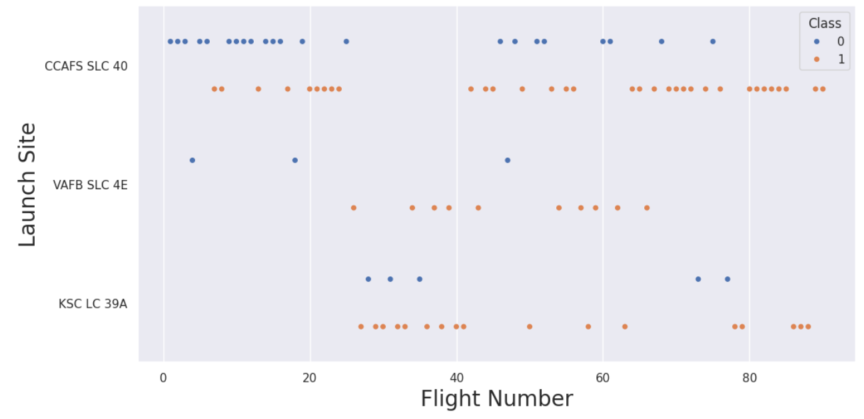
EDA with Data Visualization

Slide 12
EDA with Data Visualization
Once we get a hint of the relationships using scatter plot. We will then use further visualization tools such as bar graph and line plots graph for further analysis.
Bar graphs is one of the easiest way to interpret the relationship between the attributes. In this case, we will use the bar graph to determine which orbits have the highest probability of success.
We then use the line graph to show a trends or pattern of the attribute over time which in this case, is used for see the launch success yearly trend.
We then use Feature Engineering to be used in success prediction in the future module by created the dummy variables to categorical columns.

Slide 13
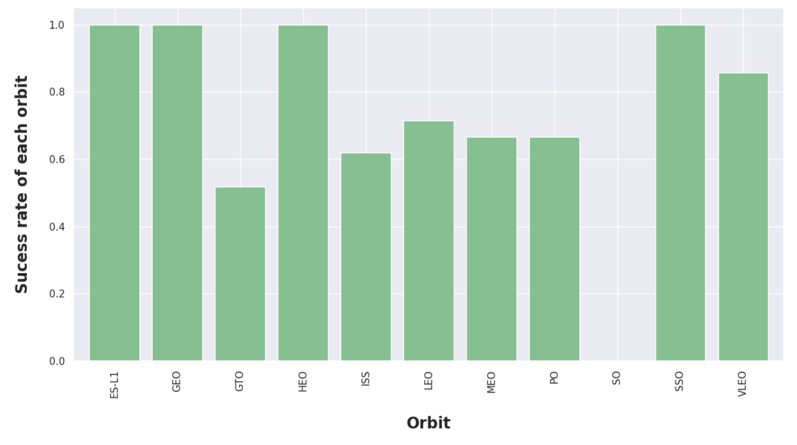
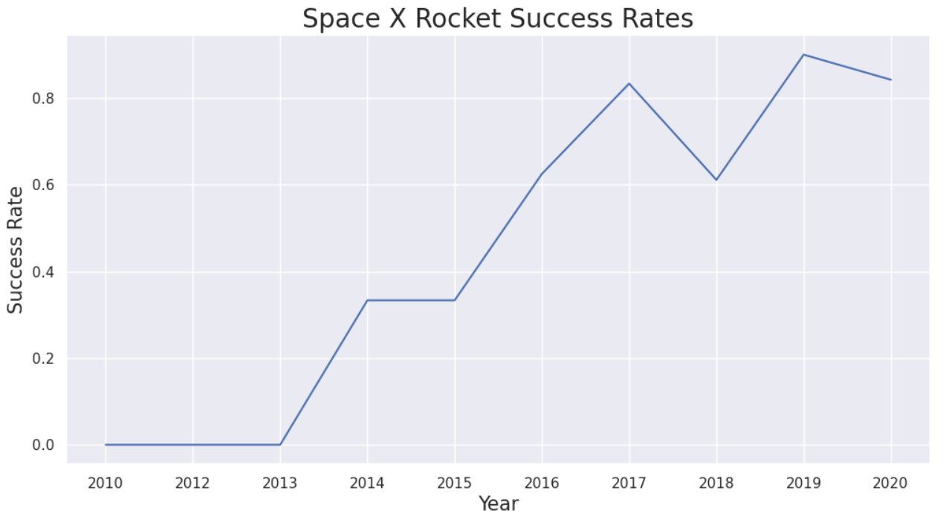
EDA with Data Visualization

Slide 14
EDA with SQL
Using SQL, we had performed many queries to get better understanding of the dataset, Ex:
Displaying the names of the launch sites.
Displaying 5 records where launch sites begin with the string ‘CCA’.
Displaying the total payload mass carried by booster launched by NASA (CRS).
Displaying the average payload mass carried by booster version F9 v1.1.
Listing the date when the first successful landing outcome in ground pad was achieved.
Listing the names of the boosters which have success in drone ship and have payload mass greater than 4000 but less than 6000.
Listing the total number of successful and failure mission outcomes.
Listing the names of the booster_versions which have carried the maximum payload mass.
Listing the failed landing_outcomes in drone ship, their booster versions, and launch sites names for in year 2015.
Rank the count of landing outcomes or success between the date 2010-06-04 and 2017-03-20, in descending order

Slide 15
Build an Interactive Map with Folium
To visualize the launch data into an interactive map. We took the latitude and longitude coordinates at each launch site and added a circle marker around each launch site with a label of the name of the launch site.
We then assigned the dataframe launch_outcomes(failure,success) to classes 0 and 1 with Red and Green markers on the map in MarkerCluster().
We then used the Haversine’s formula to calculated the distance of the launch sites to various landmark to find answer to the questions of:
How close the launch sites with railways, highways and coastlines?
How close the launch sites with nearby cities?

Slide 16
Build a Dashboard with Plotly Dash
We built an interactive dashboard with Plotly dash which allowing the user to play around with the data as they need.
We plotted pie charts showing the total launches by a certain sites.
We then plotted scatter graph showing the relationship with Outcome and Payload Mass (Kg) for the different booster version.

Slide 17
Predictive Analysis (Classification)
Building the Model
Load the dataset into NumPy and Pandas
Transform the data and then split into training and test datasets
Decide which type of ML to use
Set the parameters and algorithms to GridSearchCV and fit it to dataset
Evaluating the Model
Check the accuracy for each model
Get tuned hyperparameters for each type of algorithms.
plot the confusion matrix.
Improving the Model
Use Feature Engineering and Algorithm Tuning
Find the Best Model
The model with the best accuracy score will be the best performing model.

Slide 18
Results
The results will be categorized to 3 main results which is:
Exploratory data analysis results
Interactive analytics demo in screenshots
Predictive analysis results

Slide 19
Flight Number vs. Launch Site
This scatter plot shows that the larger the flights amount of the launch site, the greater the the success rate will be. However, site CCAFS SLC40 shows the least pattern of this.

Slide 20
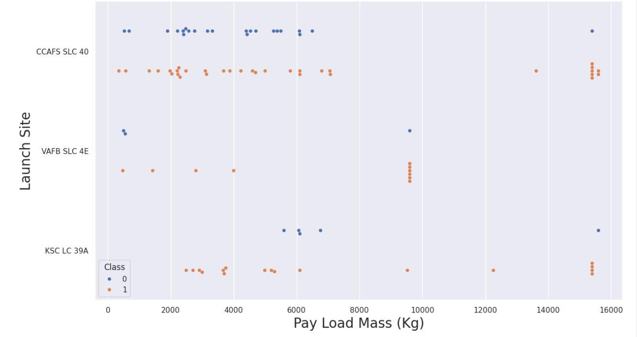
Payload vs. Launch Site
This scatter plot shows once the pay load mass is greater than 7000kg, the probability of the success rate will be highly increased.
However, there is no clear pattern to say the launch site is dependent to the pay load mass for the success rate.

Slide 21
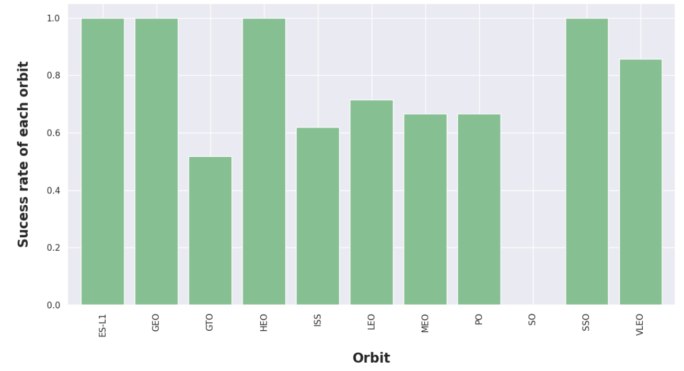
Success Rate vs. Orbit Type
This figure depicted the possibility of the orbits to influences the landing outcomes as some orbits has 100% success rate such as SSO, HEO, GEO AND ES-L1 while SO orbit produced 0% rate of success.
However, deeper analysis show that some of this orbits has only 1 occurrence such as GEO, SO, HEO and ES-L1 which mean this data need more dataset to see pattern or trend before we draw any conclusion.

Slide 22
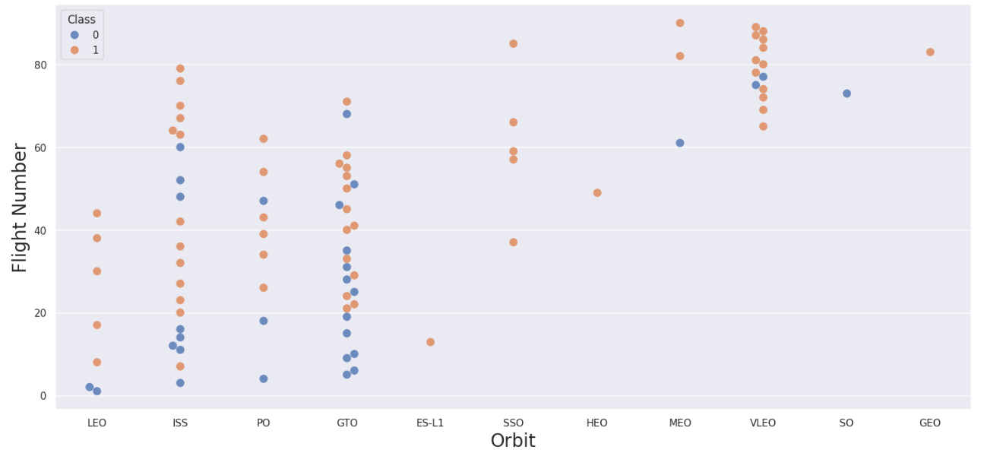
Flight Number vs. Orbit Type
This scatter plot shows that generally, the larger the flight number on each orbits, the greater the success rate (especially LEO orbit) except for GTO orbit which depicts no relationship between both attributes.
Orbit that only has 1 occurrence should also be excluded from above statement as it’s needed more dataset.

Slide 23
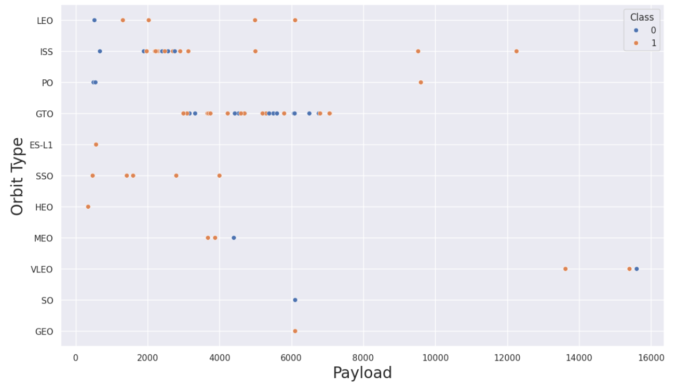
Payload vs. Orbit Type
Heavier payload has positive impact on LEO, ISS and P0 orbit. However, it has negative impact on MEO and VLEO orbit.
GTO orbit seem to depict no relation between the attributes.
Meanwhile, again, SO, GEO and HEO orbit need more dataset to see any pattern or trend

Slide 24
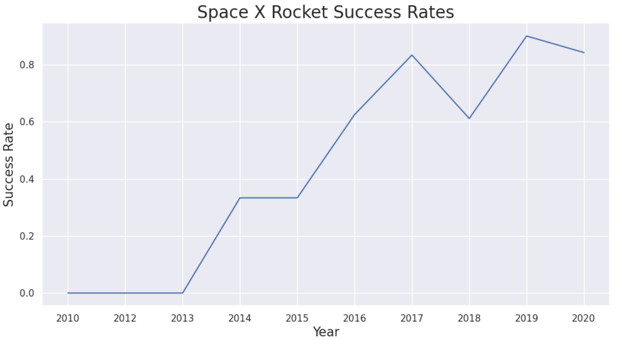
Launch Success Yearly Trend
This figures clearly depicted and increasing trend from the year 2013 until 2020.
If this trend continue for the next year onward. The success rate will steadily increase until reaching 1/100% success rate.

Slide 25
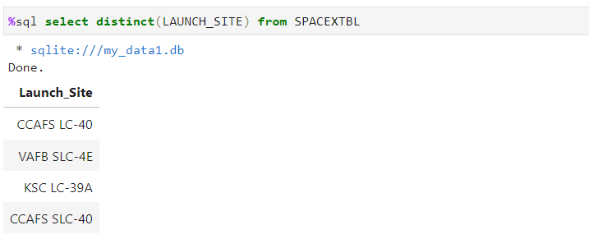
All Launch Site Names
We used the key word DISTINCT to show only unique launch sites from the SpaceX data.

Slide 26
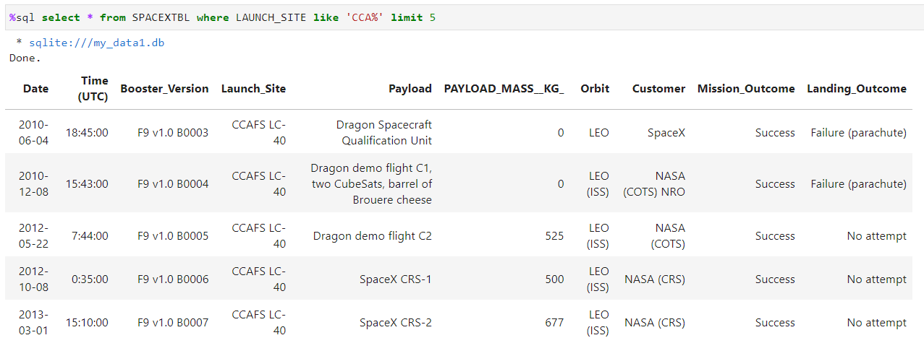
Launch Site Names Begin with 'CCA'
We used the query above to display 5 records where launch sites begin with `CCA`

Slide 27
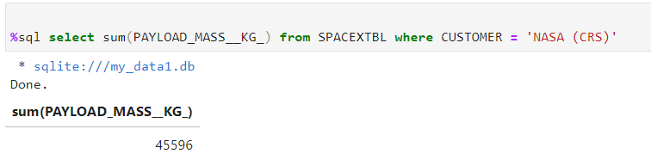
Total Payload Mass
We calculated the total payload carried by boosters from NASA as 45596 using the query below

Slide 28
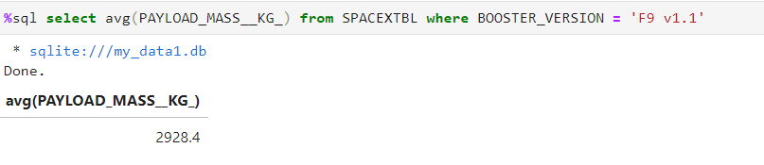
Average Payload Mass by F9 v1.1

Slide 29
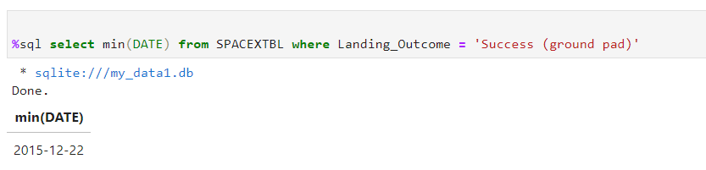
First Successful Ground Landing Date

Slide 30
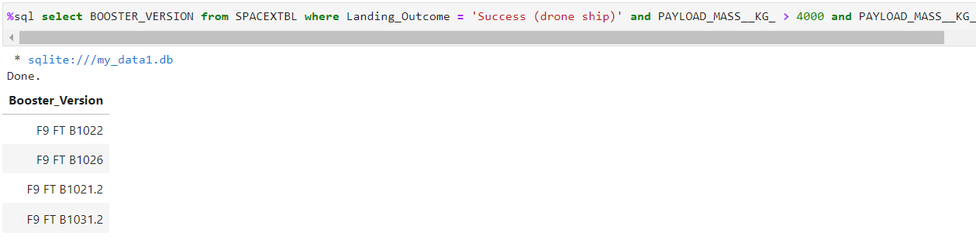
Successful Drone Ship Landing with Payload between 4000 and 6000

Slide 31
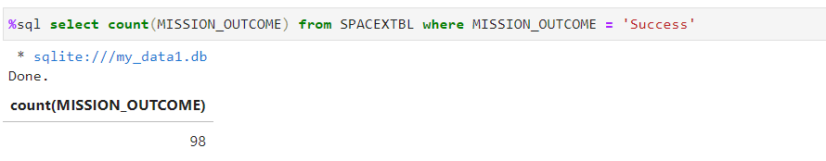
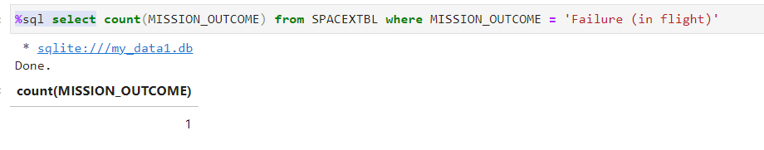
Total Number of Successful and Failure Mission Outcomes

Slide 32
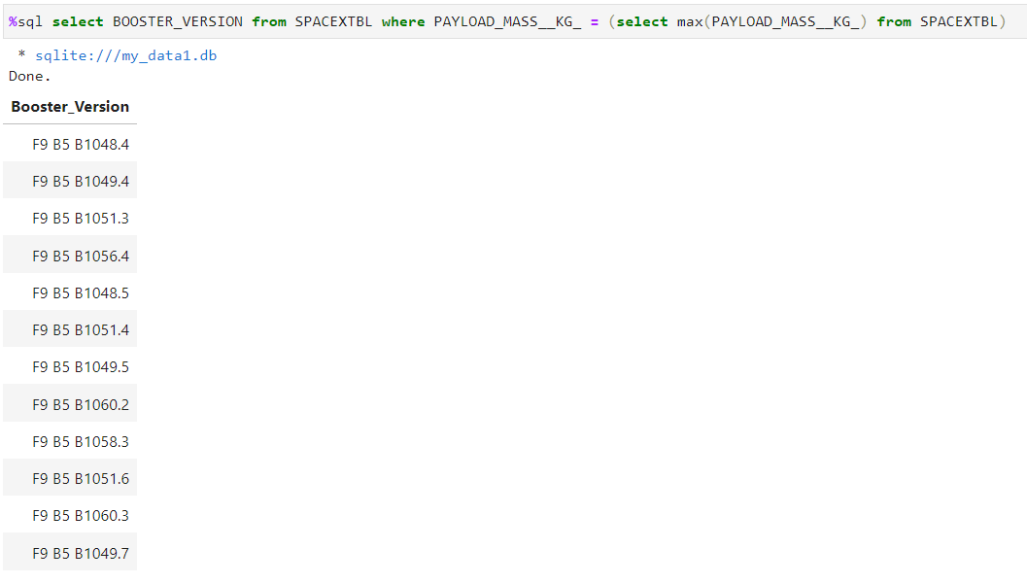
Boosters Carried Maximum Payload

Slide 33
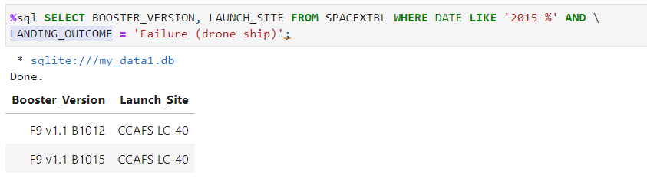
2015 Launch Records

Slide 34
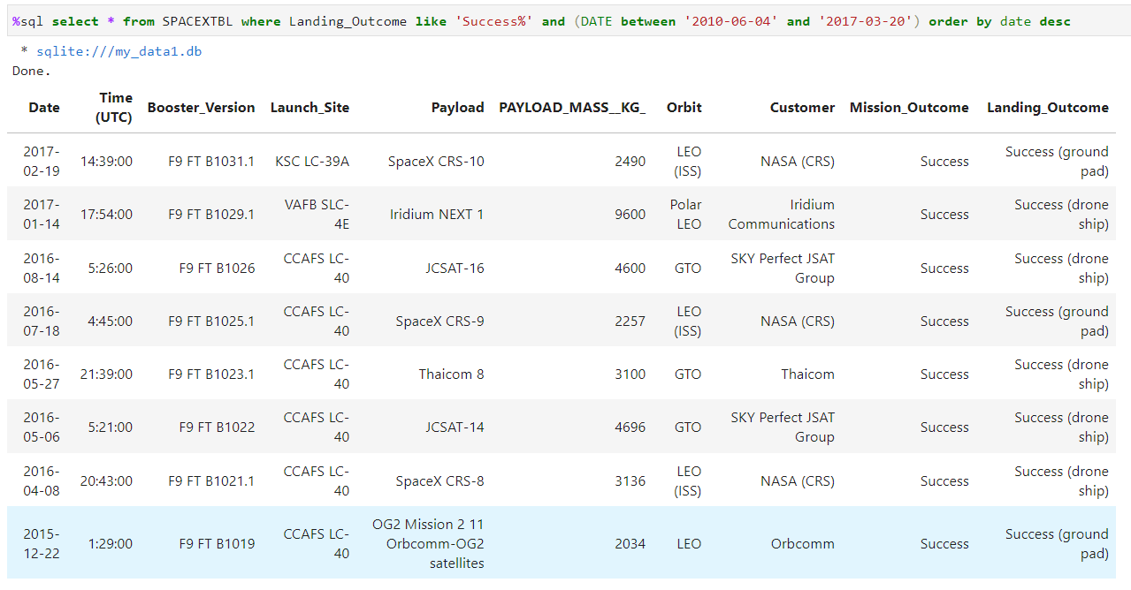
Rank Landing Outcomes Between 2010-06-04 and 2017-03-20

Slide 35
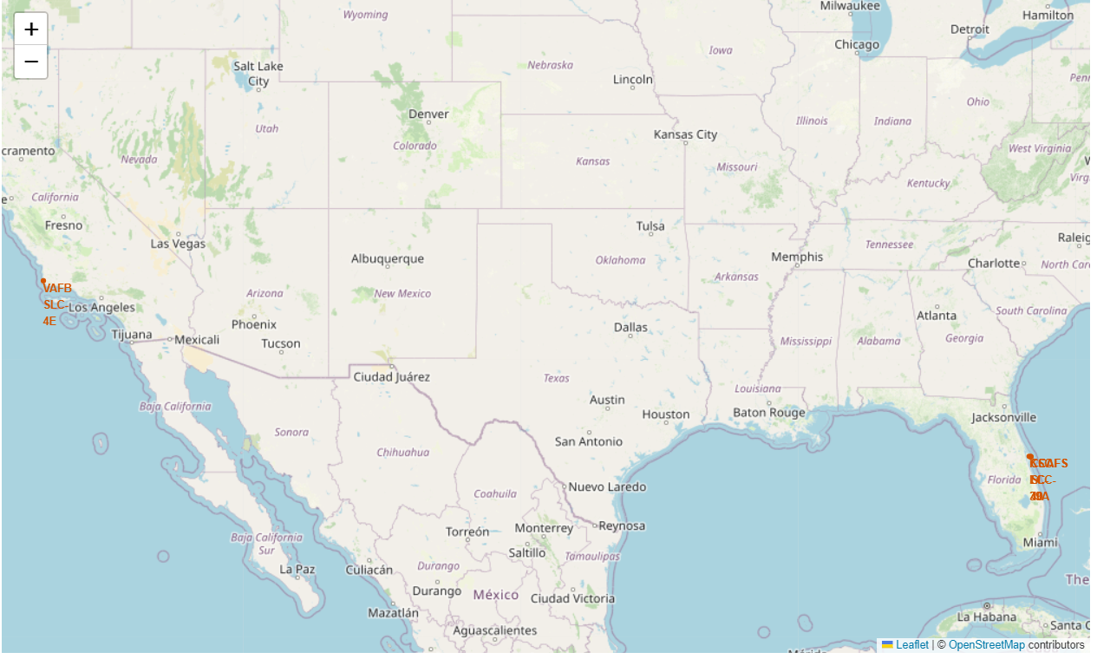
Location of all the Launch Sites

Slide 36
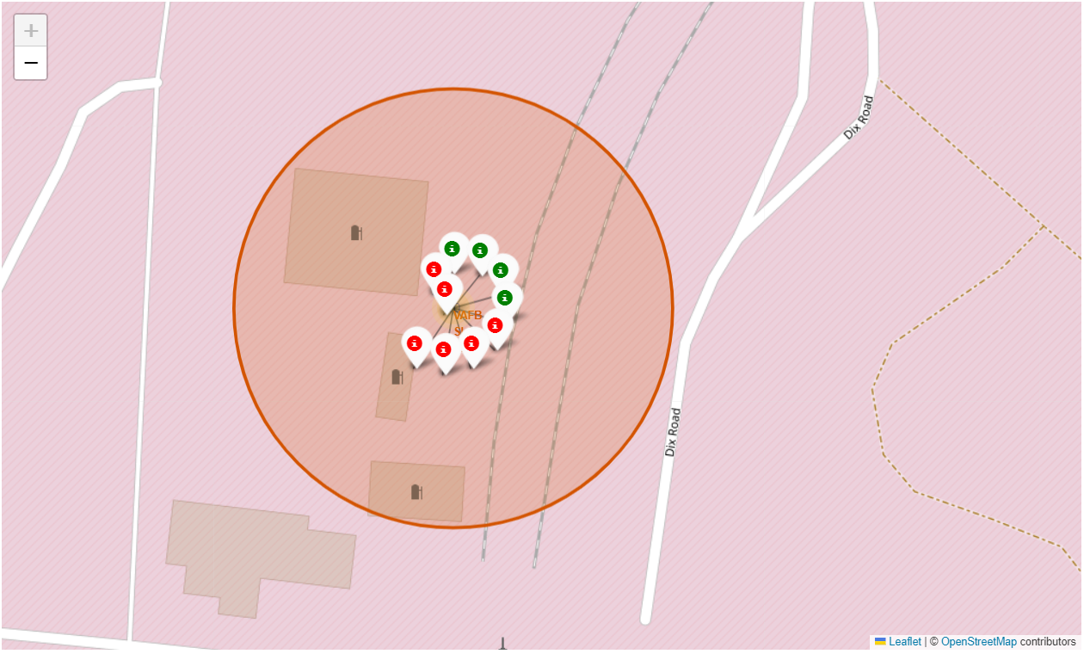
Markers showing launch sites with color labels

Slide 37
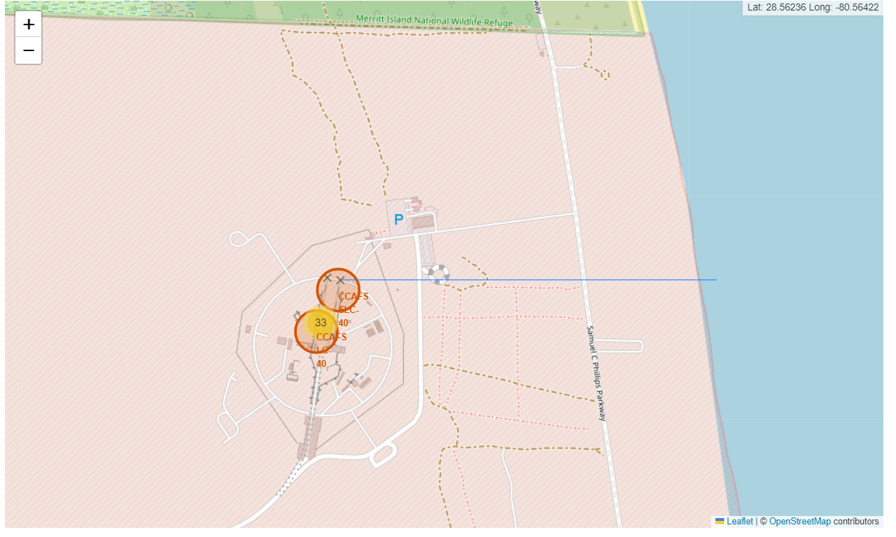
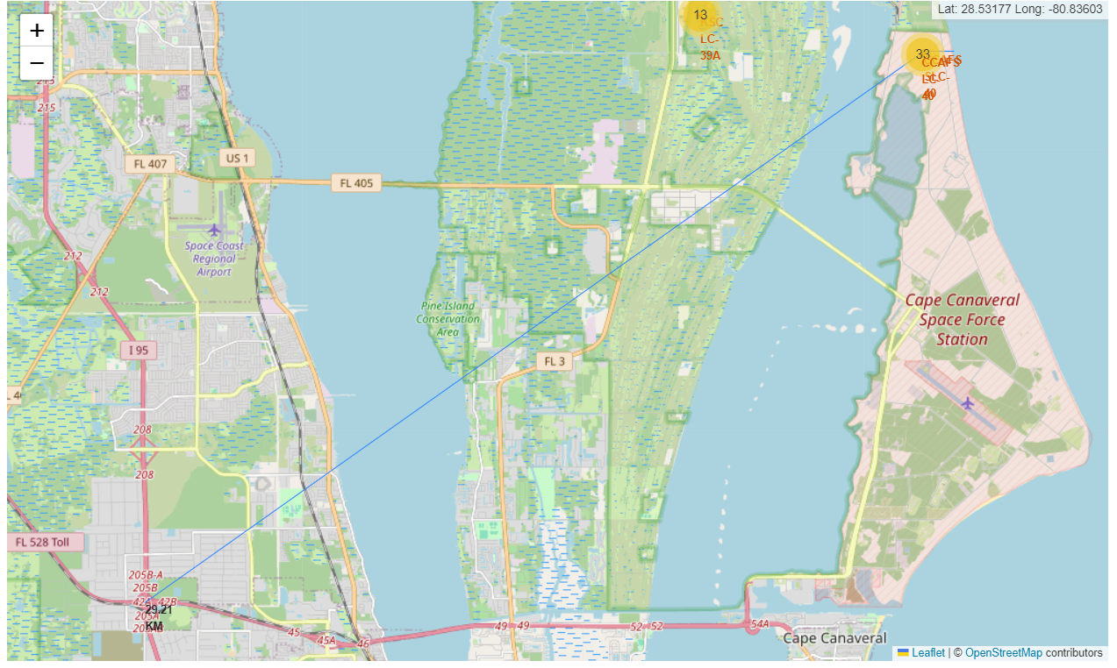
Launch Sites Distance to Landmarks

Slide 38
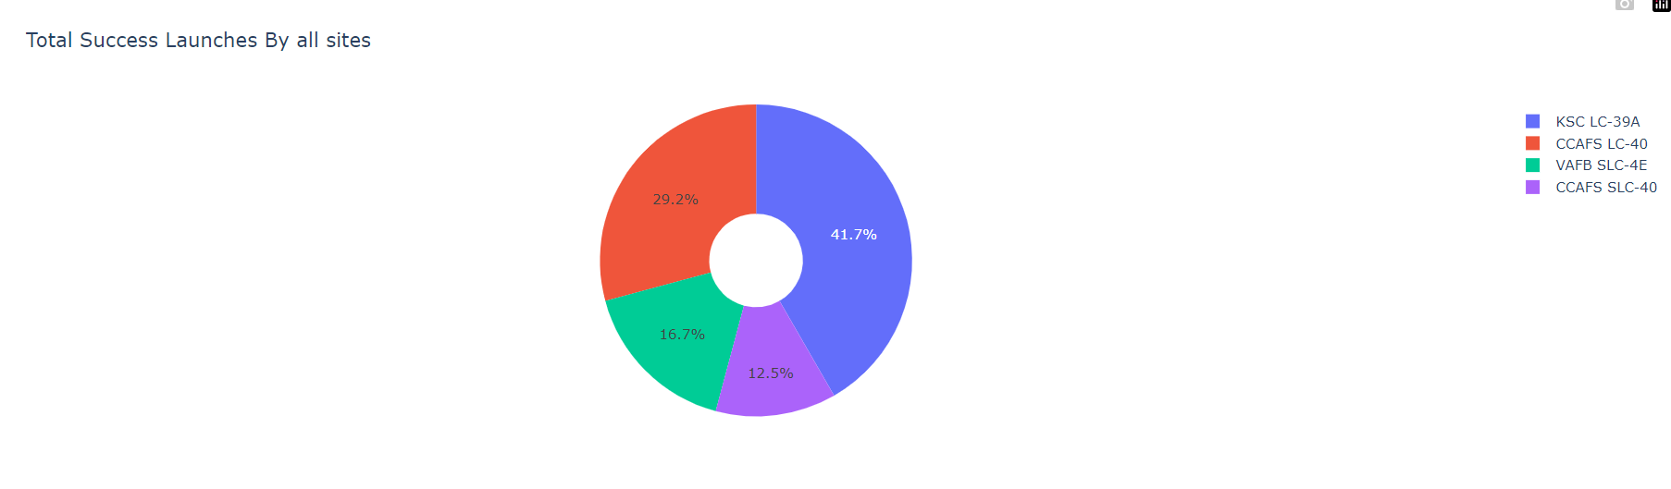
The success percentage by each sites

Slide 39
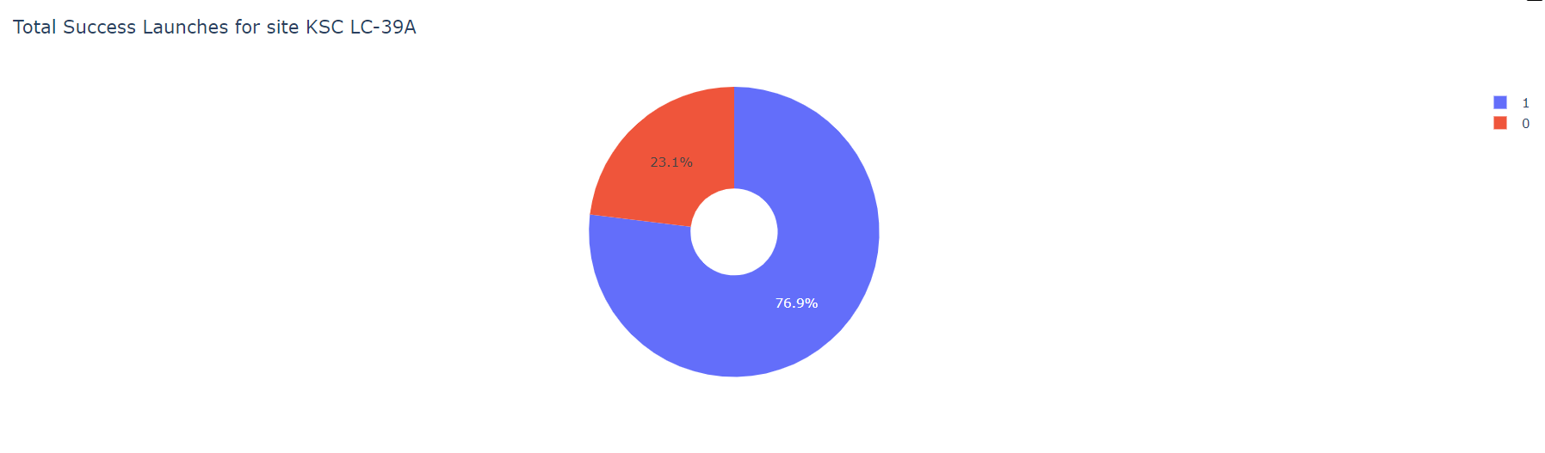
The highest launch-success ratio: KSC LC-39A

Slide 40
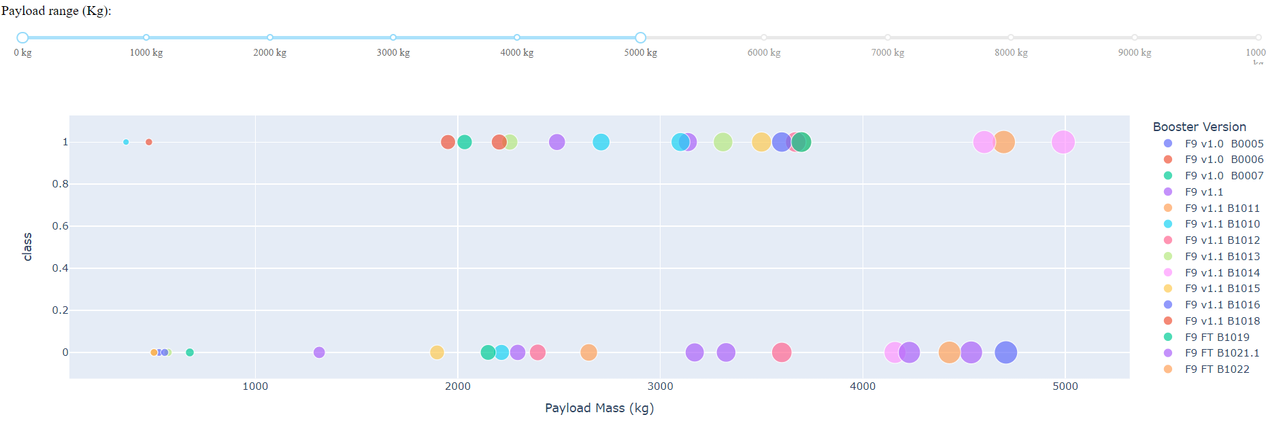
Payload vs Launch Outcome Scatter Plot

Slide 41
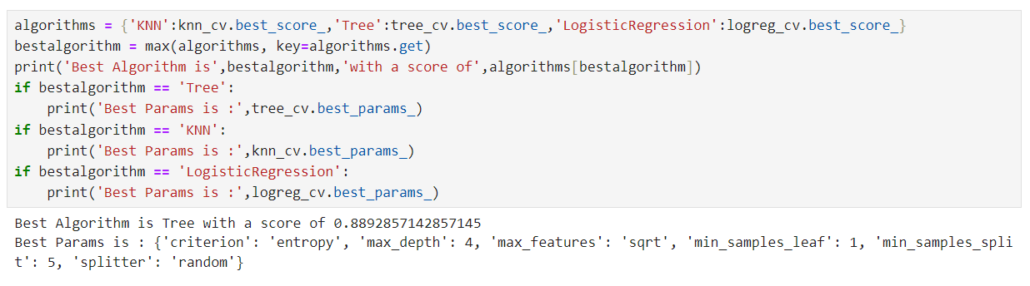
Classification Accuracy

Slide 42
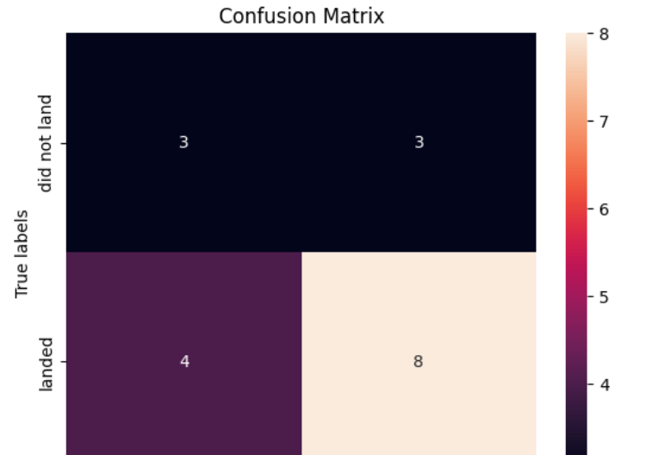
Confusion Matrix
The confusion matrix for the decision tree classifier shows that the classifier can distinguish between the different classes. The major problem is the false positives .i.e., unsuccessful landing marked as successful landing by the classifier.

Slide 43
Conclusion
We can conclude that:
The Tree Classifier Algorithm is the best Machine Learning approach for this dataset.
The low weighted payloads (which define as 4000kg and below) performed better than the heavy weighted payloads.
Starting from the year 2013, the success rate for SpaceX launches is increased, directly proportional time in years to 2020, which it will eventually perfect the launches in the future.
KSC LC-39A have the most successful launches of any sites; 76.9% • SSO orbit have the most success rate; 100% and more than 1 occurrence.

