Slide 1


Exercise 06: Transient step response
<Advanced Analogue Building Blocks>
Kirchhoff-Institute for Physics, Uni-Heidelberg
Zhenxiong Yuan
2017.06.10

Slide 2
Contents
Overview of transient step response
  Linear setup for small step
  Slew rate for large step
Simulation and analysis: small step transient response
Simulation and analysis: big step transient response

Slide 3
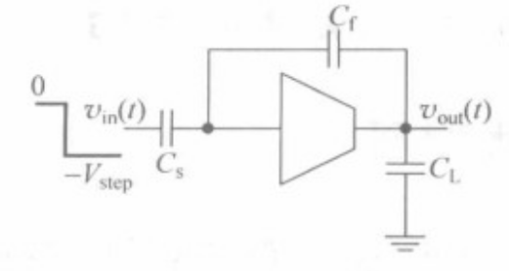
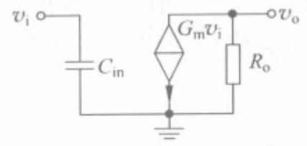
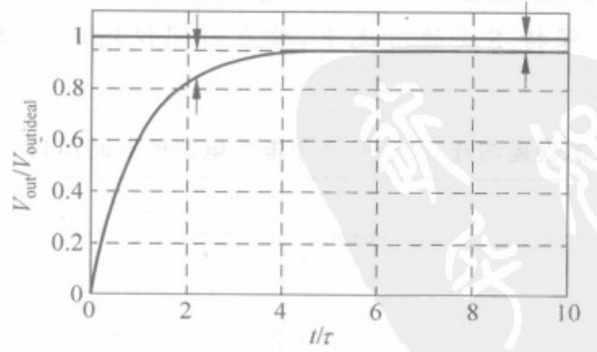
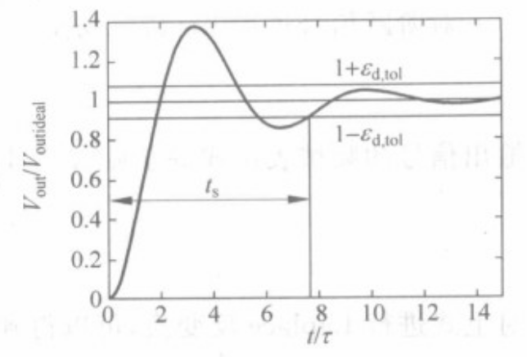
Linear setup
Consider a capacitive feedback circuit using single OTA
Dynamic error
Static error

Slide 4
simulation
In “Ex6/OTA_Step”, using the parameters stored, do simulation and compare the results for different settings below:
  Set Cs=Cf=500fF, CL=10pF, Vstep=10mV
  Set Cs=Cf=500fF, CL=500fF, Vstep=10mV
Analysis: what’s the effect of the zero on the dynamic settling time?

Slide 5
Slewing
In “Ex6/OTA_Step”, using the parameters stored, do simulation and compare the results for different settings below:
  Set Cs=Cf=500fF, CL=10pF, Vstep=1V
  Calculate the slew rate, slewing time and settling time
Analysis the slew rate, slewing time and settling time
  For simple OTA
  For two stage OTA

