Slide 1


Hadronic shower simulation models
Group Meeting
Kirchhoff-Institute for Physics, Uni-Heidelberg
Zhenxiong Yuan
2017.08.01

Slide 2
Contents
Hadronic shower simulation models
Hadrons in the SiW ECAL
Hadrons in the SciFe AHCAL
Charge track segments in Hadronic showers
Shower evolution with time

Slide 3
Hadrons in the SiW ECAL
Comparison between data and simulation
  Total ECAL energy
  Transverse energy profile
  Longitudinal distribution of interaction point
  Longitudinal energy profile
All data from pions

Slide 4
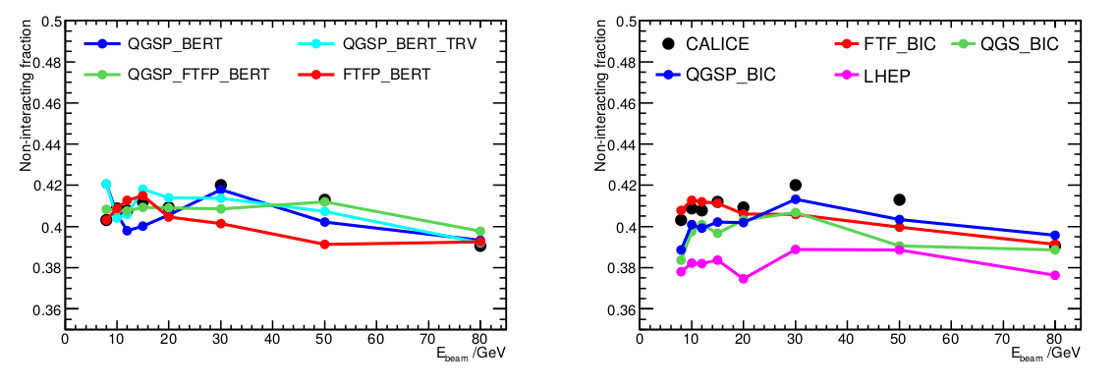
Total ECAL energy
Mean fraction of non-interacting pions in the ECAl
Gives confidence in the cross-section simulated in GEANT4

Slide 5
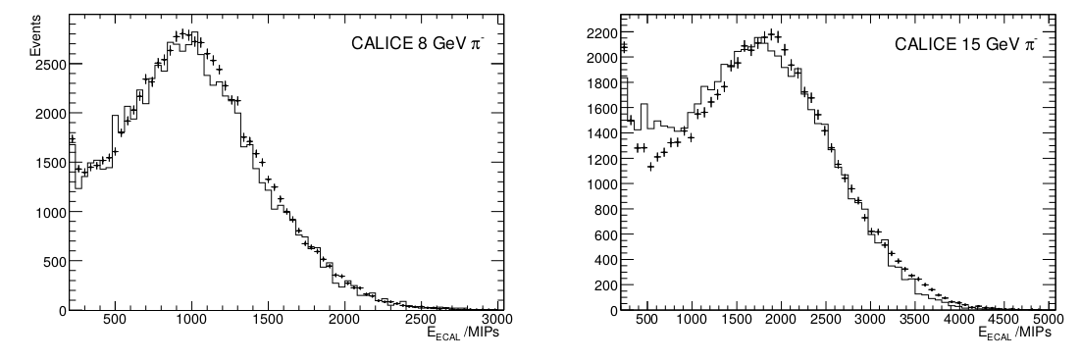
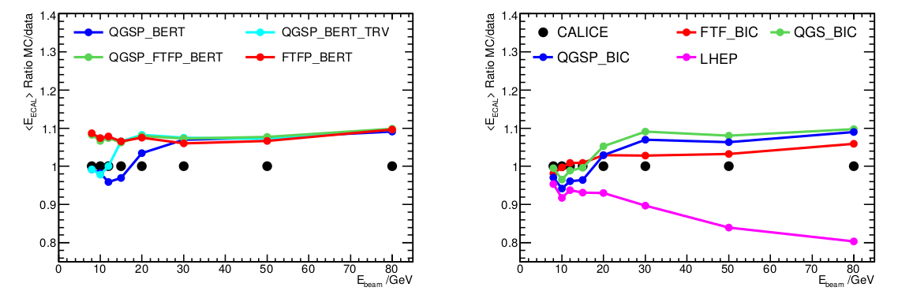
Total ECAL energy
Energy deposited in the ECAL

Slide 6
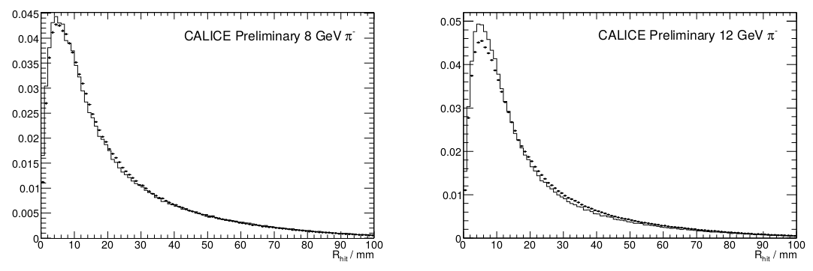
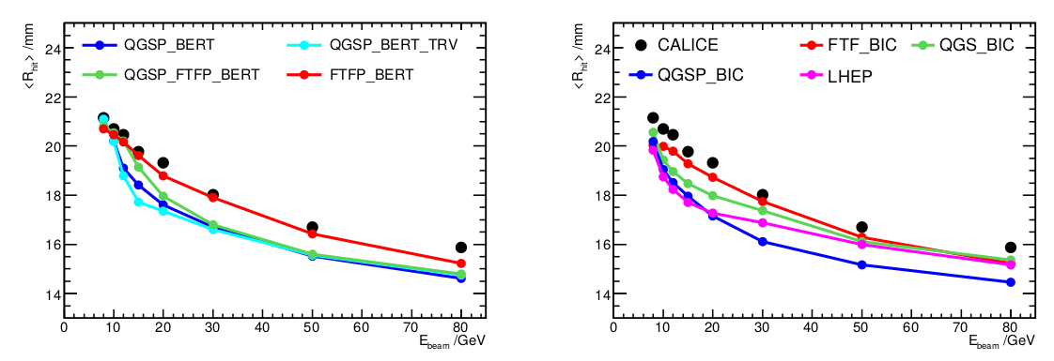
Transverse energy profile
Radial distribution of hits(energy weighted)

Slide 7
  Shower starting point

