Slide 1
Noise, filtering and shaping
HighRR SPICE Hands-On 2017, Day 3

Slide 2
Contents
Lecture
  Review of Day1 and Day2
  Limitations of the maximum energy resolution
  Noise analysis of the pre-amplifier stage
  Filtering and shaping
Hands-on
  Analysis: Find the a and b coefficients
  SPICE: Noise PSD of the pre-amplifier output
  Analysis: Noise at the CR-RC shaper output
  SPICE: Simulation of CR-RC shaper
  SPICE: Comparison of different filter/shaper structure

Slide 3
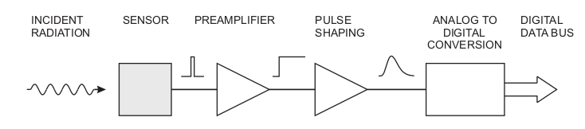
Review
review

Slide 4
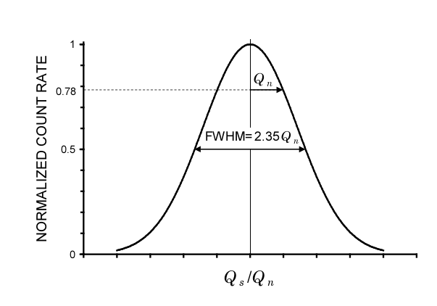
Detector resolution
Intrinsic detector resolution associated with the statistical properties
  Generated electron-hole pairs are subjected to random fluctuations
  Full-Width at Half Maximum (FWHM)

Slide 5
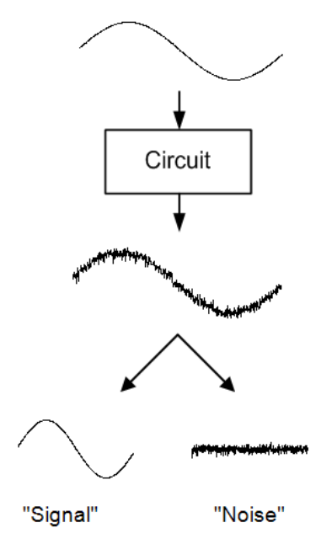
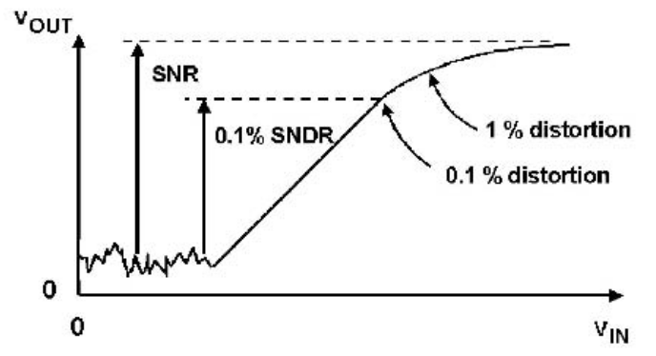
Electronic resolution
Signal-to-Noise ratio (SNR)
Signal-to-Noise and Distortion ratio (SNDR)
Equivalent noise signal, like ENC

Slide 6
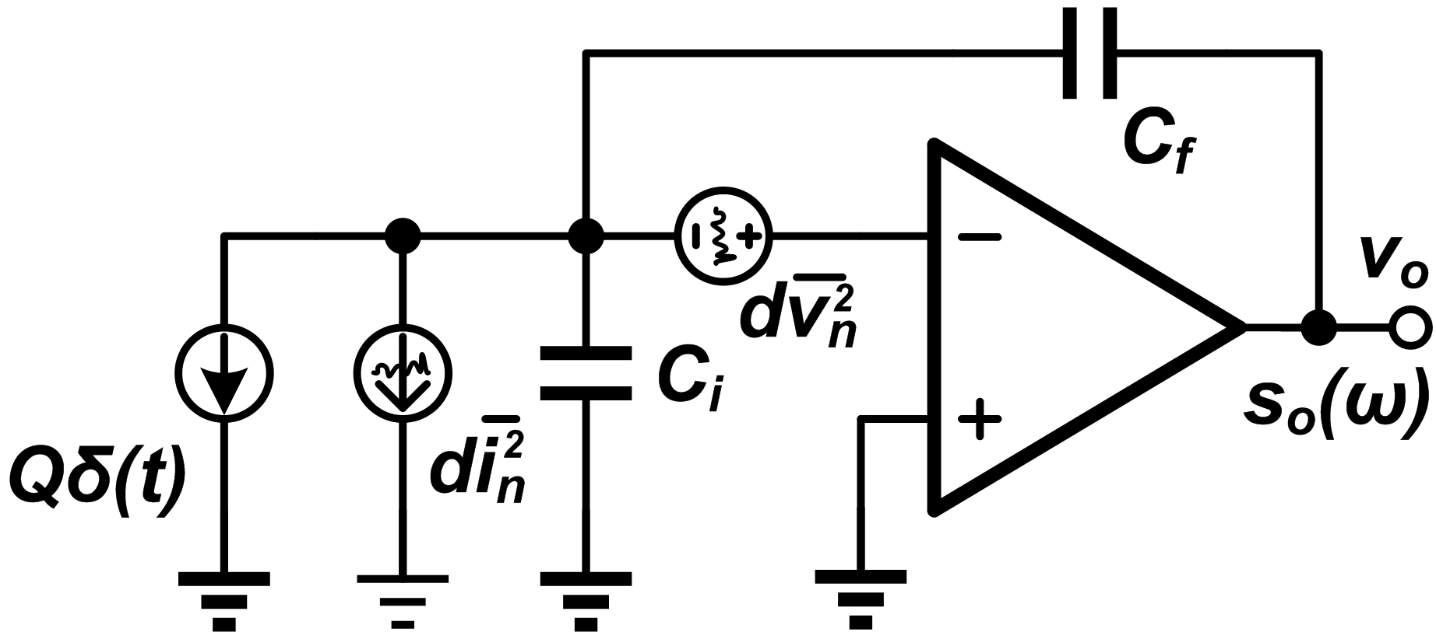
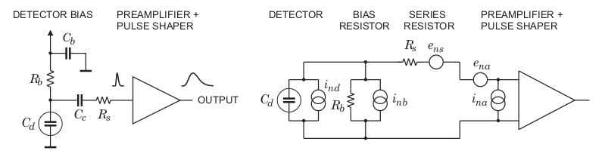
Noise sources - 1
Noise from the detector
  Bias resistor, detector shot noise, ...
Noise from Rs can be ignored

Slide 7
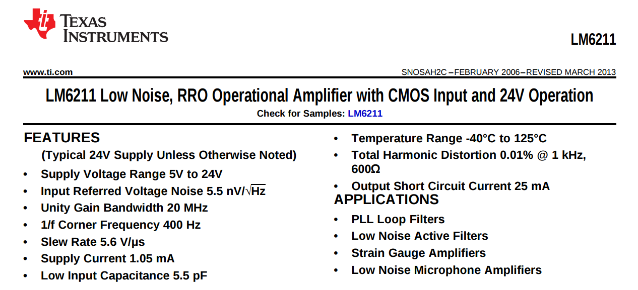
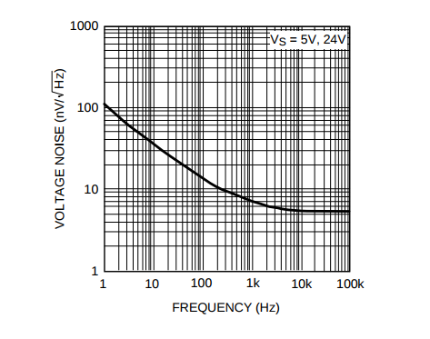
Noise sources - 2
Noise from the electronics system
  Amplifier, resistor, ...

Slide 8
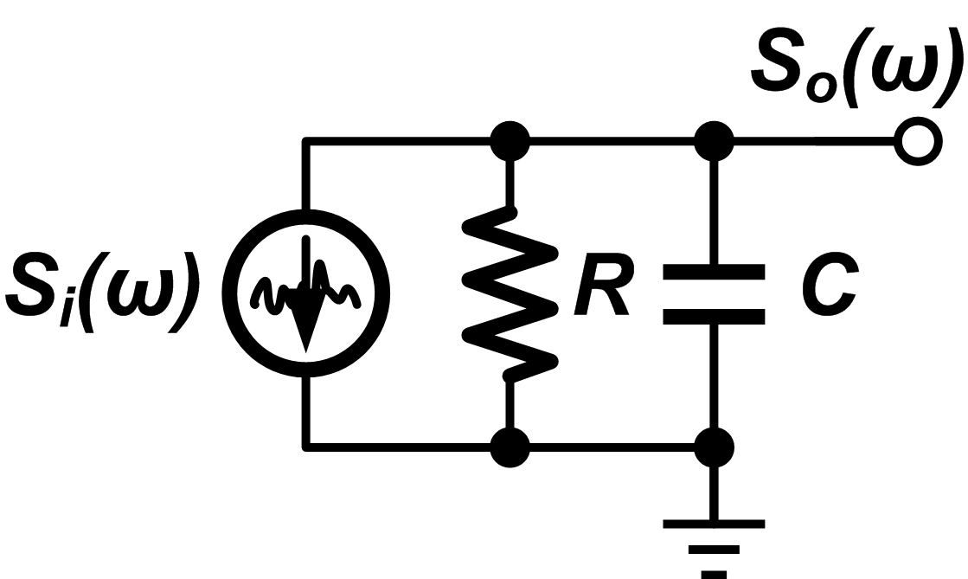
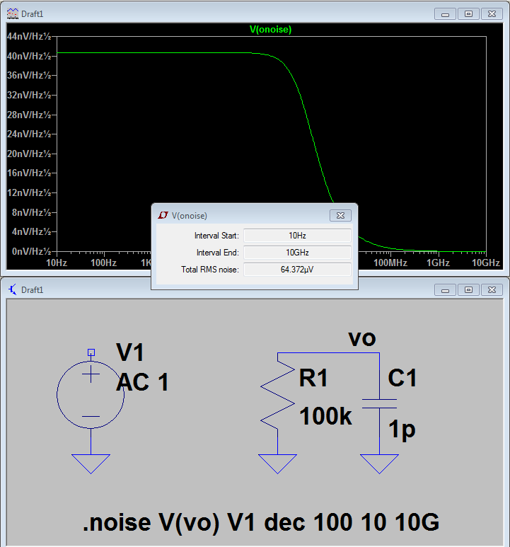
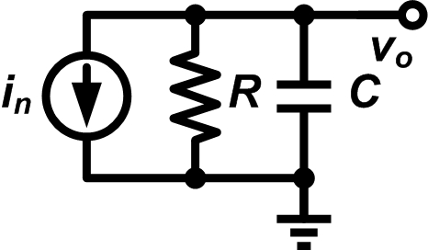
Noise analysis: RC circuit
How to calculate the noise voltage (mean-squared value)
Example, RC circuit, calculate the noise at the output node
  Find the noise source
  Noise transfer function
  Output noise PSD
C=1pF, v_{n} = 64uV (T=300K)

Slide 9
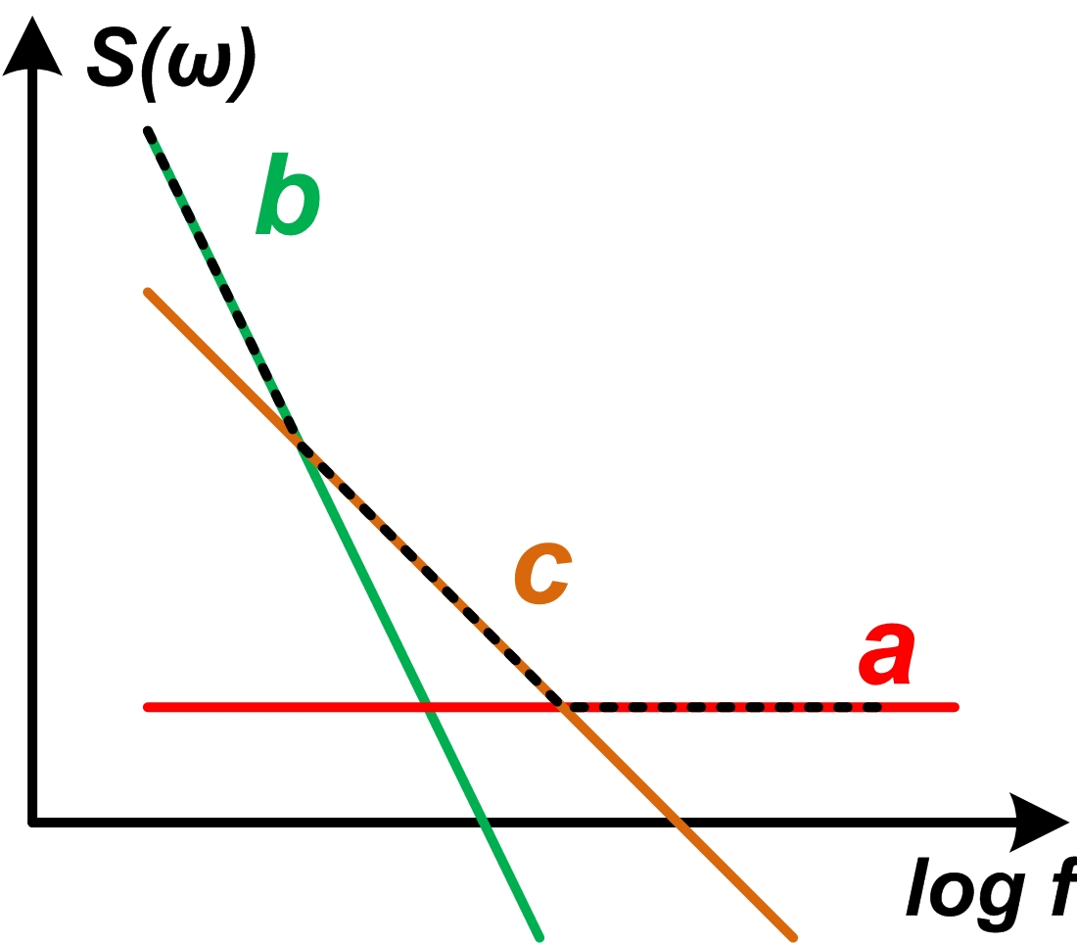
Noise of pre-amplifier
Leakage current noise
HV bias resistor thermal noise
Opamp thermal noise
Opamp 1/f noise
Noise PSD at the output
Mathematically
Needs filter!

Slide 10
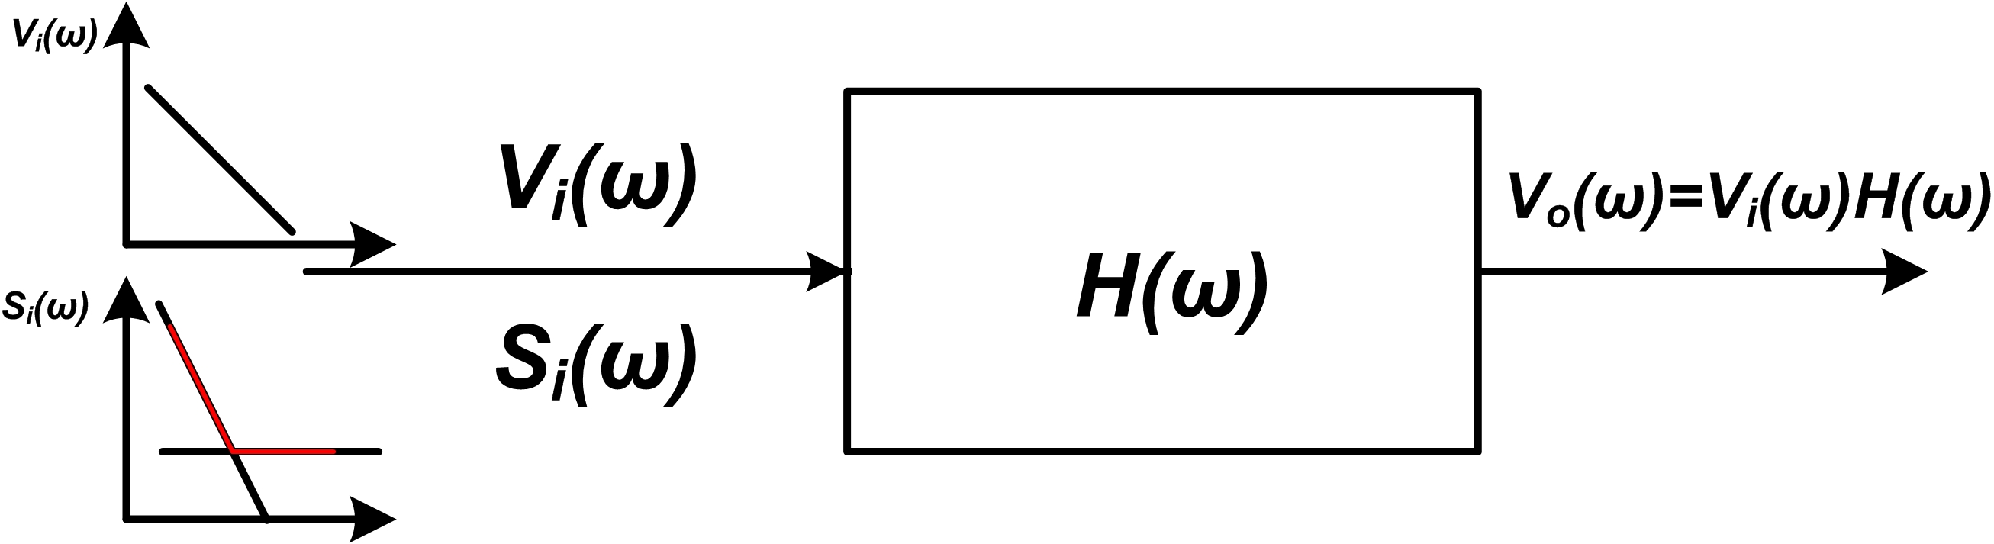
Filtering - 1
What’s the filter supposed to do?
  Filter out the frequency components of noise
  Keep the frequency components of signal
Optimized filter to give the best SNR
  Exist for our system(ignore c noise)
  Inferiority coefficient
Theoretical limits
The optimized value for one filter structure

Slide 11
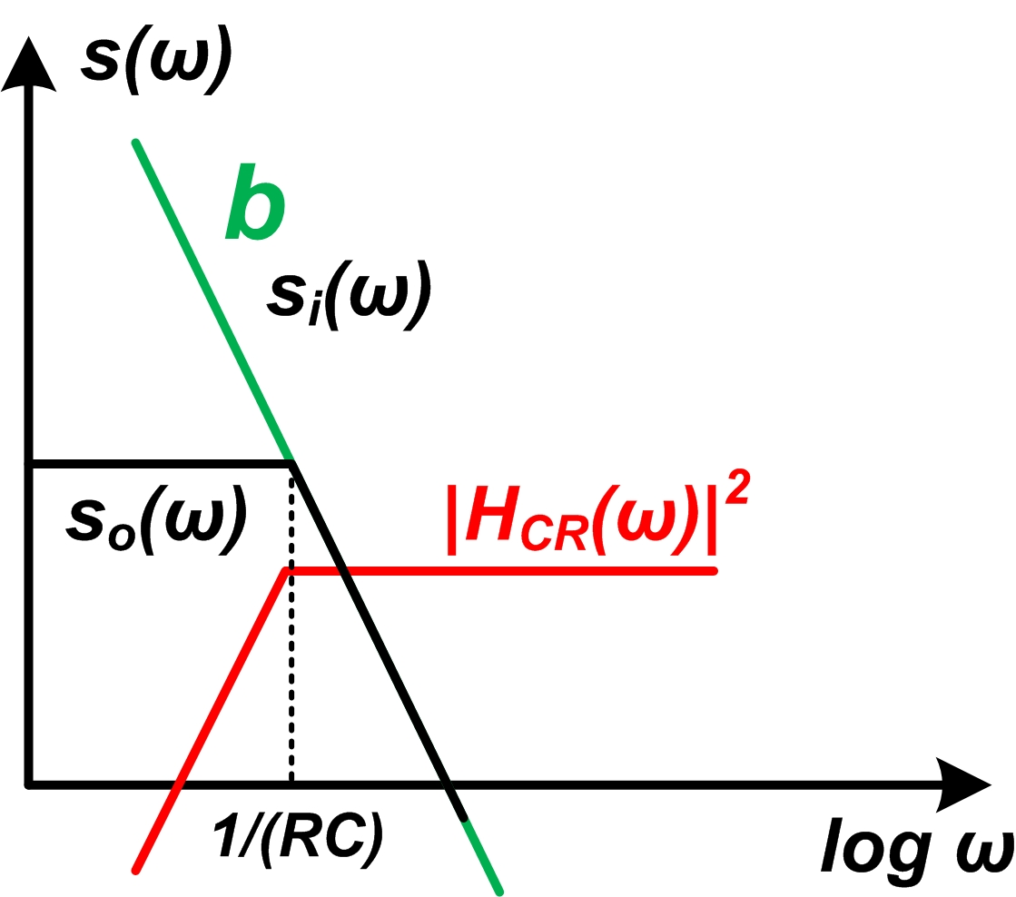
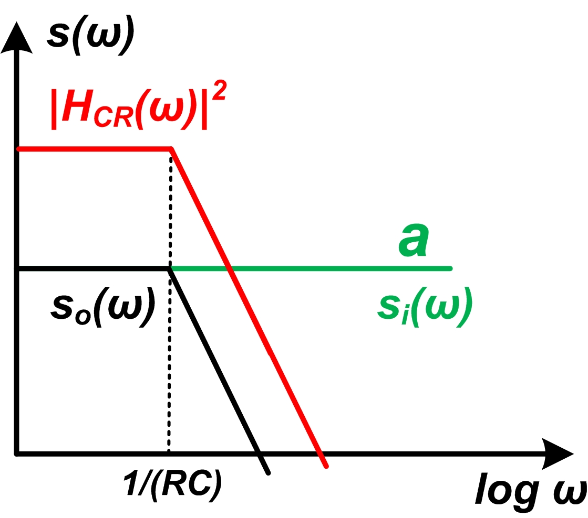
Filtering - 2
What kind of filter do we need?
  “b” components gives infinity at low frequency
  Needs high-pass filter, CR filter
  “a” component give infinity at high frequency
  Needs low-pass filter, RC filter
CR-RC filter is the simplest one

Slide 12
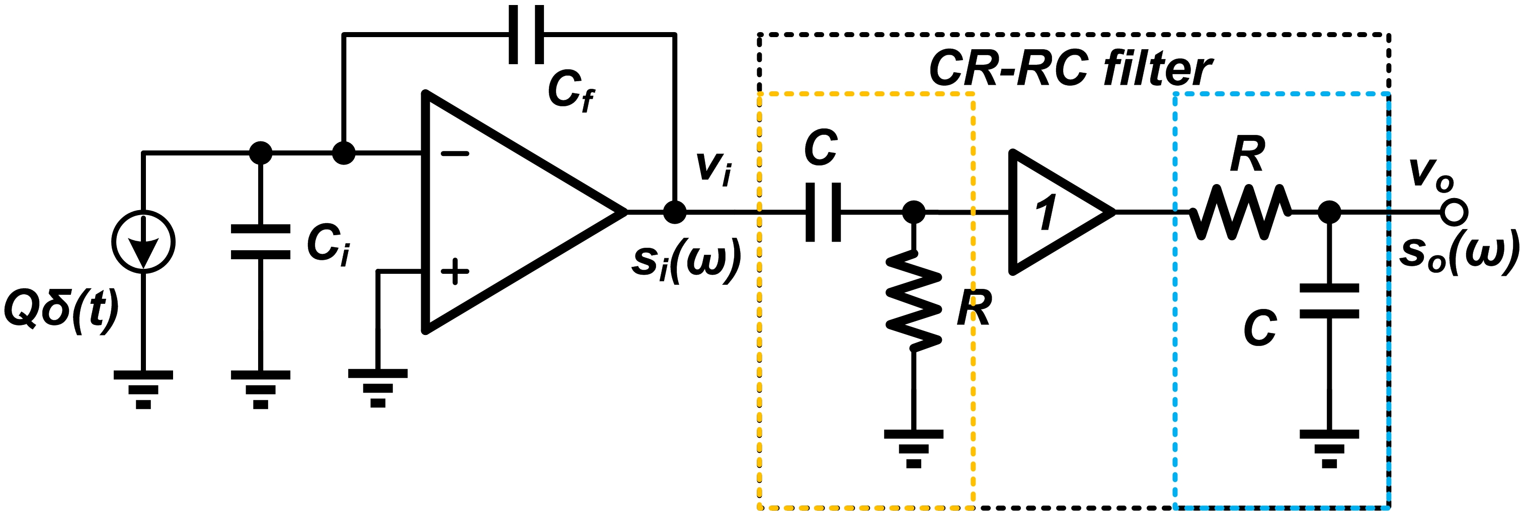
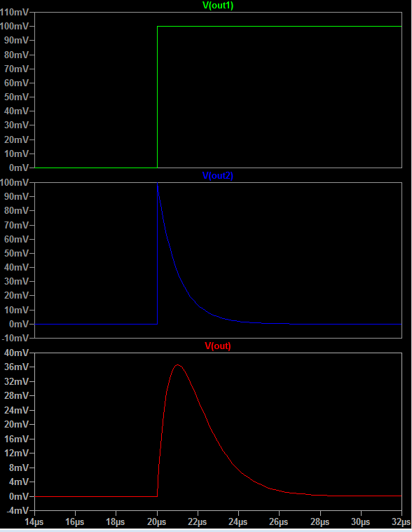
CR-RC filter
v_{i}
It also filters out some of the frequency components of the signal !
But what we measure is the amplitude of the output signal, not the energy or power of the signal
  No price is paid for CR filter
  Amplitude decrease after RC
After CR filter, no amplitude loss
After RC filter, amplitude loss

Slide 13
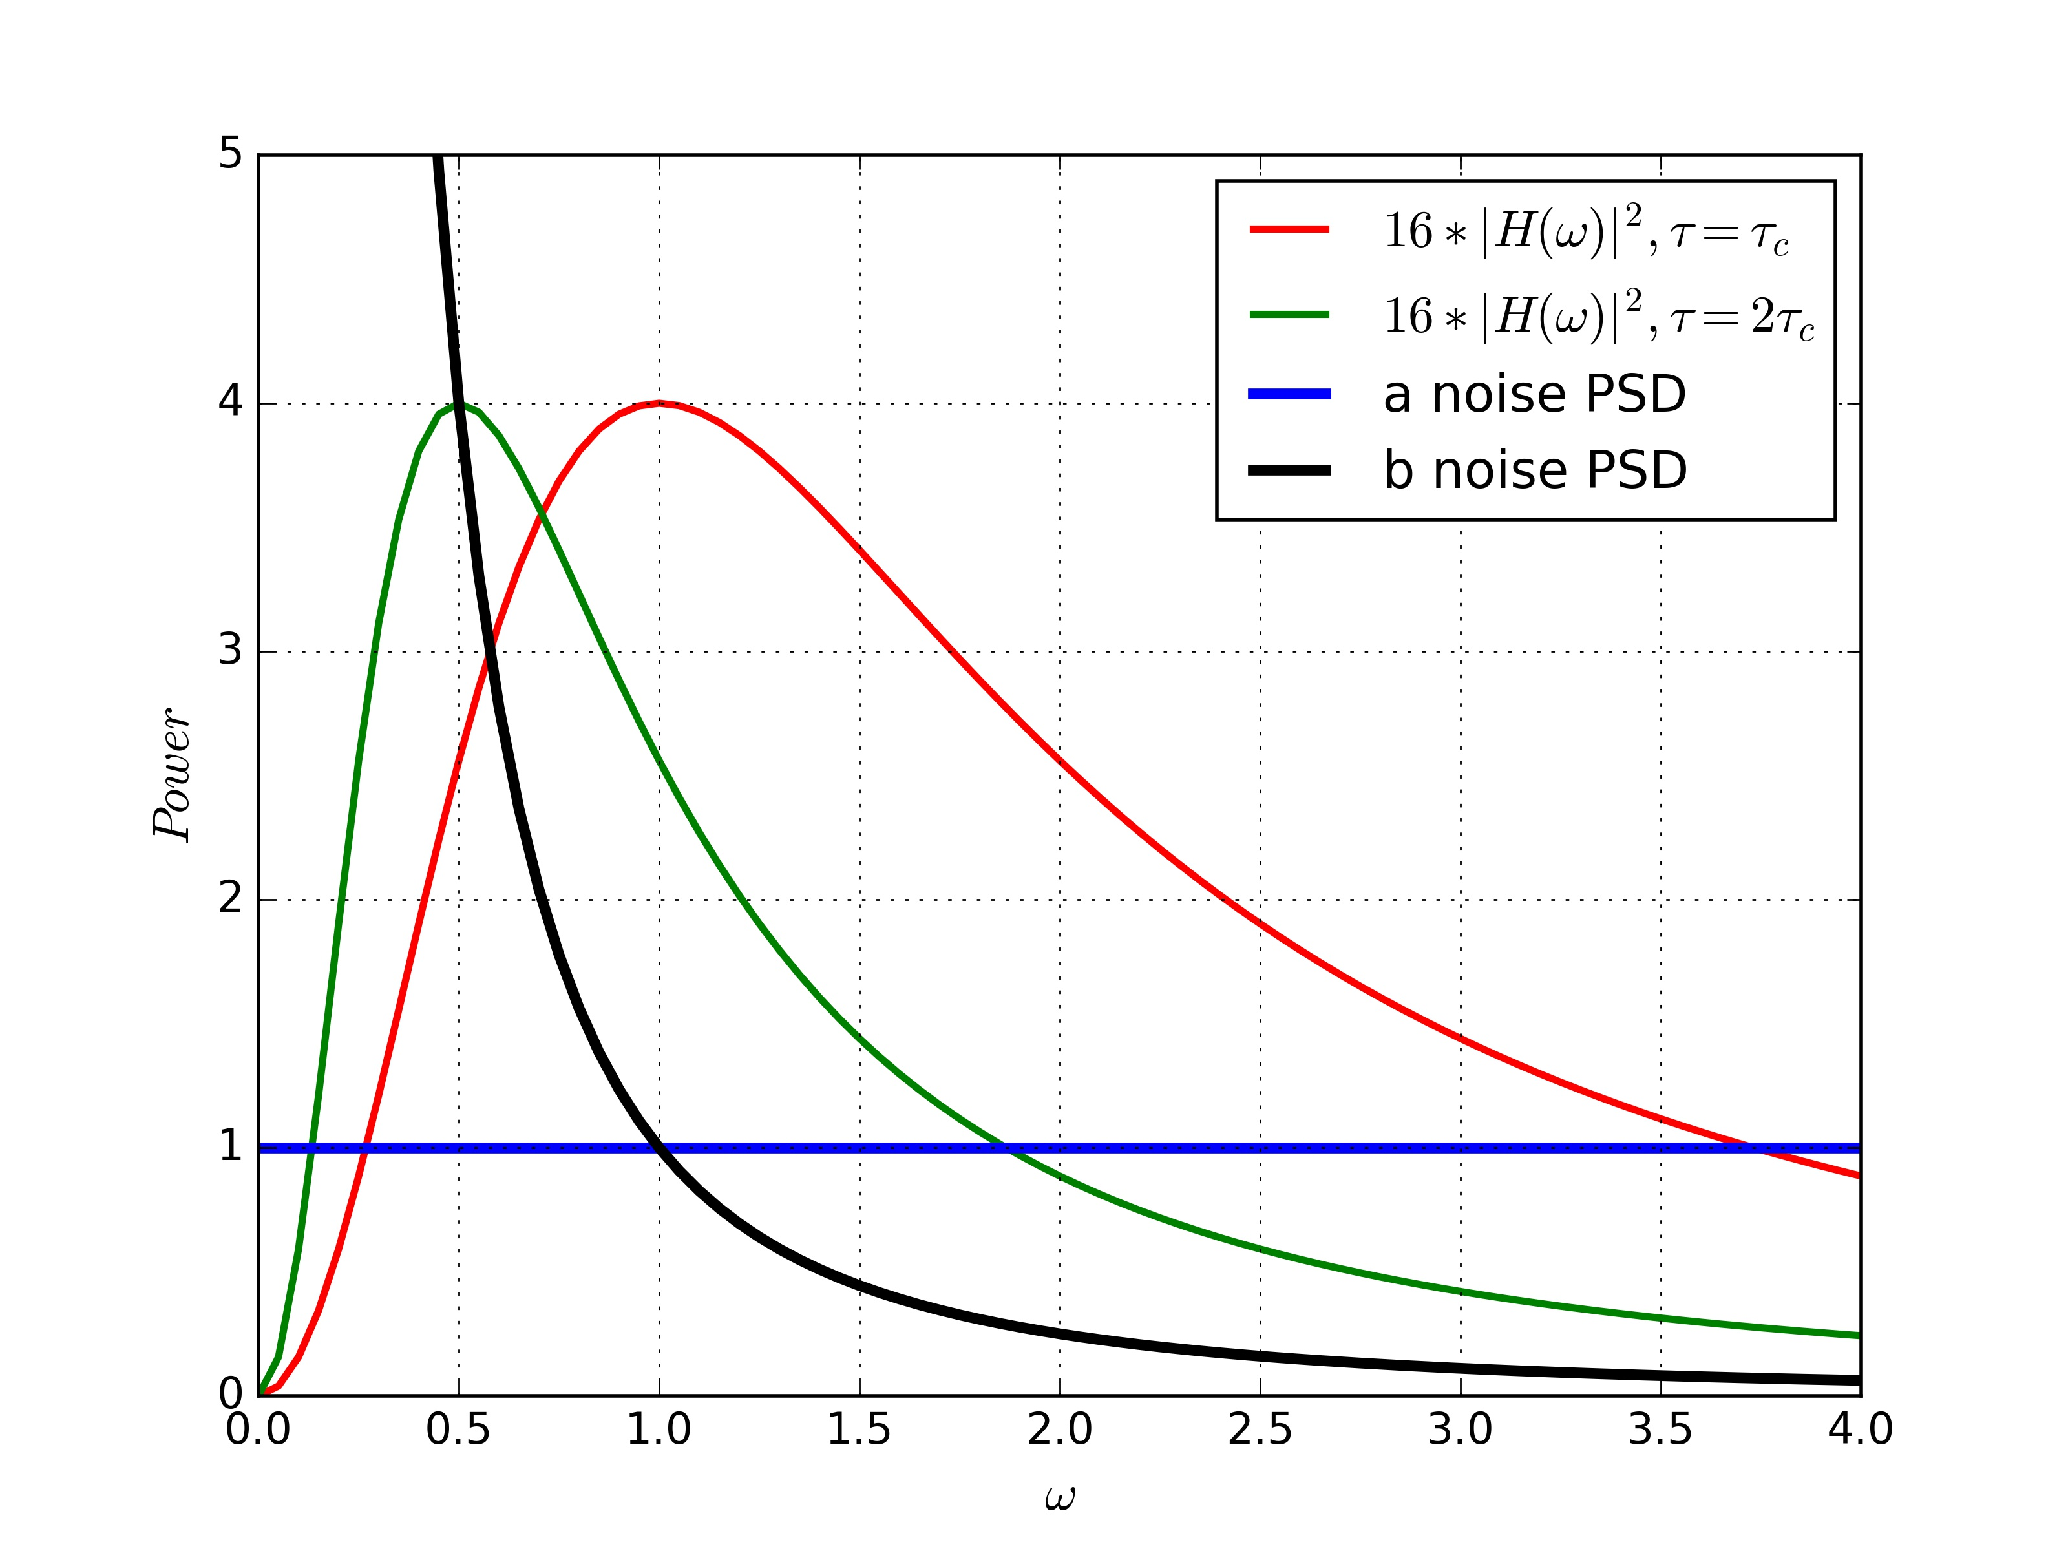
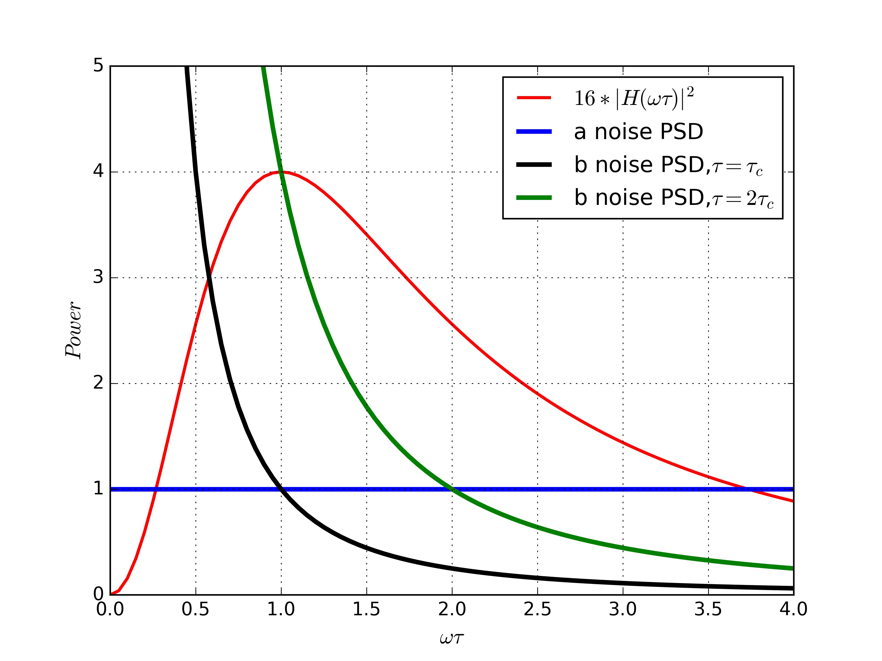
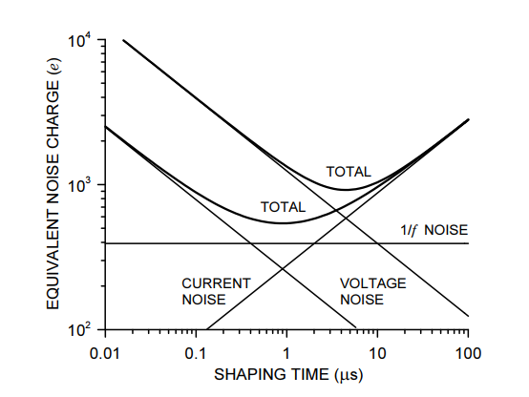
CR-RC filter
Optimum shaping time-constant
Contribution from “a” noise I_{a}
Contribution from “b” noise I_{b}
a
b

Slide 14
Not only the SNR matters -
Ballistic loss

Slide 15
Not only the SNR matters -
pile-up

Slide 16
Not only the SNR matters -
baseline

Slide 17
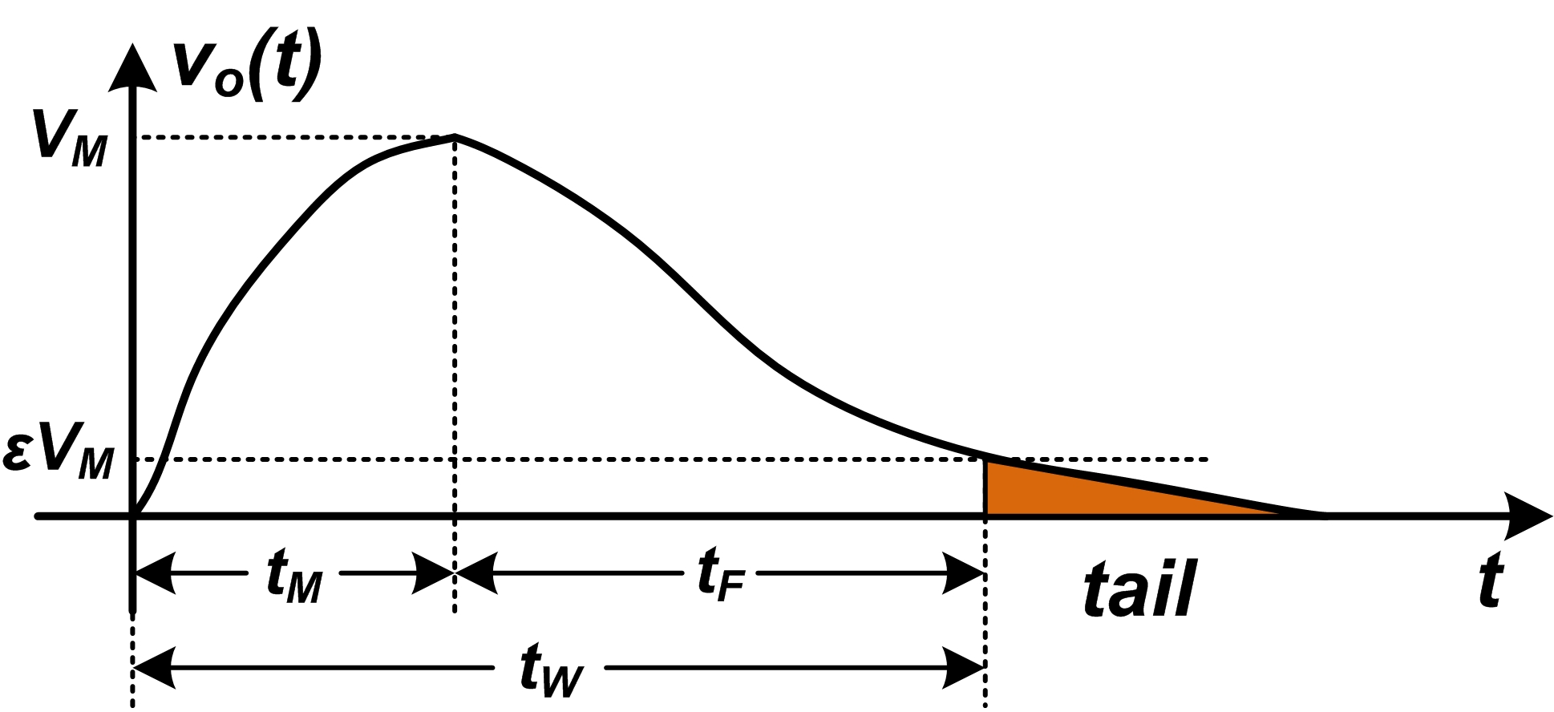
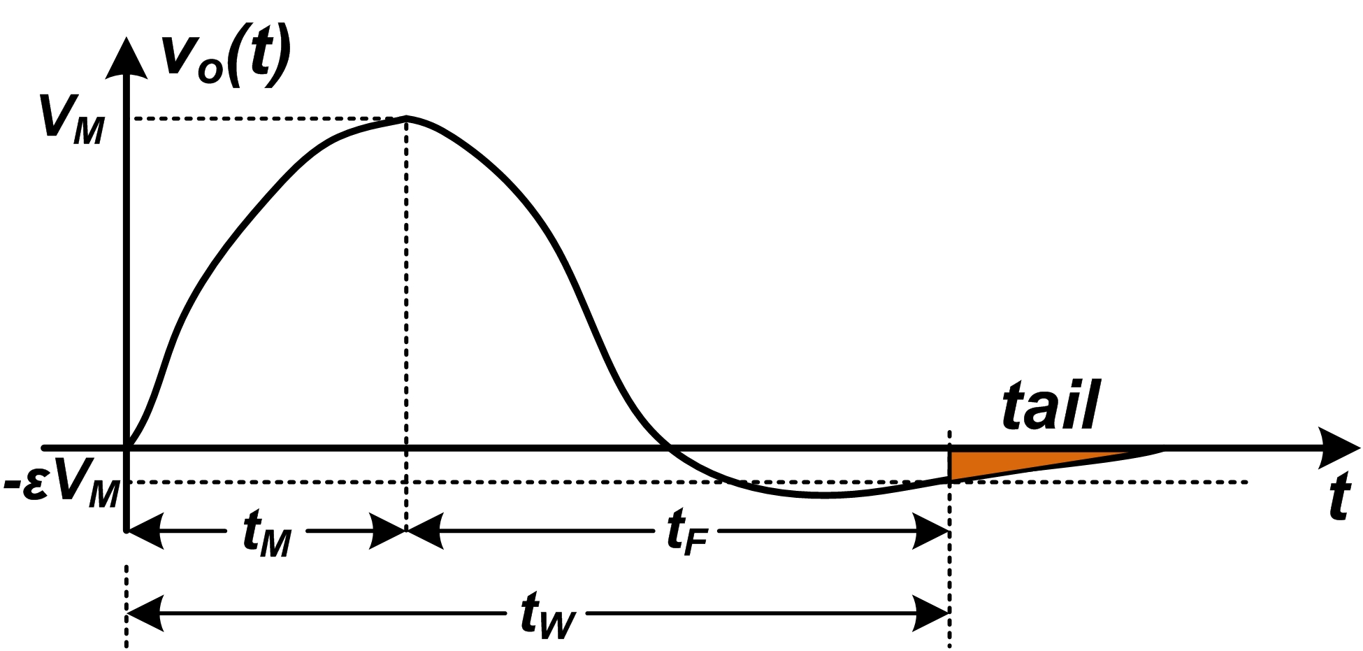
Shaping - 1
Filtering and shaping --- same thing with different emphasis
  Filtering: from SNR perspective, frequency domain
  Shaping: from signal shape perspective, time domain
Parameters for shape
  Unipolar/ bipolar?
  Peaking time t_{M}, recovery time t_{F}, signal width t_{W}

Slide 18
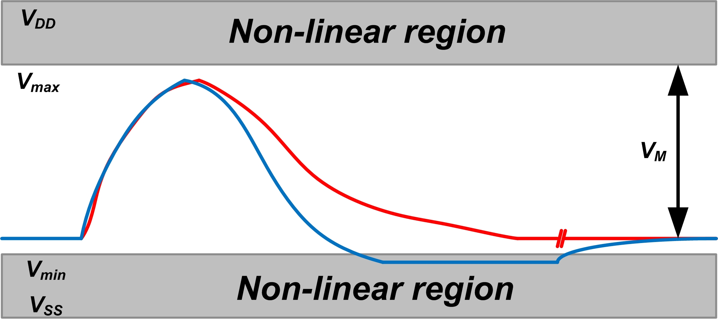
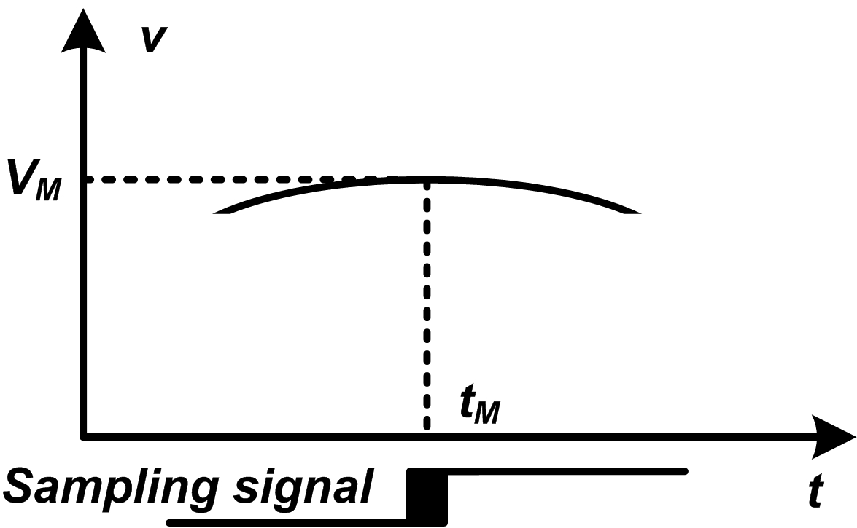
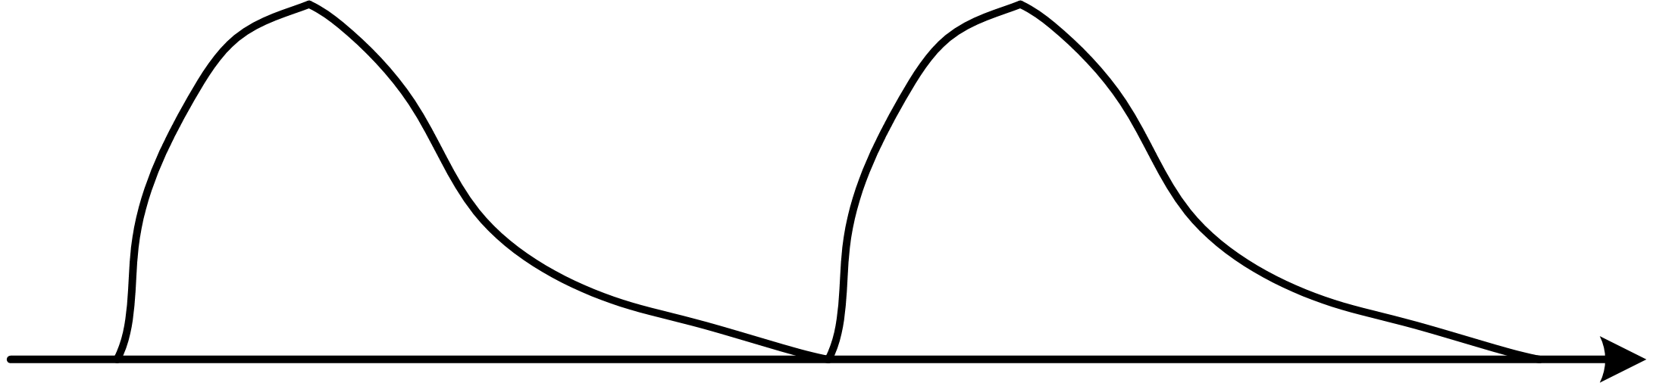
Shaping - 2
Requirements for the waveform in high energy resolution measurement system under moderate data rate
  Linear
  Narrow signal width t_{W} , for higher data rate
  Unipolar
  Flat plateau
  Simple, easy to tune the shaping time-constant
  Different from the timing measurement system or high data rate system

Slide 19
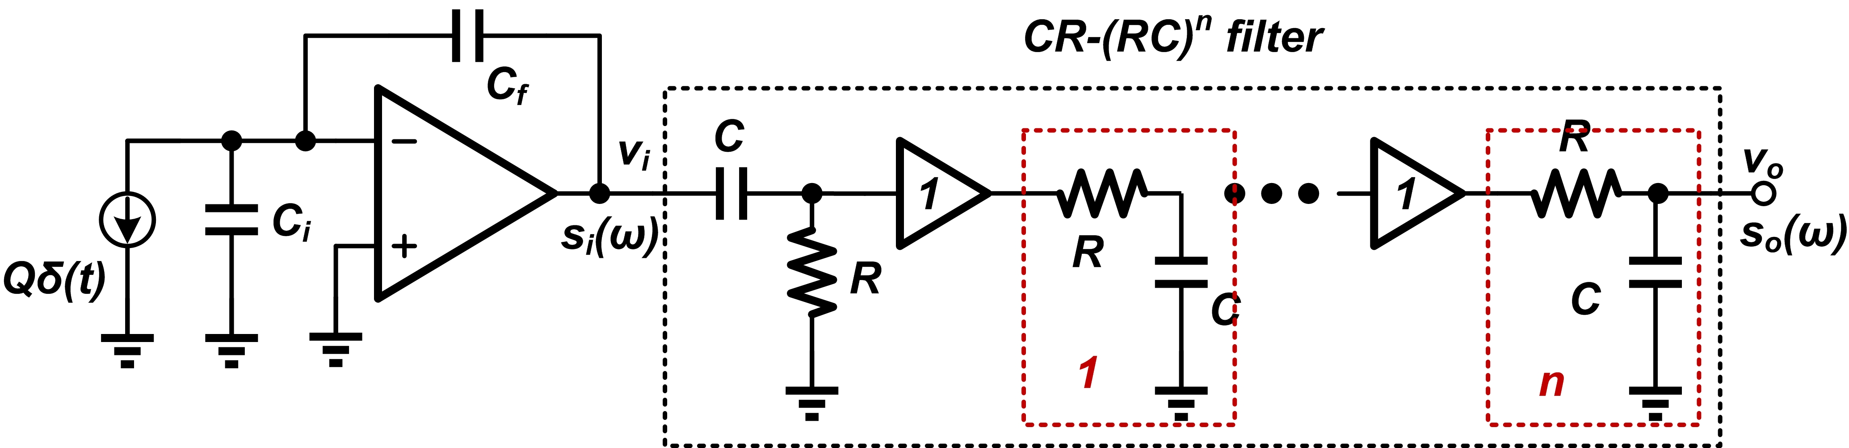
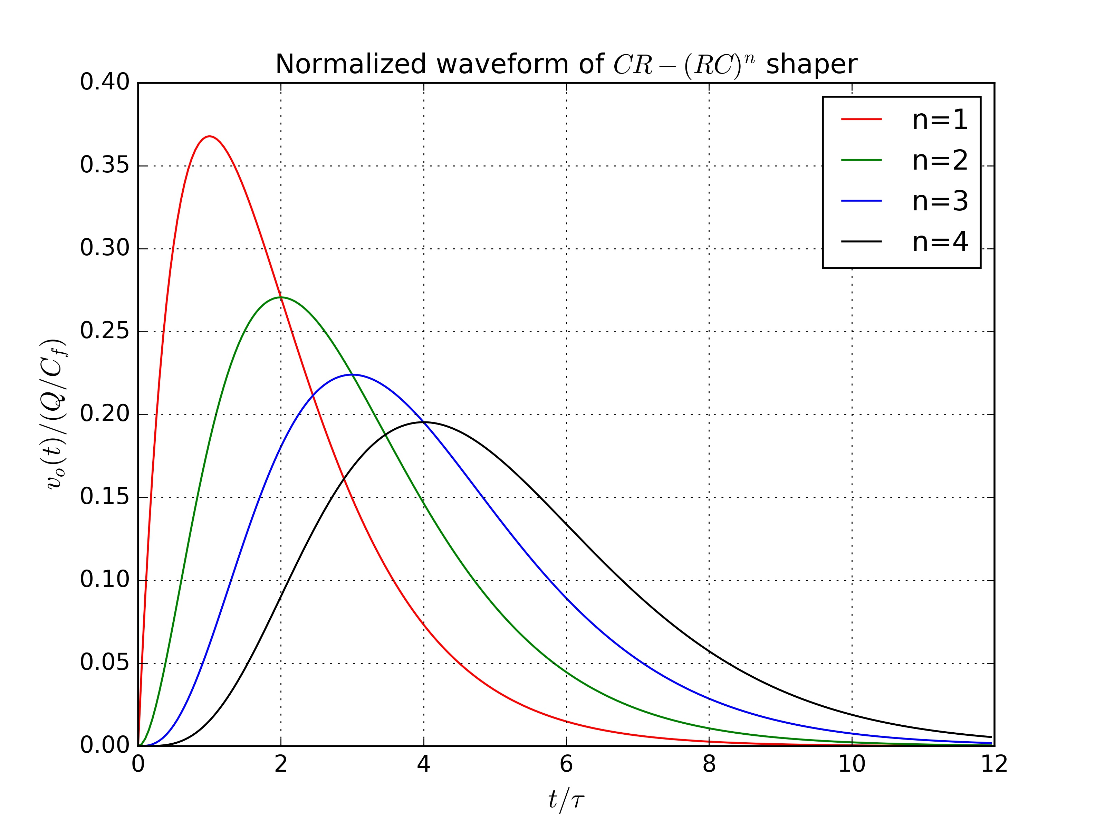
CR-(RC)^{n} filter - 1
The most common pulse shaper employed in the detector readout system
  Semi-Gaussian shape can be easily realized with simple components
  Reasonable SNR performance and counting rate behavior
Waveform gets more symmetric as the increase of order n
It is a good practice to choose time-constant of CR and RC to be the same

Slide 20
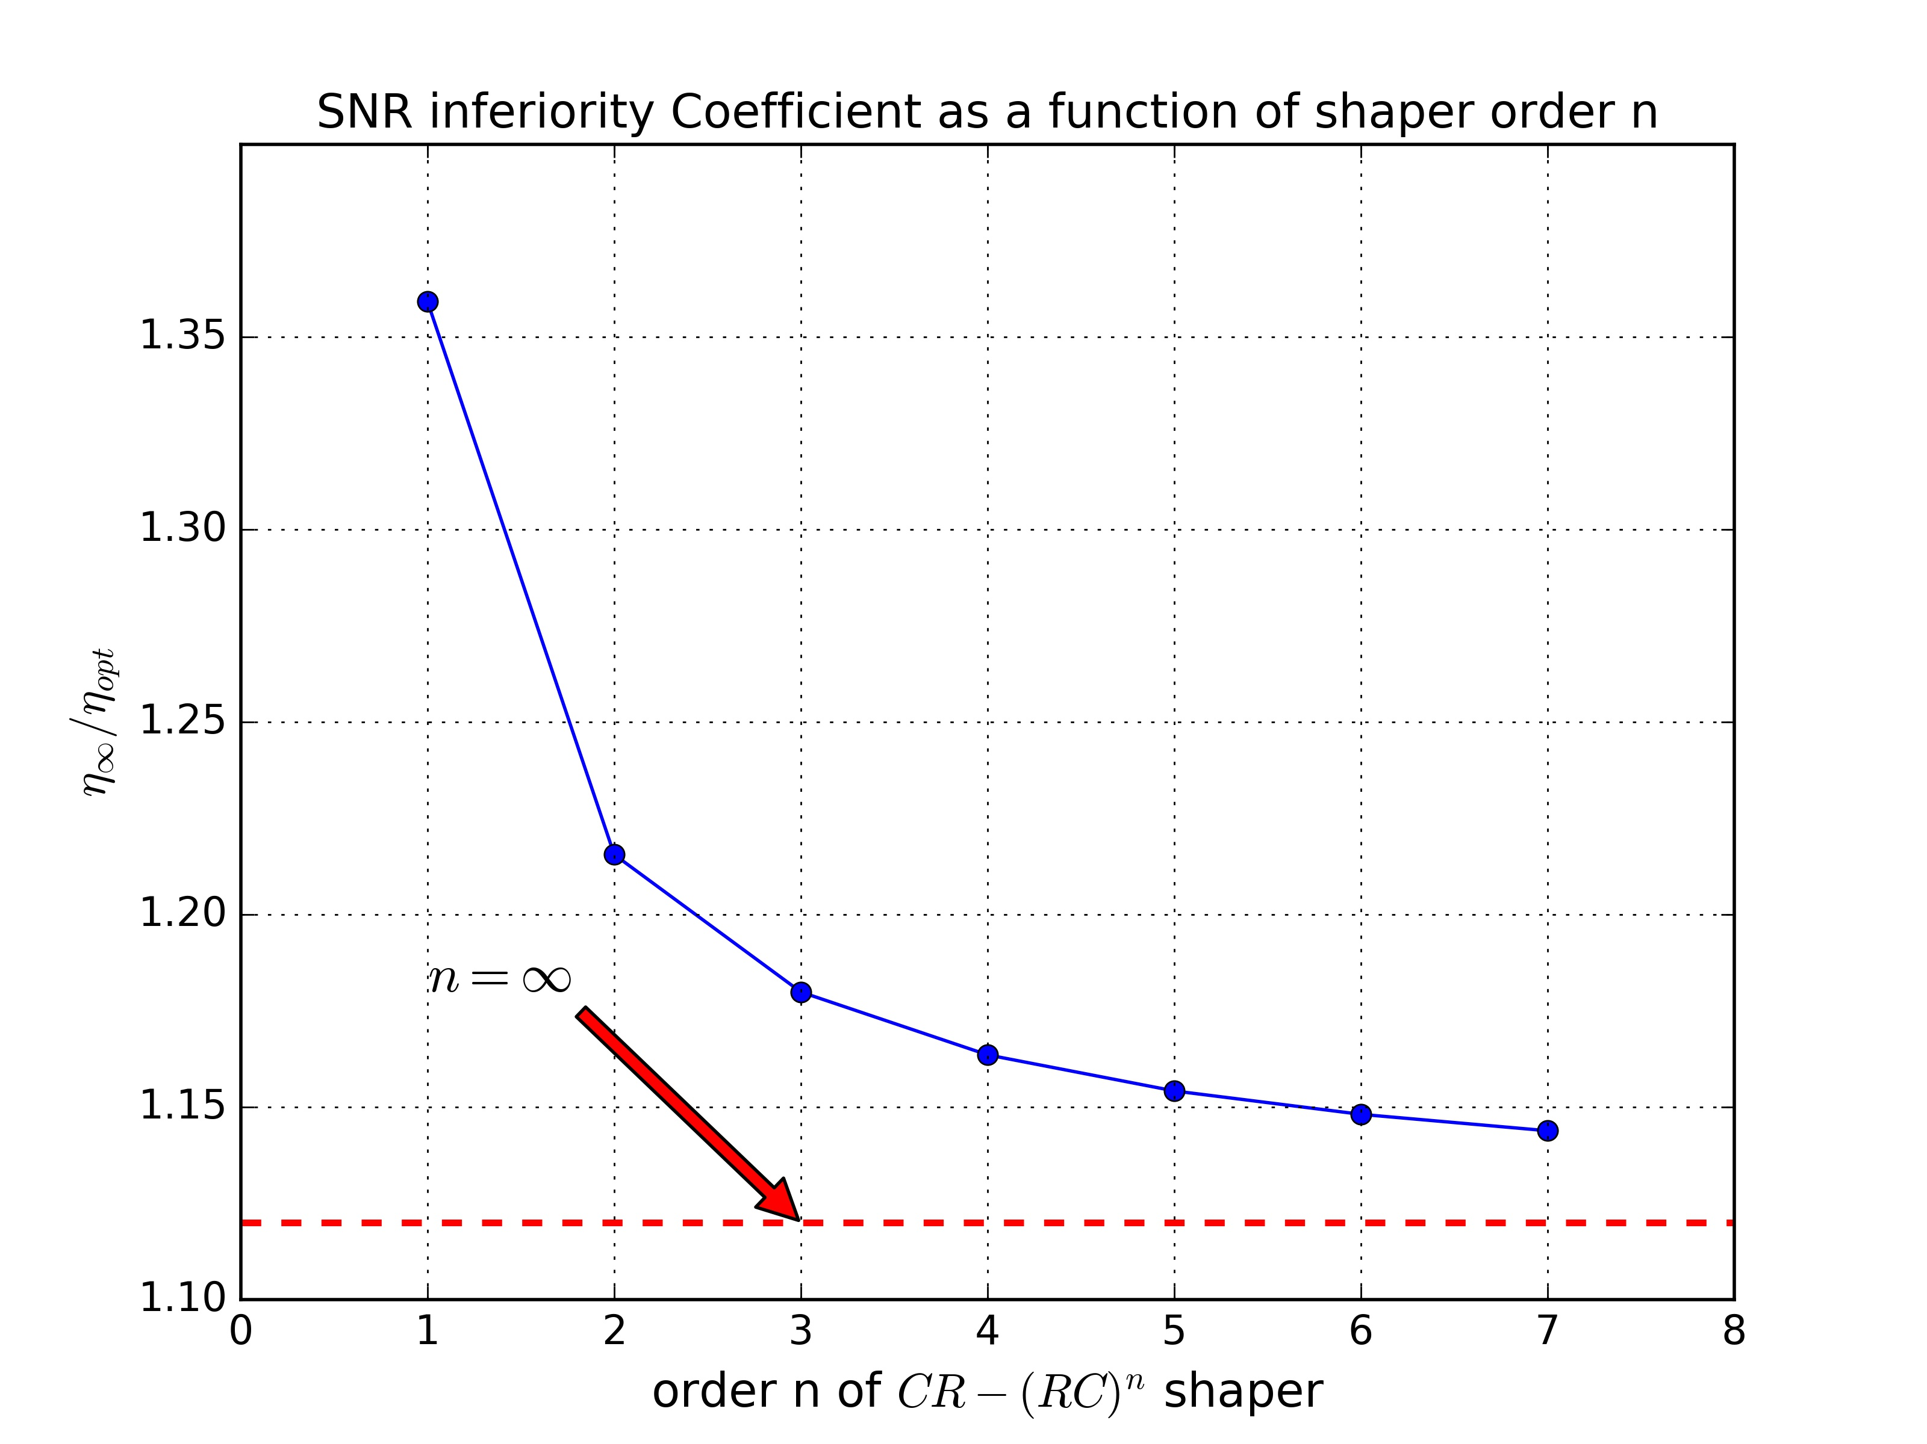
CR-(RC)^{n} filter - 2
One can always benefit from the increase of shaper order n
  Optimum shaping time constant is different.
  In practice, n = 1,2,3,4 are widely employed
  Further increase n won’t gain too much

Slide 21
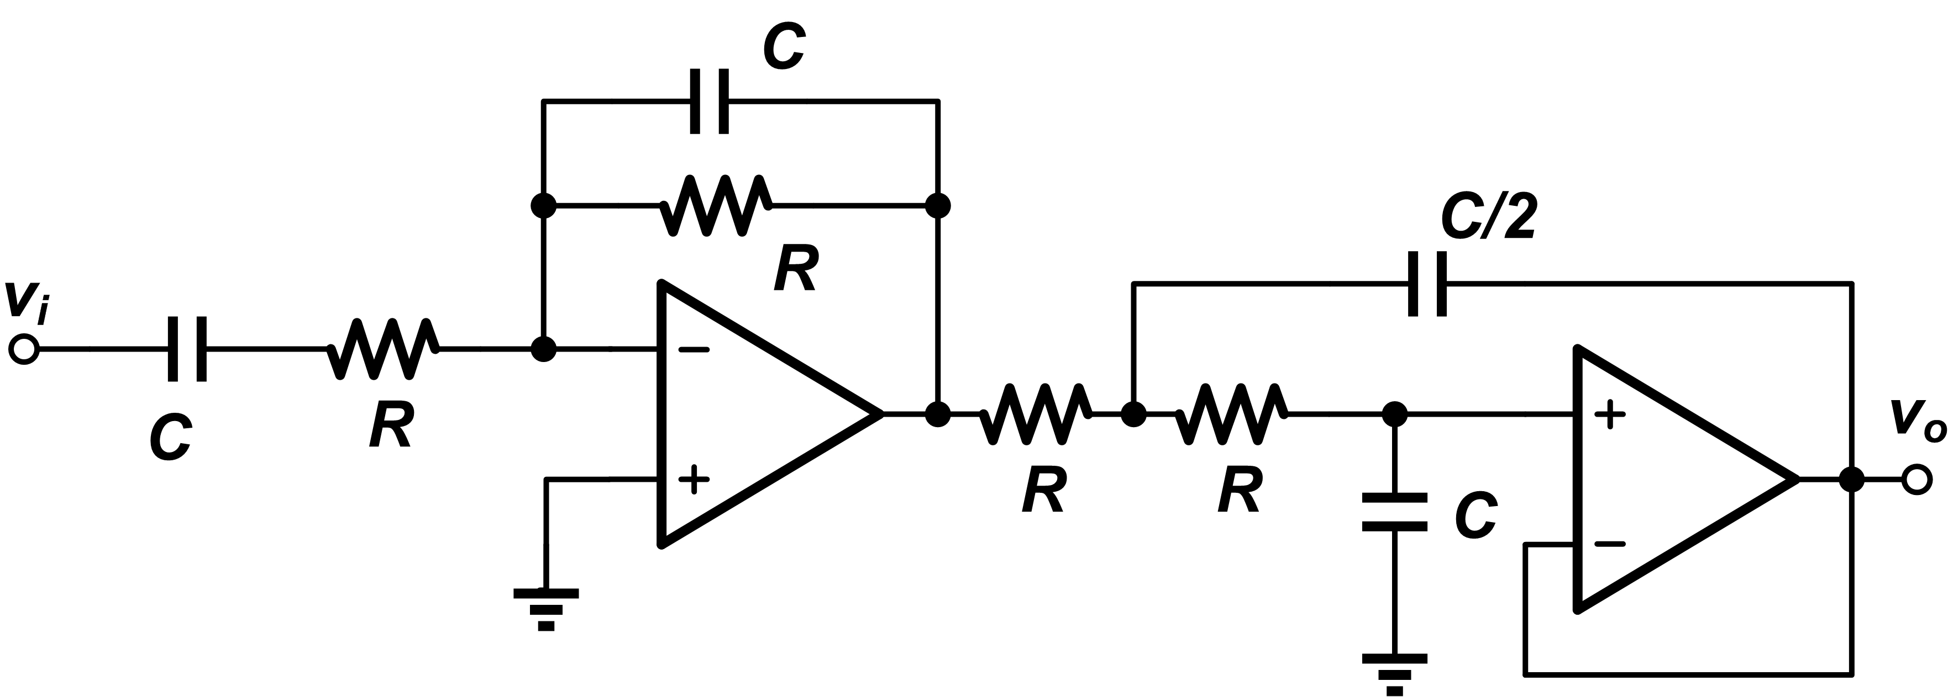
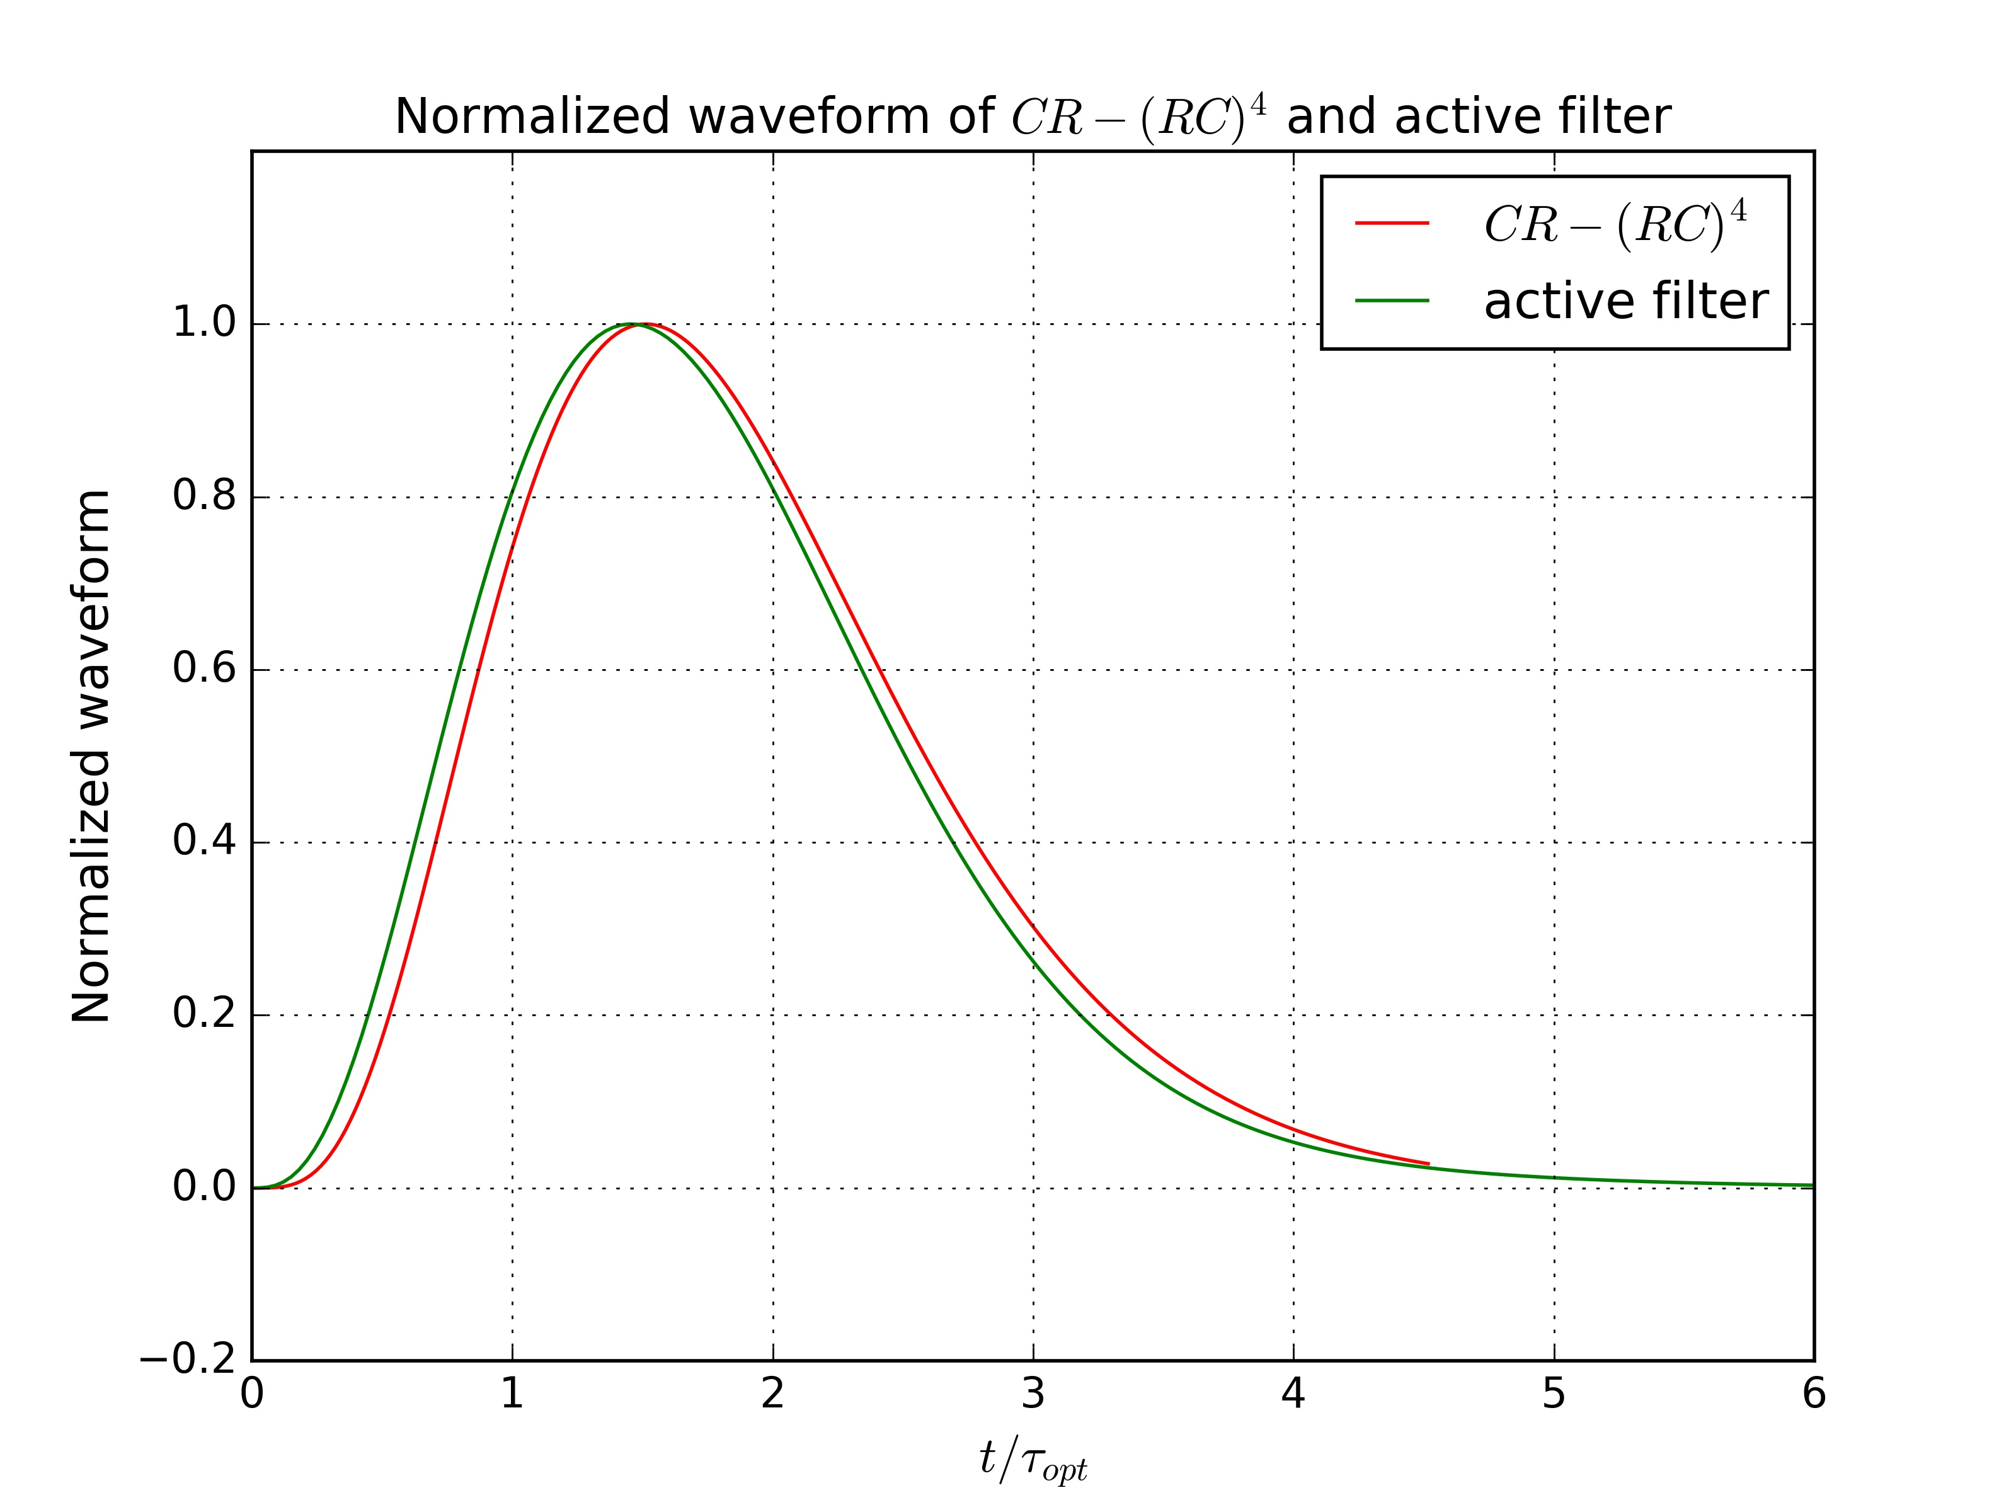
Active filter
Another option to implement the low-pass filter
Advantages:
  Less components and filter stage
  Complex poles. More flexible to tune, easy to achieve semi-Gaussian shape ...

Slide 22
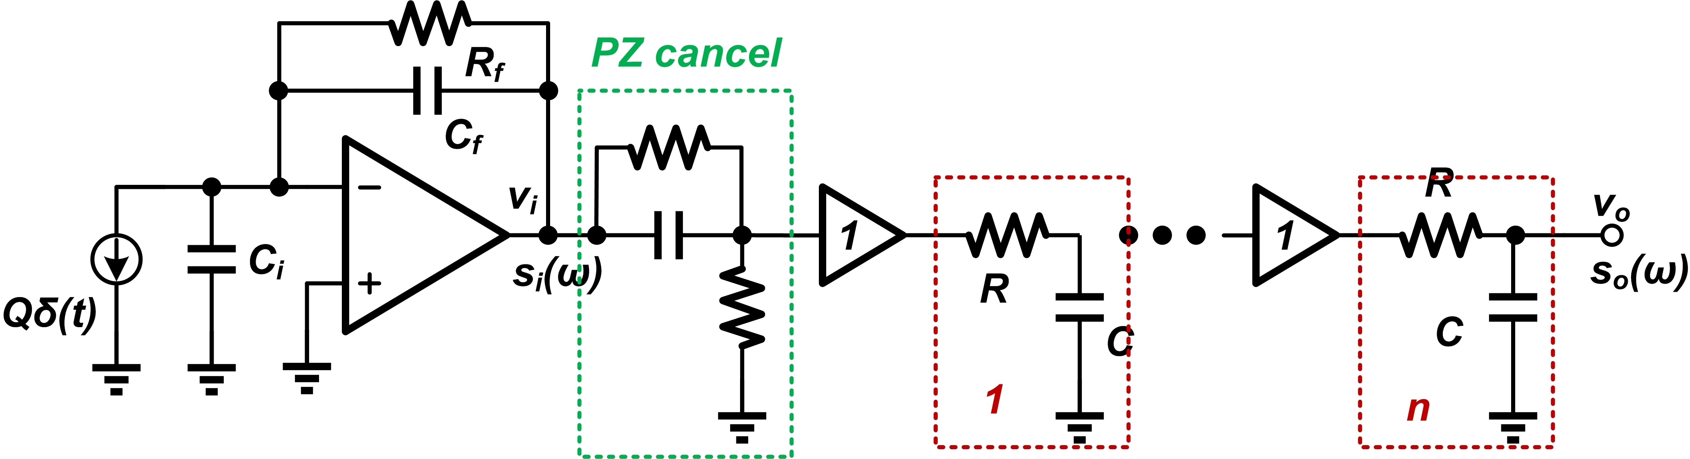
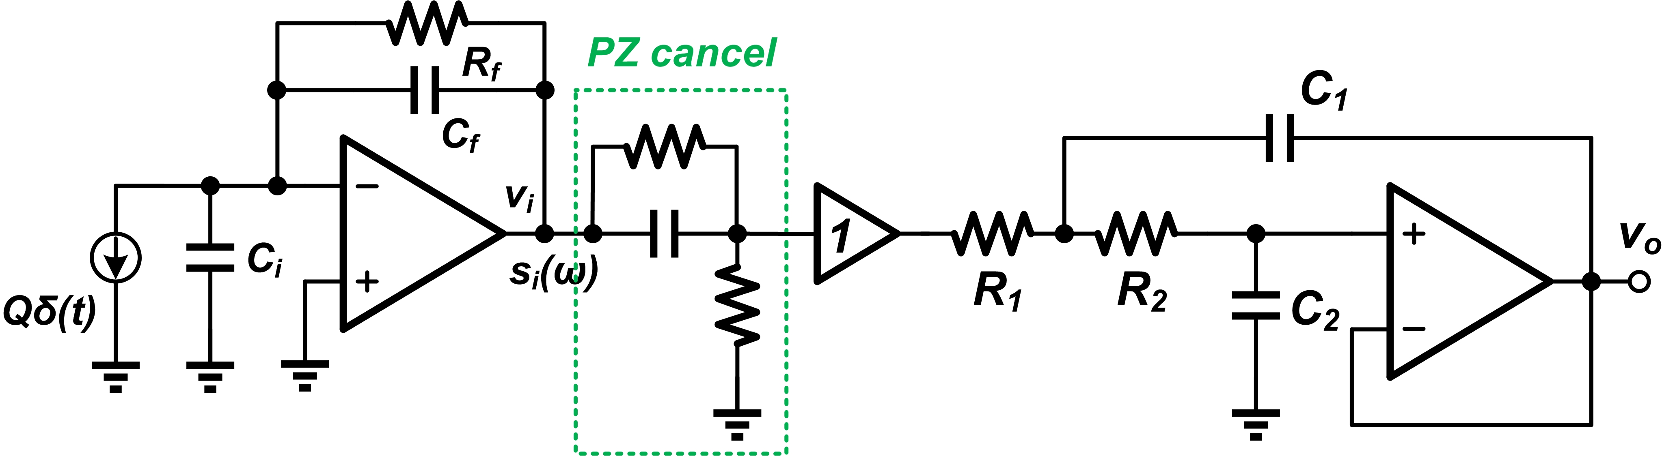
Shaper with PZ cancel
CR-(RC)^{n}
Active filter

Slide 23
Contents
Lecture
  Review of Day1 and Day2
  Limitations of the maximum energy resolution
  Noise analysis of the pre-amplifier stage
  Filtering and shaping
Hands-on
  Analysis: Find the a and b coefficients
  SPICE: Noise PSD of the pre-amplifier output
  Analysis: Noise at the CR-RC shaper output
  SPICE: Noise simulation of CR-RC shaper output
  SPICE: Comparison of different filter/shaper structure
Do always try to understand the simulation result

Slide 24
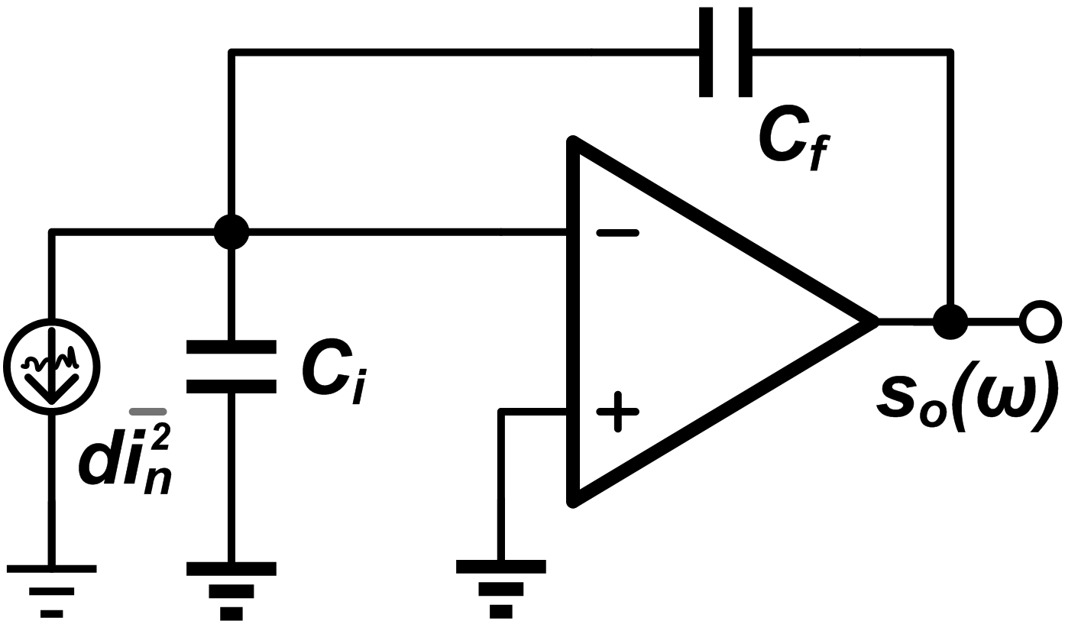
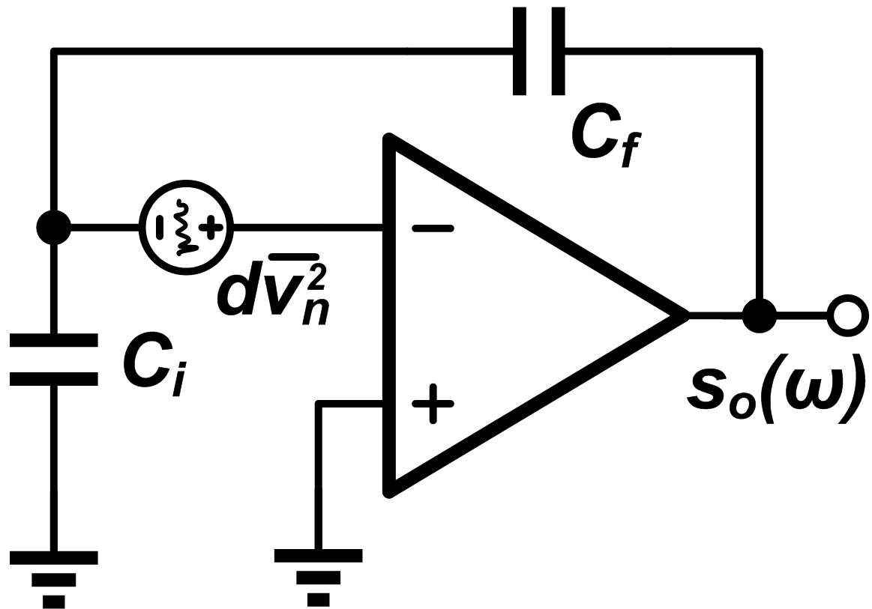
Noise analysis of the pre-amplifier
Find the a , b and c coefficients
a² =
b² =
c² =

Slide 25
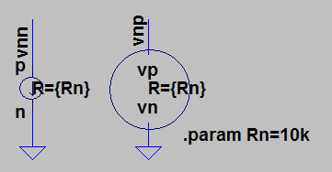
Noise source in our simulation
Same configuration
Current source di²_{n} given the “noise current source”, with PSD
voltage source dv²_{n} given the “noise voltage source”, with PSD
Calculation will show that
Noise current source
Noise voltage source

Slide 26
Noise simulation of the pre-amplifier
In file “day3_CSA_Noise”, do the .tran simulation to verify the functionality of this circuit.
Set C_{i} = 99pF, C_{f} = 1pF, do the .noise simulation, find out corner frequency
  Get “a” value
  Get “b” value
  Get t_{c} = a/b
Sweep the value of C_{i} in the range of 0~1nF, to see the changes of “a” and “b” noise components in the PSD

Slide 27
Noise analysis of CR-RC filter
Calculate the output noise of CR-RC
  Input PSD
  Noise transfer function
  Output PSD
  integration
Useful integration formula

Slide 28
Noise simulation of CR-RC filter
In file “day3_CSA_CRRC_Noise”, do the .tran simulation, for output “out”
  Maximum value V_{M} and peak time t_{M}
  Pulse width t_{W}(1%)
Set C_{i} = 99pF, C_{f} = 1pF, do the .noise simulation, get the output noise value
  Fit with your analysis results?
Sweep the value of C_{i} in the range of 0~1nF, plot V_{n}~C_{i}
Sweep the shaping time “ts” in the range of 0.1~10u, plot V_{n}~ts.
  Which is the optimized shaping time for CR-RC filter?
  For the optimized shaping time, calculate SNR (eta)
  Calculate the inferiority coefficient (F)

Slide 29
Comparison of different shaper
Finish the circuit blocks of “day3_SCA_CRRCx_Noise” (x=2,3,4). Finish the block “day3_ActiveFileter_Noise”
Set the shaping time for every block at optimum, which is given in lecture. For the active filter, set the shaping time constant the same of CR-(RC)⁴
Do .tran simulation, find out the Maximum value V_{M ,}peak time t_{M} and pulse width t_{W}(1%)
Do .noise simulation, find out the output noise V_{n}
Complete the table below
 | CR-RC | CR-(RC)² | CR-(RC)³ | CR-(RC)⁴ | Active filter
V_{M}
t_{M}
t_{W}(1%)
V_{n}
F

