Slide 1
Noise, filtering and shaping
HighRR SPICE Hands-On 2017, Day 3
Konrad Briggl
Huangshan Chen
Zhenxiong Yuan
Notes:
Good afternoon, everyone! This afternoon, as scheduled, I am going to talk about the noise issue.

Slide 2
Contents
Lecture
  General signal processing chain
  Limitations of the energy resolution
  Noise analysis of the pre-amplifier stage
  Filtering and shaping
Hands-on
  Analysis: Find the a and b coefficients
  SPICE: Noise PSD of the pre-amplifier output
  Analysis: Noise at the CR-RC shaper output
  SPICE: Simulation of CR-RC shaper
  SPICE: Comparison of different filter/shaper structure
Do always try to understand the simulation result
Notes:
Here is the contents we going to cover.
We will talk briefly about the general signal processing chain, and explain some of the limitation to the resolution.
Noise in the pre-amplifer stage is always one of the biggest issues in those limitations. We are going to analyse it. And introduce some circuits to filter out some noise.

Slide 3
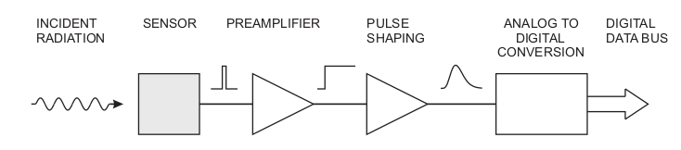
General signal processing chain
Purpose
  Acquire an electrical signal from the sensor
  Tailor the time response of the system to optimize
    Minimum detectable signal, data rate...
  Digitize the signal and store for subsequent analysis
Counting, timing measurement, energy (amplitude) measurements…
Generally, cannot optimize simultaneously all properties...
Notes:
You have already seen this signal processing chain yesterday.
Radiation is absorbed in the sensor and converted into an electrical signal. The small signal is integrated in a pre-amplifer, and then fed into a pulser shaper, to meet the requirements of applications. And then digitized for subsequent storage and analysis.
Generally, there are diverse requirements, these requirements cannot be optimized simultaneously.
According to applications, there are different goals for the detector system. Some of it may just want to count the existence of a events, or want to measure the time of arrival. And some of applications want to do the energy measurements.
This lecture will focus on the energy measurements.

Slide 4
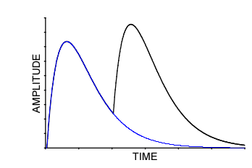
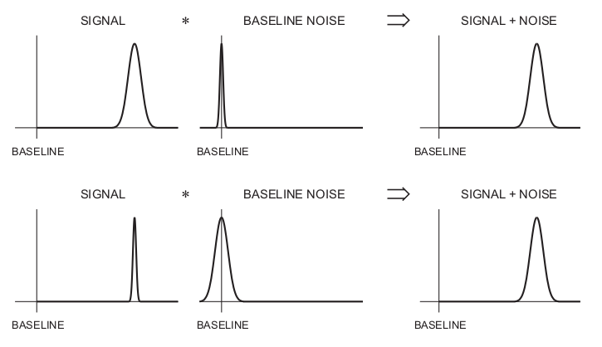
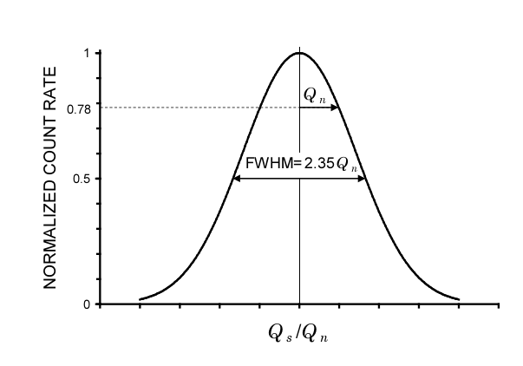
Limitations to the energy resolution
Intrinsic detector resolution associated with the statistical properties
Noise: from detector, from electronics…
Information distortion: pile-up, ballistic loss…
Full Width at Half Maximum (FWHM)
Equivalent noise charge (ENC)
pile-up
Scintillation-based
Semiconductor detector
Notes:
Here, gives some of limitations to the resolution we can achieve.
The first one arise from the the fact that not all the incident energy is used in generating electron-ion pairs or electron-hole pairs and some of them are wasted in the form of exciting lattice vibrations. So the generated pairs are intrinsically subject to random fluctuations.
The second limitation comes from the noise of the readout circuit.
The picture in the left bottom shows the combined effects of these two limitations. Different detector systems will have different dominant. For the scintillation-based detector, the fluctuation of the detector signal is usually larger than that of the electronics; but for the semiconductor detectors, the noise of electronics will play a big role.
There are also other kind of limitations in the electronics rather than noise, like pile-up.

Slide 5
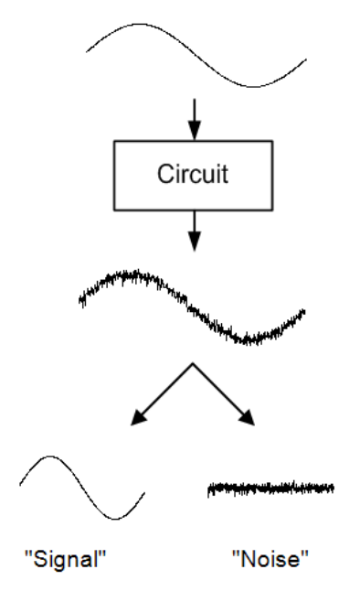

Electronic noise
Consider n carriers of charge e moving with a velocity v through a sample length l
Fluctuation of this current
Velocity fluctuation:
Thermal noise
Number fluctuation:
shot noise
1/f noise
Notes:
Now, we focus on the noise.
Consider a current flowing through a sample, bounded by two electrodes. N carriers moving with velocity v, the induced current is given in this form.
The fluctuation of this current is given by the total differential. From this formula, you can see that two mechanisms contribute to the total noise, velocity and number fluctuations.
Velocity fluctuation originate from thermal motion. Due to thermal excitations, along with the average drift velocity, there are always followed with a random velocity fluctuation.
Number fluctuations occur in many circumstances. One source is carrier flow that is limited by emission over a potential barrier. The example is shot noise in the diode or the semiconductor detector. Another source of number fluctuations is carrier trapping caused by the imperfections in a crystal lattice, this lead to a frequency dependent spectrum, like 1/f noise.

Slide 6
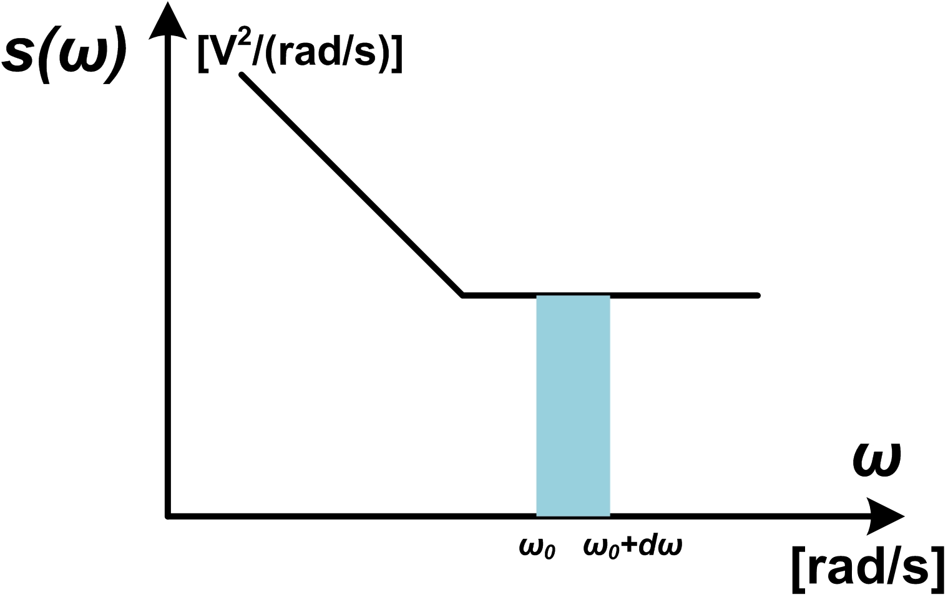
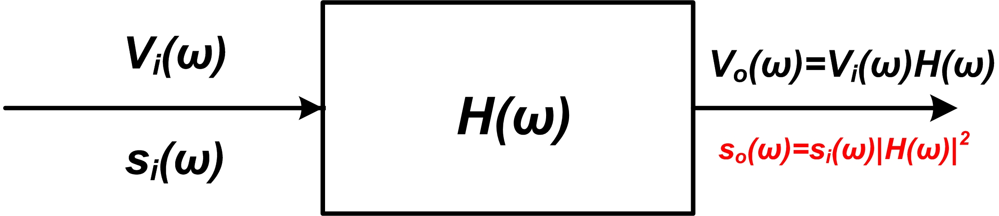
How to describe the noise?
noise power spectral density (PSD)
  Voltage noise, unit: V²/(rad/s), or V²/Hz
  Mean-square noise voltage
  Current noise power spectral density, Unit: A²/(rad/s)
Example:
  Noise voltage PSD of a resistor:
  Noise current PSD of a resistor:
  Noise current of a diode:
  ….
Noise PSD after a system with transfer function H(w)
Notes:
The noise is described by the power spectral density. It basic state that in a unit interval of omega, how many power for the noise.
The right picture shows the voltage noise power spectral density. The mean-squared noise voltage can be calculated in this formula.
There are also noise expressed in terms of current, then we have the current noise power density, whose integration gives the mean-squared noise current.
There list some examples, for a resistor, the noise voltage PSD is expressed in this form fout kT times the resistance. For the noise of a diode or semiconductor device, the noise current PSD is proportional to to the leakage current.
For a noise source with PSD si pass through a system with transfer function of H omega, then the output PSD so, will be the original PSD si times the squared absolute value of the transfer function.

Slide 7
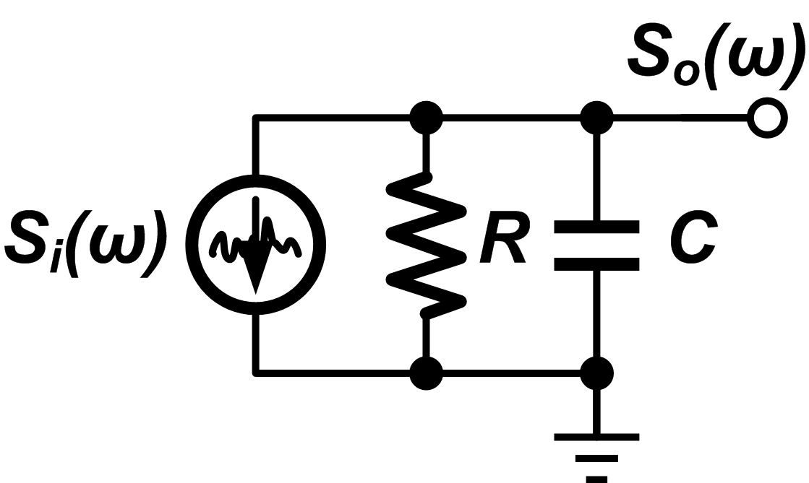
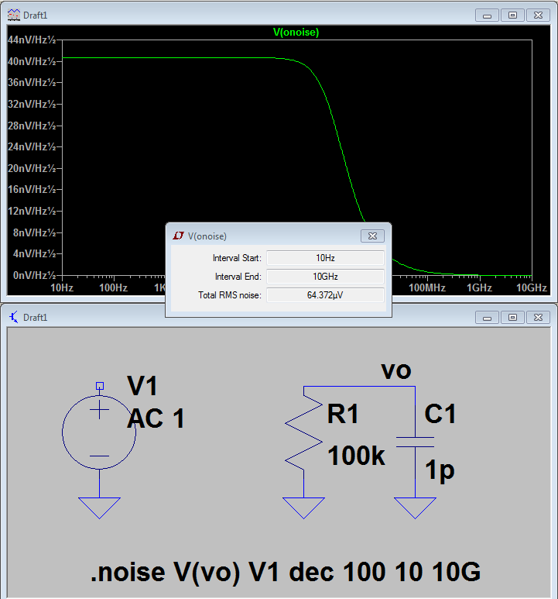
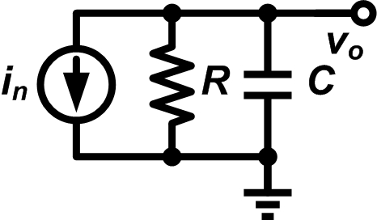
Noise analysis: RC circuit
How to calculate the noise voltage (mean-squared value)
Example, RC circuit, calculate the noise at the output node
  Find the noise source
  Noise transfer function
  Output noise PSD
C=1pF, v_{n} = 64uV (T=300K)
Notes:
Here, we give a small example how to calculate the noise voltage of a simple RC circuit.
First, we find out the power spectral density expressed in terms of current.
Then we calculate the transfer function of the current source to the voltage of output node. Basically, just need to replace the s with j omega.
Follow the procedure in last slide, the can calculate the output noise voltage power spectral density. And then we integrated it and obtain the mean-squared noise voltage.
The final result is relatively simple and only determined by the temp T and capacitance.

Slide 8
Noise in the signal processing chain
Ignore the noise contributions
majority contributions
Notes:
Do you have any questions?
In the signal processing chain, the noise from the detector and pre-amplifier stage always pay a majority contribution. And the contributions from the pulse shaper or the ADC sometimes we can ignore them.

Slide 9
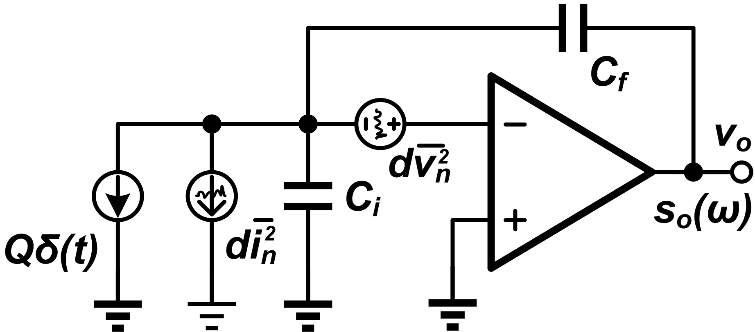
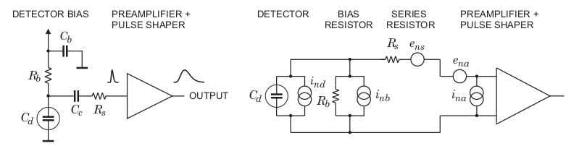
Noise sources - 1
Noise from the detector
  Bias resistor, detector shot noise, ...
Leakage current noise
HV bias resistor thermal noise
Noise from Rs can be ignored
Notes:
So, let move on to the noise sources of the electronics.
The first one is the noise comes from the detector. It is not the same as the intrinsic detector resolution caused by statistics.
In previous slide, we talk about the shot noise of the detector caused by the leakage current, this componen is shown in this formula.
Also, there always bias circuit for the detector, this resistor can introduce thermal noise.
The equivalent noise source of the detector, is shown in the top picture, as a current source. The power density is constant, and includes the contributions of both shot noise of detector and thermal noise of the bias resistor.

Slide 10
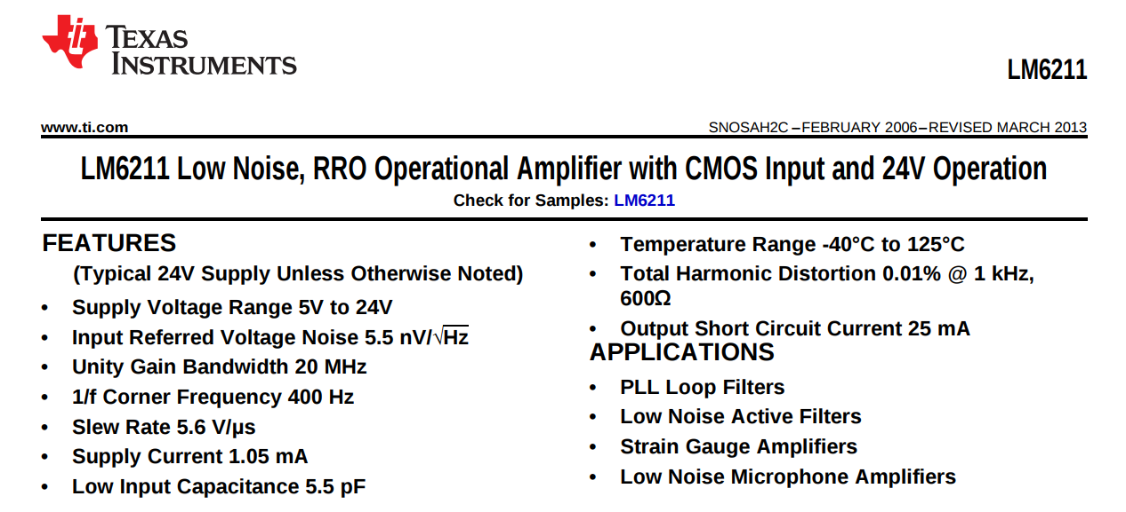
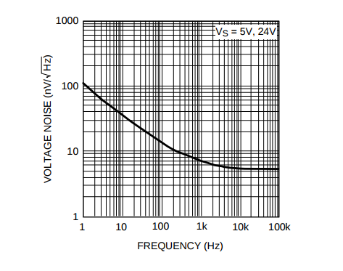
Noise sources - 2
Noise from the electronics system
  Amplifier, ...
Opamp thermal noise
Opamp 1/f noise
Notes:
The noise of the pre-amplifer stage is mainly comes from the opamp we used.
The bottom picture shows the datasheet of a commercial opamp. As you can see from the power spectra density, the noise of the opamp consists of two components, one is the thermal noise, and the other one is the 1/f noise.
The equivalent noise circuit is shown in this top picture.

Slide 11
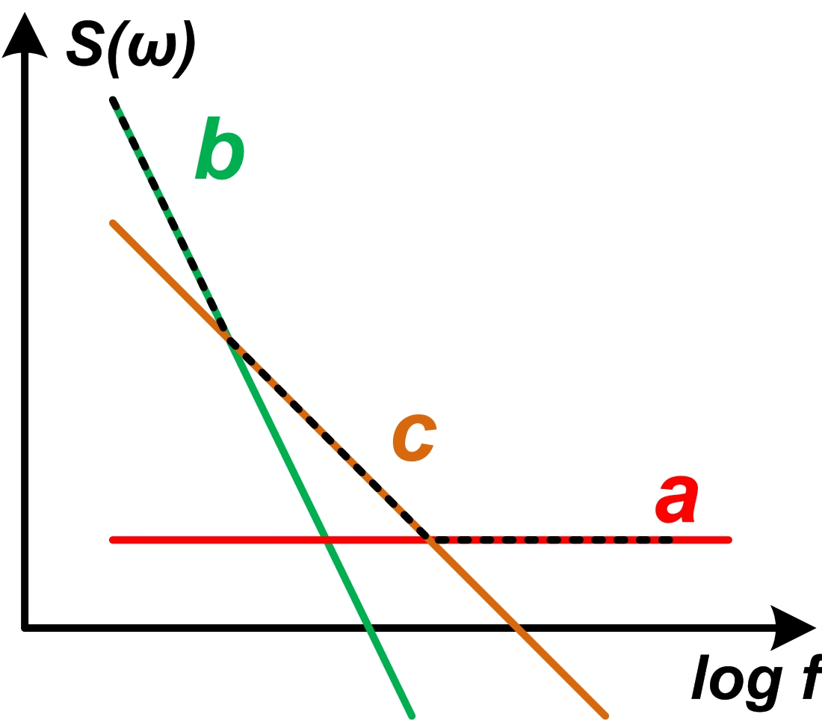
Noise of pre-amplifier
b
Leakage current noise
HV bias resistor thermal noise
a, c
Hands-on: get value of a, b and c
Opamp thermal noise
Opamp 1/f noise
Noise PSD at the output
Mathematically
Needs filter!
If c-components is ignored, then a and b characterize
the noise behavior of the system
Notes:
Then we summarize the two noise sources of the pre-amplifer stage.
The current noise is mainly from the detector, including the leakage current noise of the detector, and the thermal noise of the bias resistor. The voltage noise is mainly from the opamp, it has two components, thermal noise and 1/f noise.
We want to calculate the voltage noise power spectral density at the output node. After some calculation, we can express the PSD in this simple form.
The power density consists of a constant components, we call it a-components, or a-noise, this components is originally from the thermal noise of the opamp. And a component which is inverse proportional to the omega square, we call it b-components, or b-noise. This one is original from the detector and its bias resistor. Also, there is a component inverse proportional to the omega, we call it c-components, or c-noise, this is from the 1/f noise of opamp.
The spectral density of individual components are shown in the right picture. This axis is in log-scale. We tend to ignore the c-noise for simplicity, then we can define a important constant tau c equals to a/b
OK, let we find out the mean-squared value of the output noise voltage by integrating this formula, we find out this integration cannot converge! In reality when we measure the noise at this node, it definitely gives a finite value. This is because the time we spend on measuring is finite, and thus setting
Nevertheless, this means we should perform some kind of filtering.

Slide 12
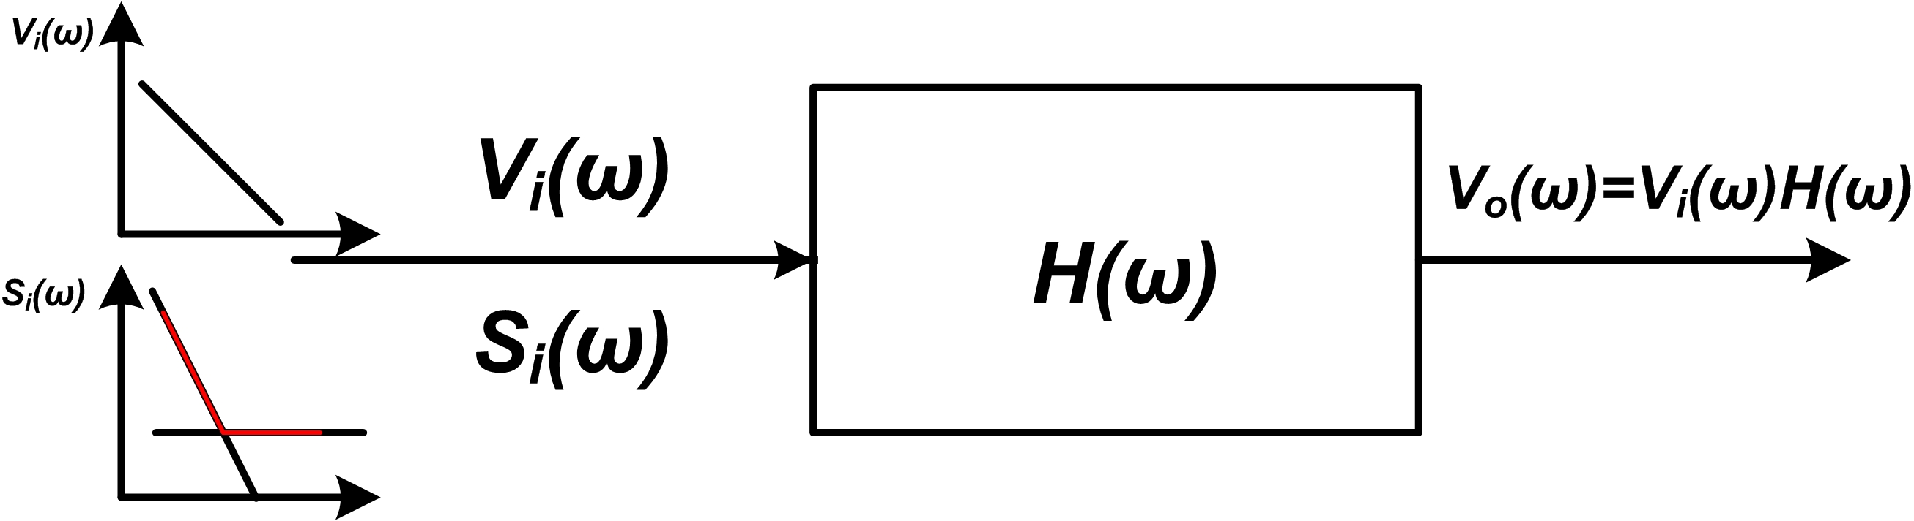
Filtering - 1
What’s the filter supposed to do?
  Filter out the frequency components of noise
  Keep the frequency components of signal
Best-optimized filter to give the best SNR
  Exist for our system (ignore c noise)
  For every filter structure, there are optimized setting for parameters
Theoretical limits
Output of the pre-amplifier become the input of the filter/shaper.
Notes:
OK, filtering. The basic goal of filtering is to filter out the frequency components of noise as much as possible, while keeping the frequency components of the signal.
So after the filtering, the signal to noise ratio will expect to improve.
For our system, the signal and the noise share some frequency components. For this kind of situation, we can theoretically build a best-optimized filter to give us the best possible SNR
If we ignore the c-noise, then we can get the theoretical SNR limits.
Q is the input charge, Cf is the feedback capacitor, and a,b are defined in the previous slides. Since the feedback capacitor also have some parts in the expression of a and b, it is not capable of saying that a smaller feedback capacitor gives us a better SNR.
Piratically, we cannot achieve the best solution. So, there are many structure can be chosen. And for every structure, there are optimized parameters for this very filter.

Slide 13
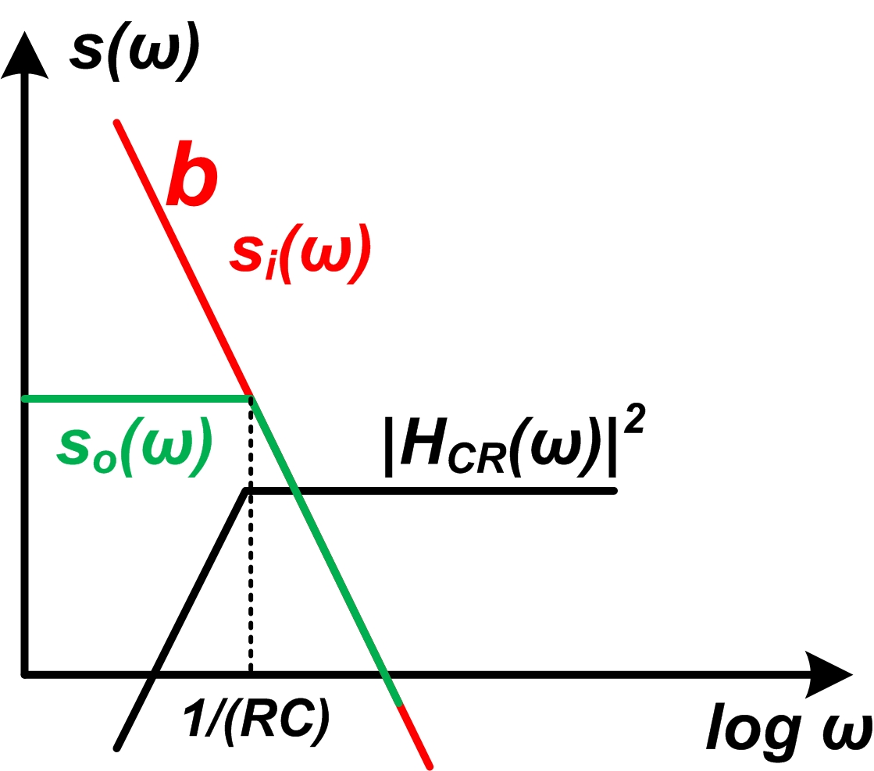
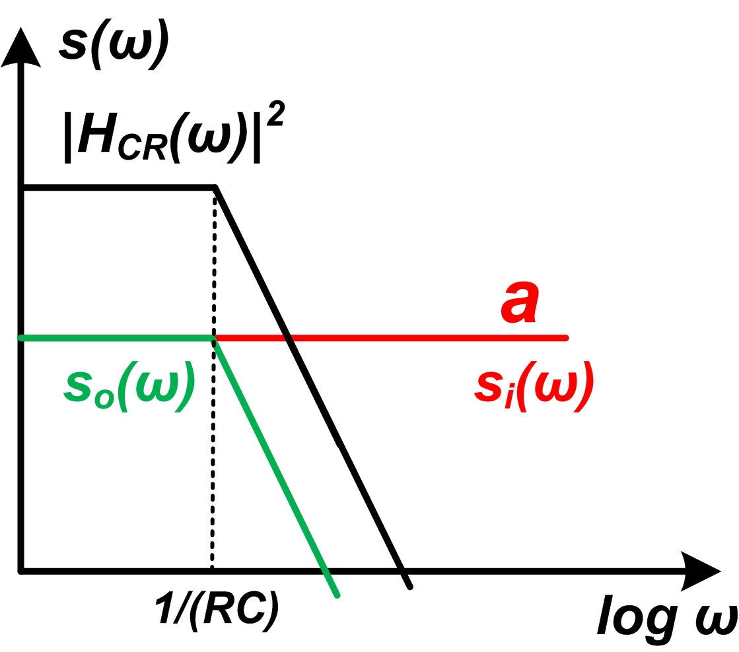
Filtering - 2
What kind of filter do we need?
  “b” components gives infinity at low frequency
  Needs high-pass filter, CR filter
  “a” component give infinity at high frequency
  Needs low-pass filter, RC filter
CR-RC filter is the simplest one
Notes:
Then what kind of filter do we need? Remember that the integration of the power spectral density is not converge. Let first find out which parts is not converge.
For the b-noise, it has problem when the frequency goes lower and lower. So if we cut off the low frequency components of the noise, it will be converge. So we need a high-pass filter to filter out the low frequency components. This is shown in the top picture, before filtering , the b-components in the red line cannot be integrated to be a finite value, so we perform a high-pass filter, which is in the black line. Then the power-spectra-density in green line, this one can be integrated to give a finite value. For the high-pass filter, the simplest one is CR filter.
We can conclude that, we need both the high pass filter and low-pass filter, namely the band-pass filter. Among all the options, the CR-RC filter is the simplest one.

Slide 14
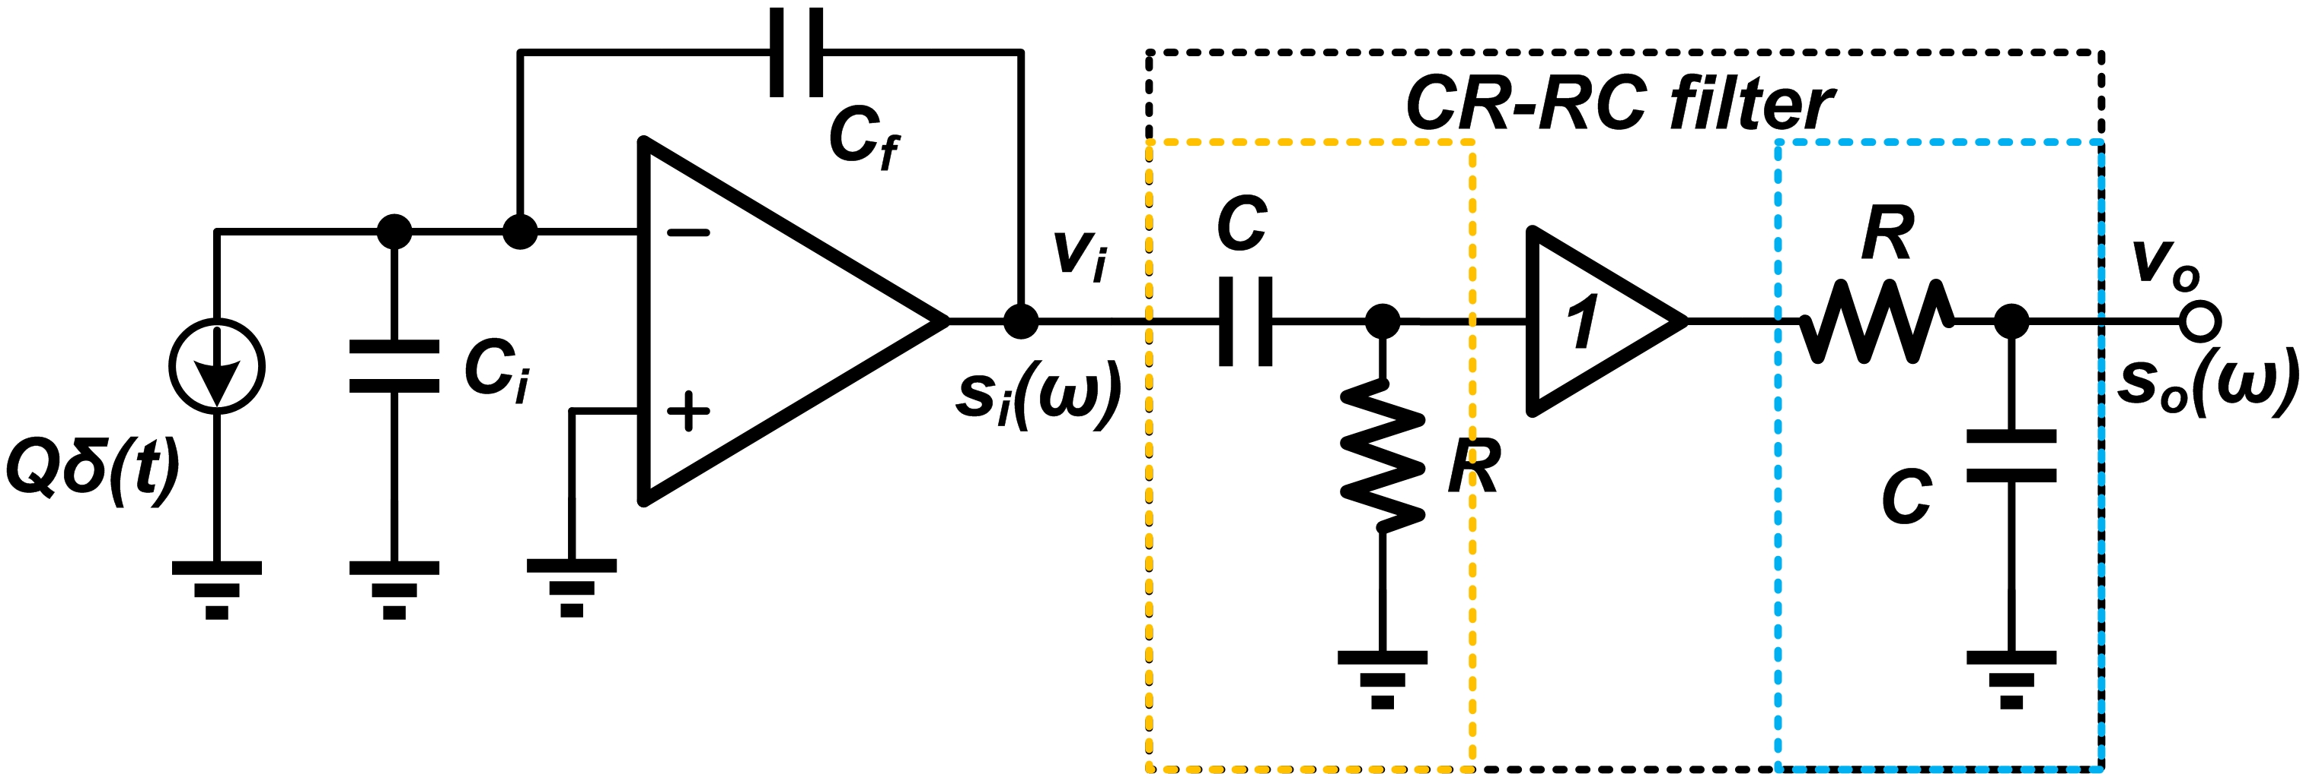
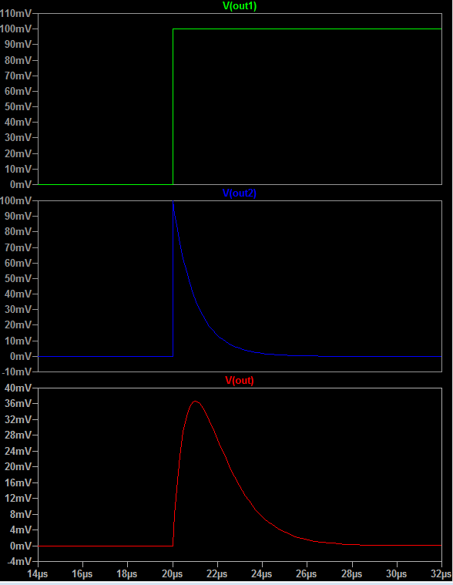
CR-RC filter
v_{i}
It also filters out some of the frequency components of the signal !
But what we measure is the amplitude of the output signal, not the energy or power of the signal
  No price is paid for CR filter
  Amplitude decrease after RC
  In each case, expect a improve in SNR
After CR filter, no amplitude loss
After RC filter, amplitude loss
Notes:
Let take a look at the CR-RC filter. The CR after the pre-amplifer stage will block the low frequency components for both signal and noise. But from the simulation in the right, there is no amplitude loss after the CR filter.
Then the RC filter does reduce the amplitude of the signal, but in each case, we expect a improve in SNR.
So in the exercises, you can try to plot the noise power density of these three node, and make a comparison.
The CR-RC filter only have one parameters, the RC time constant. How can we choose it?

Slide 15
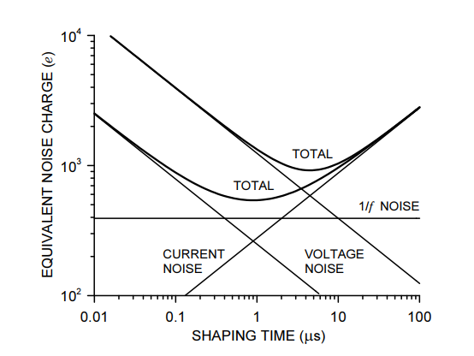
CR-RC filter
Contribution from “a” noise I_{a}
Contribution from “b” noise I_{b}
There are optimum shaping time constant for the CR-RC filter
a
b
Notes:
OK, let do some math.
The contribution from a-noise is the integration of a-square times the squared absolute value of transfer function. We notice that the transfer function itself is the function of omega tau as a whole. Using the play some small trick, we find this slightly different integral a constant. That is to say, the contribution from the a-component is inverse proportional to the time constant.
The same trick can apply to the b-noise, we can conclude that the the contribution from the b-noise is proportional to the time constant.
Detailed analysis shows that the overall noise voltage can be expressed in this formula. So, we can see that, there is a optimum time constant, which is related to the value of a and b.
This picture shows, as the increase of the time constant, which means the bandwidth of the shaper get smaller, the contributions from the b-noise, or the noise from the detector will dominant.
As the decrease of ...

Slide 16
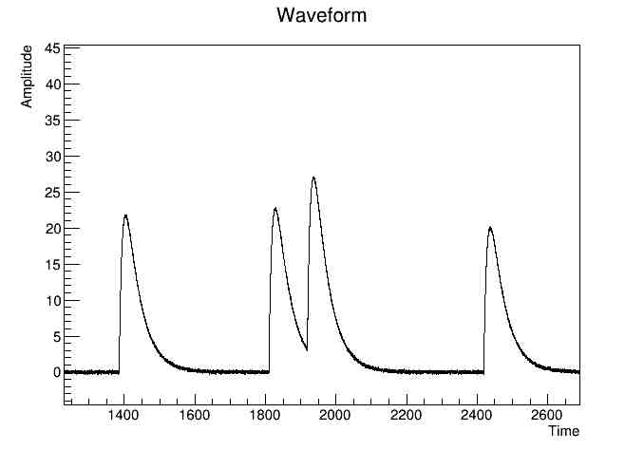
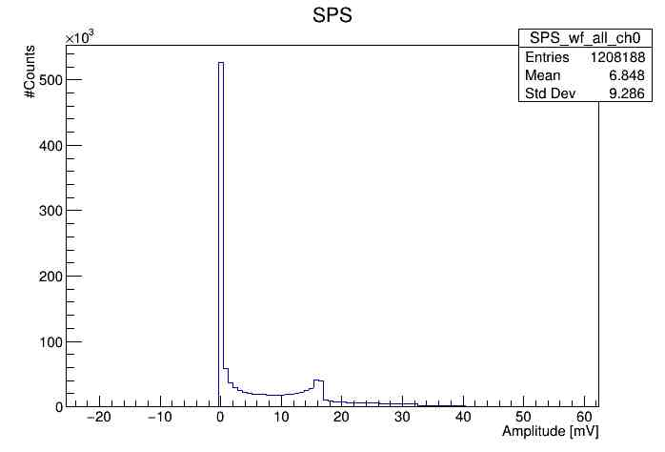
Not only the SNR matters -
Pile-up
  The arrival time of events are subject to random fluctuations.
  Occurs when two pulses overlap.
Notes:
We already mentioned that not only the noise issue matters when considering the measurement resolutions, also the waveform plays a big role.
Assume that the detector always gives out identical amount of charge, when there is no overlap between two pulses, we will expect the measured amplitude spectrum is one peak with Gaussian distributions.
Since the time interval of two signal is subject to random passion distribution, then there is a chance when the two pulses overlap, this is called pile-up.
In this case, the spectrum will not longer look like a gaussian distribution. The right picutre shows the metor calor simulation result considering the pile-up effect.
Corresponding.

Slide 17
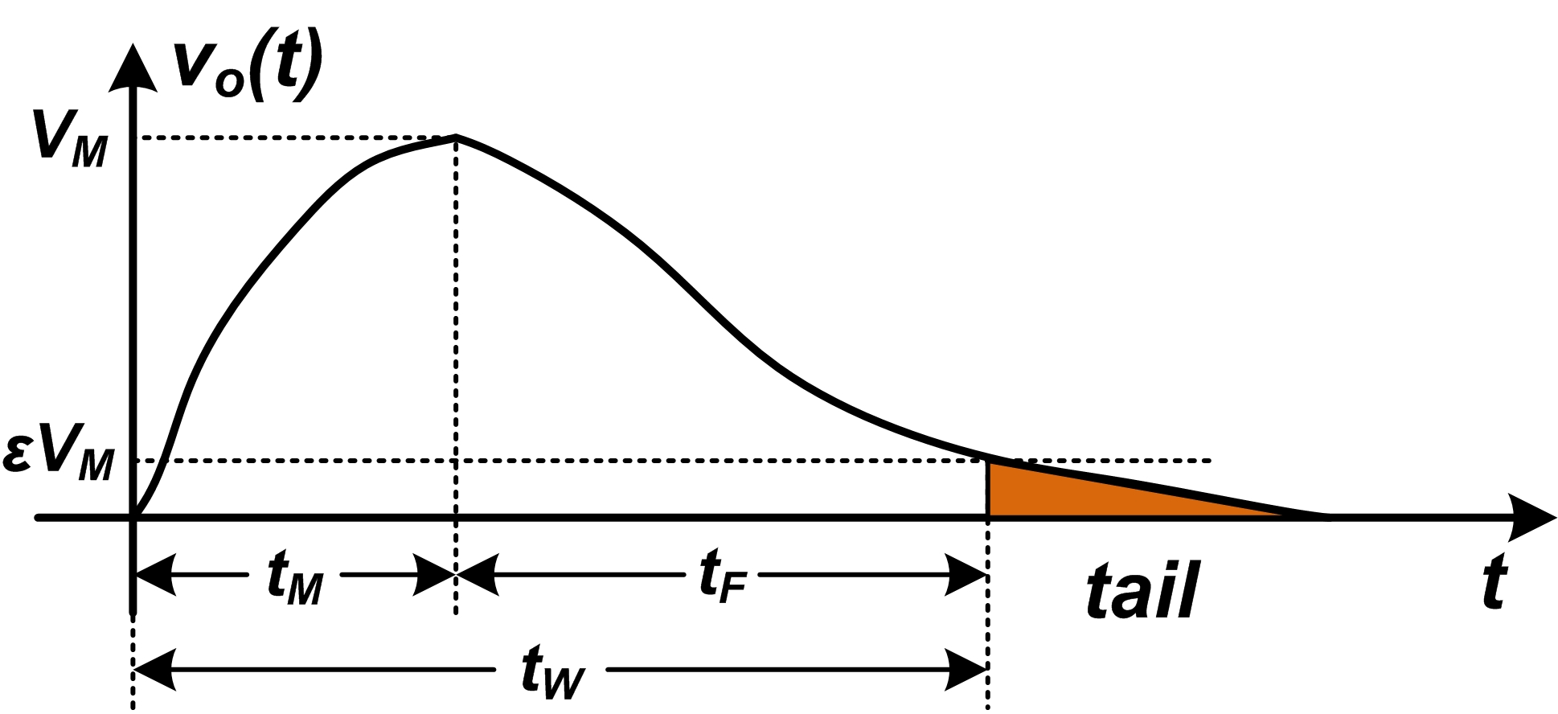
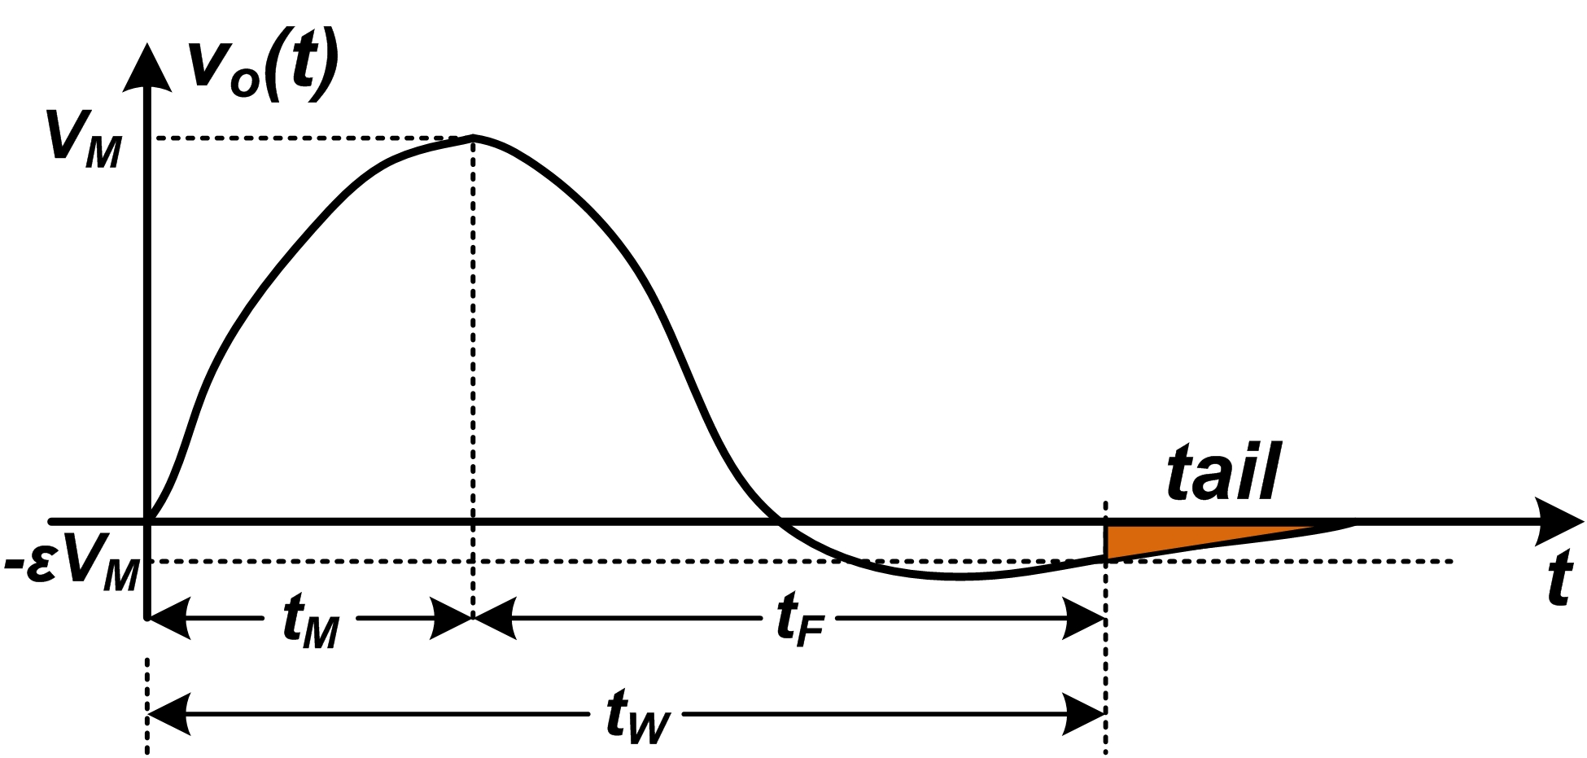
Shaping - 1
Filtering and shaping --- same thing with different emphasis
  Filtering: from SNR perspective, frequency domain
  Shaping: from signal shape perspective, time domain
Parameters for shape
  Unipolar/ bipolar?
  Peaking time t_{M}, recovery time t_{F}, signal width t_{W}
Notes:
Let take a look at the shaping. From the slide about CR-RC filter, we already notice that, when we perform filtering, the shape of the waveform also changes. And if we want to change the waveform, then we also filter out some of the frequency components. So filtering and shaping are essential the same thing.
But why we distinguishing it? Because they are response to different requirement by the application…..
When we want to compare the shape of a waveform, there are some parameters.

Slide 18
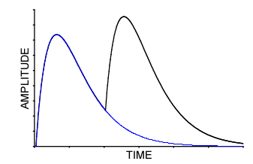
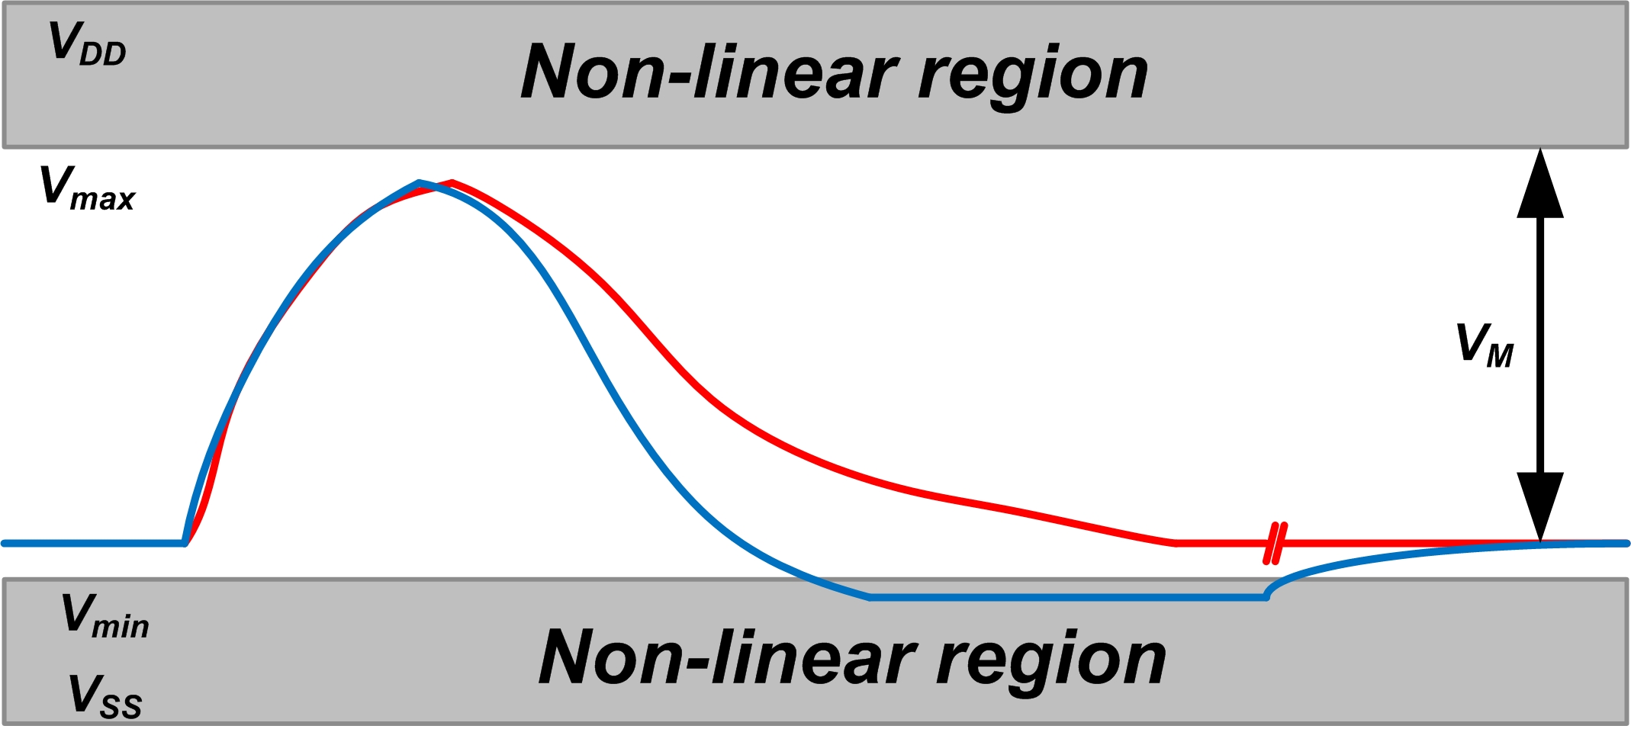
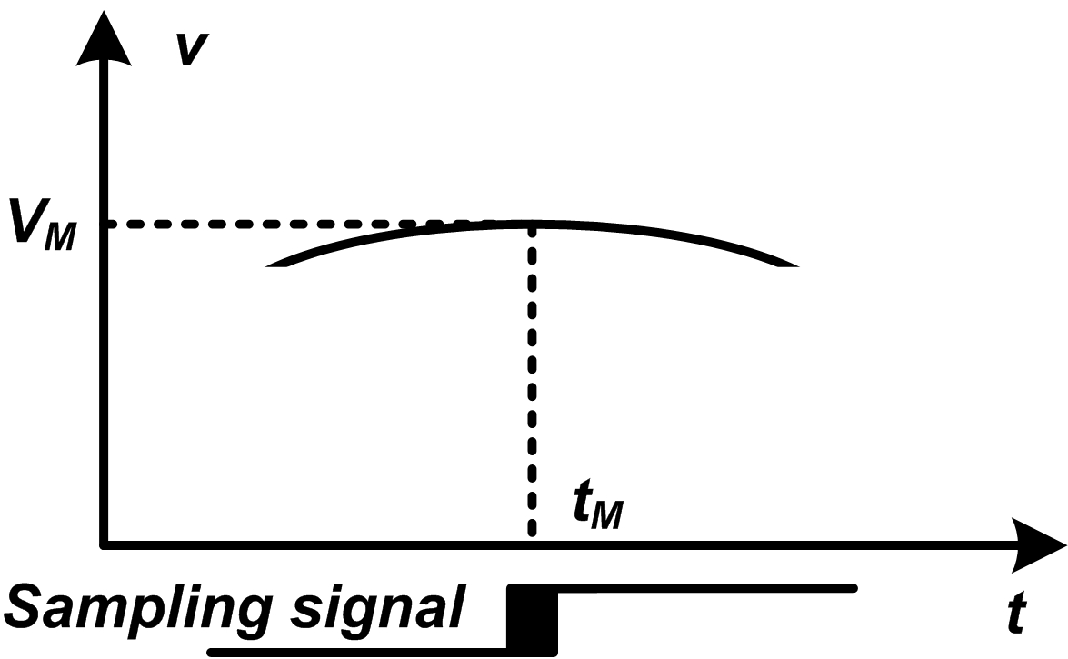
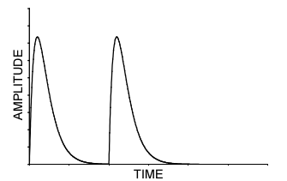
Shaping - 2
Requirements for the waveform in high energy resolution measurement system under moderate data rate
  Linear
  Narrow signal width t_{W} , for higher data rate
  Unipolar
  Flat plateau
  Simple, easy to tune the shaping time-constant
  Different from the timing measurement system or high data rate system
Notes:
Different application will have different requirements on the waveform, in terms of energy measurement, here we list some of requirements.
At the case of pile-up, reducing the signal width will allow the first pulse return to the baseline before the second pulse arrives. This is good for high data rate.
Also, since every realistic opamp have a limit work region, we always tend to use the full range, so the base line is set to very low. In this case, if the waveform is bipolar, when a large signal is applied, the undershoot will turn the amplifier into a non-linear region, this will take a very long time to recovery. So this is the reason why we prefer the unipolar signal.
For the ADC, we use a sampling signal to sample the amplitude value. But there are always some jitter added to this signal, so we prefer to have a flat plateau to minimize the effects of sampling jitter.

Slide 19
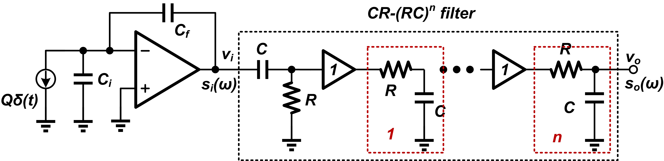
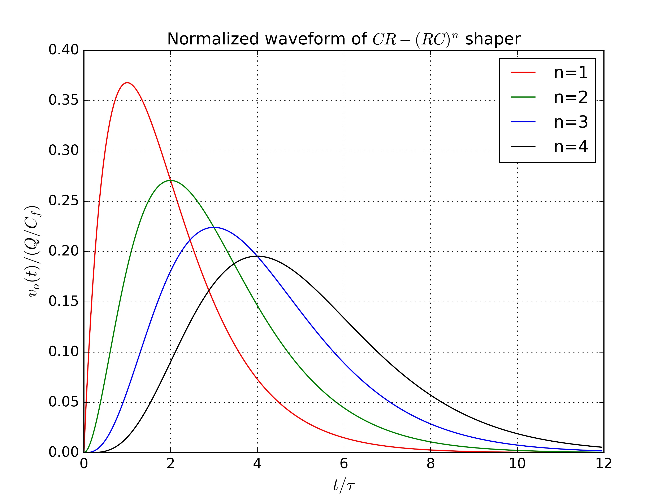
CR-(RC)^{n} filter - 1
The most common pulse shaper employed in the detector readout system
  Semi-Gaussian shape can be easily realized with simple components
  Reasonable SNR performance and counting rate behavior
Waveform gets more symmetric as the increase of order n
It is a good practice to choose time-constant of CR and RC to be the same
Notes:
Now, we move on to other kind of shapers, the CR-RC n filter with higher order. From the schematic view, compared with the CR-RC filter, it only add more RC blcoks.
They are the most common used shaper

Slide 20
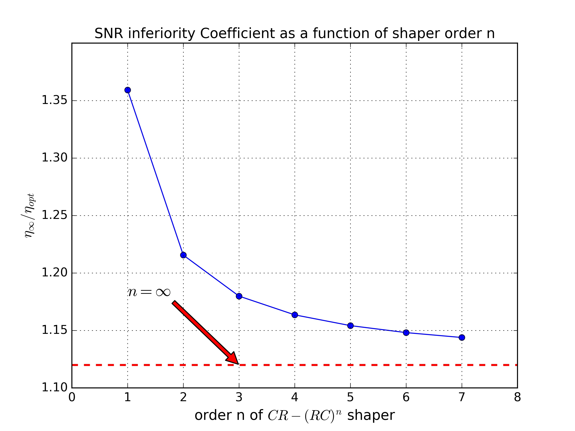
CR-(RC)^{n} filter - 2
One can always benefit from the increase of shaper order n
  Optimum shaping time constant is different.
  In practice, n = 1,2,3,4 are widely employed
  Further increase n won’t gain too much

Slide 21
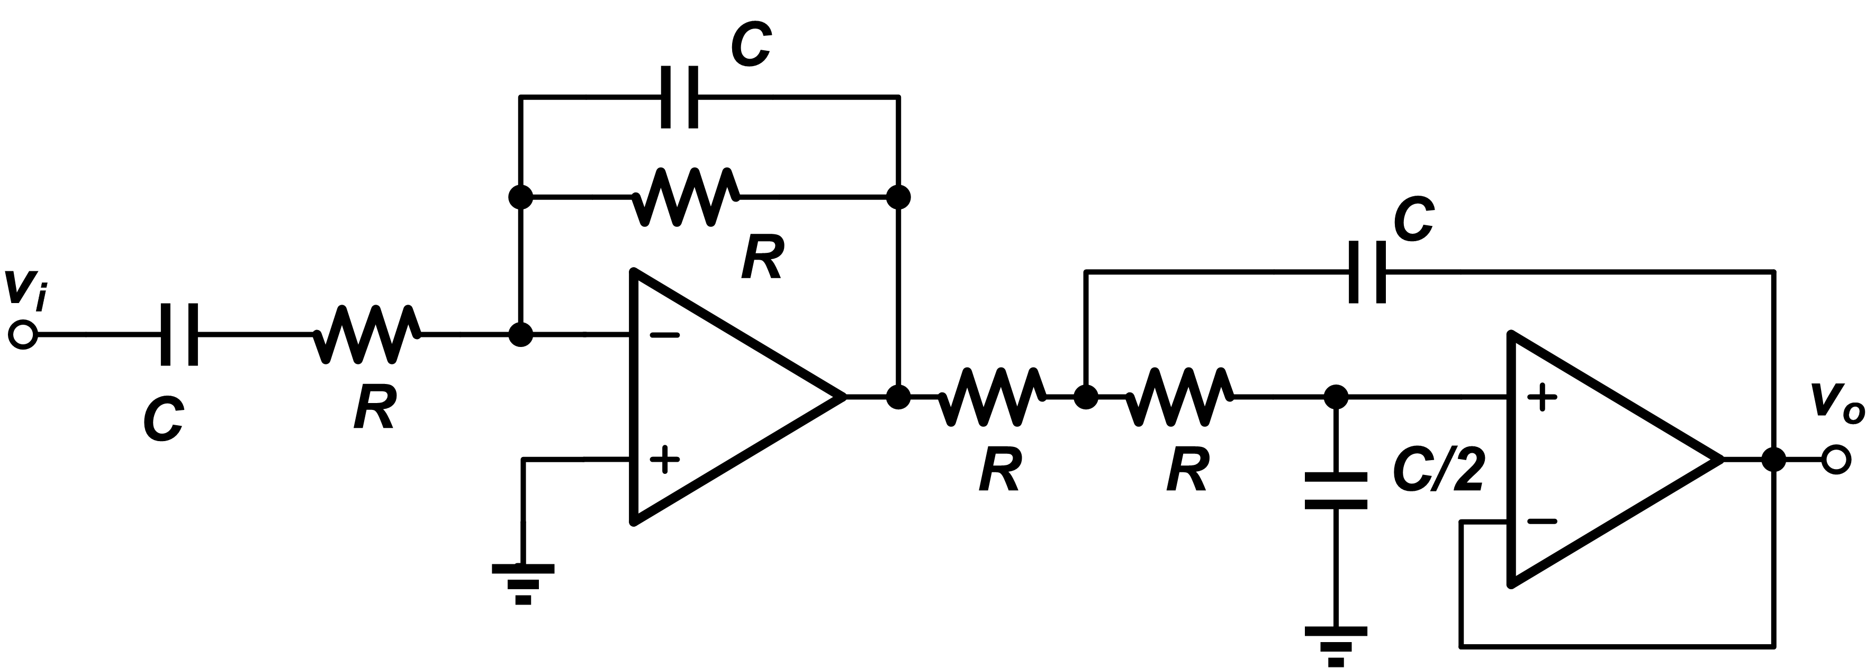
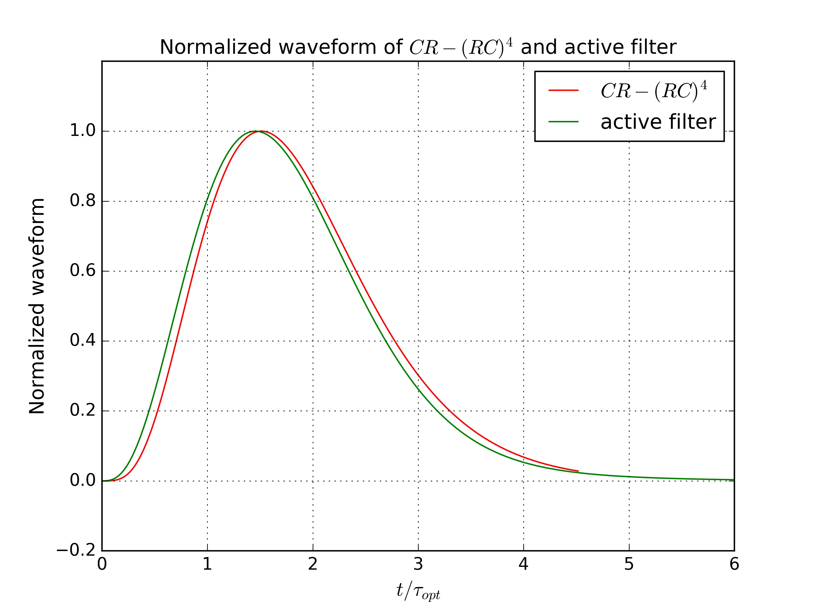
Active filter
Another option to implement the low-pass filter
Advantages:
  Less components and filter stage
  Complex poles. More flexible to tune, easy to achieve semi-Gaussian shape ...

Slide 22
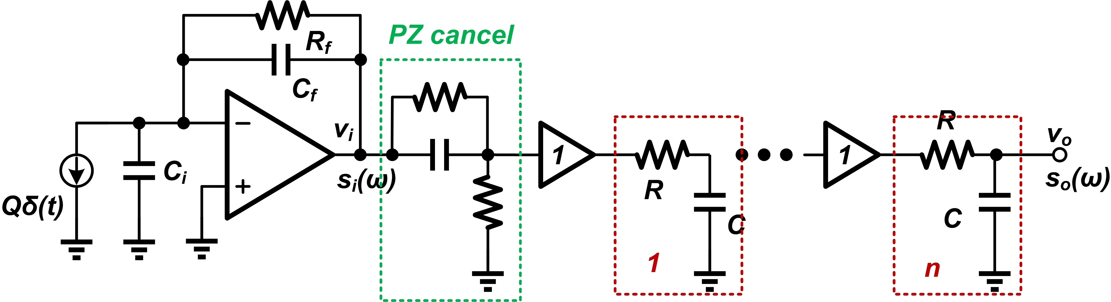
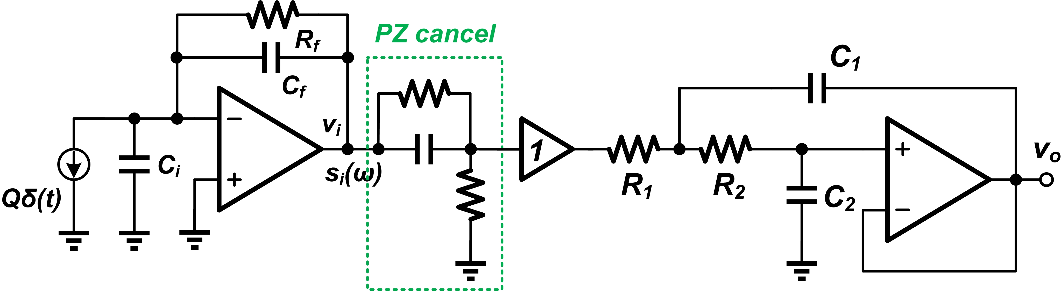
Shaper with PZ cancel
CR-(RC)^{n}
Active filter

Slide 23
Summary
Signal processing chain
Noise mainly from the pre-amplifier and detector
Filter/shaper to filter out the noise, the optimum shaping time constant is determined by noise components.
Filter/ Shaper Comparator
Incident
particle
Sensor
Pre-amplifier
ADC
To Digital Circuit
01010011
Notes:
Now, we can make a summary.
The electronics noise is mainly from the noise of pre-amplifier and the noise of detector.
The filter or shaper is adopted to filter out the noise, and the optimum shaping time constant is determined by the noise components.

Slide 24
Contents
Lecture
  Review of Day1 and Day2
  Limitations of the maximum energy resolution
  Noise analysis of the pre-amplifier stage
  Filtering and shaping
Hands-on
  Analysis: Find the a and b coefficients
  SPICE: Noise PSD of the pre-amplifier output
  Analysis: Noise at the CR-RC shaper output
  SPICE: Noise simulation of CR-RC shaper output
  SPICE: Comparison of different filter/shaper structure
Do always try to understand the simulation result

Slide 25
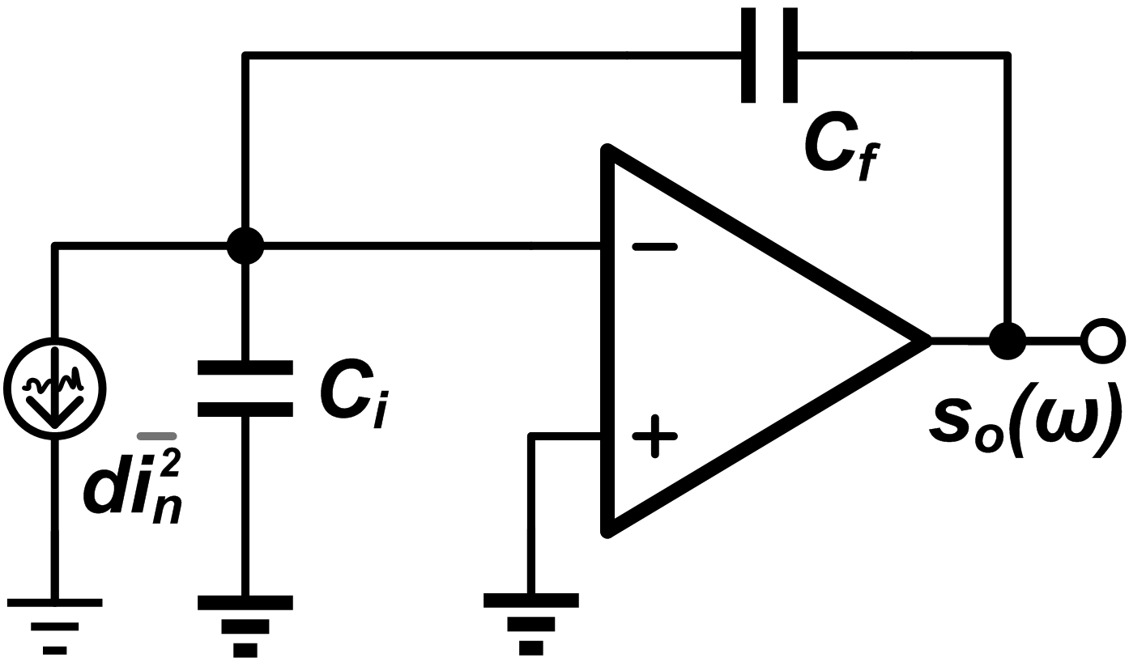
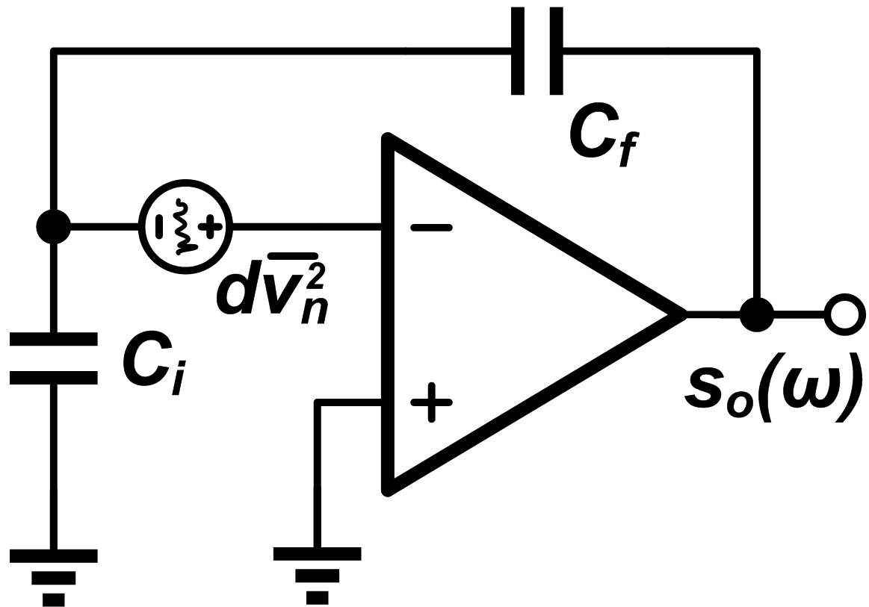
Noise analysis of the pre-amplifier
Find the a , b and c coefficients
a² =
b² =
c² =

Slide 26
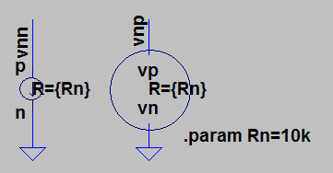
Noise source in our simulation
Same configuration
Current source di²_{n} given the “noise current source”, with PSD
voltage source dv²_{n} given the “noise voltage source”, with PSD
Calculation will show that
Noise current source
Noise voltage source

Slide 27
Noise simulation of the pre-amplifier
In file “day3_CSA_Noise”, do the .tran simulation to verify the functionality of this circuit.
Set C_{i} = 99pF, C_{f} = 1pF, do the .noise simulation, find out corner frequency
  aa and bb in the measurement is not the same as “a” and “b” in lecture
Sweep the value of C_{i} in the range of 0~1nF, to see the changes of “a” and “b” noise components in the PSD

Slide 28
Noise analysis of CR-RC filter
Calculate the output noise of CR-RC
  Input PSD
  Noise transfer function
  Output PSD
  integration
Useful integration formula

Slide 29
Noise simulation of CR-RC filter
In file “day3_CSA_CRRC_Noise”, do the .tran simulation, for output “out”
  Maximum value V_{M} and peak time t_{M}
  Pulse width t_{W}(1%)
Set C_{i} = 99pF, C_{f} = 1pF, do the .noise simulation, get the output noise value
  Fit with your analysis results?
Sweep the value of C_{i} in the range of 0~1nF, plot V_{n}~C_{i}
Sweep the shaping time “ts” in the range of 0.1~10u, plot V_{n}~t_{s}.
  Which is the optimized shaping time for CR-RC filter?
  For the optimized shaping time, calculate ENC
P.17

Slide 30
Comparison of different shaper
Finish the circuit blocks of “day3_SCA_CRRCx_Noise” (x=2,3,4). Finish the block “day3_ActiveFileter_Noise”
Find out the optimum shaping time constant by simulation. Compare it with the theoretical formula.
Do .tran simulation, find out the Maximum value V_{M ,}peak time t_{M} and pulse width t_{W}(1%). Do .noise simulation, find out the output noise V_{n}
Complete the table below(Q=1pC, C_{i} = 99pF, C_{f} = 1pF, tc=1us)
 | CR-RC | CR-(RC)² | CR-(RC)³ | CR-(RC)⁴ | Active filter
t_{s}
V_{M}
t_{M}
t_{W}(1%)
V_{n}
ENC

