Slide 1
Solutions to Day3 Hands-On
HighRR SPICE Hands-On 2017, Day 3

Slide 2
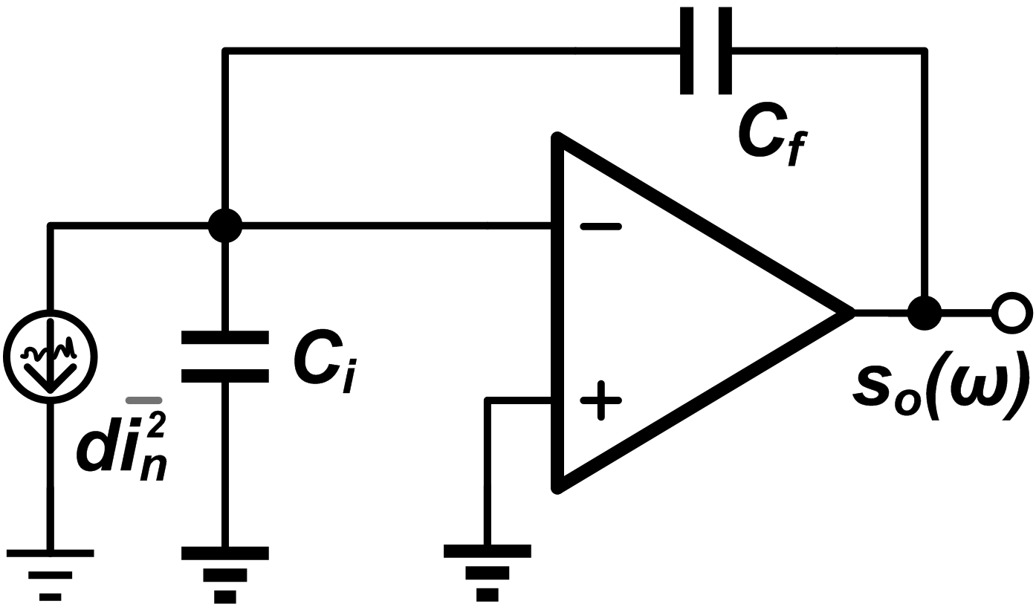
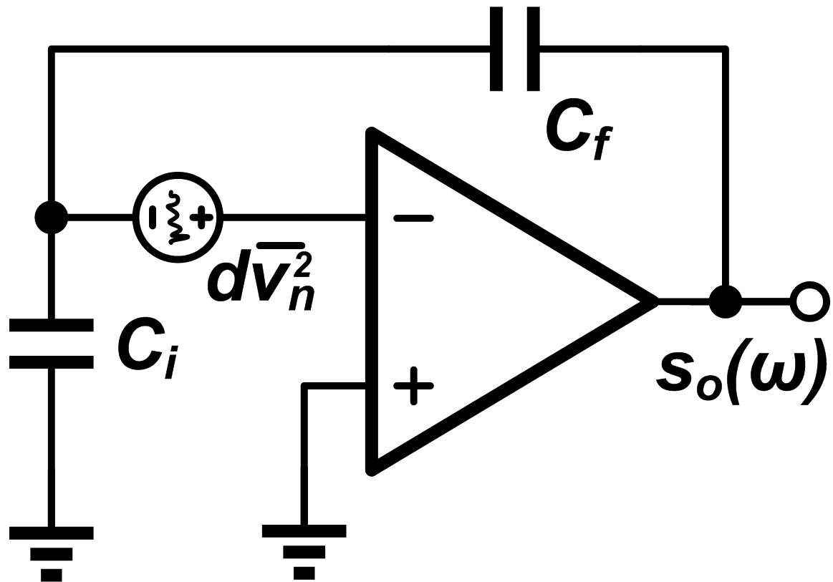
Noise analysis of the pre-amplifier
Find the a , b and c coefficients

Slide 3
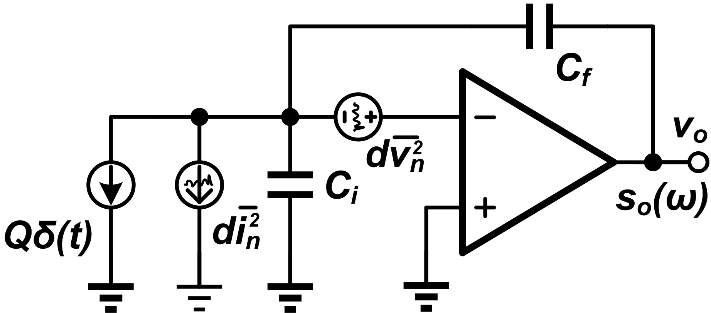
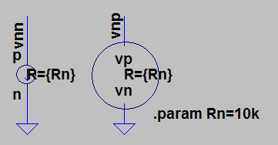
Noise source in our simulation
Same configuration
Current source di²_{n} given the “noise current source”, with PSD
voltage source dv²_{n} given the “noise voltage source”, with PSD
Calculation will show that
Noise current source
Noise voltage source

Slide 4
Noise simulation of the pre-amplifier
In file “day3_CSA_Noise”, do the .tran simulation to verify the functionality of this circuit.
Set C_{i} = 99pF, C_{f} = 1pF, do the .noise simulation, find out corner frequency
  Get t_{c} = a/b = 1us
Sweep the value of C_{i} in the range of 0~1nF, to see the changes of “a” and “b” noise components in the PSD

Slide 5
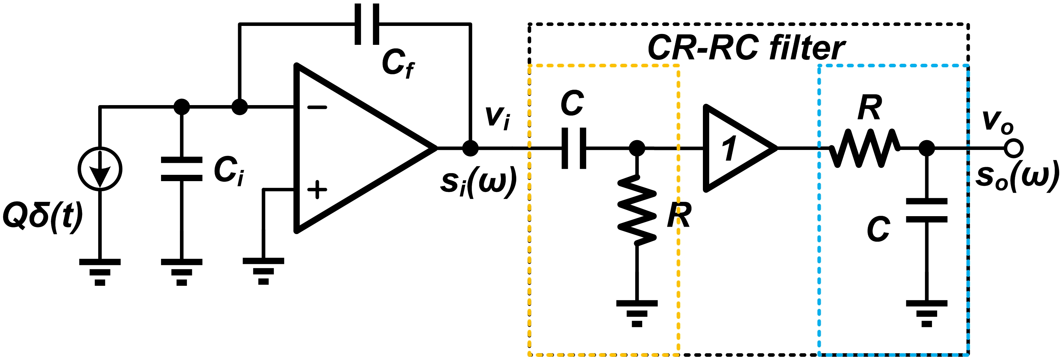
Noise analysis of CR-RC filter
Calculate the output noise of CR-RC
  Input PSD
  Noise transfer function
  Output PSD
  integration
Useful integration formula

Slide 6


Noise simulation of CR-RC filter
In file “day3_CSA_CRRC_Noise”, do the .tran simulation, for output “out”
  Maximum value V_{M} and peak time t_{M}
  Pulse width t_{W}(1%)
Set C_{i} = 99pF, C_{f} = 1pF, do the .noise simulation, get the output noise value
  Fit with your analysis results?
Sweep the value of C_{i} in the range of 0~1nF, plot V_{n}~C_{i}
Sweep the shaping time “ts” in the range of 0.1~10u, plot V_{n}~ts.
  Which is the optimized shaping time for CR-RC filter?
  For the optimized shaping time, calculate SNR (eta)
  Calculate the inferiority coefficient (F)

Slide 7
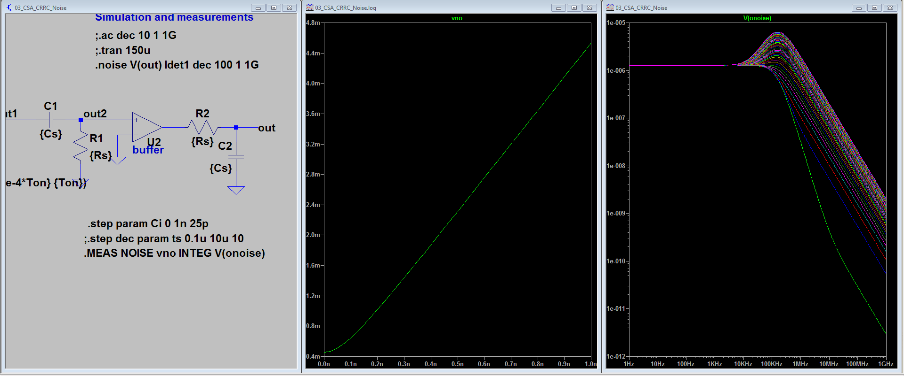
Sweep input capacitance

Slide 8
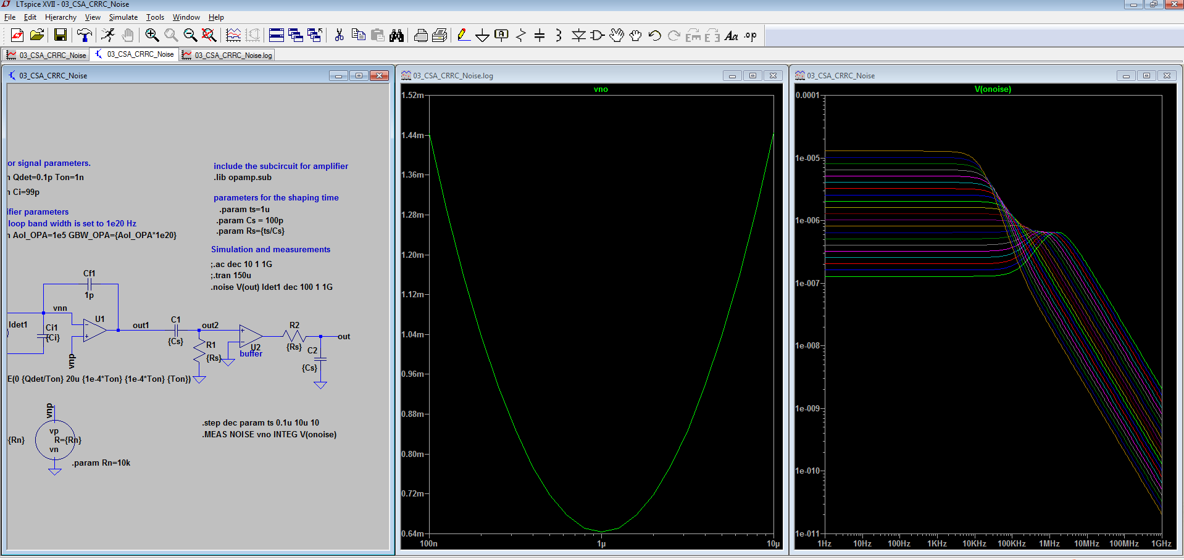
Sweep shaping time constant
Log scale,
Optimized at Ts = 1us

Slide 9
Comparison of different shaper
Finish the circuit blocks of “day3_SCA_CRRCx_Noise” (x=2,3,4). Finish the block “day3_ActiveFileter_Noise”
Set the shaping time for every block at optimum, which is given in lecture. For the active filter, set the shaping time constant the same of CR-(RC)⁴
Do .tran simulation, find out the Maximum value V_{M ,}peak time t_{M} and pulse width t_{W}(1%). Do .noise simulation, find out the output noise V_{n}
Complete the table below(Q=1pC, C_{i} = 99pF, C_{f} = 1pF)
 | CR-RC | CR-(RC)² | CR-(RC)³ | CR-(RC)⁴ | Active filter
t_{s} | 1 us | 0.58 us | 0.45 us | 0.38 us | 0.60 us
V_{M} | 367 mV | 270 mV | 224 mV | 195 mV | 312.5
t_{M} | 1 us | 1.17 us | 1.34 us | 1.52 us | 1.45 us
t_{W}(1%) | 7.63 us | 5.66 us | 5.26 us | 5.11 us | 5.10 us
V_{n} | 643 uV | 423 uV | 340 uV | 292 uV | 469 uV
ENC

