Slide 1
Testbeam in Hamburg

Slide 2
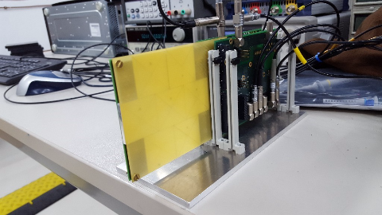
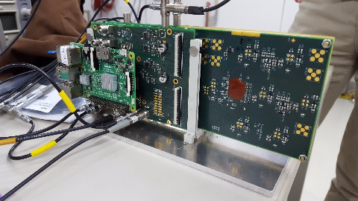
Hardware
3 layers(15 channels)
  Two layers full equipped with seven scintillator tiles and SiPMs(#32,#33)
  One layer only central channel equipped(#34)
Interface boards
  Clock
  Power supply
Raspberry
  Configuration
  Read data(time, amplitude)
System
  Box behind telescope and AHCAL

Slide 3
Measurements in General
Setup and check the MIP response
Calibrations using the LED
MIP under different gain scale
Event validation
Synchronization between layers
Efficiency
Power pulsing
Synchronized to AHCAL

Slide 4
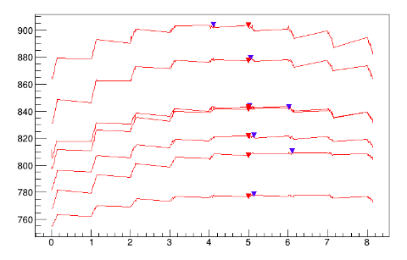
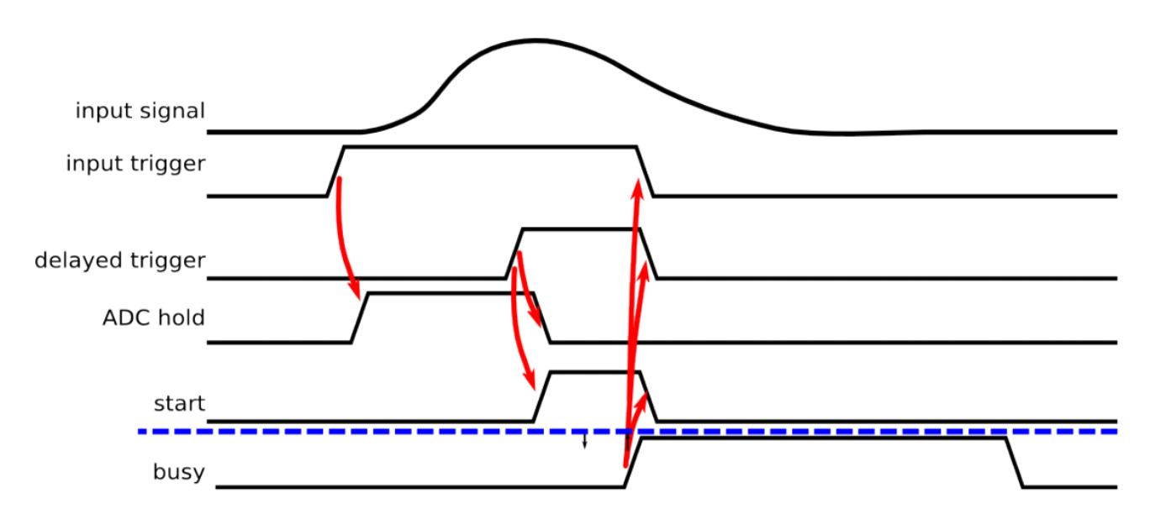
Calibrations: hold delay
Hold delay
Ensure ADC always sample at the peak of the input signal
Scan hold-delay DAC values
Optimized hold delay setting can apply to the MIP
ADC Sampled value
Global hold delay DAC
delay

Slide 5
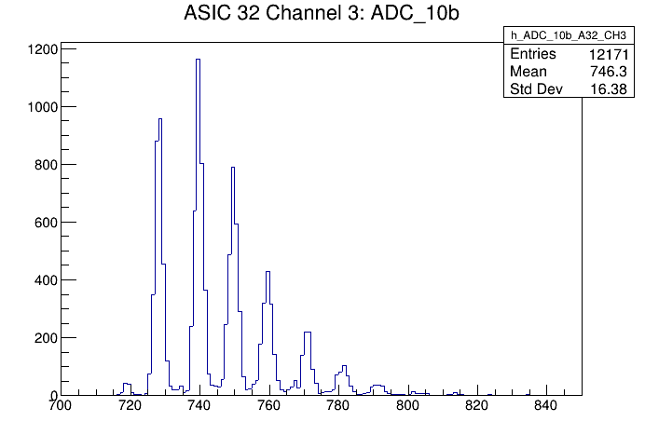
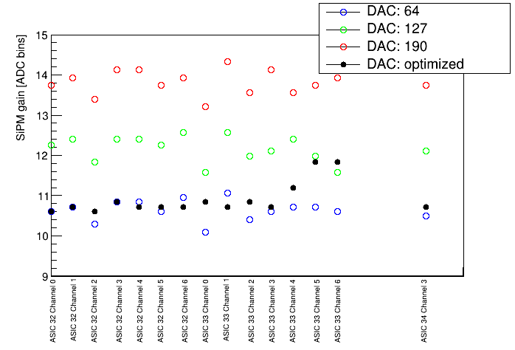
Calibrations: SiPM gain
SiPM gain
Set the SiPM gain to be uniform for all channels
  tune the SiPM bias DAC
  Global HV=58V
Procedures
  LED runs → SPS → gain
  Gain ~ DAC value
  Select the DAC value to get a fixed SiPM gain

Slide 6
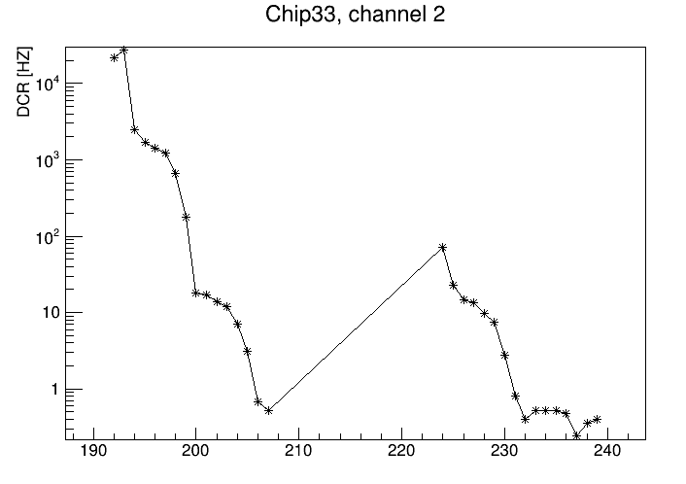
Calibrations
Trigger threshold
Put the threshold level so that the DCR of 5Hz for all channels
  Tune the trigger threshold DAC(global + local)
Procedure
  DCR scan for different DAC
  Set the DAC value
Global threshold = 6
Global threshold = 7
Fine DAC: 0~15
Fine DAC: 0~15

Slide 7
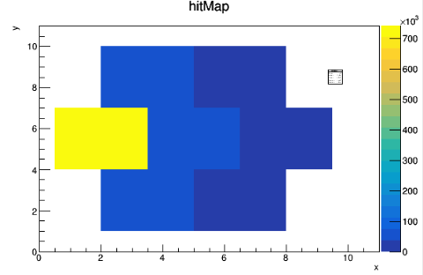
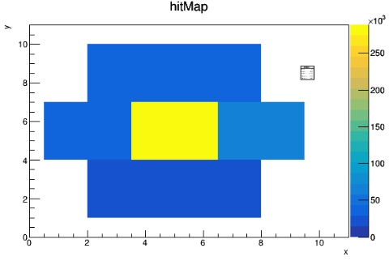
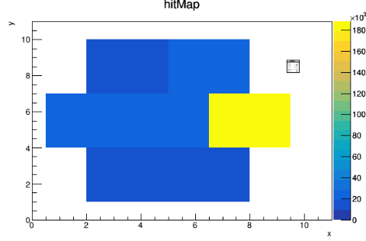
Surface scan
System center align to the beam center
Changing the location of the system
HitMap: Number of hit to the sensors
Changing the horizontal position of system

Slide 8
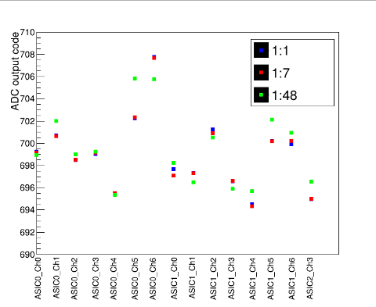
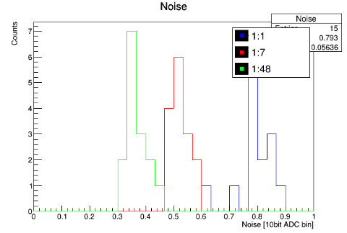
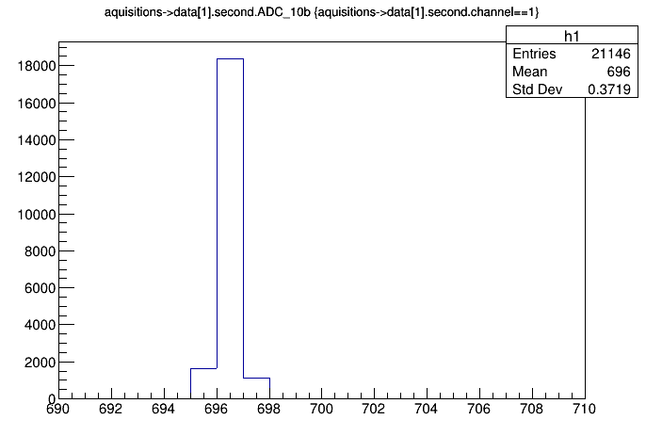
Pedestal
Pedestal: output of the chip when no input signal
Small dispersion(4 bin) between HG/LG branches
Very small shift in two pedestal runs → pedestal stable
4 bin
Mean value of pedestal
Noise distributions of pedestal

Slide 9
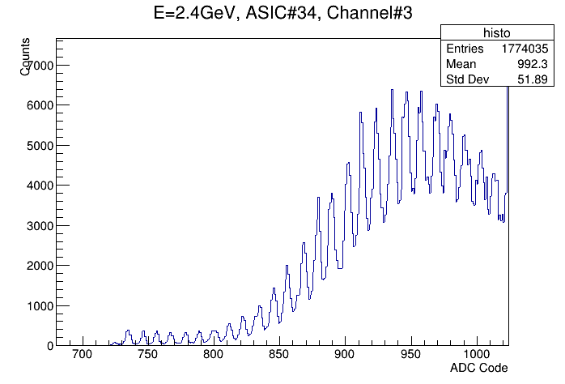
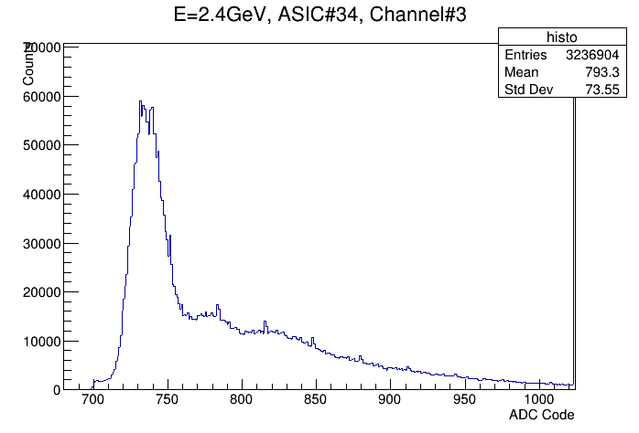
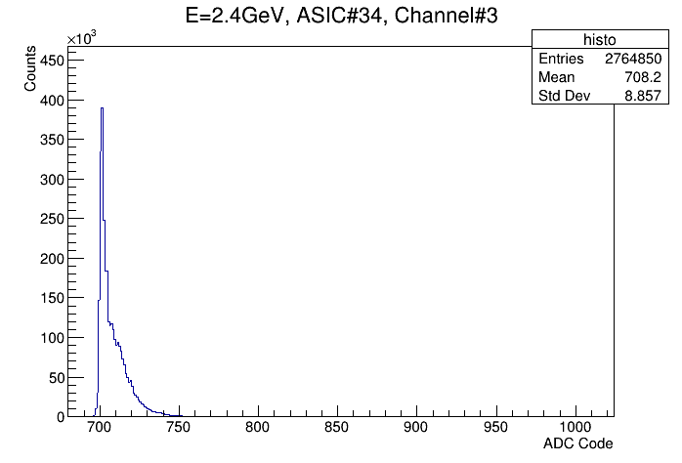
MIP: fixed gain
Spectrum of MIP(Minimized ionization particle) response
MIP for different gain scale
  HG(1:1), single photo spectrum visible
  About 25 p.e. detected for one MIP in E=2.4GeV
  HG(1:7), two-three MIPs recognizable in central sensor
25p.e
HG(1:1)
MG(1:7)
LG(1:48)

Slide 10
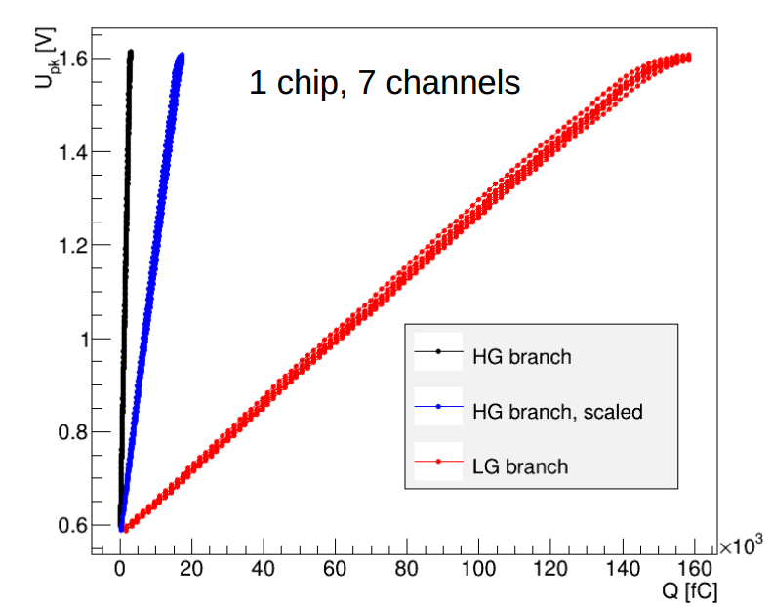
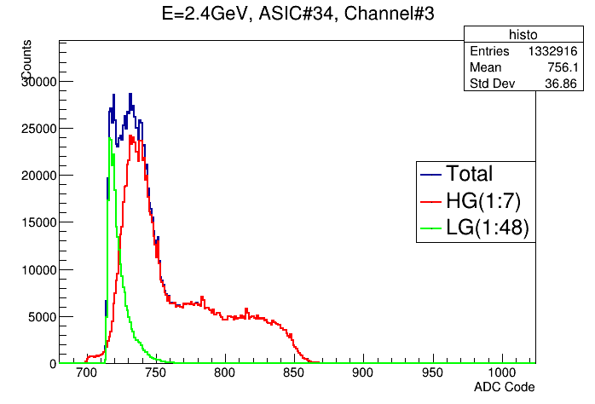
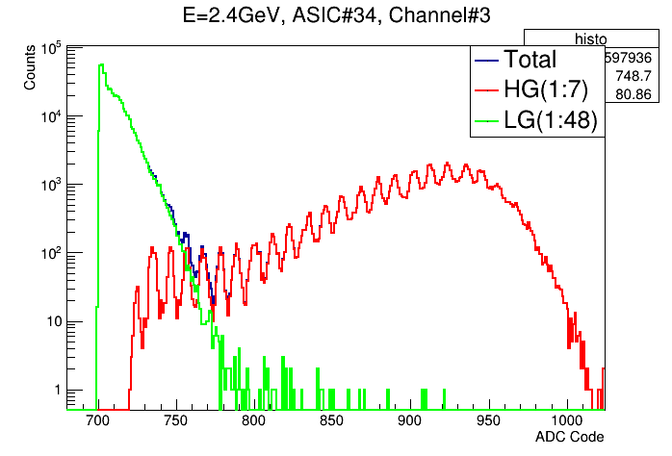
MIP: Auto-gain
Automatic selection between HG/LG branch
  For large input signal, switch to LG
  For small input signal, switch to HG, good noise performance
Scan the gain selection decision level
Functional
LG(1:48) / MG(1:7)
LG(1:48) / HG(1:1)

Slide 11
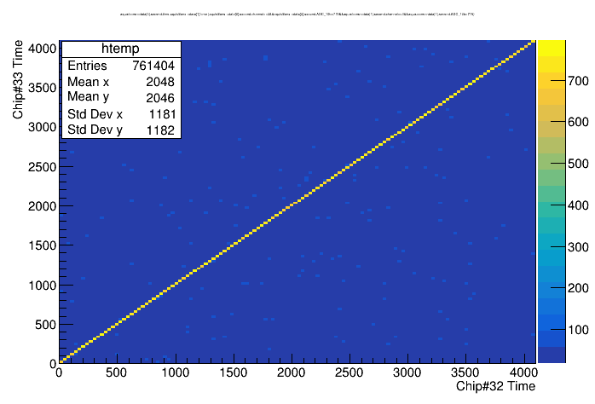
Synchronization between layers
Time information
Synchronization between the same channel in two layers

Slide 12
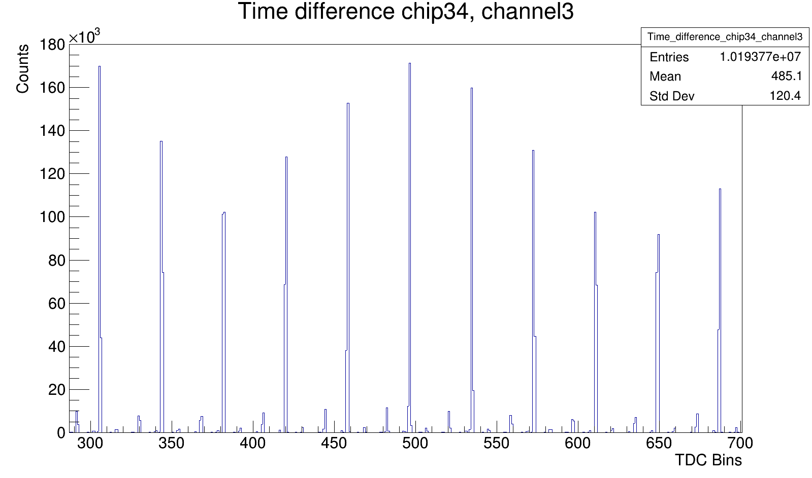
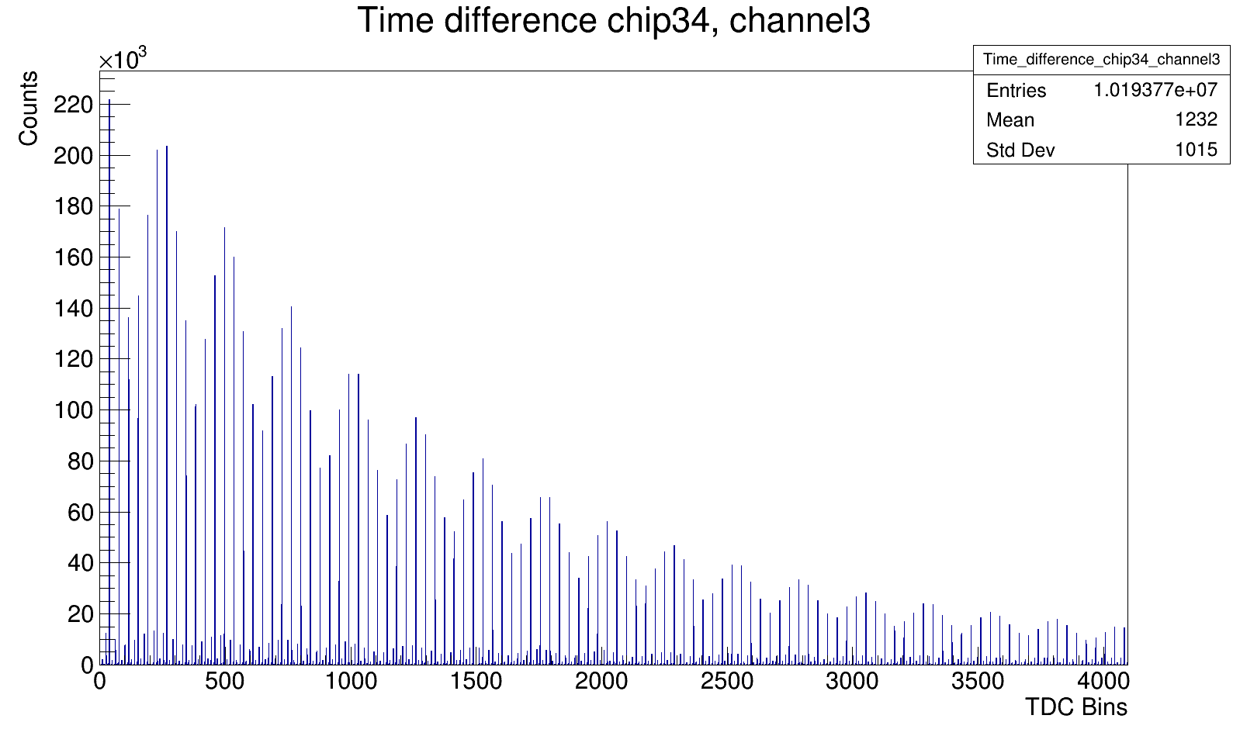
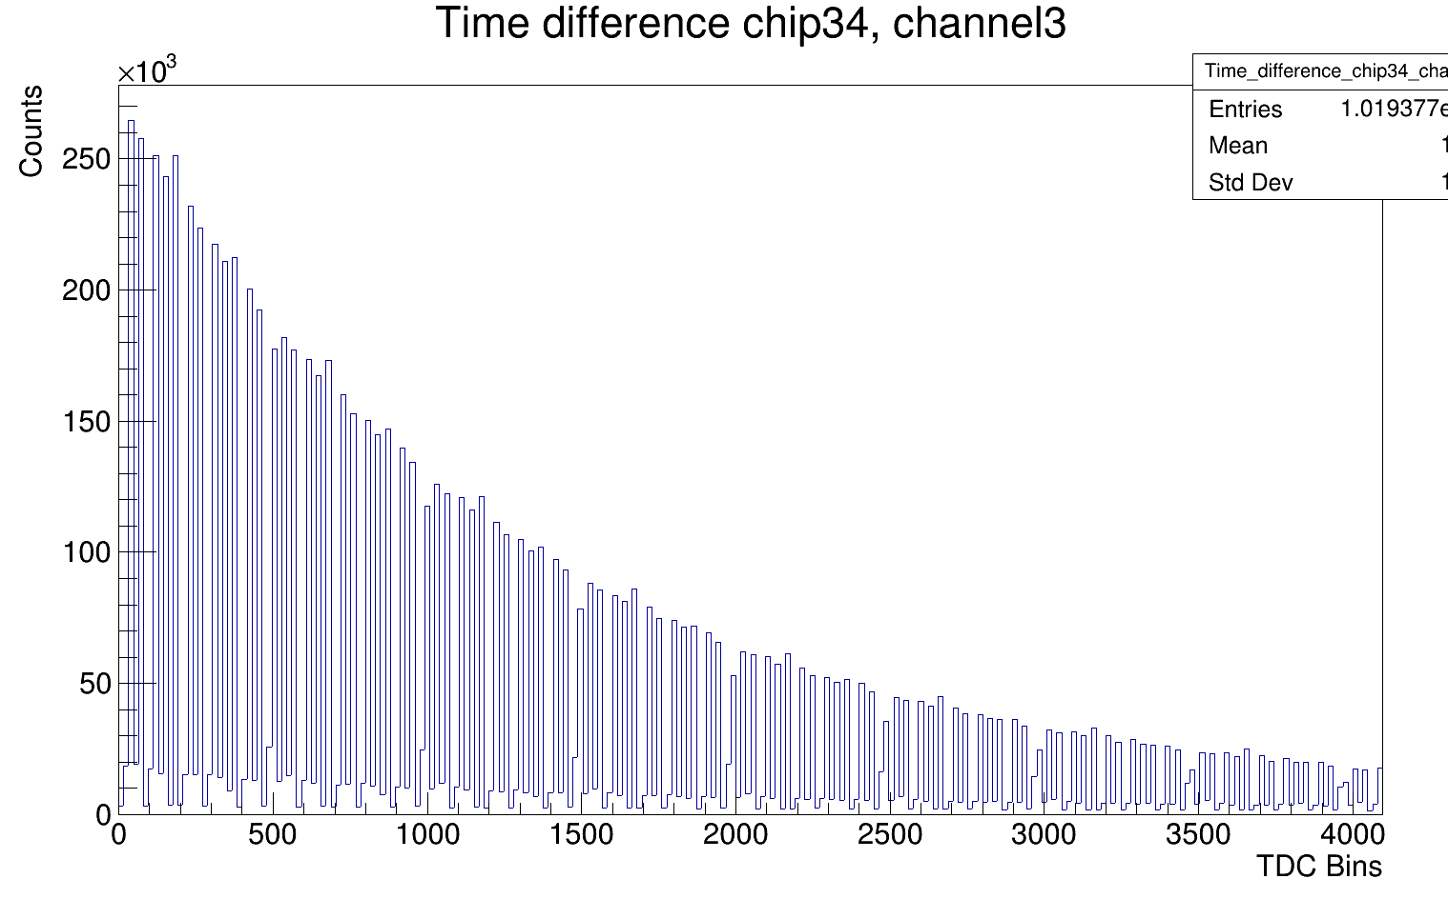
Time Distributions
Time interval between two contiguous events
Beam revolution frequency is 1MHz(td=1us)
Small modulation: time interval is not the integral times of the TDC counter (Vanish if rebin, → exponential)
1us
After rebinning 16

Slide 13
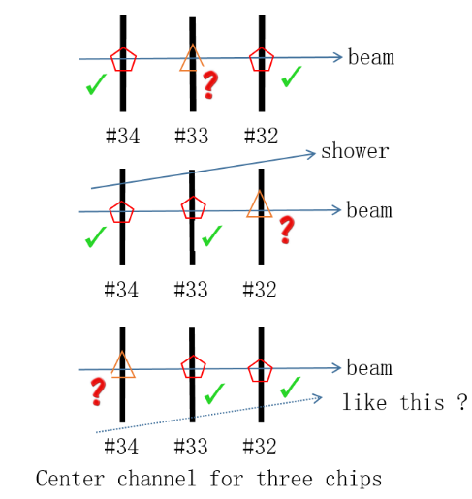
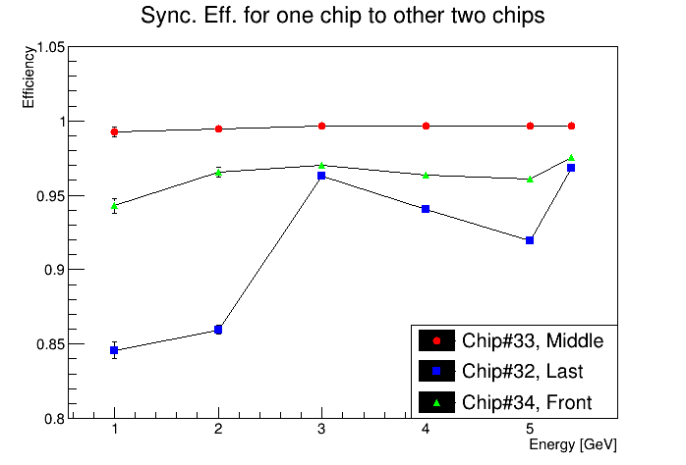
Efficiency
If two layers have the sync event, the chance for the third layer also has the sync event.
Scan for different energy/rate

Slide 14
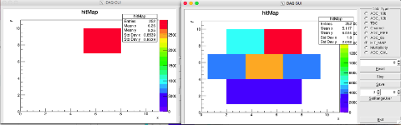
Validation
Event validation for first FIFO level
Validation: output selection
  Ideally, only the same channel have significant hits
  Noise, shower… contributes hits for others channels
  The central channel get most hits
Chip#33,
enabled channel
Chip#32,
same channel
Chip#32,
others channels
6
6

Slide 15
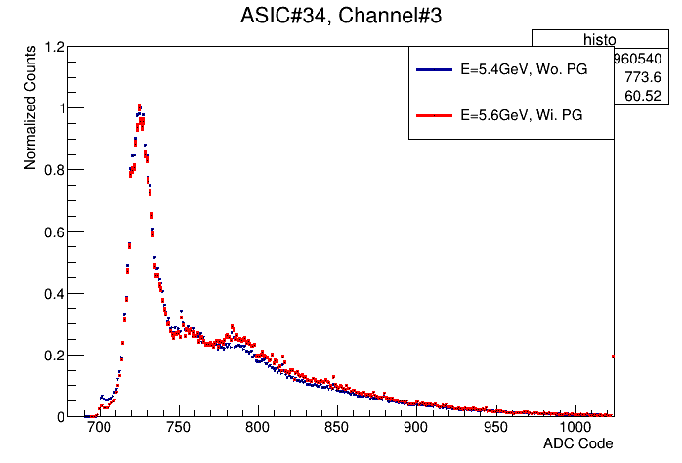
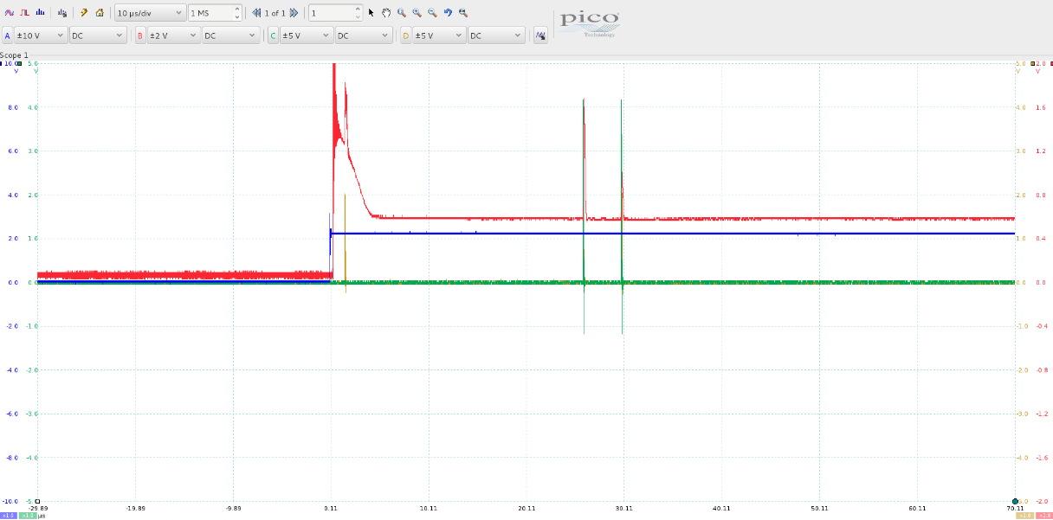
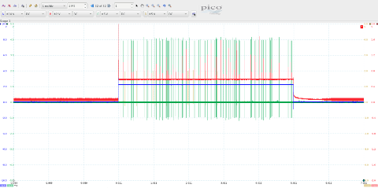
Power pulsing
Front-end bias switch on/off
  Functional
  5us to start-up and stable
  No apparent shift to the MIPs
  Dark count is small(power gating signal sync. to the beam)
~5 us
Front-end output
Power gating
trigger

Slide 16
Summary
One month ago, we got “nothing” for testbeam …
Both hardware and software …
Efforts to capture the cosmic MIP in lab but got nothing …
we finished a long list beyond expectation

Slide 17
