Slide 1





Semantic-Enhanced Differentiable Search Index Inspired by Learning Strategies
Yubao Tang¹, Ruqing Zhang¹, Jiafeng Guo¹, Jiangui Chen¹,
Zuowei Zhu², Shuaiqiang Wang², Dawei Yin², Xueqi Cheng¹
{tangyubao21b, zhangruqing, guojiafeng, chenjiangui18z, cxq}@ict.ac.cn
{zhuzuowei,wangshuaiqiang}@baidu.com
yindawei@acm.org
Notes:
Hello everyone. Welcome to today's presentation.
During this video, we'll explore a new retrieval paradigm, differentiable search index.
The title is Semantic-Enhanced Differentiable Search Index Inspired by Learning Strategies
We have dedicated considerable time to design one specific implementation of the paradigm.
let’s begin.

Slide 2



Document Retrieval
1. Information needs
2. Query
3. Relevance matching
4. Relevant documents
User
Search engine
Corpus
Notes:
Document retrieval is a vital IR task.
They employ relevance matching to sort relevant documents from the large-scale corpus.

Slide 3


Document Retrieval
Dense retrieval
Bi-encoder architecture maps queries and documents into dense representations
Similarity functions are utilized to compute relevance scores
Limitations
Difficulty in end-to-end optimization
Simplistic functions overlook the potential for fine-grained interactions
Suffering from large memory footprint
Query
Encoder
Query
Representation
Score
A consolidated model
Ranked list
Documents
Encoder
Index
Corpus
Notes:
The mainstream approach in IR is dense retrieval.
It employs the Bi-encoder architecture to map queries and documents into dense representations and further uses similarity functions to compute relevance scores
However, it still has limitations.
It cannot achieve the end-to-end optimization.
And it needs high computational costs and memory footprint.
（单击鼠标）We can observe that this process can be formalized as a sequence-to-sequence problem, and we may consider using a consolidated model to address it.
（单击鼠标）It is similar to the human thinking process, where we don't rely on matching but rather answer questions through a similar associative approach.

Slide 4
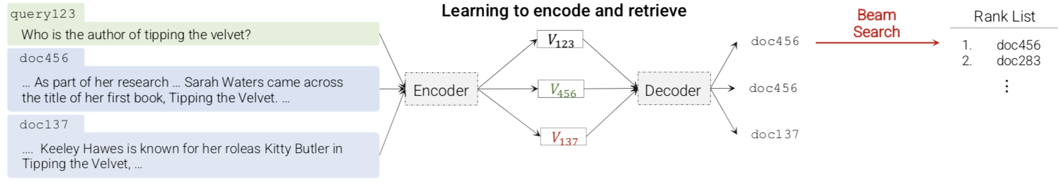
Differentiable Search Index (DSI)
The information of all the documents within a corpus is encoded into the model parameters.
Formalizing the document retrieval task as a Seq2Seq problem
Directly mapping string queries to relevant document identifiers (docids)
Advantages
Enabling the end-to-end optimization
Supporting fine-grained interaction with the model parameters
The autoregressive decoding significantly reduces the memory space and computational cost
Transformer Memory as a Diﬀerentiable Search Index, 2021, NeurIPS
Notes:
Recently, An alternative retrieval paradigm is proposed, that is Differentiable Search Index (DSI).
The information of the corpus is encoded into the model parameters.
The model can directly map queries to relevant document identifiers
This paradigm can overcome the limitations of dense retrieval.

Slide 5


Two basic tasks of DSI
The indexing task
Learning a mapping from the document content to its identifier (docid).
The index is stored in model parameters, and indexing is simply another kind of model training.
The retrieval task
Mapping queries to relevant docids
Notes:
DSI achieves this functionality by jointly optimizing two basic tasks
The first is the indexing task,
It aims to learn a mapping from the document content to its identifier (docid).
The index is stored in model parameters, and indexing is simply another kind of model training.
The second is the retrieval task, mapping queries to relevant docids

Slide 6
Challenges for DSI
How to assign an identifier to each document
A single token (arbitrary unique integer) or a string of tokens which can be arbitrary numeric string or semantic numeric string via hierarchical clustering, as the identifiers
How to learn the associations between a document and its identifier
Taking the documents as inputs and generates identifiers as outputs
Transformer Memory as a Diﬀerentiable Search Index, 2021, NeurIPS
Notes:
And It needs to further consider two challenges.
The first challenge is
how to assign an identifier to each document?
Up to now, there are several types, such as an arbitrary unique integer, or a string of tokens, which can be arbitrary numeric string or semantic numeric string via hierarchical clustering
The second challenge is
how to learn the associations between a document and its identifier?
The normal method is taking the documents as inputs and generating identifiers as outputs.

Slide 7
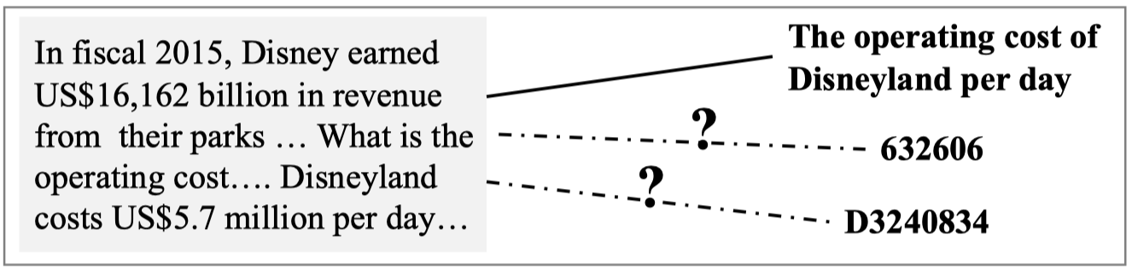

Memory and recall for humans
How does the human mind remember documents
Learning Strategies in Cognitive Psychology are intended to influence learner’s encoding process
The teaching of learning strategies, 1983, Innovation abstracts
Notes:
These problems can be related to the process of human memory and recall.
How does human remember a document and recall it better.
Cognitive psychology offers various learning strategies to address the question.

Slide 8
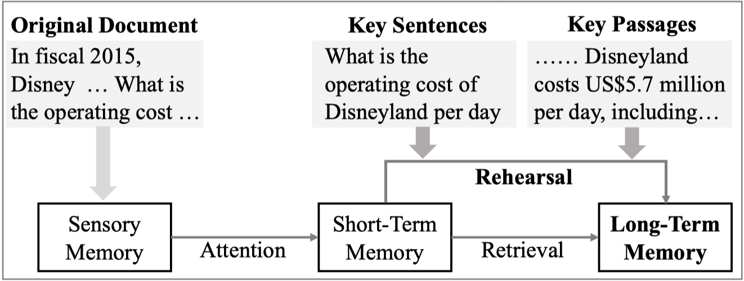
Memory and recall for humans
Elaboration Strategies
Naming a document with natural language words which have semantic relationships with it, would contribute to better encoding and recall for human brain
Rehearsal Strategies
Ones who underline the important contents in a document are able to recall substantially more information and higher long-term
Cognition: Exploring the science of the mind, 1997, WW Norton & Co
Cognitive psychology, 2005, Pearson Education New Zealand
Notes:
In Cognitive psychology, Elaboration Strategies are typical methods
Specifically, it can be that naming a document with natural language words which have semantic relationships with it.
This would contribute to better encoding and recall for human brain
Another useful method is Rehearsal Strategies
It means ones who underline the important contents in a document are able to recall substantially more information and higher long-term memory.

Slide 9
Approach

Slide 10
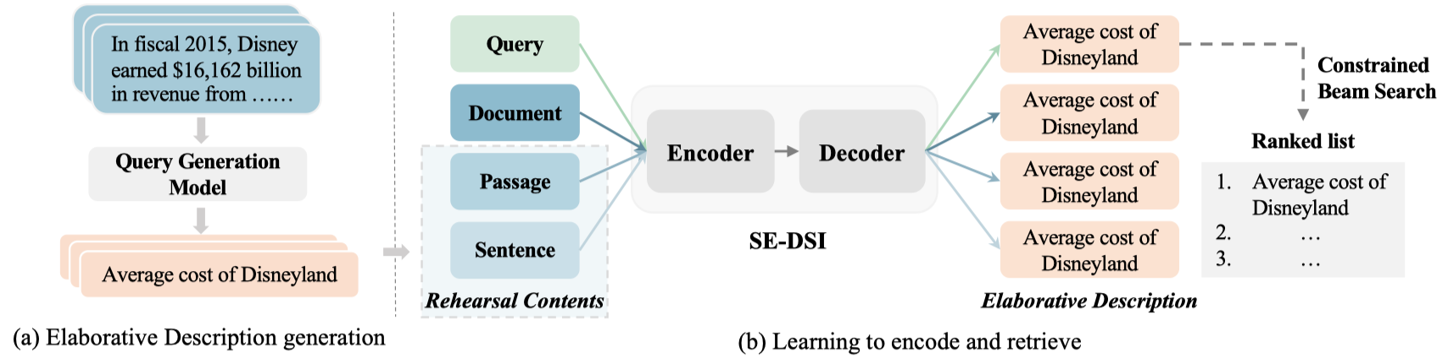
Approach
A novel Semantic-Enhanced DSI model (SE-DSI)
Elaborative Description(ED): describes the identifiers in natural language. We propose to generate ED for each document by off-the-shelf DocT5query Model.
Rehearsal Contents(RCs): we propose to select multiple important parts in a document as RCs, and the original document augmented with RCs are used to memorize the original document.
Notes:
Inspired by these learning strategies, we propose a novel Semantic-Enhanced DSI model.
We refer to it as SE-DSI for short.
On one hand, we propose the Elaborative Description as the document identifier.
It describes the identifiers in natural language. We propose to generate ED for each document by off-the-shelf DocT5query Model.
On the other hand, to enhance the indexing task, we propose Rehearsal Contents.
We select multiple important parts in a document as RCs, and the original document augmented with RCs are used to memorize the original document.

Slide 11



Approach
Rehearsal Contents(RCs)
Informative
Fluency
Diversity
Notes:
Further for the Rehearsal Contents, they need to fulfill the three conditions,,
(单击鼠标) The first is
Informative: they should contain the important information of the original document, enabling the model to learn to comprehend and encode the document into the parameters.
(单击鼠标) The second is
Fluency: they should be fluent and readable for the model to acquire the text encoding ability.
(单击鼠标) The third is
Diversity: they should contain different granularity of semantic units (e.g., the sentence- and passage-level), so as to achieve elaboration of the document for storage enhancement.

Slide 12
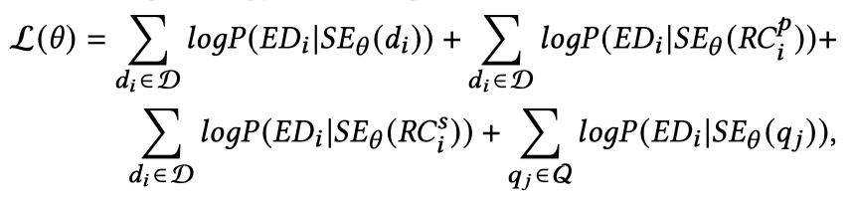
Approach
Rehearsal Contents(RCs)
Leading-style
directly use the leading passages and sentences of each original document as RCs
Summarization-style
leverage the document summarization technique to highlight multiple important parts that can reveal the essential topics of the document
Notes:
Specifically, we design two types:
The first is the leading-style.
It directly use the leading passages and sentences of each original document as RCs.
The second is the summarization-style.
It leverages the document summarization technique to highlight multiple important parts that can reveal the essential topics of the document.

Slide 13
Offline and online experiments
Notes:
We conduct both offline and online experiments.

Slide 14
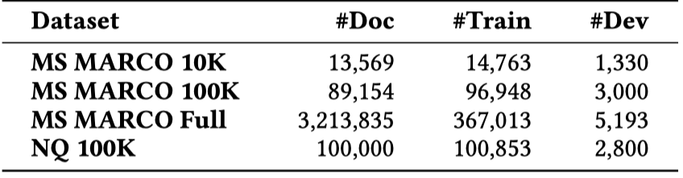
Offline experiments settings
Datasets
Baselines
Traditional document retrieval methods
BM25, RepBERT
DSI methods
DSI-ARB(arbitrary unique integer), DSI-SEM(semantic structured number)
DSI-QG
Notes:
For the offline experiments, we use the representative ad-hoc retrieval datasets, MS MARCO and Natural questions.
The baseline contains two types, namely the traditional document retrieval methods, and DSI methods.
For the traditional document retrieval methods, we choose the typical term-based method, BM25, and a dense retrieval method, RepBERT.
For the DSI methods , we choose the DSI-ARB ,it uses aribitrary unique integer as the docid.
And DSI-SEM uses semantic structured number as the docid.
DSI-QG uses a data augmentation technique, for the indexing task, it transform the documents as pseudo queries, and directly learn the relationships between the pseudo queries to their docids.

Slide 15
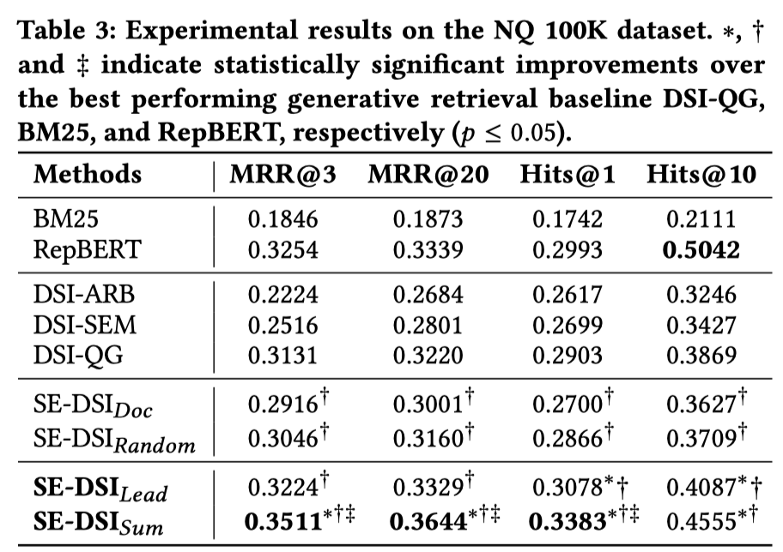
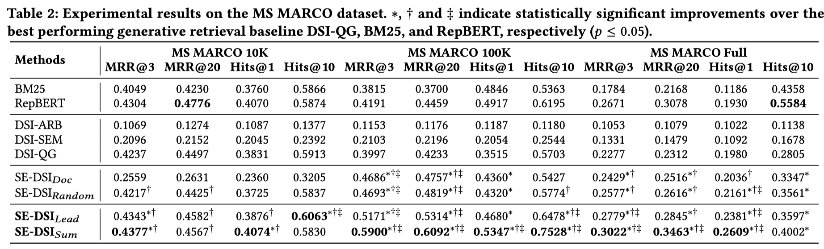
Offline Experimental results
Main results
SE-$DSI_{Lead}$and SE-$DSI_{Sum}$can perform significantly better than strong baseline solutions
Notes:
The main results show that both leading-style and summarization-style SE-DSI can perform significantly better than strong baseline solutions

Slide 16
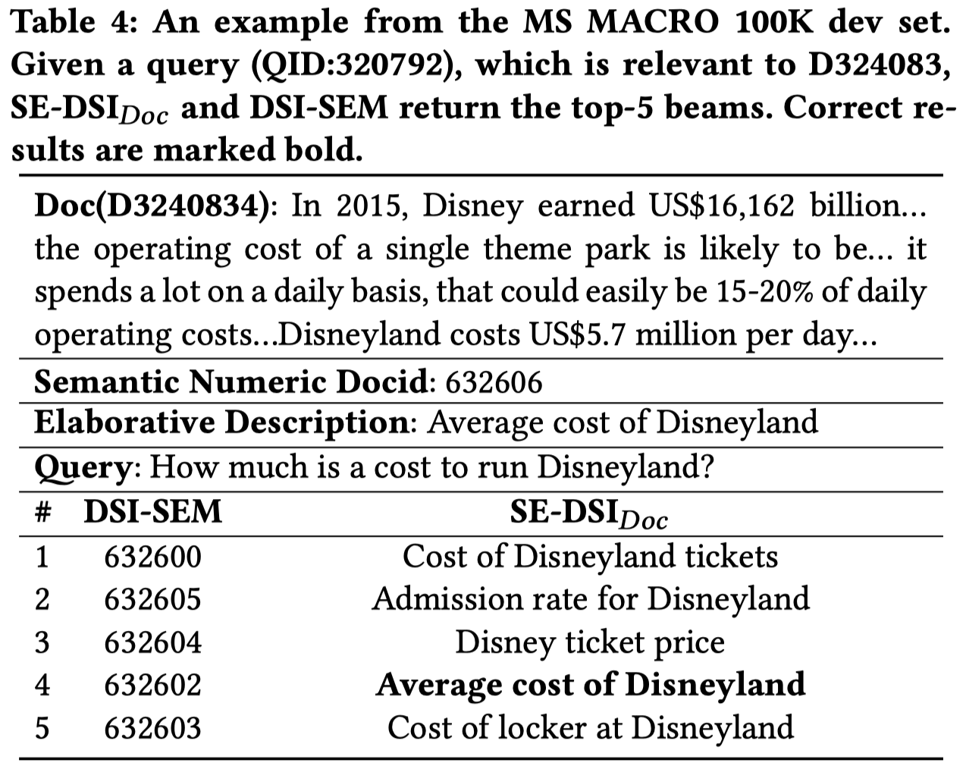
Offline Experimental results
Analysis on elaborative description
These results indicate the effectiveness of representing a document with our proposed ED as the docid, which is a natural language text containing enhanced semantic meanings.
Notes:
We conduct a case study to analysis the elaborative description.
We sample an example from MS MARCO.
Given the same query, DSI-SEM generates the semantic structured numbers, and our method generates the elaborative descriptions.
These results indicate the effectiveness of representing a document with our proposed ED as the docid, which is a natural language text containing enhanced semantic meanings.

Slide 17
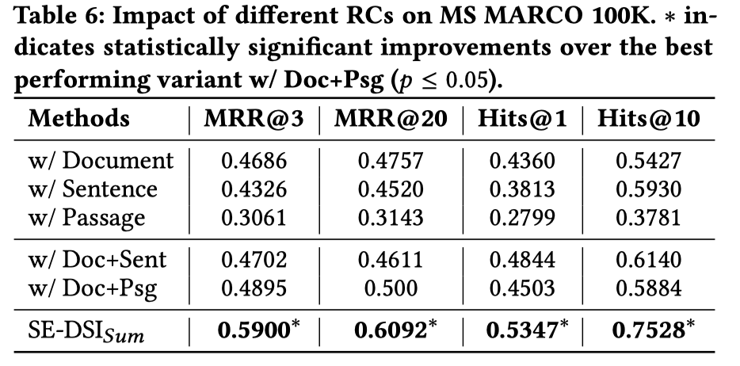
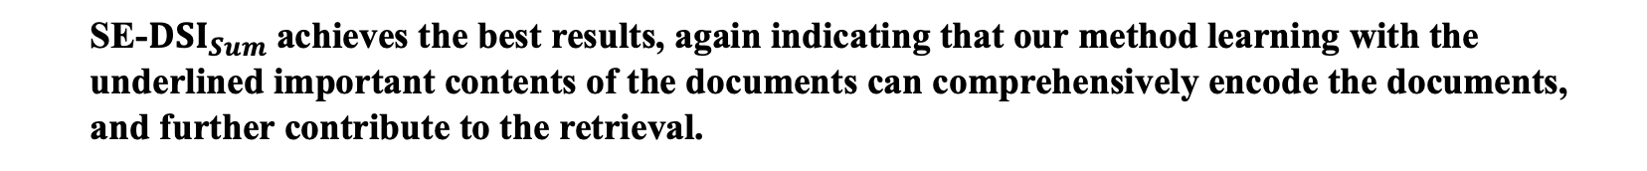
Offline Experimental results
Analysis on rehearsal contents
SE-$DSI_{Sum}$achieves the best results, again indicating that our method learning with the underlined important contents of the documents can comprehensively encode the documents, and further contribute to the retrieval.
Notes:
To analysis the impact of the rehearsal contents , we conduct the ablation study.
The summarization style of our method achieves the best results, again indicating that our method learning with the underlined important contents of the documents can comprehensively encode the documents, and further contribute to the retrieval.

Slide 18
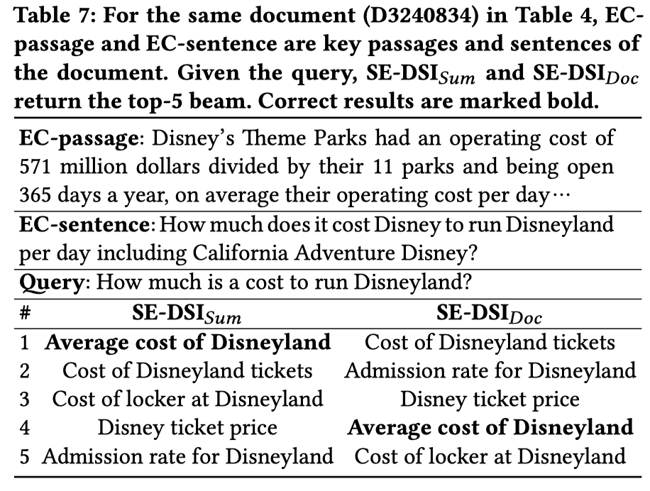
Offline Experimental results
Analysis on rehearsal contents
Augmenting key information does help document memorization and distinguish similar documents.
Notes:
We also conduct a case study for the rehearsal contents.
For the same document, we compare the generated docids by the summarization style and the normal style.
We find that augmenting key information does help document memorization and distinguish similar documents.

Slide 19
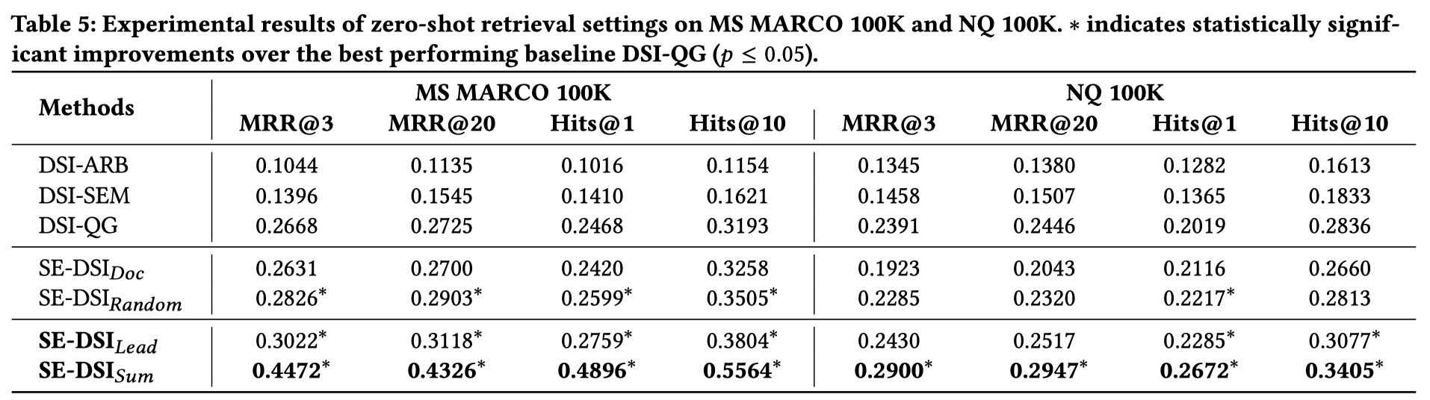
Offline Experimental results
Zero-shot setting
only performing indexing without the retrieval task
ED and RCs help the model to encode all the information about the corpus into the model parameter and SE-DSI works like a human with a knowledgeable brain.
Notes:
We also conduct zero-shot setting.
The model only performs the indexing without the retrieval task
ED and RCs help the model to encode all the information about the corpus into the model parameters and our method works like a human with a knowledgeable brain.

Slide 20

Online A/B Experiments
Site Retrieval task (Applied in Baidu search)
The user may specify his/her information needs through a query for official sites.
Official sites are defined as Web pages that have been operated by universities, departments, or other administrative units
Notes:
Furthermore, we applied our method in the Baidu search engine.
It is the biggest Chinese search engine.
In practical, the user may specify his/her information needs through a query for official sites.
Official sites are defined as Web pages that have been operated by universities, departments, or other administrative units.
Due the requirements of high reliability and authority, therefore, the Baidu search engine sets up a dedicated business task, to return relevant official sites.
Since the total number of the official site URL set is moderate, and the update frequency is lower than other retrieval scenarios, it is suitable to apply the DSI paradigm for official site retrieval.

Slide 21
Online A/B Experiments
Datasets
Site URL
Site name
Site Domain
ICP record ( a registration name)
Web page
Evaluation Metrics
Site-level Recall@k: the predicted site URL is completely consistent with the ground-truth site URL.
Domain-level Recall@k: the predicted site URL and the ground-truth site URL are in the same site domain.
www.apple.com
Apple official site
apple.com
Notes:
The dataset contains the following terms, site url, site name, domain and web pages
We evaluate the methods with Site-level Recall and Domain-level Recall

Slide 22
Online A/B Experiments
Baselines
DualEnc
An Ernie-based dual-tower architecture model
It needs to learn a query encoder and a site encoder with (query, site attributes) pairs, where the site attributes use the site name, ICP record, and web page contents.
SingleTow
A single-tower method, including an Ernie-based encoder and a feed-forward layer, in which the weight is initialized with the site representations learned from DualEnc.
During training, it takes the query as input, and the output logits of the feed-forward layer are passed through a softmax function, generating a probability distribution of sites.
The probability of each site serves as the relevance score.
Notes:
We have two baselines of baidu.
The first one is Dual encoder , it is an Ernie-based dual-tower architecture model
The second is SingleTower, it includes an Ernie-based encoder and a feed-forward layer,
in which the weight is initialized with the site representations learned from DualEnc.
During training, it takes the query as input, and the output logits of the feed-forward layer are passed through a softmax function, generating a probability distribution of sites.
The probability of each site serves as the relevance score.

Slide 23
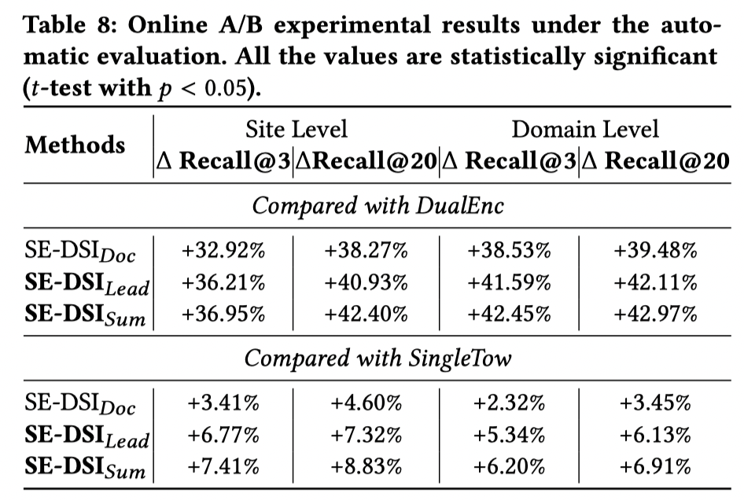
Online A/B Experiments Results
For SE-DSI, the site representation is in the form of model parameters, making the query interact with global information, which is more flexible and deeper than explicit similarity functions.
Notes:
The online A/B experimental results show that, our SE-DSI gains the best performance.

Slide 24
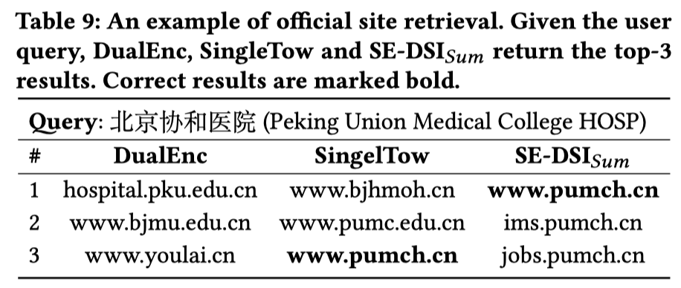
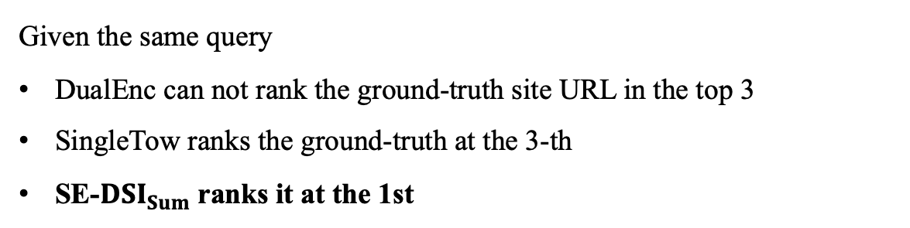
Online A/B Experiments Results
Given the same query
DualEnc can not rank the ground-truth site URL in the top 3
SingleTow ranks the ground-truth at the 3-th
SE-$DSI_{Sum}$ranks it at the 1st
Notes:
There is a case.
Given the same query, our method can generate the ground-truth docid at the first position, while other two baselines cannot.

Slide 25
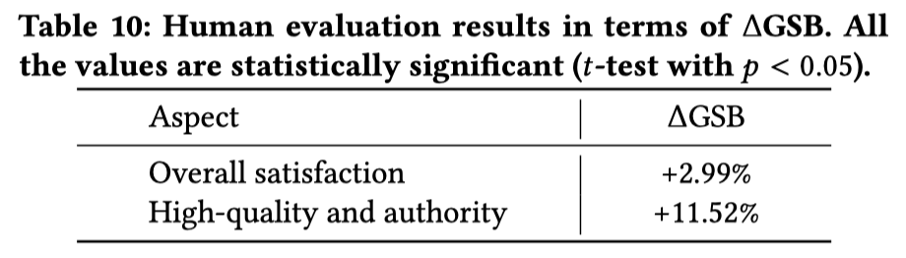
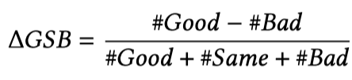
Online A/B Experiments Results
Side-by-side comparison
SE-DSI has achieved significant positive gains in terms of both aspects
Notes:
We further conduct human evaluation, SE-DSI has achieved significant positive gains in terms of both aspects.

Slide 26
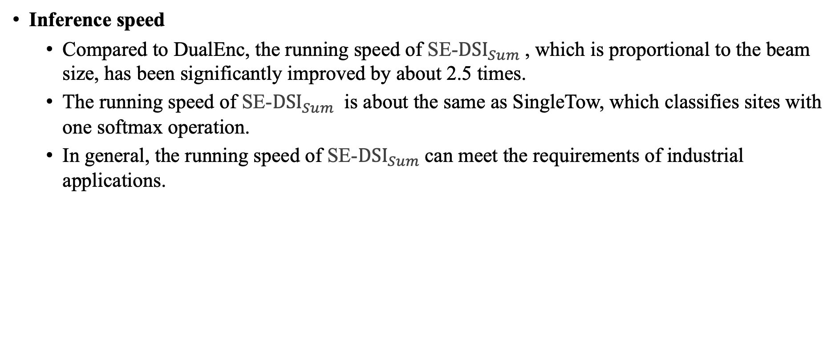
Online A/B Experiments
Inference speed
Compared to DualEnc, the running speed of SE-$DSI_{Sum}$, which is proportional to the beam size, has been significantly improved by about 2.5 times.
The running speed of SE-$DSI_{Sum}$ is about the same as SingleTow, which classifies sites with one softmax operation.
In general, the running speed of SE-$DSI_{Sum}$can meet the requirements of industrial applications.
Notes:
Considering the practical use, we also evaluate the inference speed.
In general, the running speed of our method can meet the requirements of industrial applications.

Slide 27
Conclusion
Designing a proper generative model to“memorize”the whole corpus for document retrieval remains a challenge.
Inspired by learning strategies, we have proposed SE-DSI to advance the original DSI, which takes the input of the original document augmented with RCs containing important parts and outputs the ED with explicit semantic meanings.
The offline experimental results on several representative retrieval datasets demonstrated the effectiveness of our SE-DSI model.
The online evaluation again verified the value of this work.
Notes:
Finally, to summarize our work,
designing a proper generative model to“memorize”the whole corpus for document retrieval remains a challenge.
Inspired by learning strategies, we have proposed SE-DSI to advance the original DSI, which takes the input of the original document augmented with RCs containing important parts and outputs the ED with explicit semantic meanings.
The offline experimental results on several representative retrieval datasets demonstrated the effectiveness of our model.
The online evaluation again verified the value of this work.

Slide 28



Future work
Dynamic Corpora
New Architecture
Learning
Notes:
As a novel document retrieval paradigm, the performance of DSI models remains a large room to be improved.
In future work, we would like to focus on the following directions
In the view of the
(单击鼠标) Scenario: the document corpus is usually dynamic in real-world search engines;
(单击鼠标) Architecture: there is potential in exploring to use other model architectures or yet to come larger autoregressive models;
(单击鼠标) Learning: how to define learning strategies and identifiers, etc.

Slide 29
Thank you!
Notes:
Thank you for joining me today. I hope this presentation has provided valuable insights into the new retrieval paradigm.
I'm grateful for the support and guidance of my advisors and colleagues.
Thank you once again for your attention. Have a wonderful day!

