Slide 1
Version Control with Git
Open Source Distributed Goodness

Slide 2
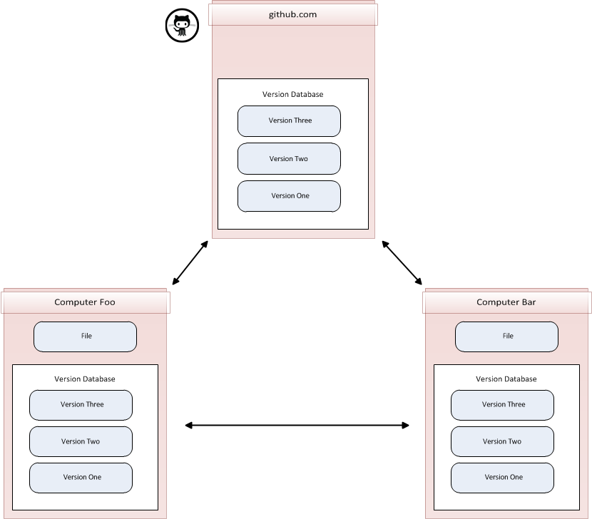
Distributed Version Control

Slide 3
github Preliminaries
git { http://git-scm.com/ }
github:help { https://help.github.com/ }
git:download { http://git-scm.com/downloads }
Pro Git { http://git-scm.com/book }
Configure Name
git config --global user.name “Your Name”
Configure Email
git config --global user.email “youremail@web.com”
Configure SSH Keys
If your project files are >= 1GB in total size then you cannot use github *

Slide 4
The Essentials
Clone a Repository
git clone git@github.com:sbaskin89/REU-2012.git
Add files
git add *
git add *.c
git add Rectangle.java
Committing the Files
git commit –m “Brief description of changes.”
Push to Master
git push origin master
Fetch from Master (does not merge files)
git fetch origin
Pull from Branch/Master (does merge files)
git push origin master
Branch
See Chapter 3 in Pro Git
Merge
See Chapter 3 in Pro Git
Notes:
You will do this first with the repository assigned to you.

Slide 5
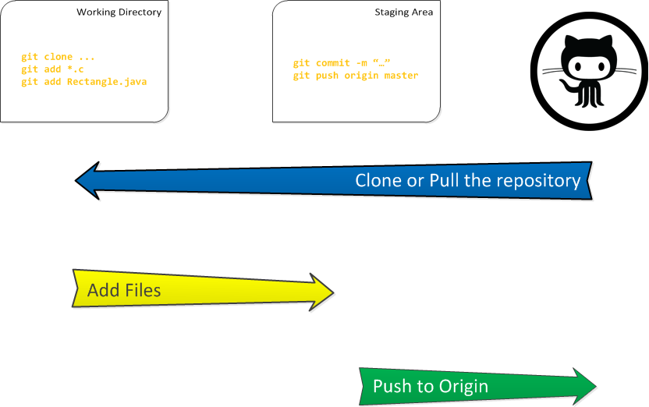
In a nutshell…

