Slide 1
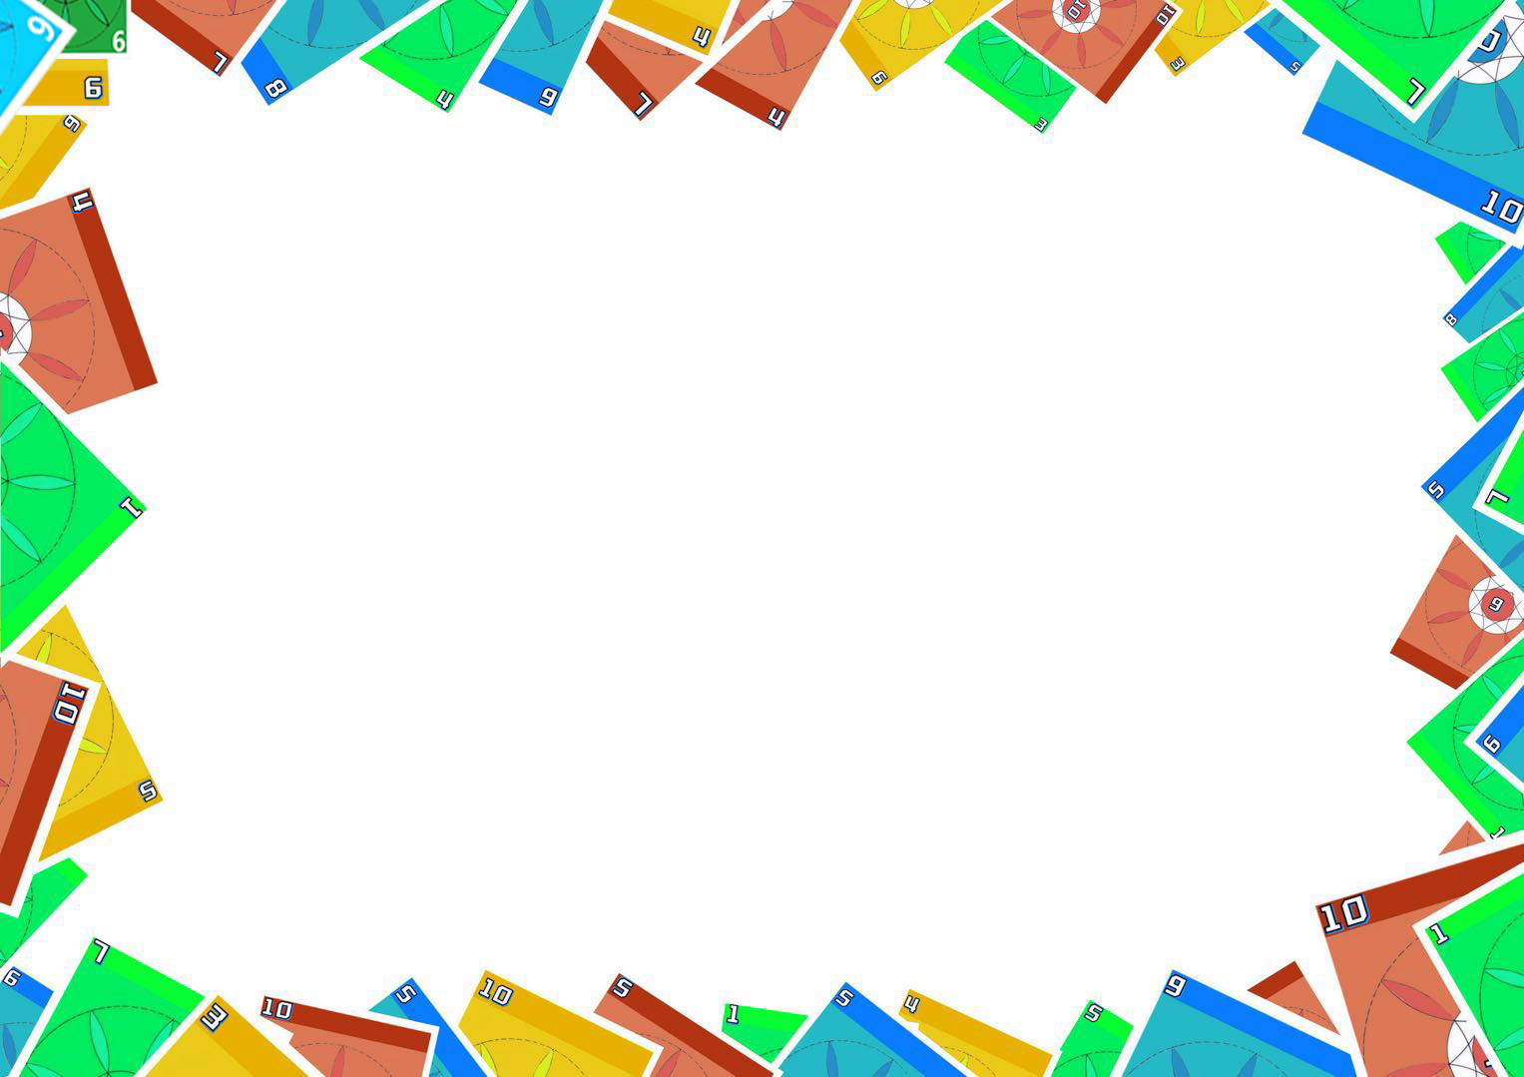
C o u r s e w o r k 2
Group Project Presentation
—Notty: A Card Game with Pygame
Team Member:
Mingxin Cao/Xinyu Liu/Xiuyuan Tao/Tzu Chun Yu/Siwen Zhao
COMP4008 Programming University of Nottingham

Slide 2
1
Xiuyuan Tao
UI design and frontend interaction
2
Siwen Zhao
Team and
frontend GUI development, UI and frontend interaction design
Roles
3
Tzu Chun Yu
Backend logic development, Final code acceptance person
4
Mingxin Cao
Backend logic development, coordination, and support
5
Xinyu Liu
Code and feature testing

Slide 3
Perfect teammates
Every member of the team was extremely dedicated and put in significant time and effort.
While completing their own tasks, they also actively helped other teammates.
Since the formation of our group, we have held a total of seven team meetings.
Detailed meeting minutes and email summaries were created for each session, and these records can be found in the "Basic Info" file of our submitted documents.
5

Slide 4
PROJECT OVERVIEW
Our project was managed using GitHub.
Click and see more
Click to play demo

Slide 5
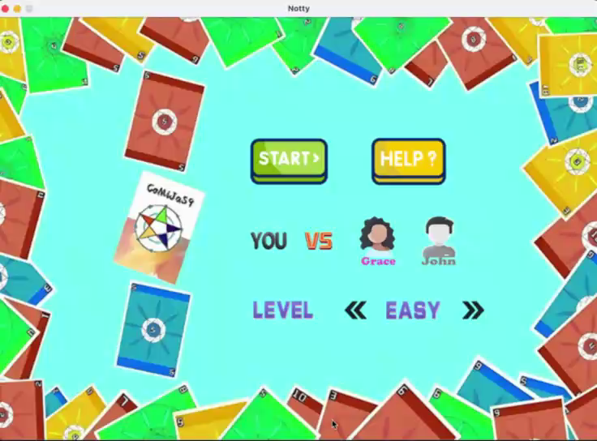

Slide 6
Special Design
is
special
the
what
part
81%
90%
40%
53%
26%

Slide 7
Easy Mode
Human Player:
A victory assistance mechanism is included, ensuring that human players always draw or steal cards that can form valid group.
AI Player:
Randomly select an action from the action pool (self.ai_actions_pool):
➡️discard, draw, steal, skip.
1. If discard is chosen:
➡️If discarding is possible, perform the action, then re-select randomly.
➡️If discarding is not possible, re-select a different action.
2. If draw or steal is chosen:
➡️Can only be executed once per turn, then removed from the action pool and re-selected.
3. If skip is chosen:
➡️The turn ends immediately.
Special
Design

Slide 8
Medium Mode
AI Player ➡ Calculate ️
If the hand can form a valid set, prioritize the discard action.If discarding is not possible, attempt other actions.
Behavior selection based on calculated score:
Calculate the percentage of forming a valid set for each possible action and execute the action with the highest percentage.
Percentage calculation rules:
➡️Draw: The probability is based on drawing 1, 2, or 3 cards. The more cards drawn, the higher the probability of forming a valid group.
➡️Steal: The probability is evaluated based on the opponent's hand. If the opponent's hand has fewer than 5 cards, the steal percentage is 0.
➡️Skip: Fixed at the lowest percentage. This option is chosen only if all other actions have lower scores.

→

Special
Design




Action limitations:
Each turn, draw and steal can only be executed once.
Discard can be repeated until it is no longer possible.



Slide 9
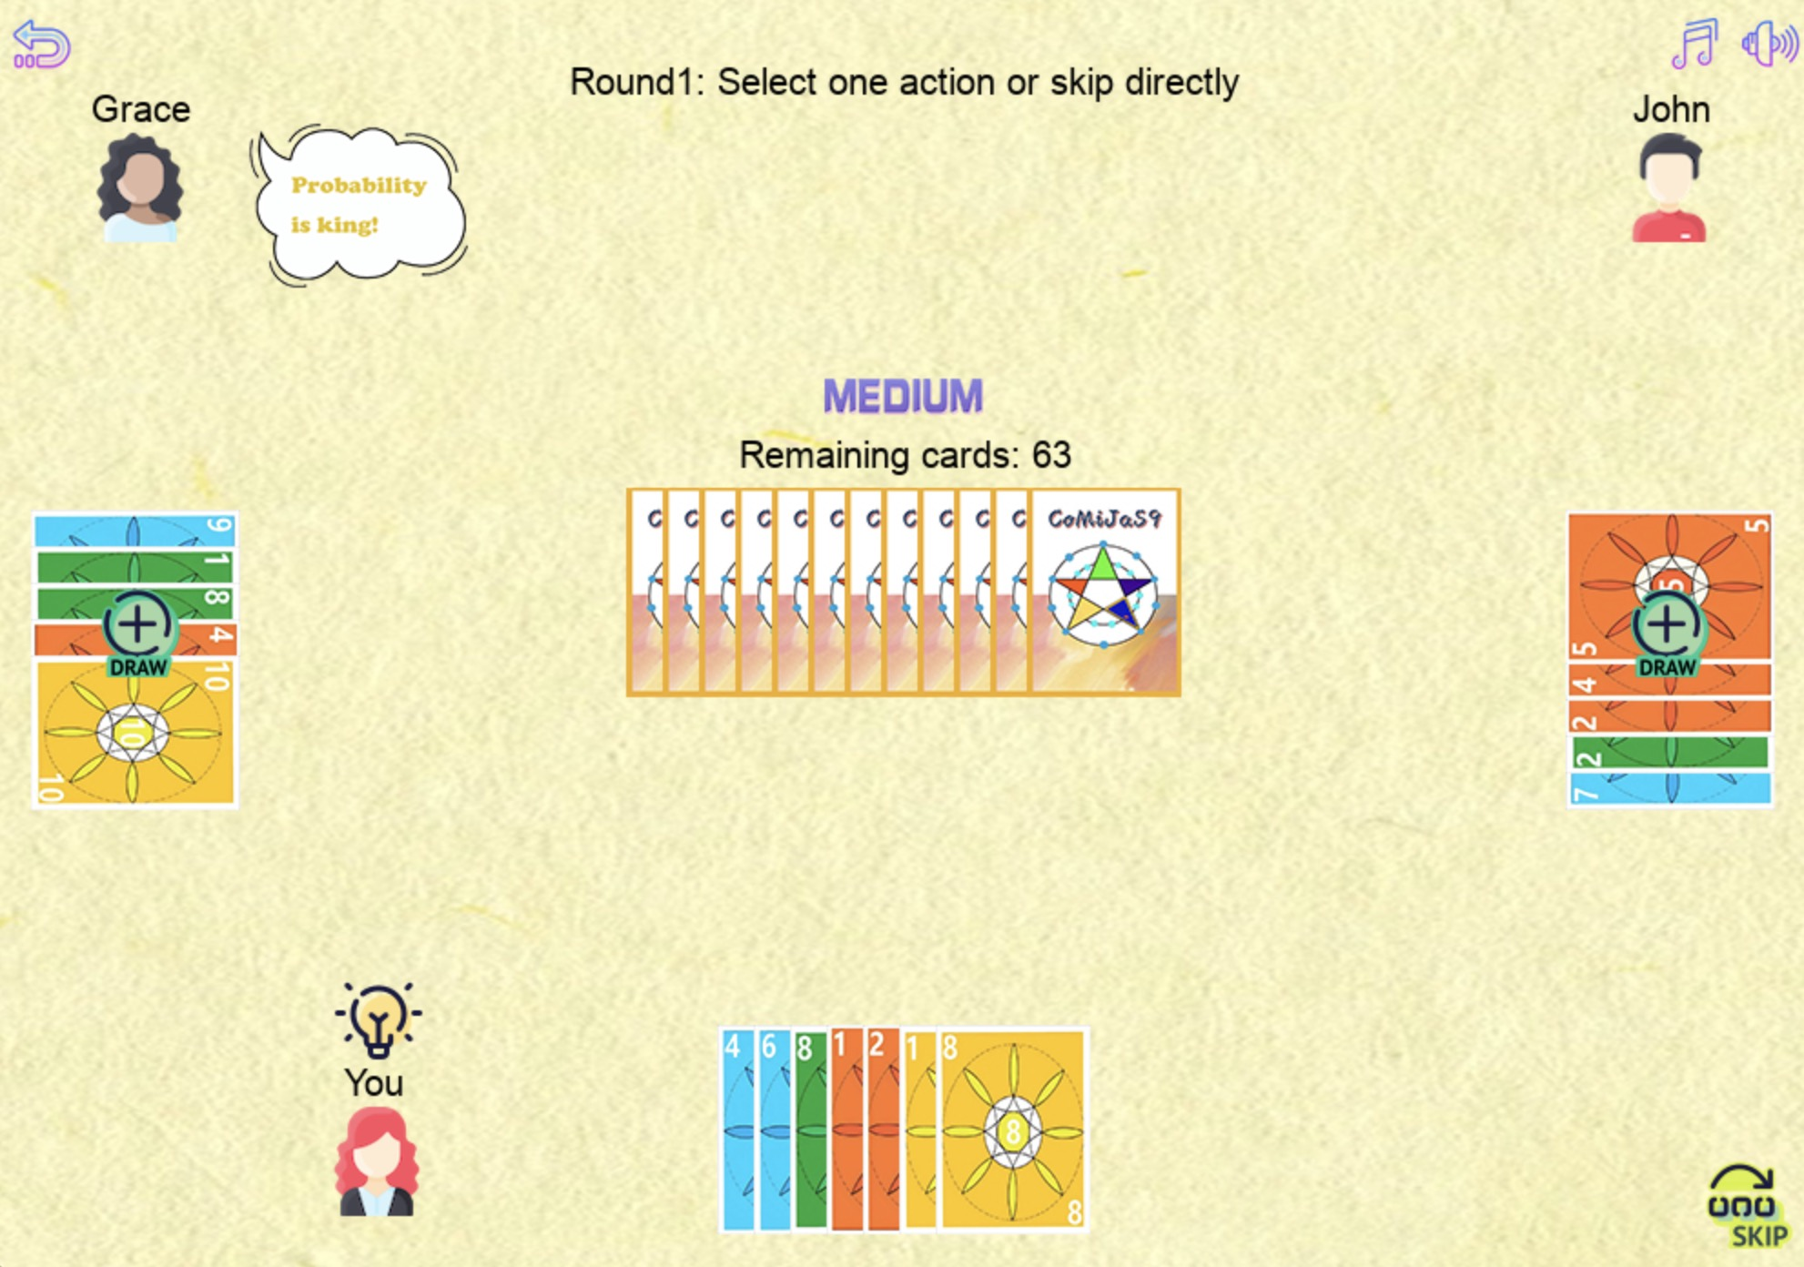

Slide 10
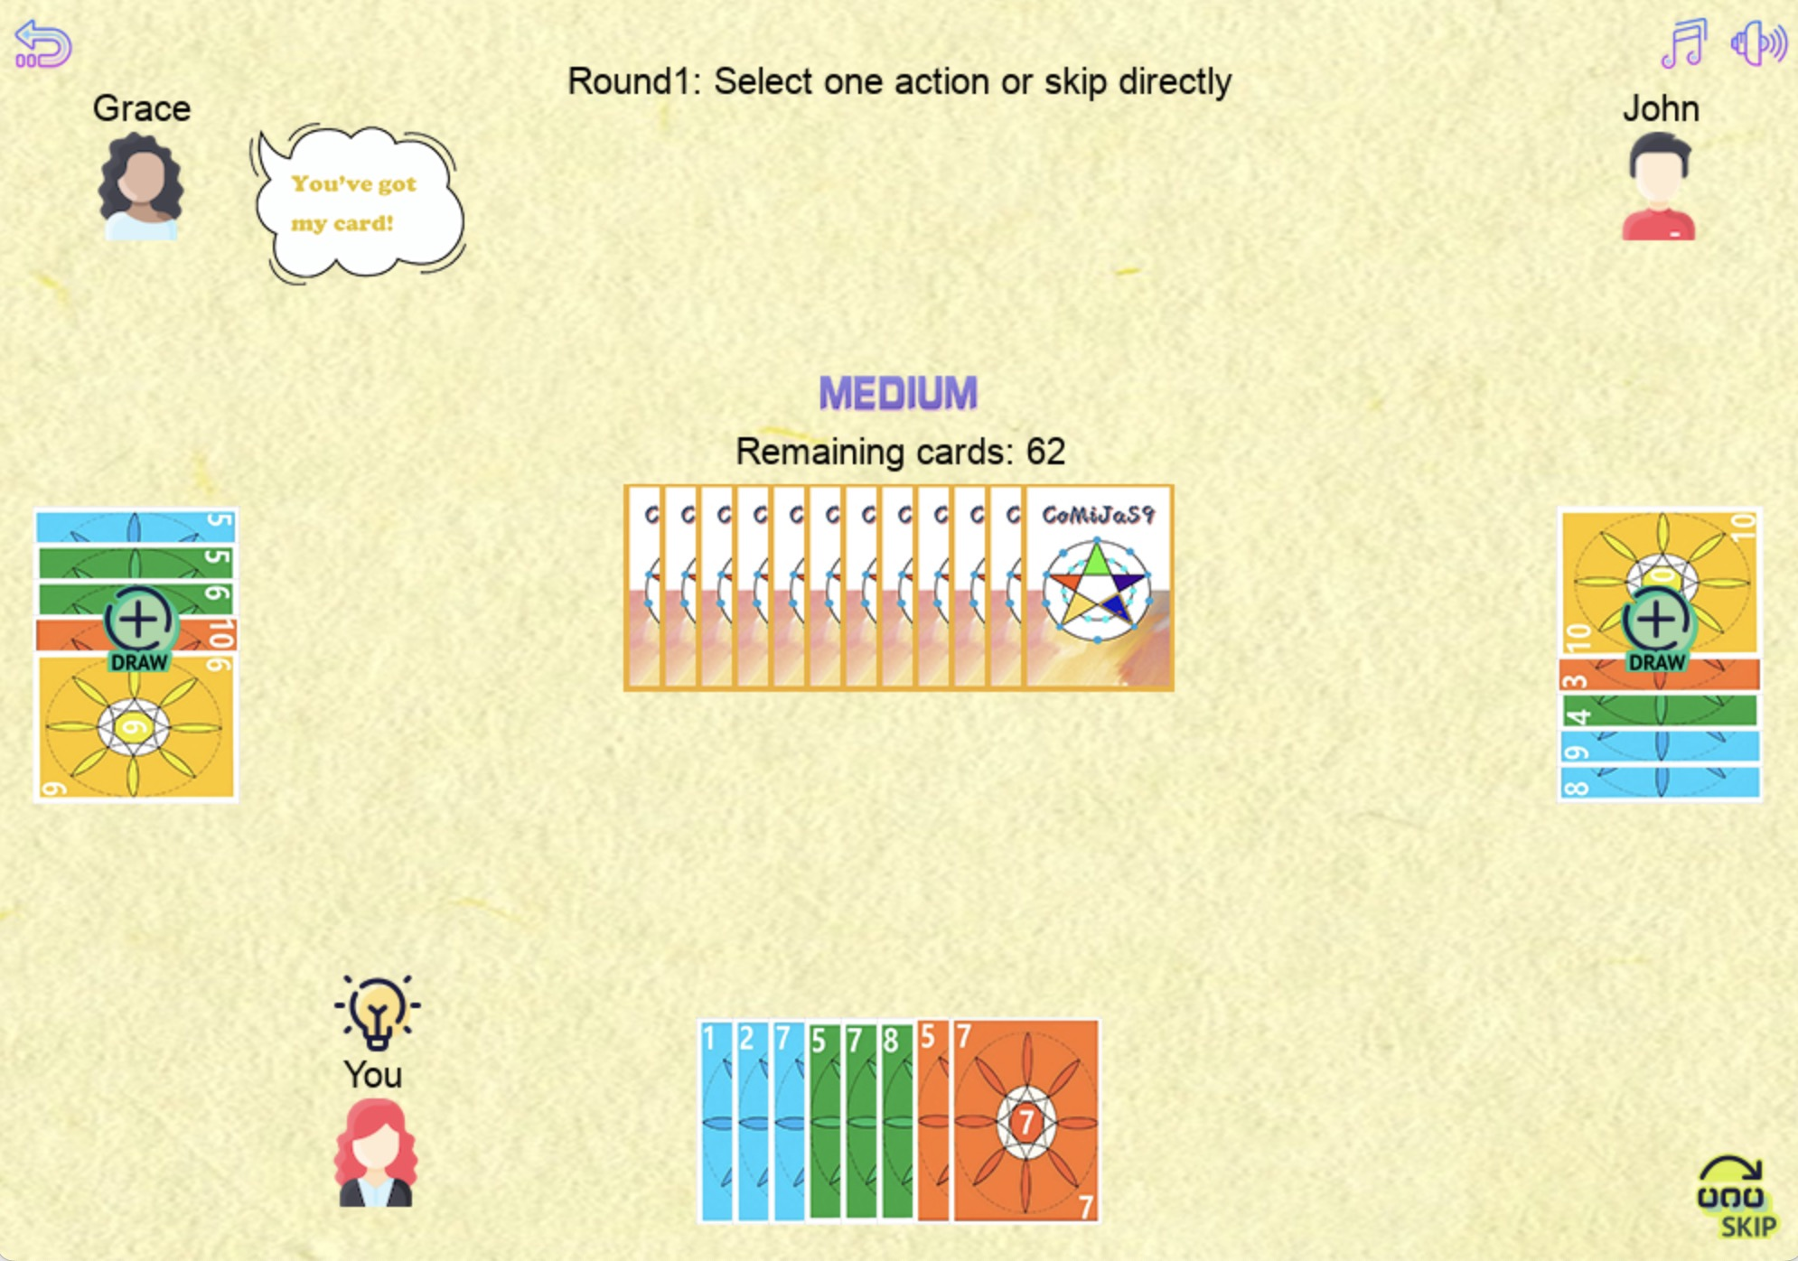

Slide 11
Hard Mode
AI Player ➡ Disrupt️
Hard Mode builds on Medium Mode by adding logic to disrupt opponents:
Disrupt Opponents:
Analyze the probability of opponents forming valid group.
When an opponent has a higher probability of discarding than the player and holds more than 1 card, prioritize the steal action.
w
a

Slide 12
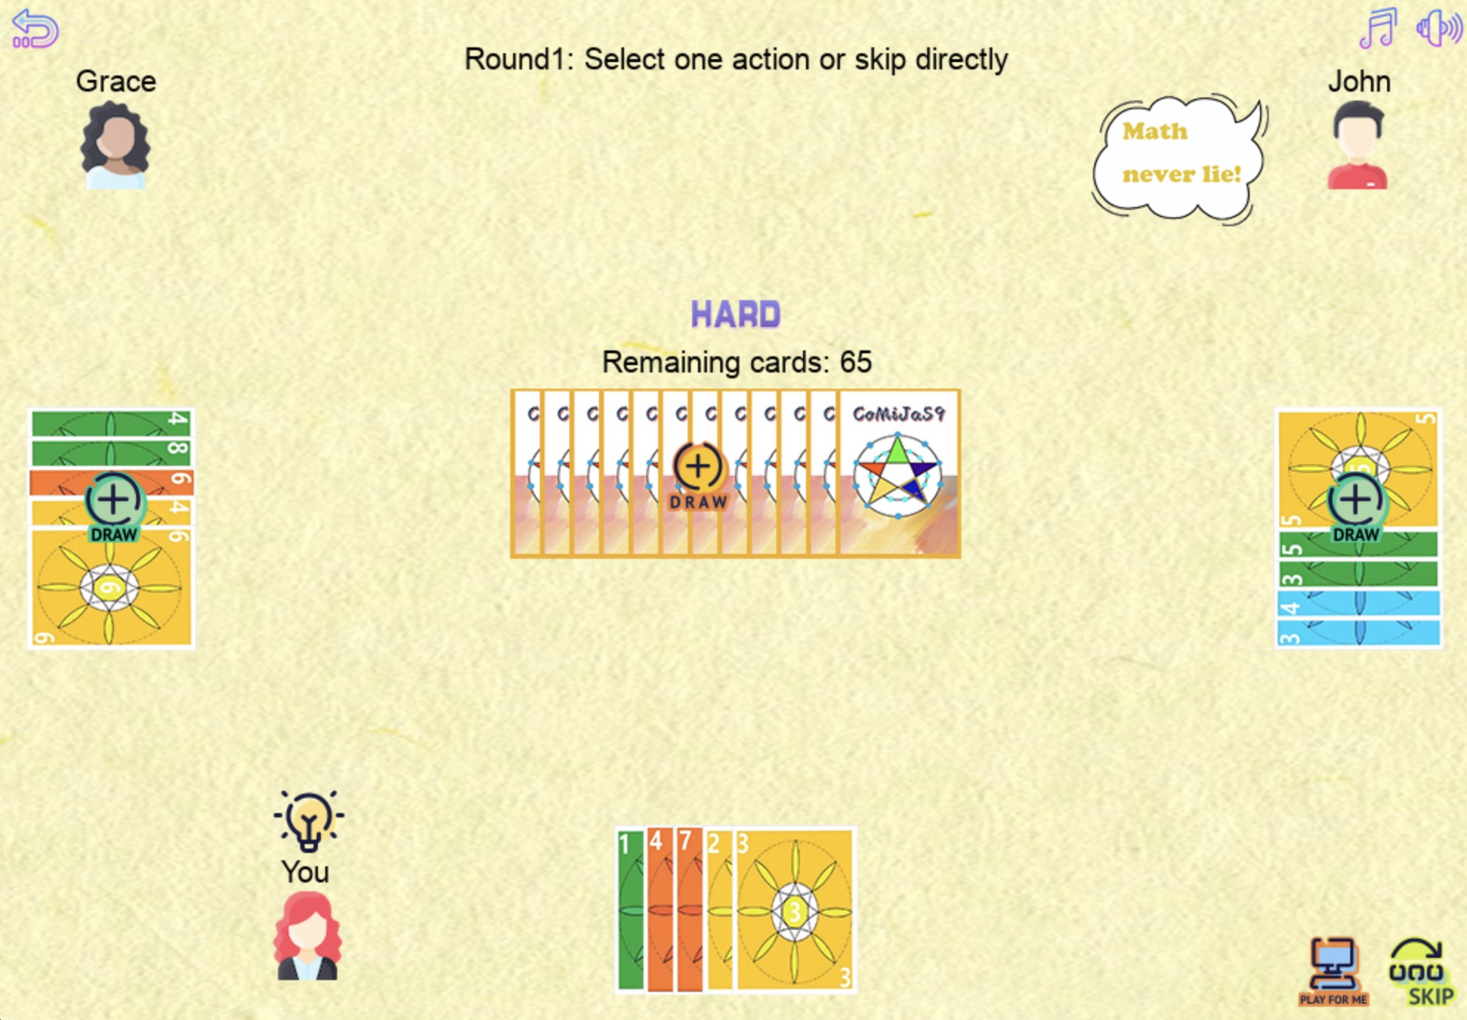

Slide 13
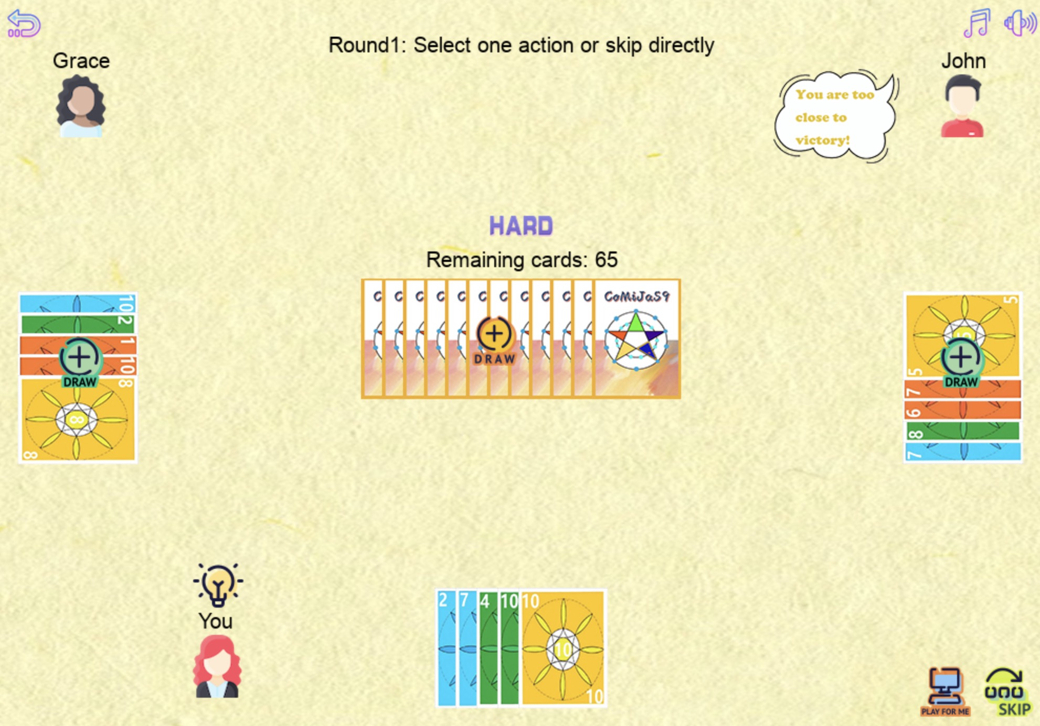

Slide 14
T H A N K S !
Questions are welcome
We would like to express our heartfelt gratitude to all the team members for their dedication, hard work, and collaboration throughout this project.
﻿
We extend our sincere thanks to Dr. Colin Johnson and Dr. Daniel Karapetyan for their excellent teaching and guidance throughout the semester in the Programming course.
﻿
Additionally, we are deeply thankful to our teaching assistants, Rongjun Dong, Cas Widdershoven, and Susan Ali, for their consistent support and assistance.
﻿
Your guidance has made this learning experience truly enriching.

