Slide 1
Code Discussion
4/12/2022

Slide 2
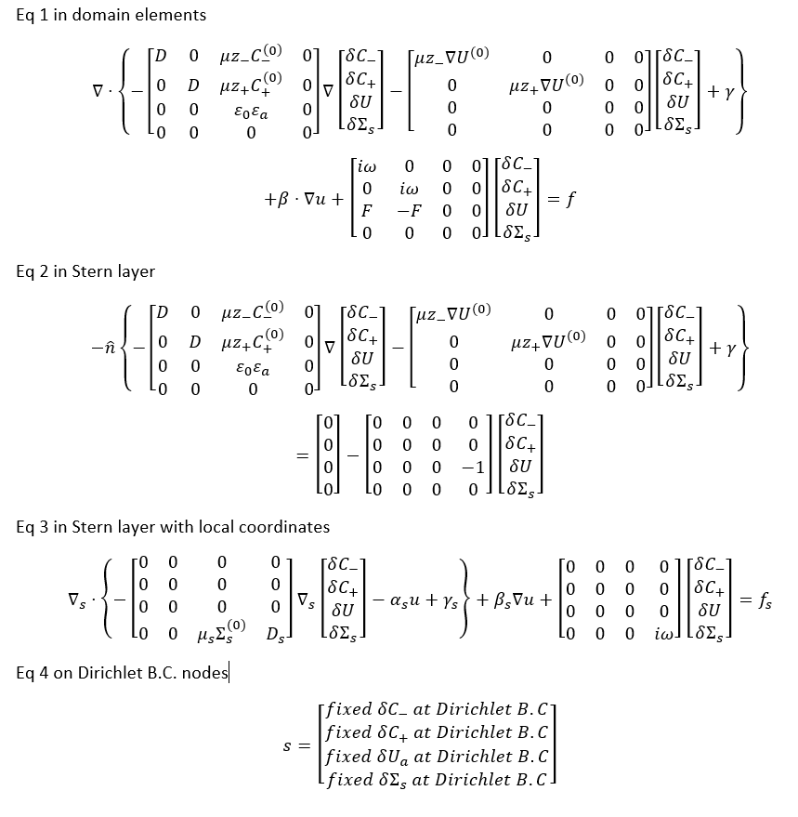
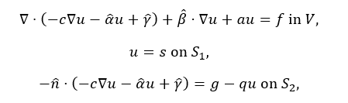






Equations
$$\left[c\right]$$
$$\left\{u\right\}$$
$$\left[\hat{α}\right]$$
$$\left[a\right]$$
$$\left\{g\right\}$$
$$\left[q\right]$$

Slide 3
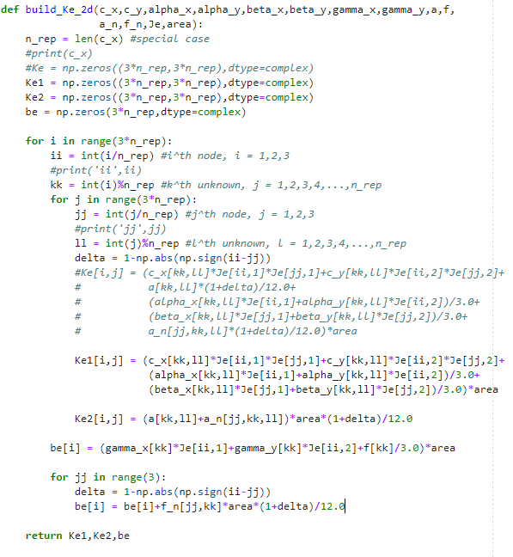






$$\left[c\right]$$
$$\left\{u\right\}$$
$$\left[\hat{α}\right]$$
$$\left[a\right]$$
$$\left\{g\right\}$$
$$\left[q\right]$$

Slide 4
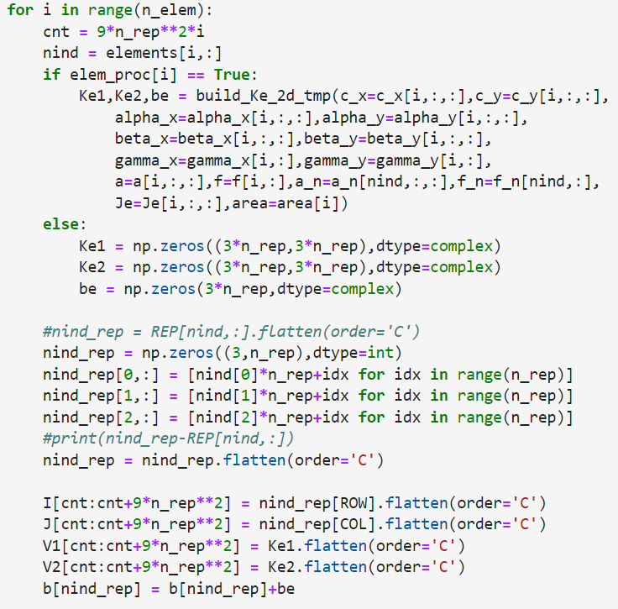
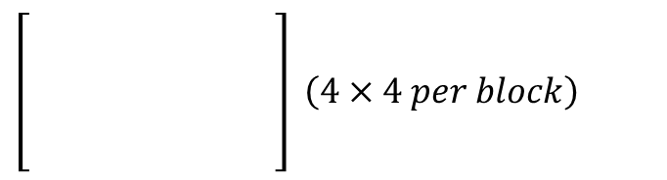
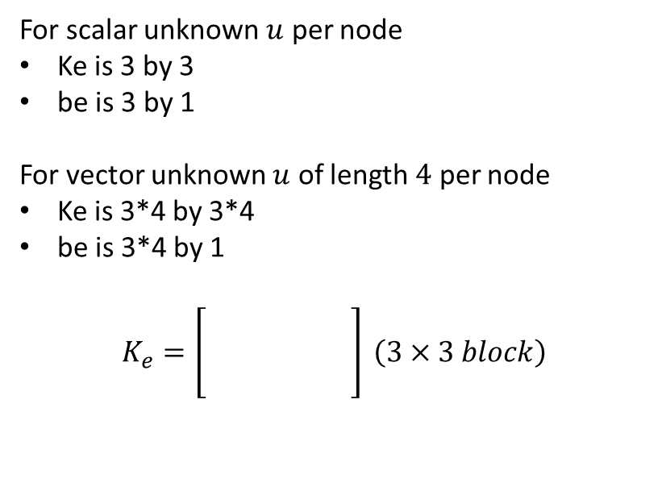
Assemble_Ke_2d
For scalar unknown $u$ per node
Ke is 3 by 3
be is 3 by 1
For vector unknown $u$ of length $4$ per node
Ke is 3*4 by 3*4
be is 3*4 by 1
$$K_{e}=\left[\begin{matrix} & & \\ & & \\ & & \end{matrix}\right] \left(3×3 block\right)$$
$\left[\begin{matrix} & & & \\ & & & \\ & & & \\ & & & \end{matrix}\right] \left(4×4 per block\right)$
Notes:
Others: 1) dtype=float 2)

Slide 5
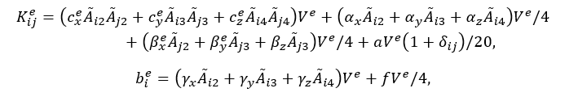

Build_Ke_2d
How to compute Ke and be efficiently per element for vector unknown $\left\{u\right\}$?
Using the sparsity of $c_{x}$ etc.?

Slide 6

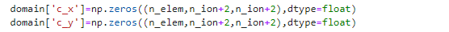
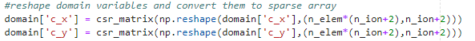

Notes
Je computed in the beginning
$c_{x}$ etc. are saved in csr_matrix format
Explore sparse matrix-vector product in computing Ke and be?

