Slide 1


Clinic Management
System
A Relational Database Design & Implementation Project
Team Members
Yousef elsayed Mohamed · 221001880
Abdelrahman nasr · 222000063
Instructor: Dr. Mohamed Elsayeh

Slide 2
Project Overview
Purpose
Department
10 departments including Cardiology, Neurology, Oncology…
The Clinic Management System is designed to manage patients, appointments, clinics, doctors, and departments. It simplifies scheduling, stores patient records, and tracks medical history — all backed by a fully relational SQL database.
Clinic
10 clinics linked to their respective departments
Doctor
Project Goals
10 doctors assigned to departments
• Design a normalized relational database for clinical operations
Patient
• Enable efficient CRUD operations (Create, Read, Update, Delete)
10 patients with personal & contact information
• Write practical SQL queries for healthcare use cases
Appointment
• Maintain data integrity using foreign keys & constraints
10 appointments with diagnosis, cost, status & timing

Slide 3
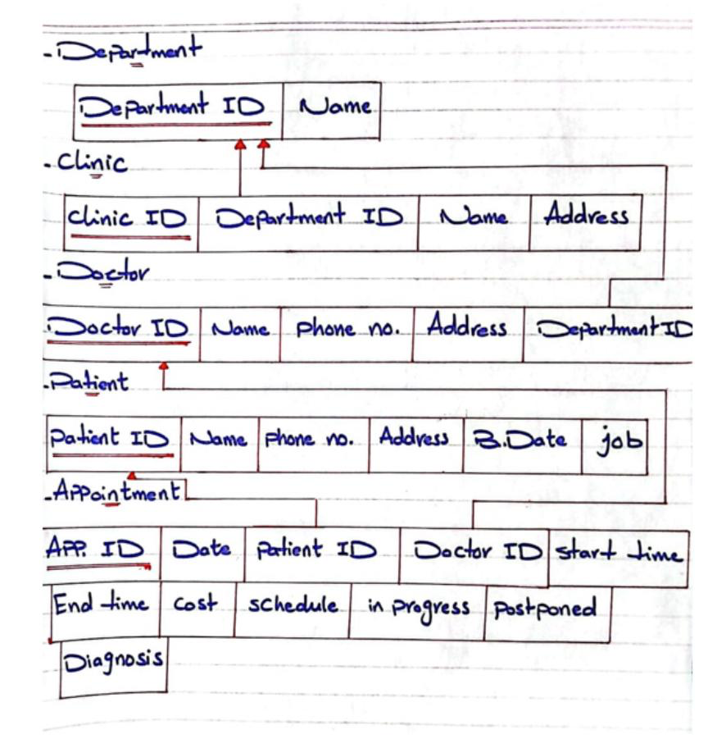
Database Schema
Department
DepartmentID (PK), Name
Clinic
ClinicID (PK), Name, Address, DepartmentID (FK)
Doctor
DoctorID (PK), Name, PhoneNumber, Address, DepartmentID (FK)
Patient
PatientID (PK), Name, PhoneNumber, Address, BirthDate, Job
Appointment
AppointmentID (PK), Date, PatientID (FK), DoctorID (FK),
StartTime, EndTime, Cost, Status, Diagnosis
Logical Relational Schema — showing primary keys (underlined) and foreign key links

Slide 4
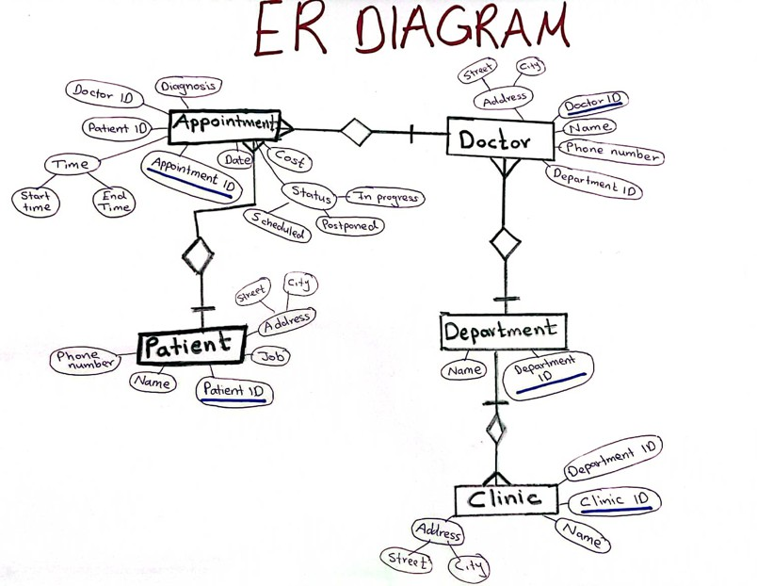
ER Diagram
Relationships
Department → Clinics
1 : N
One department manages many clinics
Department → Doctors
1 : N
One department contains many doctors
Doctor → Appointments
1 : N
One doctor handles many appointments
Patient → Appointments
1 : N
One patient can have multiple appointments
Clinic → Department
N : 1
Each clinic belongs to one department
Hand-drawn ER Diagram showing entities, attributes, relationships, and cardinality ratios

Slide 5
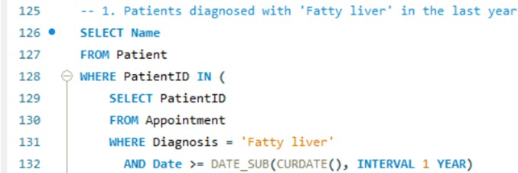
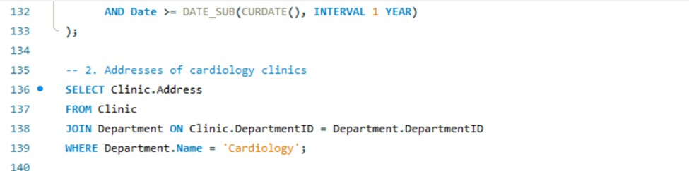
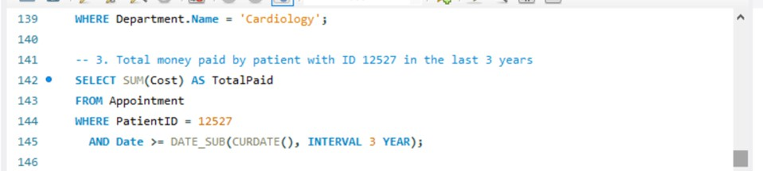
Sample SQL Queries
Query 1 — Patients diagnosed with Fatty Liver in the last year
Query 2 — Addresses of Cardiology Clinics (JOIN)
Query 3 — Total Amount Paid by Patient #12527 in the Last 3 Years (Aggregate)

Slide 6
Data Population & CRUD Operations
Sample Data Overview
Table | Records | Key Fields
Department | 10 | Cardiology, Neurology, Oncology, Pediatrics…
Clinic | 10 | Heart Clinic, Brain Clinic, Cancer Clinic…
Doctor | 10 | Dr. Ayman, Dr. Leila, Dr. Sara…
Patient | 10 | Ali Ahmed, Sara Youssef, Tamer Sherif…
Appointment | 10 | Statuses: Completed, Scheduled, Postponed
INSERT INTO – Add new departments, clinics, doctors, patients, appointments
CREATE
SELECT – Retrieve patient lists, diagnoses, clinic addresses, cost totals
READ
UPDATE SET – Modify patient contact info, appointment status, clinic addresses
Sample UPDATE Operations
UPDATE
• Update patient address & phone (PatientID 12530)
• Set appointment status to 'Postponed' (AppointmentID 20003)
DELETE FROM – Remove records while maintaining referential integrity
• Update clinic address (ClinicID 101)
DELETE

Slide 7
Key Takeaways
Designed a fully normalized relational database with 5 entities
Thank
You!
Implemented foreign key constraints for full data integrity
Wrote complex queries using JOINs, subqueries & aggregates
Populated all tables with 10+ realistic test records each
Questions?
Demonstrated CRUD operations across all tables

