Slide 1
深度學習程式設計
第28組
107501556林昱辰

Slide 2
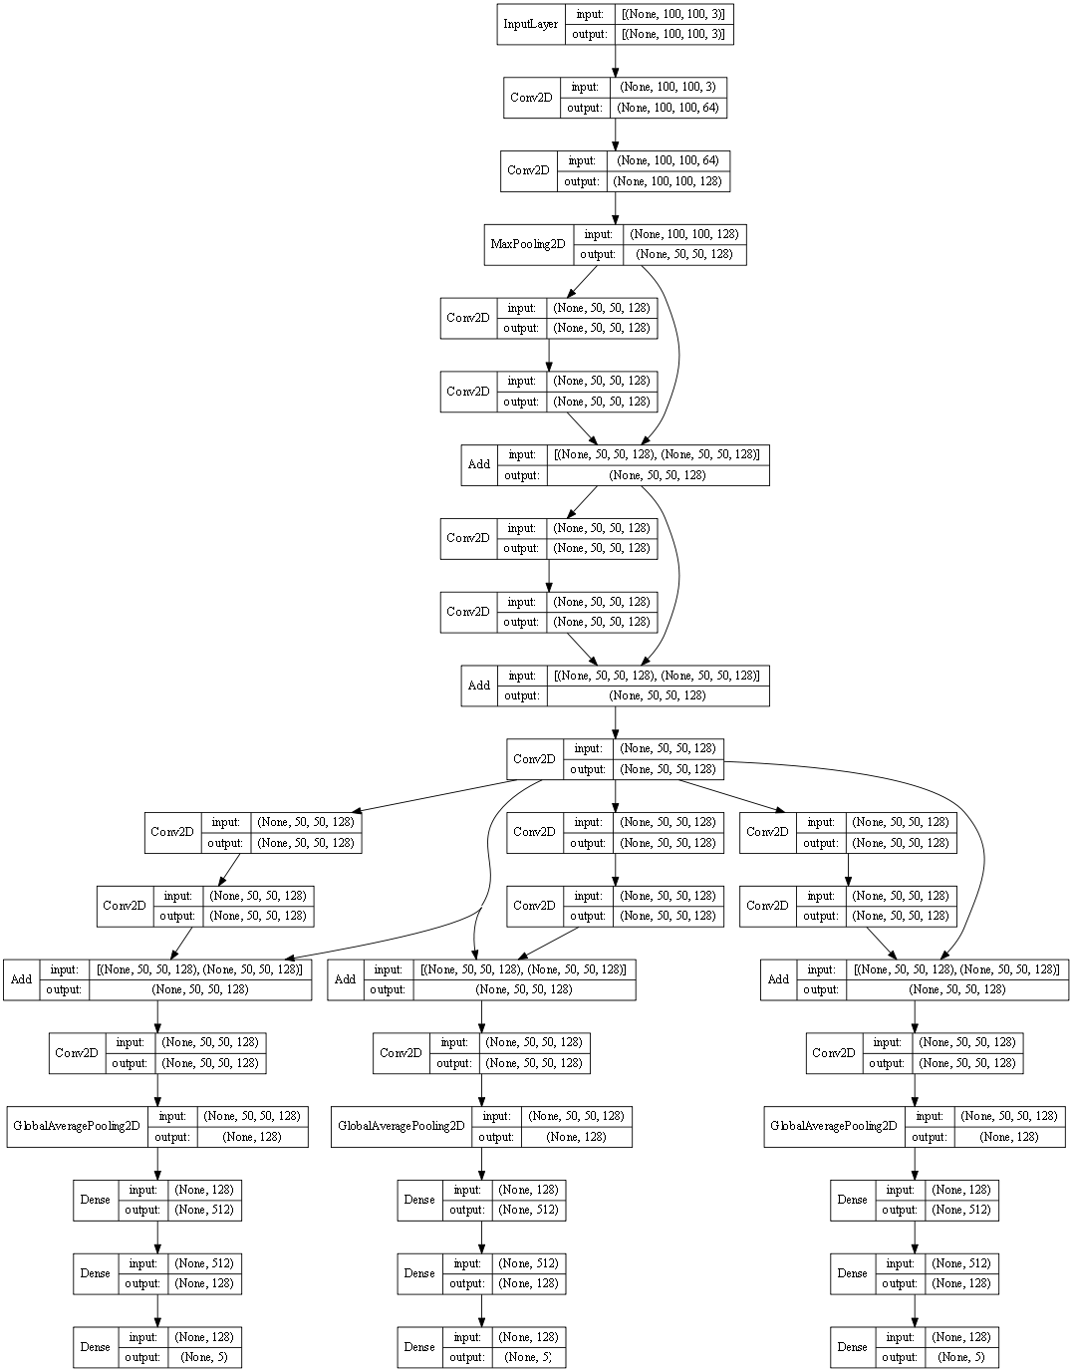

Architecture
Previous layer
Adds previous layer’s feature map to current layer’s feature map
(Residual block from resnet)
Current layer
Activations after conv and dense:
All ReLU
Loss function:
Sparse categorical crossentropy
Loss weights distributed evenly between circle, triangle and square
Global average pooling

Slide 3
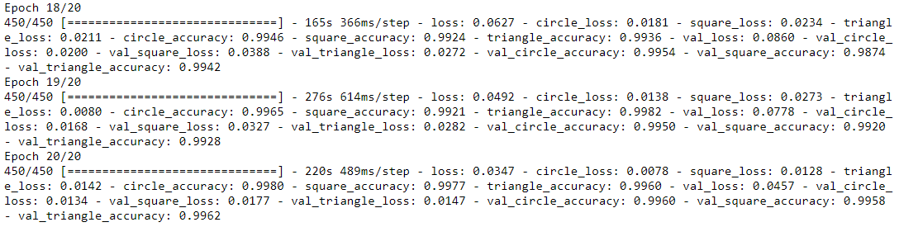
Images provided for training: 50000
Training: 45000
Testing: 5000
Final testing accuracy during training:

Slide 4
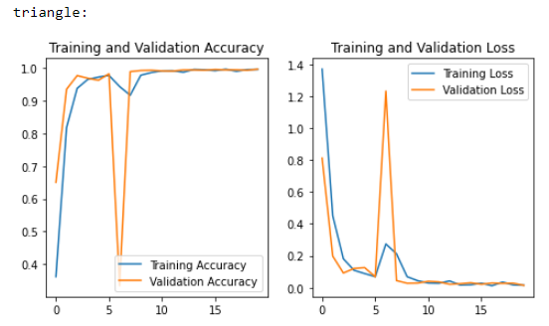
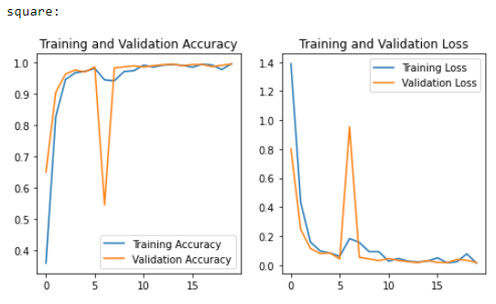
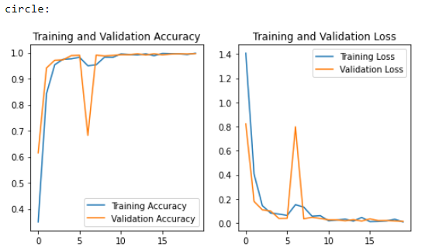
Total of 20 epochs trained
Accuracy and loss per epoch:

Slide 5
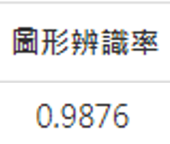
Directions for improvement:
Data augmentation
Maybe less/more layers would be better?
Try spend more time fine-tuning…
Transfer learning with Resnet

