Slide 1
Two-message Key Exchange with Strong Security from Ideal Lattices
Zheng Yang (University of Helsinki)
Yu Chen (Chinese Academy of Sciences)
Song Luo (Chongqing University of Technology)
April 17th, CT-RSA 2018

Slide 2
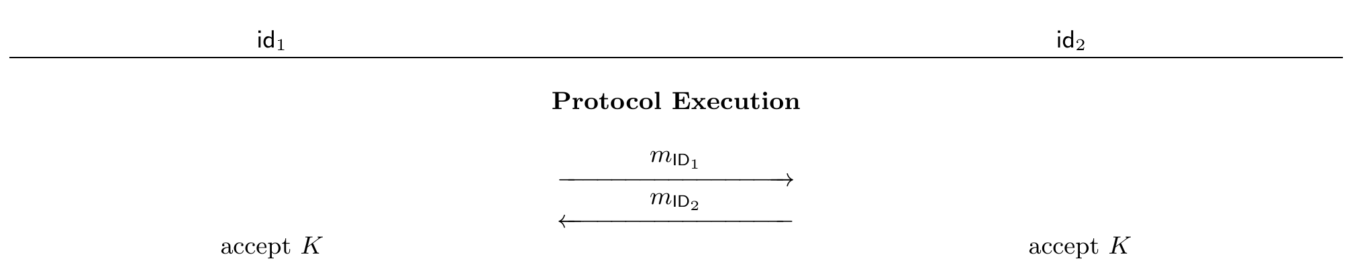
Background: Two-message Key Exchange (TMKE)
Two-message Key exchange
Two messages: m_{id1}, m_{id2}——derived from party’s (ephemeral) secrets.
Shared session key K——computed from party’s (ephemeral) secrets and exchanged messages
Appealing to practice: low bandwidth and asynchronous communication
Message generation function
Session key generation function

Slide 3
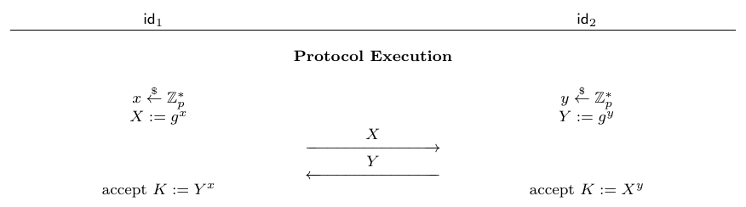
The Simplest Example of TMKE
Seminal TMKE: Diffie-Hellman key exchange (DHKE) [DH76]
Cyclic group G =< g > of prime order p
Two messages: X, Y
Passively secure; active attacker can implement man-in-the middle attack

Slide 4
Motivation
Quantum computers are about to get real
DL, factoring, …., not hard against quantum algorithms
Lattice-based Cryptography
Quantum secure
Simple, efficient, and highly parallel
Existing Lattice-based AKE, e.g.:
AsiaCCS’13, Fujioka et al. ,
—— standard model, CK+ model without perfect forward secrecy (PFS)
Eurocrypt’15, Zhang et al.,
—— random oracle, BR model without PFS and leakage of ephemeral secret key
CT-RSA’14, Kurosawa and Furukawa (KF scheme)
——standard model, eCK model without PFS Is it Secure?

Slide 5
Overview of Our Results
Revisit the security of the KF scheme (CT-RSA’14)
finding an attack
Propose a new generic TMKE scheme
New cryptographic primitive: One-time CCA-secure KEM
Without random oracles
eCK-PFS model: known session key (KSK) , key compromise impersonation (KCI) , chosen identity and public key (CIDPK), ephemeral secret key leakage (ESKL), and perfect forward secrecy (PFS)
Instantiation of TMKE from ideal lattices

Slide 6
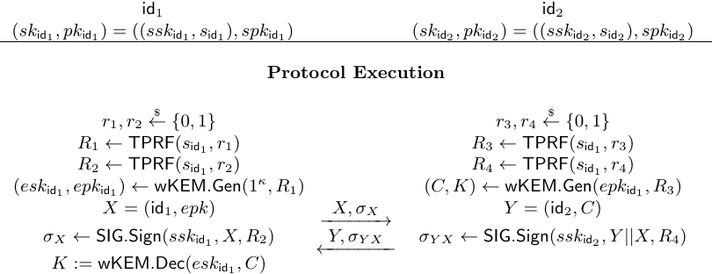
The KF scheme
Building Blocks: Twisted PRF (TPRF), Signature (SIG), IND-CPA KEM (wKEM)
ElGamal
*
*

Slide 7
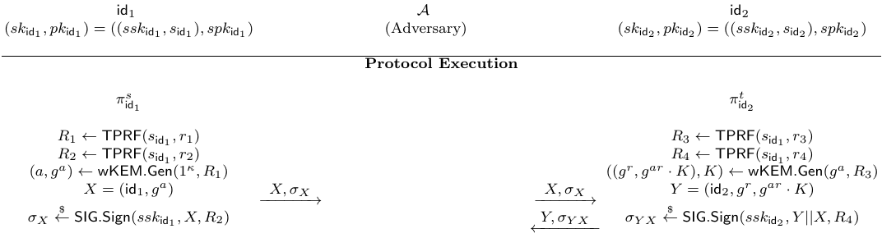
Insecurity of the KF scheme: Attack
test oracle
test oracle is fresh and has no partner oracle at id₁

Slide 8
Insecurity of the KF scheme: Problems
Not tied to session info
unknown key share
One-time CCA attack against the KEM, CPA-secure KEM does not suffice

Slide 9
How to remedy the KF scheme?
Main idea
Enhance the security of KEM
CPA to one-time CCA
Employ Key Derivation function
bind the session key with session specific information to defend active attacks

Slide 10
Our New Generic TMKE Protocol
Building blocks
One-time KEM (OTKEM): encapsulate the session key
Signature (SIG): authenticate exchanged messages
IND-CPA KEM (wKEM): implement NAXOS trick against ephemeral key leakage (generate the pk for OTKEM)
Pseudo-random function (PRF): act as KDF to bind session key with session specific information

Slide 11
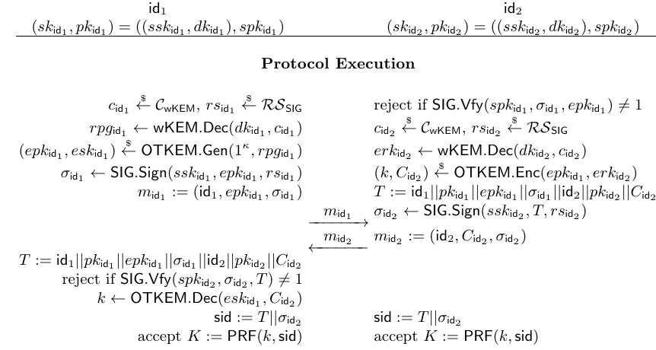
A New Generic TMKE Protocol
All protocol messages

Slide 12
Instantiations from Ideal Lattices
Building blocks’ instantiations from existing works:
Signature (SIG): Ruckert (PQCrypto’10)
IND-CPA KEM (wKEM): Peikert (PQCrypto’14).
Pseudo-random function (PRF): Banrjee et al. (Eurocrypt’12)
One-time KEM (OTKEM): q-bounded IND-CCA KEM (q=1), Cramer et al. Asiacrypt’07 (less efficient)
Can we build efficient OTKEM from ideal lattices?

Slide 13
Efficient OTKEM from Ideal Lattices
Direct construction
Ring-Learning with Errors (RLWE):
Target collision resistant hash function (TCRHF):
Similar to construction of OTS from OWF
n

Slide 14
Thank you very much for your attention!

