Slide 1
Elder Fitness Android App
Bing Xie
Yuchen Qiao
Da Huo
Notes:
Most of what I am talking about is covered in the guidelines for use, found at the front of the RDA.

Slide 2
Requirement
Record the daily and weekly data of the running and running track and climbing stairs of the user and stakeholder.
Application could send the current location of the elder stakeholder to his or her family to guarantee their safety when they encounter emergency situations or lose action capacity.
Notes:
Background
System Structure
Database ER diagram
Requirements Analysis
Functionalities Demo
Results Analysis
Future Work
Q&A

Slide 3
Features of our App
1. A welcome page and several guide pages to briefly introduce this application.
2. Users can register an account and login.
3. This app can track walking and running route on map, and it can show the current distance user have travelled and time consumptions so far.
4. This app can record the total height of walking up and down the stairs.
5. This app can compute calories consumed per day and per week.
6. There is a data visualization which is formed by five charts.
7. Elder can click the "EMERGENCY" button to inform relatives for seeking help.
8. This app also has automatic alarm mechanism to keep elder users being in safe.

Slide 4
Our Advantages
Deep understanding of stakeholder needs:
Recording the daily and weekly data of the running and climbing stairs.
Sending the current location of the elder stakeholders to their family if it need.
Commercial potential:
Hardly to find an app can serve fitness for elder people well in current app stores.
This app can be expanded in order to match multi user stories because of high expandability.
Highest level of UI polish:
A welcome page and several guide pages to briefly introduce the functionalities.
user-friendly interface, customized button and data visualization.
Great encapsulation, ready for publication in app stores.
Solid evaluation procedure:
The project team used Scrum in development process.
We made several test cases for each of all functionalities in order to guarantee reliability.

Slide 5
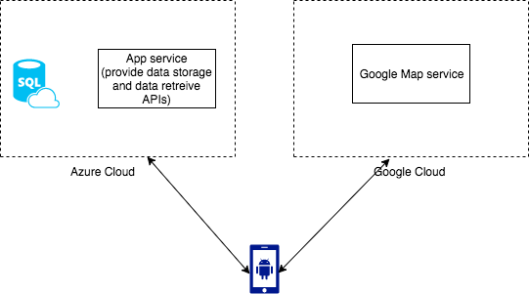
Azure Cloud && Google Cloud

Slide 6
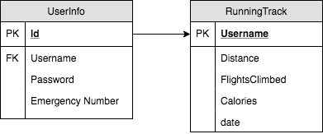
Azure database ER diagram

Slide 7
Safety
1) Automatic safety mechanism
TimerTask are used to check whether the user move more than 50 meters.
2) Manually safety mechanism

Slide 8
Sensor
1) GPS
Collect latitude and longitude data
Maps to Google map
Given gps data, Google service return location address
2) Sms
Use the returned address for sending text message.
3) Barometer
Calculate Flights Climbed

Slide 9
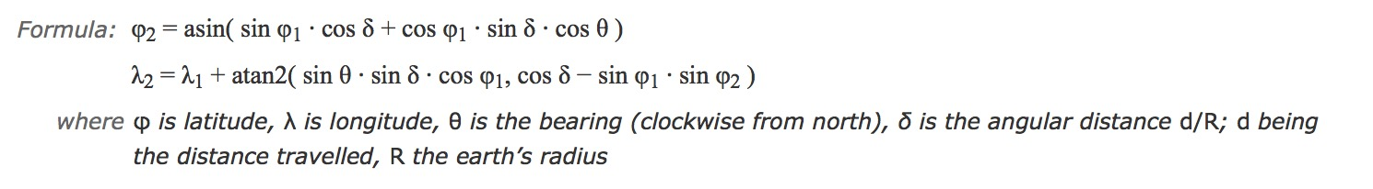
Research part
Formula basis for calculating walking distance. [1]

Slide 10
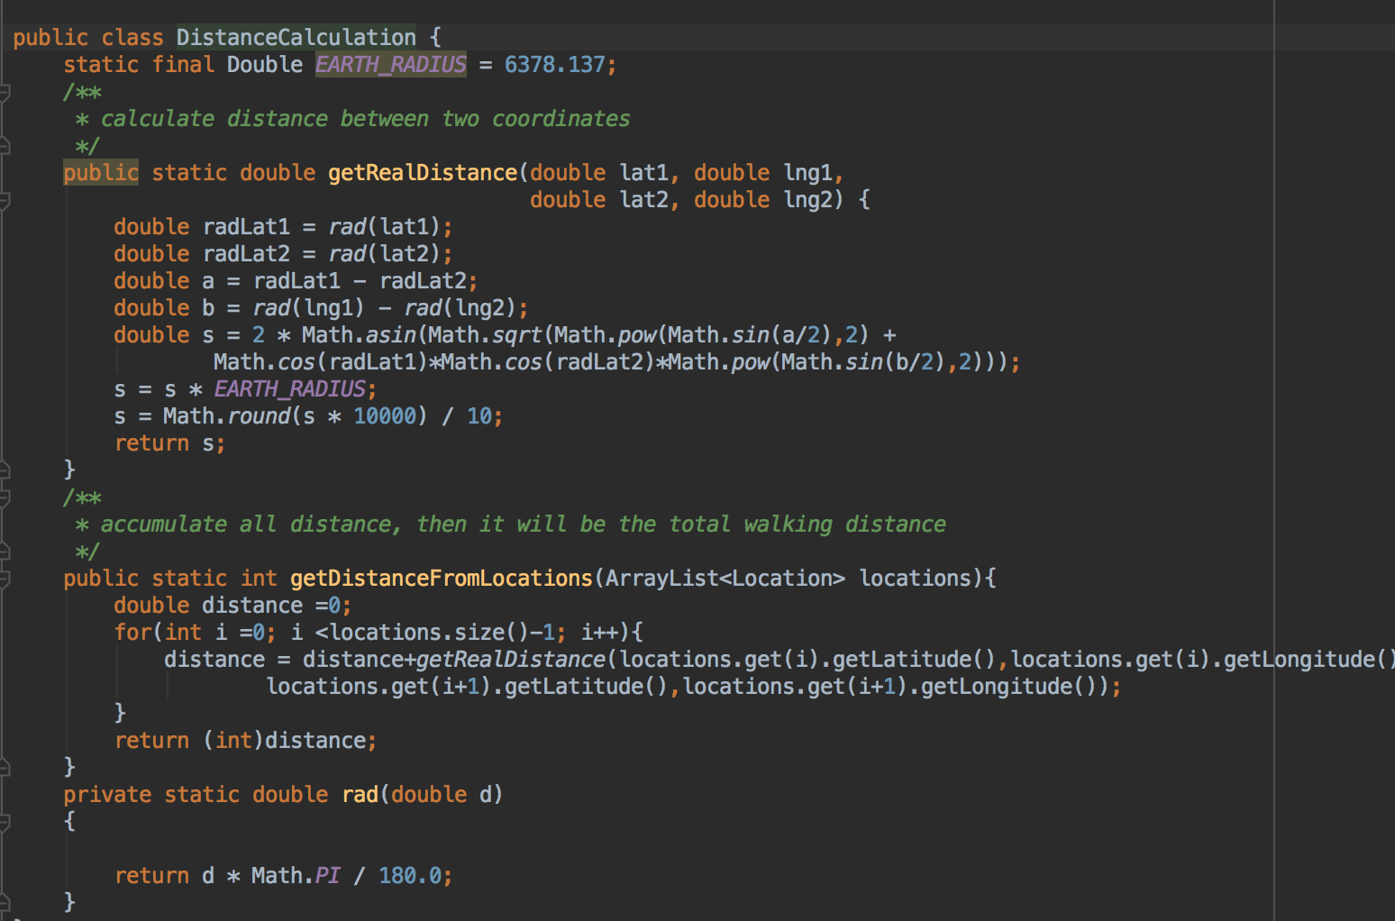
Code based on research
Calculate Running Distance based on GPS data

Slide 11
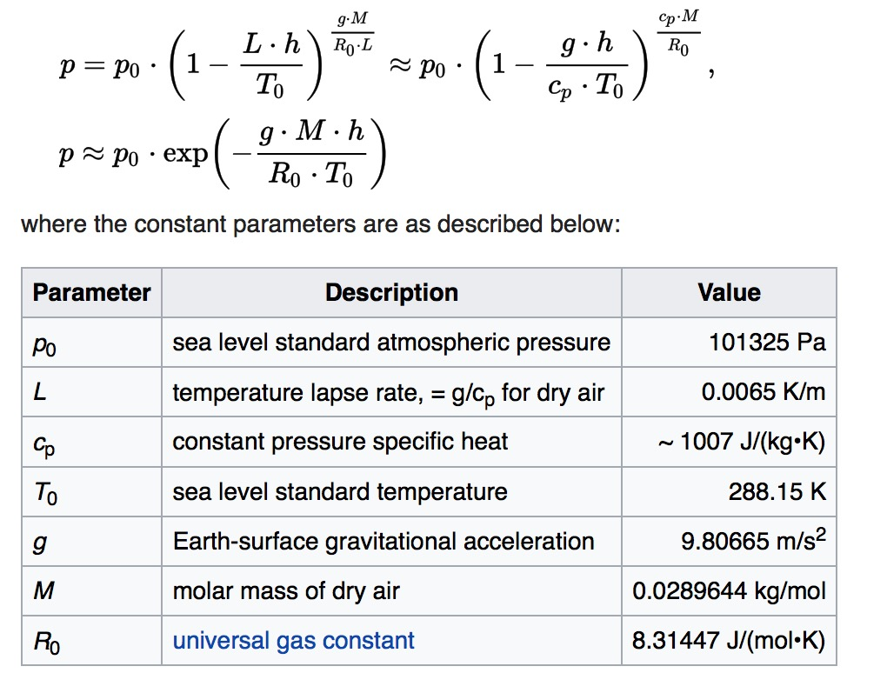
Research
Formula basis for calculating Flights Climb[2]

Slide 12
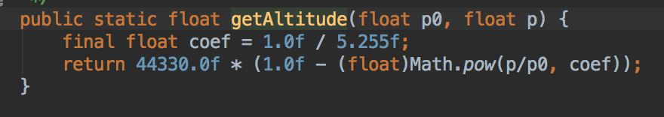
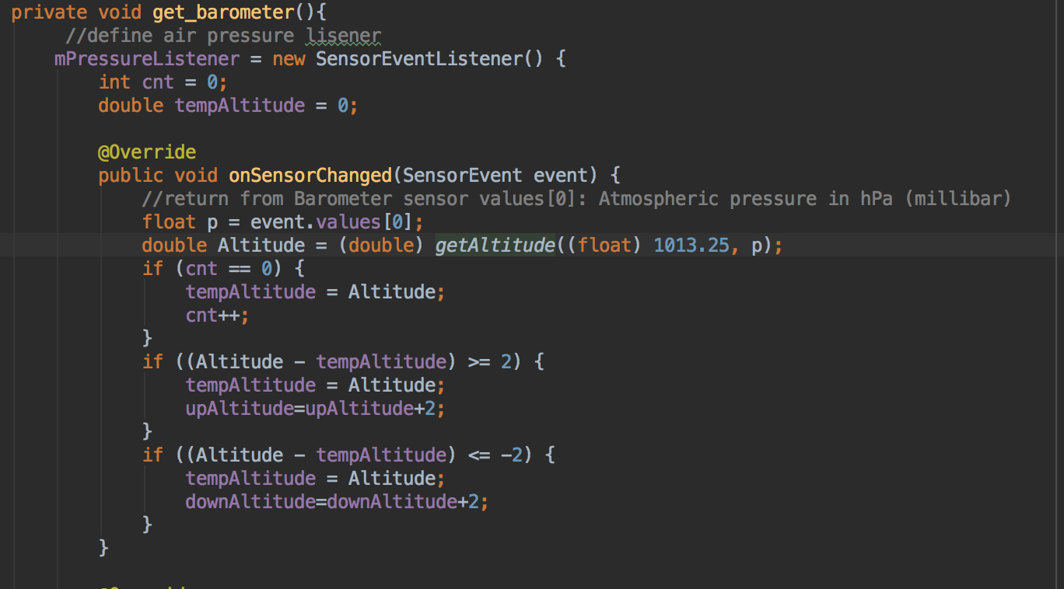
Code based on research
Formula transfer air pressure to Altitude
By my numbers of experiments, 2m could be best for sample rate.

Slide 13
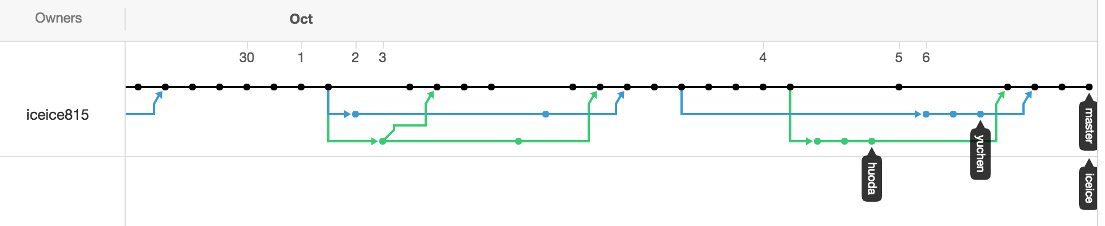
Code
1) Use git to manage the code
From 9/24 to 6/10, we have approximately 55 commits, numbers of code merge and 5000 lines code.

Slide 14
Reference
[1] http://www.movable-type.co.uk/scripts/latlong.html
[2] https://en.wikipedia.org/wiki/Atmospheric_pressure

Slide 15


© Copyright The University of Melbourne 2011

