Slide 1
Detection of AF and APB in PPG
0716206 陳昱丞
310551175 蔡金玲

Slide 2
Background Introduction

Slide 3

Atrial fibrillation (AF)
the most common cardiac arrhythmia in the developed world.
Some people with atrial fibrillation experience symptoms such as palpitations (a sudden pounding, fluttering feeling in the chest), fatigue, dizziness, chest discomfort, and shortness of breath.
may not cause any symptoms, and some people find it during a health check.

Slide 4

Long-term atrial fibrillation, which prevents the blood from flowing as quickly as it can and also causes the blood to clot more quickly. If the blood clot is pumped out of the heart, it can travel to the brain, causing a stroke.
If it flows to other parts, different conditions may also occur, such as thrombosis of the small intestine, kidney or lower extremity blood vessels.

Slide 5
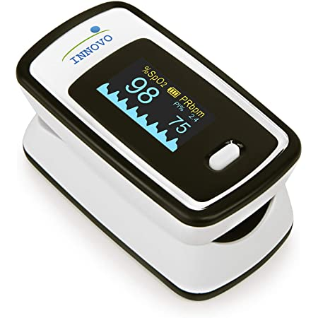
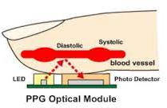
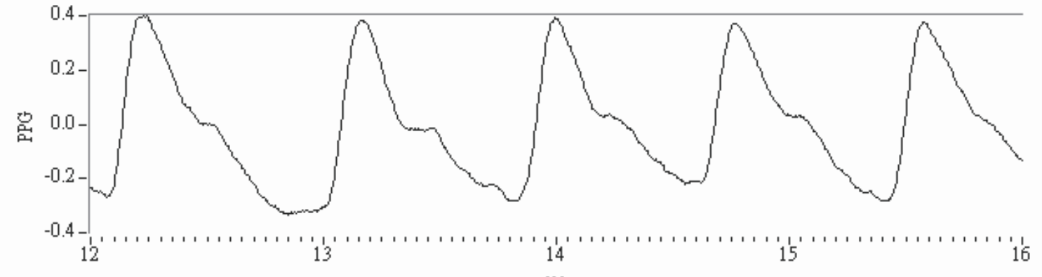
A photoplethysmogram (PPG)
an optically obtained plethysmogram
can be used to detect blood volume changes in the microvascular bed of tissue.
A PPG is often obtained by using a pulse oximeter which illuminates the skin and measures changes in light absorption.
pulse oximeter
PPG signal

Slide 6
Purpose

Slide 7
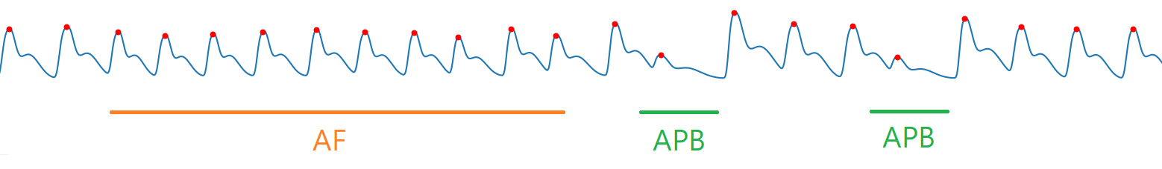
Purpose
Detection of AF(atrial fibrillation) and APB(atrial premature beats) in PPG(photoplethysmography)

Slide 8
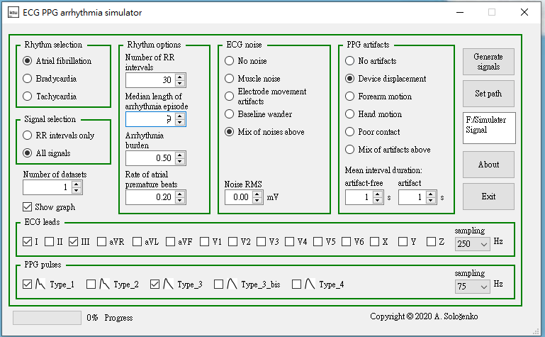
Data Set
SIM_ARR(PPG Signal Simulator with Arrhythmia Episodes)
https://physionet.org/content/ecg-ppg-simulator-arrhythmia/1.3.0/

Slide 9

Data distribution
 | Other | AF | APB | AF &APB | Total
no noise | 14930 | 24451 | 28260 | 18464 | 86105
noise | 41920 | 64045 | 70667 | 47668 | 224300
Total | 56850 18.3% | 88496 28.5% | 98927 31.8% | 66132 21.3% | 310405

Slide 10
Data distribution
 | Other | AF | APB | AF &APB | Total
no noise | 14930 | 24451 | 28260 | 18464 | 86105
noise | 41920 | 64045 | 70667 | 47668 | 224300
Total | 56850 18.3% | 88496 28.5% | 98927 31.8% | 66132 21.3% | 310405
Classification: (1)Other (2)AF (3)APB (4)AF&APB
Train data/Test data = 67%/33%

Slide 11
Approaches

Slide 12
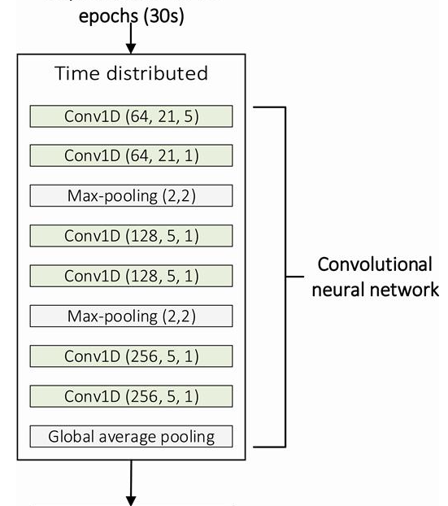
Neural Network Design
refer to
Henri Korkalainen, Juhani Aakko, Brett Duce, Samu Kainulainen, Akseli Leino, Sami Nikkonen, Isaac O Afara, Sami Myllymaa, Juha Töyräs, Timo Leppänen, Deep learning enables sleep staging from photoplethysmogram for patients with suspected sleep apnea, Sleep, Volume 43, Issue 11, November 2020, zsaa098, https://doi.org/10.1093/sleep/zsaa098

Slide 13


Regularization analysis
Regularization
standard dropout
noise label
gradient centralization
learning rate dropout
learning rate dropout+standard dropout
Mixup
In input data
in feature
in higher layer feature

Slide 14

Regularization Analysis

Slide 15
Regularization Analysis
WO: Without Regularization
SD: Standard Dropout
NL: Noisy Label (Probabilistic End-to-end Noise Correction for Learning with Noisy Labels, CVPR 2019)
GC: Gradient Centralization (Gradient Centralization: A New Optimization Technique for Deep Neural Networks)
LRD: Learning Rate Dropout (Learning Rate Dropout, IEEE2022)
SD_LRD: Standard Dropout with Learning Rate Dropout

Slide 16
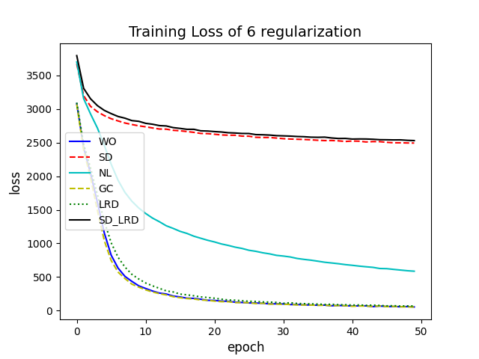
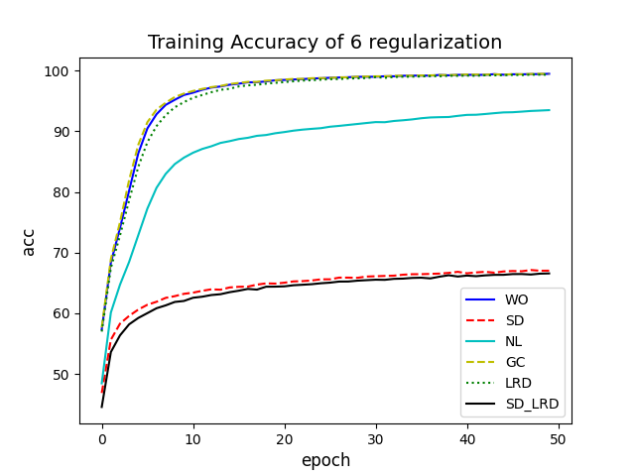

Slide 17
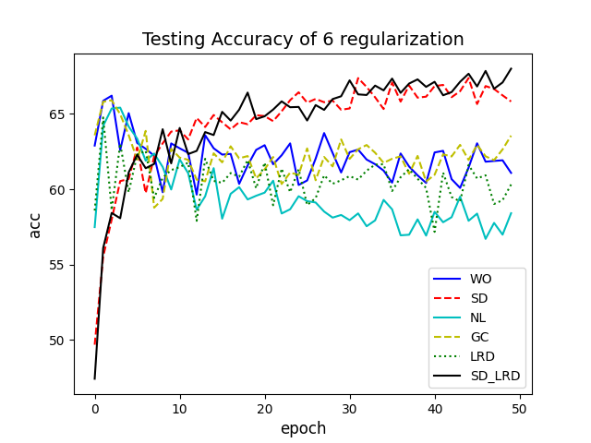

Slide 18
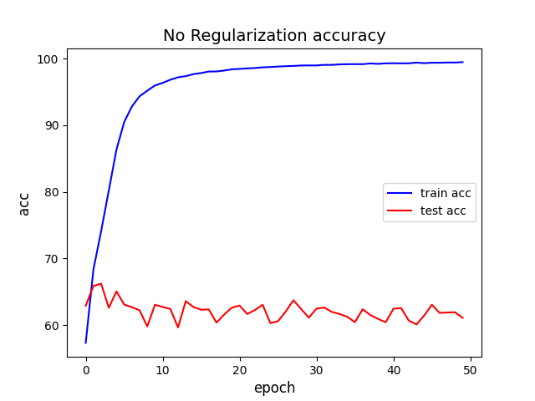
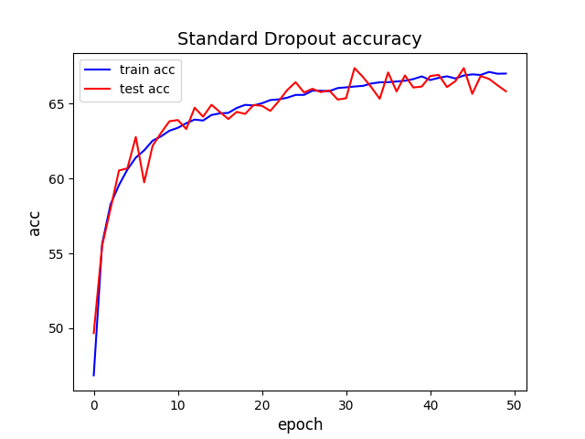
Regularization 強度:
SD = SD_LRD > NL > GC = LRD = WO
Testing 準確度:
SD = SD_LRD > GC > WO > LRD > NL
Standard Dropout 有最強的 Regularization 效果，能最有效消除 overfitting，也能達到最高的 accuracy。而 Learning Rate Dropout 在這個 case 效果不大，我認為是因為我們的 data 是波形圖，其特徵並不明顯。若 regularization 強度不夠強，結果就容易和 without regularization 差不多。

Slide 19
Mixup

Slide 20
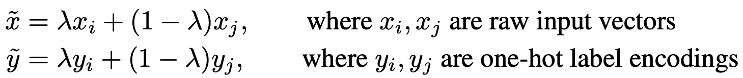
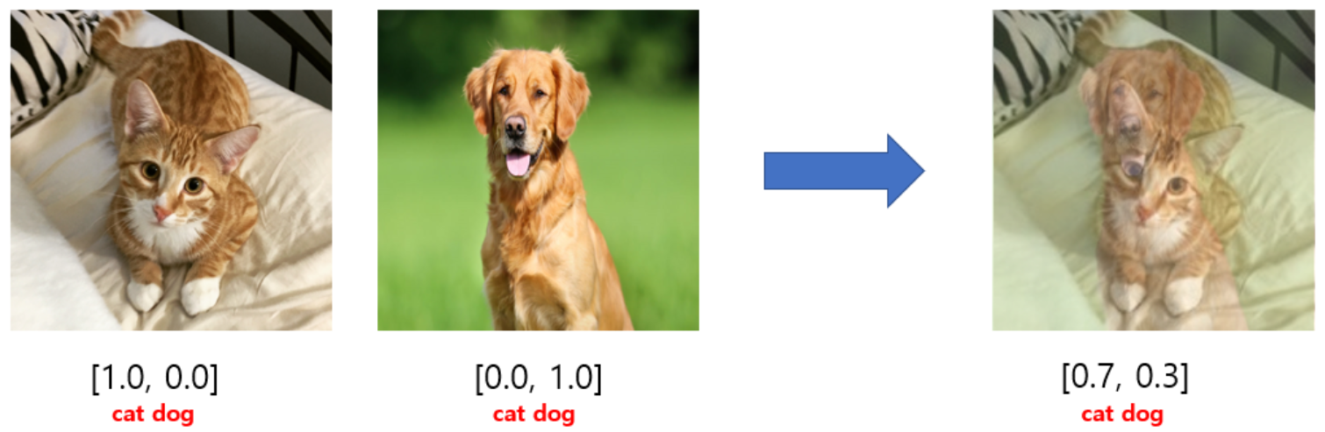
mixup
a domain-agnostic data augmentation technique.
The main thing is to mix features and their corresponding labels so that the network is not overconfident about the relationship between features and their labels.
Makes the data more diverse.
It's implemented with the following formulas:
proposed in mixup: Beyond Empirical Risk Minimization by Zhang et al.

Slide 21
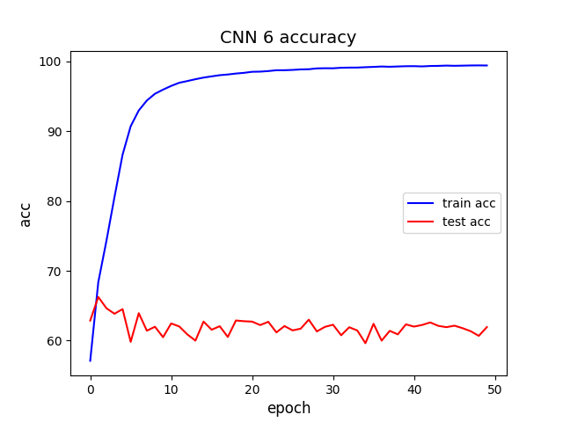
原本的model有較嚴重的overfitting現象，期待透過mixup使訓練資料更加多元及完整，能在一定程度上解決overfitting的現象。

Slide 22

Experimental design
Mixup added in:
Input Data
Feature
Higher feature

Slide 23
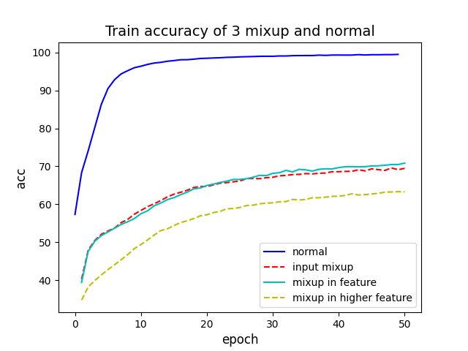
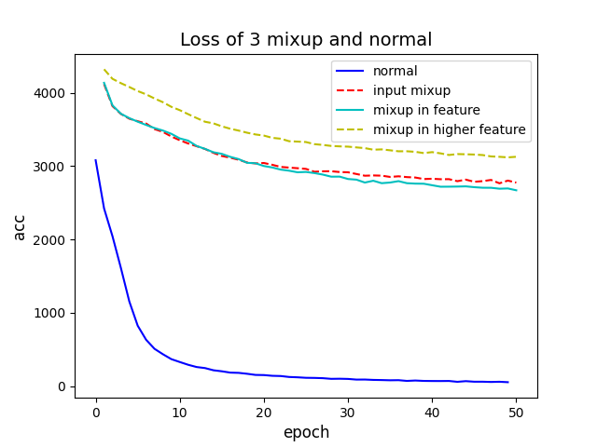
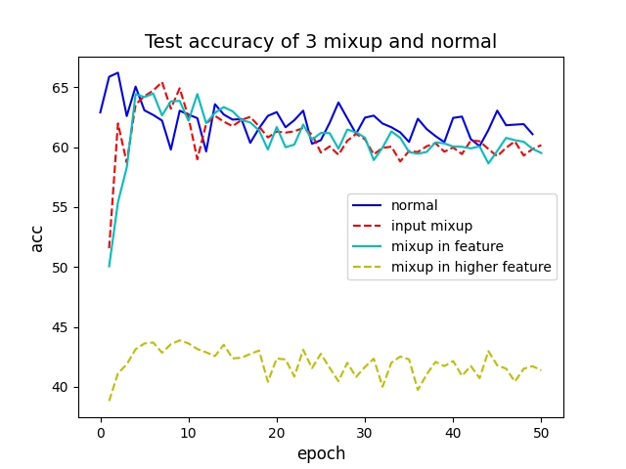
Loss

Slide 24
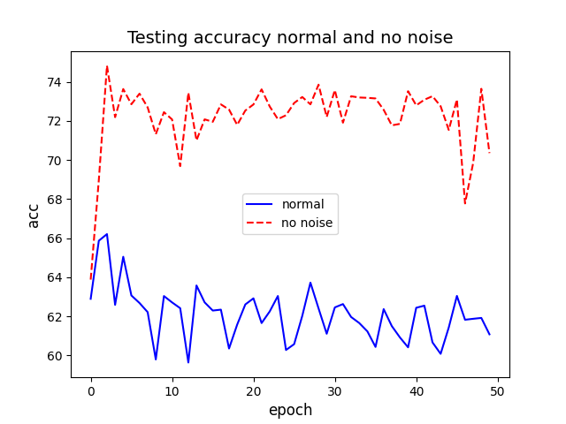
推測加入mixup後的accuacy反而變低，應該是因為我們原始的model其對抗signal noise的效果本身就不是很好，而在特徵並不明顯的波形圖中，加入mixup之後，應該是一定程度上的造成signal 的 noise。

Slide 25
THANK YOU

Slide 26
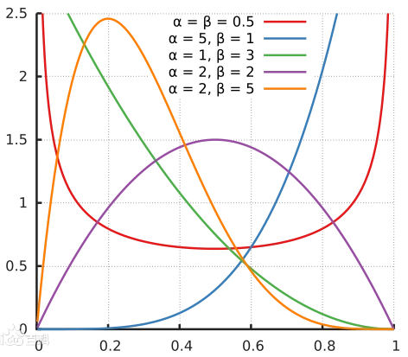
Beta distribution

