Slide 1
C / C++ Common Bugs
Presenter: Yu-Cheng Chen
Date: 2023/8/9

Slide 2
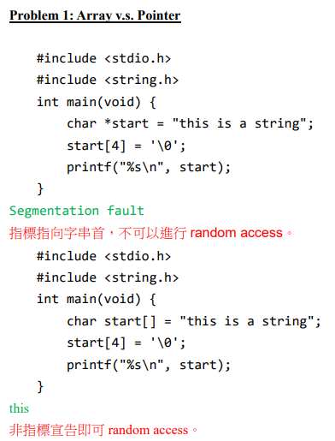
Problem 1

Slide 3
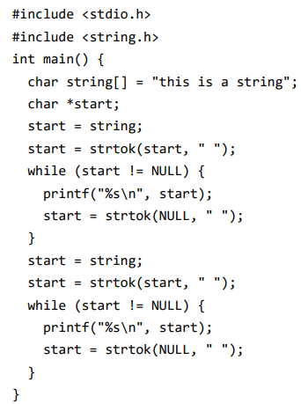
Problem 2
this
is
a
string
start 指標已經在第一個 loop 被 strtok 切開，第二個 loop 讀就只剩下切開後的第一 part。
this

Slide 4
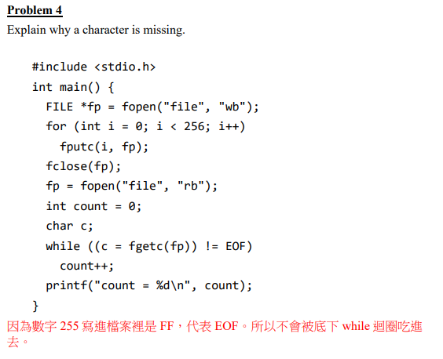
Problem 3

Slide 5
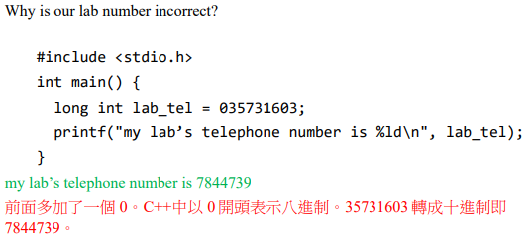
Problem 4

Slide 6
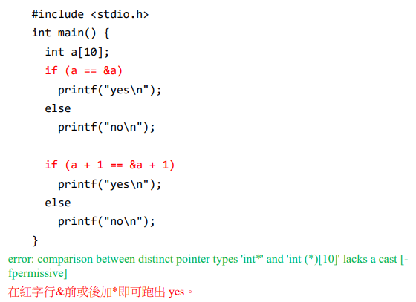
Problem 5

Slide 7
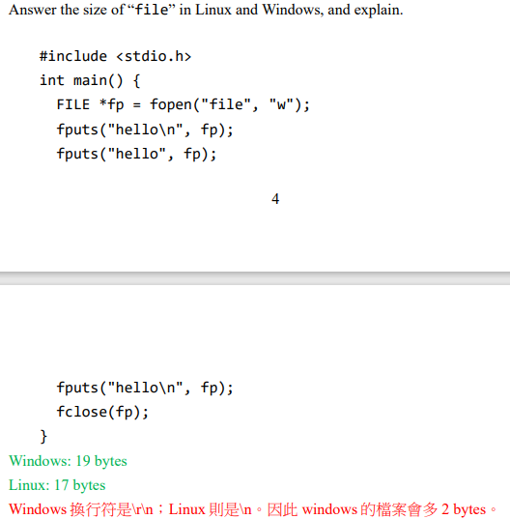
Problem 6

Slide 8
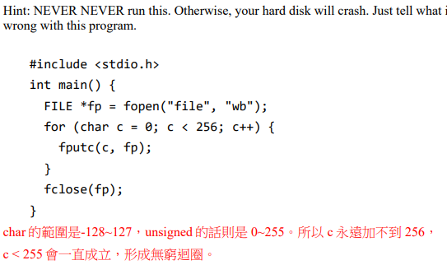
Problem 7

Slide 9
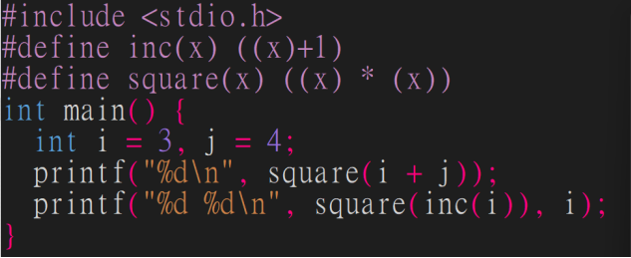
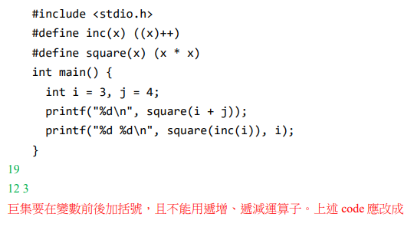
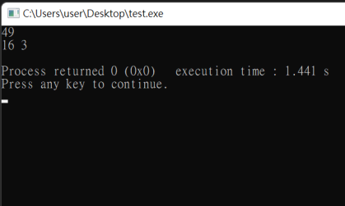
Problem 8

Slide 10
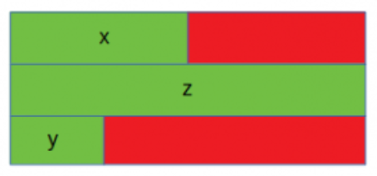
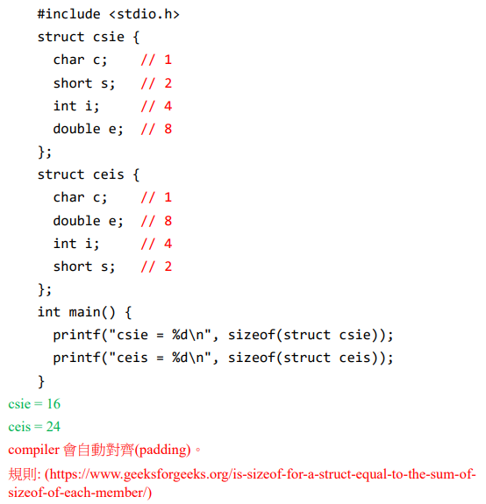
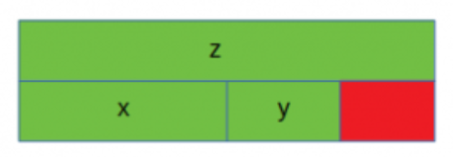
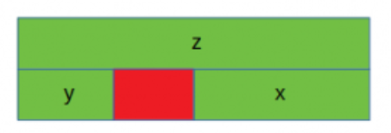
Problem 9
Is sizeof for a struct equal to the sum of sizeof of each member? - GeeksforGeeks
4
8
2
8
4
2
8
2
4

Slide 11
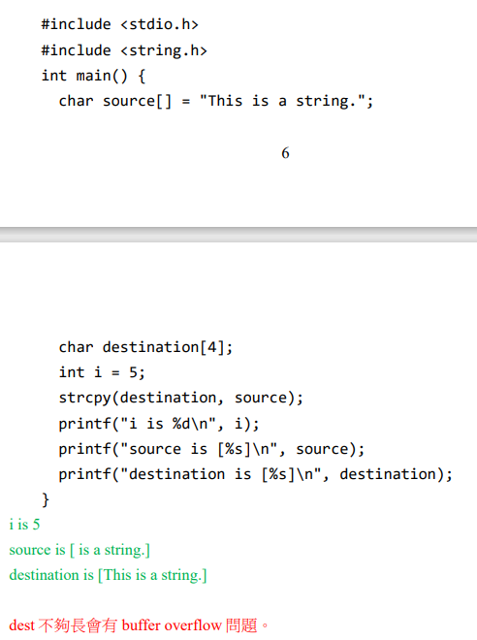
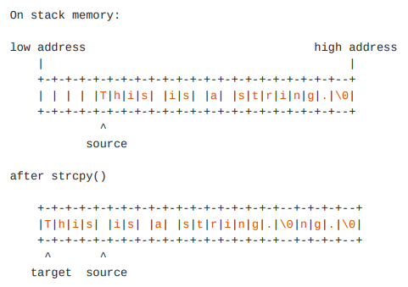
Problem 10

Slide 12
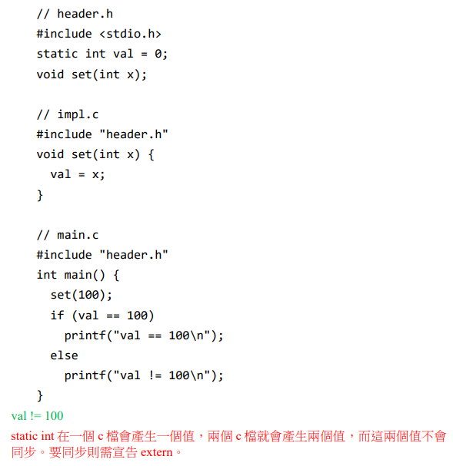
Problem 11

Slide 13
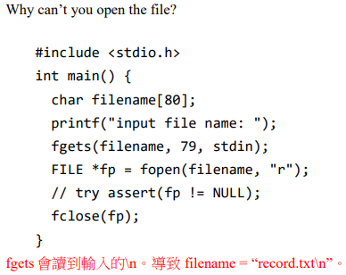
Problem 12

Slide 14
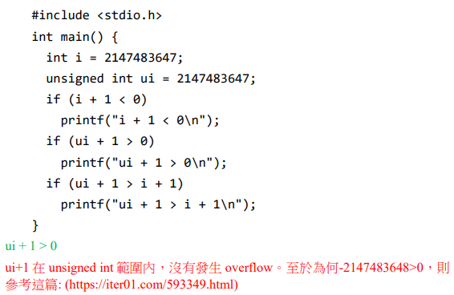
Problem 13
C/C++ 中的算術及其陷阱 | IT人 (iter01.com)

Slide 15
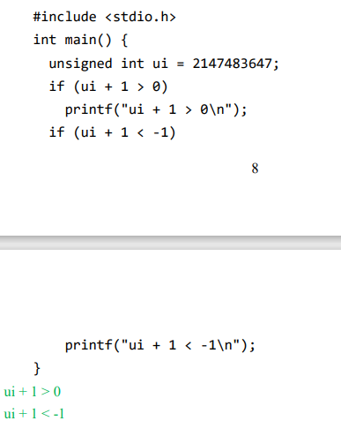
Problem 14
當一個 signed int 和一個 unsigned int 進行比較時，signed int 會被自動轉型成 unsigned int 進行比較。
因此 -1 => 4294967295

Slide 16
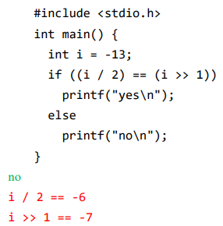
Problem 15

Slide 17
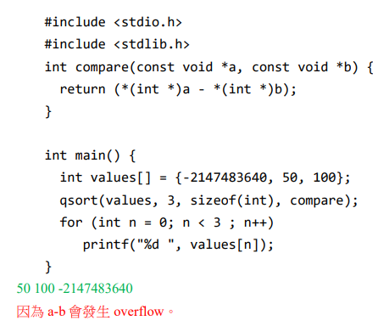
Problem 16

Slide 18
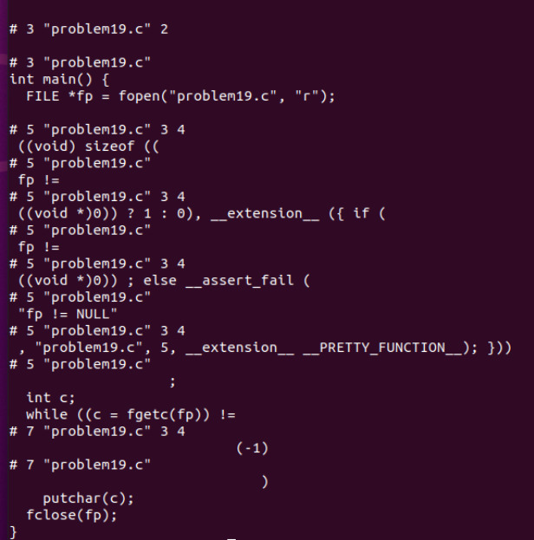
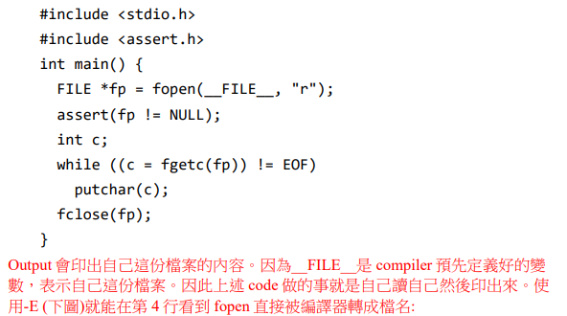
Problem 17

Slide 19
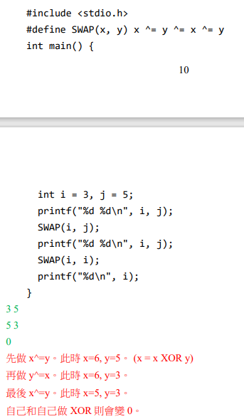
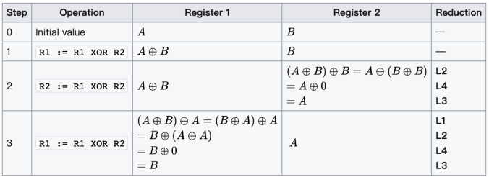
Problem 18
XOR Swap Algorithm:

Slide 20
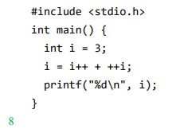
Problem 19
3
5

Slide 21
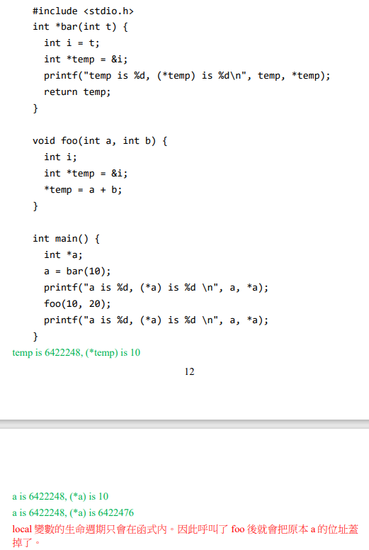
Problem 20

Slide 22
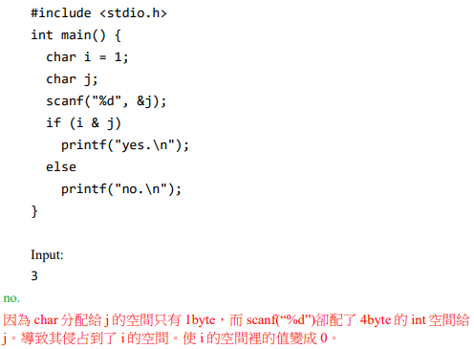
Problem 21

Slide 23
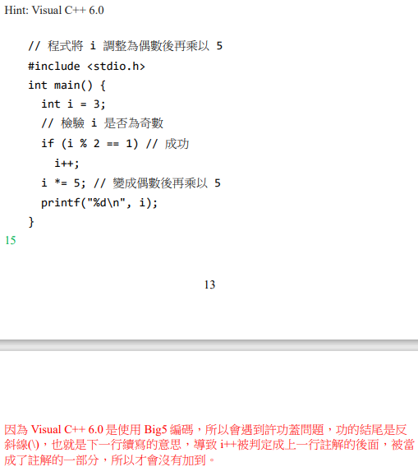
Problem 22

Slide 24
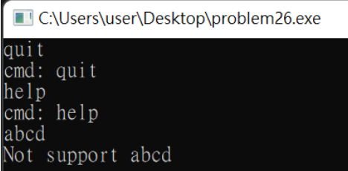
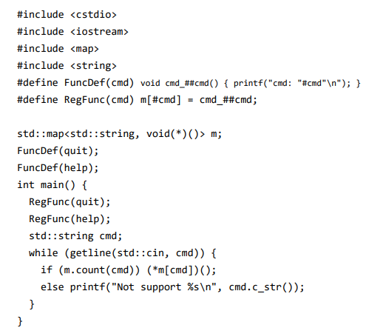
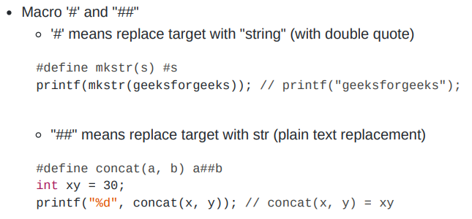
Problem 23

Slide 25
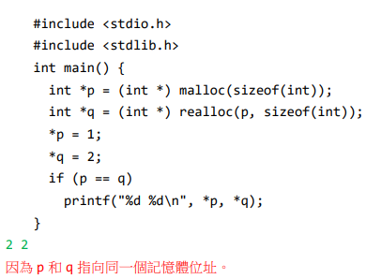
Problem 24

Slide 26
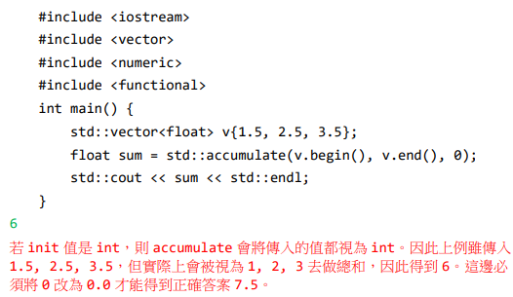
Problem 25

Slide 27
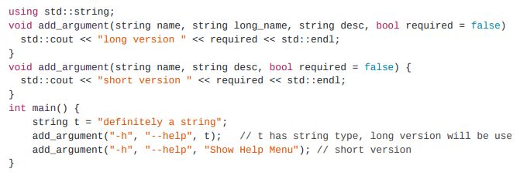
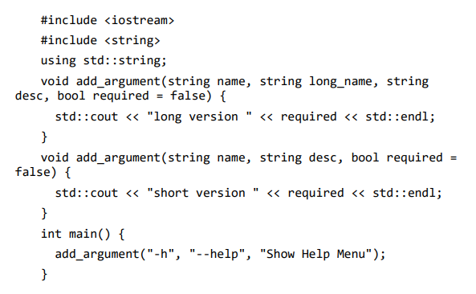
Problem 26
String constant does not have type string thus it's taken as bool, ended up in the short version function.
short version 1

