Slide 1
Shell Script & Useful Tools
Presenter: Yu-Cheng Chen
Date: 2023/8/9

Slide 2
Outline
Conda
Dockerfile and Podman
Shell Script
Variables
Mathematical Operations
Data Structures
Expressions
Tmux

Slide 3
Virtual Environments
Virtual environments in Python:
Configure a separate Python interpreter environment for each project to avoid dependency and version issues.
Avoid excessive installations of unnecessary packages to maintain a clean development environment and prevent contamination.
Easy to setup Pytorch and Tensorflow.
Easy to cleanup.

Slide 4
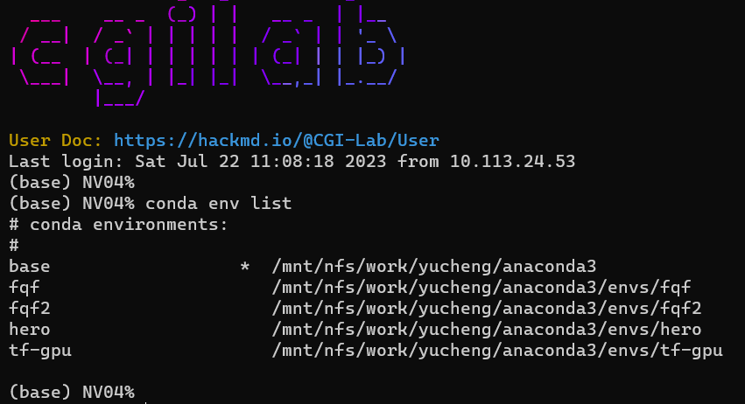
Virtual Environments
Virtual environments in Python:
conda
pipenv
virtualenv

Slide 5
Q1: Conda
Create conda environment for Tensorflow:
conda create -n tf-gpu tensorflow-gpu
conda activate tf-gpu
Checkout Anaconda website:
https://docs.anaconda.com/anaconda/user-guide/tasks/tensorflow/

Slide 6
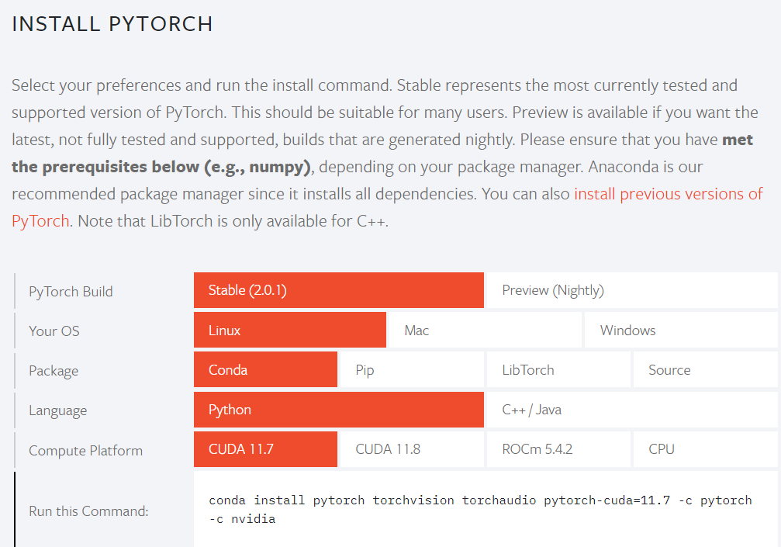
Q1: Conda
Create conda environment for Pytorch:
conda create -n pytorch-gpu2 python=3.9
conda activate pytorch-gpu2
conda install pytorch torchvision torchaudio pytorch-cuda=11.7 -c pytorch -c nvidia
Checkout Pytorch website:
https://pytorch.org/

Slide 7
Q1: Conda
Useful command:
conda env list
conda list
conda activate <name>
conda deactivate
conda env remove -n <name>

Slide 8
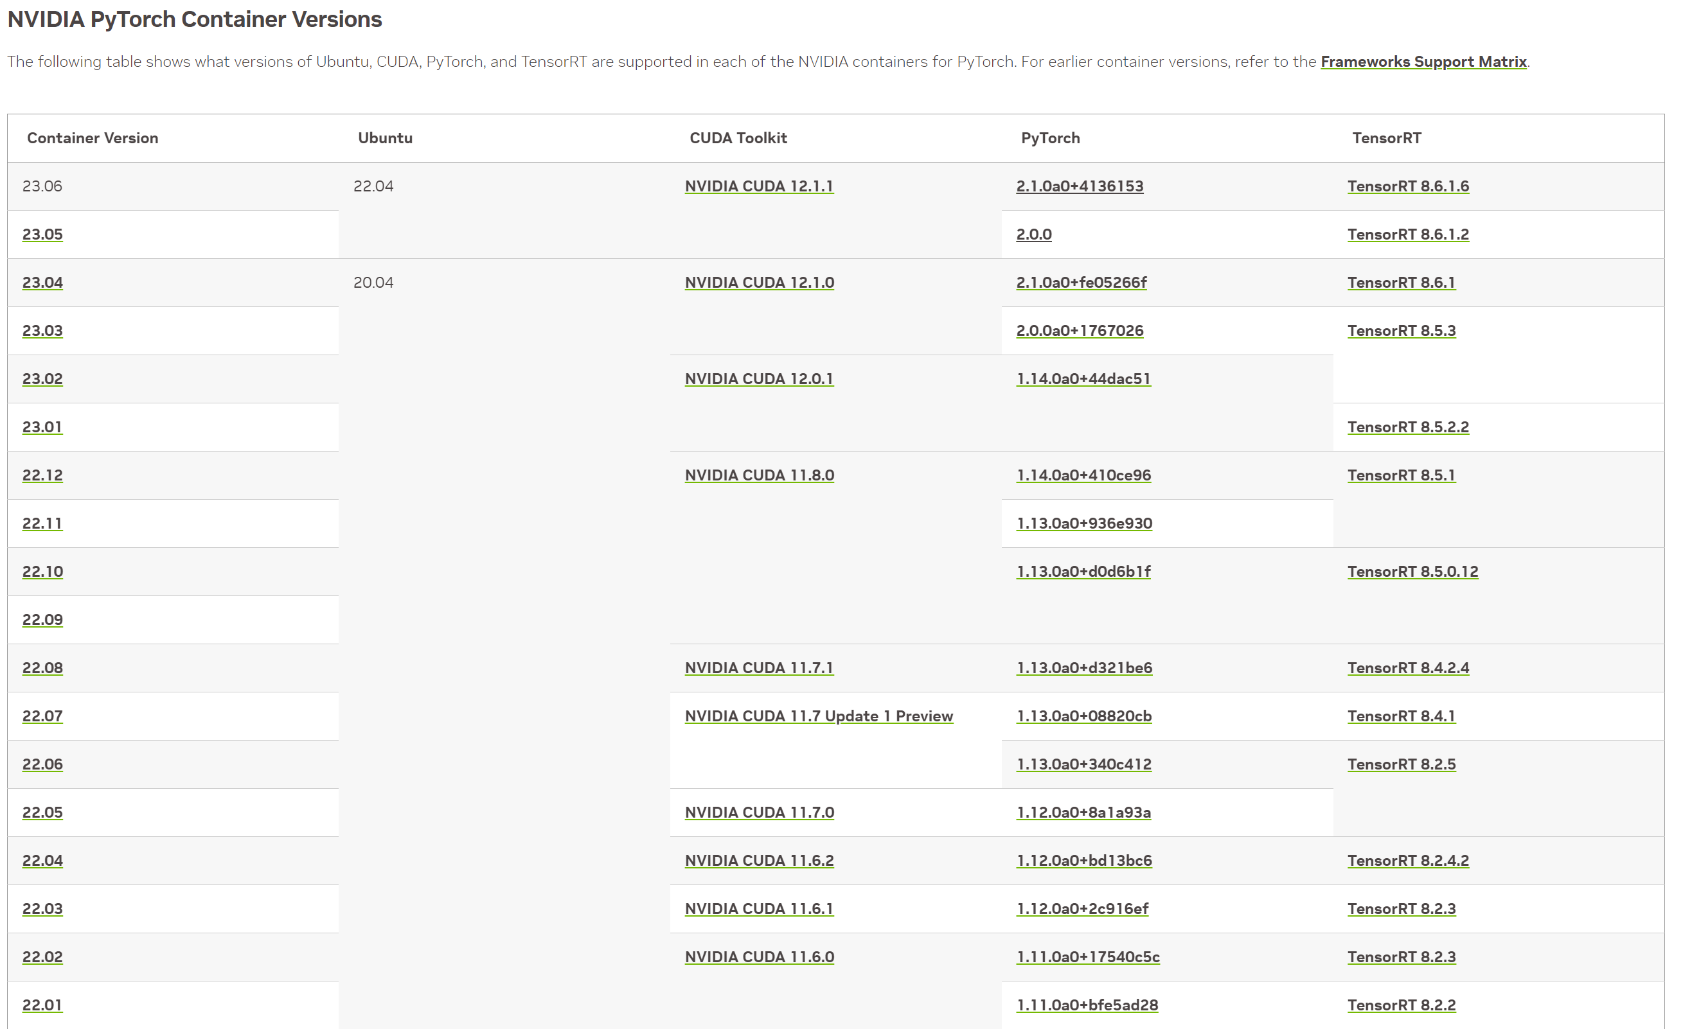
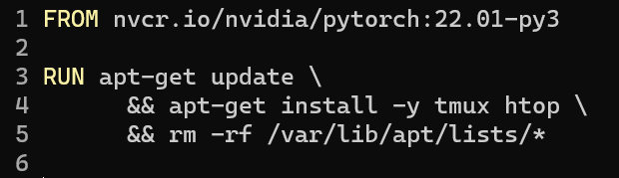
Q2: Dockerfile
Have to match your driver’s CUDA version.
Create a container with access to GPUs.
nvidia-smi should work.
Install specific packages.
https://docs.nvidia.com/deeplearning/frameworks/pytorch-release-notes/rel-23-06.html

Slide 9
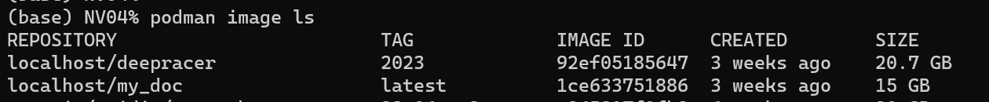
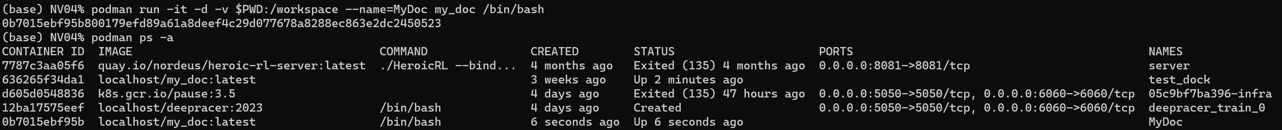
Q2: Dockerfile and Podman
podman build -t <image_name> -f Dockerfile .
podman image ls
podman run -it -d -v $PWD:/workspace --name=<container_name> <image_name> /bin/bash
podman ps -a

Slide 10
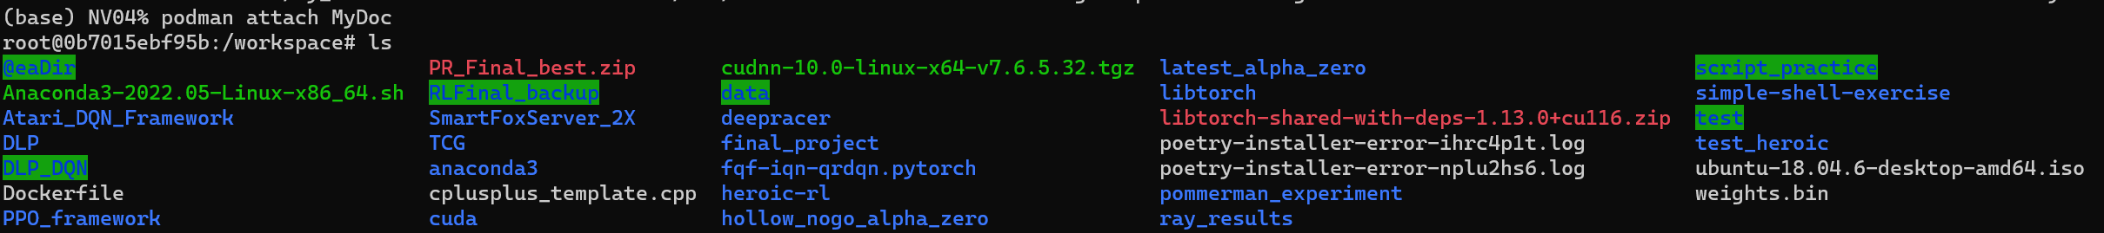
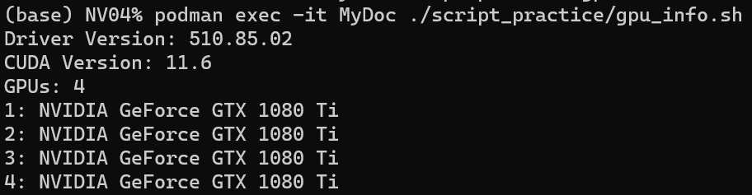
Q2: Dockerfile and Podman
podman attach <container_name>
Detach: ctrl-p, ctrl-q (先按ctrl-p, 再按ctrl-q) (Use `exit` will shutdown the container)
podman exec -it MyDoc <cmd>

Slide 11
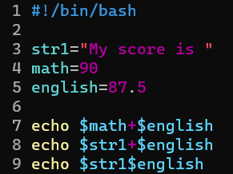

Shell Script - Variables
Variable_name=value. No space in both sides.
Bash does not have the concept of datatypes, but you can consider the default type as string.
Use $ or ${ } to get the value of variable.
Example:

Slide 12
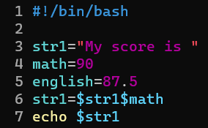

Shell Script - Variables
String append:

Slide 13
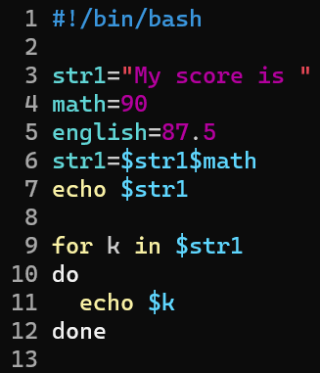
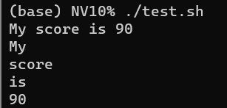
Shell Script - Variables
String split:
Use for loop (will be covered later)

Slide 14
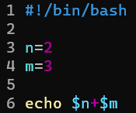

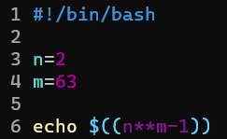

Shell Script - Math Operations
Can not use + directly.
Can use $(( )) in integer calculation.
+, -, *, /, %, ** work.
Range is long long.
For complex math operations, use bc (basic calculator).
+, -, *, /, %, ^, sqrt… work.
echo “expression”| bc

Slide 15
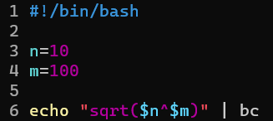
Shell Script - Math Operations
Examples of using bc:
Big number calculation.

Slide 16
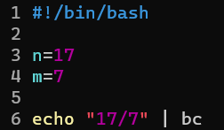
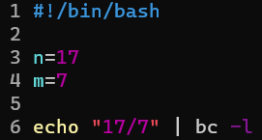
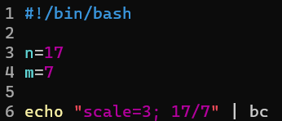



Shell Script - Math Operations
Examples of using bc:
Float number calculation.

Slide 17
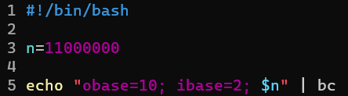

Shell Script - Math Operations
Examples of using bc:
Binary operation.

Slide 18
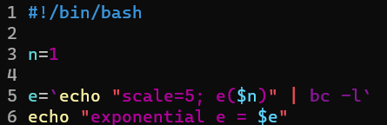

Shell Script - Math Operations
Examples of using bc:
Store the result of complete operation.
-l: standard math library.
e: a built-in math functions.
Use ` ` or $( ) to store the result of an output.

Slide 19
Shell Script - Data Structures
Bash Array can store a large group of variables.
There are two types of bash arrays:
Indexed: the array is referred via integers or numbers.
Associative: the array is referred via strings or a set of characters and words.
Bash does not support multidimensional arrays.

Slide 20



Shell Script - Data Structures
Indexed array:
Declare:
Assign values:
Method 1:
Method 2:

Slide 21

Shell Script - Data Structures
Associative array:
Declare:
Assign values:
Method 1:
Method 2:

Slide 22
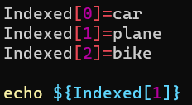
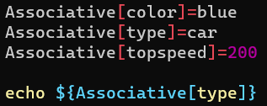
Shell Script - Data Structures
Reference and print an array element:
Use ${name[index]}
Indexed array:
Associative array:

Slide 23
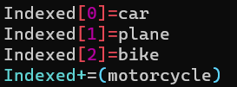
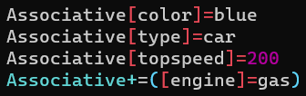
Shell Script - Data Structures
Add a variable to a Bash Array:
Use += operator.
Indexed array:
Associative array:

Slide 24
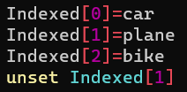
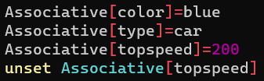
Shell Script - Data Structures
Remove elements in Bash Array:
Use unset.
Indexed array:
Associative array:

Slide 25
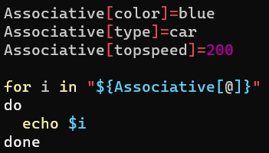
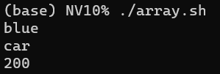
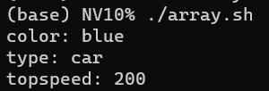
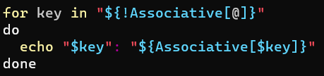
Shell Script - Data Structures
Loop through an array:

Slide 26
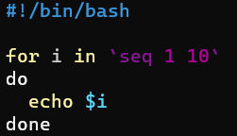
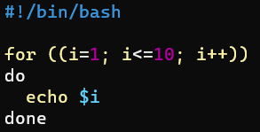
Shell Script - Expressions
for loop:
for var in something_iterable
do
#something
done

Slide 27
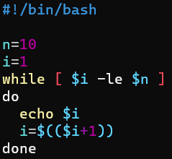
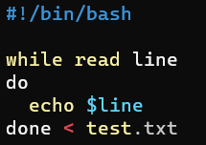
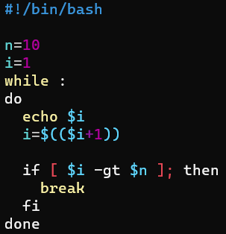
Shell Script - Expressions
while loop:
while [ condition ]
do
#something
done

Slide 28
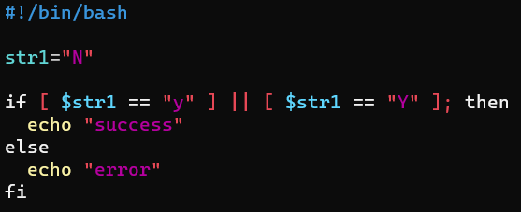
Shell Script - Expressions
if:
if [ cond1 ]; then
elif [ cond2 ]; then
else
fi
==, != are for strings.
-gt, -lt, -ge, -le, -eq, -ne are for numbers.
Use &&, || for multiple conditions.

Slide 29
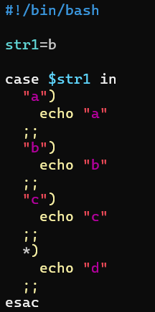
Shell Script - Expressions
case:
case $var in
“a”)
# something
;;
“b”)
# something
;;
*)
#something
;;
esac

Slide 30
Shell Script - Expressions
awk
Alfred Aho, Peter Weinberger, and Brian Kernighan.
Processing text files.
Text analysis.
awk structure
awk ‘pattern { action }’
pattern: BEGIN, END, regex.
action: if, while, for …… grammar similar to C.

Slide 31
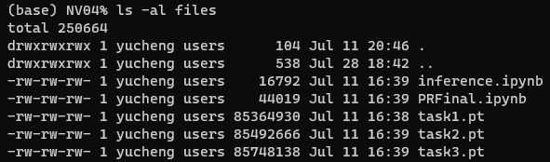
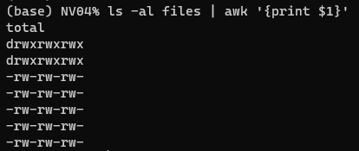
Shell Script - Expressions
awk example:

Slide 32
Shell Script - Expressions
awk example:
$0
$9 or $NF
$1
$2 …… separated by space (by default)

Slide 33
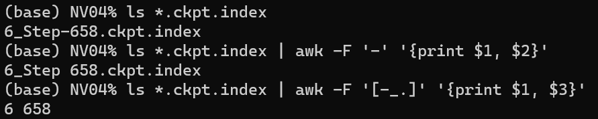

Shell Script - Expressions
awk split example:
Separator: -F $′FS′$
Multiple separator: -F $′[ FS ]′$

Slide 34

Shell Script - Other Useful Tricks
Read from stdin:
read -p <prompt statement> <variable_name>
Add `Help` command in your script:
if [ "$1" == "--help" ] || [ "$1" == "-h" ];
then
echo “Usage <arg1> <arg2> …”
exit 0
fi

Slide 35
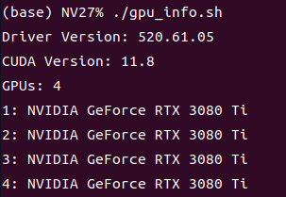
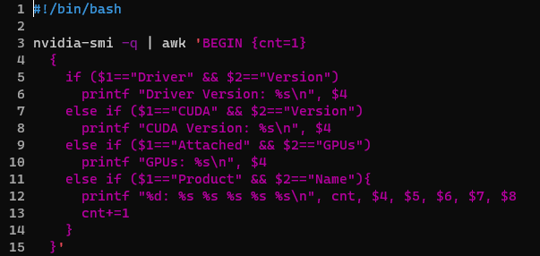
Q3 using awk
Q3: Write a script that shows:
Ans:

Slide 36
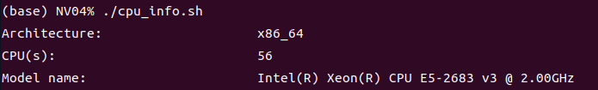
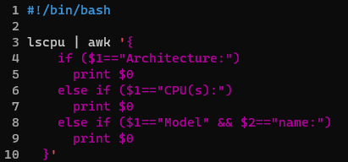
Q4 using awk
Q4: Write a script that shows:
Ans:

Slide 37
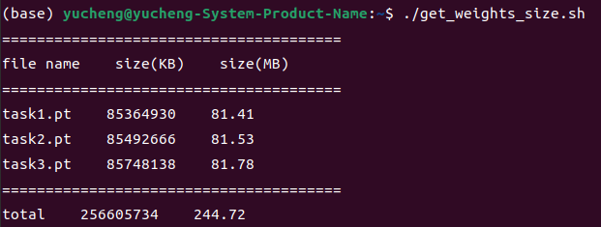
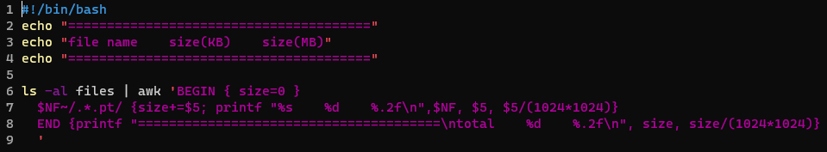
Q6 using awk
Q6: Write a script that shows:
Ans:
Using regular expressions to match lines.
Syntax: word ~ /regex/

Slide 38
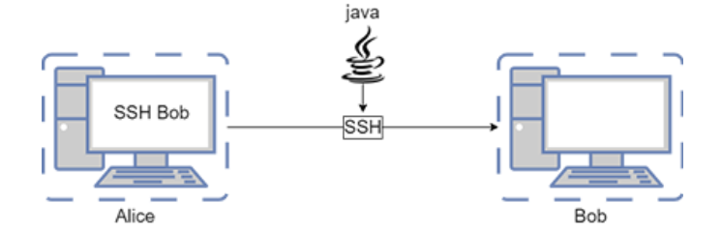
Tmux
Terminal multiplexer
Why tmux ?
Server kills your process when you disconnect !

Slide 39
Tmux
Terminal multiplexer
Why tmux ?
Server kills your process when you disconnect !
exit or connection timeout

Slide 40
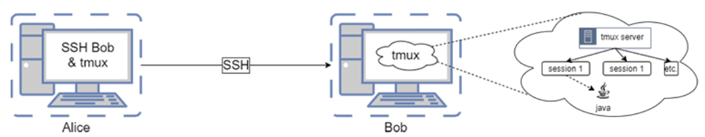
Tmux
Alice ssh to Bob and run Tmux.
The process that Alice run is running on the Tmux server, not related to ssh.
The disconnection of ssh has no effect.

Slide 41
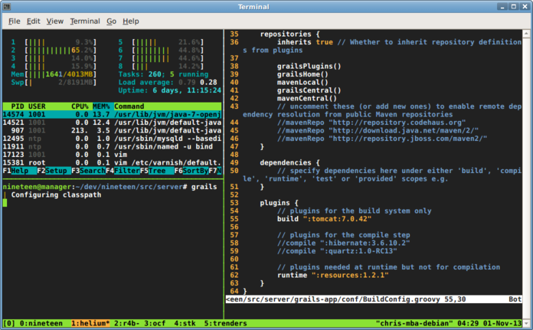
Tmux UI
session

Slide 42
Tmux UI
window

Slide 43
Tmux UI
pane

Slide 44
Tmux Command
a + b: press together (同時按)
a , b: press a then press b (先按a, 再按b)
Action | Command
Split pane (horizontal) | Ctrl + b , %
Split pane (vertical) | Ctrl + b , “
Choose pane | Ctrl + b , →
Close pane | Ctrl + d
New window | Ctrl + b , c
Previous window | Ctrl + b , p
Next window | Ctrl + b , n

Slide 45
Tmux Command
Action | Command
Choose window | Ctrl + b , <number>
Resize pane | Ctrl + b + →
Rolling mode | Ctrl + b , PageUp
Exit Rolling mode | q
Detach | Ctrl + b , d

Slide 46
Tmux Command
Action | Command (outside tmux)
Install | apt install tmux
Enter tmux (new session) | tmux
Attach to tmux session | tmux attach –t <name>
list tmux session | tmux ls
Attach to latest session | tmux a
Kill session | tmux kill-session -t <name>

Slide 47

Q5 tmux script

Slide 48

Tmuxinator
apt install tmuxinator
.tmuxinator.yml
tmuxinator start .

Slide 49

Nvitop
pip install nvitop

Slide 50


Q7 Associative array & sort
@ also ok.

Slide 51

Q8 awk
cat file.txt | awk
'$0 ~ /^([0-9][0-9][0-9])-[0-9][0-9][0-9]-[0-9][0-9][0-9][0-9]$|
^(\([0-9][0-9][0-9]\) )[0-9][0-9][0-9]-[0-9][0-9][0-9][0-9]$/ {print $0}'

Slide 52


Q9 awk, for, seq
c=2

Slide 53



Q10 awk

Slide 54


Q11 change text color
enable interpretation of backslash escapes
do not output the trailing newline
Change text color in terminal:
Color list: https://gist.github.com/vratiu/9780109

Slide 55


Q12 array
Access array elements and calculate:
Indexed array

Slide 56

Q13 case

Slide 57


Q14 parse input arguments
./port_status_ans.sh 127.0.0.1 80 8080
$0
$1
$2
$3
$@

Slide 58


Q15 call function
Function call like executing another script.
String comparison needs “ ” both sides.

Slide 59
Reference
Awk:
Linux awk 命令 | 菜鸟教程 (runoob.com)
Awk regular expression:
How to use regular expressions in awk | Opensource.com
Nvidia PyTorch Released container images:
https://docs.nvidia.com/deeplearning/frameworks/pytorch-release-notes/rel-23-06.html
Bash color list:
https://gist.github.com/vratiu/9780109
Bash array:
https://www.hostinger.com/tutorials/bash-array
Basic calculator (bc):
https://www.geeksforgeeks.org/bc-command-linux-examples/

Slide 60
Reference
Shell script:
https://linux.vbird.org/linux_basic/centos7/0340bashshell-scripts.php
https://medium.com/@yihengwu/%E7%A8%8B%E5%BC%8F%E7%AD%86%E8%A8%98-shell-script-%E7%B0%A1%E6%98%93%E7%AD%86%E8%A8%98-841cfc3ae3ab
Bash read:
https://www.delftstack.com/zh-tw/howto/linux/read-from-a-file-or-user-input-in-bash/
Tmuxinator
https://github.com/tmuxinator/tmuxinator
Tmux
https://blog.csdn.net/u014261408/article/details/89931729

