Slide 1
ns-3 tutorial
  Presenter: Tom Henderson
  University of Washington
  Simutools Conference
  March, 2008

Slide 2
Acknowledgments
Thanks to Mathieu Lacage and Craig Dowell for assembling the tutorial source code and materials
Thanks to ns-3 development team!
Tom Henderson is supported by NSF CNS-0551686 (University of Washington)‏

Slide 3
Goals of this tutorial
Learn about the ns-3 project and its goals
Understand the software architecture, conventions, and basic usage of ns-3
Read and modify an example ns-3 script
Learn how you might extend ns-3 to conduct your own research
Provide feedback to the ns-3 development team

Slide 4
Assumptions
Some familiarity with C++ programming language
Some familiarity with Unix Network Programming (e.g., sockets)‏
Some familiarity with discrete-event simulators

Slide 5
Outline
Introduction to ns-3
Reading ns-3 code
Tweaking ns-3 code
Extending ns-3 code

Slide 6
What is ns (or ns-2)?
ns is a discrete-event network simulator for Internet systems
  protocol design, multiple levels of abstraction
  written in multiple languages (C++/OTcl)‏
ns has a companion network animator called nam
  hence, has been called the nsnam project
ns-3 is a research-oriented, discrete event simulator

Slide 7
ns-3 features
open source licensing (GNU GPLv2) and development model
Python scripts or C++ programs
alignment with real systems (sockets, device driver interfaces)‏
alignment with input/output standards (pcap traces, ns-2 mobility scripts)‏
testbed integration is a priority
modular, documented core

Slide 8
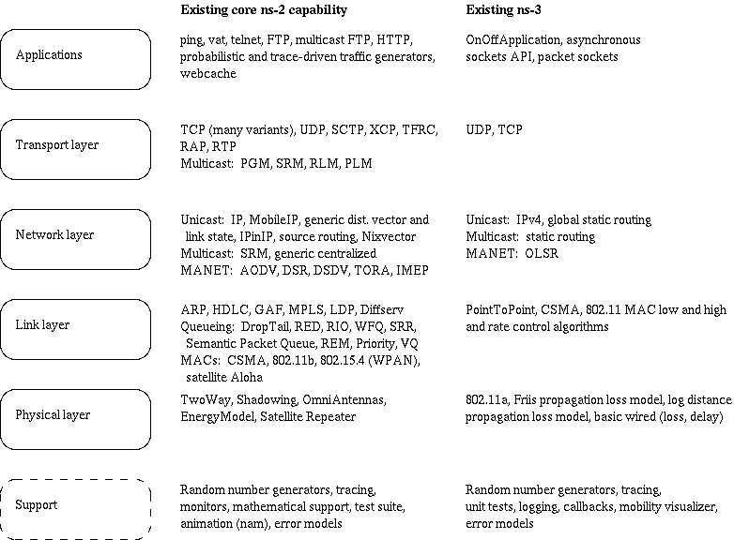
ns-3 models
Project focus has been on the software core, to date

Slide 9
ns-3 people
NSF PIs:
  Tom Henderson, Sumit Roy (University of Washington), George Riley (Georgia Tech.), Sally Floyd (ICIR)‏
Associated Team: INRIA Sophia Antipolis, Planete group
  Walid Dabbous, Mathieu Lacage (software lead)‏
Developers: Raj Bhattacharjea, Gustavo Carneiro, Craig Dowell, Joseph Kopena, Emmanuelle Laprise
`

Slide 10
ns-3 relationship to ns-2
ns-3 is not an extension of ns-2
does not have an OTcl API
  C++ wrapped by Python
synthesis of yans, ns-2, GTNetS simulators, and new software
  example ns-2 models so far: random variables, error models, OLSR
guts of simulator are completely replaced
new visualizers are in works

Slide 11
ns-3 status (March 2008)‏
ns-3 is in a pre-alpha state
monthly development releases
APIs being finalized
emphasis has been on setting the architecture
new users should expect rough edges
many opportunities to work on the core models

Slide 12
ns-3 status (March 2008)‏
What others are already using ns-3 for:
wifi-based simulations of OLSR and other MANET routing
MANET routing (SMF and unicast protocols)‏
OntoNet: Scalable Knowledge Based Networking" by Joe Kopena and Boon Thau Loo (UPenn)

Slide 13
ns-3 roadmap (2008)‏
near term (through June)‏
finalize and release simulation core (April/May)‏
  core APIs
ns-3.1 complete release (June timeframe)‏
  add Internet and Device models
  add validation framework
  some higher-level topology/scenario APIs

Slide 14
ns-3 roadmap (2008)‏
planned for later this year
emulation modes
statistics
support for real code
additional ns-2 porting/integration
distributed simulation
visualization

Slide 15
Resources
Web site:
  http://www.nsnam.org
Mailing list:
  http://mailman.isi.edu/mailman/listinfo/ns-developers
Tutorial:
  http://www.nsnam.org/docs/tutorial/tutorial.html
Code server:
  http://code.nsnam.org
Wiki:
  http://www.nsnam.org/wiki/index.php/Main_Page

Slide 16
Links to materials
Today's code
  http://www.nsnam.org/tutorials/simutools08/ns-3-tutorial.tar.gz3-tutorial.tar.gz
Tutorial slides:
  PPT: http://www.nsnam.org/tutorials/simutools08/ns-3-tutorial.ppt3-tutorial.ppt
  PDF: http://www.nsnam.org/tutorials/simutools08/ns-3-tutorial.pdf

Slide 17
Questions so far?

Slide 18
Outline
Introduction to ns-3
Reading ns-3 code
Tweaking ns-3 code
Extending ns-3 code

Slide 19
Reading ns-3 code
Browsing the source code
Conceptual overview
Script walkthrough

Slide 20
Basics
ns-3 is written in C++
Bindings in Python
ns-3 uses the waf build system
i.e., instead of ./configure;make, type ./waf
simulation programs are C++ executables (python scripts)‏

Slide 21
Browse the source
tomh@A3803721 ~/home/ns-3-dev
$ ls
AUTHORS README VERSION examples samples tutorial waf wscript
LICENSE RELEASE_NOTES doc ns3 src utils waf.bat
Pause presentation to browse source code
http://www.nsnam.org/tutorials/simutools08/ns-3-tutorial.tar.gz

Slide 22
Doxygen documentation
Most of the ns-3 API is documented with Doxygen
  http://www.stack.nl/~dimitri/doxygen/
Pause presentation to browse Doxygen
http://www.nsnam.org/doxygen/index.html

Slide 23
the waf build system
Waf is a Python-based framework for configuring, compiling and installing applications.
  It is a replacement for other tools such as Autotools, Scons, CMake or Ant
  http://code.google.com/p/waf/
Pause presentation to build with waf

Slide 24
waf key concepts
For those familiar with autotools:
configure -> ./waf -d [optimized|debug] configure
make -> ./waf
make test -> ./waf check (run unit tests)‏
Can run programs through a special waf shell; e.g.
  ./waf --run simple-point-to-point
  (this gets the library paths right for you)‏

Slide 25
The basic model
Application
Application
Application
Application
Sockets-like
API
Protocol
stack
Protocol
stack
Packet(s)‏
Node
Node
NetDevice
NetDevice
NetDevice
Channel
NetDevice
Channel

Slide 26
Fundamentals
Key objects in the simulator are Nodes, Packets, and Channels
Nodes contain Applications, “stacks”, and NetDevices

Slide 27
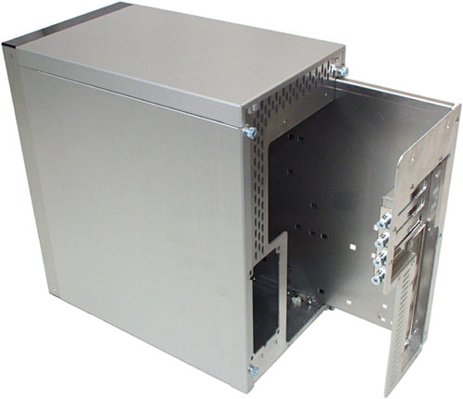


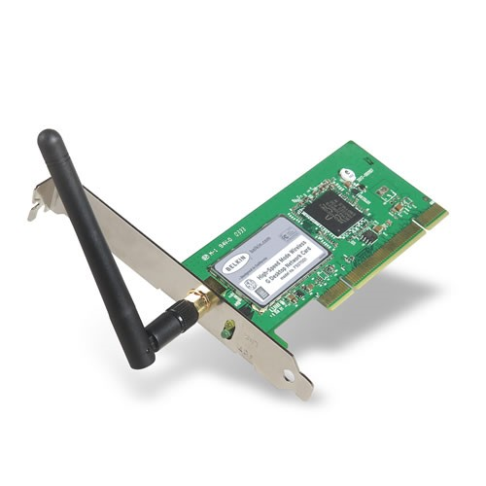
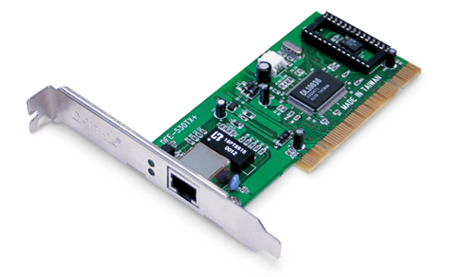
Node basics
A Node is a husk of a computer to which applications, stacks, and NICs are added
Application
Application
Application
“DTN”

Slide 28
NetDevices and Channels
NetDevices are strongly bound to Channels of a matching type
Nodes are architected for multiple interfaces
WifiChannel
WifiNetDevice

Slide 29
Node basics
Two key abstractions are maintained:
1) applications use an (asynchronous, for now) sockets API
2) the boundary between IP and layer 2 mimics the boundary at the device-independent sublayer in Linux
  i.e., Linux Packet Sockets

Slide 30
ns-3 Packets
each network packet contains a byte buffer, a list of tags, and metadata
  buffer: bit-by-bit (serialized) representation of headers and trailers
  tags: set of arbitrary, user-provided data structures (e.g., per-packet cross-layer messages, or flow identifiers)‏
  metadata: describes types of headers and and trailers that have been serialized
    optional-- disabled by default

Slide 31
ns-3 Packets
to add a new header, subclass from Header, and write your Serialize() and Deserialize() methods
  how bits get written to/from the Buffer
Similar for Packet Tags
Packet Buffer implements a (transparent) copy-on-write implementation

Slide 32
example: UDP header
class UdpHeader : public Header
{
public:
void SetDestination (uint16_t port);
...
void Serialize (Buffer::Iterator start) const;
uint32_t Deserialize (Buffer::Iterator start);
private:
uint16_t m_sourcePort;
uint16_t m_destinationPort;
uint16_t m_payloadSize;
uint16_t m_initialChecksum;
}

Slide 33
example: UDP header
void
UdpHeader::Serialize (Buffer::Iterator start) const
{
Buffer::Iterator i = start;
i.WriteHtonU16 (m_sourcePort);
i.WriteHtonU16 (m_destinationPort);
i.WriteHtonU16 (m_payloadSize + GetSerializedSize ());
i.WriteU16 (0);
if (m_calcChecksum)‏
{
uint16_t checksum = Ipv4ChecksumCalculate (...);
i.WriteU16 (checksum);
}
}

Slide 34
Simulation basics
Simulation time moves discretely from event to event
C++ functions schedule events to occur at specific simulation times
A simulation scheduler orders the event execution
Simulation::Run() gets it all started
Simulation stops at specific time or when events end

Slide 35



Sample script walkthrough
WiFi (AdHoc network)‏
Backbone
CSMA (LAN)‏
Hierarchical mobility
1) AdHoc movement in backbone
2) Local movement relative to Access Point
WiFi
(Infra-structure)‏
WiFi
(Infra-structure)‏
Applications: UDP flow,
Routing: OLSR on backbone

Slide 36
Sample script walkthrough
Walk through mixed-wireless.cc

Slide 37
(aside) similar looking code in Python
import sys
import ns3 as ns
def main():
## Set up some default values for the simulation. Use the Bind()‏
## technique to tell the system what subclass of Queue to use,
## and what the queue limit is
## The below Bind command tells the queue factory which class to
## instantiate, when the queue factory is invoked in the topology code
ns.DefaultValue.Bind("Queue", "DropTailQueue")‏
ns.DefaultValue.Bind("OnOffApplicationPacketSize", "210")‏
ns.DefaultValue.Bind("OnOffApplicationDataRate", "448kb/s")‏
ns.CommandLine.Parse(sys.argv)‏
## Here, we will explicitly create four nodes. In more sophisticated
## topologies, we could configure a node factory.
n0 = ns.InternetNode()‏
n1 = ns.InternetNode()
n2 = ns.InternetNode()
n3 = ns.InternetNode()‏
...

Slide 38
examples/ directory
examples/ contains other scripts with similar themes
$ ls
csma-broadcast.cc simple-point-to-point.cc
csma-multicast.cc tcp-large-transfer-errors.cc
csma-one-subnet.cc tcp-large-transfer.cc
csma-packet-socket.cc tcp-nonlistening-server.cc
mixed-global-routing.cc tcp-small-transfer-oneloss.cc
simple-alternate-routing.cc tcp-small-transfer.cc
simple-error-model.cc udp-echo.cc
simple-global-routing.cc waf
simple-point-to-point-olsr.cc wscript

Slide 39
Outline
Introduction to ns-3
Reading ns-3 code
Tweaking ns-3 code
Extending ns-3 code

Slide 40
ns-3 logging
ns-3 has a built-in logging facility to stderr
Features:
  can be driven from shell environment variables
  Multiple log levels like syslog
  Function and call argument tracing
Intended for debugging, but can be abused to provide tracing
  we do not guarantee that format is unchanging

Slide 41
ns-3 logging example
NS_LOG_UNCOND();
NS_LOG environment variable
per-source-file logging
log levels
example scripts

Slide 42
attributes and tracing
Next, we would like to talk about attributes (default values, settable and gettable values) and tracing
To understand this, we'll introduce the ns-3 Object system

Slide 43
Object metadata system
ns-3 is, at heart, a C++ object system
ns-3 objects that inherit from base class ns3::Object get several additional features
  dynamic run-time object aggregation
  an attribute system
  smart-pointer memory management
Disclaimer: This is not all main-line ns-3 code-- parts are in
a proposal in the mathieu/ns-3-param repository

Slide 44
Object aggregation use case
You can aggregate objects to one another at run-time
  Avoids the need to modify a base class to provide pointers to all possible connected objects
Object aggregation is planned to be the main way to create new Node types (rather than subclassing Node)‏

Slide 45
Object aggregation example
void
WifiChannel::Send (Ptr<WifiPhy> sender, Ptr<const Packet> packet, ...)‏
{
Ptr<MobilityModel> senderMobility = 0;
Ptr<MobilityModel> receiverMobility = 0;
...
senderMobility = sender->GetNode ()->
GetObject<MobilityModel> ();
}
class Node does not need to know
about MobilityModel

Slide 46
Use cases for attributes
An Attribute represents a value in our system
An Attribute can be connected to an underlying variable or function
  e.g. TcpSocket::m_cwnd;
  or a trace source

Slide 47
Use cases for attributes (cont.)‏
What would users like to do?
  Know what are all the attributes that affect the simulation at run time
  Set a default initial value for a variable
  Set or get the current value of a variable
  Initialize the value of a variable when a constructor is called
The attribute system is a unified way of handling these functions

Slide 48
How to handle attributes
The traditional C++ way:
  export attributes as part of a class's public API
  walk pointer chains (and iterators, when needed) to find what you need
  use static variables for defaults
The attribute system provides a more convenient API to the user to do these things

Slide 49
The traditional C++ way
class Foo
{
public:
void SetVar1 (uint32_t value);
uint32_t GetVar1 (void);
static void SetInitialVar1(uint32_t value);
void SetVar2 (uint32_t value);
uint32_t GetVar2 (void);
static void SetInitialVar2(uint32_t value);
...
private:
uint32_t m_var1; // document var1
uint32_t m_var2; // document var2
static uint32_t m_initial_var1;
static uint32_t m_initial_var2;
}
Foo::Foo() : m_var1(Foo::m_initial_var1), m_var2(Foo::m_initial_var2)‏
{
}
to modify an instance of Foo, get the pointer somehow, and use the public accessor functions
to modify the default values, modify the statics
Default values may be available in a separate framework (e.g. ns-2 Bind())‏

Slide 50
Navigating the attributes
Attributes are exported into a string-based namespace, with filesystem-like paths
  namespace supports regular expressions
Attributes also can be used without the paths
  e.g. “WifiPhy::TxGain”
A Config class allows users to manipulate the attributes

Slide 51
Navigating the attributes using paths
Examples:
  Nodes with NodeIds 1, 3, 4, 5, 8, 9, 10, 11:
    “/NodeList/[3-5]|[8-11]|1”
  UdpL4Protocol object instance aggregated to matching nodes:
    “/$UdpL4Protocol”
  EndPoints which match the SrcPort=1025 specification:
    “/EndPoints/*:SrcPort=1025”

Slide 52
What users will do
e.g.: Set a default initial value for a variable
(Note: this replaces DefaultValue::Bind())‏
  Config::Set (“WifiPhy::TxGain”, Double (1.0));
Syntax also supports string values:
  Config::Set (“WifiPhy::TxGain”, “1.0”);
Attribute
Value

Slide 53
What users will see
Set or get the current value of a variable
  Here, one needs the path in the namespace to the right instance of the object
  Config::SetAttribute(“/NodeList/5/DeviceList/3/Phy/TxGain”, Double(1.0));
  Double d = Config::GetAttribute(“/NodeList/5/NetDevice/3/Phy/TxGain”);
Users can get Ptrs to instances also, and Ptrs to trace sources, in the same way

Slide 54
CreateObject<> ();
CreateObject<> is a wrapper for operator new.
ns3::Object objects must be created on the heap using CreateObject<> (), which returns a smart pointer; e.g.
Ptr<Node> rxNode = CreateObject<Node> ();

Slide 55
Create<> ();
What is Create<> ()?
Create<> provides some smart pointer help for objects that use ns3::Ptr<> but that do not inherit from Object.
Principally, class ns3::Packet
Ptr<Packet> p = Create<Packet> (data,size);

Slide 56
Non-default constructors
The attribute system allows you to also pass them through the CreateObject<> constructor.
This provides a generic non-default constructor for users (any combination of parameters), e.g.:
Ptr<WifiPhy> phy = CreateObject<WifiPhy> (
“TxGain”, Double (1.0));

Slide 57
How is all this implemented (overview)‏
class Foo P public Object
{
public:
static TypeId GetTypeId (void);
private:
uint32_t m_var1; // document var1
uint32_t m_var2; // document var2
}
Foo::Foo() {
}
TypeId Foo::GetTypeId (void)‏
{
static TypeId tid = TypeId(“Foo”);
.SetParent (<ooParent>
.SetGroupName (“FooDefaults”)‏
.AddConstructor<Foo> ();
.AddAttribute (“m_var1”, “document var1”,
UInteger(3),
MakeUIntegerAccessor (&Foo::m_var1),
MakeUIntegerChecker<uint32_t> ())‏
.AddAttribute (“m_var2”, “”, ...)‏
return tid;
}

Slide 58
A real TypeId example
TypeId
RandomWalk2dMobilityModel::GetTypeId (void)‏
{
static TypeId tid = TypeId ("RandomWalkMobilityModel")‏
.SetParent<MobilityModel> ()‏
.SetGroupName ("Mobility")‏
.AddConstructor<RandomWalk2dMobilityModel> ()‏
.AddAttribute ("bounds",
"Bounds of the area to cruise.",
Rectangle (0.0, 0.0, 100.0, 100.0),
MakeRectangleAccessor (&RandomWalk2dMobilityModel::m_bounds),
MakeRectangleChecker ())‏
.AddAttribute ("time",
"Change current direction and speed after moving for this delay.",
Seconds (1.0),
MakeTimeAccessor (&RandomWalk2dMobilityModel::m_modeTime),
MakeTimeChecker ())‏
.AddAttribute ("distance",
"Change current direction and speed after moving for this distance.",
Seconds (1.0),
MakeTimeAccessor (&RandomWalk2dMobilityModel::m_modeTime),
MakeTimeChecker ())‏

Slide 59
Also part of Object: smart pointers
ns-3 uses reference-counting smart pointers at its APIs to limit memory leaks
  Or “pass by value” or “pass by reference to const” where appropriate
A “smart pointer” behaves like a normal pointer (syntax) but does not lose memory when reference count goes to zero
Use them like built-in pointers:
Ptr<MyClass> p = CreateObject<MyClass> ();
p->method ();

Slide 60
Statements you should understand now
Ptr<Ipv4AddressAllocator> ipAddrs = CreateObject<Ipv4AddressAllocator> ();
C++ Smart Pointer
ns3::Object
Config::SetDefault (“OnOffApplication::DataRate”, String(“448kb/s”));
Config::SetDefault (“/NodeList/*/DeviceList/*/Phy/TxGain”, Double(10.0));
Attribute namespace

Slide 61
Tracing model
Tracing is a structured form of simulation output
  tracing format should be relatively static across simulator releases
Example (from ns-2):
+ 1.84375 0 2 cbr 210 ------- 0 0.0 3.1 225 610
- 1.84375 0 2 cbr 210 ------- 0 0.0 3.1 225 610
r 1.84471 2 1 cbr 210 ------- 1 3.0 1.0 195 600
r 1.84566 2 0 ack 40 ------- 2 3.2 0.1 82 602
+ 1.84566 0 2 tcp 1000 ------- 2 0.1 3.2 102 611
Needs vary widely

Slide 62
Crude tracing
#include <iostream>
...
int main ()‏
{
...
std::cout << "The value of x is " << x << std::endl;
...
}

Slide 63
slightly less crude
#include <iostream>
...
int main ()‏
{
...
NS_LOG_UNCOND ("The value of x is " << x);
...
}

Slide 64
Simple ns-3 tracing
these are wrapper functions/classes
see examples/mixed-wireless.cc
#include "ns3/ascii-trace.h"
AsciiTrace asciitrace ("mixed-wireless.tr");
asciitrace.TraceAllQueues ();
asciitrace.TraceAllNetDeviceRx ();

Slide 65
Simple ns-3 tracing (pcap version)‏
these are wrapper functions/classes
see examples/mixed-wireless.cc
#include "ns3/pcap-trace.h"
PcapTrace pcaptrace ("mixed-wireless.pcap");
pcaptrace.TraceAllIp ();

Slide 66
ns-3 tracing model (revisit)‏
Fundamental #1: decouple trace sources from trace sinks
Fundamental #2: prefer standard trace outputs for built-in traces
Trace source
Trace source
Trace sink
Trace source
configurable by
user
unchanging

Slide 67
Tracing overview
Simulator provides a set of pre-configured trace sources
  Users may edit the core to add their own
Users provide trace sinks and attach to the trace source
  Simulator core provides a few examples for common cases
Multiple trace sources can connect to a trace sink

Slide 68
Multiple levels of tracing
Highest-level: Use built-in trace sources and sinks and hook a trace file to them
Mid-level: Customize trace source/sink behavior using the tracing namespace
Low-level: Add trace sources to the tracing namespace
  Or expose trace source explicitly

Slide 69
Highest-level of tracing
Highest-level: Use built-in trace sources and sinks and hook a trace file to them
// Also configure some tcpdump traces; each interface will be traced
// The output files will be named
// simple-point-to-point.pcap-<nodeId>-<interfaceId>
// and can be read by the "tcpdump -r" command (use "-tt" option to
// display timestamps correctly)‏
PcapTrace pcaptrace ("simple-point-to-point.pcap");
pcaptrace.TraceAllIp ();

Slide 70
Mid-level of tracing
Mid-level: Customize trace source/sink behavior using the tracing namespace
void
PcapTrace::TraceAllIp (void)‏
{
NodeList::Connect ("/nodes/*/ipv4/(tx|rx)",
MakeCallback (&PcapTrace::LogIp, this));
}
Regular expression editing
Hook in a different trace sink

Slide 71
Asciitrace: under the hood
void
AsciiTrace::TraceAllQueues (void)‏
{
Packet::EnableMetadata ();
NodeList::Connect ("/nodes/*/devices/*/queue/enqueue",
MakeCallback (&AsciiTrace::LogDevQueueEnqueue, this));
NodeList::Connect ("/nodes/*/devices/*/queue/dequeue",
MakeCallback (&AsciiTrace::LogDevQueueDequeue, this));
NodeList::Connect ("/nodes/*/devices/*/queue/drop",
MakeCallback (&AsciiTrace::LogDevQueueDrop, this));
}

Slide 72
Lowest-level of tracing
Low-level: Add trace sources to the tracing namespace
Config::Connect ("/NodeList/.../Source",
MakeCallback (&ConfigTest::ChangeNotification, this));

Slide 73
Statistics
Disclaimer: not yet part of ns-3
Avoid large trace files
Full statistics support planned for later in 2008
Reuse tracing framework
One similar approach: ns-2-measure project
  http://info.iet.unipi.it/~cng/ns2measure/
  Static “Stat” object that collects samples of variables based on explicit function calls inserted into the code
  Graphical front end, and framework for replicating simulation runs

Slide 74
Revisit our script
WiFi (AdHoc network)‏
Backbone
CSMA (LAN)‏
Hierarchical mobility
1) AdHoc movement in backbone
2) Local movement relative to Access Point
WiFi
(Infra-structure)‏
WiFi
(Infra-structure)‏
Applications: TCP flow,
Routing: OLSR routing

Slide 75
Design patterns for topology scripts
Design approaches
Use simple helper functions with attributes
Use reusable “frameworks”
Note: This area of our API is under discussion; feedback wanted

Slide 76
The Helper approach
Is not generic
Does not try to allow code reuse
Provides simple 'syntactical sugar' to make simulation scripts look nicer and easier to read for network researchers
Each function applies a single operation on a ''set of same objects”

Slide 77
Helper Objects
NodeContainer: vector of Ptr<Node>
NetDeviceContainer: vector of Ptr<NetDevice>
InternetStackHelper
WifiHelper
MobilityHelper
OlsrHelper
... Each model provides a helper class

Slide 78
setup backbone
NodeContainer backbone;
backbone.Create (20);
MobilityHelper mobility;
mobility.SetPositionAllocator (“GridPositionAllocator”, “MinX”, Double (-100), ...);
mobility.SetMobilityModel (“RandomDirectionMobilityModel”)‏
mobility.Layout (backbone
WifiHelper wifi;
wifi.SetMac (“AdhocWifiMac”);
wifi.SetPhy (“WifiPhy”, “TxGain”, Double (10));
wifi.SetRemoteStationManager (“ConstantRateWifiManager”, “DataMode”, String (“wifia-54mb”))‏
Ptr<WifiChannel> channel = ...;
NetDeviceContainer backboneDev = wifi.Build (backbone, channel);

Slide 79
setup wifi subnets
for (uint32_t I = 0; I < 20; i++)‏
  NodeContainer subnet;
  subnet.Create (29);
  subnets.push_back (subnet);
  mobility.PushReferenceModel (backbone.Get (i));
  mobility.SetMobilityModel (...)‏
  mobility.SetPositionAllocator (...);
  mobility.Layout (subnet);
  subnet.Add (backbone.Get (i));
  Ptr<WifiChannel> subnetChannel = ...;
  NetDeviceContainer subnetDev =
  wifi.Build (subnet, subnetChannel);
  subnetDevs.push_back (subnetDev);

Slide 80
setup ip over backbone and subnets
IpNetworkAddressAllocator network;
network.SetMask (“192.168.0..0”, “255.255.0.0”);
InternetStackHelper ip;
ip.SetAddressAllocator (network.GetNext ());
ip.Setup (backboneDev);
for (uint32_t I = 0; I < 20; i++)‏
  NetDeviceContainer subnetDev = subnetDevs[i];
  ip.SetAddressAllocator (network.GetNext ());
  ip.Setup (subnetDev);

Slide 81
setup olsr on backbone
OlsrHelper olsr;
olsr.Enable (backbone);

Slide 82
setup traffic sinks everywhere
TrafficSinkHelper sink;
// listen on port 1026 for protocol udp
sink.EnableUdp (1026);
sink.Setup (NodeList::Begin (), NodeList::End ());

Slide 83
setup trace sources
OnOffApplicationHelper source;
source.SetUdpDestination (“168.192.4.10”, 1026);
NodeContainer one = subnets[2].Get ();
source.Setup (one);

Slide 84
Frameworks
Observation: Many of the operations executed by the helper class are repetitively executed, in slightly different ways
// Create Nodes
// Add NetDevice and Channel
// Add Protocol Stack
// Add Applications
// Add Mobility

Slide 85
Frameworks
Idea: Can we write the same flow of operations once, but delegate them to a Manager?
The Manager implements the functions
The functions are virtual
Users wishing to specialize them can override them as needed

Slide 86
Frameworks
This design pattern is called Inversion Of Control
This provides more reusable scenario/topology scripts than ones based on the Helper classes
walk through mixed-wireless-topology.cc and src/topology/

Slide 87
Outline
Introduction to ns-3
Reading ns-3 code
Tweaking ns-3 code
Extending ns-3 code

Slide 88
How do simulator objects fit together?
ns-3 objects are C++ objects
  can be subclassed
ns-3 Objects support aggregation
ns-3 models are composed of hooking C++ classes together
in the traditional way, and also with object aggregation

Slide 89
Aside: C++ templates
templates allow a programmer to write one version of code that is applicable over multiple types
templates are declared, defined and used
Declaration:
template <typename T> T Add (T first, T second);
T Add (T first, T second);
might eventually become
int Add (int first, int second);

Slide 90
Aside: C++ templates
Definition:
template <typename T>
T Add (T first, T second)‏
{
return first + second;
}
Usage:
int x, y, z;
z = Add<int> (x, y);

Slide 91
Classes may also be templatized
Declaration:
template <typename T>
class MyStack
{
void Push (T data);
T Pop (void);
};
Definition:
template <typename T> void MyStack<T>::Push (T data)‏
{ ... }
Usage:
MyStack<int> stack;
stack.Push (x);
y = stack.Pop ();

Slide 92
Scheduler and callbacks
Let’s look at samples/main-simulator.cc
Schedules a single event, then exits
int main (int argc, char *argv[])‏
{
MyModel model;
Simulator::Schedule (Seconds (10.0), &random_function, &model);
Simulator::Run ();
Simulator::Destroy ();
}

Slide 93
ns-3 callbacks
Class template Callback<> implements the functor design pattern
Callbacks are like function pointers, but more type-safe
static double CbOne (double a, double b) {}
^ ^ ^
| ---| ------|
| | |
Callback<double, double, double> one;
Bind a function with a matching signature to a callback
one = MakeCallback (&CbOne);
double returnOne = one (10.0, 20.0);

Slide 94
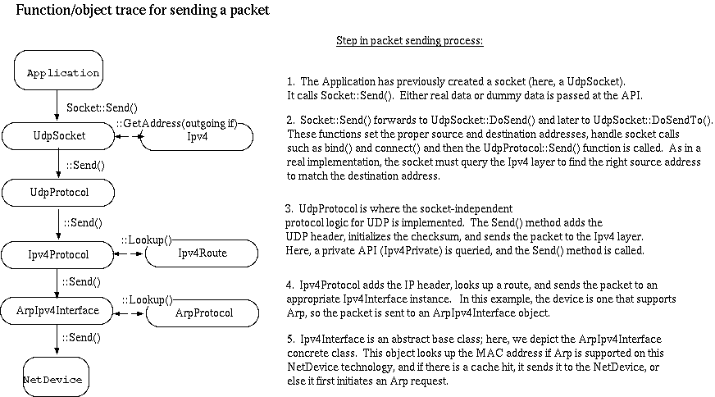
Path of a packet (send)
Note: This architecture is under additional work

Slide 95
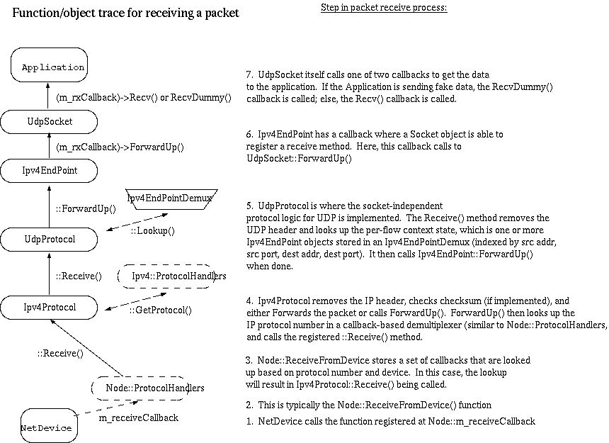
Path of a packet (receive)

Slide 96
current ns-3 routing model
classes Ipv4RoutingProtocol, Ipv4Route
Each routing protocol maintains its own RIB --> no common FIB
Routing protocols are registered with
  AddRoutingProtocol (Ptr<> protocol, int16_t priority)
Routes are looked up by querying each protocol for a route
  Ipv4L3Protocol::Lookup()

Slide 97
Writing new ns-3 models
1) Define your requirements
  reusability
  dependencies
  functionality
2) API review
  Provide sample header file for API review
  gather feedback from the ns-developers list

Slide 98
Writing new ns-3 models
3) Create a non-functional skeleton
  review coding style
  decide which compilation unit it resides in
  add to waf
  build with body ifdeffed out
  copyright and headers
  initial doxygen

Slide 99
Writing new ns-3 models
4) Build a skeleton
  header include guards
  namespace ns3
  constructor, empty function prototypes
  key variables
  Object/TypeId code
  write small test program
  start a unit test

Slide 100
Writing new ns-3 models
5) Build core functions and unit tests
  use of logging, and asserts
6) Plumb into other modules, if needed
7) Post for review on developers list
8) Resolve comments and merge

Slide 101
Porting from ns-2
Objects can be ported from ns-2 (or other simulators)‏
Make sure licensing is compatible
Example:
  ns-2: queue/errmodel.{cc,h}
  ns-3: src/common/error-model.{cc,h}

Slide 102
Validation
Can you trust ns-3 simulations?
  Can you trust any simulation?
  Onus is on the researcher to verify results
ns-3 strategies:
  Open source benefits
  Validation of models on testbeds
  Reuse of code
  Unit tests
  Event driven validation tests

Slide 103
Walk through examples (time permitting)
Beyond simple simulation scenarios
Add a new type of MAC+PHY:
subclass a NetDevice and a Channel
Add new types of transport layers:
subclass Node and Socket
subclass Ipv4 class to implement per-node Ipv4 forwarding table and Ipv4
interface configuration
for example, the Linux TCP stack could be easily integrated into a new type of node, LinuxNode with a LinuxTcpSocket
Add a new type of traffic generation and analysis:
subclass Application
• use Socket API

Slide 104
ns-3 goals for emulation
real machine
ns-3
ns-3
virtual
machine
virtual
machine
real
machine
real
machine
ns-3
Testbed
1) ns-3 interconnects virtual machines
2) testbeds interconnect ns-3 stacks

Slide 105
Summary
ns-3 is an emerging simulator to replace ns-2
Consider ns-3 if you are interested in:
  Open source and collaboration
  More faithful representations of real computers and the Internet
  Integration with testbeds
  A powerful low-level API
  Python scripting
ns-3 needs you!

Slide 106
Proposed Google Summer of Code projects
Performance Evaluation and Optimization
Linux Kernel Network Stack Integration
Parallel Simulations
GUI Development
Real World Code Integration

Slide 107
Resources
Web site:
  http://www.nsnam.org
Mailing list:
  http://mailman.isi.edu/mailman/listinfo/ns-developers
Tutorial:
  http://www.nsnam.org/docs/tutorial/tutorial.html
Code server:
  http://code.nsnam.org
Wiki:
  http://www.nsnam.org/wiki/index.php/Main_Page

