Slide 1
Pattern Recognition
Min Wang
Notes:
pattern模式 recognition识别

Slide 2
Application Cases
Character Recognition
  OCR (Optical Character Recognition)
Speech Recognition
  translation machine, identification
Intelligent Traffic
  License plate, car model
Target Recognition
  ATR (Automatic Target Recognition)
Many more…

Slide 3
What is PR?
Pattern 2
Sample
Recognition
Learning/Training
Evaluation/Test
Notes:
sample样本 learning学习 training训练 evaluation评价 test测试

Slide 4
What is PR?
Pattern recognition is the study of how machines can observe the environment, learn to distinguish patterns of interest from their background, and make sound and reasonable decisions about the categories of the patterns. (Anil K.Jain)
Notes:
PR模式识别

Slide 5

Structured PR methods (Jingsun Fu, 1960s)
Also called knowledge-based PR methods
  Structured representation (string, tree, graph)
  Structure (syntax) analysis
  Limited usage
  Difficulty in inference, recursion

Slide 6

Statistical PR methods (T.Pavlidis, 1971)
  A sample->a feature vector x^{T} = [x₁,…,x_{n}]
  Feature vectors->feature space
  How to divide the feature space
  Widely used
  Less make use of the structure relationship of patterns
Notes:
feature vector特征向量 feature space特征空间

Slide 7
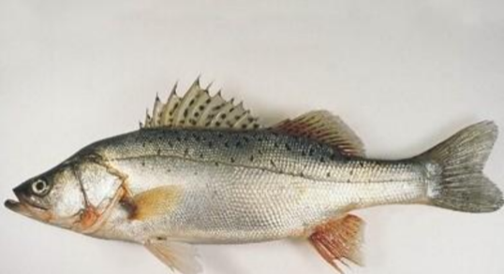


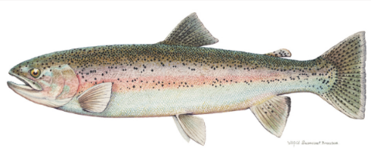
An Example
“Sorting incoming fish on a conveyor according to species using optical sensing”
Sea bass
Species
Salmon

Slide 8
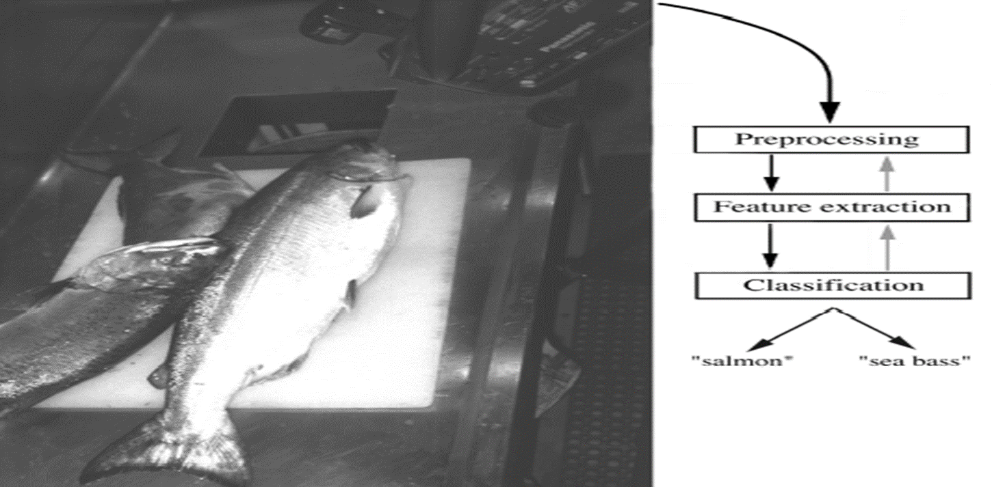

Slide 9
Preprocessing
  Use a segmentation operation to isolate fishes from one another and from the background
Feature extraction
  Reduce the Information from a single fish by measuring certain features
Classification
  Our focus
Notes:
preprocessing预处理 feature extraction特征提取 classification分类

Slide 10
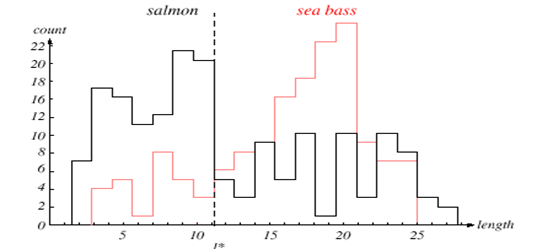
Classification by length
The length is a poor feature alone!
Select the lightness as a possible feature.

Slide 11
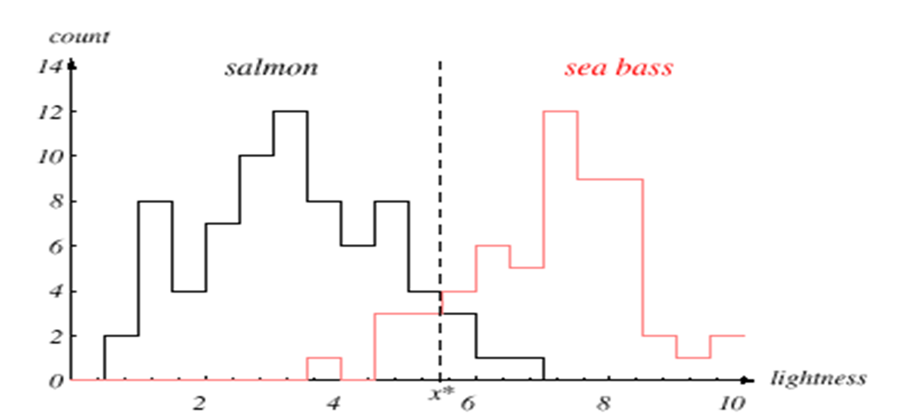
Classification by lightness

Slide 12

Decision theory
Threshold decision boundary and cost relationship
  Move our decision boundary toward smaller values of lightness in order to minimize the cost (reduce the number of sea bass that are classified salmon!)
  Central task of decision theory

Slide 13


Feature vector
Adopt the lightness and add the width of the fish
Fish x^{T} = [x₁, x₂]
Lightness Width

Slide 14

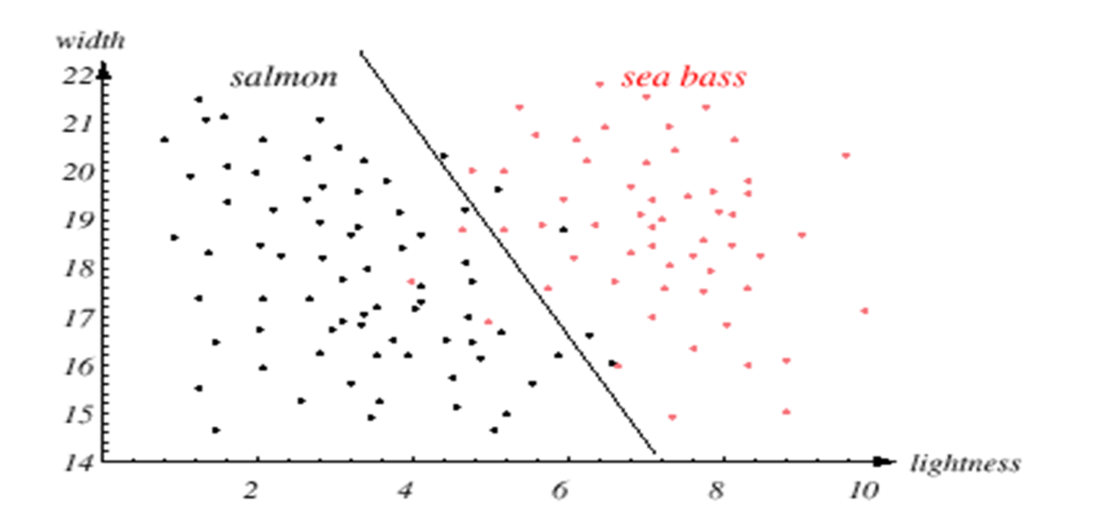
decision boundary
Underfitting!
Notes:
decision boundary决策边界 underfitting欠拟合

Slide 15
Feature choice
We might add other features that are not correlated with the ones we already have. A precaution should be taken not to reduce the performance by adding such “noisy features”
Ideally, the best decision boundary should be the one which provides an optimal performance such as in the following figure:
Notes:
feature choice特征选择

Slide 16
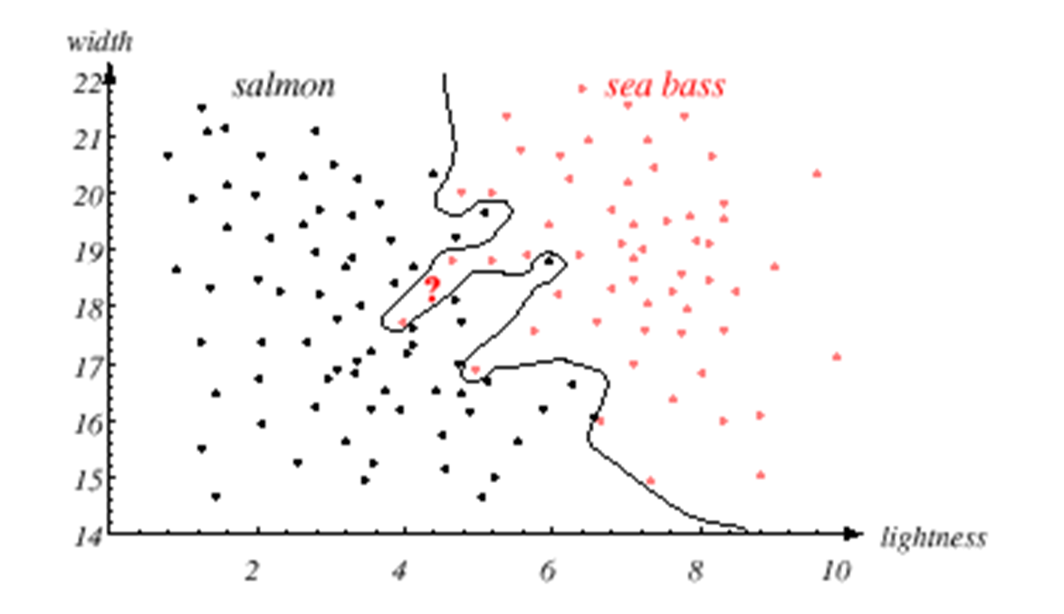
Overfitting!
Notes:
overfitting过拟合

Slide 17

Generalization
However, our satisfaction is premature because the central aim of designing a classifier is to correctly classify novel input
Issue of generalization!
Notes:
generalization泛化

Slide 18
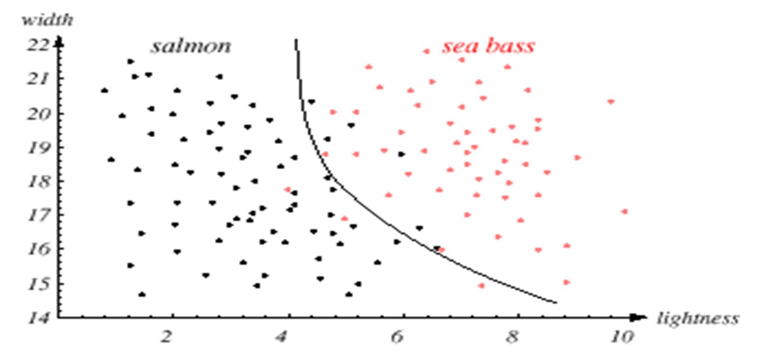
Model choice
Tradeoff!
Notes:
model choice模型选择 tradeoff平衡

Slide 19
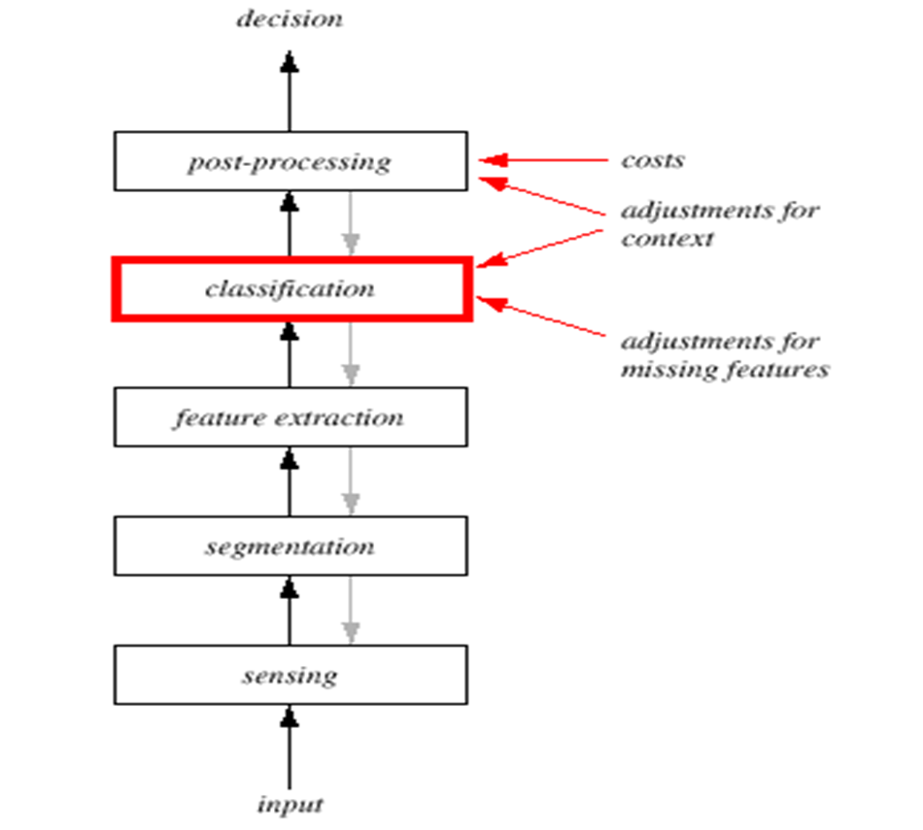
A PR System
Notes:
sensing传感 segmentation分割 post-processing后处理

Slide 20
Sensing
  Use of a transducer (camera or microphone)
  PR system depends of the bandwidth, the resolution sensitivity distortion of the transducer
  Data collection. How do we know when we have collected an adequately large and representative set of examples for training and testing the system?
  Out of our scope

Slide 21
Segmentation
  Samples should be well separated and should not overlap
  Out of our scope

Slide 22
Feature extraction
Feature choice
  Discriminative features
  Insensitive to noise
  Invariant features with respect to translation, rotation and scale
  Simple to extract
  Depends on the characteristics of the problem domain

Slide 23
Classification
  Use a feature vector provided by a feature extractor to assign the object to a category
  Model choice. Unsatisfied with the performance of our fish classifier and want to jump to another class of model
  Training. Use data to determine the classifier. Many different procedures for training classifiers and choosing models

Slide 24
Post-processing
  Measure the error rate (or performance) and switch from one set of features to another one
  Exploit context information other than from the target pattern itself to improve performance
  What is the trade-off between computational ease and performance?
  How an algorithm scales as a function of the number of features, patterns or categories?

Slide 25
Conclusion
Reader seems to be overwhelmed by the number, complexity and magnitude of the sub-problems of Pattern Recognition
Many of these sub-problems can indeed be solved
Many fascinating unsolved problems still remain

Slide 26
What you should know…
pattern,sample,recognition,
pattern recognition
feature,feature vector,
feature space,decision boundary
components of a PR system

