Slide 1
Boosting
Can we make weak learners smart?

Slide 2


Ensemble
model 1
Ensemble model
Data
model 2
……
Combine multiple models into one!
model k
Applications: classification*, regression, clustering, collaborative filtering, anomaly detection……

Slide 3
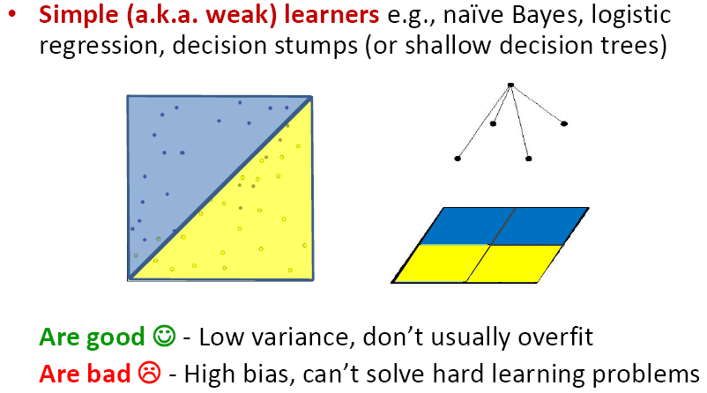

Why boost weak learners?

Slide 4
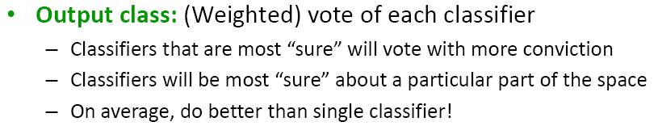
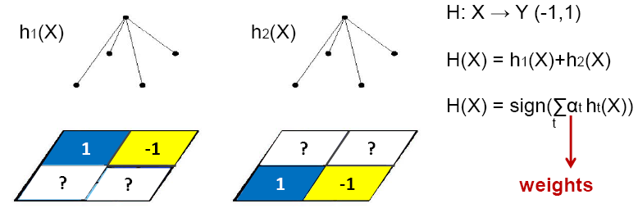
Voting (Ensemble Methods)

Slide 5
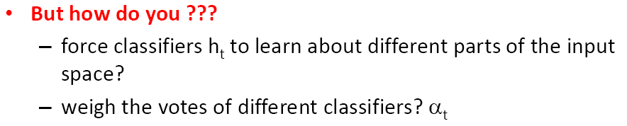
Voting (Ensemble Methods)

Slide 6
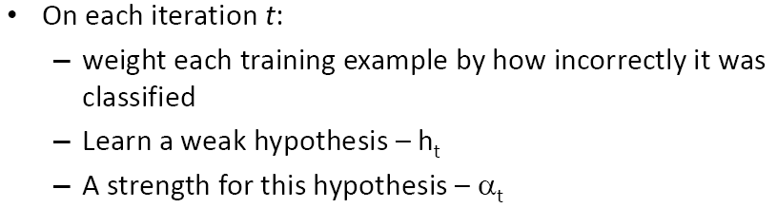


Boosting [Schapire’89]

Slide 7
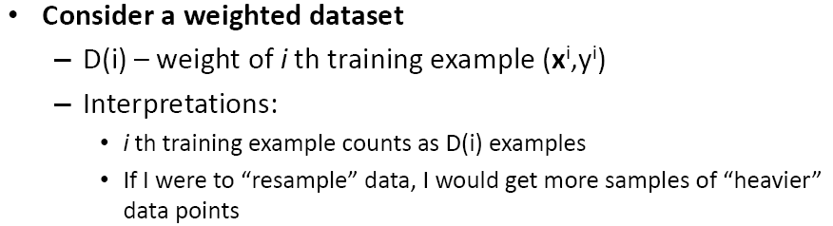
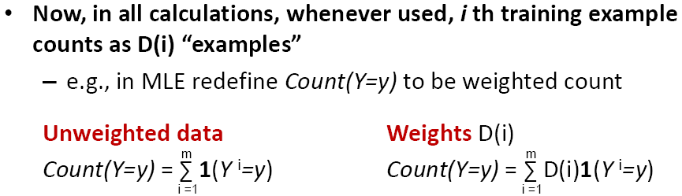
Learning from weighted data

Slide 8
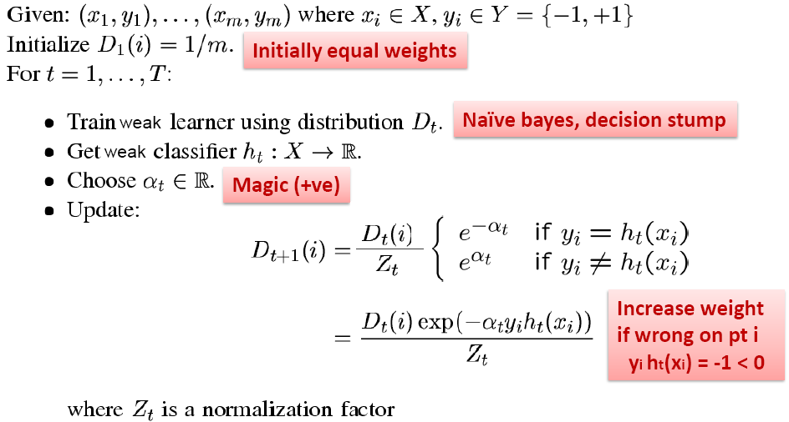
AdaBoost [Freund & Schapire ‘95]

Slide 9
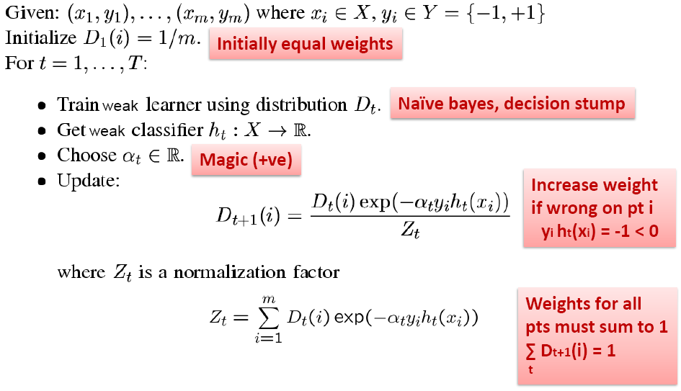
AdaBoost [Freund & Schapire ‘95]

Slide 10
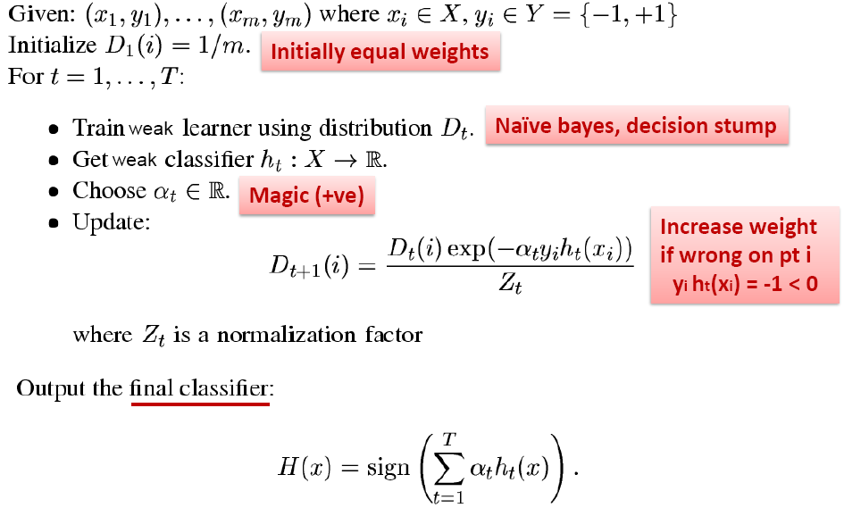
AdaBoost [Freund & Schapire ‘95]

Slide 11
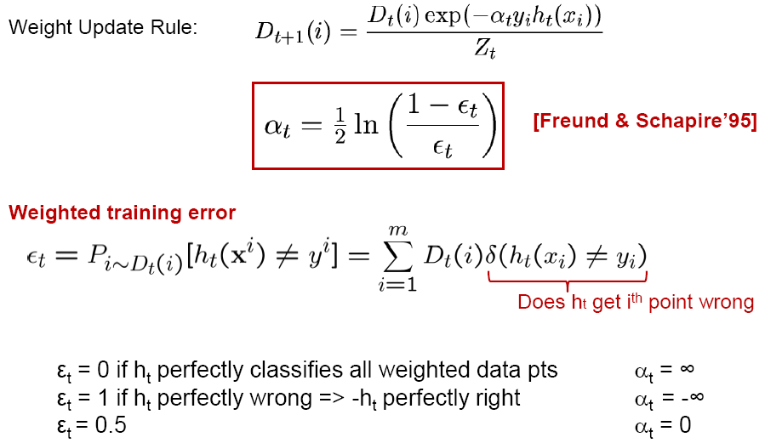
What α_{t} to choose for hypothesis h_{t}?

Slide 12
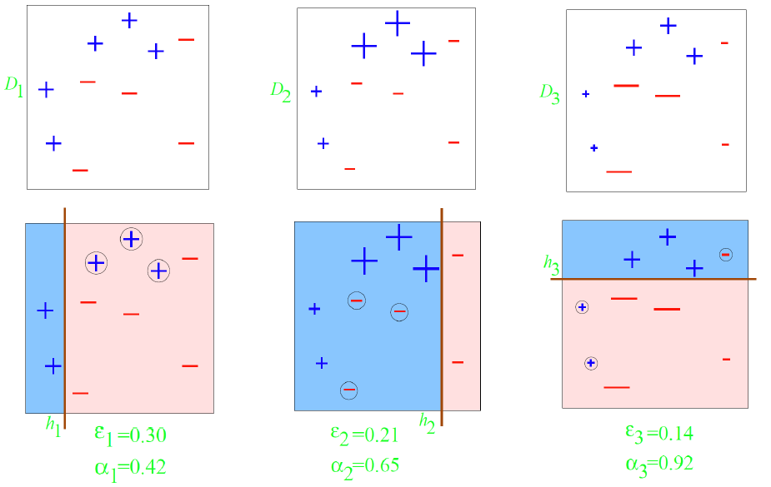
Boosting Example (Decision Stumps)

Slide 13
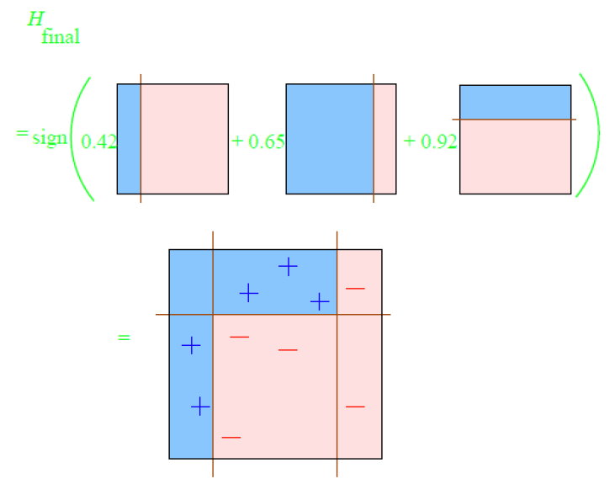
Boosting Example (Decision Stumps)

Slide 14
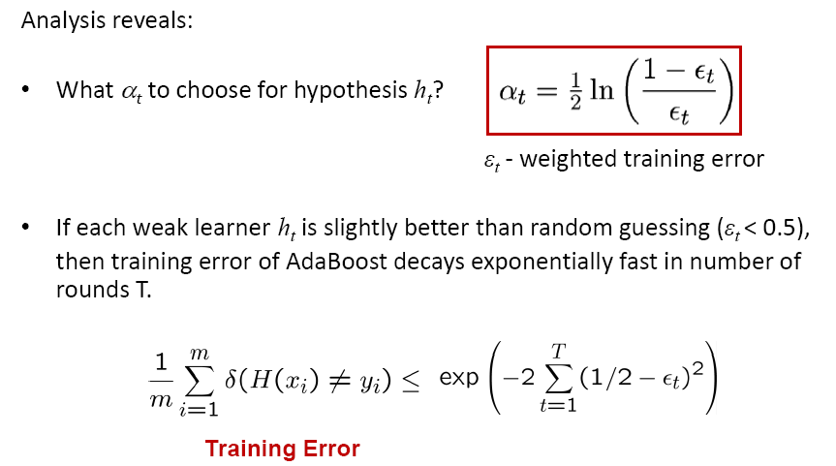
Analyzing training error

Slide 15
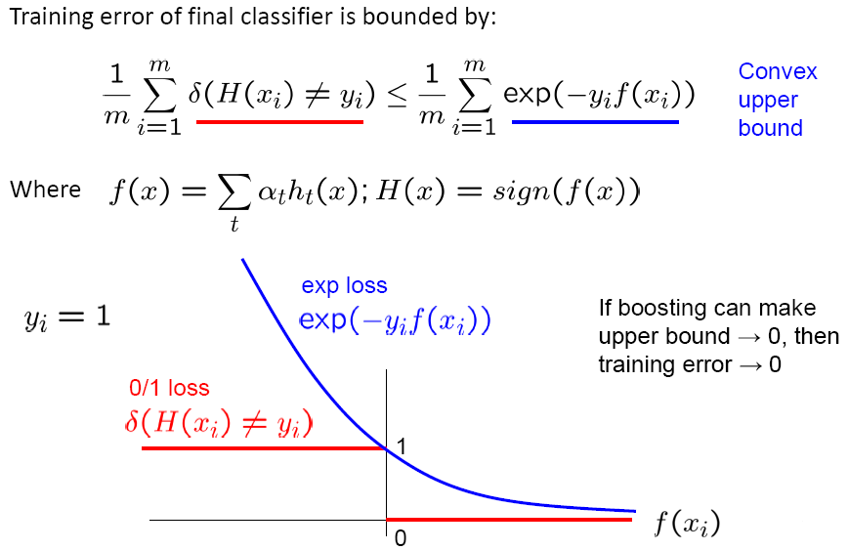
Analyzing training error

Slide 16
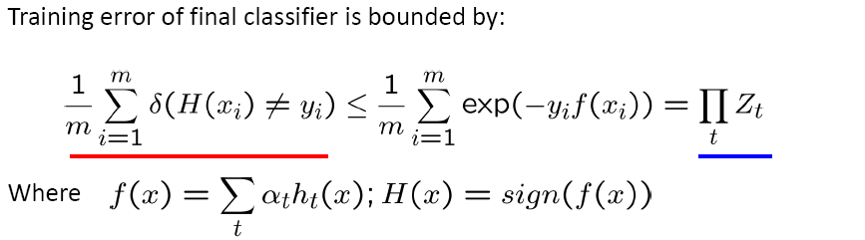
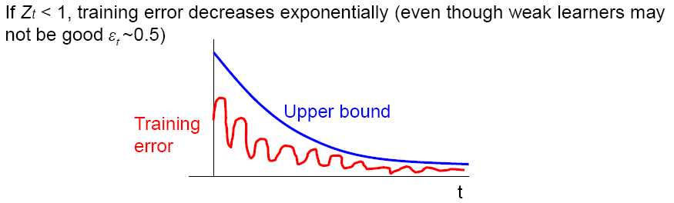
Analyzing training error

Slide 17
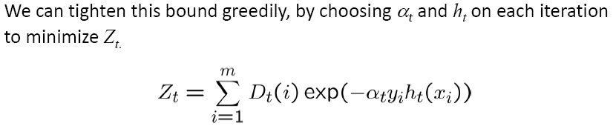
What α_{t} to choose for hypothesis h_{t}?

Slide 18
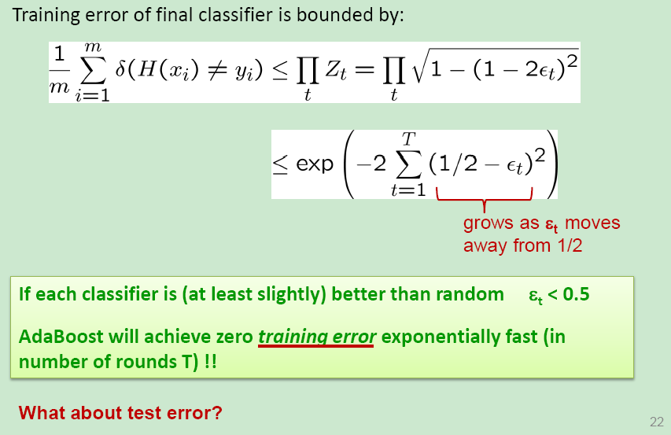
Weak classifiers made Smart

Slide 19
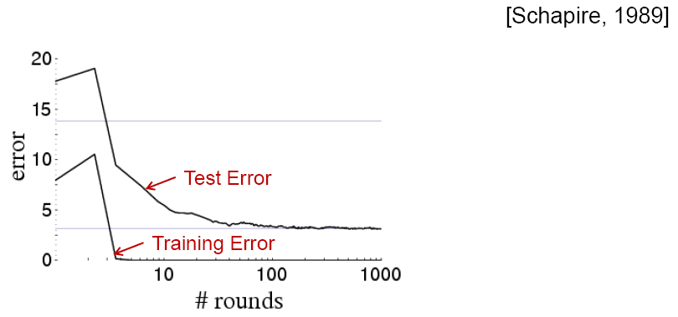
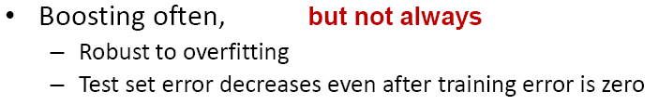
Boosting results
– Digit recognition

Slide 20

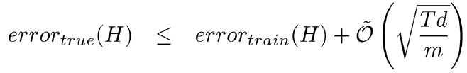
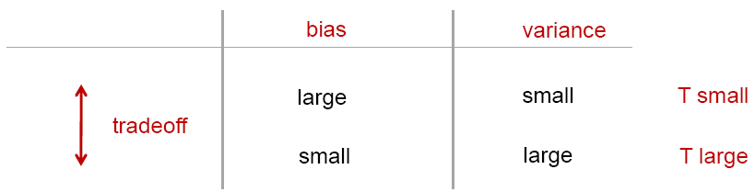
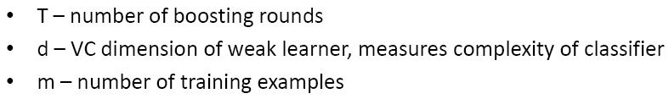
Generalization Error Bounds

Slide 21

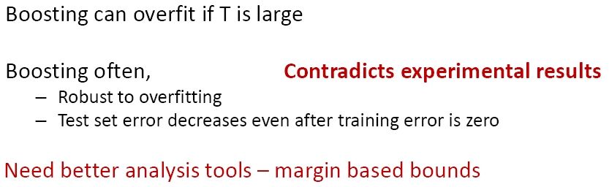
Generalization Error Bounds

Slide 22
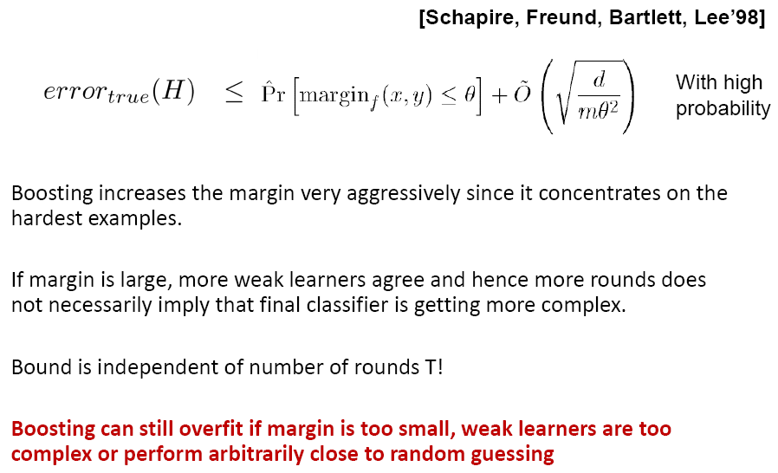
Margin Based Bounds

Slide 23
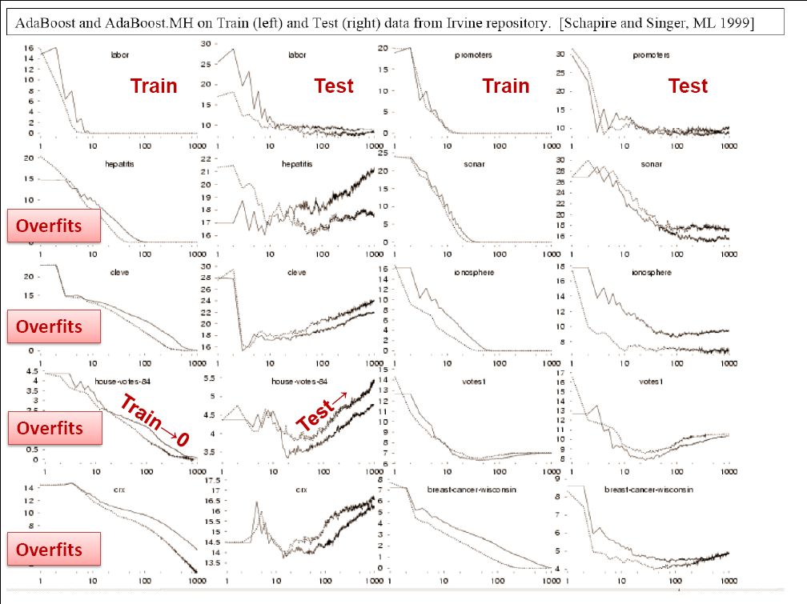

Slide 24
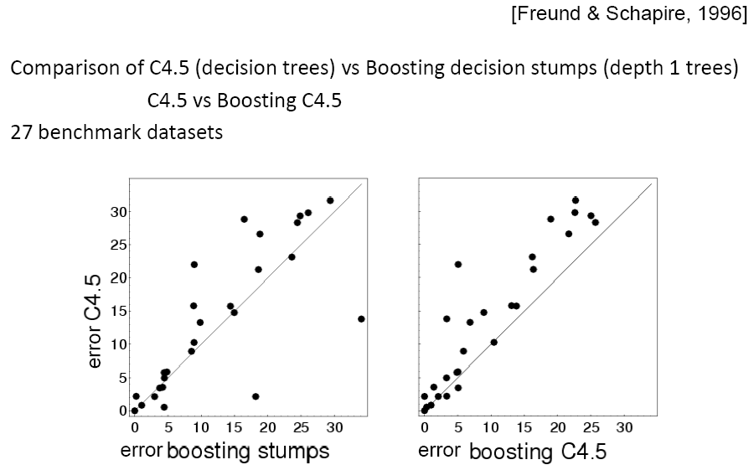
Boosting: Experimental Results

Slide 25
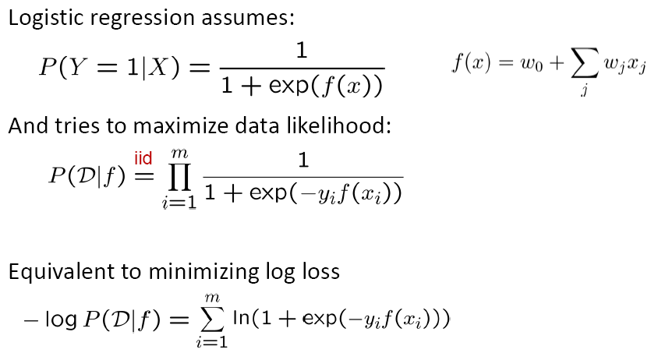
Boosting and Logistic Regression

Slide 26
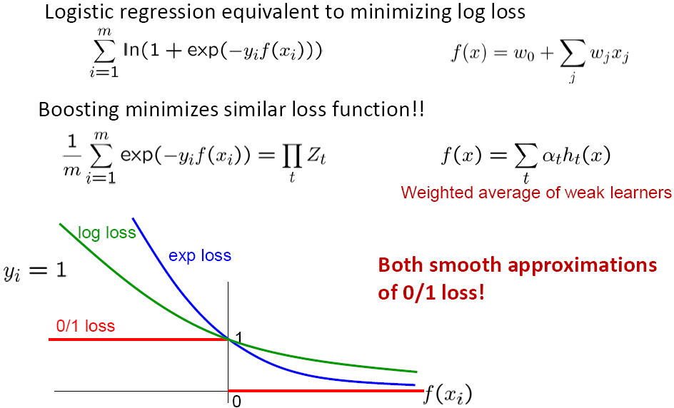
Boosting and Logistic Regression

Slide 27
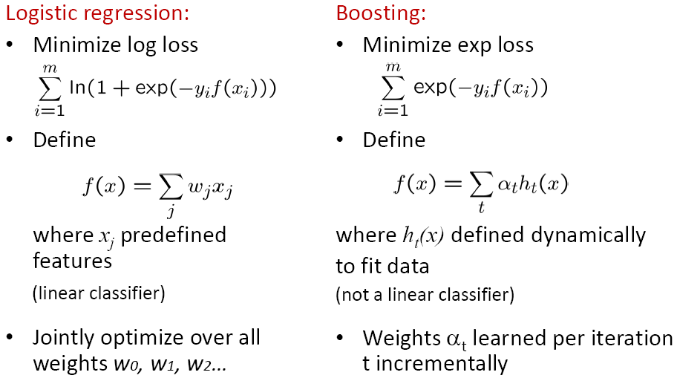
Boosting and Logistic Regression

Slide 28

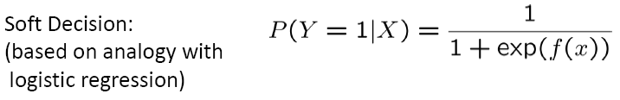
Hard & Soft Decision

Slide 29
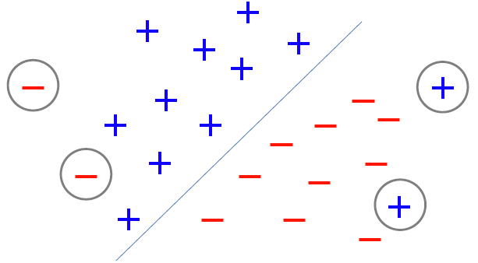
Effect of Outliers

Slide 30
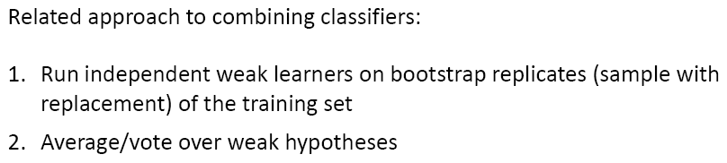
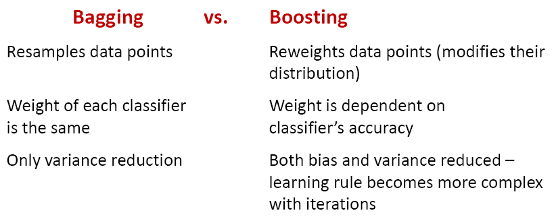
Bagging [Breiman, 1996]

Slide 31
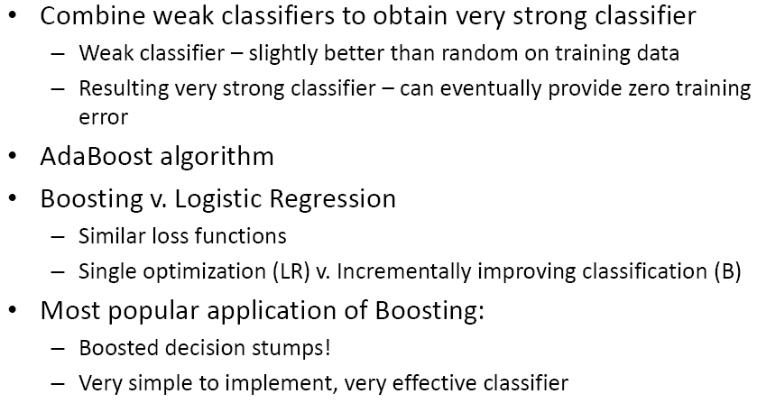
What you should know

