Slide 1
Support Vector Machines

Slide 2
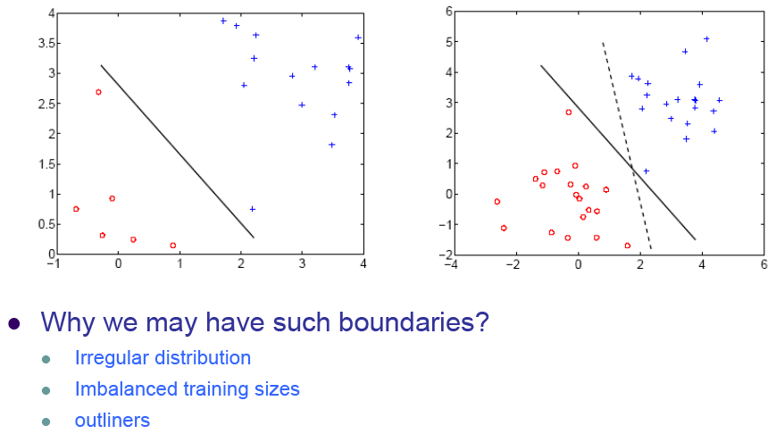
What is a good decision boundary?

Slide 3
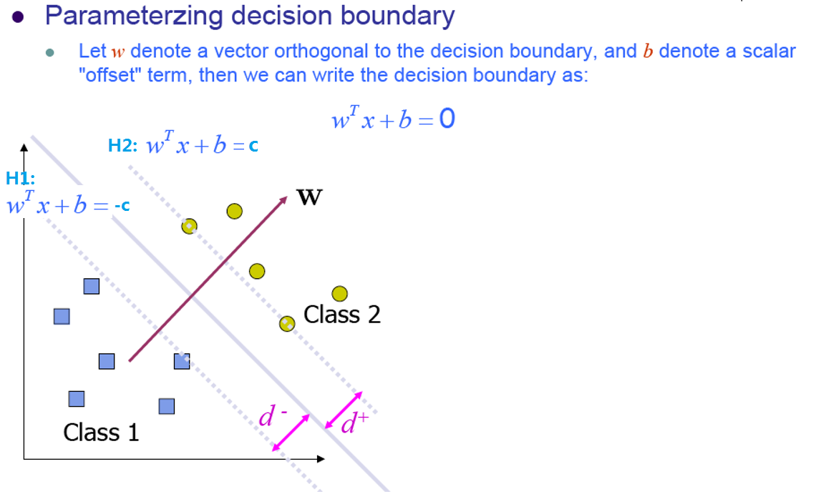
Classification and Margin

Slide 4
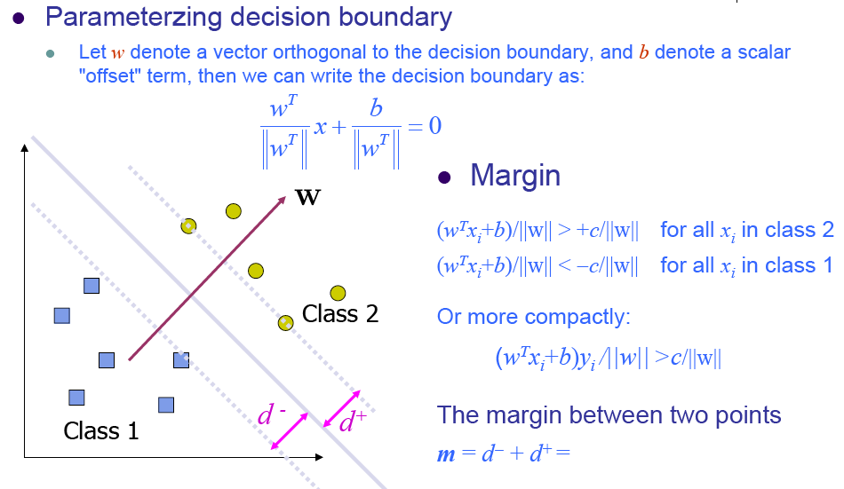
Classification and Margin

Slide 5
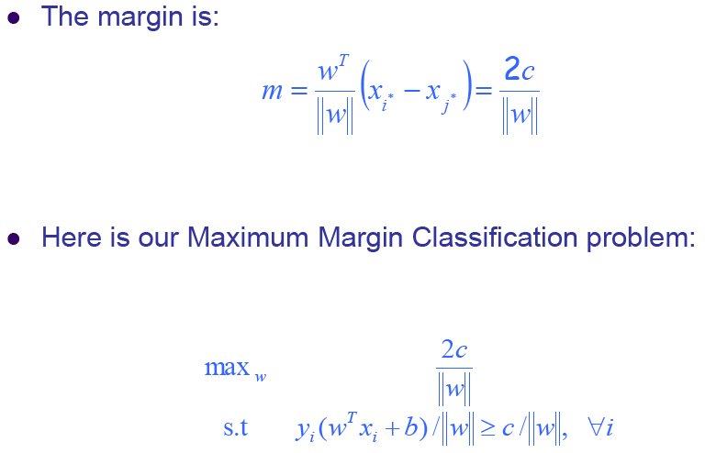
Maximum Margin Classification

Slide 6
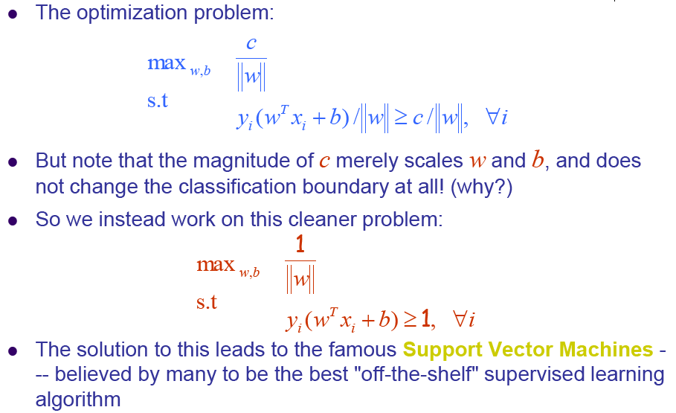
Maximum Margin Classification

Slide 7
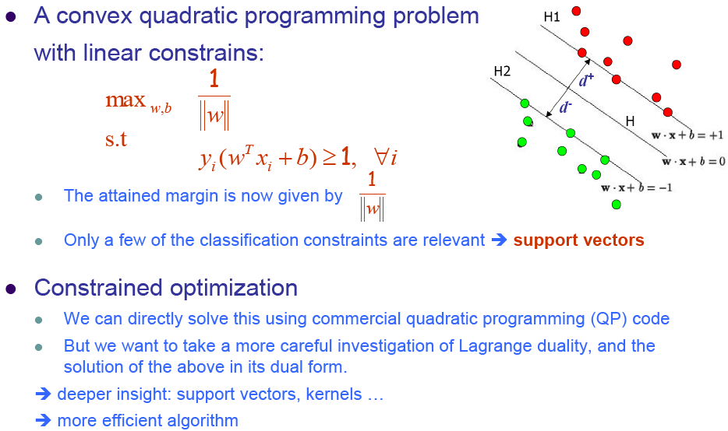
Support Vector Machine

Slide 8
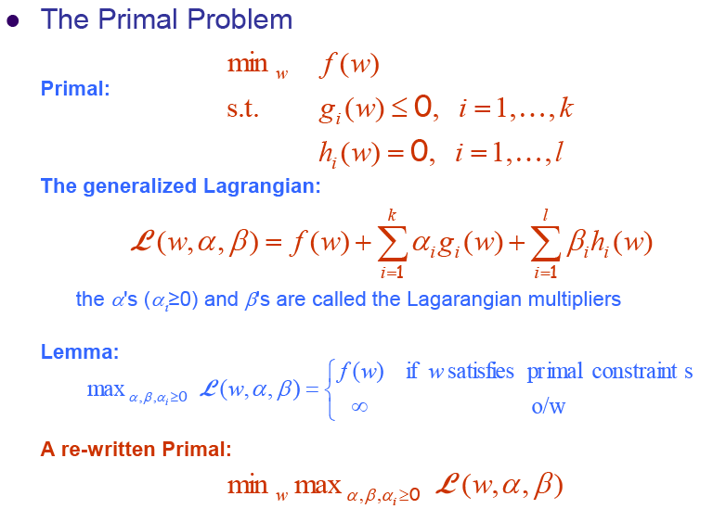
Digression to Lagrangian Duality

Slide 9
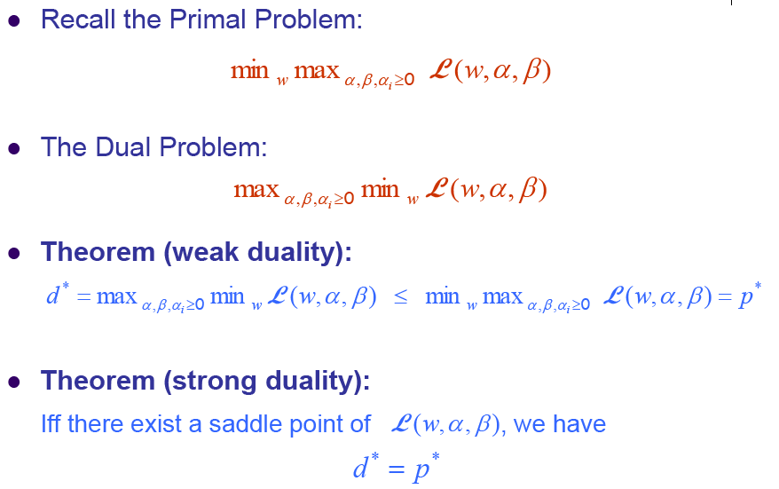
Lagrangian Duality

Slide 10
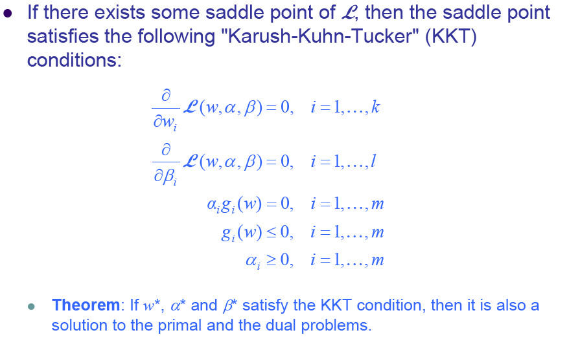
The KKT conditions

Slide 11
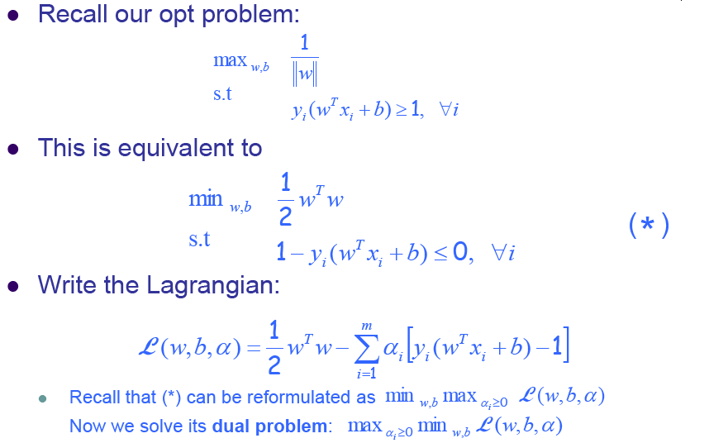
Solving optimal margin classifier

Slide 12
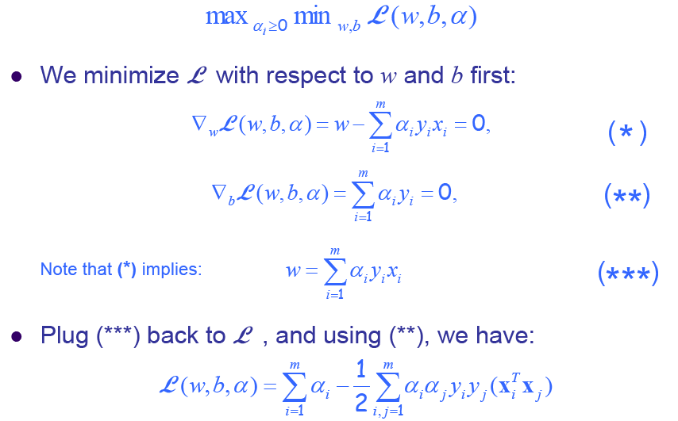
The Dual Problem

Slide 13
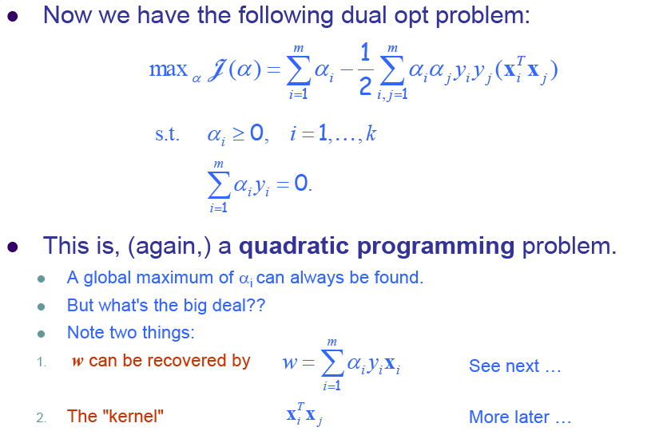
The Dual Problem

Slide 14
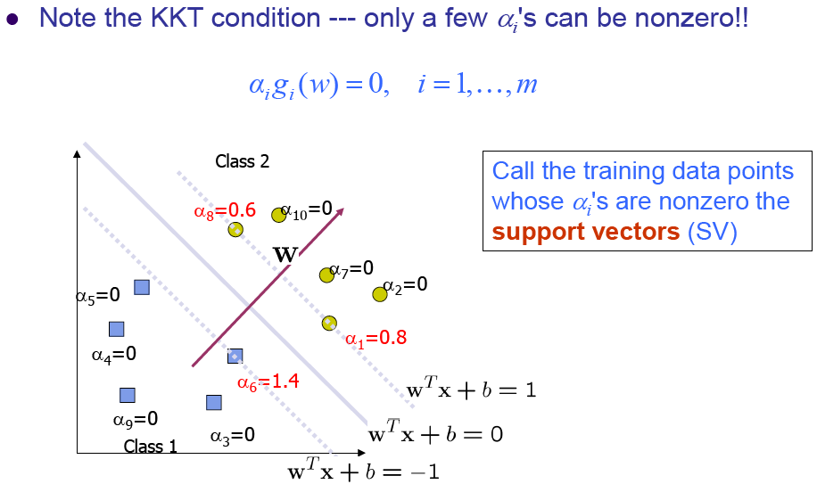
I. Support vectors

Slide 15
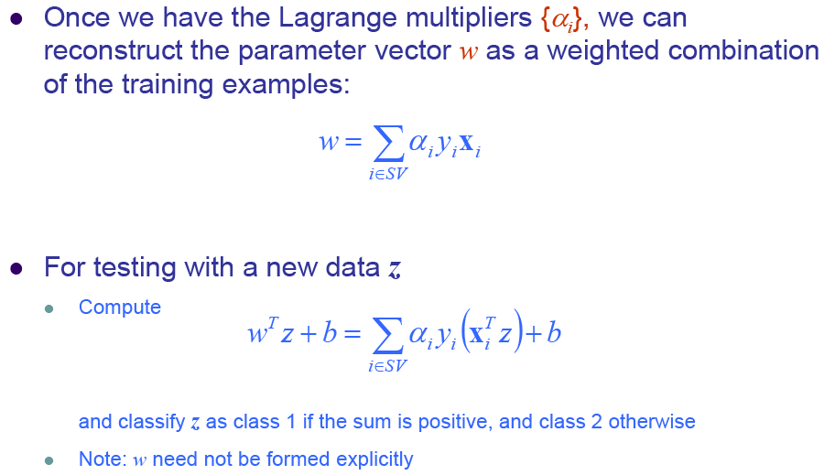
Support vector machines

Slide 16
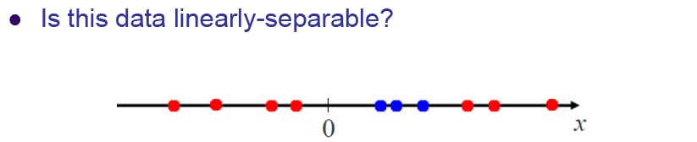
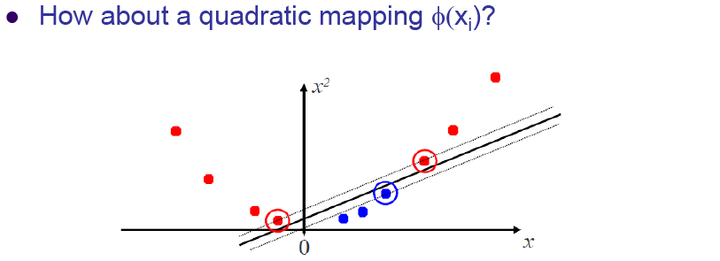
II. The Kernel Trick

Slide 17
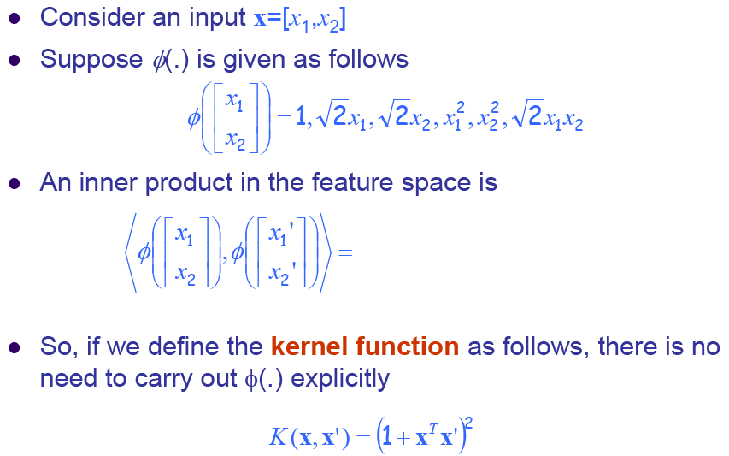
An example for feature mapping and kernels

Slide 18
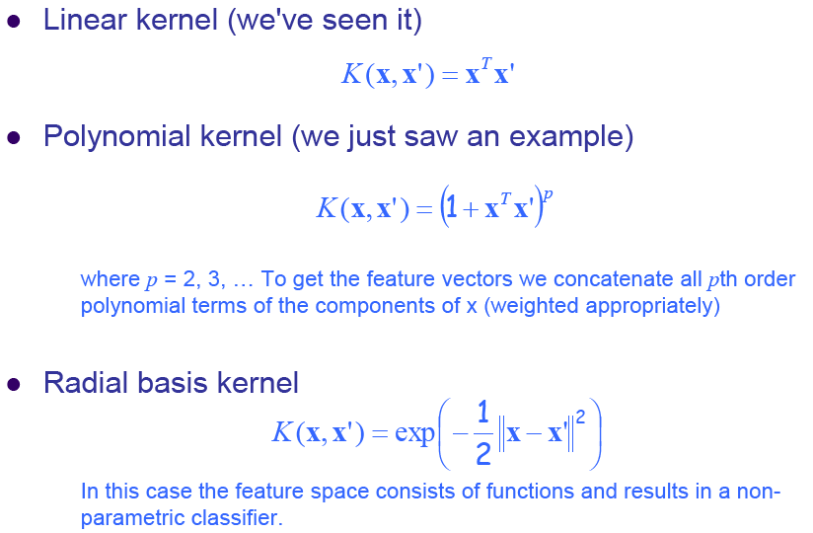
More examples of kernel functions

Slide 19
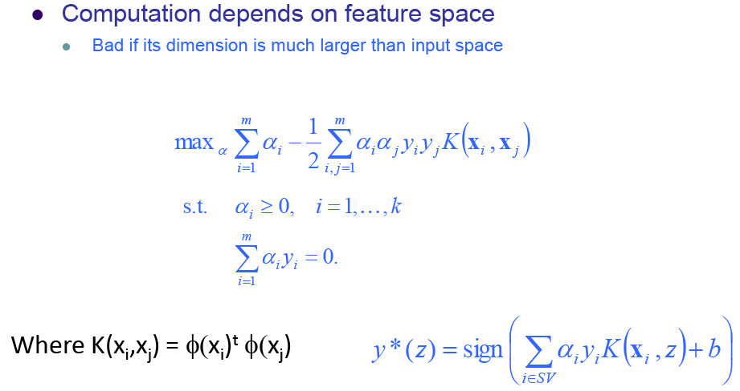
II. The Kernel Trick

Slide 20
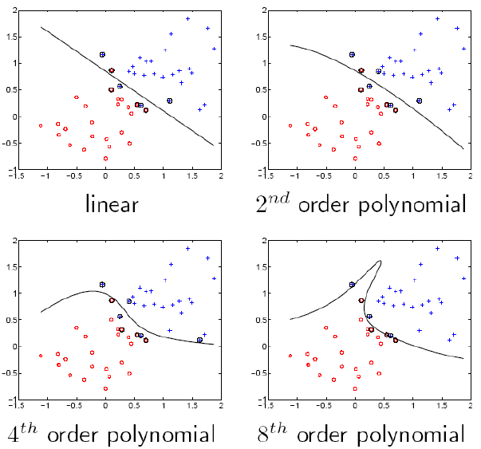
SVM examples

Slide 21
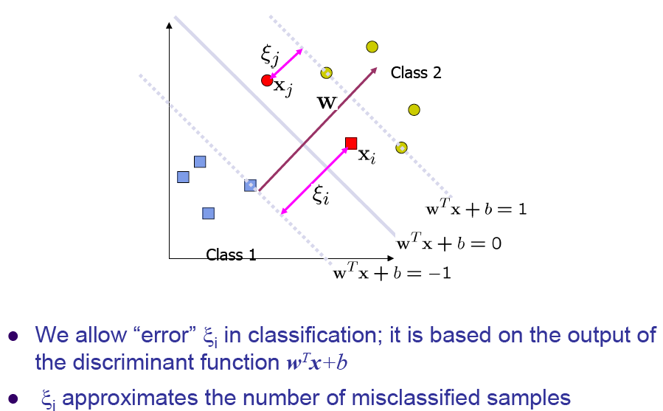
Nonlinearly Separable Problems

Slide 22
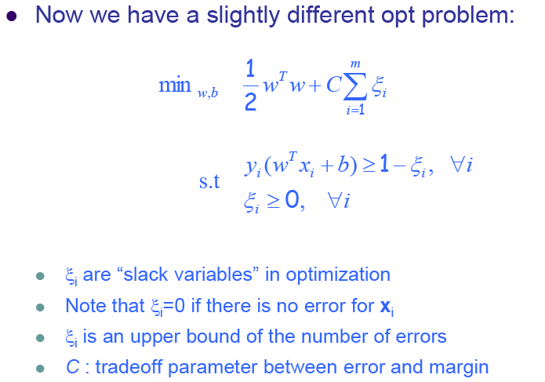
Soft Margin Hyperplane

Slide 23
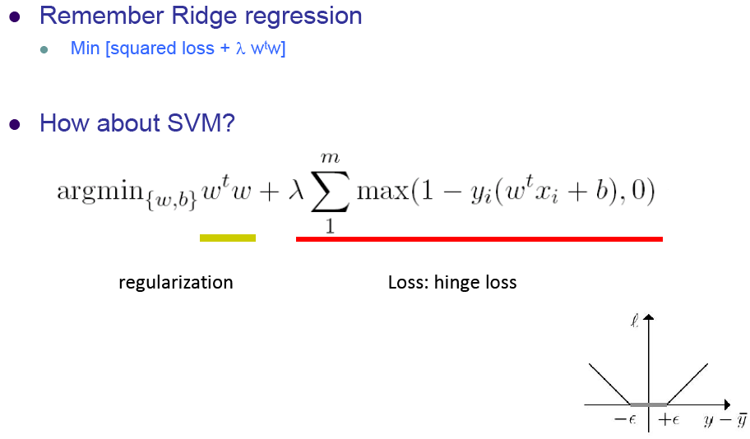
Hinge Loss

Slide 24
Software: Libsvm
http://www.csie.ntu.edu.tw/~cjlin/libsvm/
Main functions
  Svmtrain
  Svmpredict
  Svmscale : a tool for scaling input data file;
  Svmtoy: a simple graphical interface which shows how SVM separate data in a plane.

Slide 25
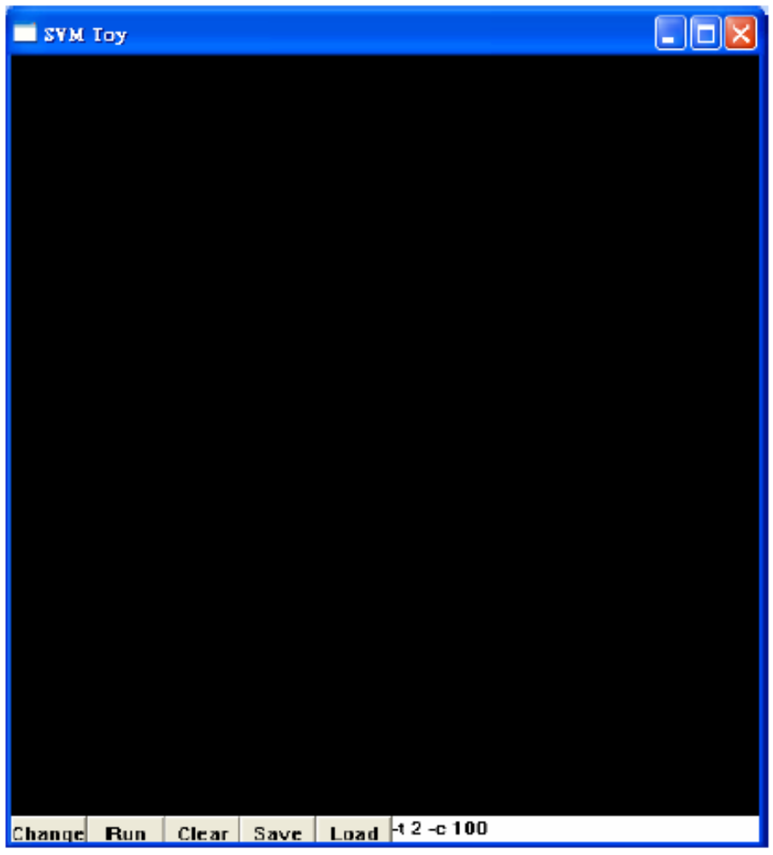
Svmtoy

Slide 26
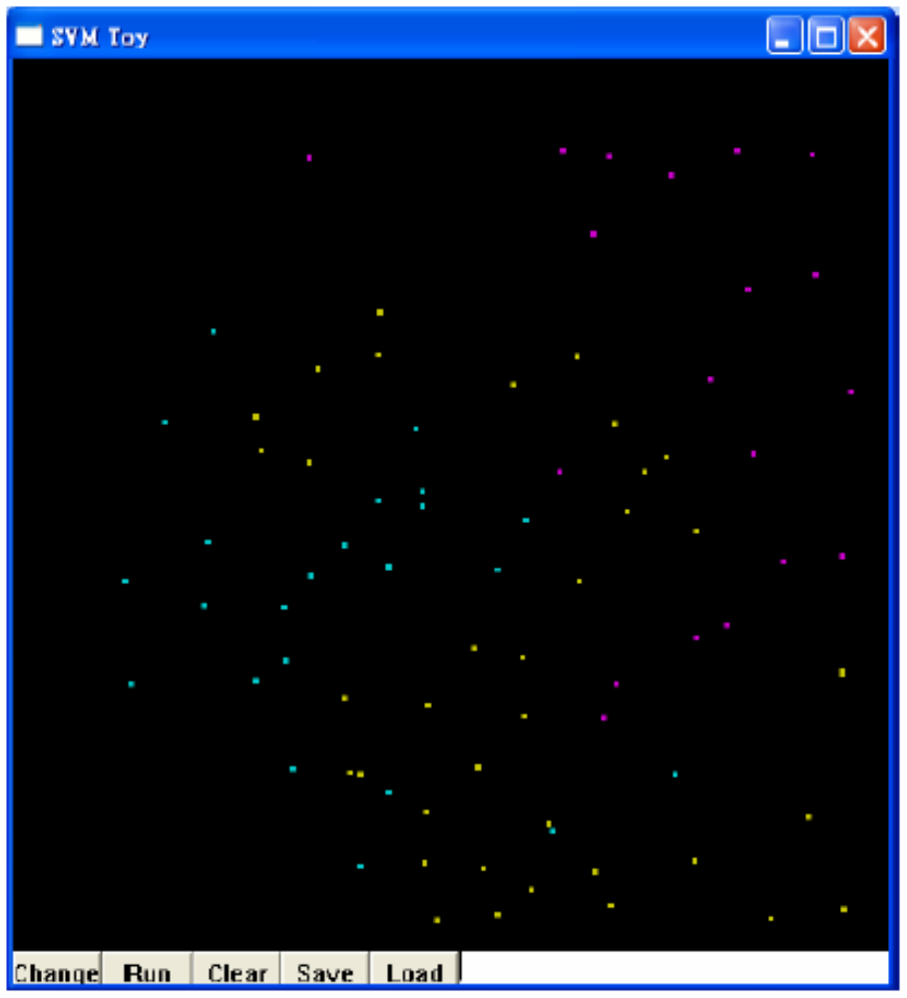

Slide 27
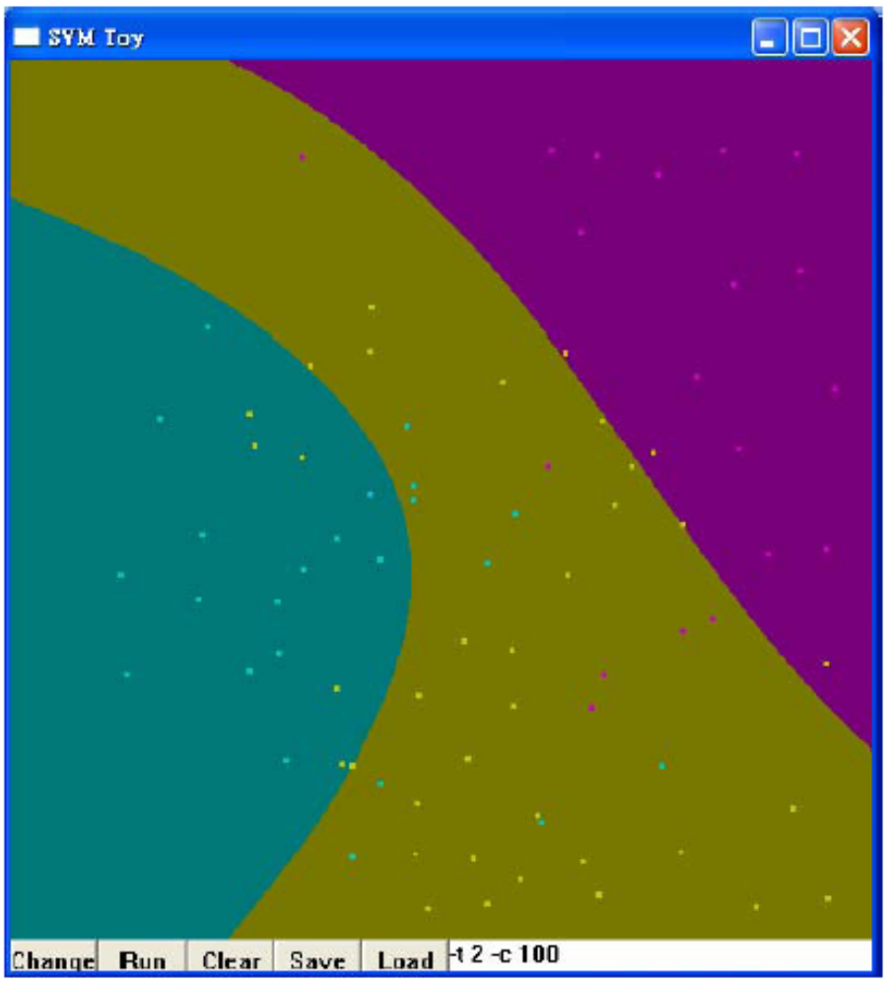

Slide 28
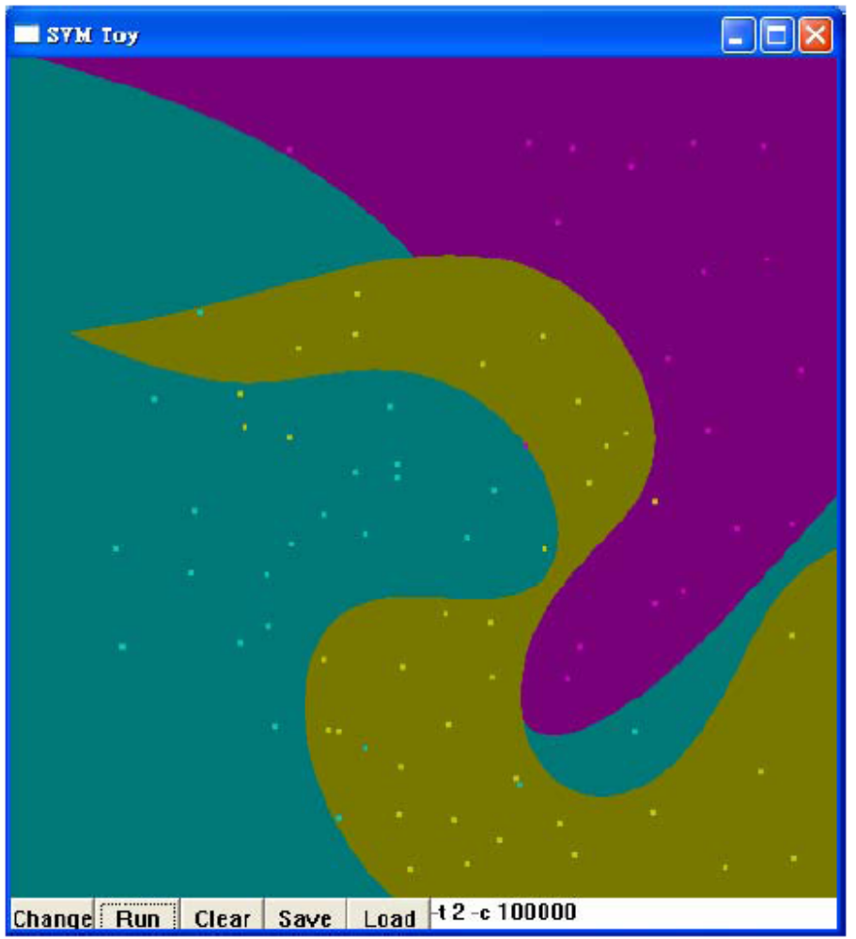

Slide 29
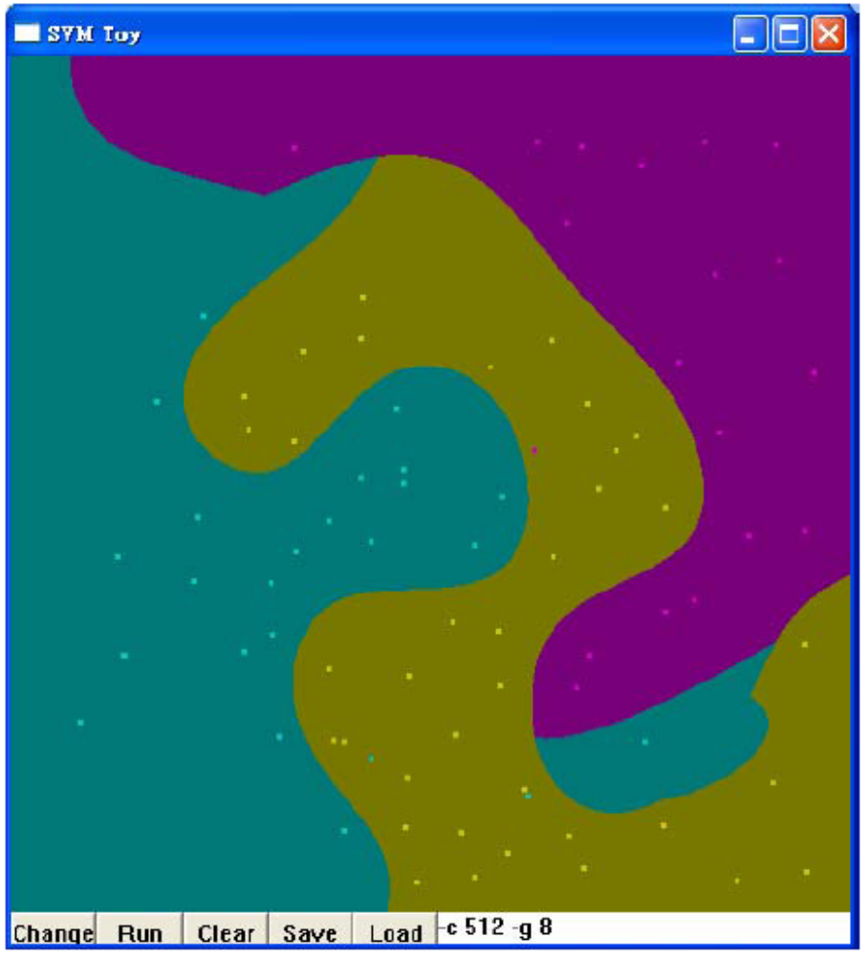

Slide 30
Steps
Transform data to the defined form of libsvm: label feature1 feature2 …
Scaling
Select kernel
Select parameters by cross validation (grid.py)
Train model
Test model

Slide 31
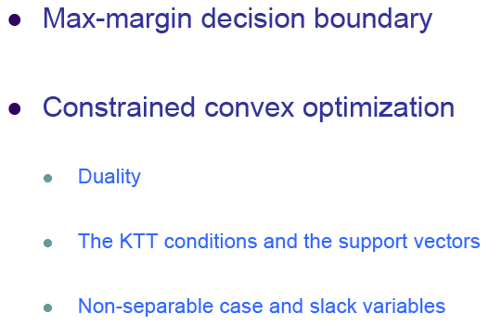
Summary

