Slide 1
Clustering
Notes:
clustering聚类

Slide 2
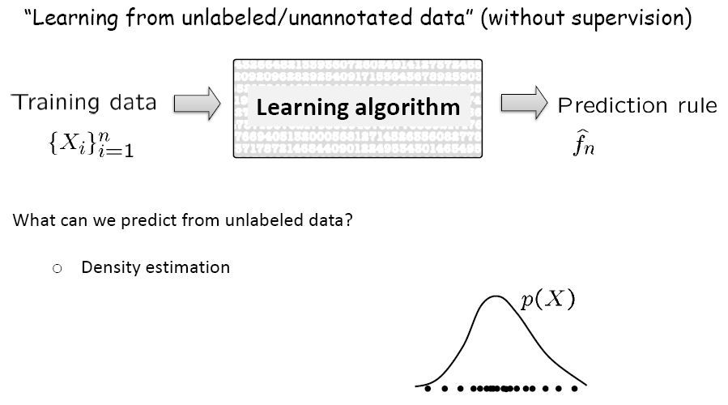
Unsupervised Learning
Notes:
unsupervised learning无监督学习 density estimation密度估计

Slide 3
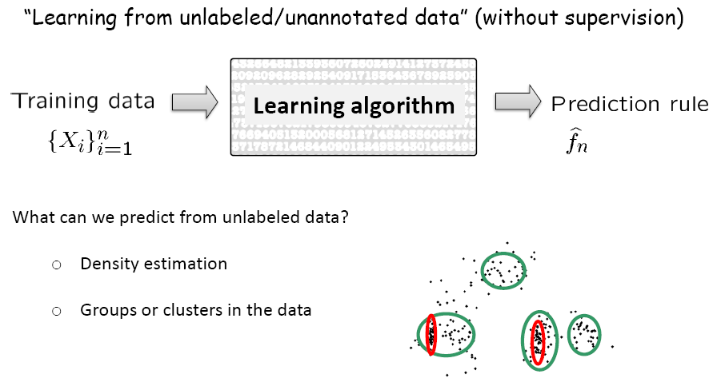
Unsupervised Learning

Slide 4
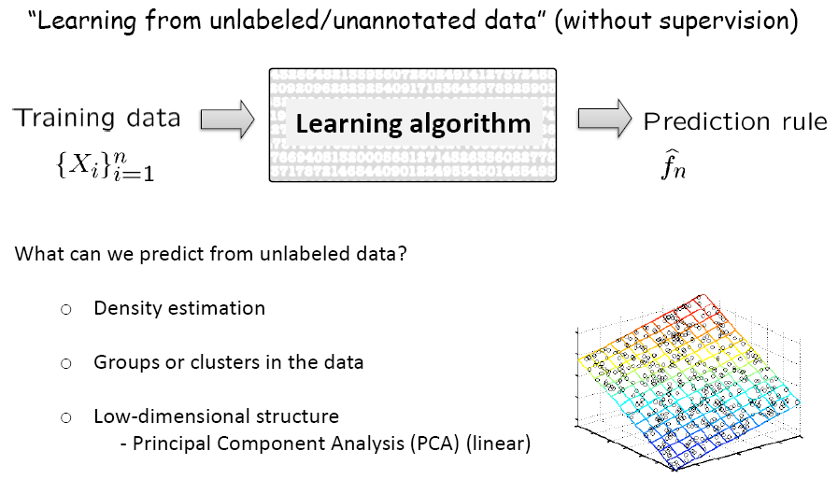
Unsupervised Learning

Slide 5
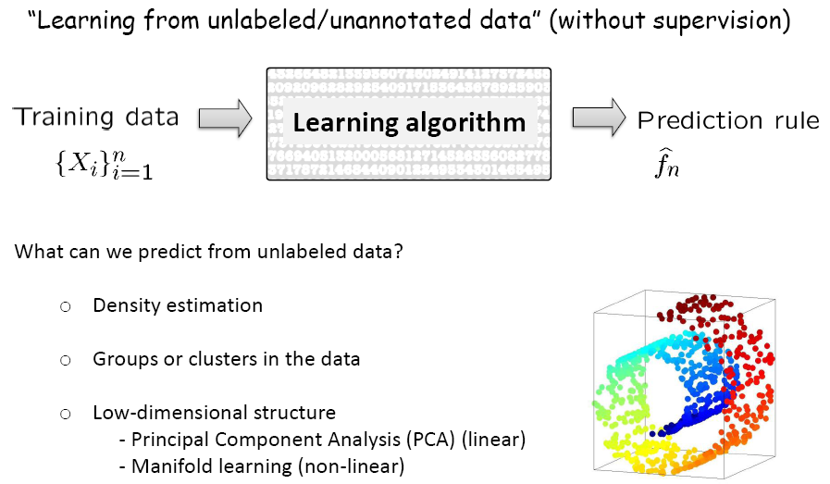
Unsupervised Learning

Slide 6
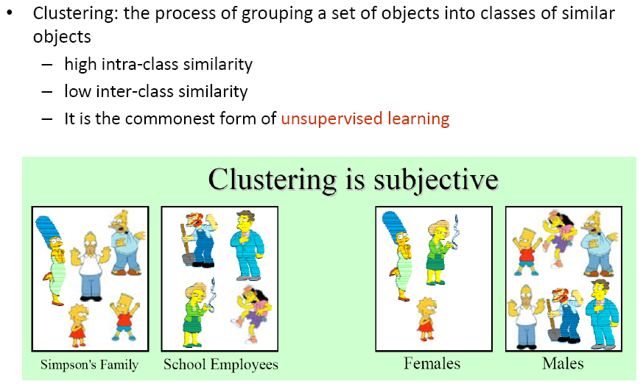
What is clustering?

Slide 7
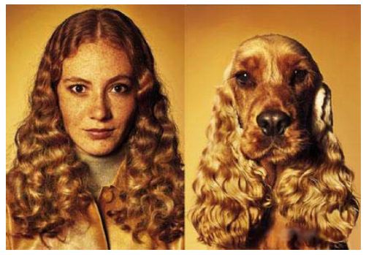
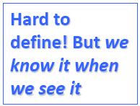

What is similarity?

Slide 8

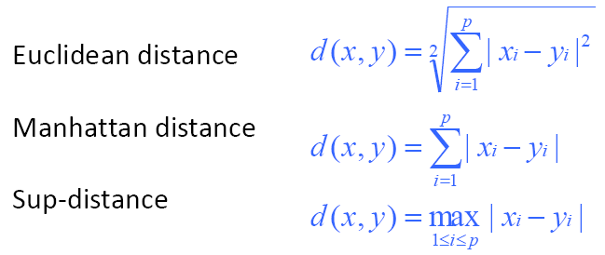
Distance metrics

Slide 9
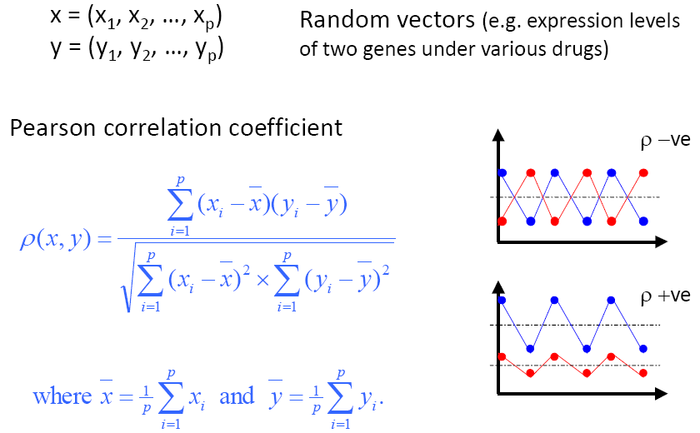
Correlation coefficient

Slide 10


Clustering Algorithms

Slide 11


Hierarchical Clustering

Slide 12
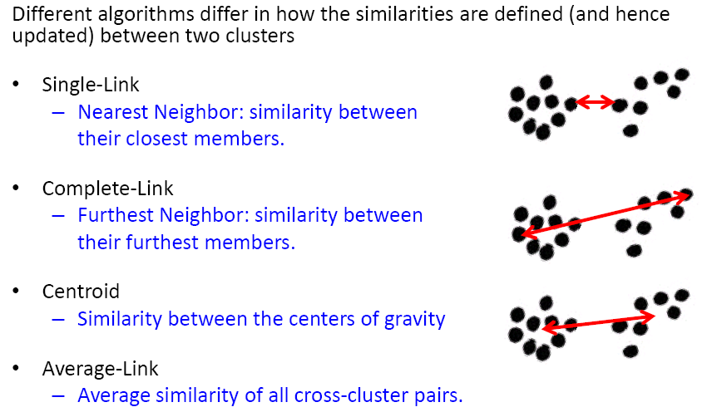
Bottom-up Agglomerative Clustering

Slide 13
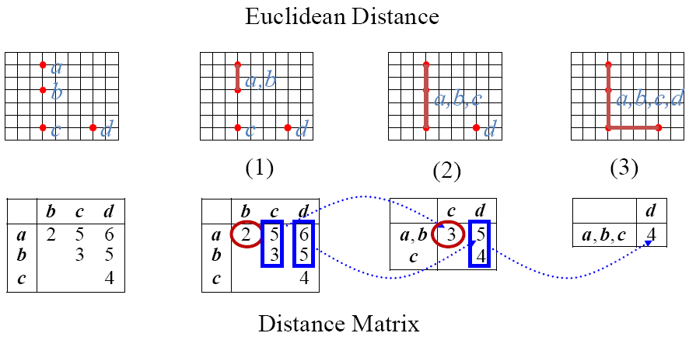
Single-Link Method

Slide 14
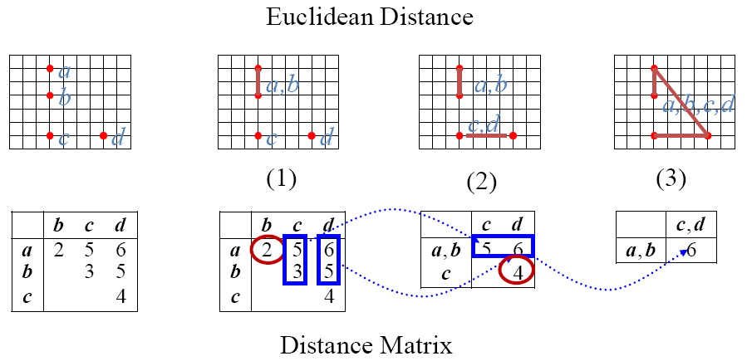
Complete-Link Method

Slide 15
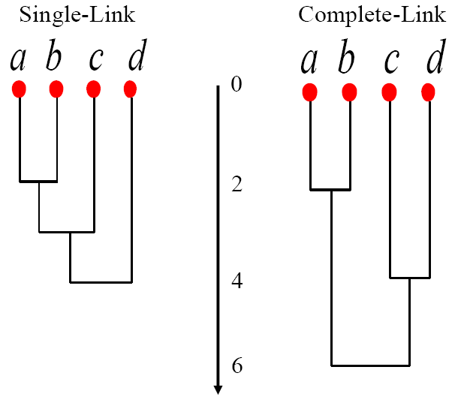
Dendrograms

Slide 16

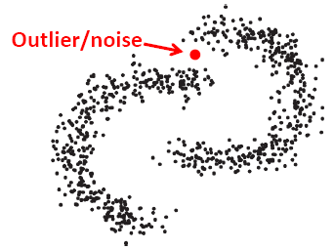
Single vs. Complete Linkage

Slide 17

Computational Complexity

Slide 18
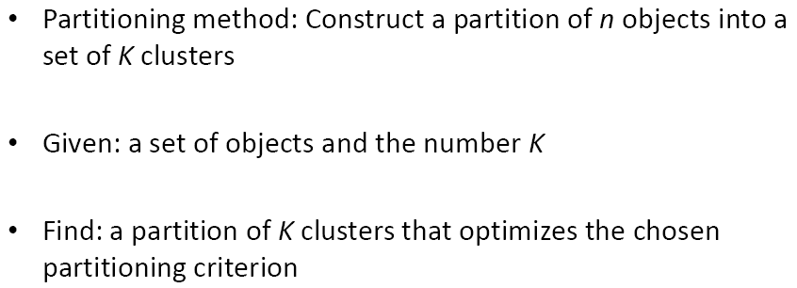

Partitioning Algorithms

Slide 19
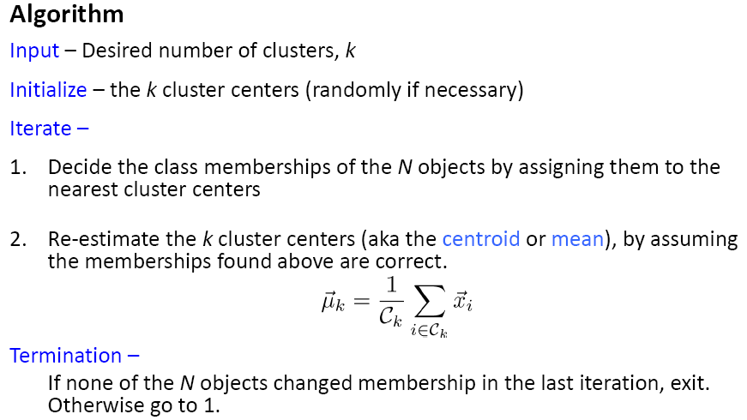
K-means Clustering

Slide 20
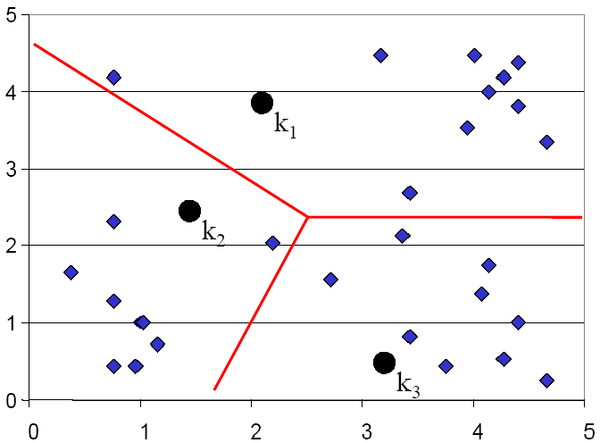

K-means Clustering: Step 1

Slide 21
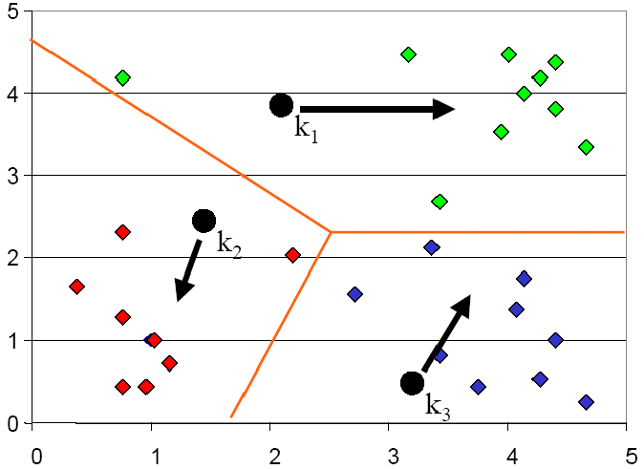
K-means Clustering: Step 2

Slide 22
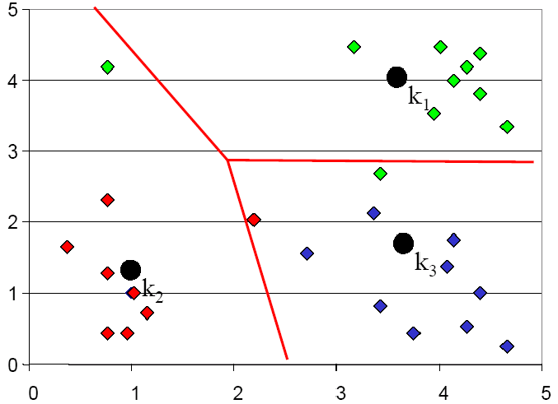
K-means Clustering: Step 3

Slide 23
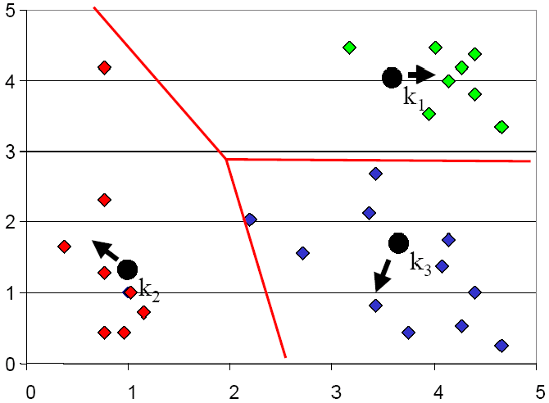
K-means Clustering: Step 4

Slide 24
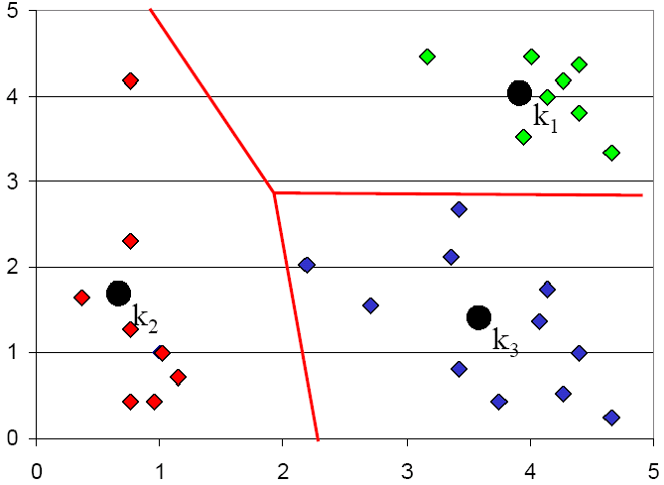
K-means Clustering: Step 5

Slide 25
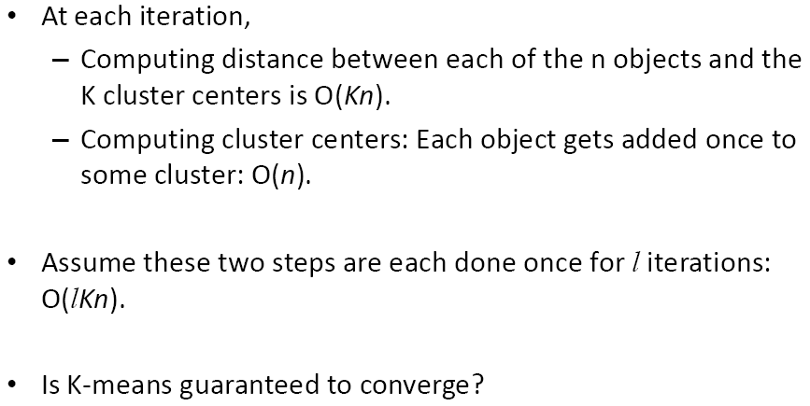
Computational Complexity

Slide 26
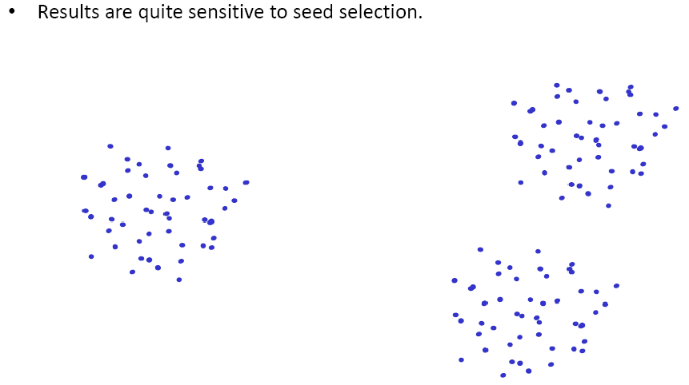
Seed Choice

Slide 27
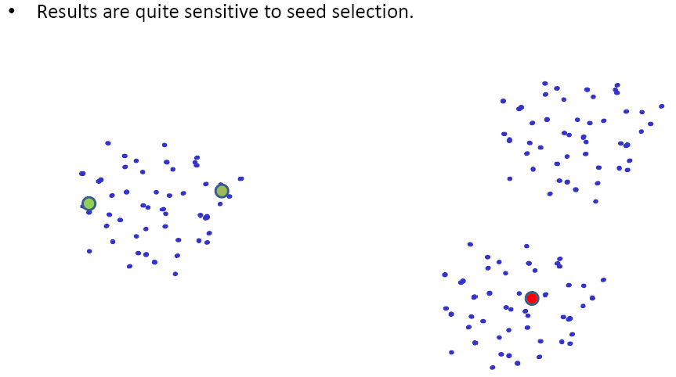
Seed Choice

Slide 28
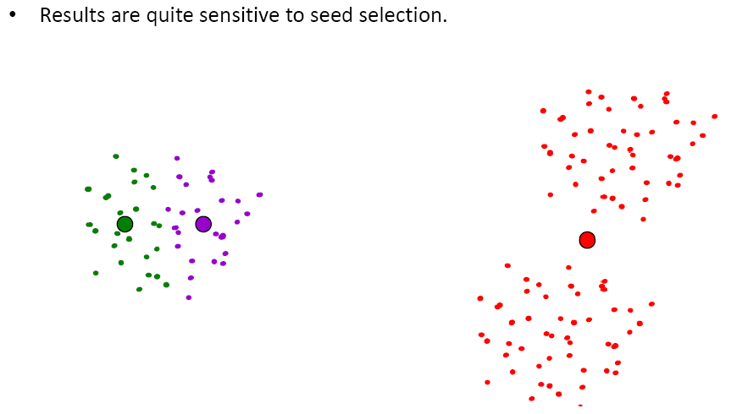
Seed Choice

Slide 29
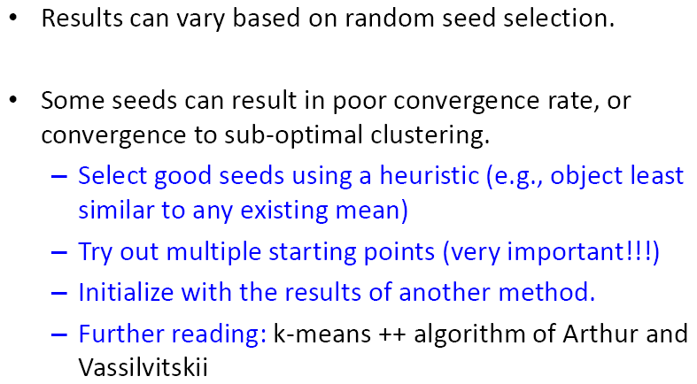
Seed Choice

Slide 30
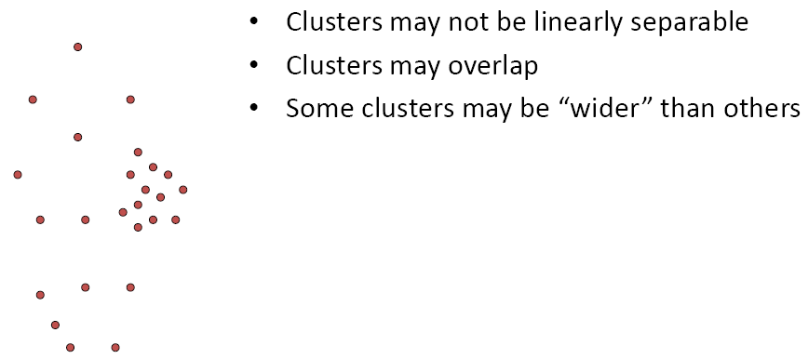
Bad cases for K-means

Slide 31
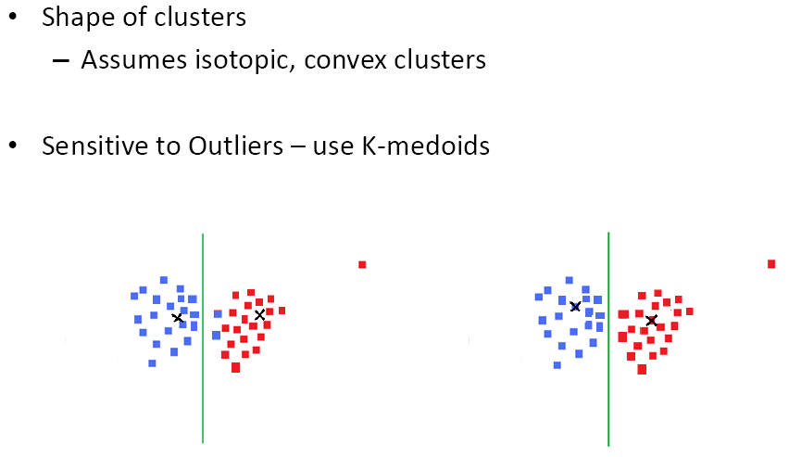
Other Issues

Slide 32
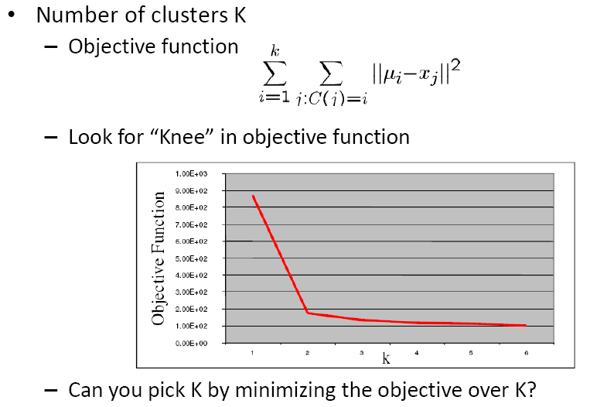
Other Issues

