Slide 1
Naïve Bayes Classifier

Slide 2
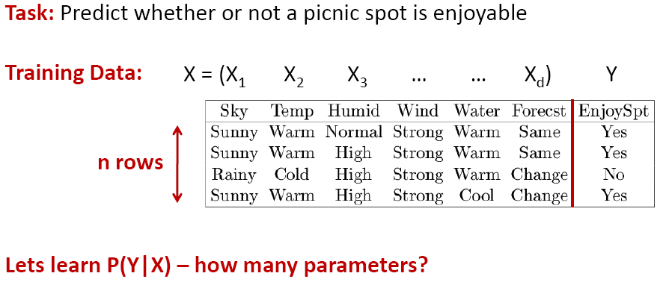



Learning the Optimal Classifier

Slide 3

Learning the Optimal Classifier

Slide 4
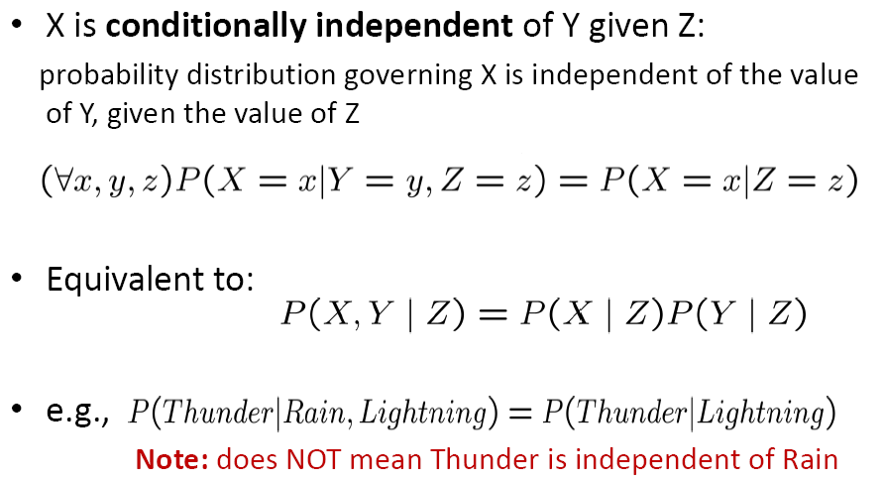
Conditional Independence

Slide 5
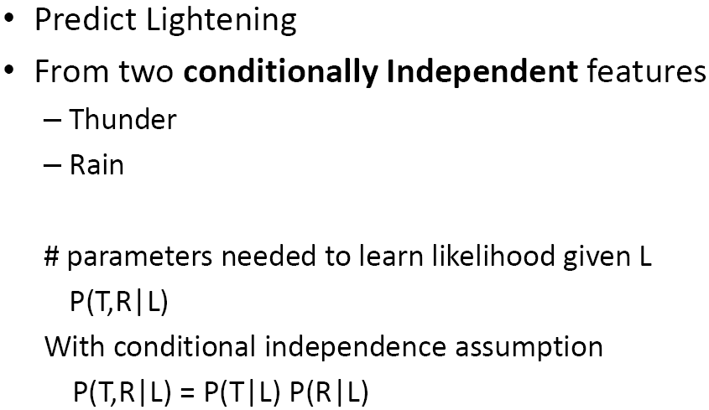


Prediction using Conditional Independence

Slide 6
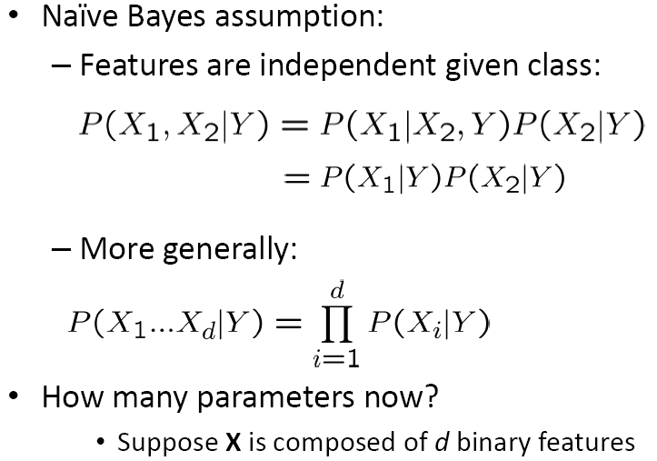

Naïve Bayes Assumption

Slide 7
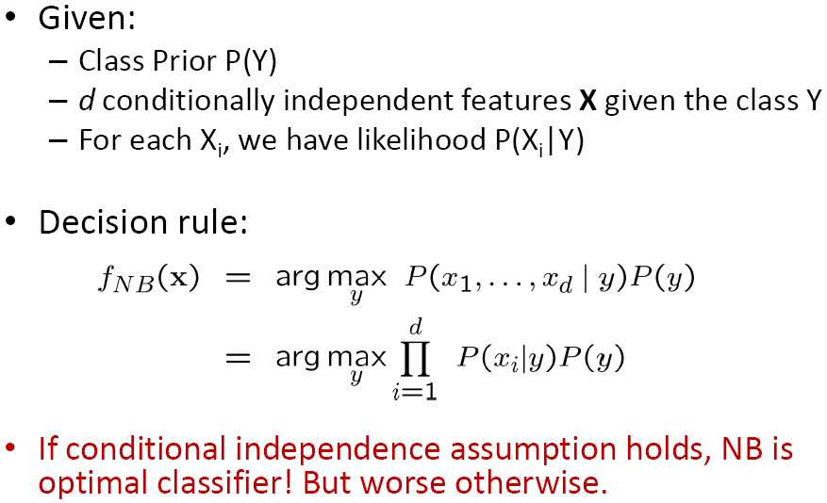
Naïve Bayes Classifier

Slide 8
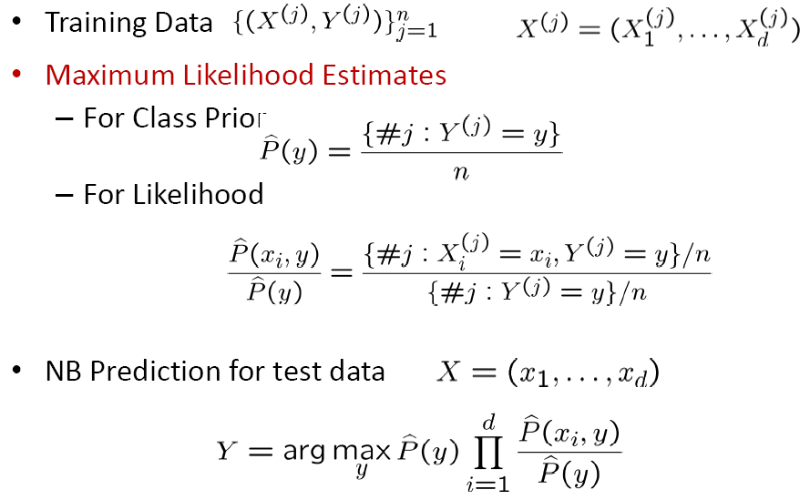
Naïve Bayes Algo – Discrete features

Slide 9
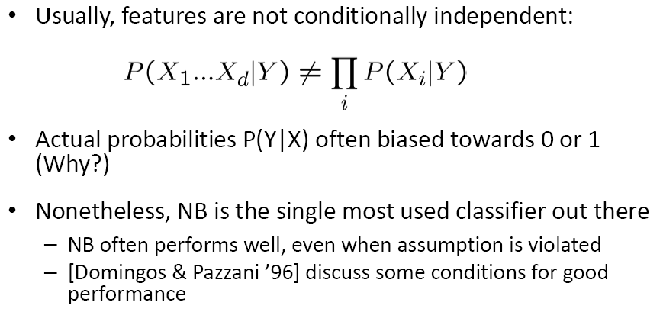
Subtlety 1 – Violation of NB Assumption

Slide 10
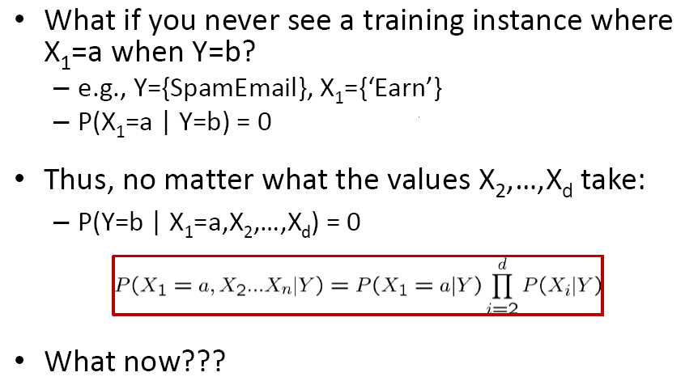
Subtlety 2 – Insufficient training data

Slide 11
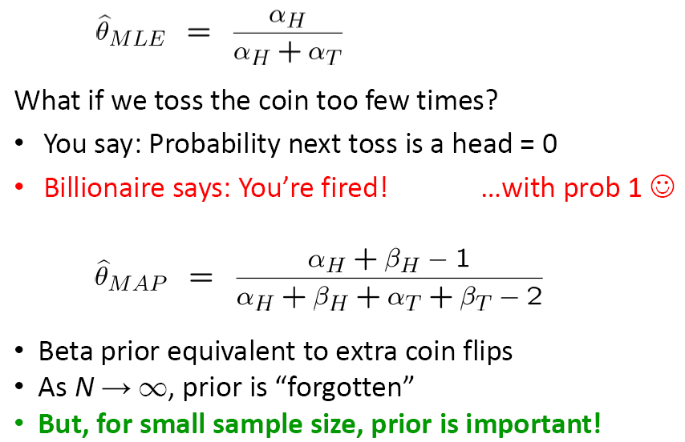
MLE vs. MAP Review

Slide 12
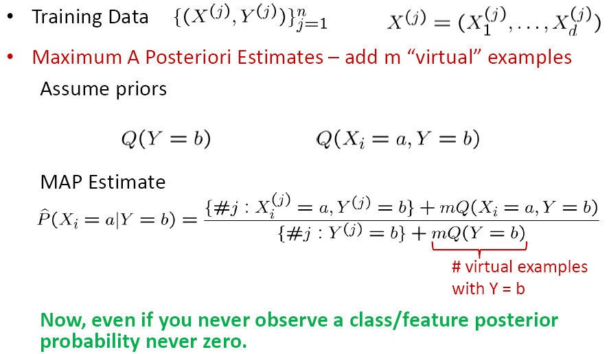
Naïve Bayes Algo – Discrete features

Slide 13
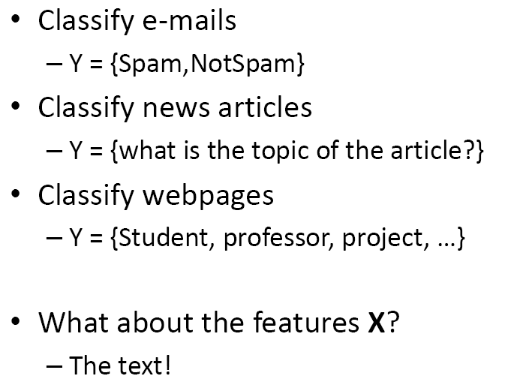
Case Study: Text Classification

Slide 14
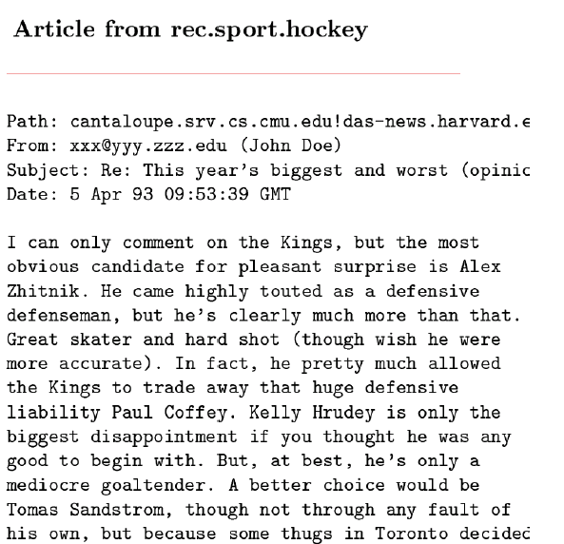
Features X are entire document – X_{i} for i^{th} word in article

Slide 15
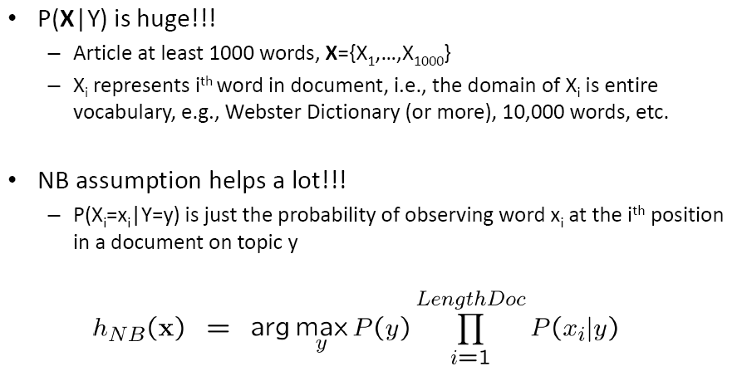
NB for Text Classification

Slide 16
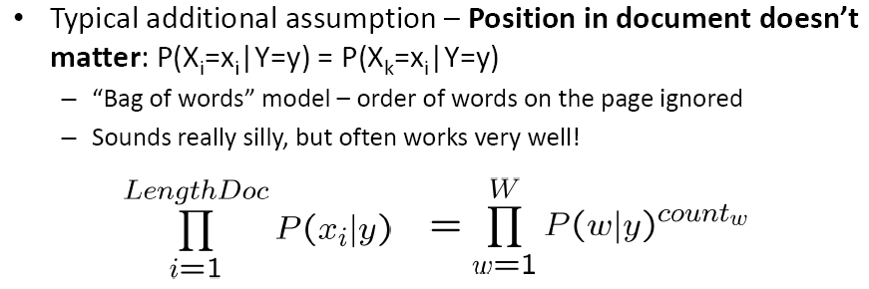

Bag of words model

Slide 17

Bag of words model

Slide 18
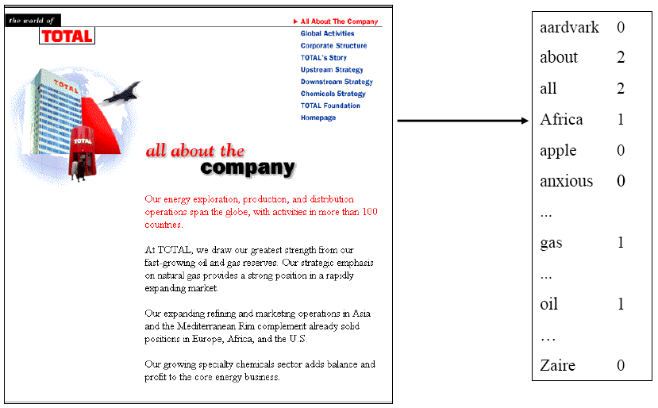
Bag of words approach

Slide 19
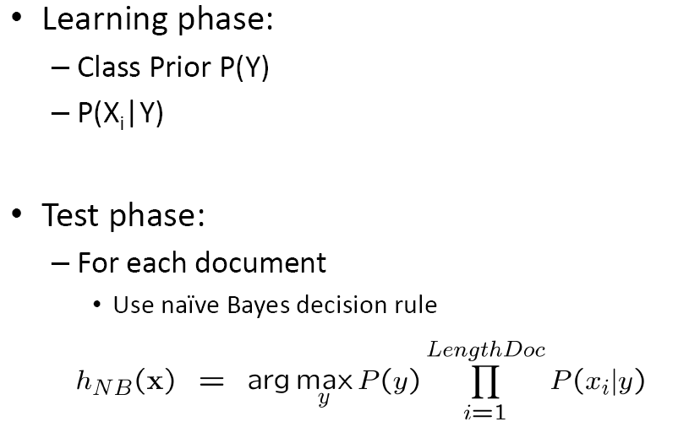
NB with bag of words for text classification

Slide 20
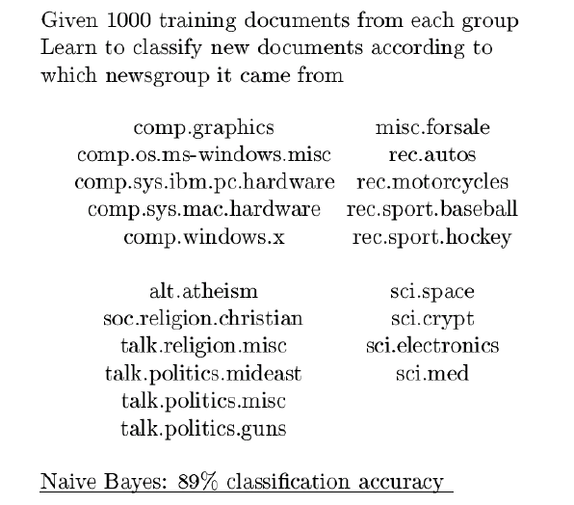
Twenty news groups results

Slide 21
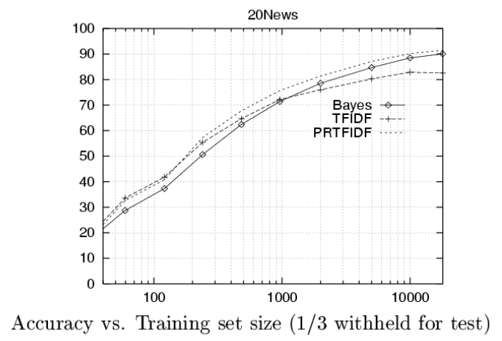
Learning curve for twenty news groups

Slide 22
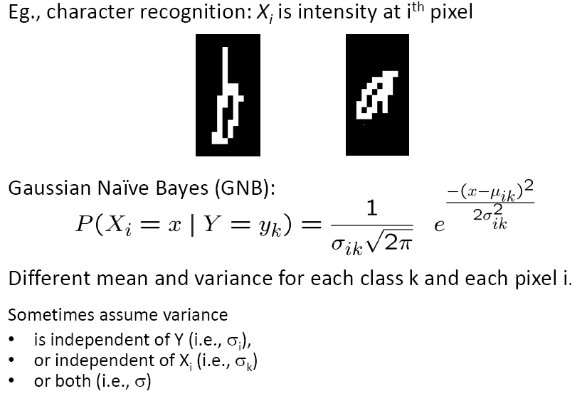
What if features are continuous?

Slide 23
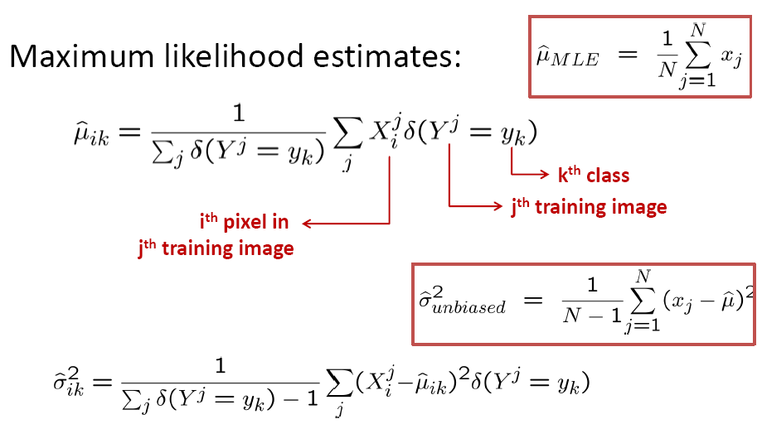
Estimating parameters: Y discrete, X_{i} continuous

Slide 24
Semi-naïve Bayes classifiers
maintain strong attribute dependencies
One-Dependent Estimator
  Each attribute is assumed to rely on at most one other attribute except the category
  Super-Parent ODE
  Tree Augmented naïve Bayes
  Averaged One-Dependent Estimator

Slide 25




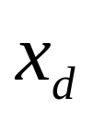
...
...
(a)NB
(b)SPODE
...
(c)TAN

Slide 26
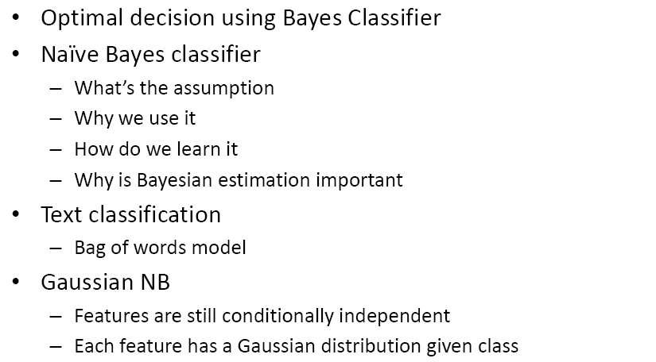
What you should know…

