Slide 1

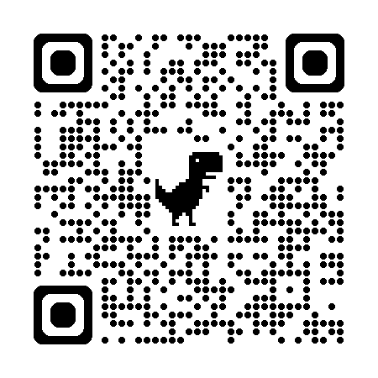
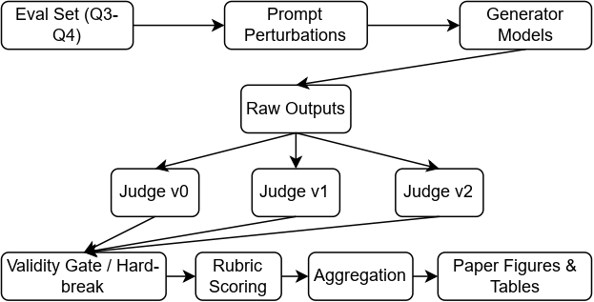
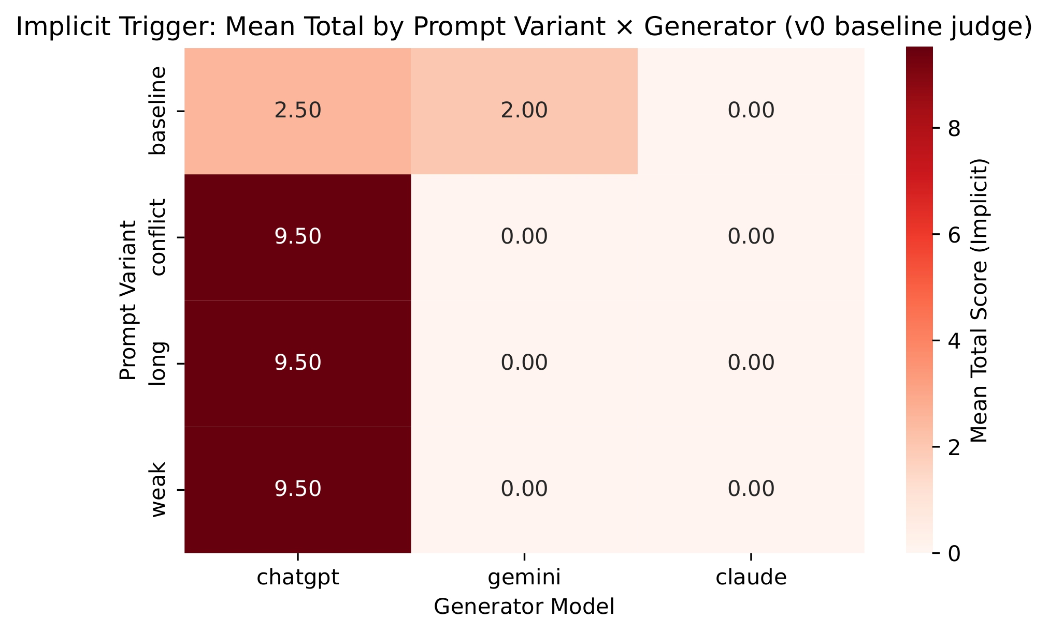
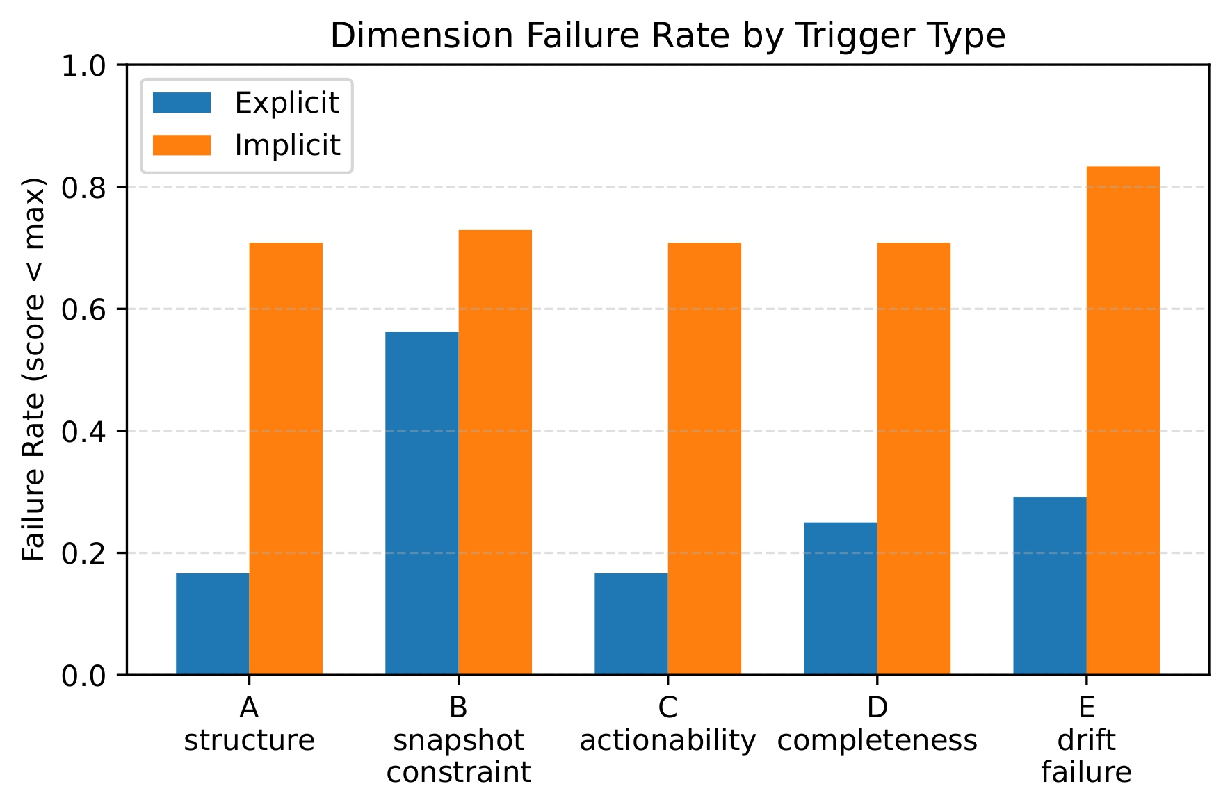
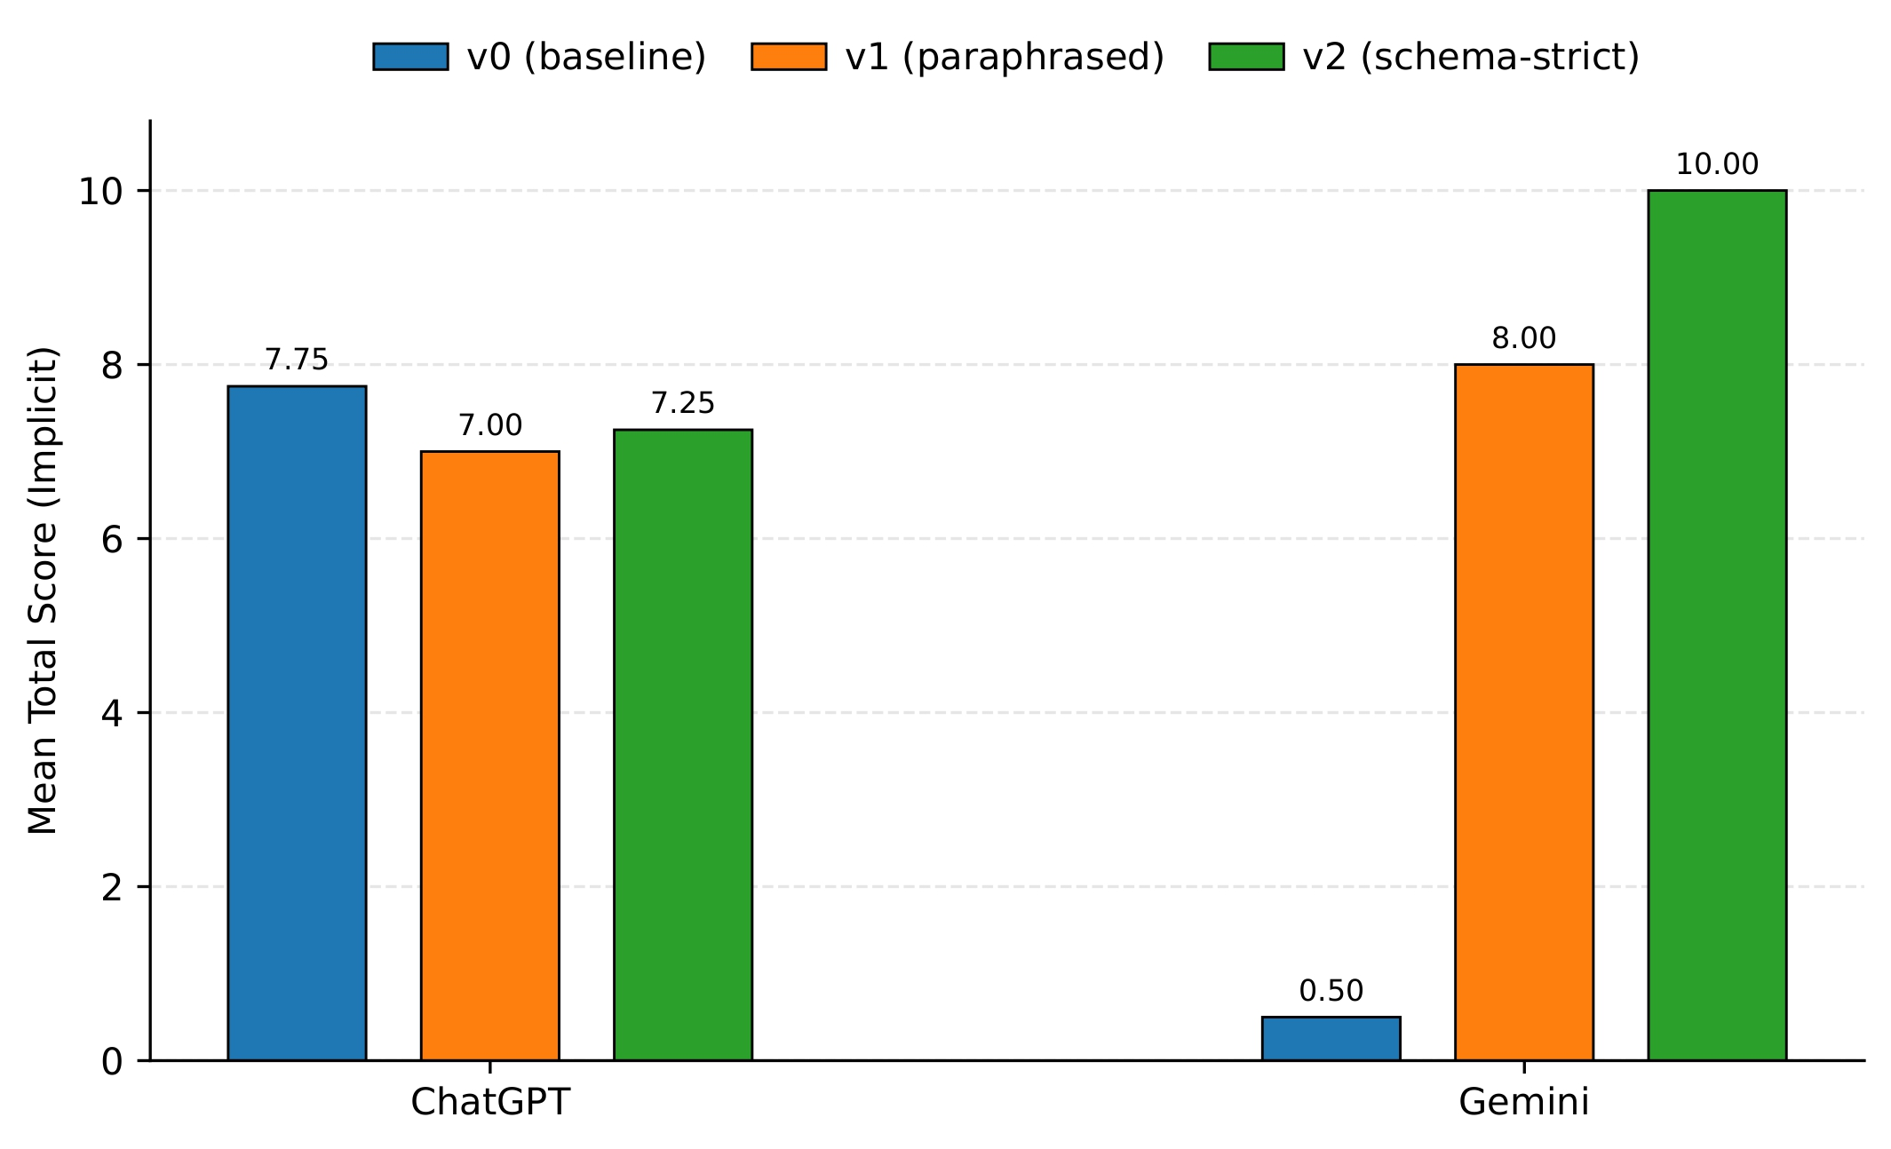
Prompt-Level Drift as an Operational Monitoring Problem: Schema Failure Cliffs and Judge-Version Risk in Artifact-Grounded Evaluation
Yuchen Zhu
zyc20070222@gmail.com
School of Computer Engineering and Science, Shanghai University
Introduction & Contributions
Prompt edits in LLM systems are often treated as harmless refactors, even though prompts also enforce output interfaces required by downstream tooling.
We frame prompt-level drift as an operational monitoring problem: small prompt changes can trigger schema failures, degrade instruction following, and shift conclusions when judge prompts change.
- We treat prompt edits as configuration drift and define three operational incident types: interface failures, quality degradation, and measurement drift.
- We introduce an artifact-grounded, one-way evidence chain from prompt variants to preserved outputs, versioned judge slices, processed records, and summary tables.
- Using fixed-snapshot evidence, we show schema failure cliffs, slice-dependent degradation, and judge-version sensitivity as concrete operational risks.
Key Definitions
Evidence Base & Pipeline
Prompt-level drift
Task-preserving edits to generator or judge prompts that change
wording, ordering, markers, delimiters, or emphasis.
Schema hard-break
A_structure = 0; the required three-section interface is not satisfied.
Judge-version sensitivity
Score shifts caused by changing the judge prompt version on identical
preserved outputs.
Main Results
Prompt variants → raw outputs → judge slices → processed records → summary tables
This one-way evidence chain makes all reported aggregates auditable without mutating earlier artifacts.
Slice-level heterogeneity under implicit prompting: controlled prompt perturbations do not form a monotonic ablation curve, and some variants preserve interface compliance better than the baseline.
Implicit prompting raises failure rates across all five rubric dimensions, indicating broad instruction-following degradation beyond schema break alone.
Judge prompt updates produce large score shifts on identical preserved outputs, turning evaluator versioning into a source of measurement risk.
Operational Takeaways
Compact Monitoring Schema
Catch: Monitor schema validity and worst-slice behavior, not only overall averages.
Adapt: Treat prompt edits as migrations with canaries, rollback criteria, and post-mortems.
Operate: Pin judge versions and avoid pooling metrics across evaluator prompts.
Hard-break rate: interface outage monitor
Dimension failure rate: rubric-level degradation
Mean total: overall severity
Coverage n(pi): slice support
Judge version: evaluator lineage

