Slide 1


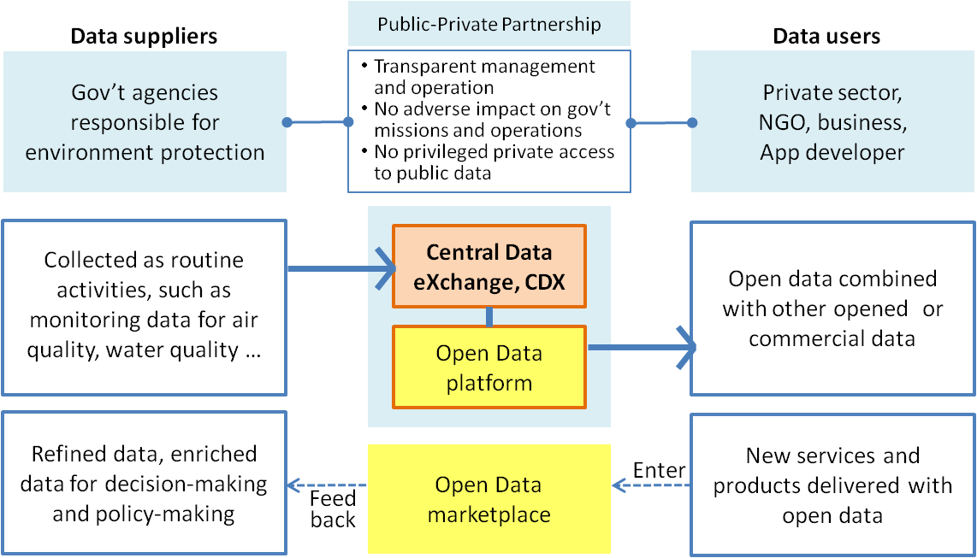
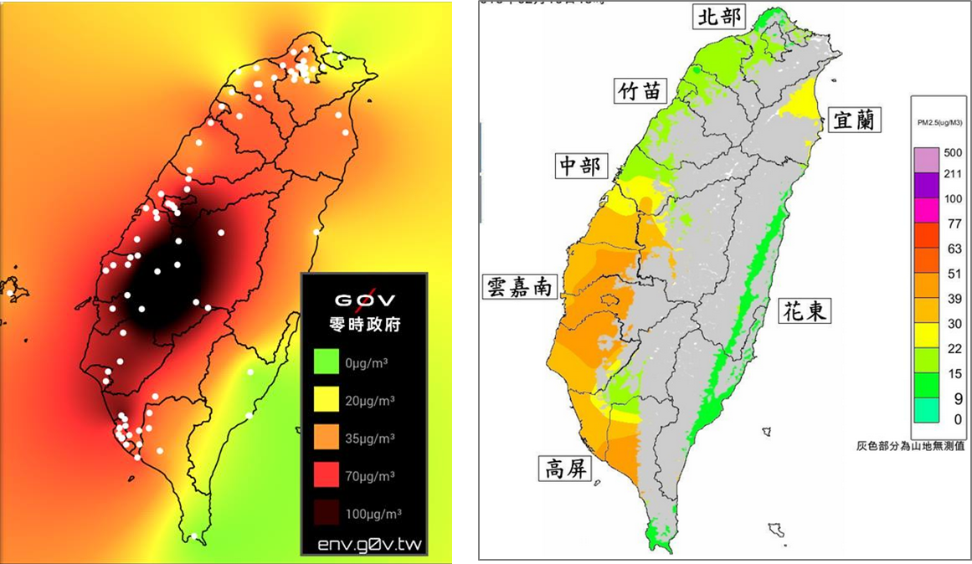
An operation and business model to exchange and open environmental data
Su-mei Huang and Yu-chi Chu
Dept. Environmental Monitoring & Information Management, and Dept. Comprehensive Planning, EPA, TAIWAN (R.O.C.)
行政院環境保護署
Environmental Protection Administration
Executive Yuan, Taiwan, R.O.C.
Introduction: Data has been referred to as the new raw material of the 21st century. However, it is currently very difficult to share environmental data since the information typically resides on geographically disparate and heterogeneous databases (systems). We proposed an operation and business model, as shown in Figure 1, which comprised with two groups of organizations working together based on the principle of partnership.
Government cannot be expected to do everything. In cooperating with the private sector as a partner can make sense based on the principle of partnership and appropriate process. The public sector continues to focus on performing services that are essential. Private sector is able to provide products and services on top of the open data made available for exploitation. Therefore, the partnership can be fulfilled through planned processes and interfaces.
Organizations they publish their data via the open interface and standard to allow others to use and reuse it. These organizations are government agencies responsible for collecting and generating data on environmental issues such as the Taiwan Environmental Protection Administration (TEPA), Water Resources Administration, Forestry Services, and some other agencies.
Organizations they aggregate published data to develop and design software applications for business and individual consumption. In addition, there are also organizations utilize published data to enhance their existing products and services.
Figure 1: The operation and business model
Publish-Subscribe Model for Data Exchange (CDX)
The Central Data eXchange (CDX) which provides a publish-subscribe solution for effective information delivery among these agencies. CDX enables TEPA and participating agencies to work with stakeholders - including local governments - to enable streamlined, electronic submission of data via the Internet. CDX also provides the capability for submitters to access their data through the use of web services.
Data that exchange through a publish-subscribe approach requires the senders to publish data without explicitly specifying recipients or having knowledge of intended recipients. Similarly, receivers must receive only those data that the subscriber has registered an interest in. Figure 2 illustrates the publish and subscribe functionality of CDX. It provides participants with the ability to:
Submit and receive data through one centralized point, in a variety of formats including Webs Forms, XML, or flat-file.
Utilize publishing services to share information collected by other stakeholders and exchange data with target systems using web services.
Open Data Platform
TEPA views environmental data as a strategic asset to protect our environment. For bring tangible benefits to public, we are on track to fulfill the requirement of the open data policy proposed by Executive Yuan, Taiwan’s central government in 2013.
There are currently over 176 datasets on the open data platform including hourly air quality monitoring data, UVI values, water monitoring data, etc. The datasets are in various formats such as JSON, XML, SHP, and KML for spatial data. We have taken a number of measures to encourage use of the datasets already published. For ensuring the data quality, we also establish a working group to oversee and provide input to the open data efforts.
One of the basic ideas behind making government data “open” is to allow the public and entrepreneurs to use and combine public data with other data in new and useful ways. TEPA has put a lot of thought into the identification of high value data sets and the roles and rules under these datasets will be made available to private sector “partners” for recombination with other resources.
When public and private data are combined some interesting intellectual property, ownership, and pricing questions will be raised. In addition, there are some other issues need to be address such as using same dataset but with different interpretation shown in Figure 3.
Figure 2: The publish and subscribe functionality of CDX
(a)
(b)
Contact:
Phone: +886-2-23117722 ext. 2340, 2700 Email: sumhuang@epa.gov.tw, ycchu@epa.gov.tw Web: http://www.epa.gov.tw Addr: 83, Section 1, Zhonghua Rd, Taipei, 10042, Taiwan (R.O.C.)
Figure 3: Using same dataset of hourly air quality monitoring data, but with difference interpretation. (a) was made by a NGO (http://env.g0v.tw) and (b) was made by TEPA (http://taqm.epa.gov.tw/taqm/tw/ContourMap.aspx). Does this cause adverse impact on government mission?

