Slide 1


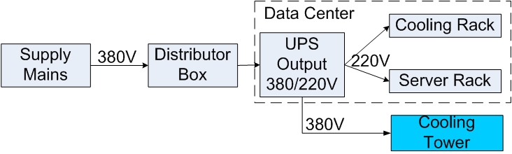
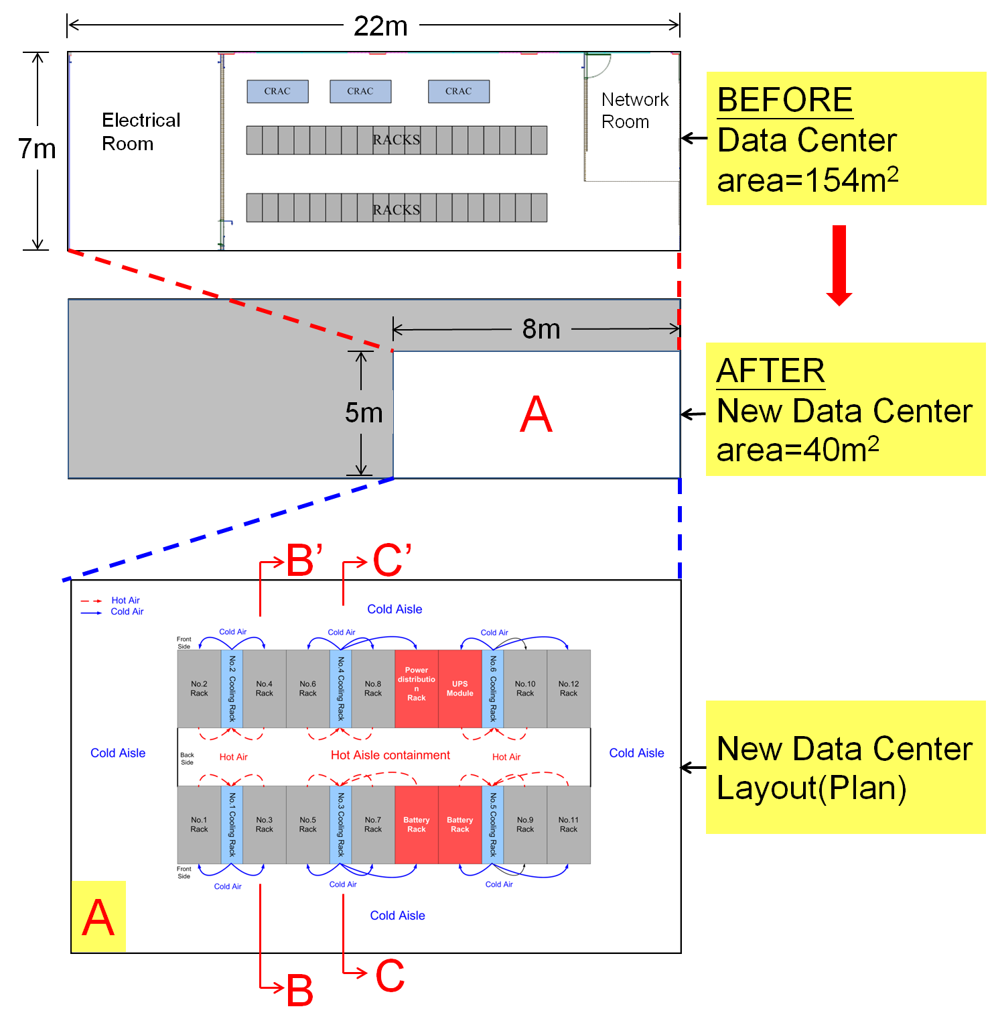
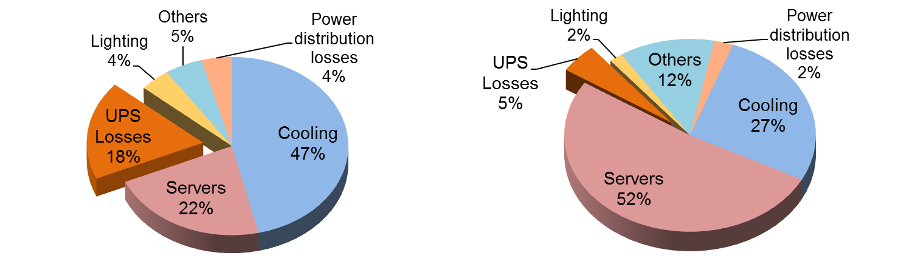
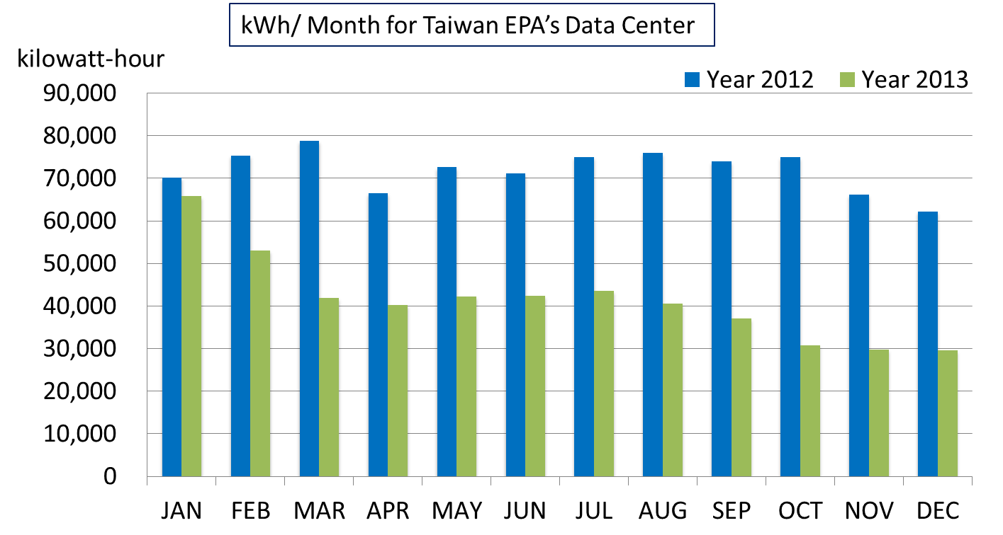
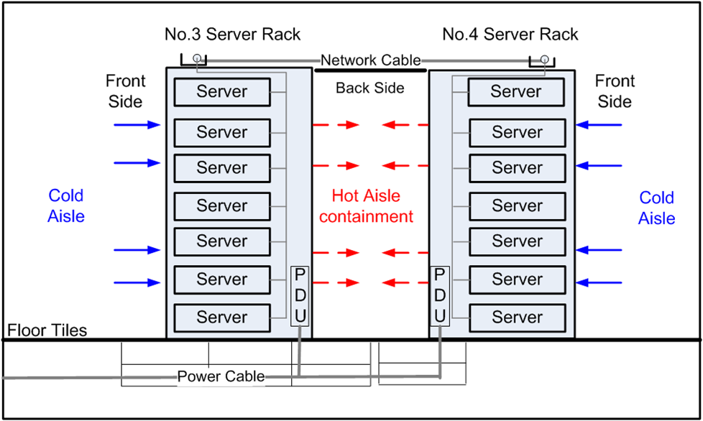
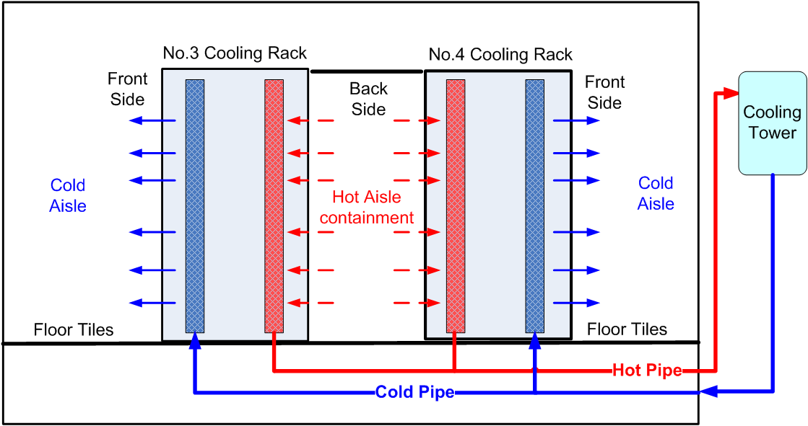
Consuming Less Energy and Using Less Floor Space:Taiwan EPA’s Data Center Reconstruction
Su-mei Huang, Yan-cin Wang, Yu-chi Chu
Department of Environmental Monitoring & Information Management,
Environmental Protection Administration Executive Yuan, R.O.C.(Taiwan)
行政院環境保護署
Environmental Protection Administration Executive Yuan, R.O.C.(Taiwan)
Introduction
Since 2011, the Taiwan Environmental Protection Administration (TEPA) has implemented a series of measures to reconstruct its data center for improved energy performance. These measures include server consolidation, industry best management practices and virtualization across its data centers. Over the past two years, TEPA consolidated several data centers and server rooms with plans to gain more efficiency. The administration completed a successful project which included optimizing the use of floor space and installing an efficient cooling system. TEPA currently is hosting over 150 business applications in a shared hosting environment offering many features of private cloud service.
The past plan of TEPA’s data center is shown on the top in Fig.1. The computer room air-conditioning unit (CRAC) of TEPA’s data center pushed cold air into the floor plenum and cold air ran through perforated floor tiles to cool the IT equipment in the racks. It couldn’t prevent the mixing of the hot rack exhaust air and the cool supply air drawn into the racks. On the other hand, some IT equipment in the racks was far away from CRAC and was not cold enough. CRAC accounted for 47% of the total data center energy consumption, but the cooling capacity of the CRAC was not all supplied to the IT equipment in the racks.
This poster presents the overall benefits and lessons learned from the actual work of the data center reconstruction, including air and energy management, cooling efficiency improvement, as well as floor space utilization of the data center.
Reduced about 2% Power Distribution Losses
Fig.4. New Voltage Transformation Path.
Result & Future Work
Floor Space Saving of Data Center: After TEPA has implemented a series of measures which include server consolidation, industry best management practices and virtualization across TEPA’s data center, the demand for rack was reduced from 38 down to 12. The demand for TEPA’s data center’s space was reduced from 154m² down to 40m²(as shown in Fig.1(A)).The configuration of the data center was changed, and 74% of the space of the data center was saved.
Effective air management and energy management is of crucial importance. The efficient cooling systems and UPS systems are helpful for energy saving. In Fig.5, the pie charts show the distributions of the energy consumption in TEPA’s data center. For a fixed total energy consumption of IT equipment (after IT services consolidation), the cooling systems take up a much smaller share of total energy consumed (from 47% down to 27%). The new UPS systems in the rack allows greater flexibility and more efficiently. The UPS systems losses are reduced 13%.
In Fig.6, the reconstruction of TEPA’s data center was completed in February 2013. The monthly energy saving ranges from about 26,000 kilowatt-hours to more than 44,000 kilowatt-hours. The reconstruction has also reduced operating costs and helped reduce carbon emission.
Power Use Effectiveness (PUE) , one of the energy performance metrics, is defined as the ratio of the total power to run the data center facility to the total power drawn by all IT equipment (lower PUE value is better)[2][3]. In the past, TEPA’s data center had a PUE of 2.5. Now, the PUE is down to 1.7 and we will try to further achieve a PUE as low as 1.3.
We are investigating the feasibility of direct current (DC) distribution into the rack, for the reduction of the power loss and wasted energy (TEPA’s data center power is supplied from the grid as AC power and distributed throughout the IT equipment in the rack. However, the requirement of the UPS system is DC power, the power must go through multiple conversions). The renewable energy supply (such as Solar Power) is another goal.
Methods
Air Management and Cooling Efficiency: TEPA adopted in-row RD cooling systems and all the equipment were installed into the racks to achieve a front-to-back airflow (as shown in the bottom of Fig.1). The rows of racks were placed back-to-back. The cold aisles were located in front of the racks, and would reject heat out through the hot aisles behind the racks. With the isolation, the temperature of the hot aisle did not impact the temperature of the racks (the cooling system configuration in B-B’ section for No.3 and No.4 server rack is shown in Fig.2). The in-row RD cooling system was configured to supply cold air to the cold aisles and pull return air from the hot aisles and back to the cooling towers. In accordance with IT equipment operation, the in-row RD cooling system was capable of adjusting cooling performance dynamically to improve energy saving (the cooling system configuration in C-C’ section for No.3 and No.4 cooling rack is shown in Fig.3). The new hot aisle/cold aisle configurations and air flow management can significantly increase the cooling efficiency of the cooling system of TEPA’s data center.
Energy Management and Energy Efficiency: TEPA installed a new Uninterruptible Power Supplies (UPS) system which enable to supply both 380Vac and 220Vac. The transformers between main supply (380Vac) and UPS were removed so as to reduce the losses during power distribution (new voltage transformation path is shown in Fig.4). The new power distribution units (PDU) were located in the racks. The conductor lengths from the PDU to the IT equipment were reduced, leading to the less power lost in the form of heat.
BEFORE
AFTER
Fig.5. Comparison of the Change in the Proportion of Energy Consumption.
Fig. 1. Plan View of Taiwan EPA ‘s Data Center and the Reduction of Physical Space Utilization and Changes in the Energy and Cooling Management.
Fig.6. Comparison of Monthly Energy Consumption.
Reference
[1] Gartner Report, “Hype Cycle for Data Center Power and Cooling Technologies,” 2012.
[2] VanGeet, O., “FEMP Best Practices Guide for Energy-Efficient Data Center Design,” National Renewable Energy Laboratory, 2011.
[3] Grid, G., “The Green Grid data Center Power Efficiency Metrics: PUE and DCiE, ” Green Grid report, 2007.
Fig.2. Cooling System Configuration in B-B’ Section for No.3 and No.4 Server Rack.
Fig.3. Cooling System Configuration in C-C’ Section for No.3 and No.4 Cooling Rack.
For further information please contact sumhuang@epa.gov.tw, yencwang@epa.gov.tw, ycchu@epa.gov.tw ; Ph: +886-23117722 ext. 2340,2337,2300 ; Web: http://www.epa.gov.tw

