Slide 1
S&P500 News Summary
Team 2

Slide 2
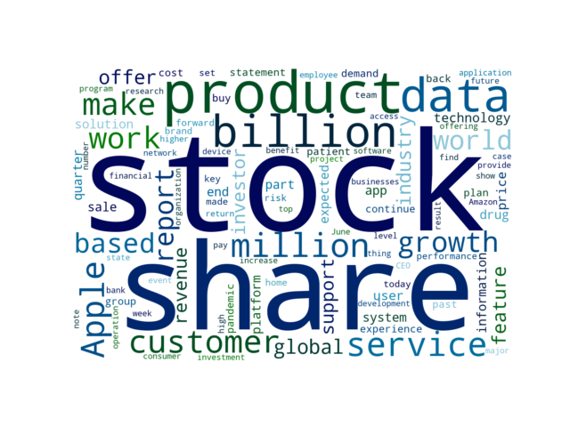
Key words of this week

Slide 3
Latest Unbiased News
Global Sportswear Market Outlook and Forecast Report 2021-2026: Rising Popularity of Athleisure / Increasing Participation of Women / Rise in Demand for Sustainable Sportswear
4 days ago | Yahoo Entertainment | POSITIVE
The "Sportswear Market - Global Outlook and Forecast 2021-2026" report has been added to ResearchAndMarkets.com's offering. With the increase in participation and government initiatives, the market for women's sports and activewear will continue to grow YoY during the forecast period.
Jewelry retailer Alex and Ani files for Chapter 11 bankruptcy protection
4 days ago | Reuters | NEGATIVE
Women shop for jewelry in ALEX AND ANI at the King of Prussia Mall, United States' largest retail shopping space, in King of Prussia, Pennsylvania, U.S., December 8, 2018. The company's estimated assets ranged from $100 million to $500 million as did its estimated liabilities, according to the filing made in the United States Bankruptcy Court for the District of Delaware.
Xilinx Acquires Silexica to Broaden its Developer Base
4 days ago | Business Wire | NEUTRAL
SAN JOSE, Calif.--(BUSINESS WIRE)--Xilinx, Inc. (NASDAQ: XLNX), the leader in adaptive computing, today announced that it has acquired Silexica, a privately-held provider of C/C++ programming and analysis tools. The integration of our technology with the Xilinx Vitis portfolio fully aligns with our goal of making adaptive computing accessible to software developers.

Slide 4
Latest Unbiased News
Qualcomm unveils 7 new IoT chipsets to power next-gen devices
4 days ago | TechRadar | NEUTRAL
Global chip major Qualcomm has unveiled seven new IoT chipsets targeted at devices meant for transportation and logistics, warehousing, video collaboration, smart cameras, retail and healthcare, among others. Equipped to support 5G mmWave/Sub-6 GHz and Wi-Fi 6E, this solution helps enable the latest generation of handhelds and tablets, industrial scanners, and human machine interface systems.
Pfizer and BioNTech to Provide 500 Million Doses of COVID-19 Vaccine to U.S. Government for Donation to Poorest Nations
4 days ago | Yahoo Entertainment | NEGATIVE
The government will, in turn, donate the Pfizer-BioNTech vaccine doses to low- and lower middle-income countries and organizations that support them. The production capacity has consistently grown due to continued enhancements to the vaccine’s supply chain, which include expanding existing facilities, adding more suppliers, and bringing on additional Pfizer/BioNTech sites and contract manufacturers around the world to produce the vaccine.
Full Cycle Developers
4 days ago | Netflixtechblog.com | NEUTRAL
The year was 2012 and operating a critical service at Netflix was laborious. The common problems across your dev teams are likely similar — from the need for continuous delivery pipelines, monitoring/observability, and so on.

Slide 5
Sentiment Analysis -- Company
Highest Positive Rate
Wells Fargo
ServiceNow
Accenture
Biogen
PayPal
Highest Negative Rate
AmerisourceBergen
Electronic Arts
Lockheed Martin
Facebook
Nike

Slide 6
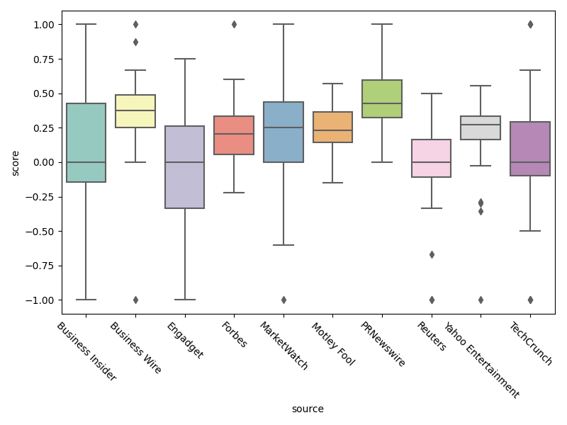
Sentiment Analysis -- Source

Slide 7
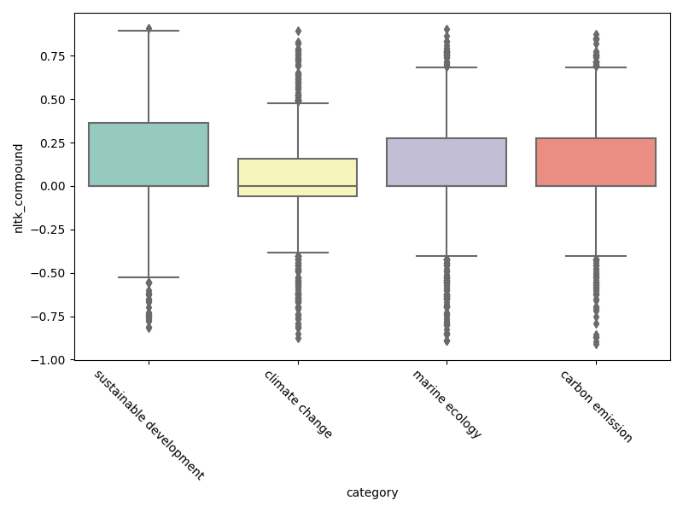
ESG Analysis -- Environment

Slide 8
ESG: Top5 Environment companies
company | total_news | score
Tesla | 18 | 36.11
Exxon Mobil | 6 | 33.33
General Motors | 5 | 50.0
Netflix | 5 | 50.0
Microsoft | 3 | 66.67

Slide 9
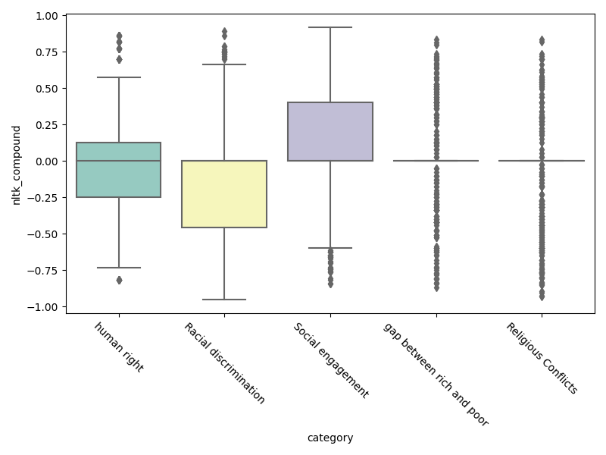
ESG Analysis -- Environment

Slide 10
ESG: Top5 Society companies
company | total_news | score
Facebook | 8 | 31.25
Netflix | 7 | 57.14
Pfizer | 4 | 50.0
AmerisourceBergen | 2 | 0.0
Intel | 2 | 25.0

Slide 11
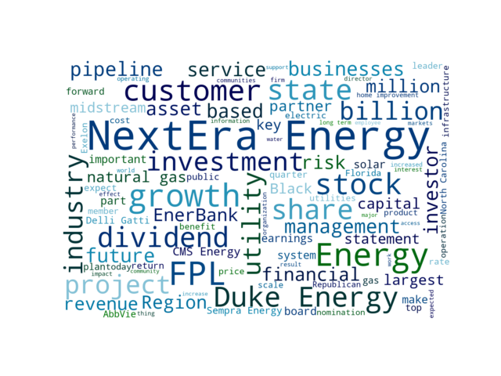
Key words of the selected categories

Slide 12
Selected Categories News
Sempra Energy To Hold Virtual Investor Day June 29
5 days ago | PRNewswire | POSITIVE
SAN DIEGO, June 9, 2021 /PRNewswire/ -- 's (NYSE: SRE) senior management team will provide an update on the company's business strategy, operational highlights and financial outlook at its virtual Investor Day event at 12 p.m. ET, June 29. Investors, analysts, media and the public may listen to a live webcast of the conference call on the company's website, sempra.com, by clicking on the appropriate audio link.
CMS Energy Announces the Strategic Sale of EnerBank USA to Regions Bank for $960 Million
6 days ago | Yahoo Entertainment | POSITIVE
- Funds key initiatives in core utility businesses (including clean energy transformation) and eliminates equity issuance needs from 2022 to 2024 JACKSON, Mich., June 8, 2021 /PRNewswire/ -- CMS Energy (NYSE: CMS) ("CMS") today announced that it has executed a definitive agreement to sell its wholly-owned subsidiary, EnerBank USA, to Regions Bank, a subsidiary of Regions Financial Corporation (NYSE: RF) ("Regions") for cash in a transaction valued at $960 million. Because the company is not able to estimate the impact of specific line items, which have the potential to significantly impact, favorably or unfavorably, the company's reported earnings per share in future periods, the company is not providing reported earnings per share guidance nor is it providing a reconciliation for the comparable future period earnings per share.

