Slide 1
S&P500 News Summary
Team 2

Slide 2
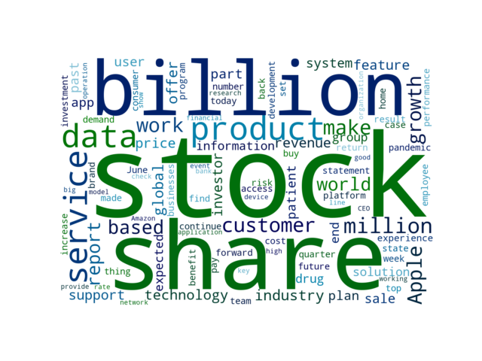
Key words of this week

Slide 3
Latest Unbiased News
Global Sportswear Market Outlook and Forecast Report 2021-2026: Rising Popularity of Athleisure / Increasing Participation of Women / Rise in Demand for Sustainable Sportswear
3 days ago | Yahoo Entertainment | POSITIVE
The "Sportswear Market - Global Outlook and Forecast 2021-2026" report has been added to ResearchAndMarkets.com's offering. With the increase in participation and government initiatives, the market for women's sports and activewear will continue to grow YoY during the forecast period.
Jewelry retailer Alex and Ani files for Chapter 11 bankruptcy protection
3 days ago | Reuters | NEGATIVE
Women shop for jewelry in ALEX AND ANI at the King of Prussia Mall, United States' largest retail shopping space, in King of Prussia, Pennsylvania, U.S., December 8, 2018. The company's estimated assets ranged from $100 million to $500 million as did its estimated liabilities, according to the filing made in the United States Bankruptcy Court for the District of Delaware.
Xilinx Acquires Silexica to Broaden its Developer Base
3 days ago | Business Wire | NEUTRAL
SAN JOSE, Calif.--(BUSINESS WIRE)--Xilinx, Inc. (NASDAQ: XLNX), the leader in adaptive computing, today announced that it has acquired Silexica, a privately-held provider of C/C++ programming and analysis tools. The integration of our technology with the Xilinx Vitis portfolio fully aligns with our goal of making adaptive computing accessible to software developers.

Slide 4
Latest Unbiased News
Qualcomm unveils 7 new IoT chipsets to power next-gen devices
3 days ago | TechRadar | NEUTRAL
Global chip major Qualcomm has unveiled seven new IoT chipsets targeted at devices meant for transportation and logistics, warehousing, video collaboration, smart cameras, retail and healthcare, among others. Equipped to support 5G mmWave/Sub-6 GHz and Wi-Fi 6E, this solution helps enable the latest generation of handhelds and tablets, industrial scanners, and human machine interface systems.
Pfizer and BioNTech to Provide 500 Million Doses of COVID-19 Vaccine to U.S. Government for Donation to Poorest Nations
3 days ago | Yahoo Entertainment | NEGATIVE
The government will, in turn, donate the Pfizer-BioNTech vaccine doses to low- and lower middle-income countries and organizations that support them. The production capacity has consistently grown due to continued enhancements to the vaccine’s supply chain, which include expanding existing facilities, adding more suppliers, and bringing on additional Pfizer/BioNTech sites and contract manufacturers around the world to produce the vaccine.
Full Cycle Developers
3 days ago | Netflixtechblog.com | NEUTRAL
The year was 2012 and operating a critical service at Netflix was laborious. The common problems across your dev teams are likely similar — from the need for continuous delivery pipelines, monitoring/observability, and so on.

Slide 5
Sentiment Analysis -- Company
Highest Positive Rate
Wells Fargo
ServiceNow
Accenture
Biogen
PayPal
Highest Negative Rate
AmerisourceBergen
Electronic Arts
Lockheed Martin
Facebook
Nike

Slide 6
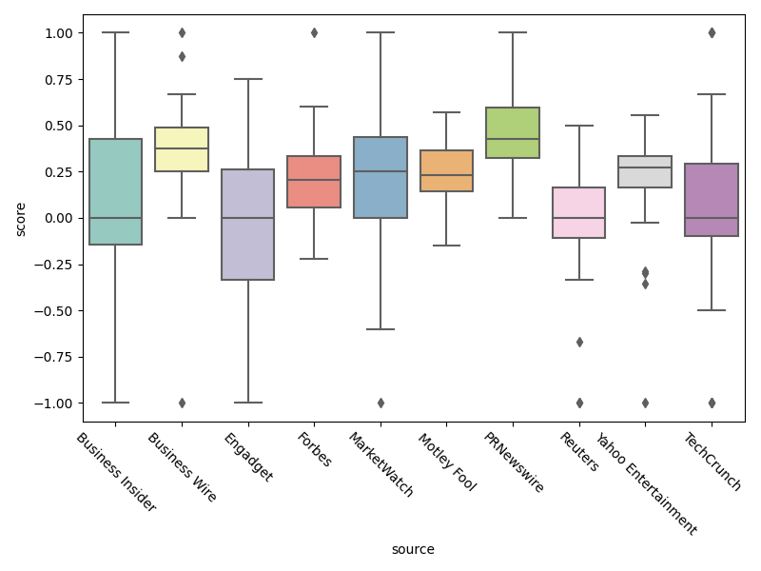
Sentiment Analysis -- Source

Slide 7
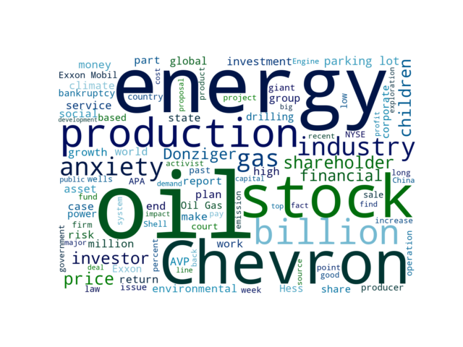
Key words of the selected categories

Slide 8
Selected Categories News
Cabot Oil & Gas Stock Is Estimated To Be Modestly Undervalued
5 days ago | Yahoo Entertainment | NEUTRAL
The stock of Cabot Oil & Gas (NYSE:COG, 30-year Financials) shows every sign of being modestly undervalued, according to GuruFocus Value calculation.
Exxon Mobil Stock Is Estimated To Be Modestly Overvalued
6 days ago | Yahoo Entertainment | NEGATIVE
The stock of Exxon Mobil (NYSE:XOM, 30-year Financials) appears to be modestly overvalued, according to GuruFocus Value calculation.

Slide 9
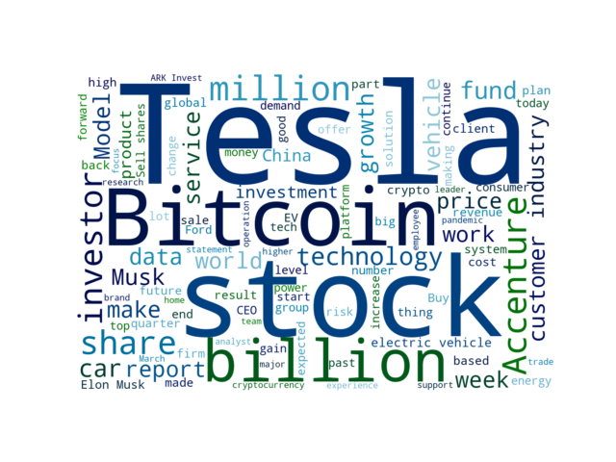
Key words of the selected companies

Slide 10
Selected Companies News
Does Elon Musk have a new enemy? Binance CEO Taunts Him Over Tesla Bitcoins
1 weeks ago | Entrepreneur | NEGATIVE
Elon Musk is embroiled in a new controversy and it seems that a new declared enemy has been named. Related: Apparently, Tesla Earns More With Bitcoin Than With the Sale of Its Own Cars However, the CEO of SpaceX clarified that his company will not get rid of the cryptocurrencies it already owns.
Tesla CEO Elon Musk says the auto chip shortage is like the toilet paper frenzy last year, only worse (TSLA)
1 weeks ago | Business Insider | NEGATIVE
• Tesla CEO Elon Musk compared the chip shortage to the toilet paper buying frenzy in 2020. Last month, during the company's earnings call Musk said supply-chain issues were causing "insane difficulties" for the electric carmaker and the chip shortage had impacted Tesla's manufacturing goals.
Tesla's Higher Prices Due to Supply Chain Pressure, Says CEO Elon Musk
1 weeks ago | Entrepreneur | NEGATIVE
Opinions expressed by Entrepreneur contributors are their own. Musk was responding to an unverified Twitter account called @Ryanth3nerd who wrote: “I really don’t like the direction @ is going raising prices of vehicles but removing features like lumbar for the Model Y...” Tesla raised the price of its Model 3 and Model Y vehicles in May --- the fifth incremental increase in only a few months, according to the Electrek website.

Slide 11
Selected Companies News
: Tesla price increases caused by major issues sourcing critical parts, Elon Musk says
1 weeks ago | MarketWatch | NEGATIVE
Major issues sourcing key parts for the production of Tesla’s automobiles are behind recent increases to the cost of the electric vehicles, Chief Executive Elon Musk said on Twitter on Monday. Auto giants including Volkswagen VOW, 0P6N, and Ford F, have warned of a looming production crisis in recent quarterly earnings, with Ford projecting a $2.5 billion hit to profits this year from the chip shortage.
Elon Musk says Tesla prices are increasing because of supply chain disruptions across the auto industry
1 weeks ago | Business Insider | NEGATIVE
• The prices of some Tesla models are going up because of the supply chain issues, CEO Elon Musk said. • Tesla earlier this month boosted prices on its Model 3 and Model Y. • The global auto industry has been hit hard by supply chain issues, notably a shortage of computer chips.
Elon Musk says Bitcoin no longer accepted for Tesla purchases
1 months ago | Mashable | NEGATIVE
Tesla CEO Elon Musk has changed his stance on cryptocurrency. Musk tweeted that the cryptocurrency's "great cost to the environment" meant Tesla won't be offering the payment option for its zero-emissions vehicles.

