Slide 1
S&P500 News Summary
Team 2

Slide 2
Latest Unbiased News

Slide 3
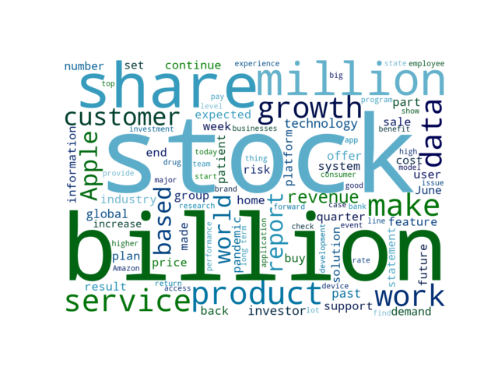
Key words of this week

Slide 4
Latest Unbiased News
Global Sportswear Market Outlook and Forecast Report 2021-2026: Rising Popularity of Athleisure / Increasing Participation of Women / Rise in Demand for Sustainable Sportswear
6 days ago | Yahoo Entertainment | POSITIVE
The "Sportswear Market - Global Outlook and Forecast 2021-2026" report has been added to ResearchAndMarkets.com's offering. With the increase in participation and government initiatives, the market for women's sports and activewear will continue to grow YoY during the forecast period.
Jewelry retailer Alex and Ani files for Chapter 11 bankruptcy protection
6 days ago | Reuters | NEGATIVE
Women shop for jewelry in ALEX AND ANI at the King of Prussia Mall, United States' largest retail shopping space, in King of Prussia, Pennsylvania, U.S., December 8, 2018. The company's estimated assets ranged from $100 million to $500 million as did its estimated liabilities, according to the filing made in the United States Bankruptcy Court for the District of Delaware.

Slide 5
Latest Unbiased News
Xilinx Acquires Silexica to Broaden its Developer Base
6 days ago | Business Wire | NEUTRAL
SAN JOSE, Calif.--(BUSINESS WIRE)--Xilinx, Inc. (NASDAQ: XLNX), the leader in adaptive computing, today announced that it has acquired Silexica, a privately-held provider of C/C++ programming and analysis tools. The integration of our technology with the Xilinx Vitis portfolio fully aligns with our goal of making adaptive computing accessible to software developers.
Qualcomm unveils 7 new IoT chipsets to power next-gen devices
6 days ago | TechRadar | NEUTRAL
Global chip major Qualcomm has unveiled seven new IoT chipsets targeted at devices meant for transportation and logistics, warehousing, video collaboration, smart cameras, retail and healthcare, among others. Equipped to support 5G mmWave/Sub-6 GHz and Wi-Fi 6E, this solution helps enable the latest generation of handhelds and tablets, industrial scanners, and human machine interface systems.

Slide 6
Latest Unbiased News
Pfizer and BioNTech to Provide 500 Million Doses of COVID-19 Vaccine to U.S. Government for Donation to Poorest Nations
6 days ago | Yahoo Entertainment | NEGATIVE
The government will, in turn, donate the Pfizer-BioNTech vaccine doses to low- and lower middle-income countries and organizations that support them. The production capacity has consistently grown due to continued enhancements to the vaccine’s supply chain, which include expanding existing facilities, adding more suppliers, and bringing on additional Pfizer/BioNTech sites and contract manufacturers around the world to produce the vaccine.
Full Cycle Developers
6 days ago | Netflixtechblog.com | NEUTRAL
The year was 2012 and operating a critical service at Netflix was laborious. The common problems across your dev teams are likely similar — from the need for continuous delivery pipelines, monitoring/observability, and so on.

Slide 7
Sentiment Analysis

Slide 8
Sentiment Analysis -- Company
Highest Positive Rate
Wells Fargo
ServiceNow
Accenture
PepsiCo
PayPal
Highest Negative Rate
AmerisourceBergen
Lockheed Martin
Electronic Arts
Facebook
General Mills

Slide 9
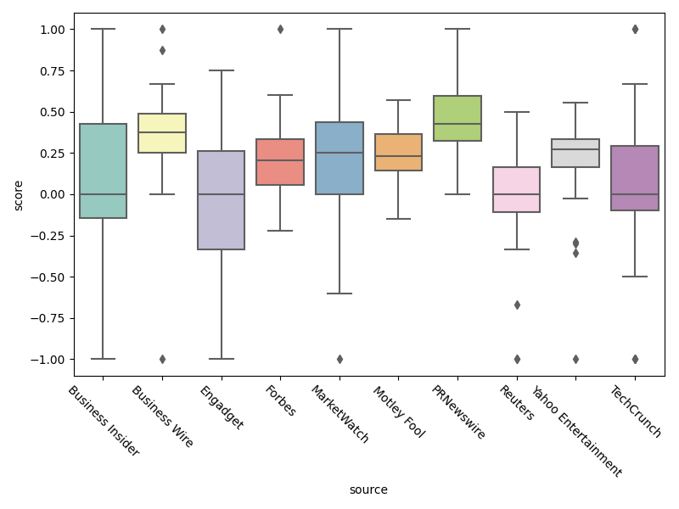
Sentiment Analysis -- Source

Slide 10
ESG Analysis

Slide 11
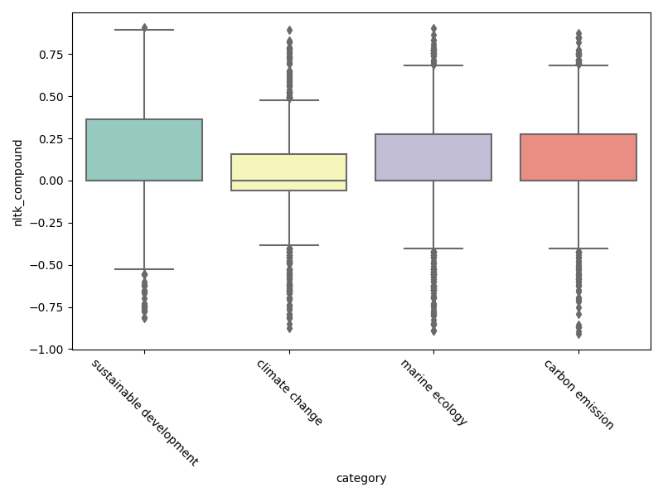
ESG Analysis -- Environment

Slide 12
ESG: Top5 Environment companies
company | total_news | score
Tesla | 18 | 36.11
Exxon Mobil | 6 | 33.33
General Motors | 5 | 50.0
Netflix | 5 | 50.0
Microsoft | 3 | 66.67

Slide 13
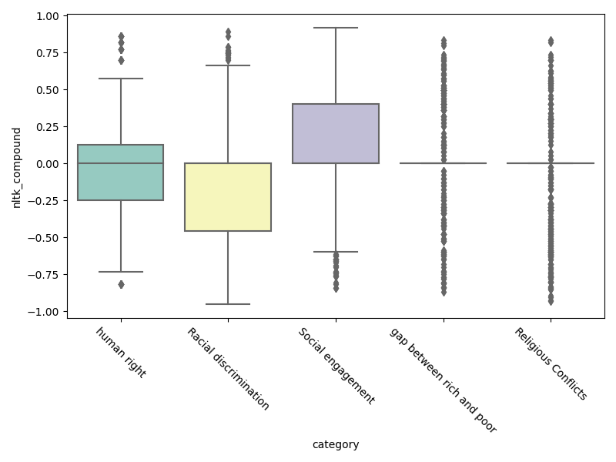
ESG Analysis -- Environment

Slide 14
ESG: Top5 Society companies
company | total_news | score
Facebook | 8 | 31.25
Netflix | 7 | 57.14
Pfizer | 4 | 50.0
AmerisourceBergen | 2 | 0.0
Intel | 2 | 25.0

Slide 15
Selected Categories
Financials | Information Technology

Slide 16
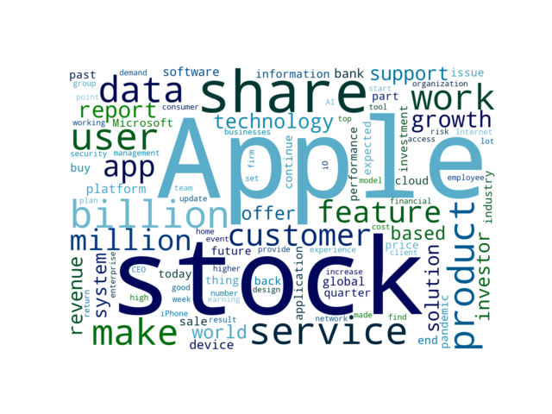
Key words of the selected categories

Slide 17
Selected Categories News
DrChrono Among the First to Support iOS 15 Feature Allowing Patients to Share Apple Health App Data with Providers
6 days ago | Stockhouse | POSITIVE
SUNNYVALE, Calif., June 09, 2021 (GLOBE NEWSWIRE) -- DrChrono Inc ., This new feature builds on Health Records on iPhone, which gives patients centralized access to their data from various health institutions, such as allergies, conditions, immunizations, lab results, medications, procedures, and vitals directly within the app.
Feature: What a 15% Global Minimum Corporate Tax Rate Means for the Stock Market
1 weeks ago | Barron's | NEUTRAL
The global tax deal that the G-7 nations reached over the weekend isn’t like pulling an emergency brake that brings a runaway train to a screeching halt. But a global agreement on a 15% minimum rate has broader implications than just subtracting a buck from S&P 500 earnings—if it would put international jostling behind and encourage countries to raise corporate tax rates across the board, in the estimation of two analysts at Gavekal Research.

Slide 18
Selected Categories News
Wearable Payment Device Market Research Report by Device Type, by Technology, by Sales Channel, by Application, by Region - Global Forecast to 2026 - Cumulative Impact of COVID-19
1 weeks ago | Yahoo Entertainment | NEUTRAL
Market Statistics: The report provides market sizing and forecast across five major currencies - USD, EUR GBP, JPY, and AUD. Market Segmentation & Coverage: This research report categorizes the Wearable Payment Device to forecast the revenues and analyze the trends in each of the following sub-markets: Based on Device Type, the Wearable Payment Device Market was studied across Fitness Trackers, Payment Wristbands, Smart Rings, and Smart Watches.

Slide 19
Selected Companies
Apple | Tesla

Slide 20
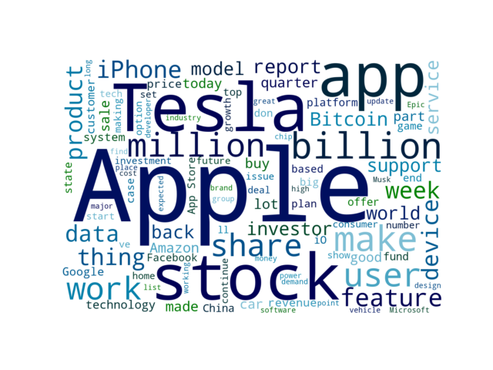
Key words of the selected companies

Slide 21
Selected Companies News
At Least One New MacBook With Apple Silicon 'Likely' at WWDC, Says Morgan Stanley Analyst
1 weeks ago | MacRumors | NEUTRAL
We're just three days away from Apple's annual developers conference, WWDC, but rumors are still divided as to whether new MacBook Pro models with Apple silicon will be announced at Apple's opening keynote on Monday. Huberty said there is potential for the new MacBook to feature the so-called "M2" chip, and if so, she assumes that shipments to customers would begin in the second half of 2021.
Best Tech Stocks To Buy Right Now? 4 To Watch
1 months ago | Stockmarket.com | POSITIVE
Top Tech Stocks To Consider Buying In The Stock Market Now Amidst all the hot earnings figures over the past few weeks, tech stocks continue to attract attention, nonetheless. Because of this, I could see investors eyeing Upwork as it is set to report earnings after today’s closing bell.

Slide 22
Selected Companies News
Apple and the Rest of Big Tech Reported Blockbuster Earnings. Why Their Stocks Went Nowhere.
1 months ago | Barron's | POSITIVE
Amazon reported a blowout quarter after Thursday’s close and now earnings from all the FAANG stocks—and Microsoft —are in the books. That didn’t sit well with shares of gig economy giants Uber, Lyft, and DoorDash but is a possible signal the Biden administration is giving worker’s rights a fresh look.
Top Stocks To Buy After Positive Earnings Reports From Facebook And Apple
1 months ago | Forbes | POSITIVE
However, on Thursday, the indices surged thanks to better-than-expected earnings from Facebook and Apple . The stock closed down 3.0% to $227.3 on volume of 1,175,867 vs its 10-day price average of $209.21 and its 22-day price average of $195.75, and is up 20.93% for the year.

