Slide 1
Effective Pairing

Slide 2
Data Science is a team sport
On teams, people and communication skills are key
Teaming is needed for project work, meetups, open-source
It’s crucial that we all learn to work well with others
Comes as a surprise to some students
If you find yourself thinking “this is not what I’m here to learn”, we need to talk about it

Slide 3
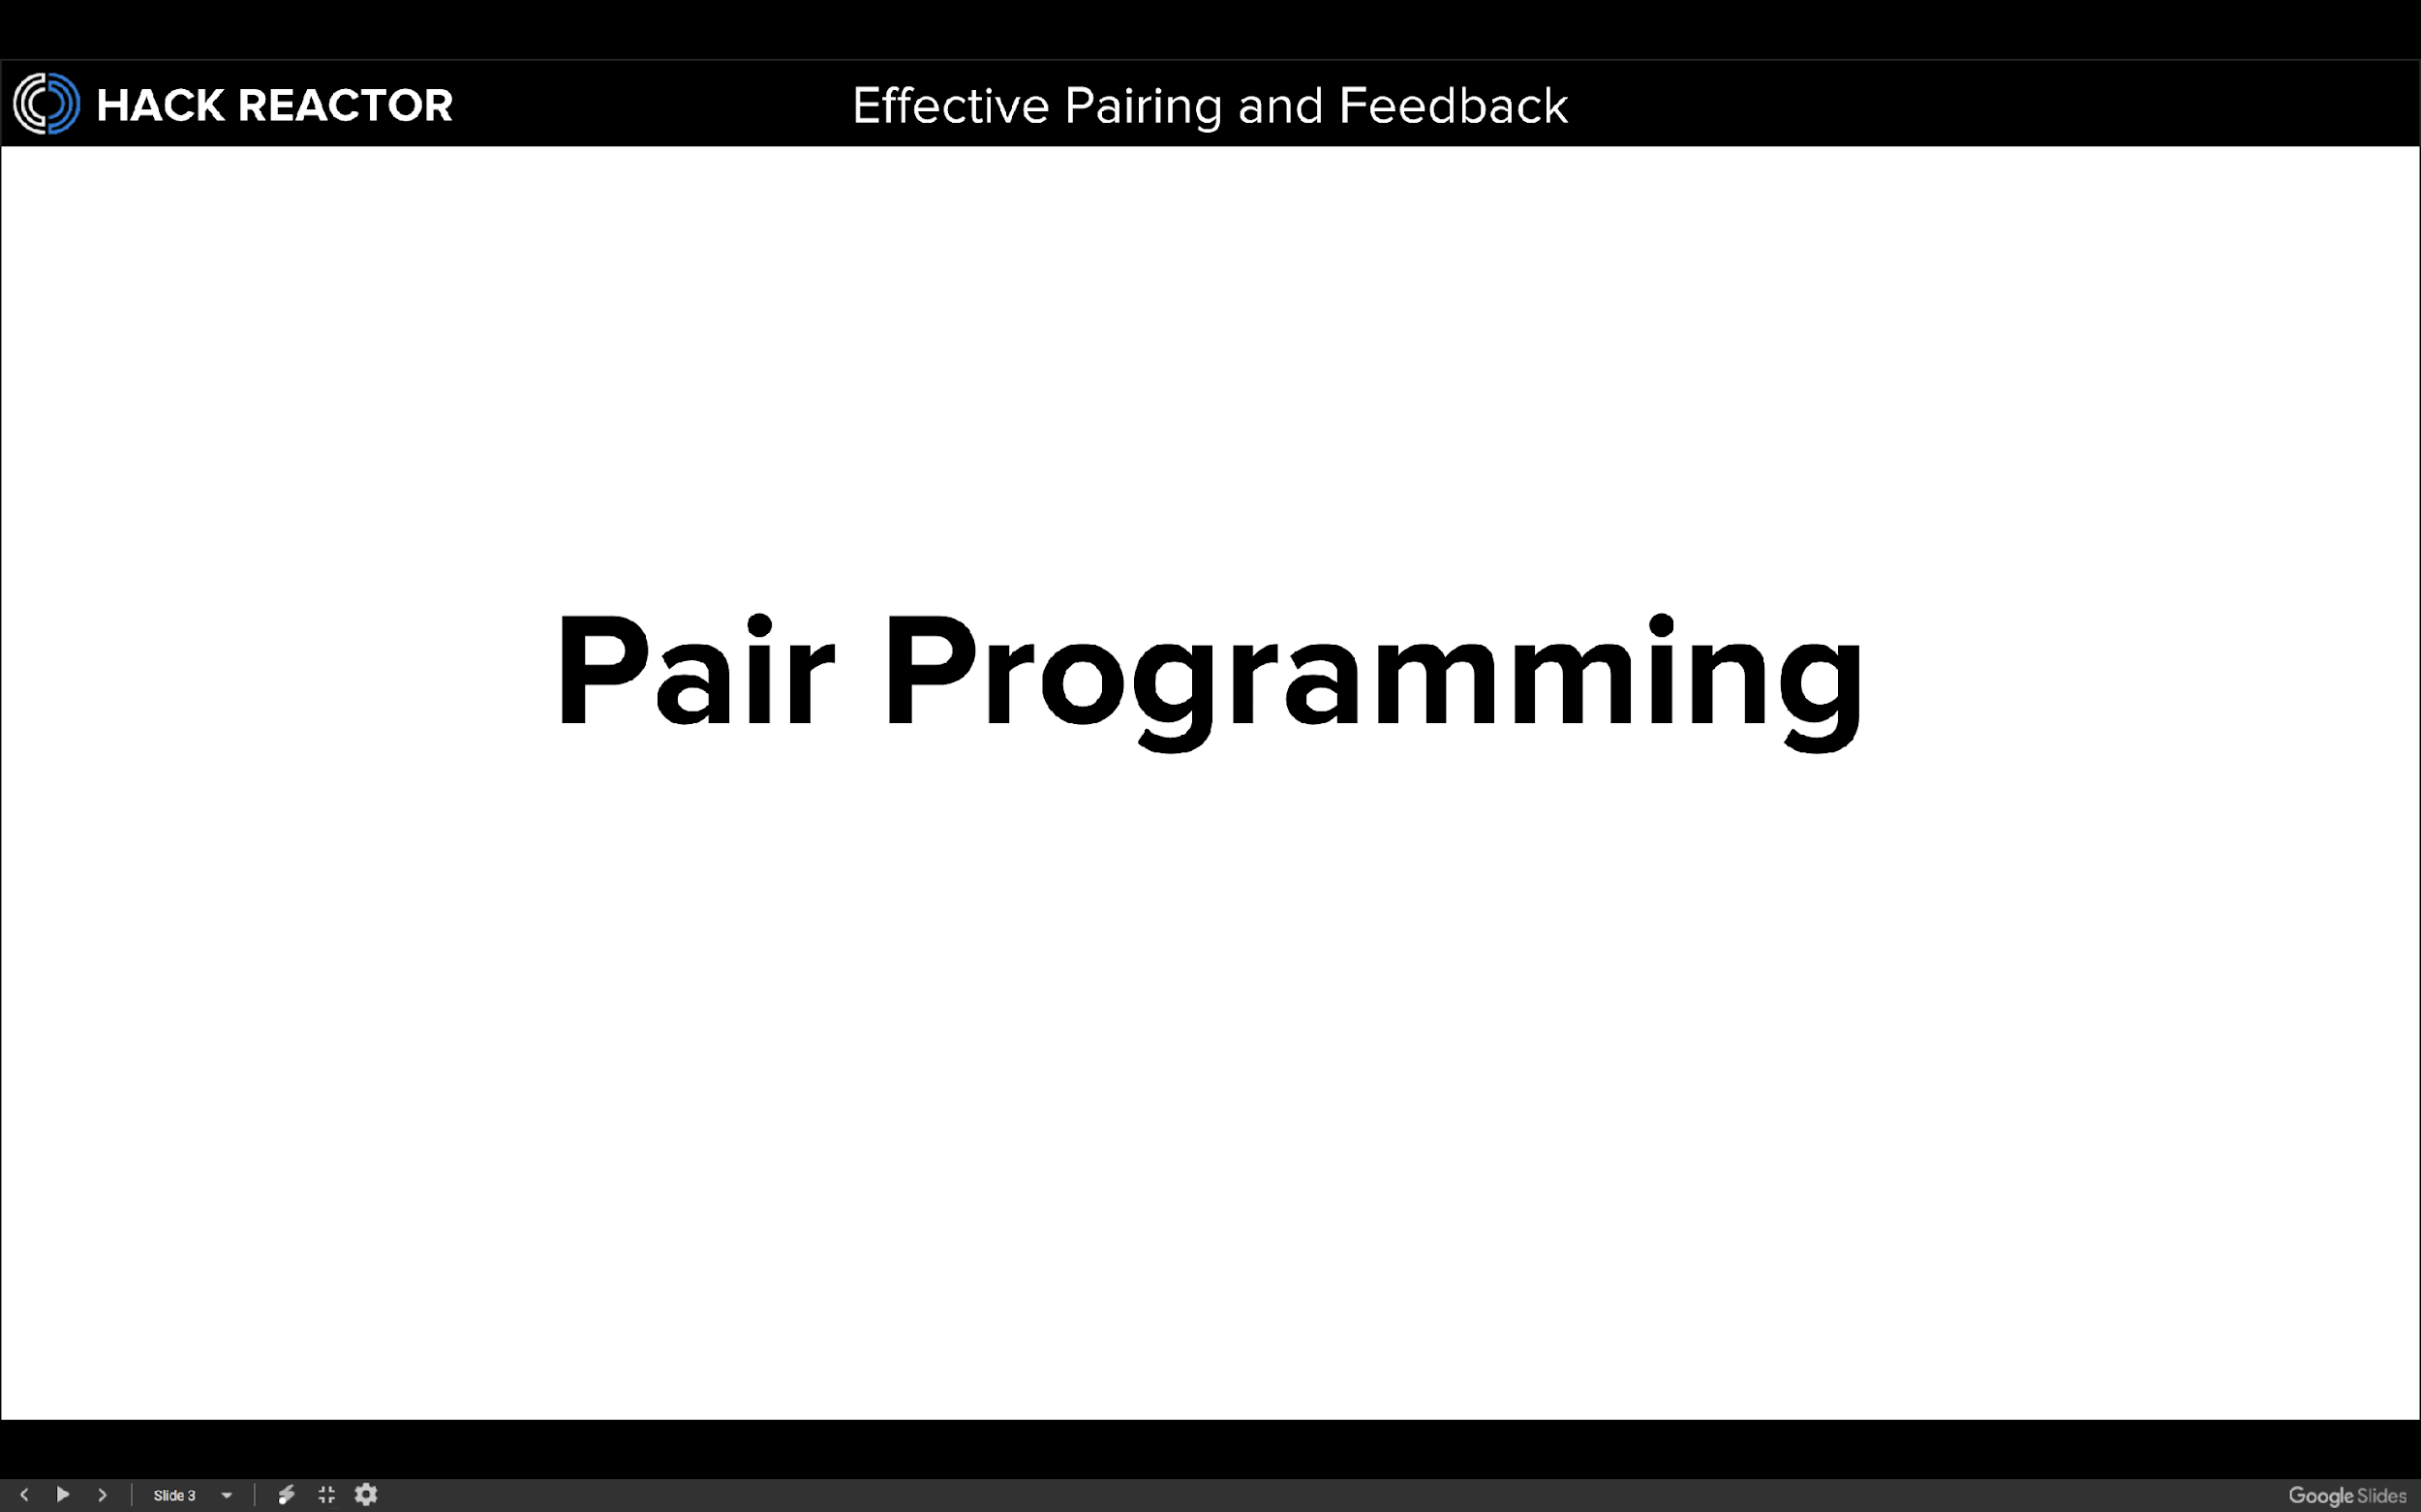

Slide 4

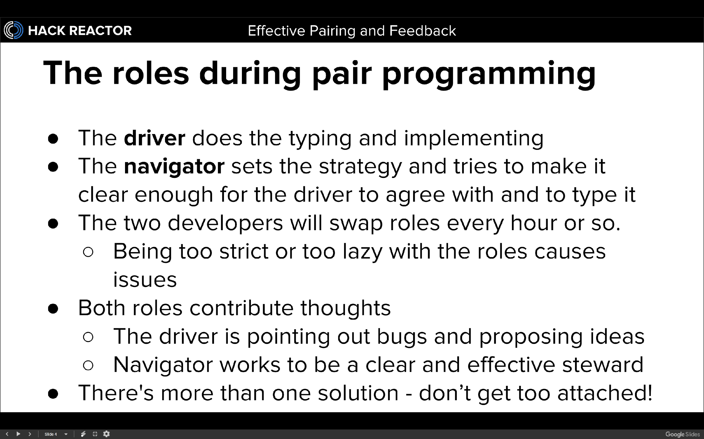

Slide 5
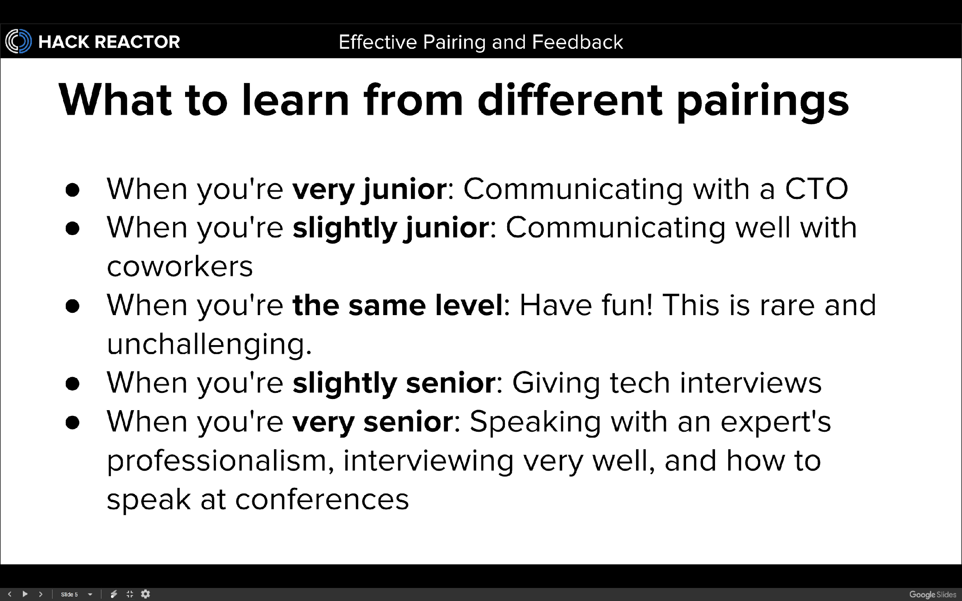

Slide 6
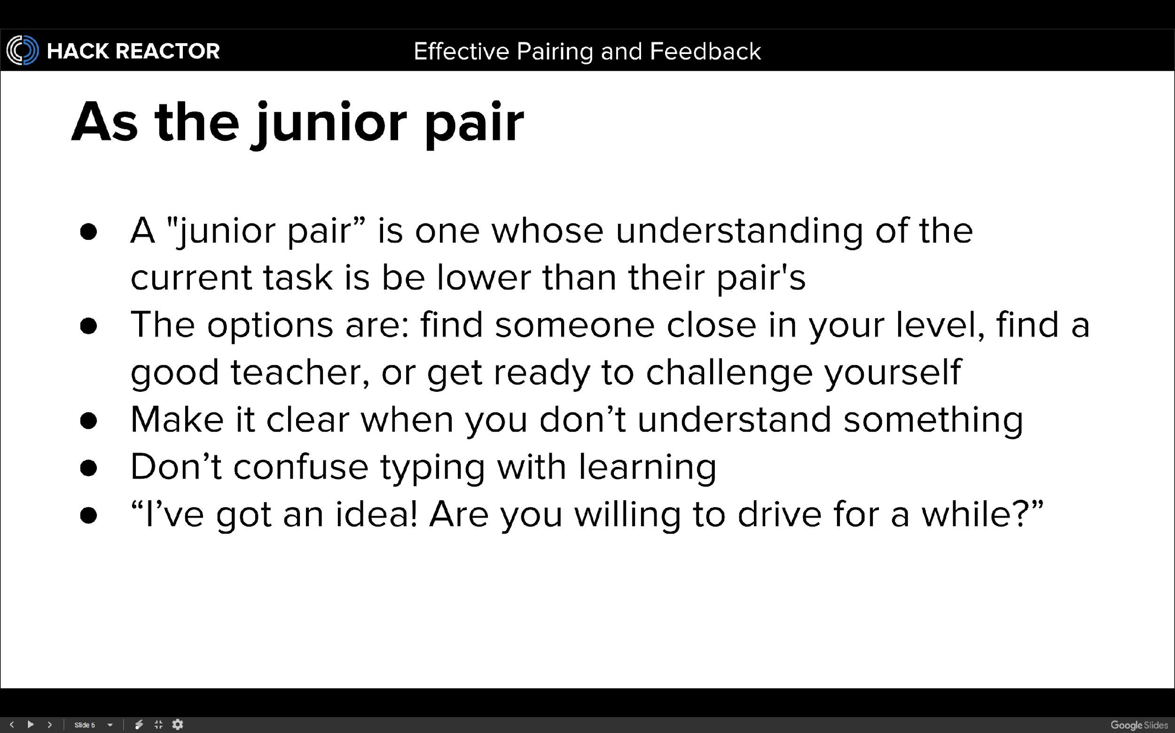

Slide 7
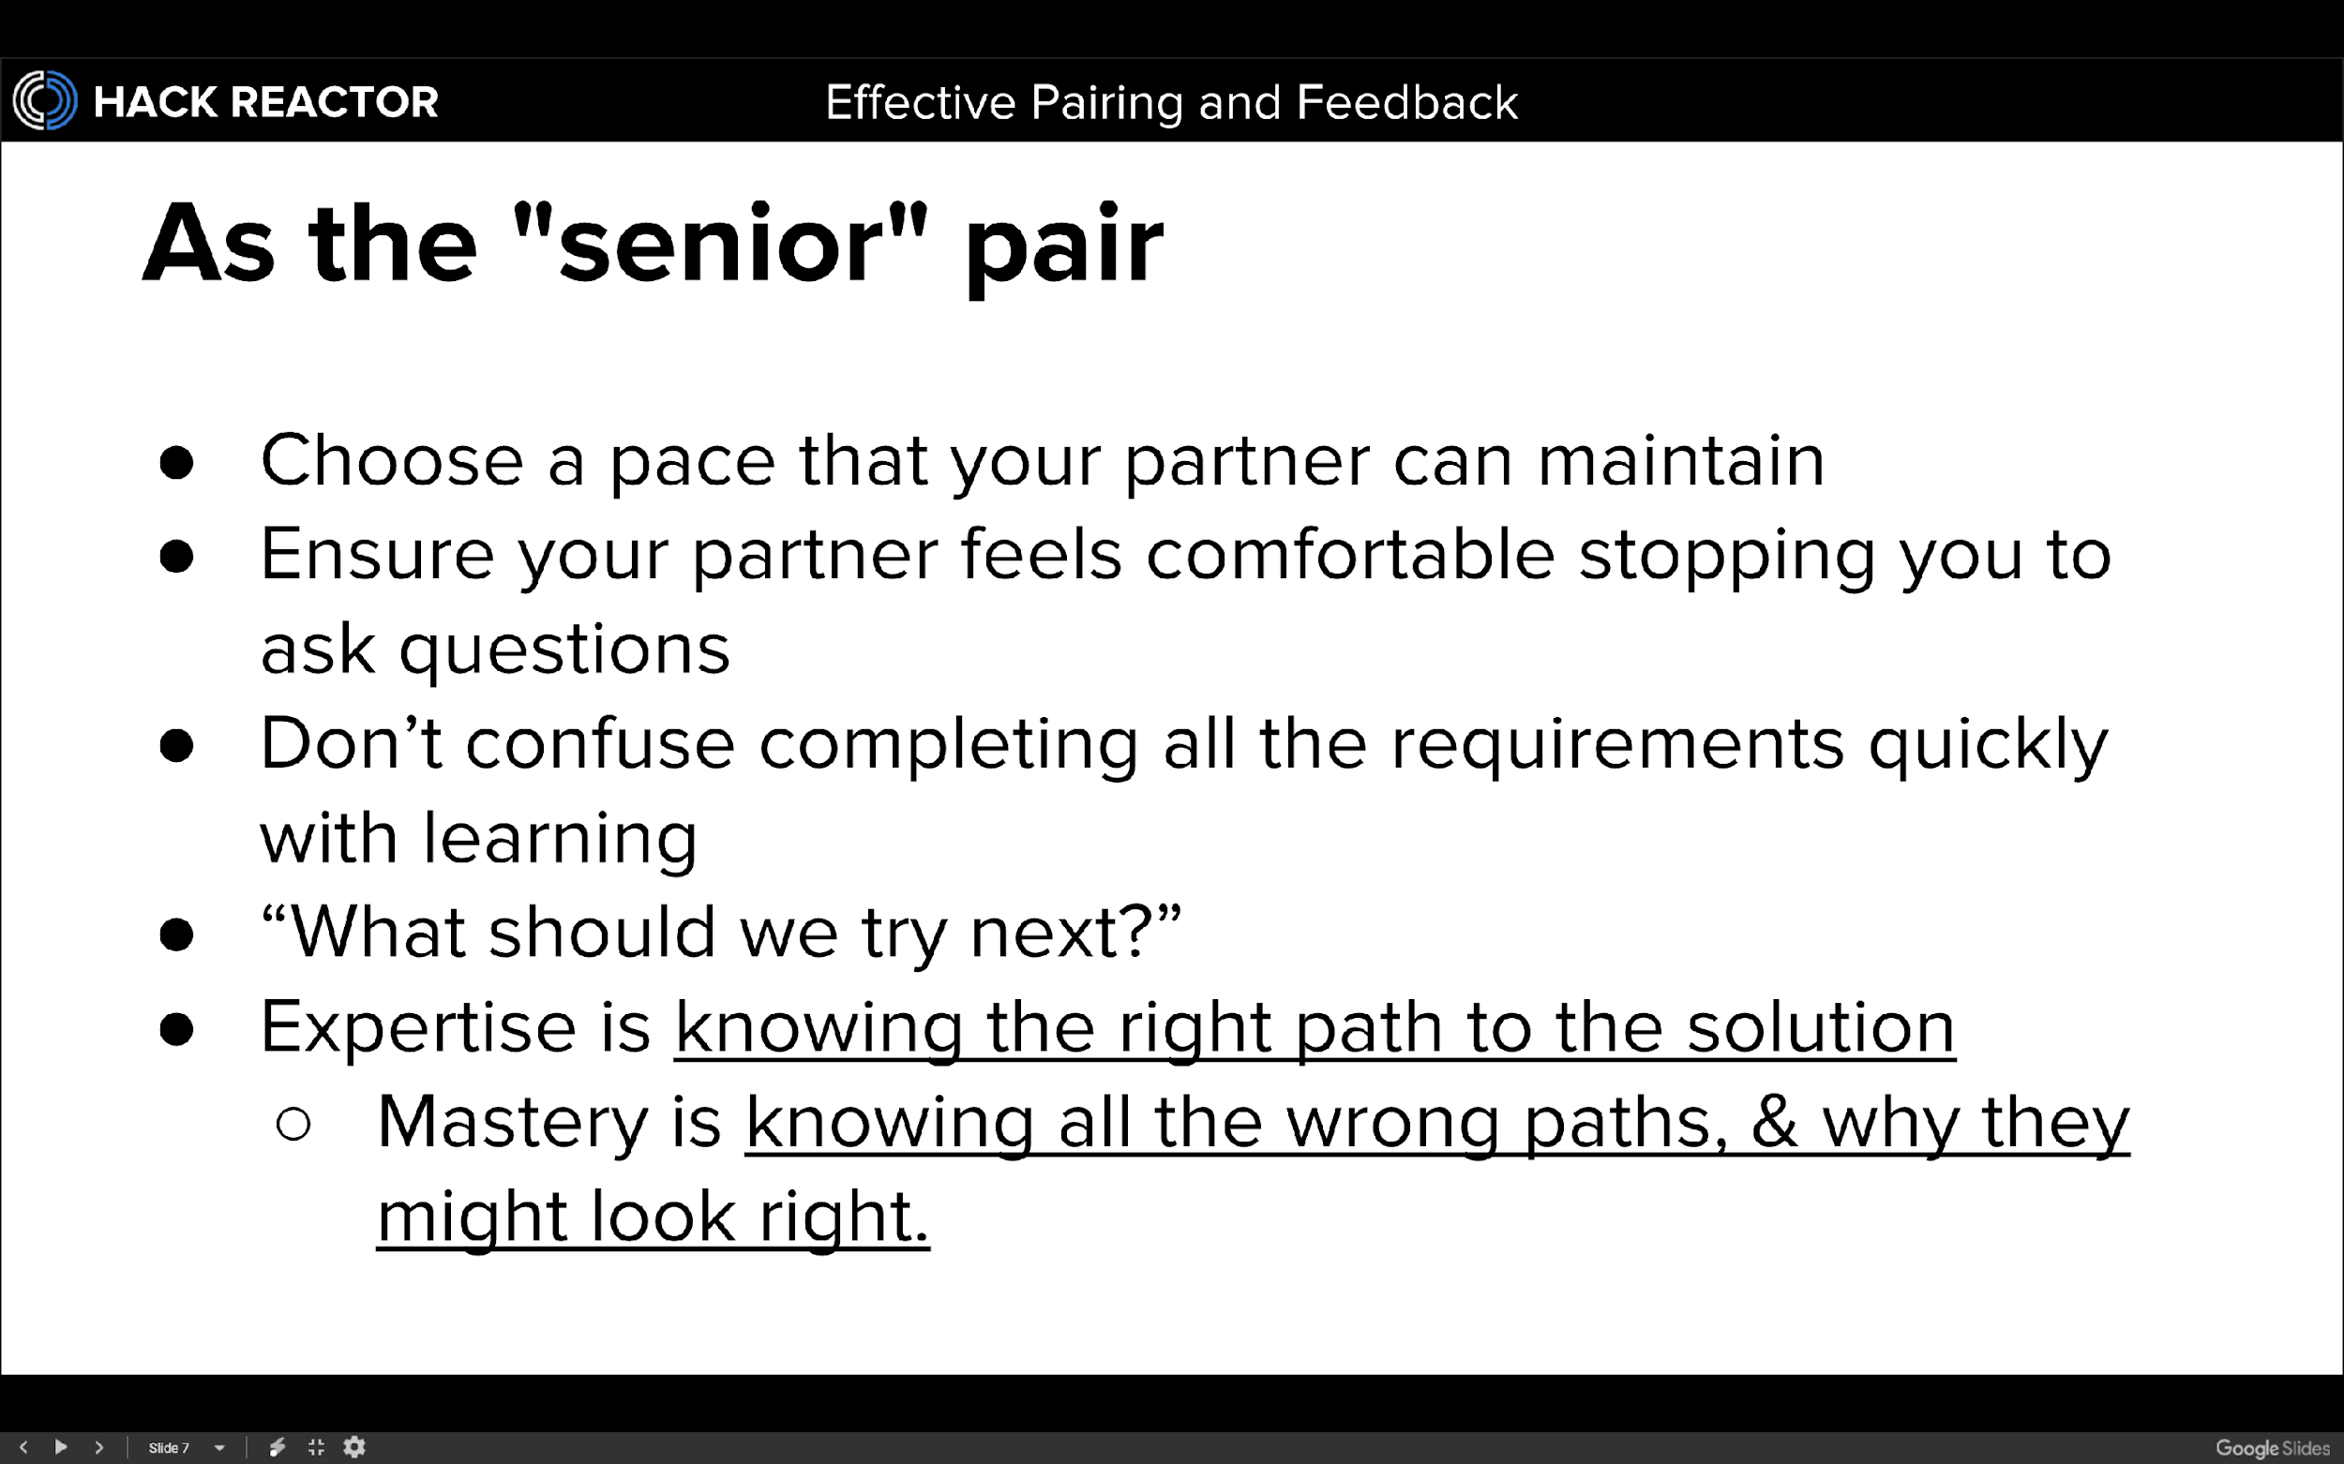

Slide 8
Pairing logistics
Agree on practices and environment (commit style & frequency, etc.)
Err on the side of having a junior driver

