Slide 1
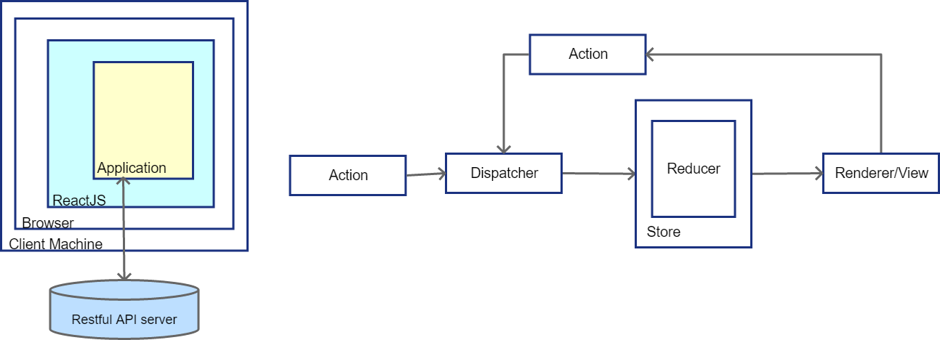
Etube Frontend Design Doc

Slide 2
Higher Order React Component
UI react Component
ACTIONS
Redux Observable/RxJS
NEW STATE
AXIOS
Redux Store
Middleware
Reducers
HTTP Request
HTTP Response
Restful API

Slide 3
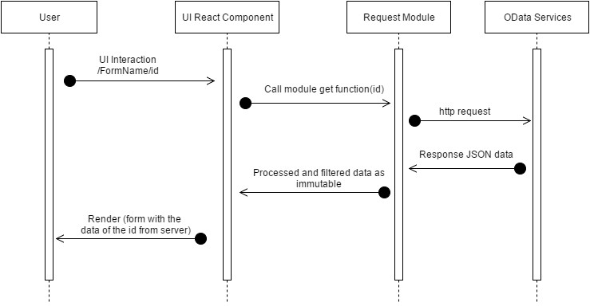
Sequence Diagram

Slide 4
Modules
CSS
aphrodite
styled-components
HTTP
axios
Video
video-react
UI Framework
material-ui
semantic-ui-react
State management
redux
redux-observable
redux-thunk
rxjs

Slide 5
Folder Structure
Project
Public – Any static content such as svg, png, ico, etc.
Server – An express web server to serve the project
Src – most source codes are here
Actions – redux actions
Components
Common – shared components should be here
Epics – redux-observable epics
Reducers – redux reducers
Store – redux store
Utils – utility functions

