Slide 1
ELEC491

Slide 2
Filter design
In this project, we have designed a high-pass filter that has the order of 100 and cutoff frequency of 1000. The frequency of the first sinusoid is 5Hz and the frequency of the second sinusoid is 10MHz. The sampling frequency is 40MHz. We used the firls() function to generate the filter.

Slide 3
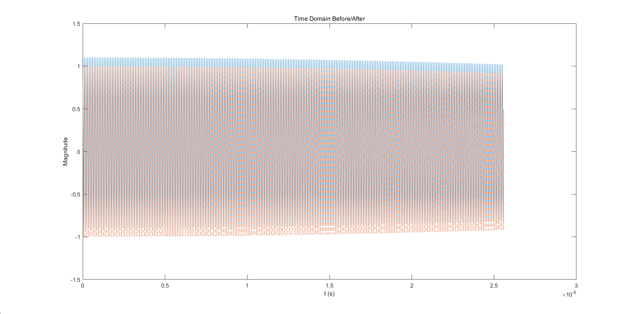
Time Domain before/after filtering

Slide 4
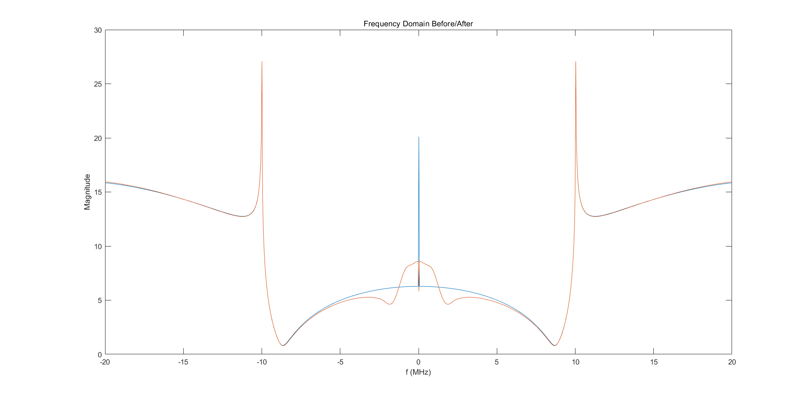
Frequency Domain before/after filtering

Slide 5
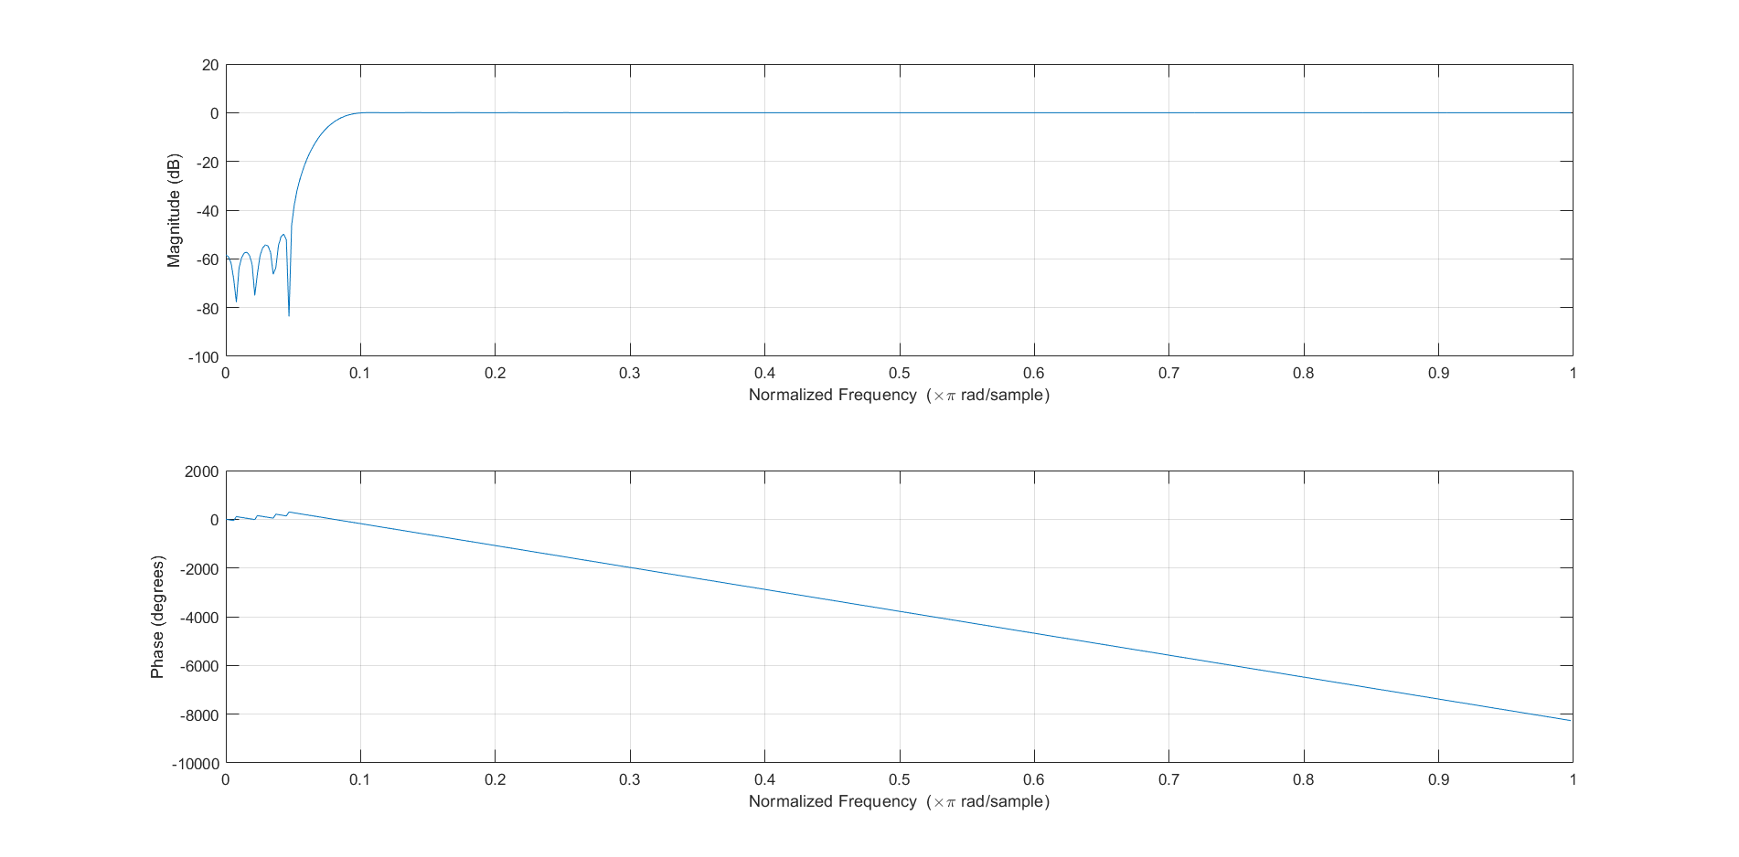
Filter Sepcification

Slide 6
GPU Acceleration
We did a MATLAB GPU implementation. We used the function called gpuArray() in Matlab and plotted the raw time of CPU and GPU and speedup plot for both Atlas and Desktop. The number of samples that we used in Desktop was 500 and in Atlas it was 1000 because Atlas had more powerful GPUs that Desktop.

Slide 7
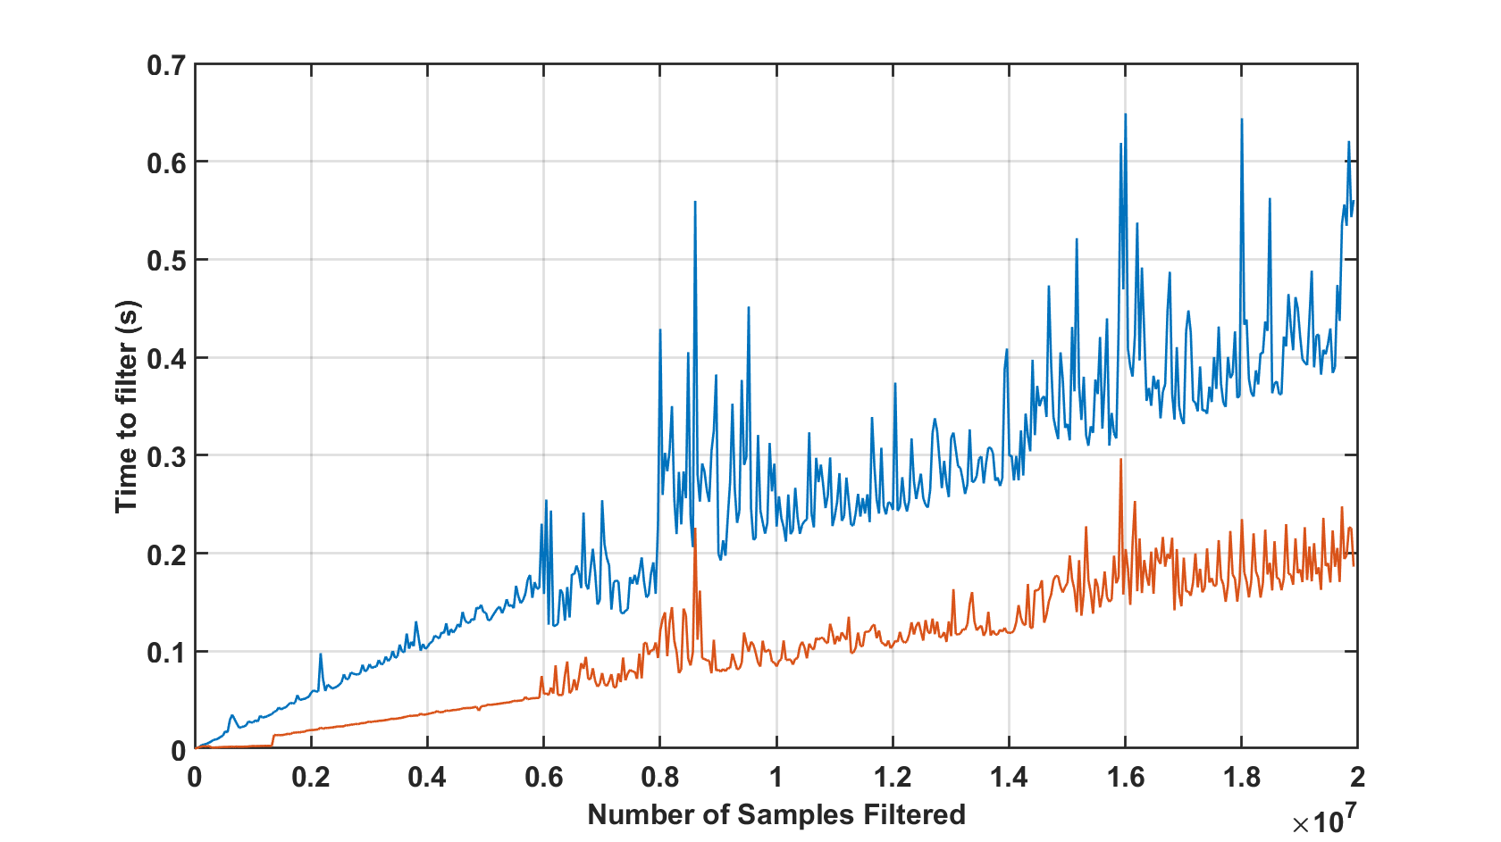
Desktop Raw time for CPU and GPU
The blue line represents the time for CPU and the orange line represents the time for GPU. The vertical axis of the raw time plot is the time for GPU and CPU.

Slide 8
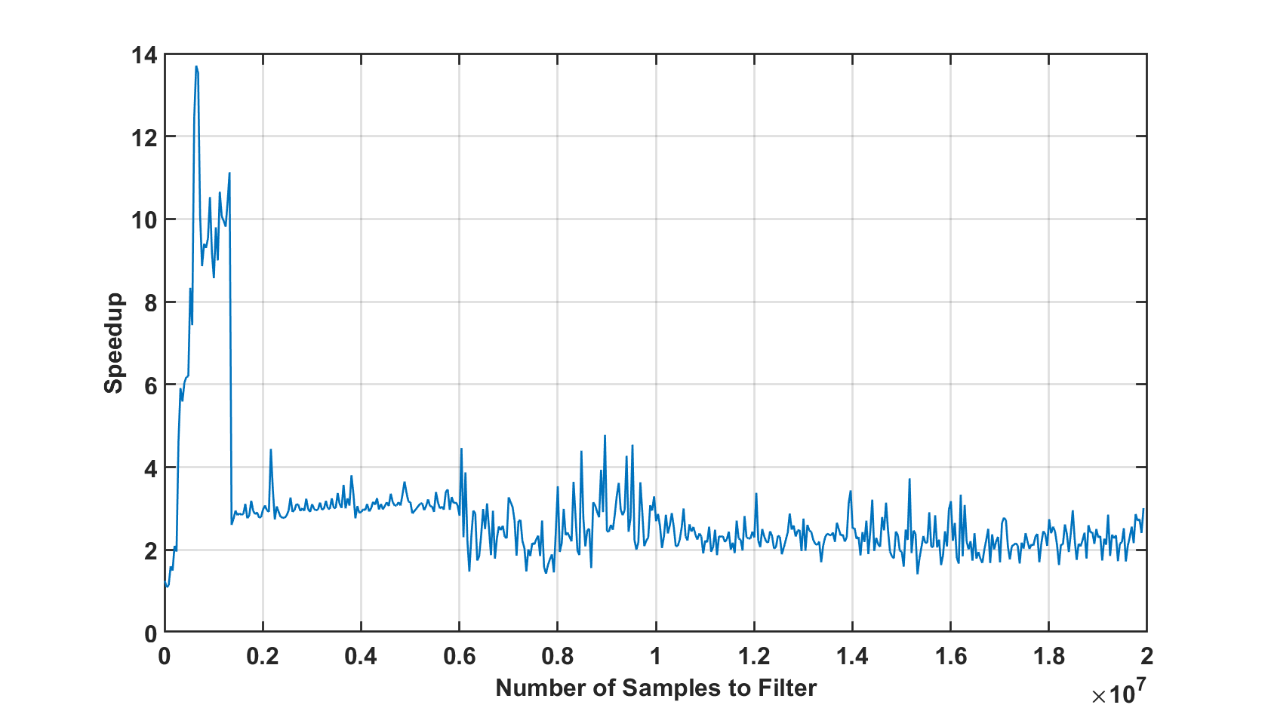
Desktop Speedup
The vertical axis of the speedup plot is the ratio between CPU time to GPU time.

Slide 9
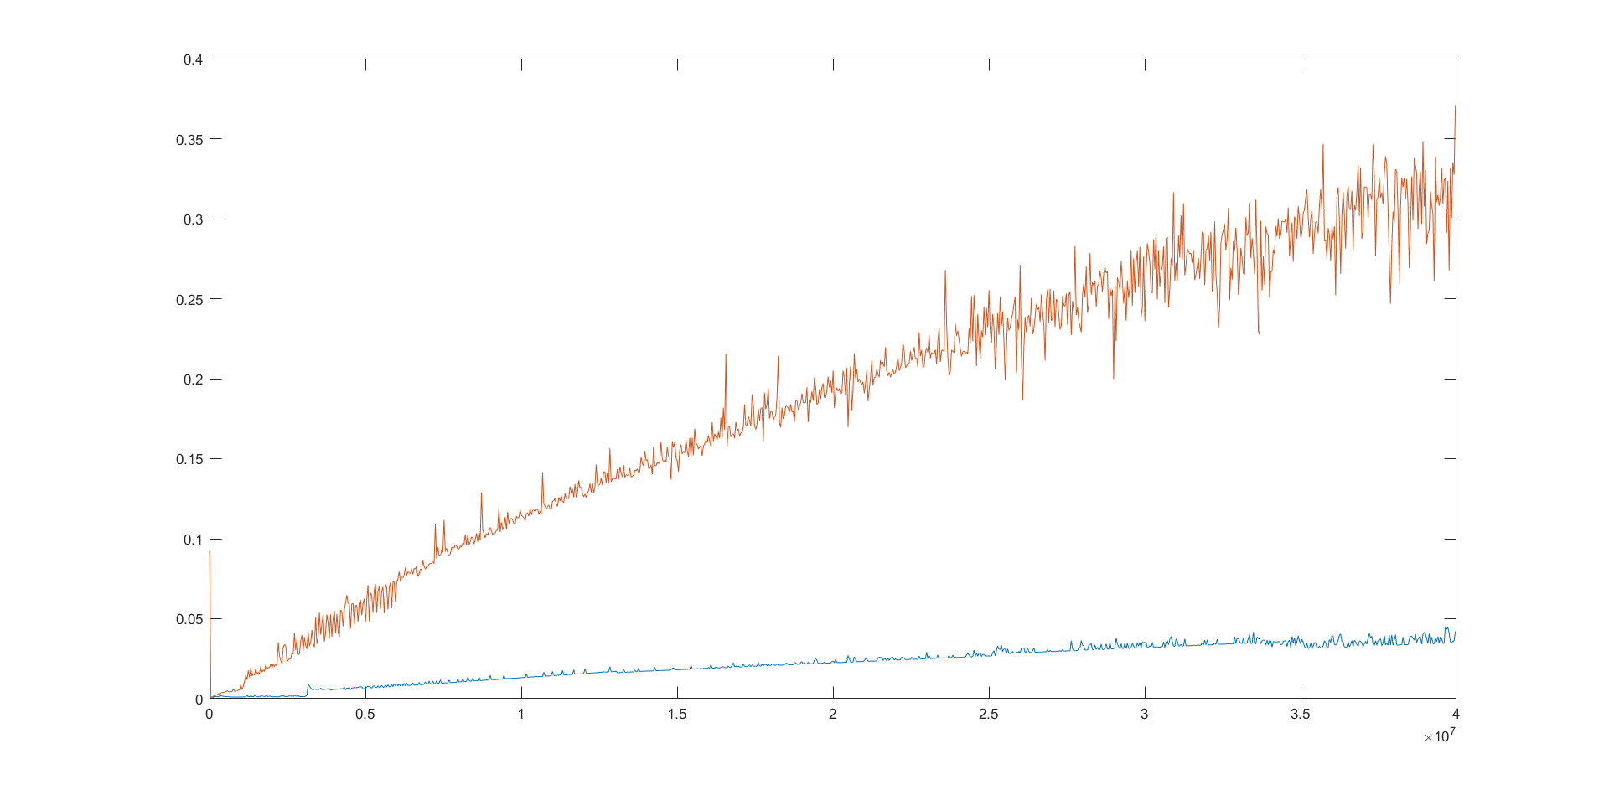
Atlas Raw time for CPU and GPU
The blue line represents the time for CPU and the orange line represents the time for GPU. The vertical axis of the raw time plot is the time for GPU and CPU.

Slide 10
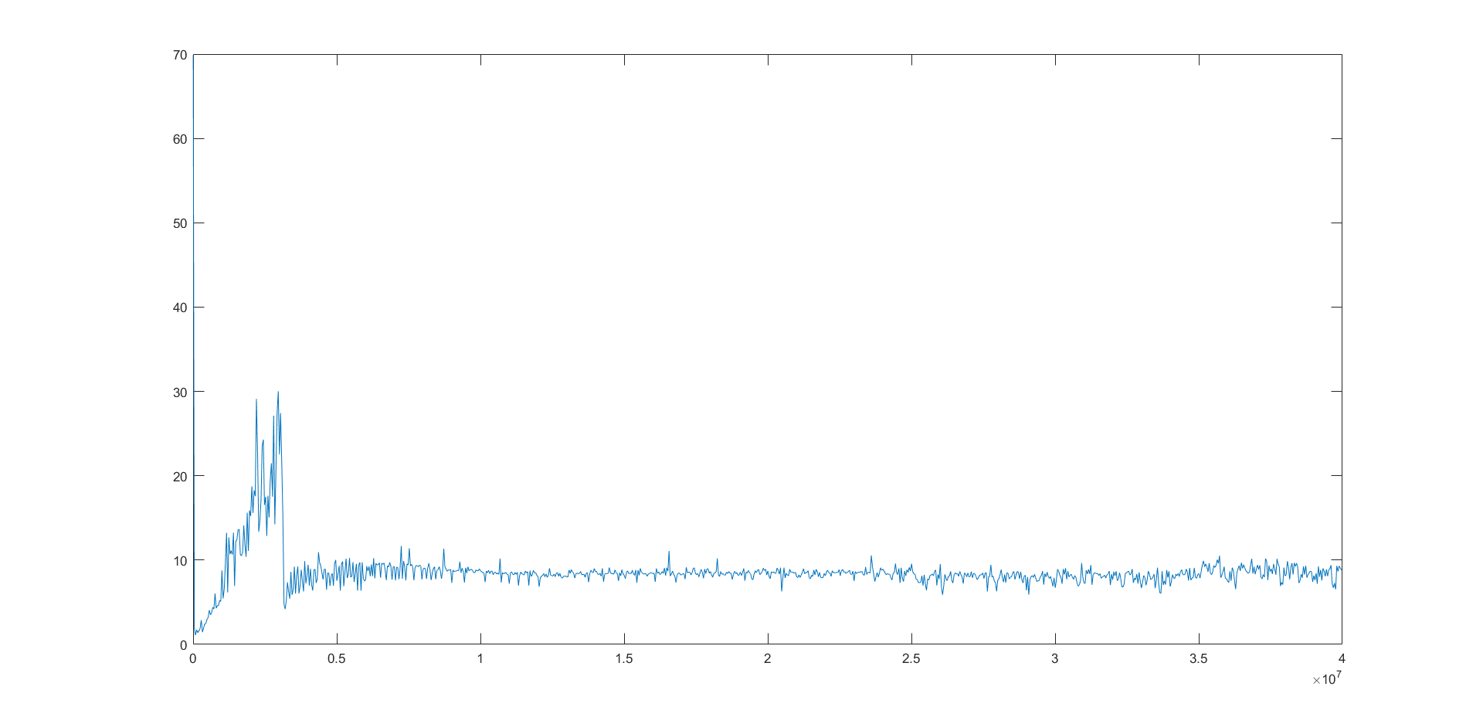
Atlas speedup
The vertical axis of the speedup plot is the ratio between CPU time to GPU time.

Slide 11
Thanks!

