Slide 1
Big Data analysis – Homework 1
游春傑:D10315001
薛聿明:D10307009
楊承翰:M10209106
程于真:M10307206
吳致芳:M10309103

Slide 2
Agenda
第一部分：
載入SPAM ARCHIVE(http://untroubled.org/spam/)從2010~2015年的資料至ElasticSearch，不需要全部的資料載入，請採用LogStash進行資料拋轉的工作。
請繳交所採用的LogStash Parser
請給予這段期間的Top 100的垃圾郵件之來源IP以及其數量分佈
請將載入完成後的資料已Kibana拉出相關的統計圖表
請萃取資料內容的5種屬性，並轉存成另外一個repository中。
第二部分：
請安裝Hadoop與安裝Spark，並採用Mahout或Spark Cluster k-means分群這些結果。請說明給予不同k值得狀況下請分布的表現。

Slide 3
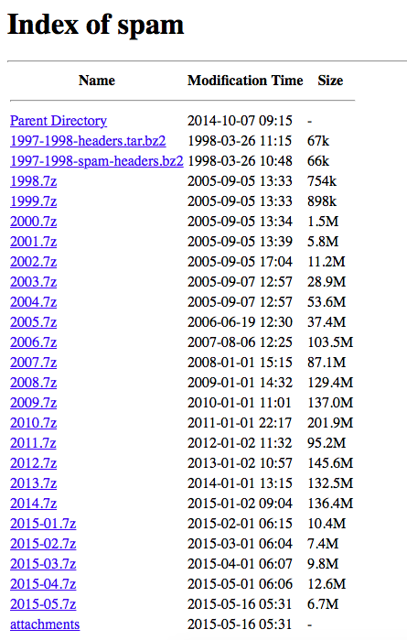
Dataset Source
抓取spam mail
http://www.untroubled.org/spam/
作業分析資料範圍為Y2010~Y2015/April

Slide 4
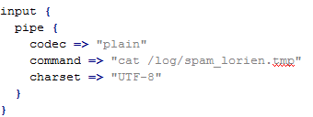
Logstash Parser - Input
由於有Logstash 會listen所有的檔案，並將檔案一直開啟，若是沒有將檔案關閉的情況下，會發生有權限存取問題(Permission Deny) 的問題，在此本組利用Pipe(管線)方式將所有的檔案導入到一個檔案(spam_lorien.tmp)內，再由Logstash 將spam mail內容讀入。

Slide 5
Logstash Parser – Filter _{(1/2)}
Spam mail的內容，利用multiline整合成一個Message
Message 利用grok取出各別的字串並存成新的欄位(Filed)
Message 利用mutate取代想要忽略的字串
Message 利用ruby 做正規化表示(Regular Expression, RE)
透過scan的方式，撈取多重資料時，最後一筆雖然有讀取到，卻無法顯示，後透過xmi順利解決
event["http"] = event["message"].scan(/(http:\/\/.*?)[\s|"|<|>|\n]/xmi).flatten

Slide 6
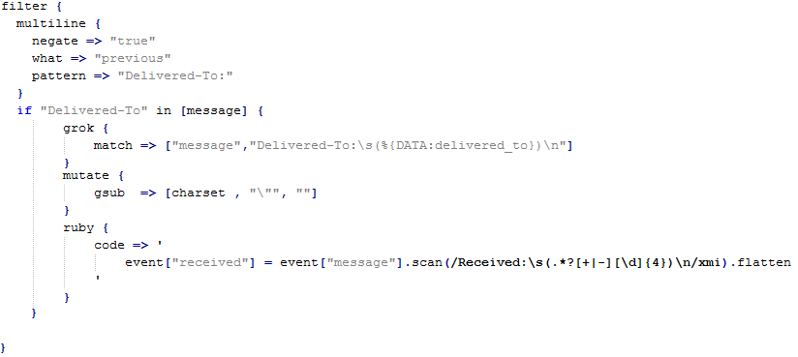
Logstash Parser – Filter _{(2/2)}

Slide 7
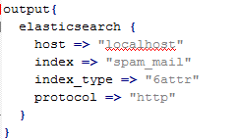
Logstash Parser – Output
將Logstash的資料輸入到Elasticsearch，一定要將index及index_type設定。

Slide 8
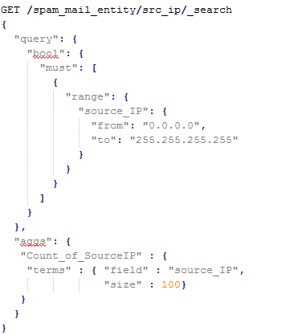
Top 100 – Elasticsearch / Sense Plug in
此法為採用“Sense”套件，直接外掛在Chrome Browser內
載點
https://chrome.google.com/webstore/detail/sense-beta/lhjgkmllcaadmopgmanpapmpjgmfcfig

Slide 9

Visualization – Kibana _{(1/4)}
要做圖表時，kibana會將某些屬性(例如：人名、檔案名稱)自動作analysis的動作，將同一資料切成多段，因此在parser資料之前，需要設定為not_analysis

Slide 10
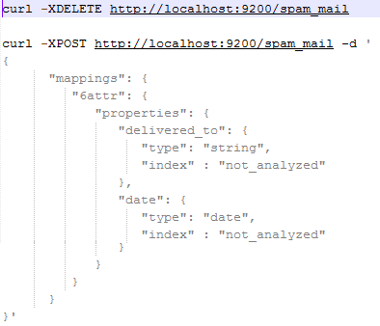
Visualization – Kibana _{(2/4)}
範列程式 – 修改index之欄位屬性；在輸入資料到Elasticsearch前，就必須要將欄位屬性設定完成。

Slide 11
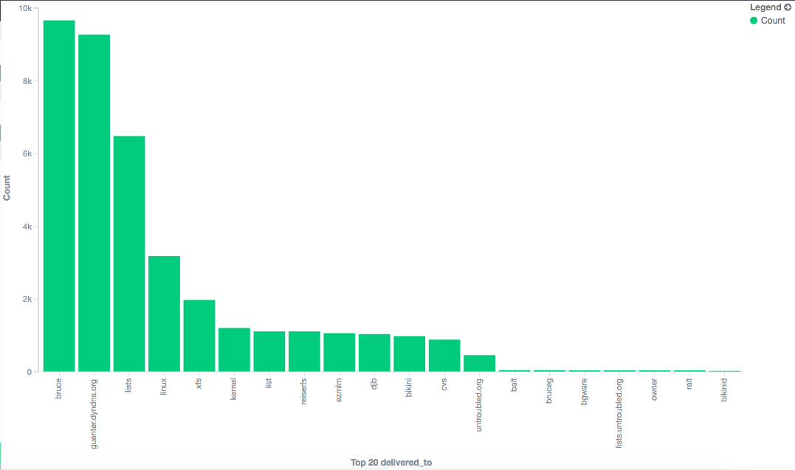
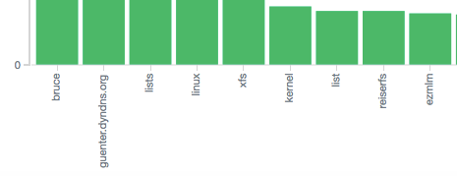
Visualization – Kibana _{(3/4)}
錯誤範例：未修改屬性前，人名被切成不同資料段

Slide 12
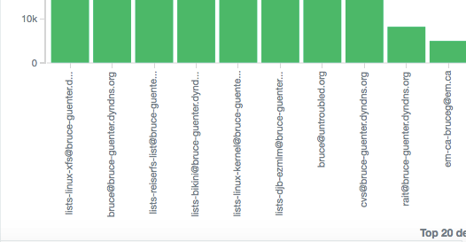
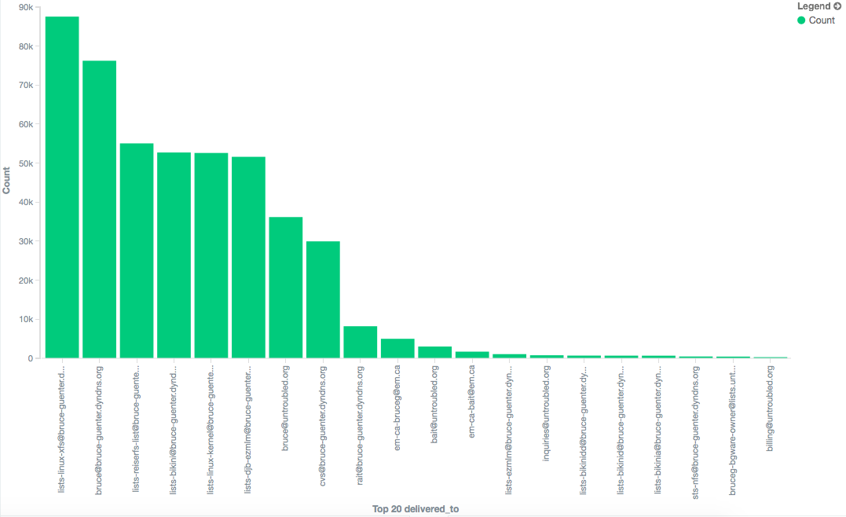
Visualization – Kibana _{(4/4)}
修改屬性後，人名視為同一筆資料

Slide 13
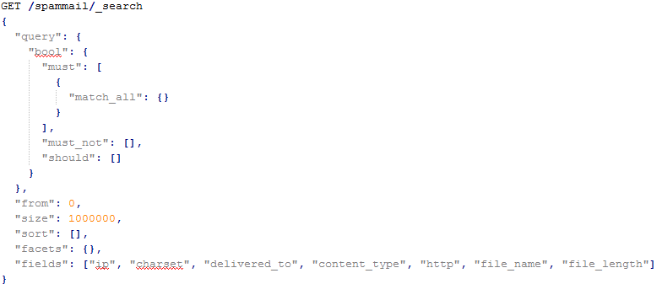
Extract 5 Attributes _{(1/2)}
Totally, extracting seven attributes by sense plug in
Source IP (ip)
Spam mail編碼方式(charset)
Delivered to後面的網址 (delivered-to)
html或純文字 (content_type)
http的網址 (http)
是否有檔案名稱 (file_name)
檔案大小 (file_length)

Slide 14
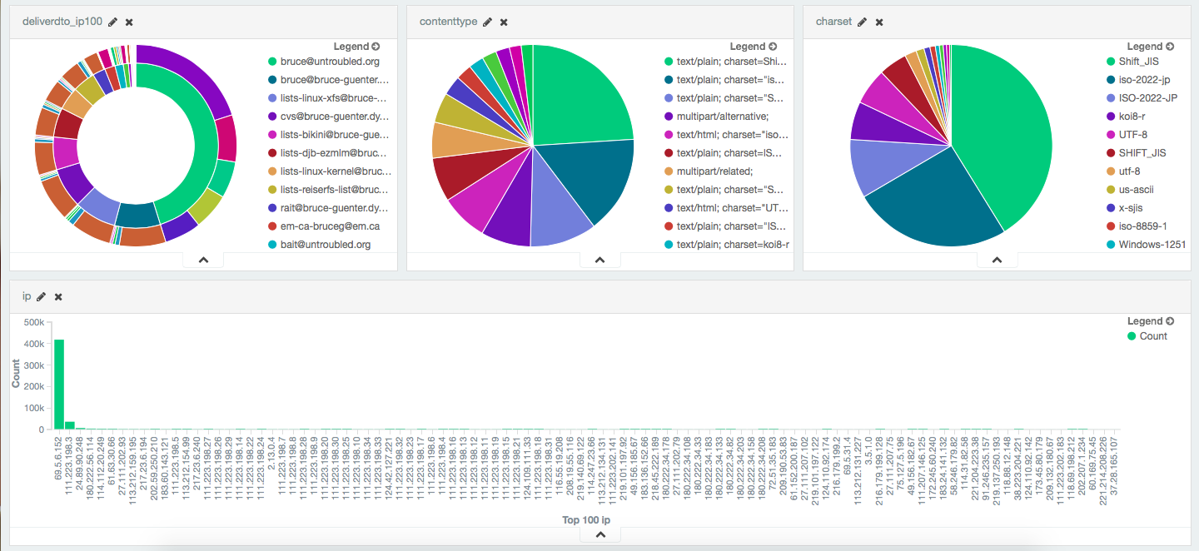
Extract 5 Attributes _{(2/2)}
Extract five attributes by sense plug in

Slide 15
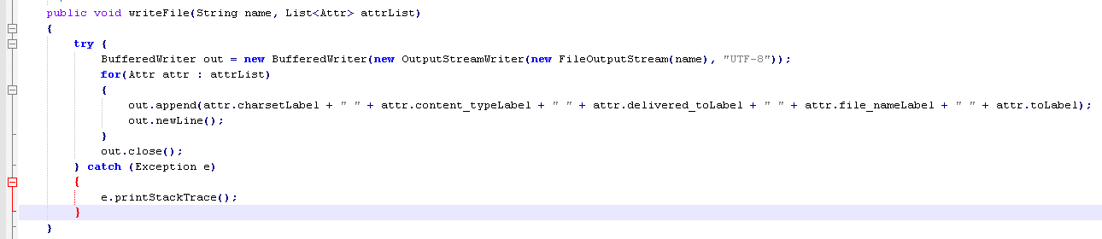
Labeling _{(1/2)}
Labeling 5 Attributes
charset
content_type
delivered_to
file_name
收件人(to)

Slide 16
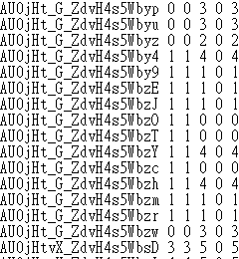
Labeling _{(2/2)}
1 | 2 | 3 | 4 | 5 | 6
_id | charset | content_type | delivered_to | file_name | to
1
2
3
4
5
6

Slide 17
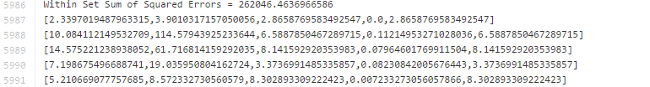
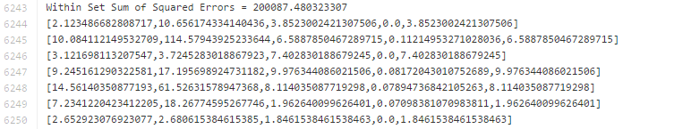
K-mean質心
三群
五群
七群

Slide 18
BigData_HW2
游春傑:D10315001
薛聿明:D10307009
楊承翰:M10209106
程于真:M10307206
吳致芳:M10309103

Slide 19
Agenda
作業內容：
(1) 請以mllib的libsvm對於該資料集進行分類，並說明Precision與Recall的結果。
(2) 請設計出一個更合適的分析方法，包含兩種以上不同方法的結合，並分析其效果。

Slide 20
資料來源
KDD99資料集
http://kdd.ics.uci.edu/databases/kddcup99/kddcup99.html
HW2連結
https://github.com/yuchunjie/BigData/tree/master/HomeWork_2

Slide 21
開發環境
Spark-1.3.0 Mahout-0.9 Hadoop-2.6.0 JDK-1.8.0_40 2 Core/2G CentOS 7 | Spark-1.3.0 Mahout-0.9 Hadoop-2.6.0 JDK-1.8.0_40 2 Core/2G CentOS 7 | Spark-1.3.0 Mahout-0.9 Hadoop-2.6.0 JDK-1.8.0_40 2 Core/2G CentOS 7 | Spark-1.3.0 Mahout-0.9 Hadoop-2.6.0 JDK-1.8.0_40 2 Core/2G CentOS 7
VMware Workstation
i7-4930k/8G x8

Slide 22
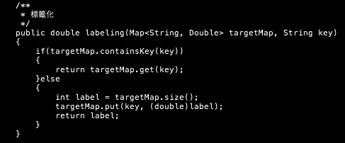
Labeling
將所有integer型態皆轉為double
Notes:
https://github.com/yuchunjie/BigData/tree/master/HomeWork_2/JAVA_Labeling

Slide 23
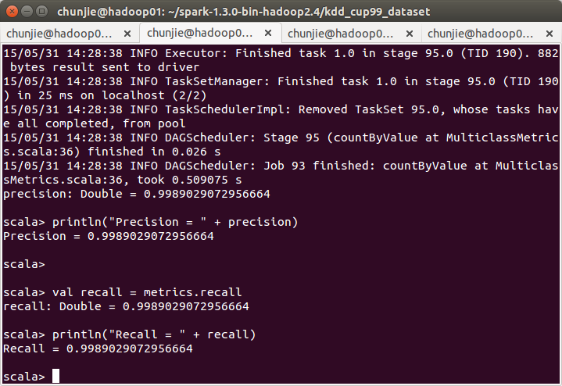
Spark Share SVM - 取1%
training:60%
testing:40%
Precision
Recall
Notes:
https://github.com/yuchunjie/BigData/tree/master/HomeWork_2/Scala

Slide 24
使用 Latent Dirichlet Allocation(LDA)
import org.apache.spark.mllib.clustering.LDA
import org.apache.spark.mllib.linalg.Vectors
// Load and parse the data
val data = sc.textFile("kdd99_labeling_1_percent_lda.txt")
//val data = sc.textFile("sample_lda_data.txt")
val parsedData = data.map(s => Vectors.dense(s.trim.split(' ').map(_.toDouble)))
// Index documents with unique IDs
val corpus = parsedData.zipWithIndex.map(_.swap).cache() // Cluster the documents into 22 (kdd99 attack types) topics using LDA
val ldaModel = new LDA().setK(22).run(corpus)
// Output topics. Each is a distribution over words (matching word count vectors)
println("Learned topics (as distributions over vocab of " + ldaModel.vocabSize + " words):")
val topics = ldaModel.topicsMatrix
for (topic <- Range(0, 22)) {
print("Topic " + topic + ":")
for (word <- Range(0, ldaModel.vocabSize)) { print(" " + topics(word, topic)); }
println()
}

Slide 25
Kmeans(分2群)
import org.apache.spark.mllib.clustering.KMeans
import org.apache.spark.mllib.linalg.Vectors
// Load and parse the data
val data = sc.textFile("kdd99_labeling_1_percent_kmeans.txt")
val parsedData = data.map(s => Vectors.dense(s.split(' ').map(_.toDouble))).cache()
// Cluster the data into two classes using KMeans
val numClusters = 2
val numIterations = 100
val clusters = KMeans.train(parsedData, numClusters, numIterations)
// Evaluate clustering by computing Within Set Sum of Squared Errors
val WSSSE = clusters.computeCost(parsedData)
println("Within Set Sum of Squared Errors = " + WSSSE)

Slide 26
不同分群數目
numClusters = 2
numIterations = 100
Result: Within Set Sum of Squared Errors = 8.225692243622847E13
numClusters = 5
numIterations = 100
Result: Within Set Sum of Squared Errors = 9.983203958121885E12
numClusters = 10
numIterations = 100
Result: Within Set Sum of Squared Errors = 2.9255161616756387E12
numClusters = 22
numIterations = 100
Result: Within Set Sum of Squared Errors = 2.877757292072352E11

Slide 27
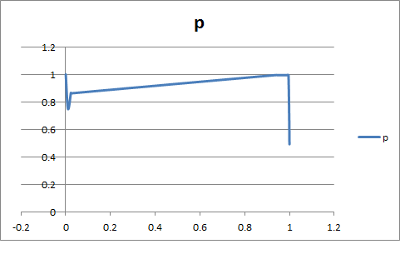
Spark Share SVM - 取1%(使用JAVA)
pr(0.0,1.0)
pr(0.009822646657571623,0.75)
pr(0.02291950886766712,0.865979381443299)
pr(0.02373806275579809,0.8613861386138614)
pr(0.024010914051841747,0.8627450980392157)
pr(0.9413369713506139,0.9956709956709957)
pr(0.9424283765347885,0.9953890489913545)
pr(0.9538881309686221,0.9945945945945946)
pr(0.9691678035470669,0.9941225860621327)
pr(0.9743519781718963,0.9941536748329621)
pr(0.9751705320600272,0.9941585535465924)
pr(0.9863574351978172,0.9942244224422442)
pr(0.9877216916780355,0.99423235374897)
pr(0.9953615279672579,0.9942763695829926)
pr(1.0,0.4931377825618945)
Notes:
https://github.com/yuchunjie/BigData/tree/master/HomeWork_2/JAVA%E7%89%88SVM

Slide 28
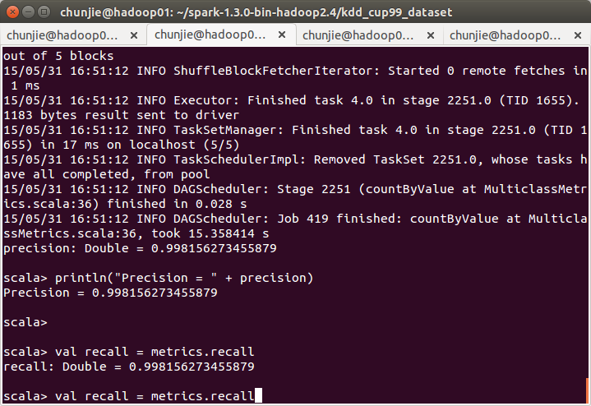
Spark Share SVM - 取10%
training:60%
testing:40%
Precision
Recall
Notes:
https://github.com/yuchunjie/BigData/tree/master/HomeWork_2/Scala

Slide 29
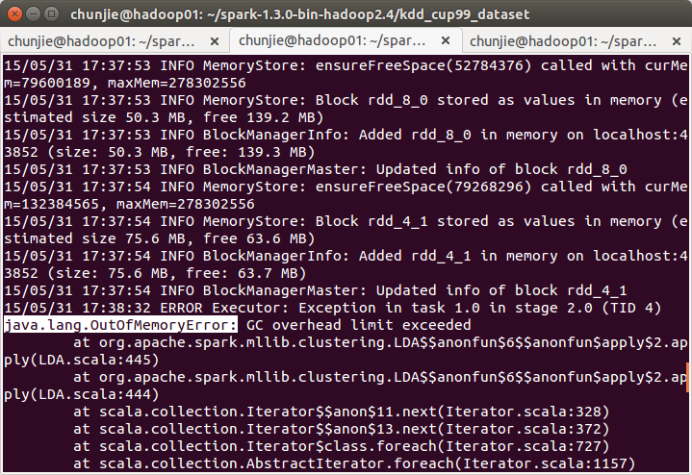
10%(使用LDA) - Out of memory!!!

Slide 30
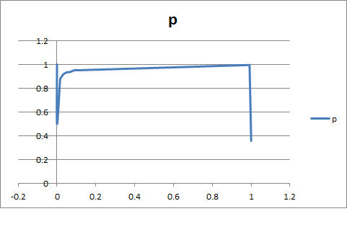
Spark Share SVM - 取10%(使用JAVA)
pr(0.0,1.0)
pr(5.141916906622789E-5,1.0)
pr(5.141916906622789E-5,0.5)
pr(0.01558000822706705,0.8706896551724138)
pr(0.015734265734265736,0.8717948717948718)
pr(0.015785684903331963,0.8721590909090909)
pr(0.01707116412998766,0.8806366047745358)
pr(0.03141711229946524,0.9160419790104948)
pr(0.03167420814479638,0.9166666666666666)
pr(0.05075071986836693,0.9346590909090909)
pr(0.05080213903743316,0.934720908230842)
pr(0.05121349238996298,0.9343339587242027)
pr(0.06396544631838749,0.9346356123215628)
pr(0.07126696832579185,0.9390243902439024)
pr(0.09060057589469354,0.9514038876889849)
pr(0.09394282188399836,0.9525547445255474)
pr(0.09522830111065406,0.9526748971193416)
pr(0.1054607157548334,0.9504170528266914)
pr(0.9913101604278075,0.9944292567184195)
pr(0.9914129987659399,0.9944298313476714)
pr(0.9914129987659399,0.9943272652261358)
pr(0.9918243521184698,0.9941758581589527)
pr(1.0,0.3576972595181166)
Notes:
https://github.com/yuchunjie/BigData/tree/master/HomeWork_2/JAVA%E7%89%88SVM

Slide 31
Thank you for your attention

