Slide 1
BigData_HW2
游春傑:D10315001
薛聿明:D10307009
楊承翰:M10209106
程于真:M10307206
吳致芳:M10309103

Slide 2
Agenda
作業內容：
(1) 請以mllib的libsvm對於該資料集進行分類，並說明Precision與Recall的結果。
(2) 請設計出一個更合適的分析方法，包含兩種以上不同方法的結合，並分析其效果。

Slide 3
資料來源
KDD99資料集
http://kdd.ics.uci.edu/databases/kddcup99/kddcup99.html
HW2連結
https://github.com/yuchunjie/BigData/tree/master/HomeWork_2

Slide 4
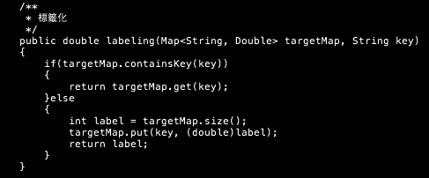
Labeling
將所有integer型態皆轉為double
Notes:
https://github.com/yuchunjie/BigData/tree/master/HomeWork_2/JAVA_Labeling

Slide 5
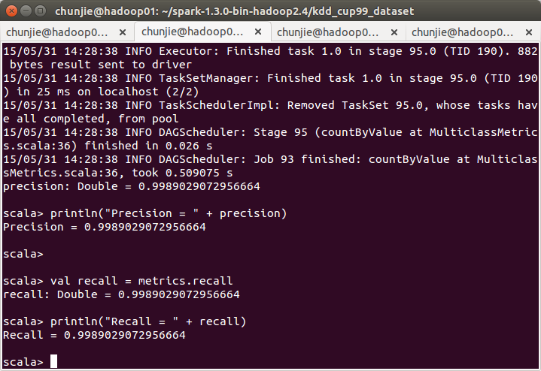
Spark Share SVM - 取1%
training:60%
testing:40%
Precision
Recall
Notes:
https://github.com/yuchunjie/BigData/tree/master/HomeWork_2/Scala

Slide 6
Scala 使用 Latent Dirichlet Allocation(LDA)
import org.apache.spark.mllib.clustering.LDA
import org.apache.spark.mllib.linalg.Vectors
// Load and parse the data
val data = sc.textFile("kdd99_labeling_1_percent_lda.txt")
//val data = sc.textFile("sample_lda_data.txt")
val parsedData = data.map(s => Vectors.dense(s.trim.split(' ').map(_.toDouble)))
// Index documents with unique IDs
val corpus = parsedData.zipWithIndex.map(_.swap).cache() // Cluster the documents into 22 (kdd99 attack types) topics using LDA
val ldaModel = new LDA().setK(22).run(corpus)
// Output topics. Each is a distribution over words (matching word count vectors)
println("Learned topics (as distributions over vocab of " + ldaModel.vocabSize + " words):")
val topics = ldaModel.topicsMatrix
for (topic <- Range(0, 22)) {
print("Topic " + topic + ":")
for (word <- Range(0, ldaModel.vocabSize)) { print(" " + topics(word, topic)); }
println()
}
分成22個分類

Slide 7
Kmeans(分2群)
import org.apache.spark.mllib.clustering.KMeans
import org.apache.spark.mllib.linalg.Vectors
// Load and parse the data
val data = sc.textFile("kdd99_labeling_1_percent_kmeans.txt")
val parsedData = data.map(s => Vectors.dense(s.split(' ').map(_.toDouble))).cache()
// Cluster the data into two classes using KMeans
val numClusters = 2
val numIterations = 100
val clusters = KMeans.train(parsedData, numClusters, numIterations)
// Evaluate clustering by computing Within Set Sum of Squared Errors
val WSSSE = clusters.computeCost(parsedData)
println("Within Set Sum of Squared Errors = " + WSSSE)

Slide 8
不同分群數目
numClusters = 2
numIterations = 100
Result: Within Set Sum of Squared Errors = 8.225692243622847E13
numClusters = 5
numIterations = 100
Result: Within Set Sum of Squared Errors = 9.983203958121885E12
numClusters = 10
numIterations = 100
Result: Within Set Sum of Squared Errors = 2.9255161616756387E12
numClusters = 22
numIterations = 100
Result: Within Set Sum of Squared Errors = 2.877757292072352E11

Slide 9
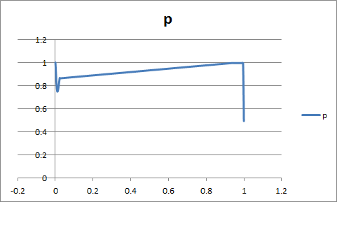
Spark Share SVM - 取1%(使用JAVA)
pr(0.0,1.0)
pr(0.009822646657571623,0.75)
pr(0.02291950886766712,0.865979381443299)
pr(0.02373806275579809,0.8613861386138614)
pr(0.024010914051841747,0.8627450980392157)
pr(0.9413369713506139,0.9956709956709957)
pr(0.9424283765347885,0.9953890489913545)
pr(0.9538881309686221,0.9945945945945946)
pr(0.9691678035470669,0.9941225860621327)
pr(0.9743519781718963,0.9941536748329621)
pr(0.9751705320600272,0.9941585535465924)
pr(0.9863574351978172,0.9942244224422442)
pr(0.9877216916780355,0.99423235374897)
pr(0.9953615279672579,0.9942763695829926)
pr(1.0,0.4931377825618945)
Notes:
https://github.com/yuchunjie/BigData/tree/master/HomeWork_2/JAVA%E7%89%88SVM

Slide 10
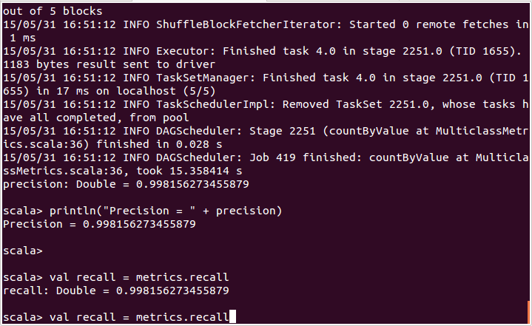
Spark Share SVM - 取10%
training:60%
testing:40%
Precision
Recall
Notes:
https://github.com/yuchunjie/BigData/tree/master/HomeWork_2/Scala

Slide 11
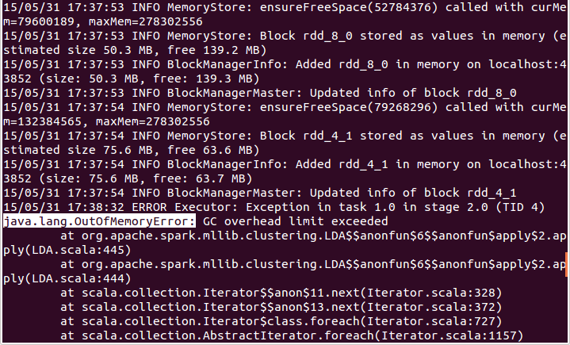
10%(使用LDA) - Out of memory!!!

Slide 12
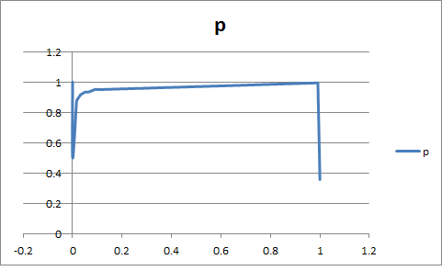
Spark Share SVM - 取10%(使用JAVA)
pr(0.0,1.0)
pr(5.141916906622789E-5,1.0)
pr(5.141916906622789E-5,0.5)
pr(0.01558000822706705,0.8706896551724138)
pr(0.015734265734265736,0.8717948717948718)
pr(0.015785684903331963,0.8721590909090909)
pr(0.01707116412998766,0.8806366047745358)
pr(0.03141711229946524,0.9160419790104948)
pr(0.03167420814479638,0.9166666666666666)
pr(0.05075071986836693,0.9346590909090909)
pr(0.05080213903743316,0.934720908230842)
pr(0.05121349238996298,0.9343339587242027)
pr(0.06396544631838749,0.9346356123215628)
pr(0.07126696832579185,0.9390243902439024)
pr(0.09060057589469354,0.9514038876889849)
pr(0.09394282188399836,0.9525547445255474)
pr(0.09522830111065406,0.9526748971193416)
pr(0.1054607157548334,0.9504170528266914)
pr(0.9913101604278075,0.9944292567184195)
pr(0.9914129987659399,0.9944298313476714)
pr(0.9914129987659399,0.9943272652261358)
pr(0.9918243521184698,0.9941758581589527)
pr(1.0,0.3576972595181166)
Notes:
https://github.com/yuchunjie/BigData/tree/master/HomeWork_2/JAVA%E7%89%88SVM

Slide 13
Thank you for your attention

